Slide 1
My future career
10/3/2024

Slide 2
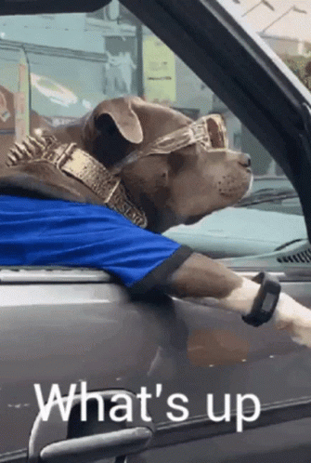
What I want to be
Hi my name is Ilyana and when I grow up I want to own or atleast work at a salon.

Slide 3
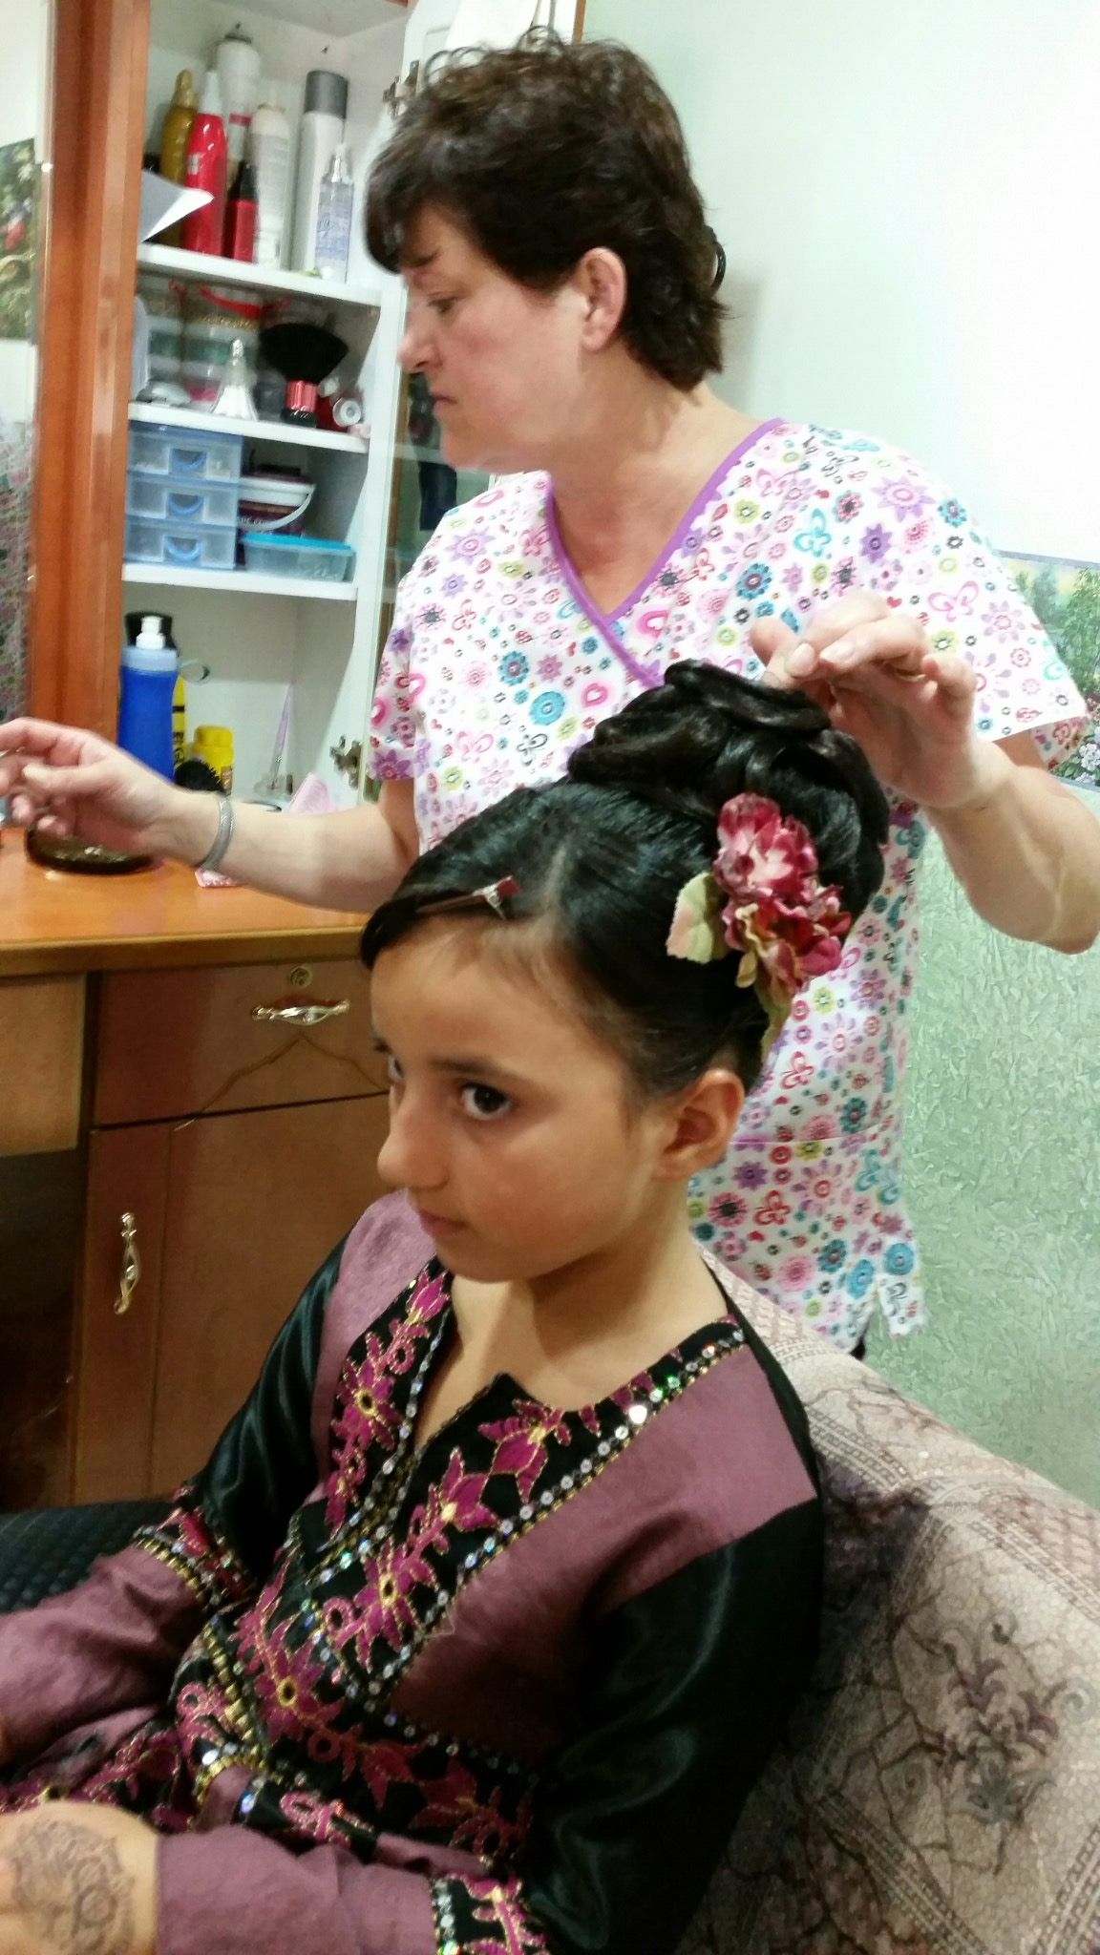
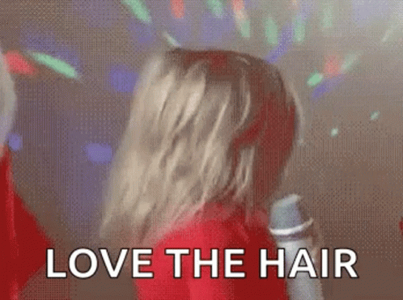
Why I want to own or work at a salon
I want to own or work at a salon because my grandma
owned a hair salon.

Slide 4
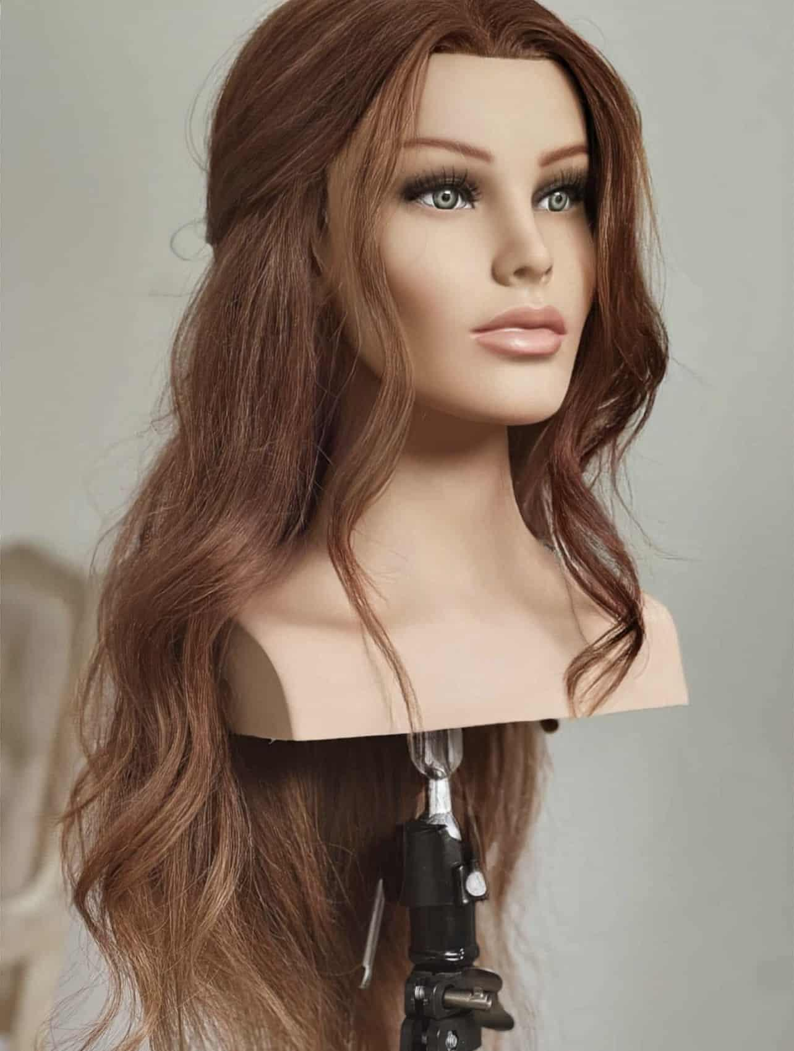
My experience
I used to style hair on mannequin heads
and I have done nails before.

Slide 5
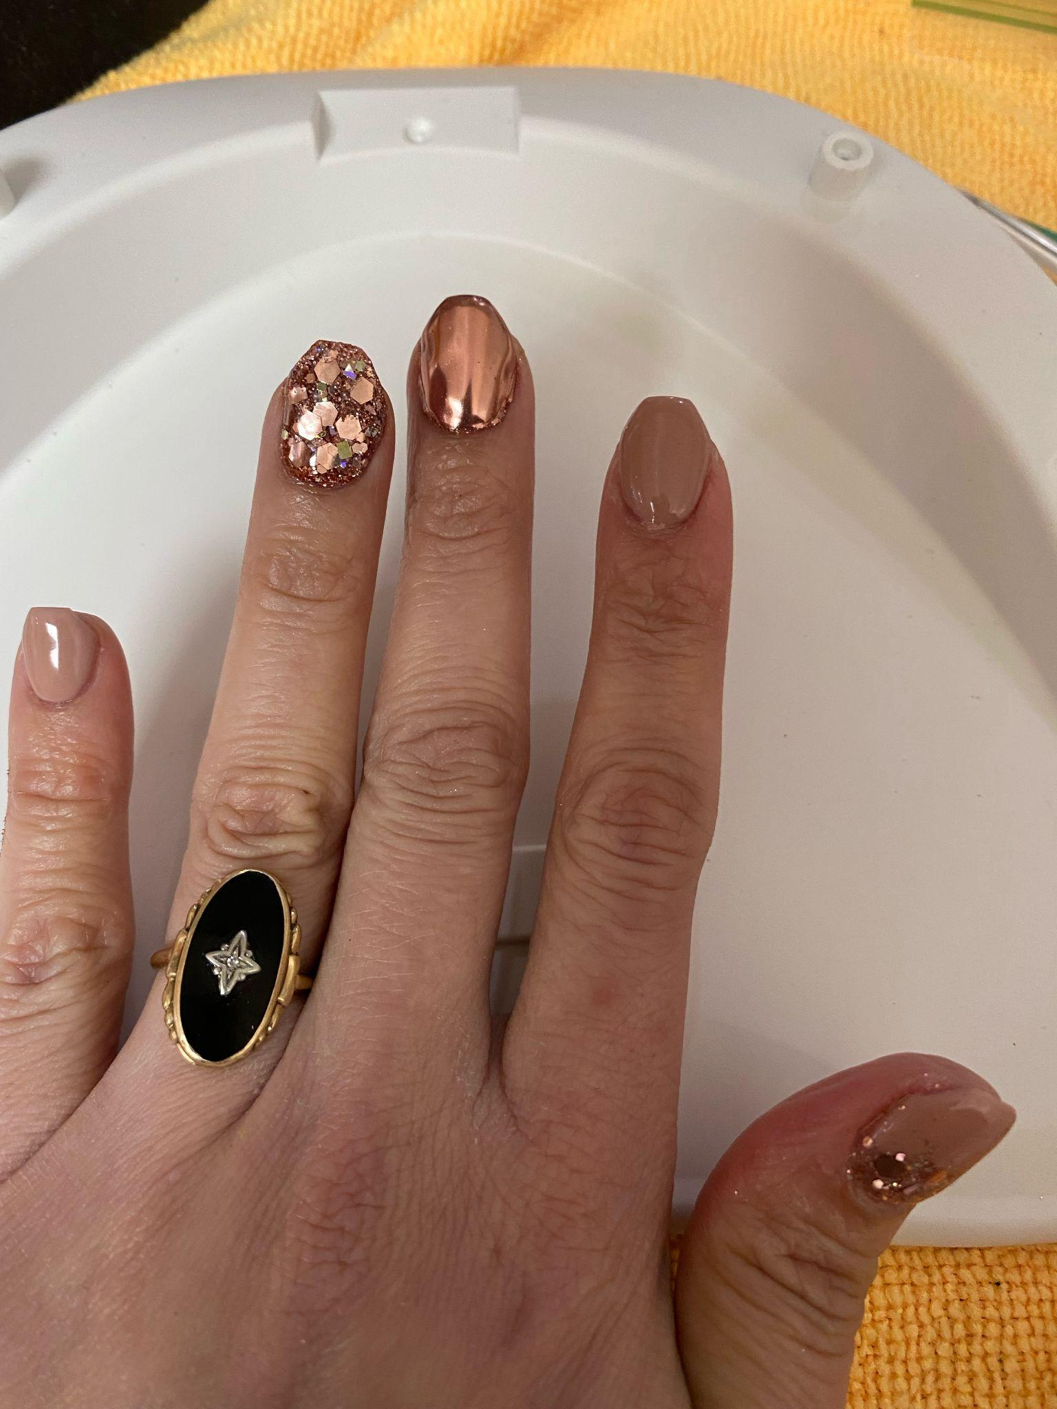
What I like most about doing hair and nails
I really like to do nails because I can do many cool designs and I also like doing nails because my mom is a nail professional.
I really like doing hair because
I can do crazy hairstyles and cute hairstyles.

Slide 6
Thank you
By: Ilyana badwan

