Slide 1
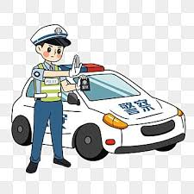
A Policeman

Slide 2
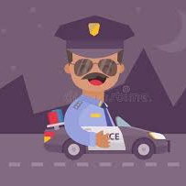
I want to become a Policeman to make a difference in the world
I like to help people in need and bring justice to those who deserve it.

Slide 3
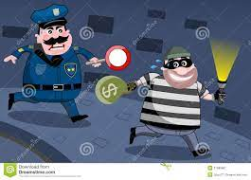
It’s the way I can enforce law and ensure security and Safety of the Community.

Slide 4
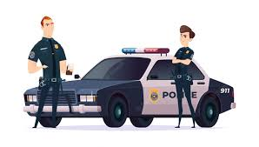
justice, Freedom, and Democracy are the most important ideals to me, and I believe that people need protection in times of both peace and war.

Slide 5
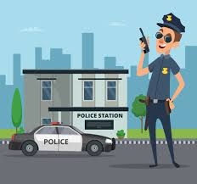
That’s why I love to become
a Policeman.

Slide 6

THANK YOU

