Slide 1
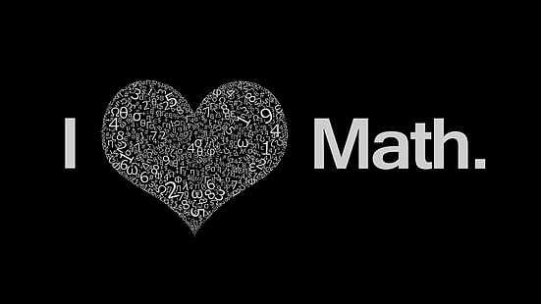


Slide 2
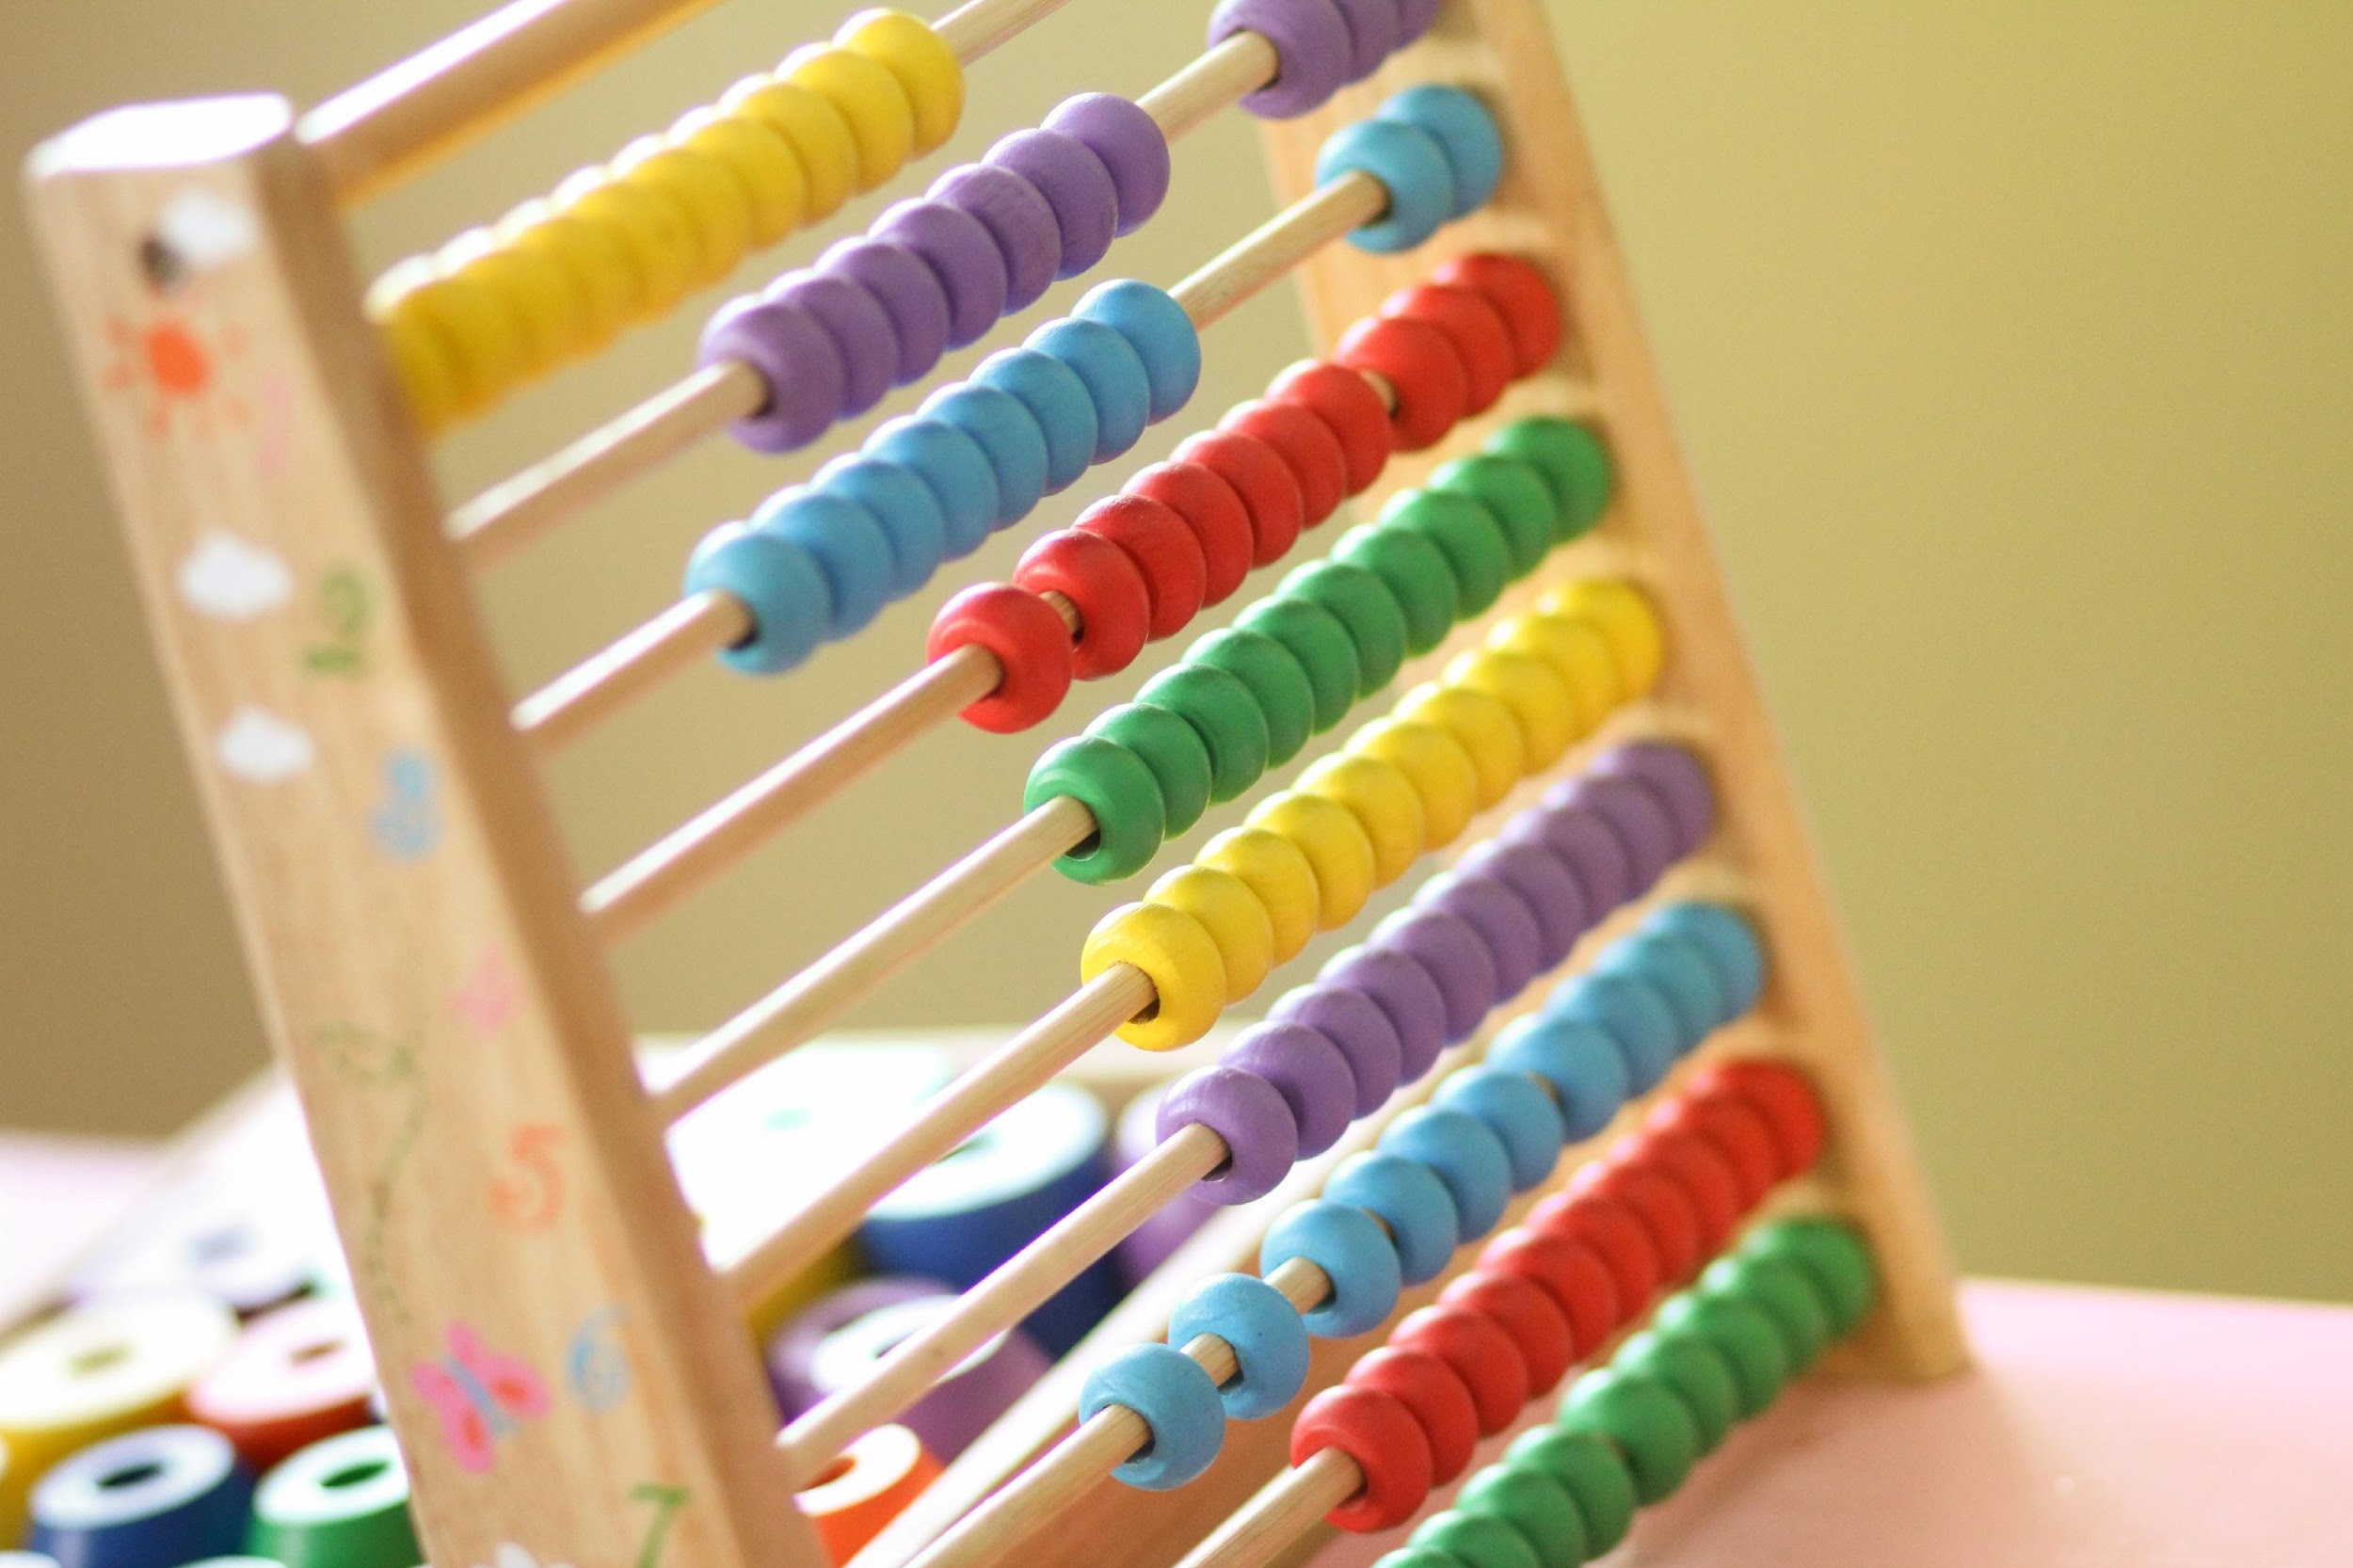
Lesson 3-1:The Distributive Property
Pg. 77
Objectives:
set the Distributive Property to solve problems involving multiplication within 100.

Slide 3

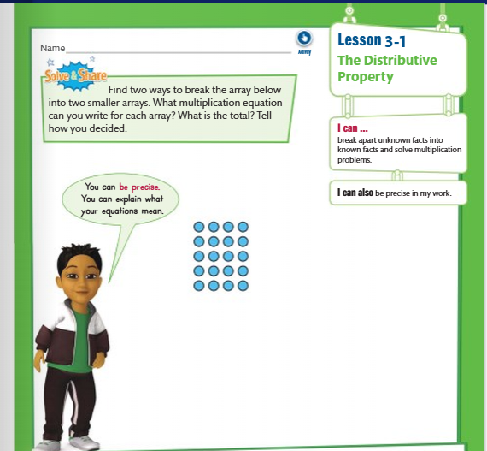
Pg. 77

Slide 4
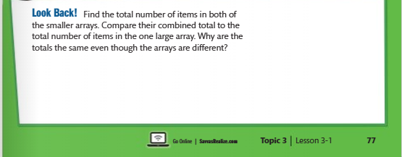

Pg. 77
Break apart the array into smaller arrays to multiply, the total number of counters doesn’t change.

Slide 5
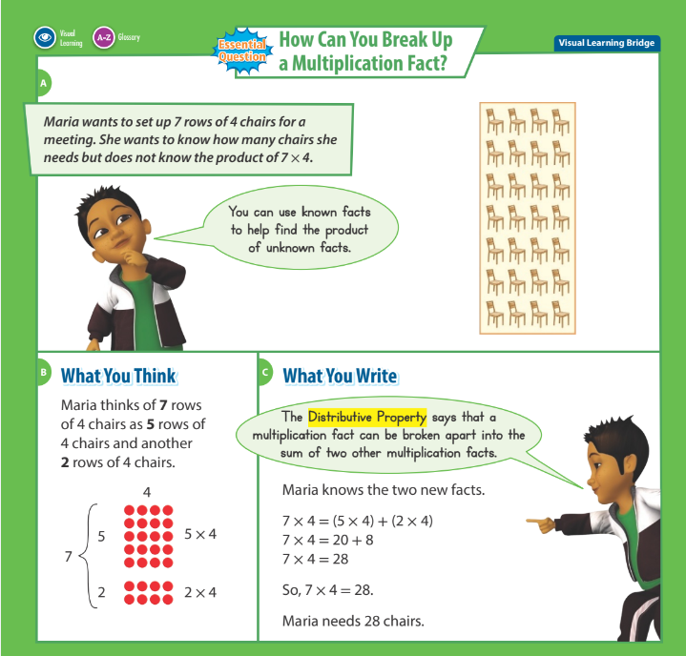
Pg. 78

Slide 6
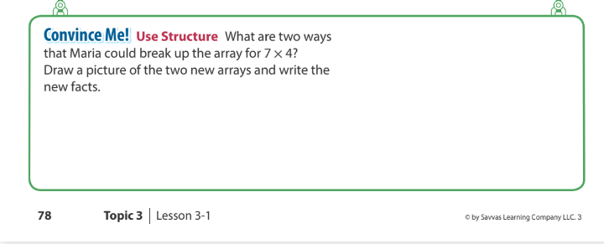
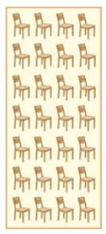
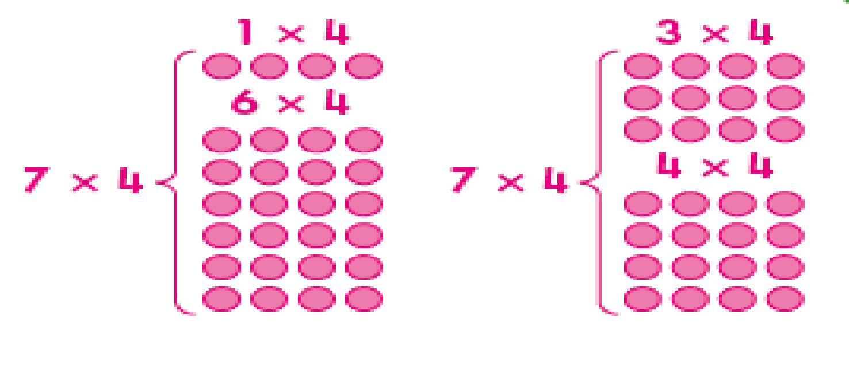
Pg. 78

Slide 7


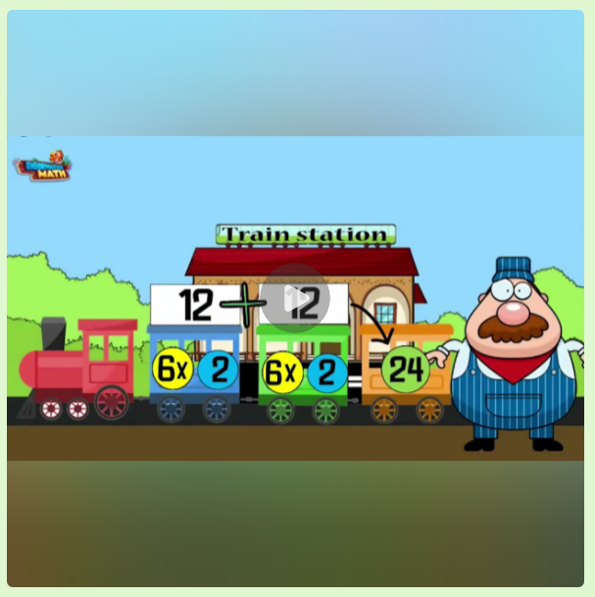
https://youtu.be/tt6C4qEDdeA?feature=shared

Slide 8

Let’s practice
now

Slide 9
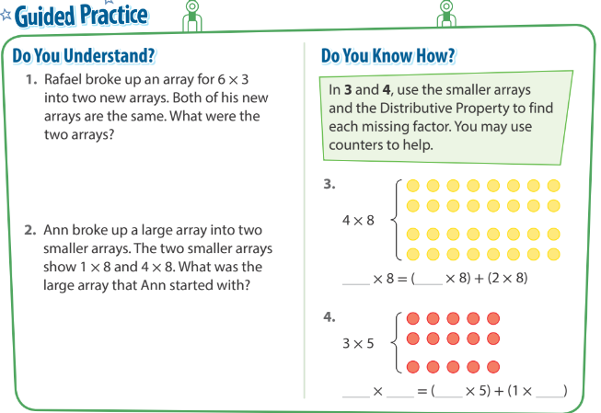



Pg. 79
Two 3 × 3 arrays.
4
2
Ann started
with a 5 × 8 array.
3
5
2
5

Slide 10
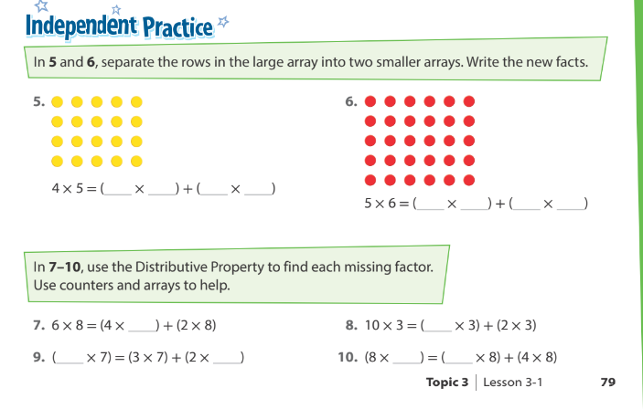
Pg. 59
1
5
3
5
3
6
2
6
8
8
5
7
8
4

Slide 11
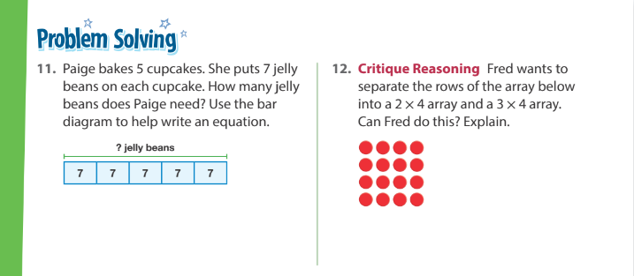
Pg. 80
5 × 7 = 35 Jelly beans.
No, (2×4)+(3×4) = 5 × 4 not 4 × 4

Slide 12
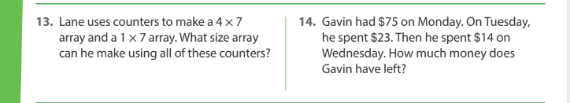
5 × 7
38 $
Pg. 80

Slide 13
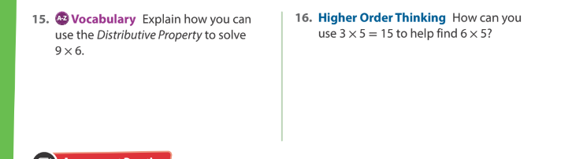
Pg. 80
6=3+3
6×5=(3×5)+(3×5)= 15+15=30
Break into the sum of two other fact
(9×3)+(9×3)=27+27=54

Slide 14
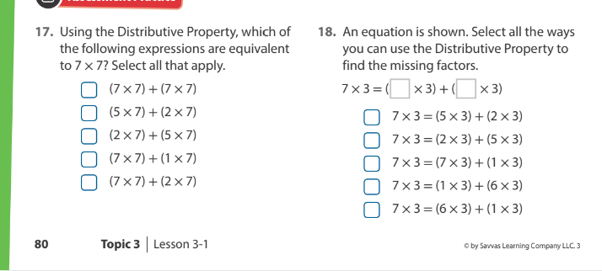
Pg. 80

Slide 15




Good Bye

Slide 16
Thank You!

Slide 17
Homework

Slide 18
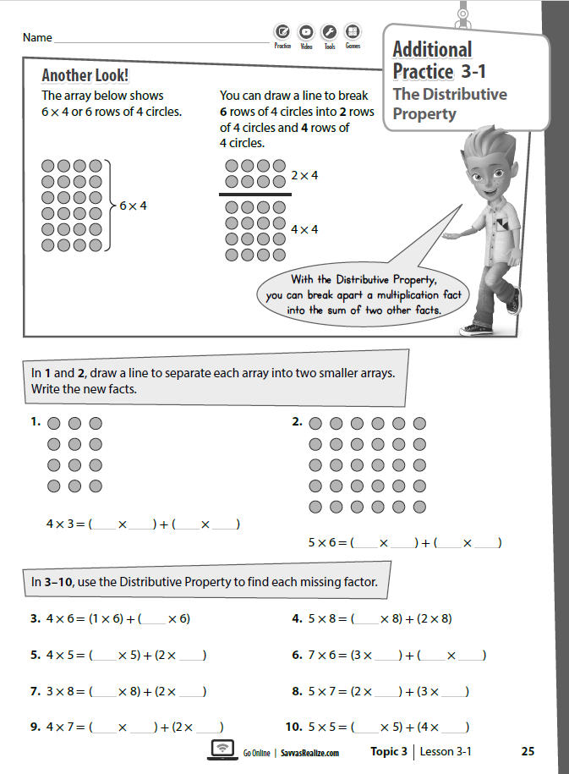

Slide 19
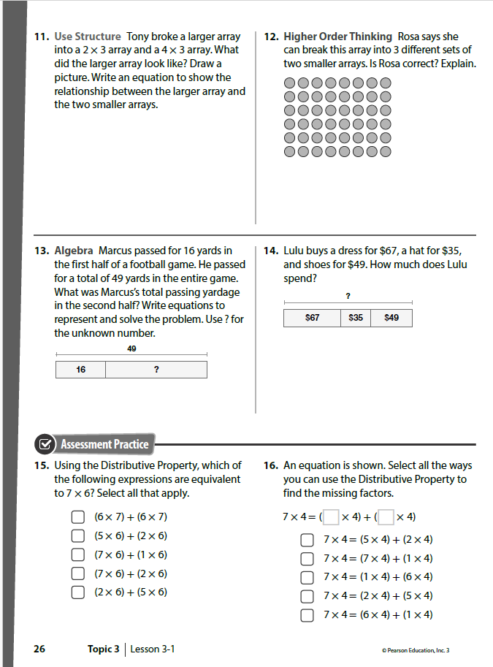

Slide 20
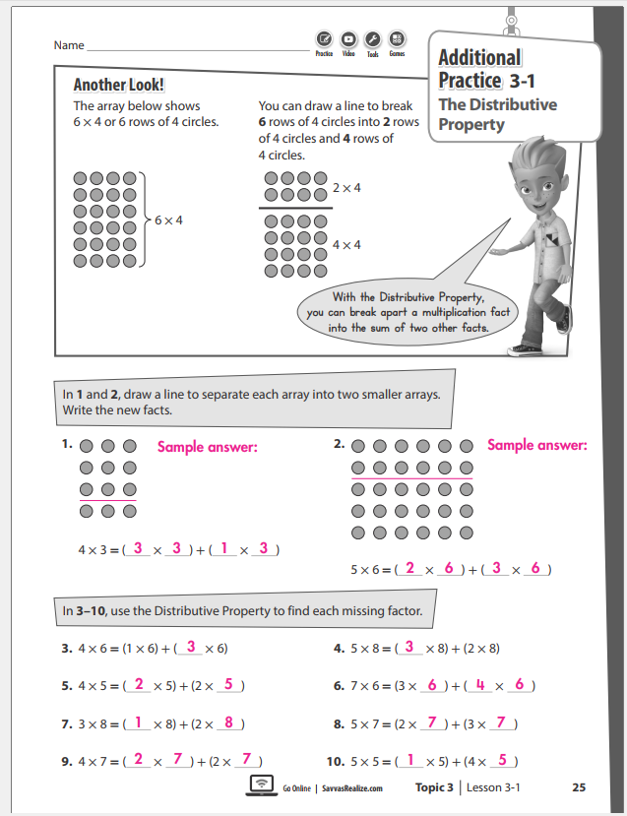

Slide 21
