Slide 1
My Projects and Activities This Semester
A Journey of Learning and Fun! By lojain

Slide 2
Hi everyone! My name is Lojain, and today I’m excited to share my projects and activities from this semester!

Slide 3
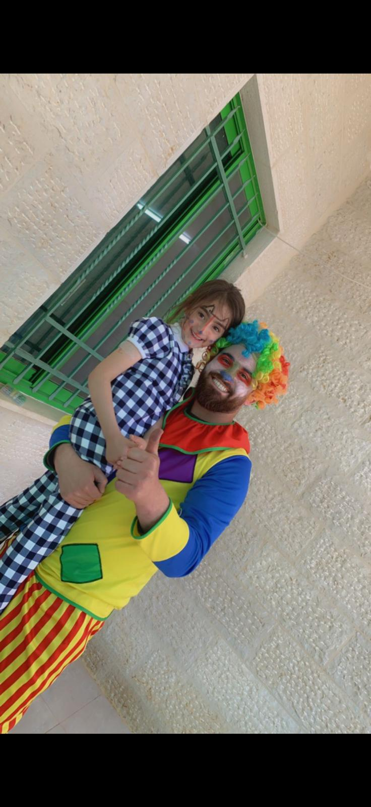
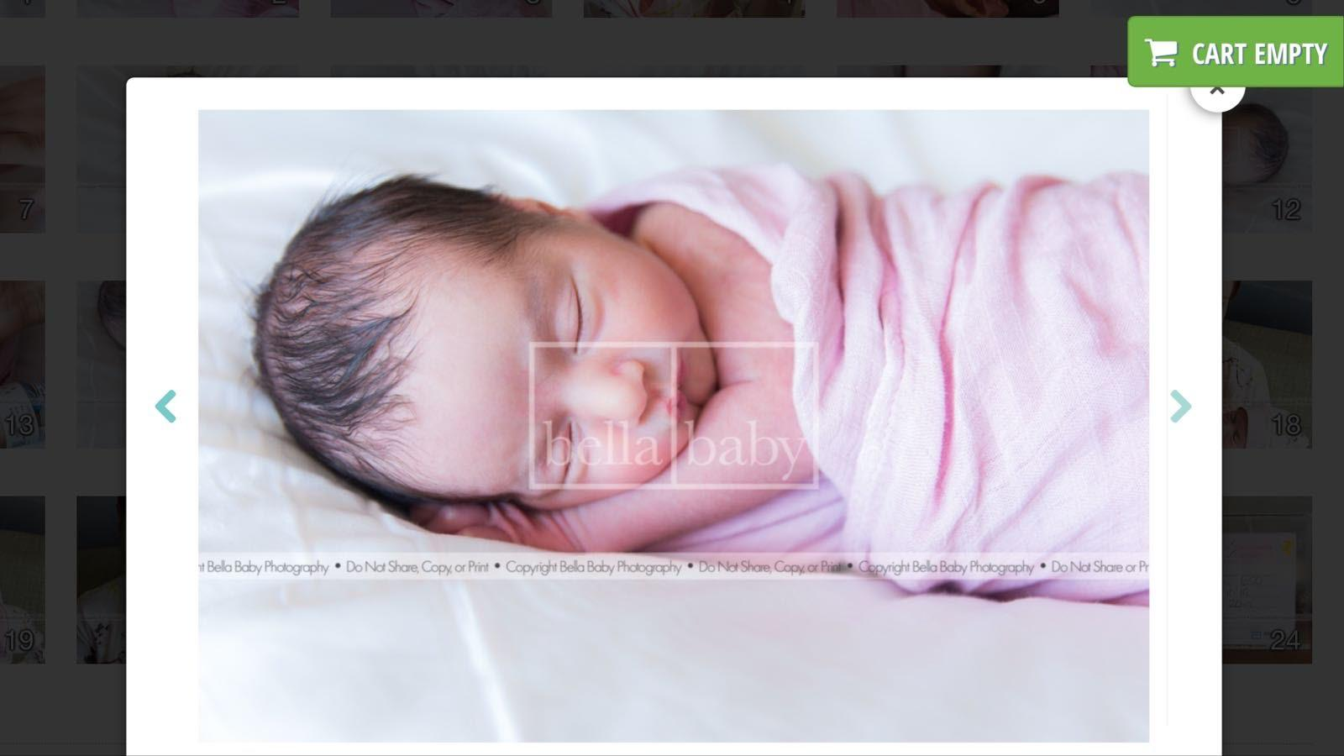
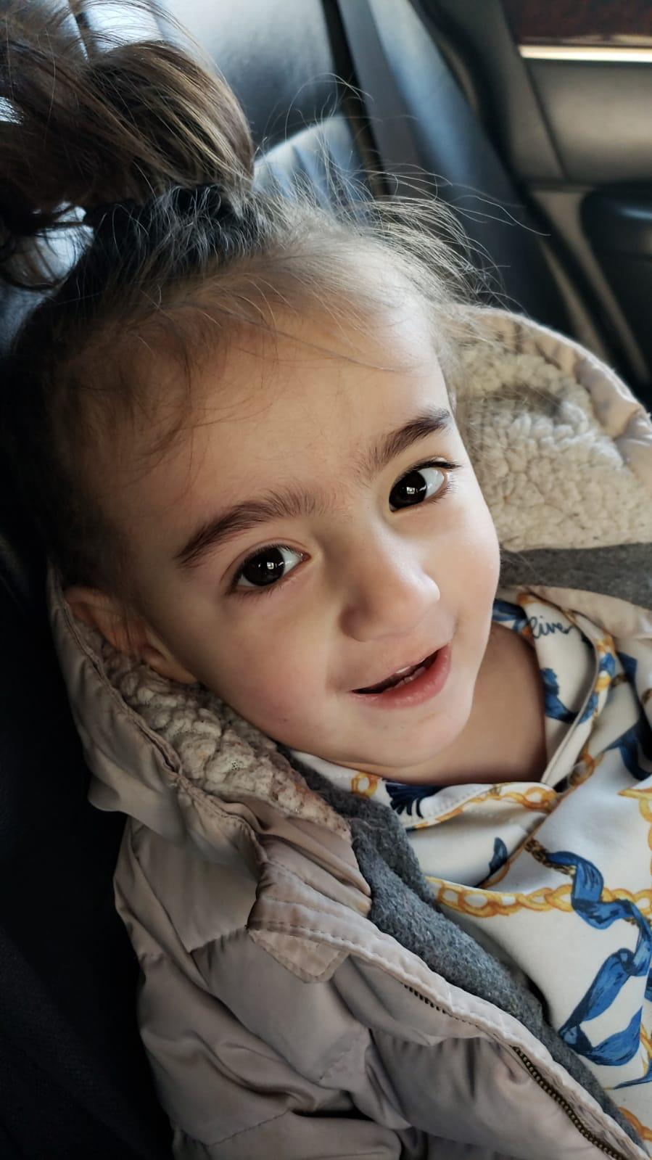
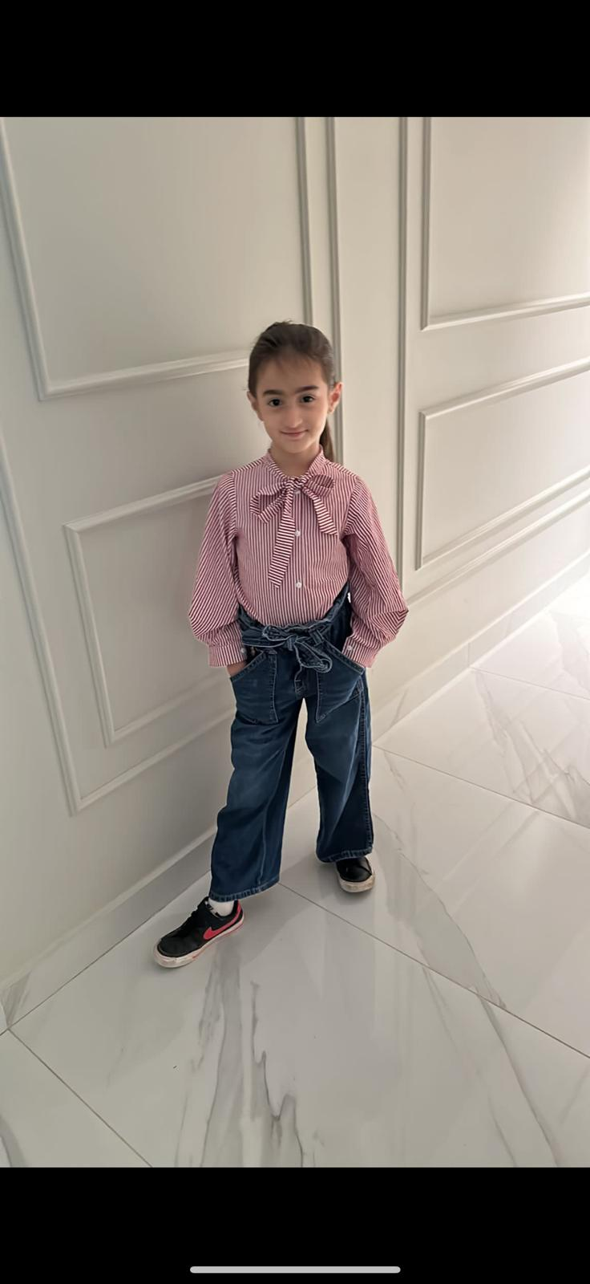
Project 1: Human Life Cycle (First 7 Years)
For my first project, I learned about the human life cycle. I talked about the first seven years of life, from being a baby to starting school. Each stage is important for our growth!

Slide 4
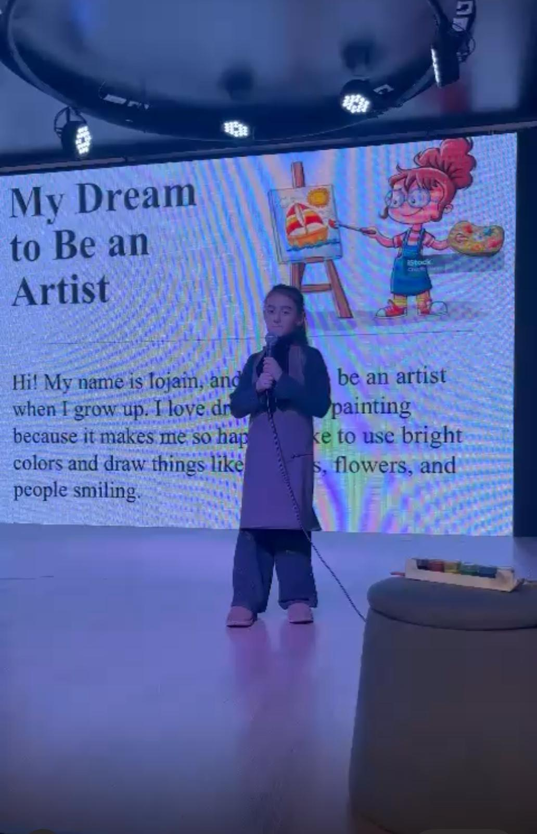
Project 2 - My Dream to Be an Artist
"In my second project, I shared my dream of becoming an artist. I love drawing and painting with bright colors. I hope to have my art in a museum and create storybooks that make people smile!

Slide 5
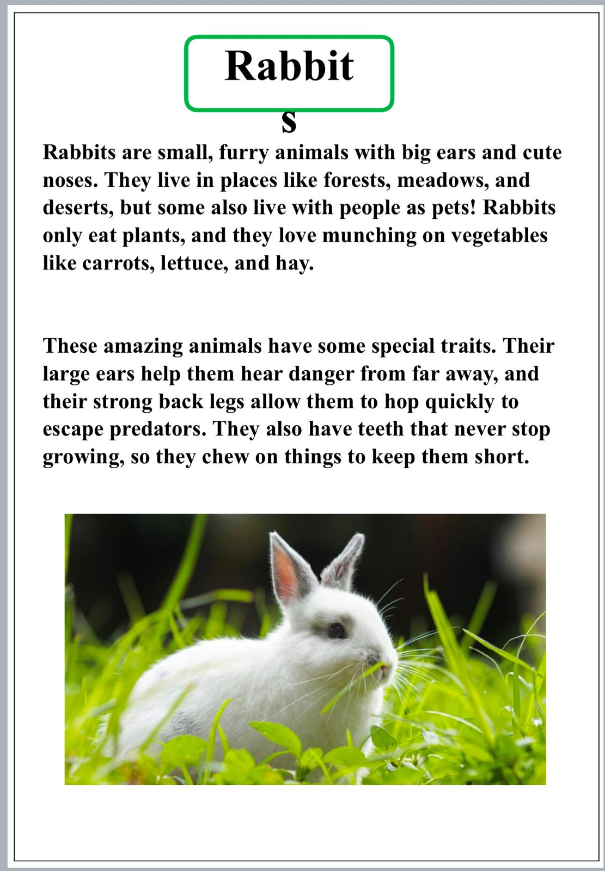
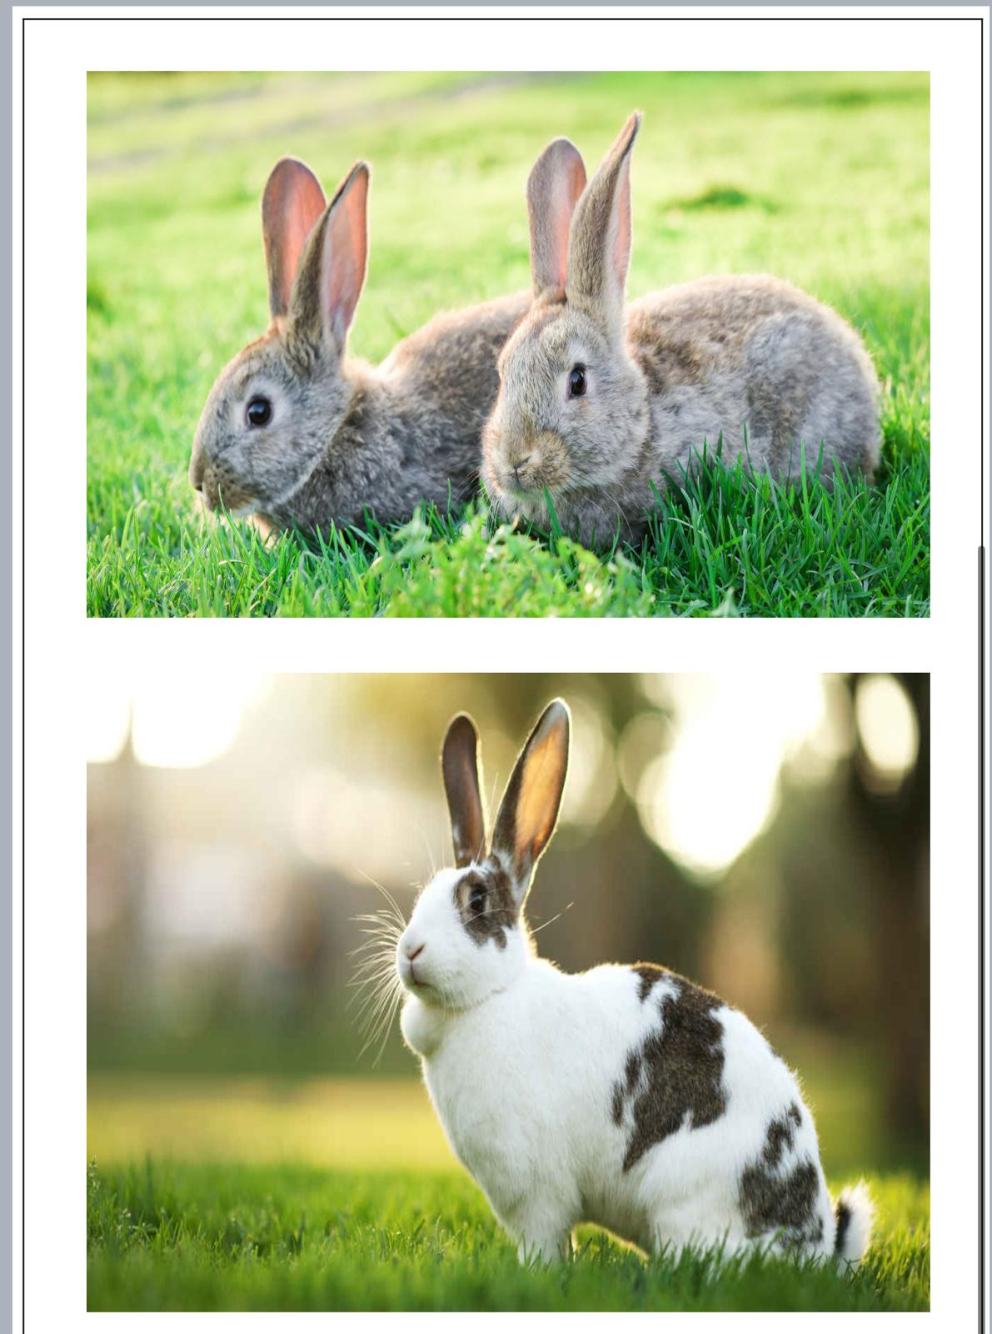
Project 3 - All About Rabbits
  For my third project, I learned about rabbits. They are small, furry animals that live in many places. They eat plants and have special traits that help them survive. I think they are really cute!"

Slide 6
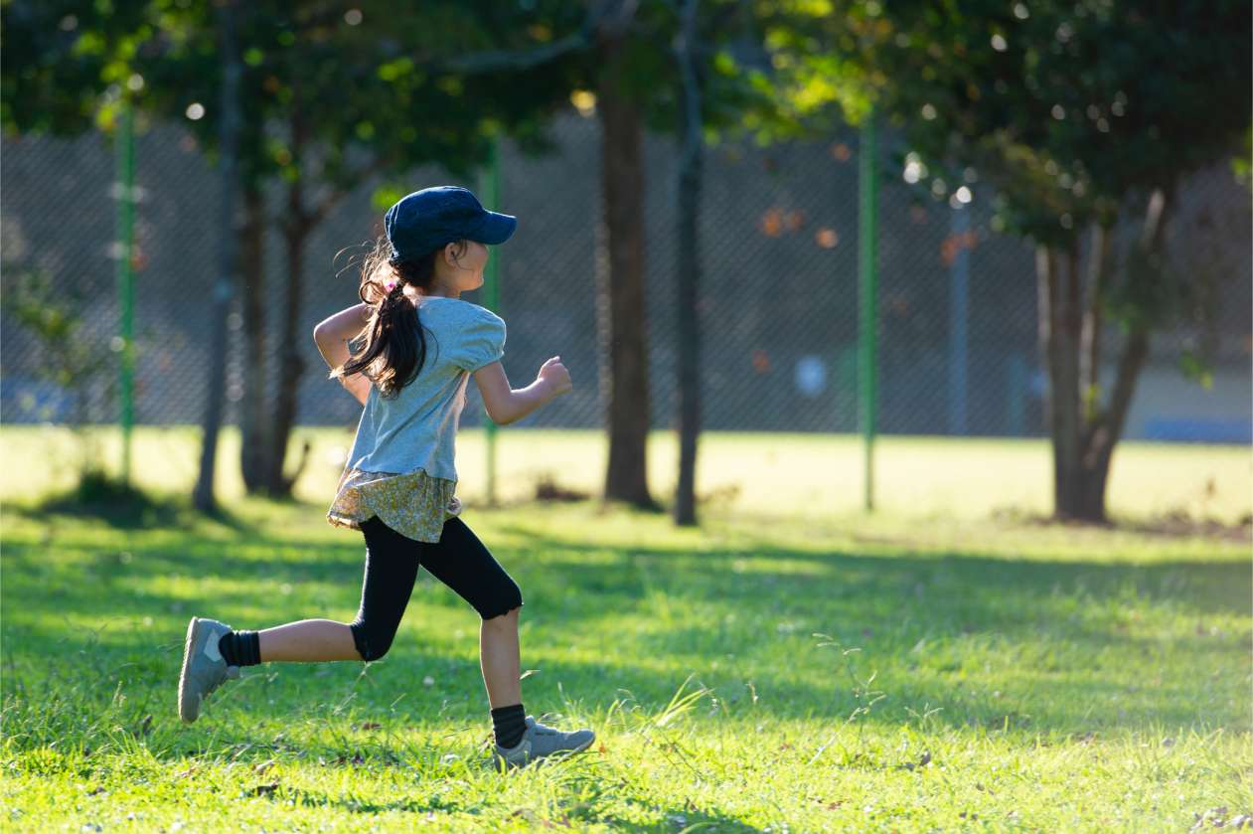
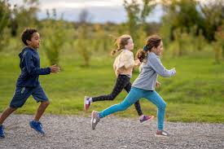
Project 4 - My Talent: Running
In my last project, I talked about my talent for running. I started running with my family, and now I practice regularly. I dream of being a fast runner like the ones I see on TV!"

Slide 7
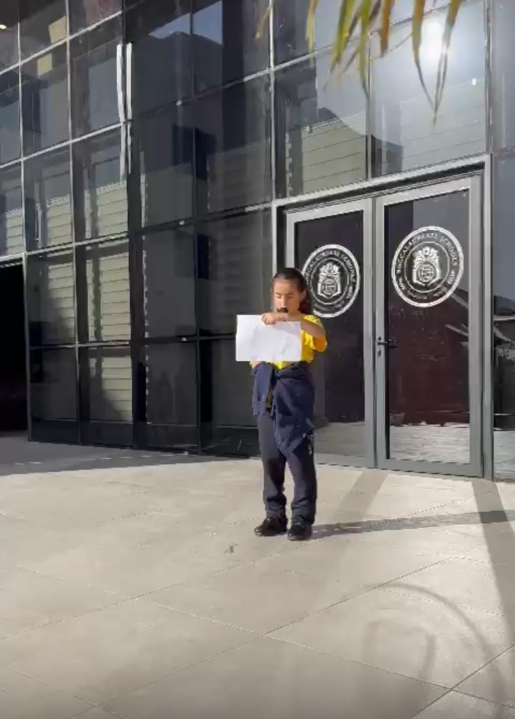
Activity 1 - Speaking on Stage
One of my activities this semester was speaking on stage. I talked about Palestine and shared interesting facts during a 'Did You Know?' presentation. It was exciting to speak in front of everyone!

Slide 8
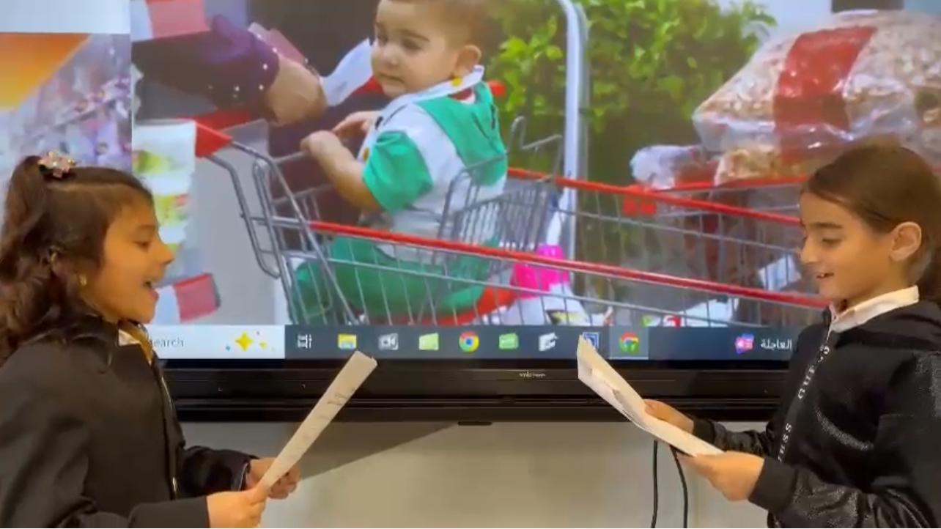
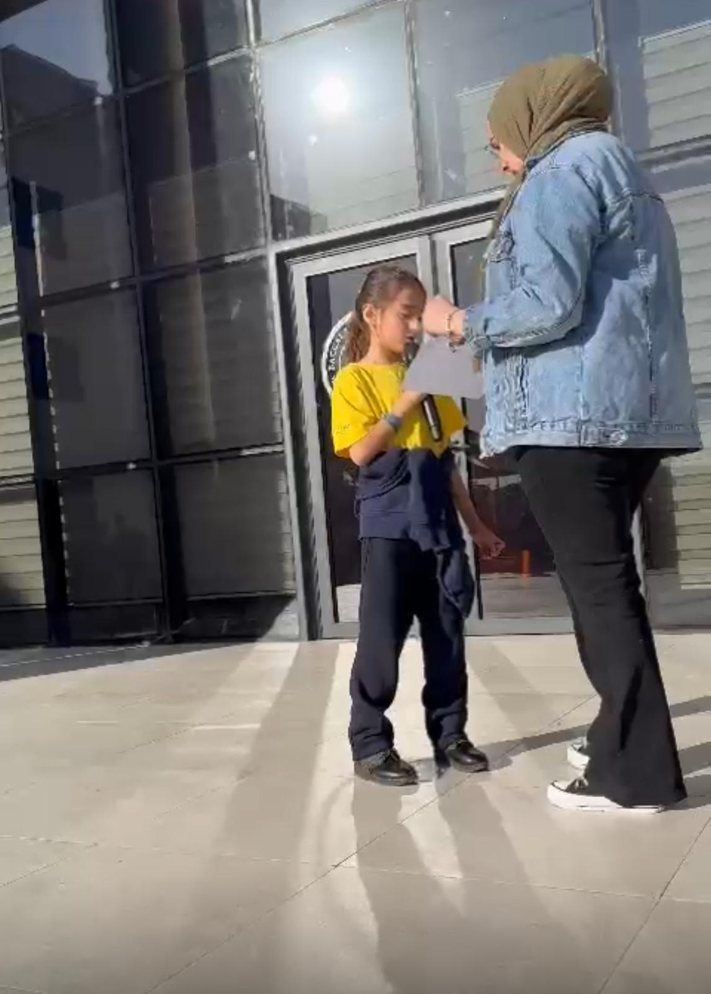
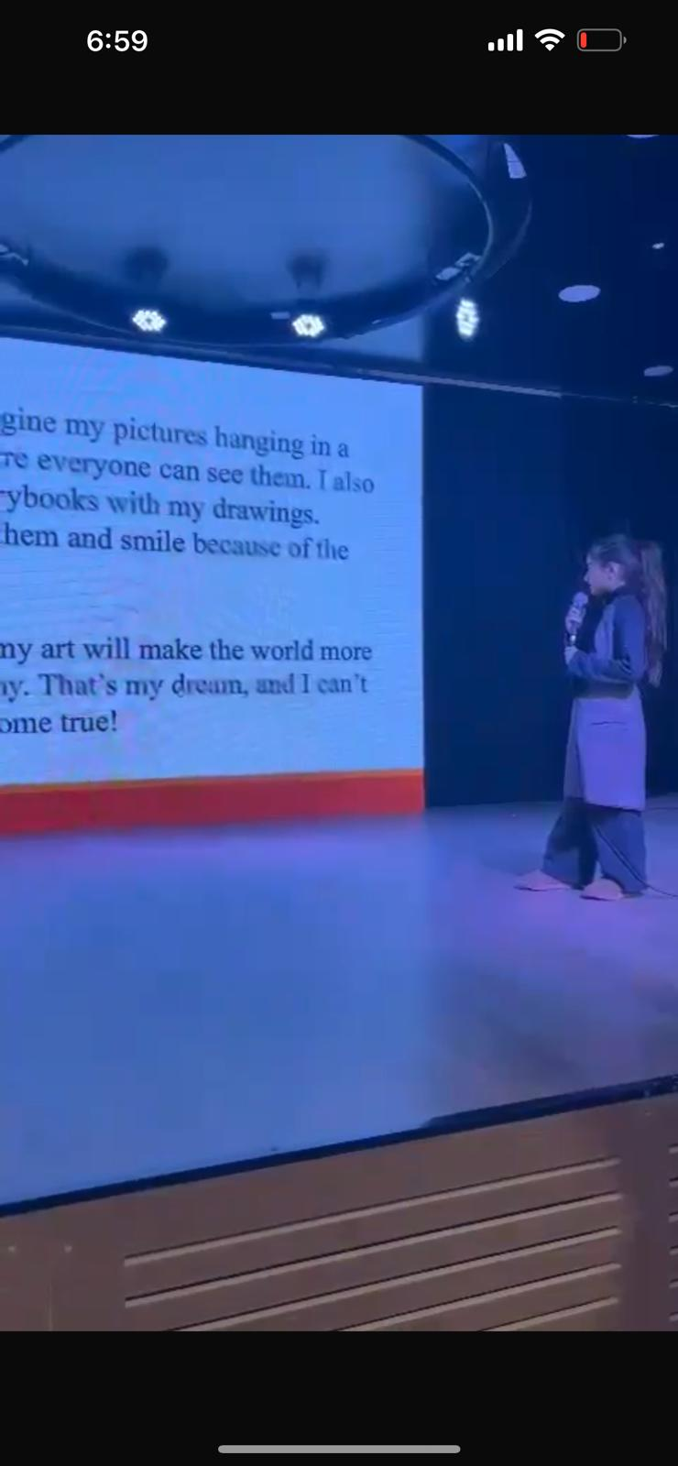
More pictures wile speaking om stage

Slide 9
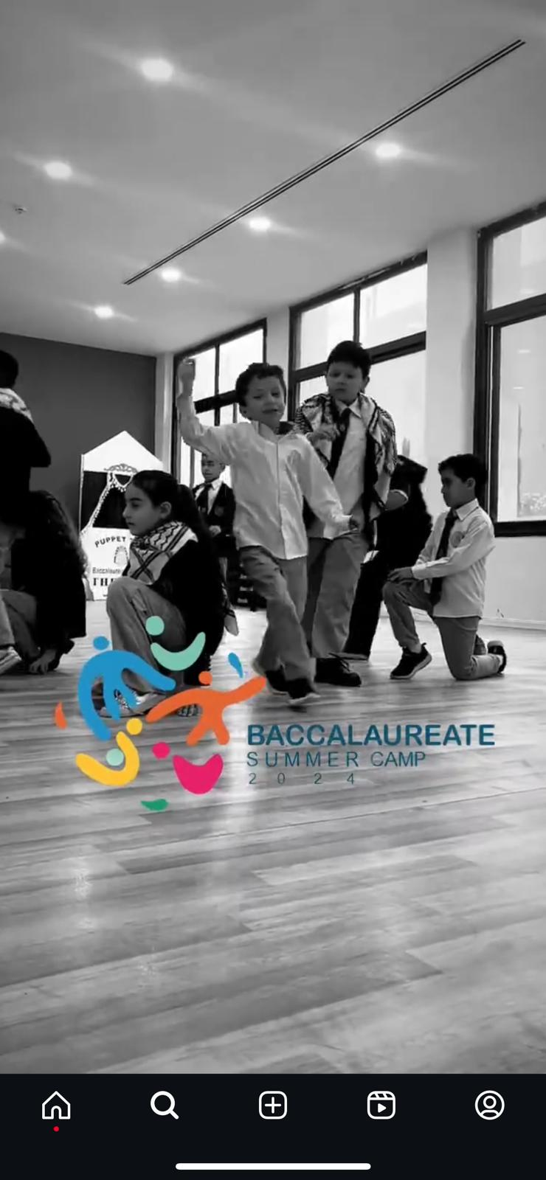
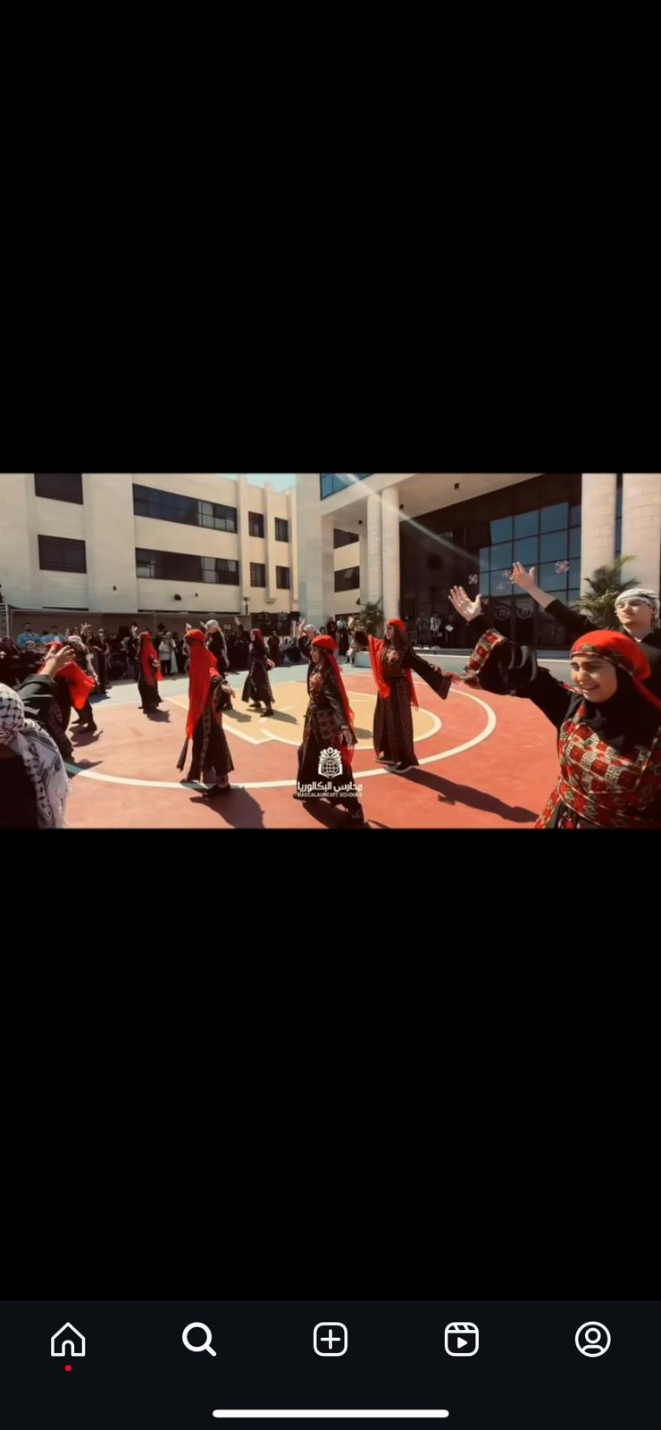
Activity 2 - Dancing Dabka
    I learned to dance Dabka, a traditional dance.
    It was fun to dance with my friends.
    We enjoyed the music and the rhythm together!

Slide 10
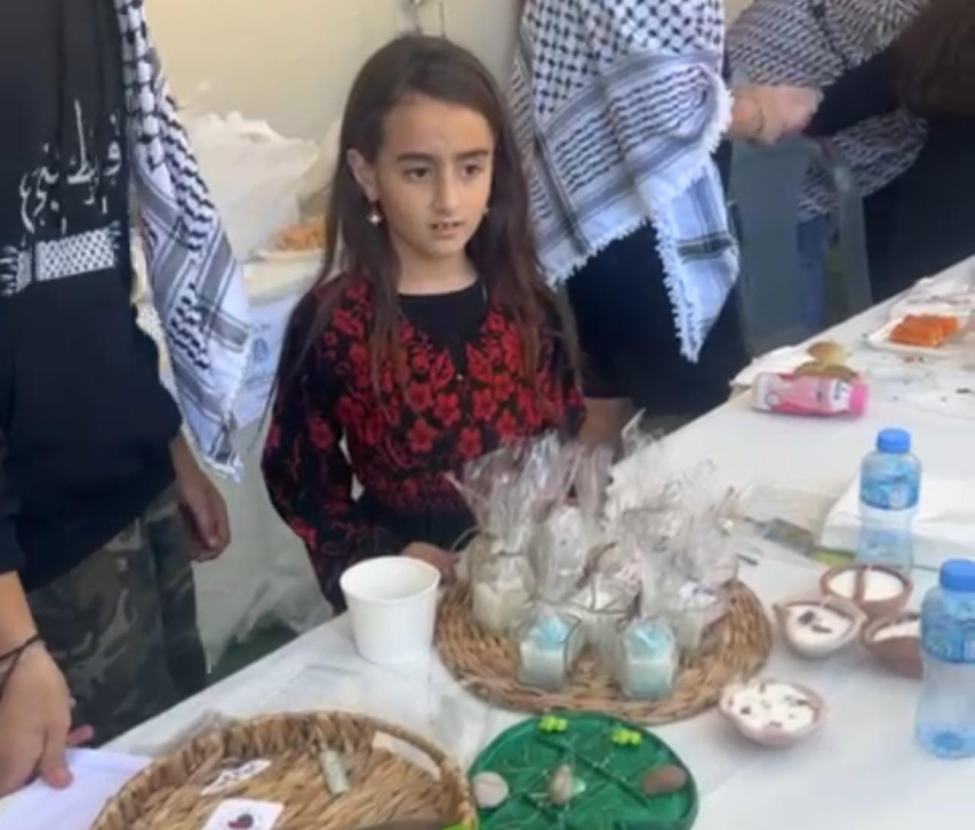
Activity 3: Wearing Traditional Clothes
  The third activity was wearing traditional clothes on Tradition Day. It was a wonderful celebration of our cultural heritage. Everyone wore their unique attire, and we learned about the significance of these clothes. It was a fun and enjoyable experience that brought us all together, allowing us to share our traditions and appreciate our diverse backgrounds!"

Slide 11
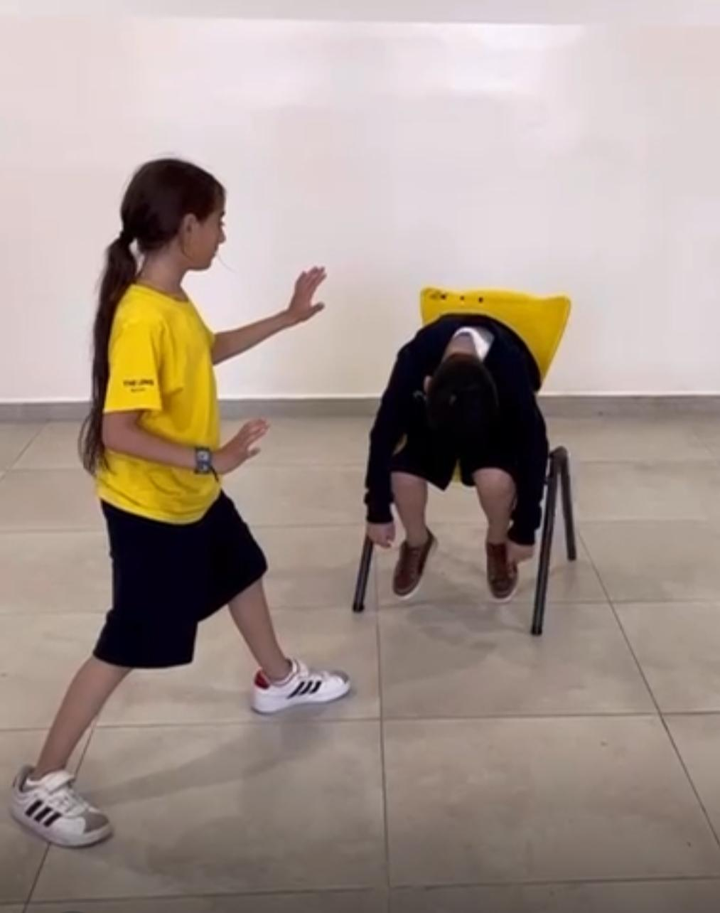
Activity 4: Playing Sports and Exercising
We had so much fun making exercises and playing funny games together! It was a great way to stay active and healthy. We enjoyed working as a team and cheering for each other, which made it even more exciting!

Slide 12
Thank You for Listening!
Thank you so much for listening to my presentation about my projects and activities this semester! I hope you enjoyed it as much as I enjoyed sharing it with you.

