Slide 1
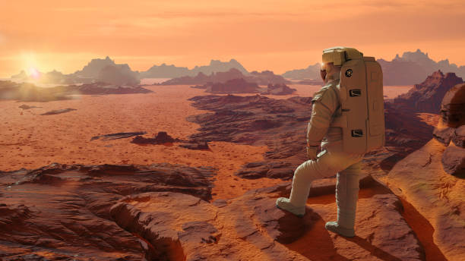
Your Space Odyssey Awaits: Explore Mars in Style!
"The Red Planet is calling. Are you ready to answer?"

Slide 2
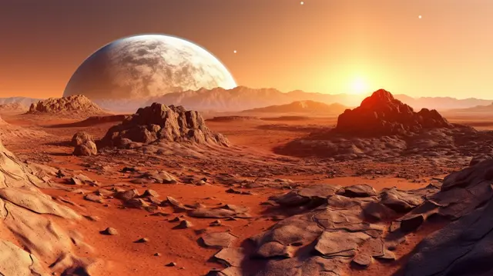
Explore the Red Planet: Mars
Mars, also known as the "Red Planet," is the fourth planet from the Sun. Its striking red color comes from iron oxide (rust) on its surface.
Why Mars?
-Breathtaking Landscapes
-Fascinating History
-Exciting Exploration Opportunities:
Fun Fact:
A day on Mars, called a "sol," is only slightly longer than an Earth day—24 hours and 37 minutes!

Slide 3
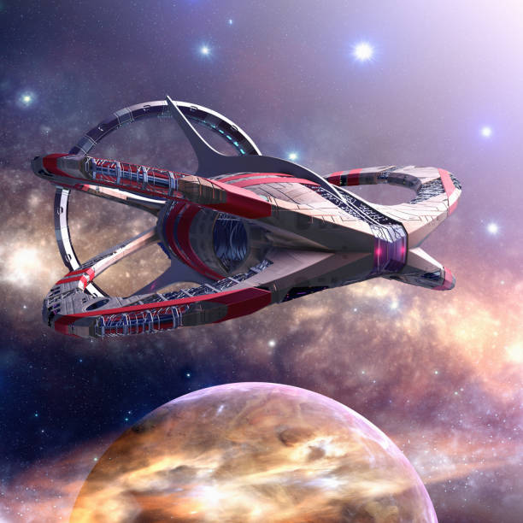
Trip Details
Destination: Mars
Travel Method: State-of-the-art spaceship - 'Cosmos Voyager X’
- Luxury seating
- AI-guided navigation
- Panoramic views of space
Duration: 6 months one way
Exciting stops at the Moon and an orbiting space station

Slide 4
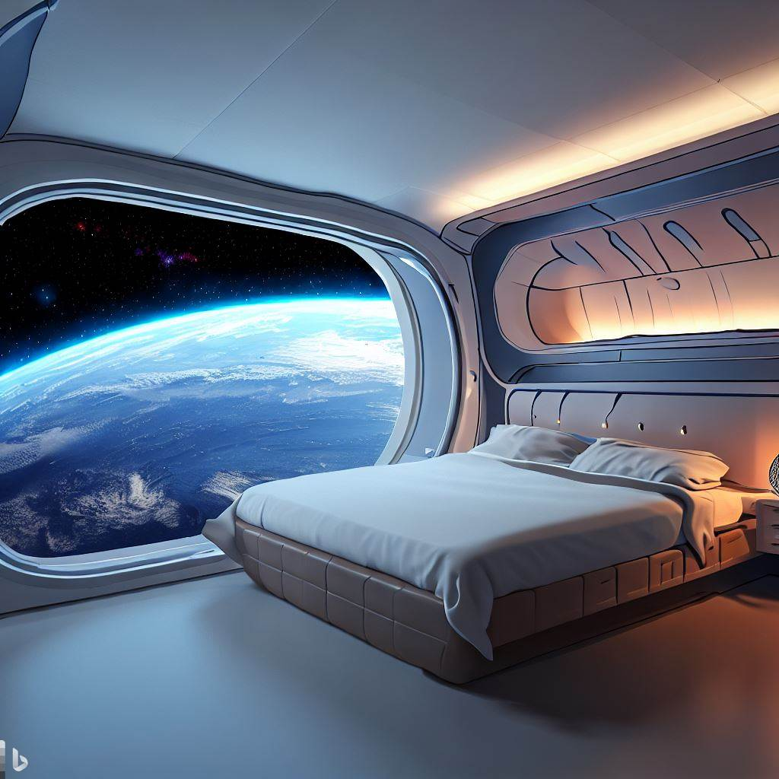
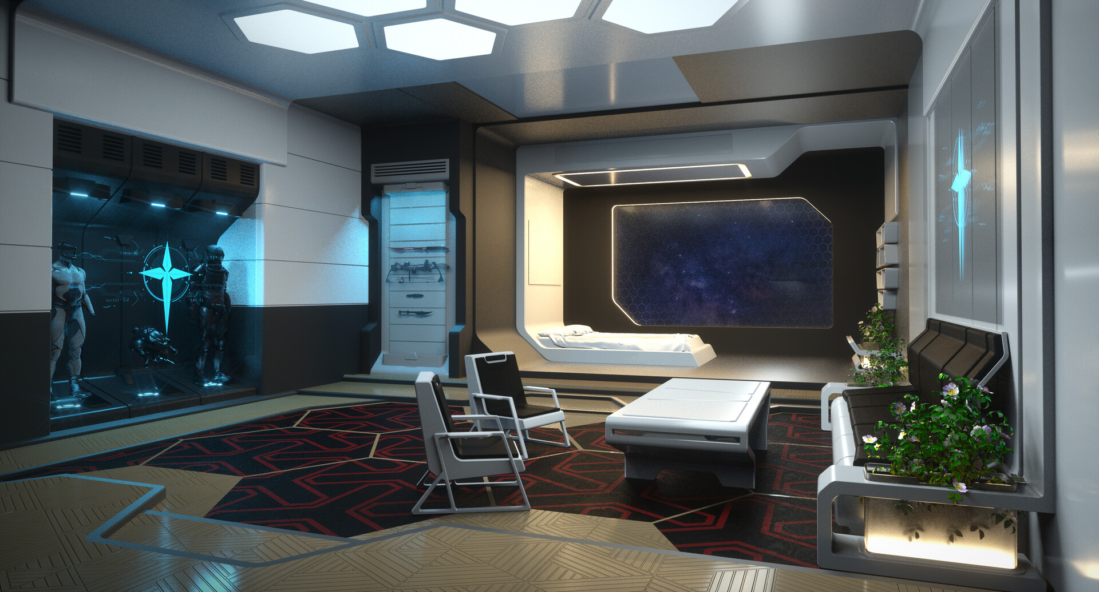
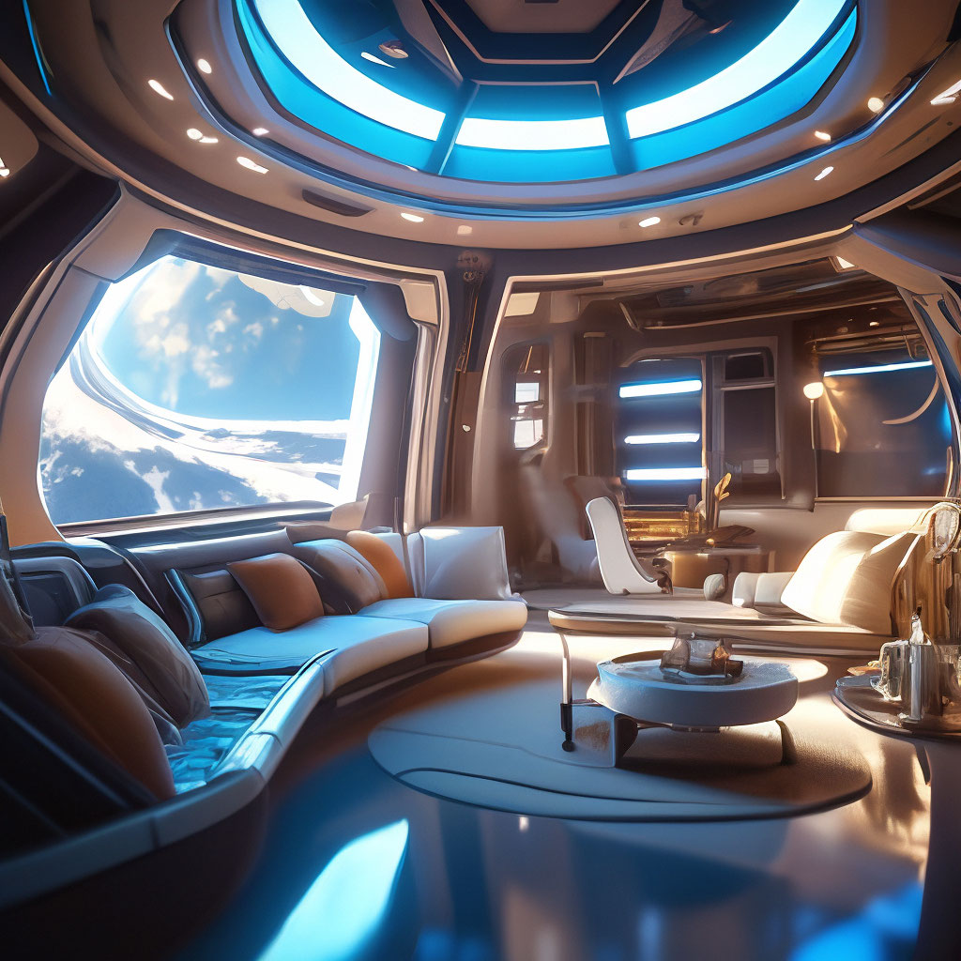


More pictures for the luxury 'Cosmos Voyager X’ spaceship interior

Slide 5

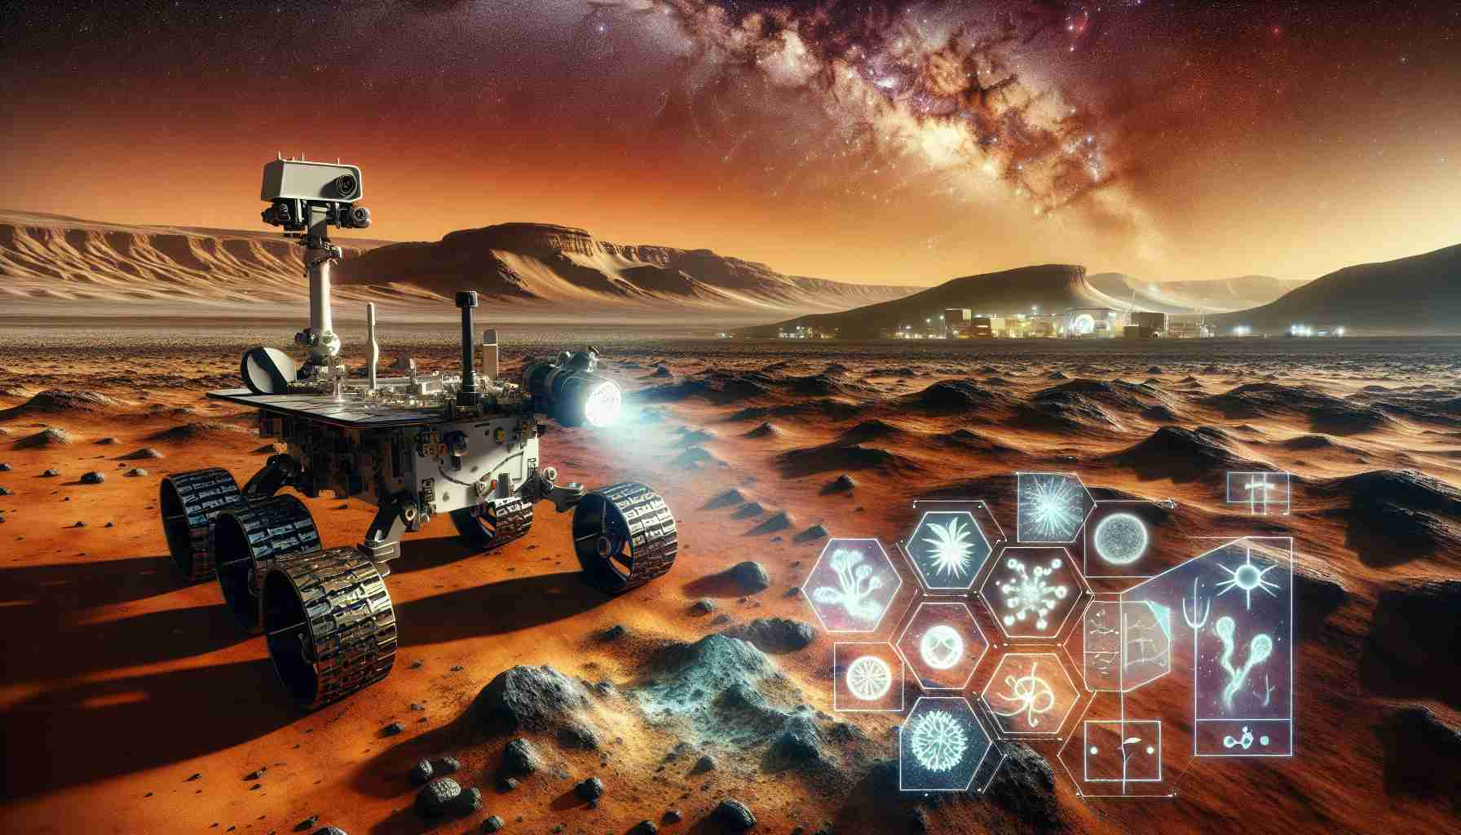
Activities & Stay
Activities:
Spacewalks:
Float among the stars with safety gear
Stargazing:
Enjoy celestial views with zero light pollution
Mars Roving Adventures: Drive cutting-edge rovers across Mars

Slide 6
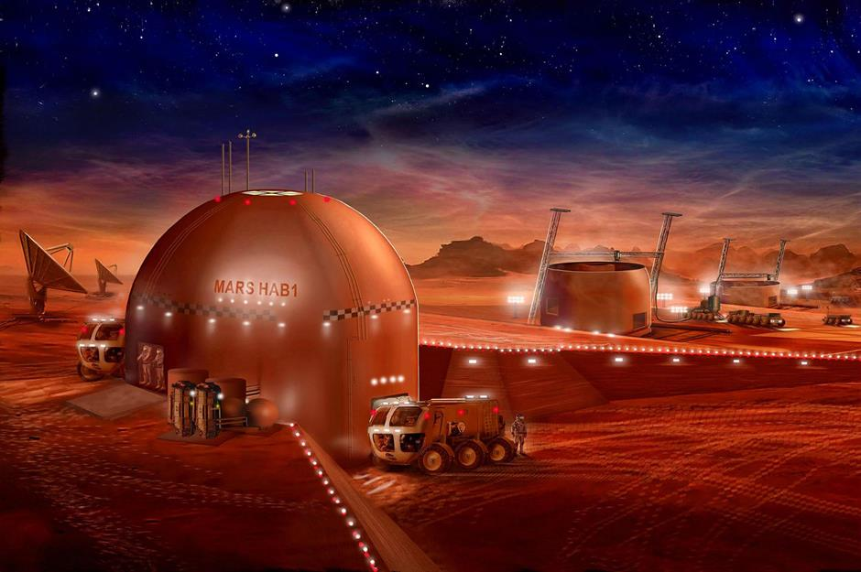

Stay:
- Mars Haven Resort: Dome-like habitat with cozy living quarters
- Artificial gardens and Martian-inspired meals
Food:
- Gourmet space meals with freeze-dried treats and Martian herbs

Slide 7
Cost and Requirements
Cost: $2.5 million per person
- Includes travel, activities, stay, and meals
Who Can Go?
- Age: 16 and above
- Health: Basic fitness test and space training course
Call to Action:
- 'Book now and be one of the first humans to step on Mars.'
- 'Your interstellar adventure awaits!'

