Slide 1
The Water Cycle
By Amr Bazzar
“Hello everyone, my name is Amr Bazzar.
Today, I will explain the Water Cycle and why it is important for life on Earth.”

Slide 2
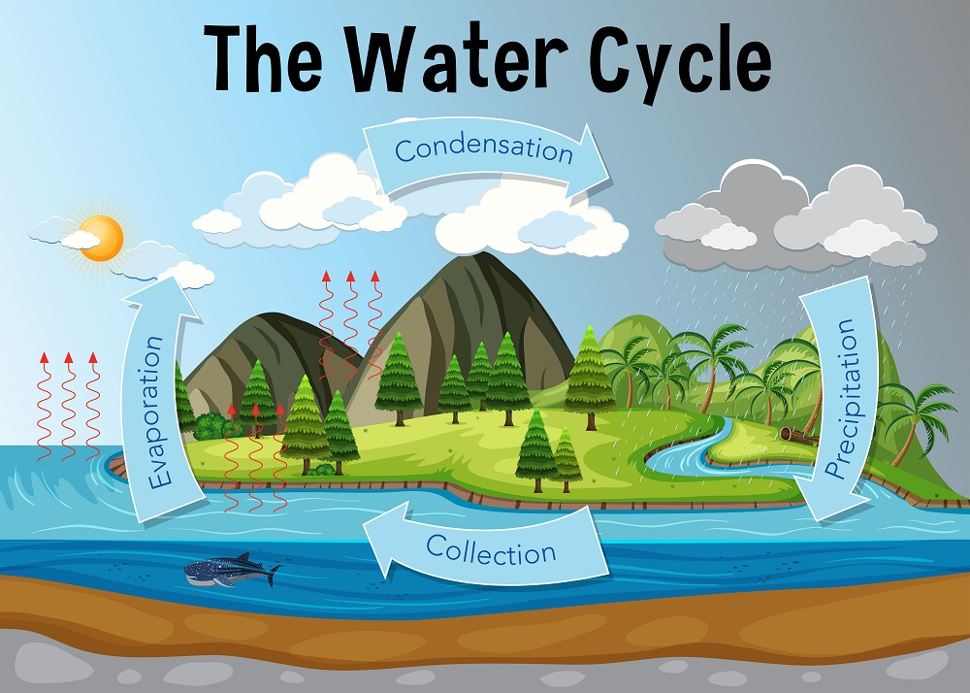
What is the Water Cycle?
Water moves around the Earth
Goes from ground - sky - ground
“ The water cycle is how water moves around our planet. It goes from the ground to the sky and then back to the ground again.”

Slide 3
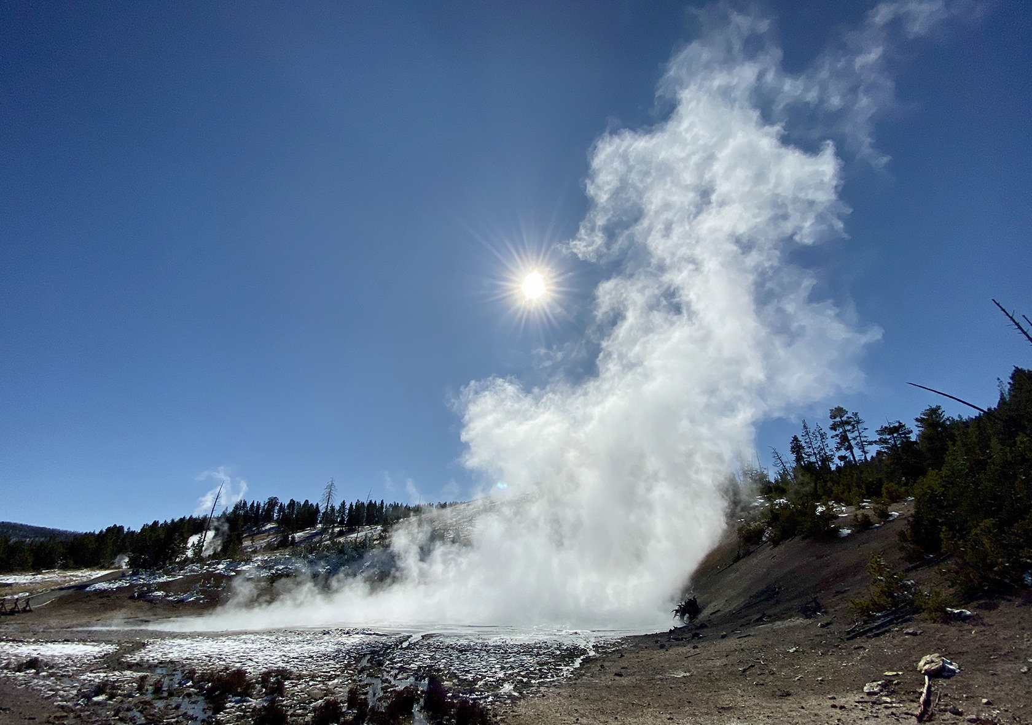
Step 1 : Evaporation
Sun heats water.
Water turns into gas.
Goes into air.
“First, the sun heats up rivers, lakes, and oceans. The water turns into gas and rises into the air. This is called evaporation.”

Slide 4
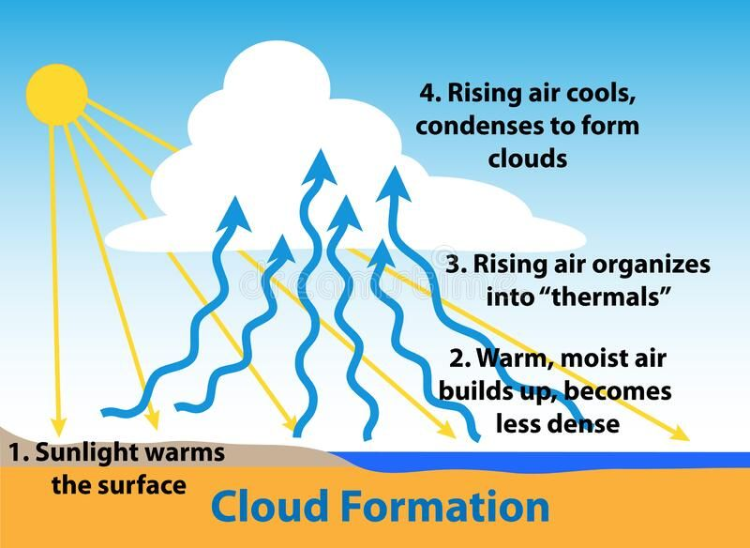
Step 2 - Condensation
Water cools.
Forms tind drops.
Makes clouds.
“Next, the water gas cools down and turns back into tiny drops. These drops join together to make clouds. This is condensation”

Slide 5
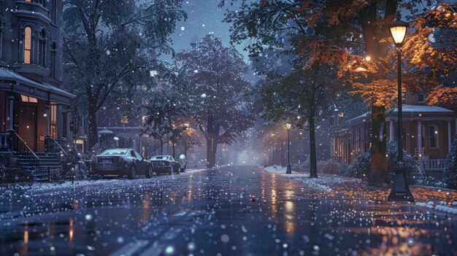
Step 3- Precipitation
Water falls down.
Rain, snow, hail.
“When the clouds get too heavy, the water falls back to Earth as rain, snow, or hail. This is precipitation.

Slide 6
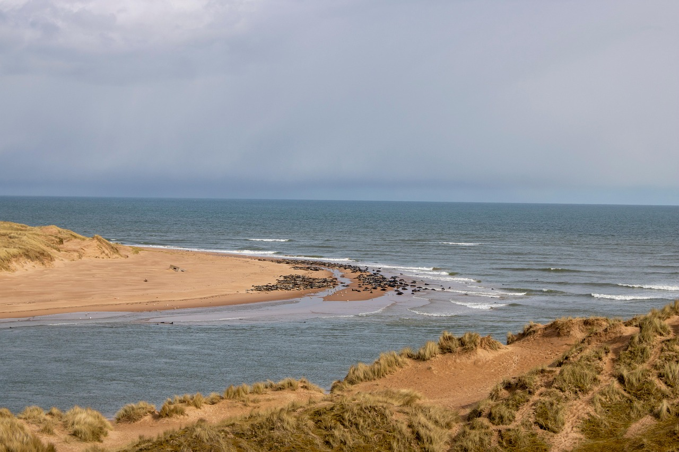
Step 4 - Collection
Water goes to rivers, lakes, oceans
Cycle starts again
“The water goes back into rivers, lakes, and oceans, and the whole cycle starts again.

Slide 7
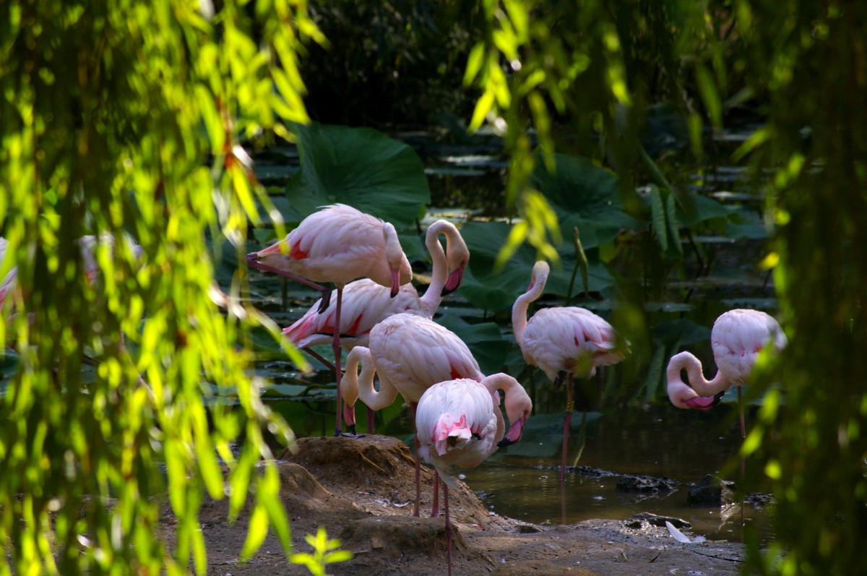
Step 7 - Why It Matters
Gives us fresh water.
Keeps plants and animals alive.
“The water cycle is very important because it gives us fresh water to drink and keeps all living things alive.”

Slide 8
Conclusion
“This is how the water cycle works.
Thank You for listening!
Do you have any questions ?

