Slide 1
My Life Journey
Mahmoud Amraneh

Slide 2
About Me
My Name is Mahmoud Amarneh
I was born in Ramallah
I am 9 years old
I live in ramallah

Slide 3
My Childhood
I loved playing football with my friends
I enjoyed drawing and playing outside
My favorite food was pizza

Slide 4
My school life
I started school at baccalaureate
I like english,math,and science
My teachers always encourage me to do my best

Slide 5
My dreams
I want to become footbool player
I hope to trave
My dream is to help people

Slide 6
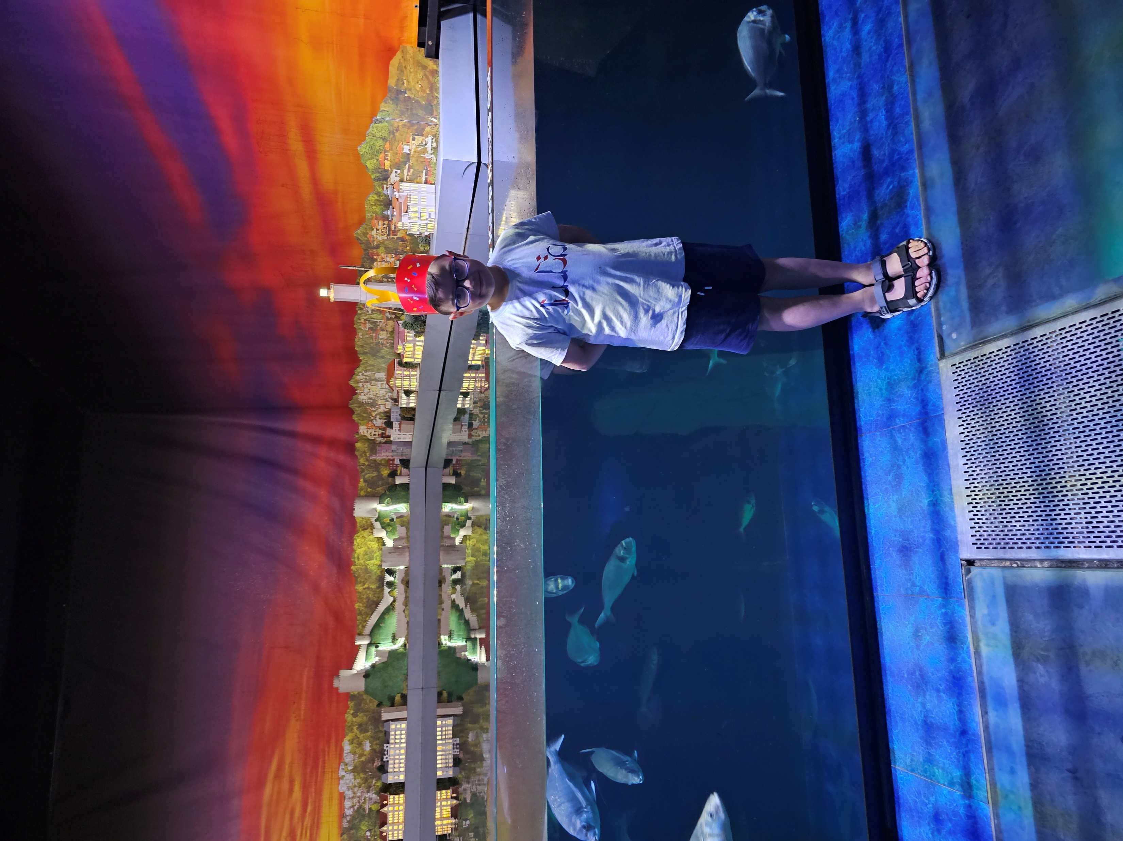
Thank you for listening

