Slide 1
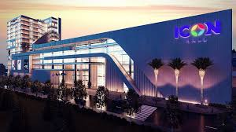
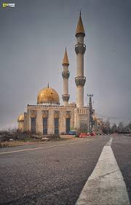
My neighborhooh,there is a mall and a mousque
Icon mall surda grand mosque

Slide 2
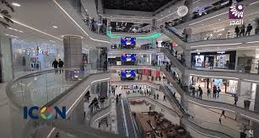
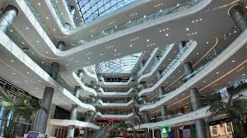
This mall is close to home,I like to go there with my mom and little brother.

Slide 3
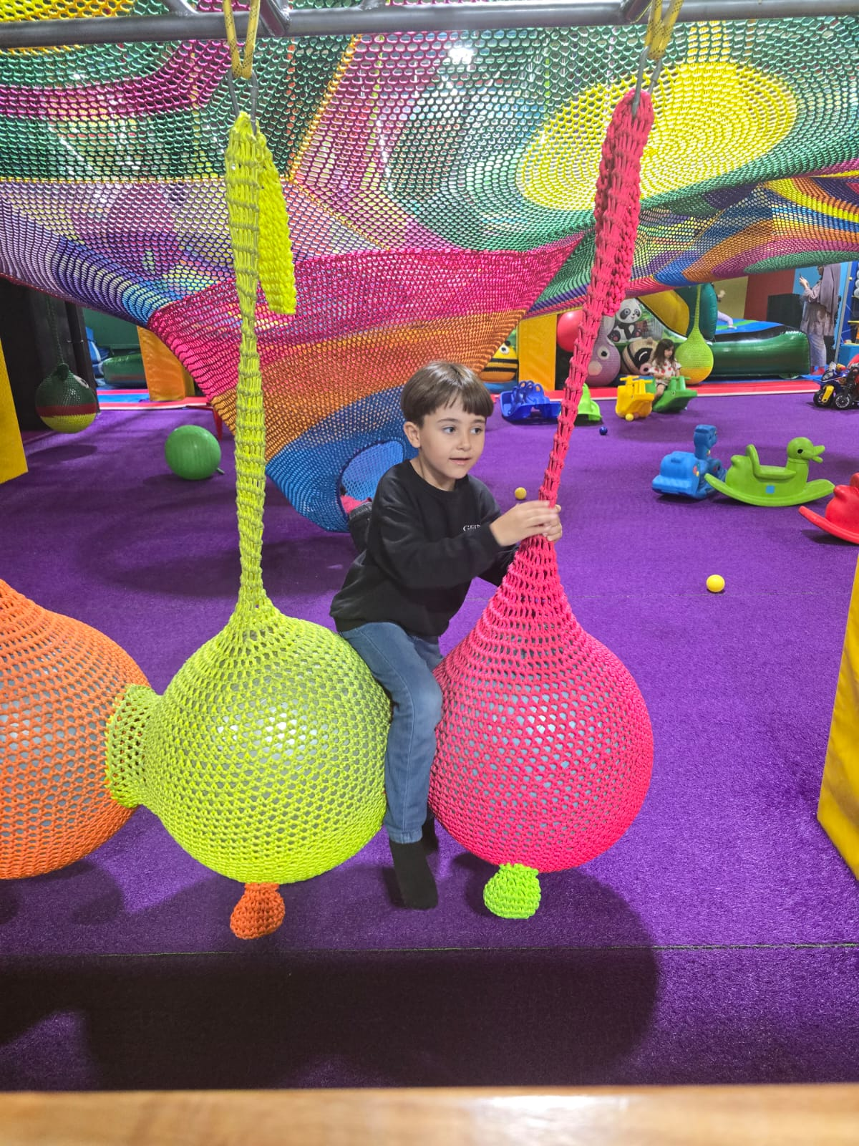
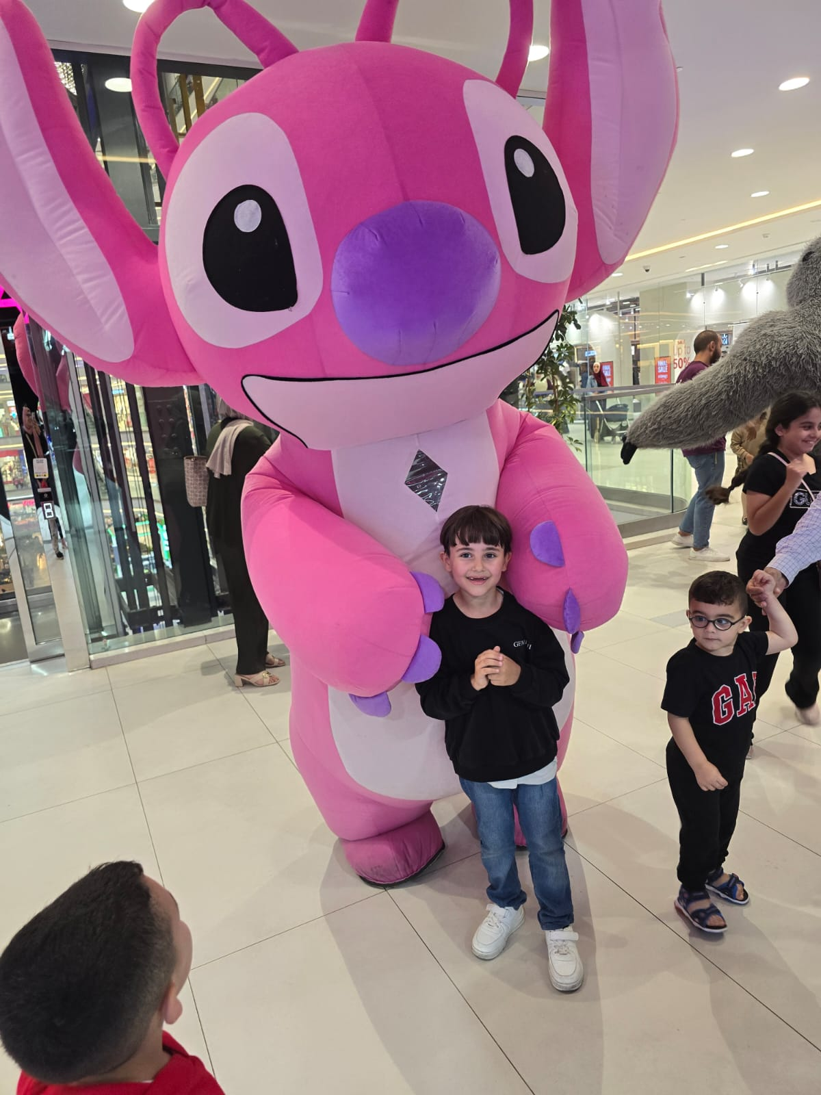
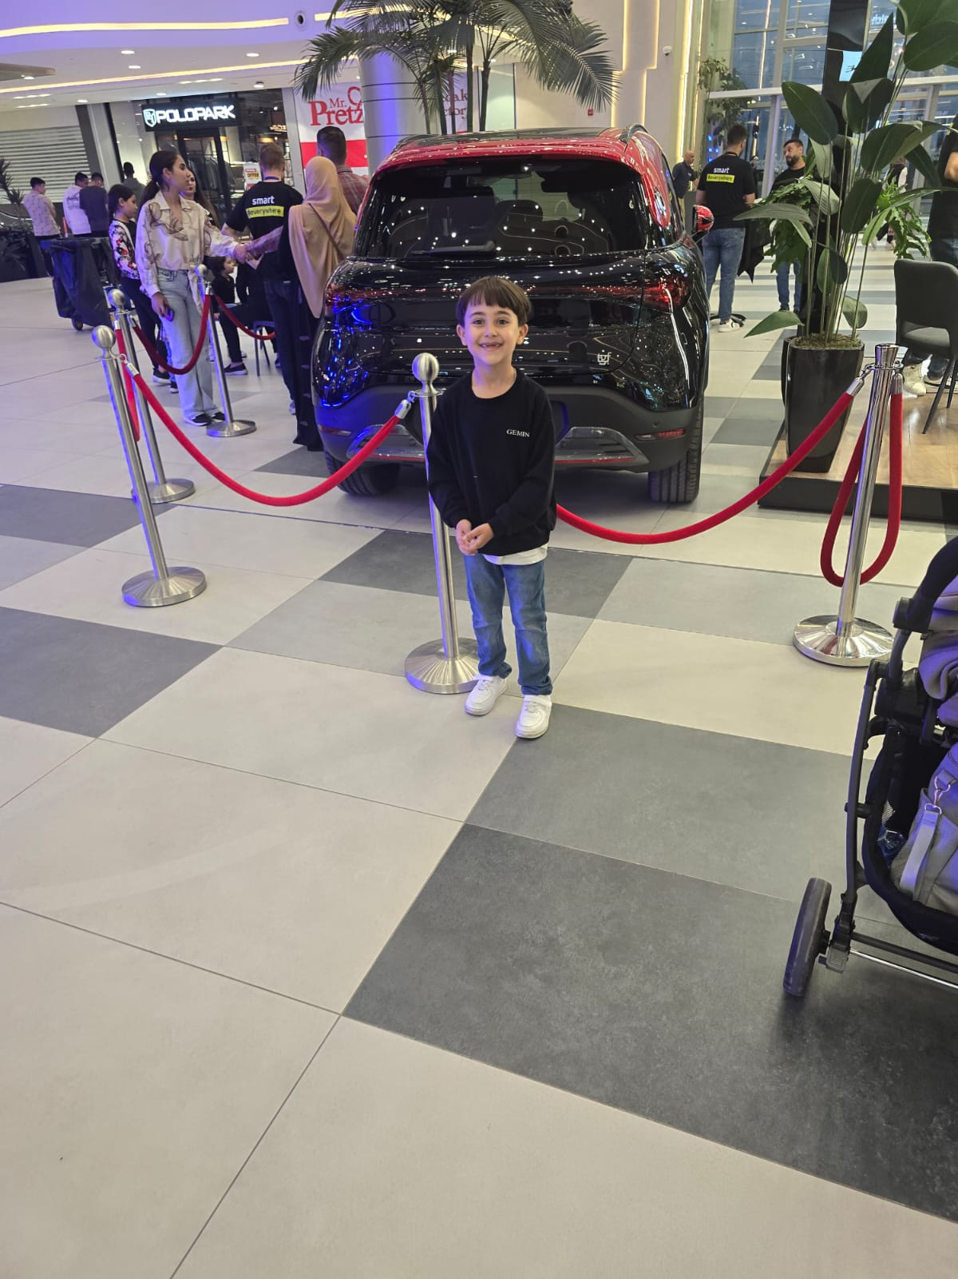
There are many resturants and a playground ,here are some pictures of me when I was playing , its my favorite place.

