Slide 1
Volleyball Skills: Underhand Reception & Underhand Serve
Amr Bazzar
6th Grade

Slide 2
What is Volleyball?
Volleyball is a game where two teams try to hit the ball over a net.
The ball can be passed, served, or hit in different ways.
Today, we’ll talk about two basic volleyball skills!

Slide 3
Underhand Reception
What is it?: Underhand reception is when you use your arms to catch or pass the ball from your teammate.
Why it’s important: It helps you control the ball and pass it back to your team.

Slide 4
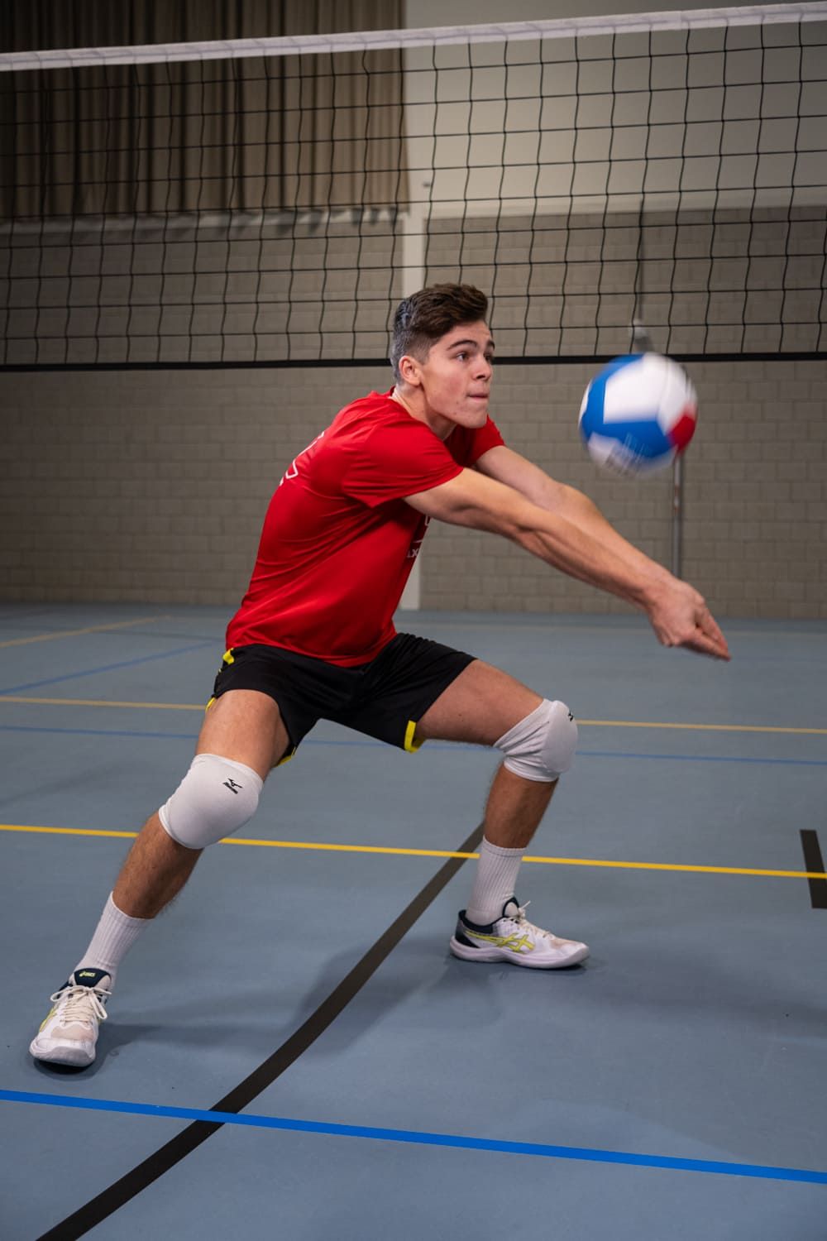
How to Do Underhand Reception
Stand with your feet apart and knees bent.
Hold your hands together, flat like a platform.
Keep your arms straight and meet the ball with your forearms.
Push the ball to your teammate by moving your arms forward.

Slide 5
Underhand Serve
What is it?: An underhand serve is when you hit the ball from below your waist to the other side of the net.
Why it’s important?: It’s a simple way to start the game by sending the ball over the net.

Slide 6
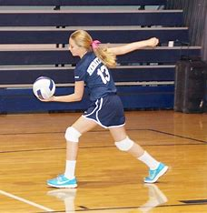
How to Do Underhand Serve
Stand behind the line and hold the ball in one hand.
Swing your other hand to hit the bottom of the ball.
Hit the ball underhand and send it over the net.

Slide 7
How Are They Different?
Underhand Reception: You catch or pass the ball to your teammate.
Underhand Serve: You send the ball over the net to the other team.
Big Difference: One is for passing, the other is for serving!

Slide 8
Conclusion
Remember: Both skills are very important for playing volleyball.
Keep practicing to get better at passing and serving the ball!

