Slide 1

Volleyball Skills
Underhand Reception & Underhand Serve
Zain Dar Naser

Slide 2

Underhand Reception
• Stand with feet shoulder-width apart.
• Bend knees slightly.
• Bring hands together to form a flat platform.
• Keep arms straight and lift from the legs.
• Guide the ball toward the setter.

Slide 3
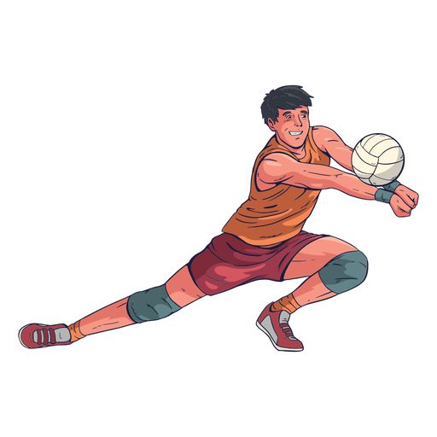
Steps of Underhand Reception
1. Move quickly to the ball.
2. Position body behind the ball.
3. Create a stable platform.
4. Contact the ball on the forearms.
5. Direct the ball upward with control.

Slide 4

Underhand Serve
• Stand with one foot forward.
• Hold the ball at waist level.
• Swing serving arm backward.
• Hit the ball with the heel of the hand.
• Follow through toward target.

Slide 5

Steps of Underhand Serve
1. Hold ball steady with non‑dominant hand.
2. Swing arm back for momentum.
3. Step forward as you strike.
4. Hit the ball from below.
5. Aim toward the opponent’s court.

