Slide 1

Volleyball: Court, Positions & Basic Rules
An engaging introduction to volleyball rules
Presented by Askar
6th Grade Student

Slide 2


What is Volleyball?
Volleyball is a fun team sport where two teams compete to hit a ball over a net using their hands and arms, promoting teamwork and coordination.

Slide 3

Number of Players in Volleyball
Understanding Team Composition and Positions
6
6
Players on Each Team
Players in Front and Back Row
Each team consists of 6 players on the court.
Teams are organized with 3 front row and 3 back row players.

Slide 4
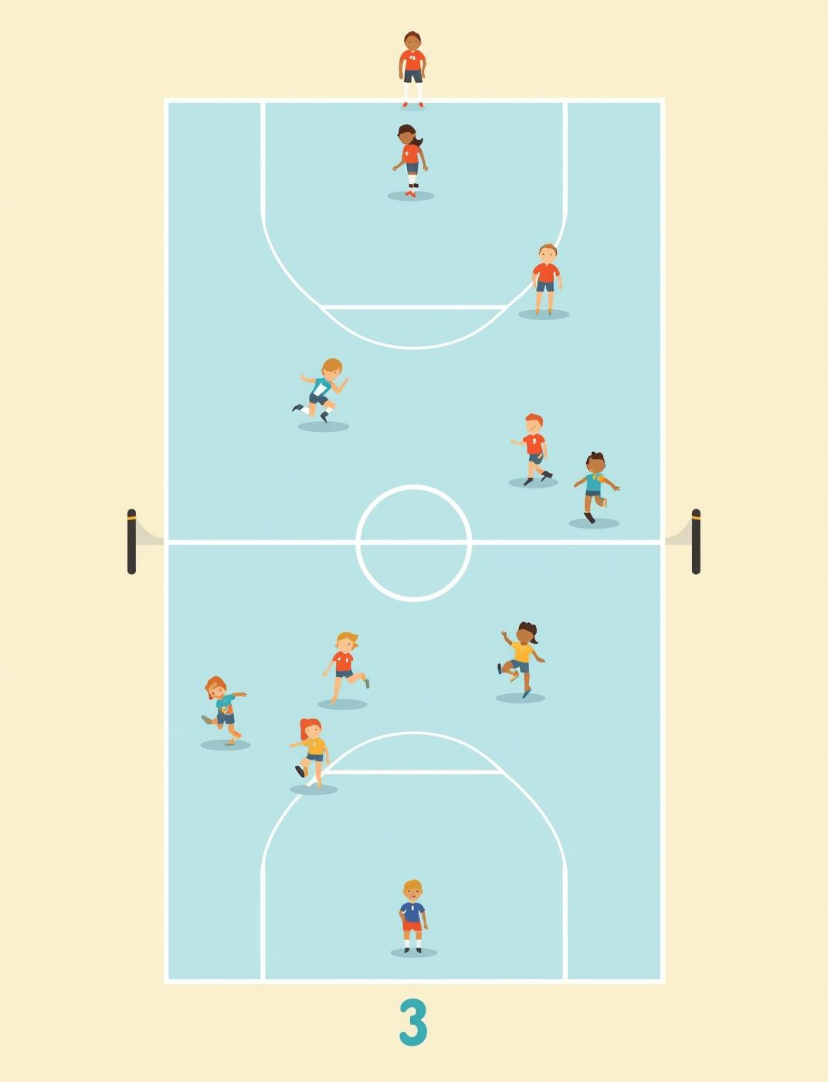
Court & Player Positions
Understanding Player Positions on Court
In volleyball, there are specific positions for each player. The front row consists of positions 4, 3, and 2, while the back row includes positions 5, 6, and 1. Players rotate clockwise!

Slide 5

Rotation Rules
Clockwise Rotation
Understanding player movement and teamwork
Players rotate clockwise after gaining a serve.
Fair Participation
Ensures everyone plays and contributes equally.
Strategic Movement
Helps teams adjust positions for better play.
Keeps Game Flowing
Maintains constant action and engagement on court.

Slide 6
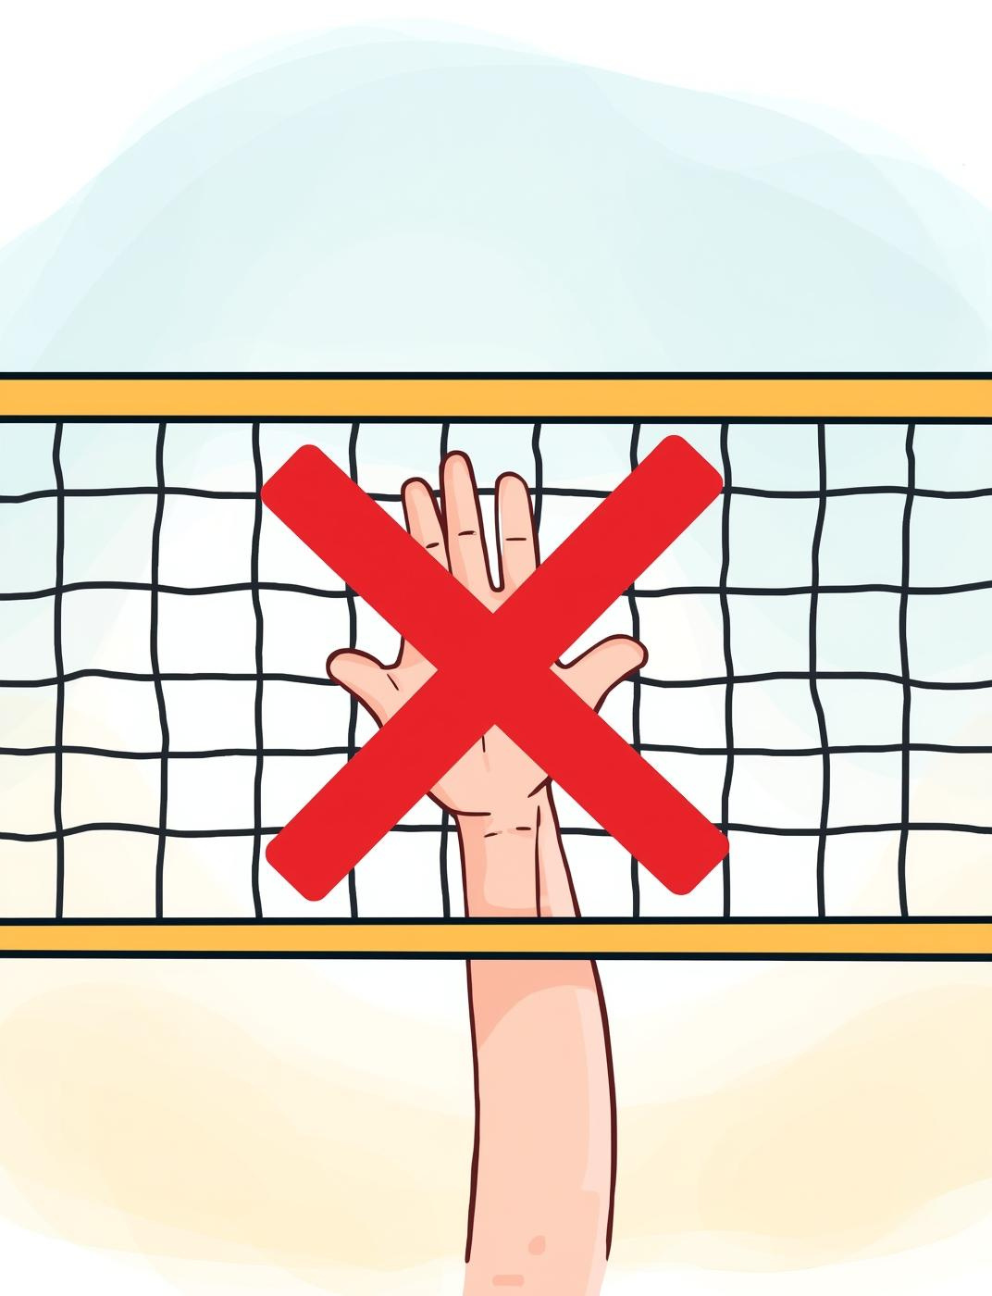
Touching the Net
Understanding Net Rules in Volleyball
Players cannot touch the net during a game. If they do, the opposing team receives a point, emphasizing the importance of maintaining proper gameplay boundaries.

Slide 7
Ball Contact Rules
01
02
03
Maximum Hits
No Double Hits
Hit, Don't Carry
Team can hit the ball up to three times
Player cannot hit the ball twice in a row
Ball must be hit, not carried

Slide 8
Common Faults
Touching the Net
Players must not touch the net during play.
Important rules to remember in volleyball
Crossing Center Line
Players cannot step over the center line boundary.
Double Hit
A player cannot hit the ball twice in succession.
Holding the Ball
The ball must be hit, not held or carried.

Slide 9
Scoring Points in Volleyball
Ball Lands In Court
Opponent's Mistake
A point is scored when the ball lands inside the opponent's court, making it essential for teams to hit accurately.
Points can also be earned when the opponent makes a mistake, such as hitting the ball out of bounds or failing to return it.

Slide 10
Teamwork
Communication
The essence of working together effectively
Clear dialogue helps players understand each other.
Trust
Believing in teammates fosters a supportive environment.
Positioning
Strategic placements enhance team performance on the court.
Coordination
Working in sync leads to successful plays and teamwork.

Slide 11
Summary of Volleyball Rules
Stay Safe
Stay Organized
Respect the Game
Follow the rules to prevent injuries and ensure fun.
Maintain team structure for effective communication and gameplay.
Play fairly and honor your opponents for a positive experience.
Work as a Team
Have Fun
Keep Learning
Support each other to enhance teamwork and achieve success.
Enjoy the game and create lasting memories with teammates.
Continuously improve skills and knowledge of volleyball strategies.

Slide 12
Volleyball Rules
Serve from End Line
Don't Carry Ball
Maximum Three Hits
Players must serve from behind the end line area.
The ball cannot be carried or thrown during play.
Each team is allowed a maximum of three hits.
No Net Touching
Stay Within Court
Points Scored Inbounds
Players must not touch the net during rallies.
The ball must remain within the court boundaries always.
Points are awarded when the ball lands in the court.

Slide 13
Player Roles in Volleyball
Setter
Outside Hitter
Middle Blocker
Orchestrates the offense by setting up plays and assists.
The primary attacker who spikes the ball over the net.
A defensive player positioned at the net to block attacks.
Opposite Hitter
Libero
Defensive Specialist
Attacker on the right side, balancing offensive strategies.
A specialized defensive player who cannot attack at the net.
Focuses on back row defense and digging to save balls.

Slide 14
Scoring in Volleyball
Understanding how points are awarded
25 points
2 points
Winning Score
Must Win By
A team must reach this score first
Teams must win by at least two points

