Slide 1
Geography and Countries survey
By Aboud

Slide 2
Why I chose this topic
I want to see how people think of this topic and how their responses will look like

Slide 3
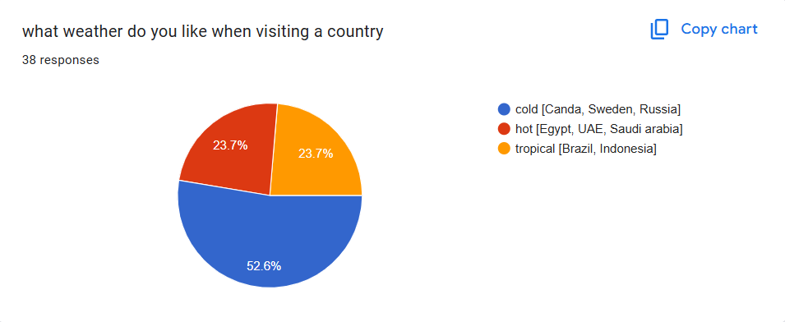
Questions

Slide 4
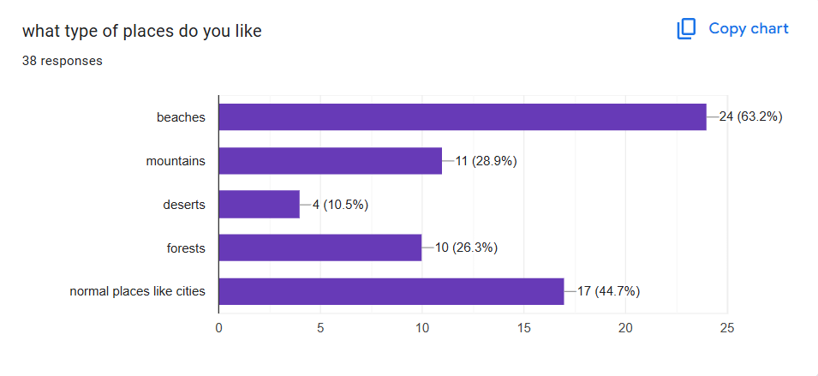
Questions

Slide 5
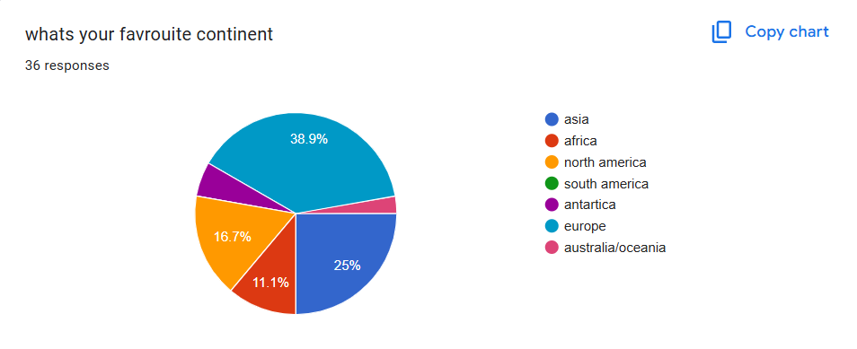
Questions

Slide 6
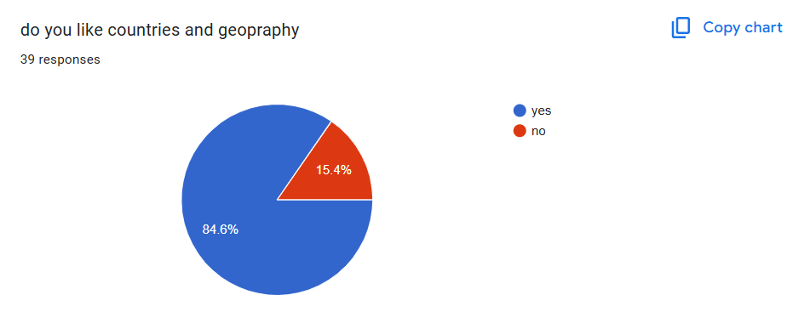
Questions

Slide 7
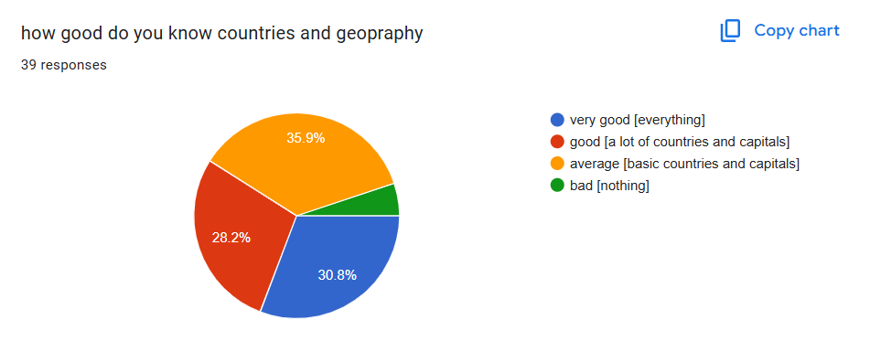
Questions

Slide 8
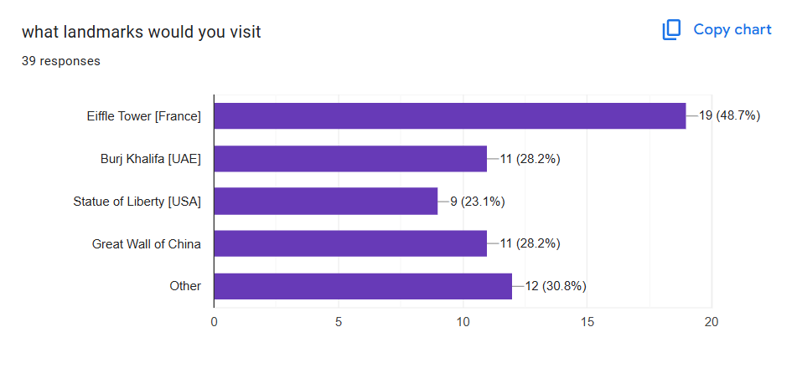
Questions

Slide 9
summary
Based on the data people liked cold places, likes the beaches, their favorite continent was Asia, and they mostly likes the Eiffle tower

Slide 10

Thank you for listening

