Slide 1
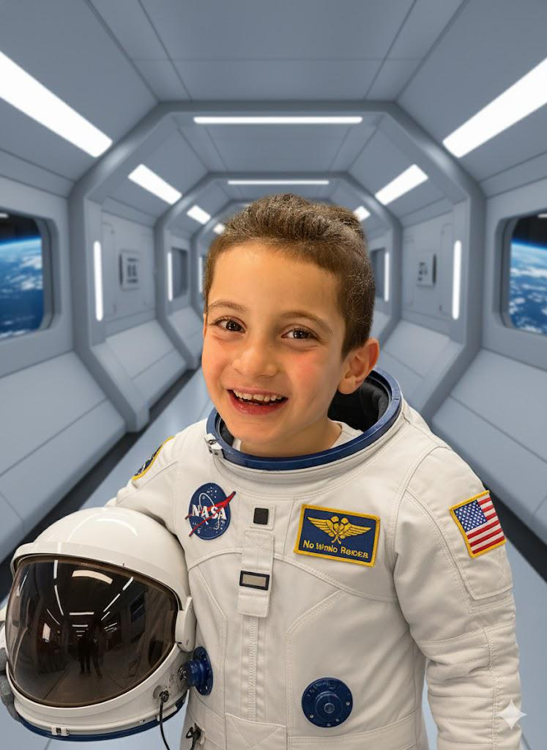
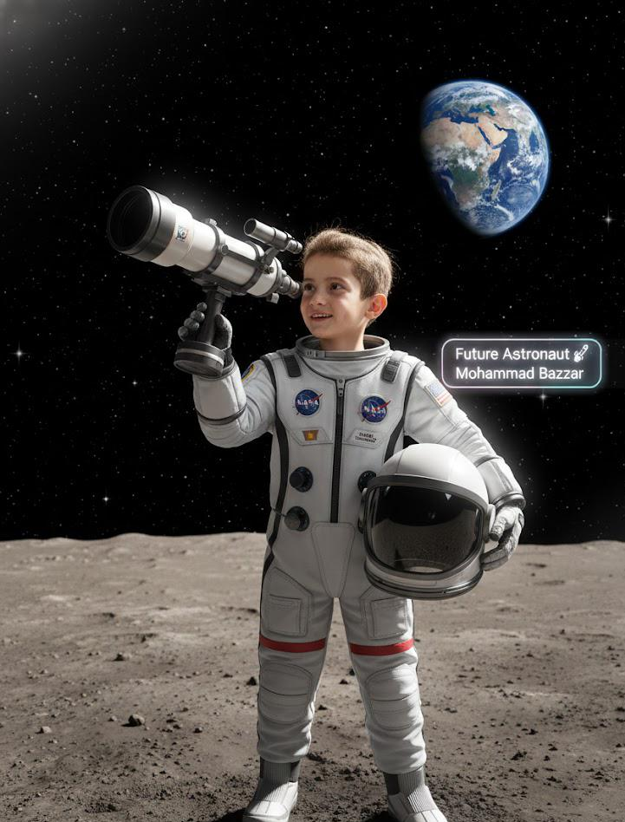
My Future Job
My name is Mohammad Bazzar.
I want to be an astronaut.

Slide 2
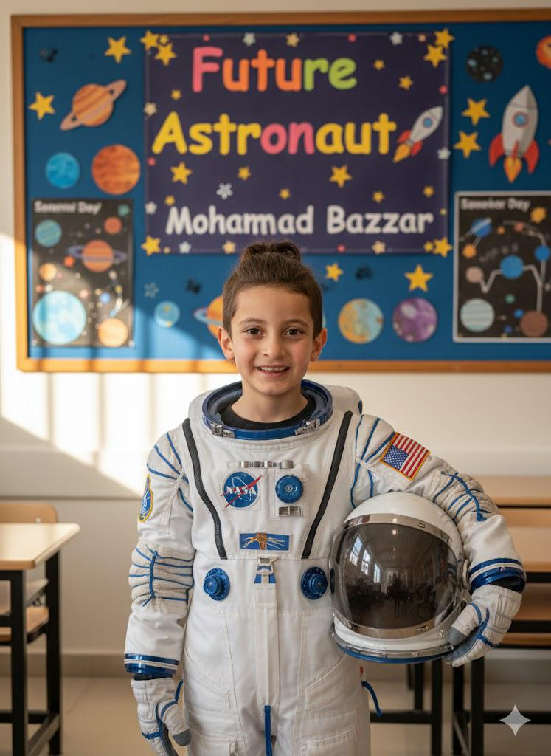
What is an Astronaut ?
An astronaut travels to space.
He explores planets and stars.
He works inside a spaceship.

Slide 3
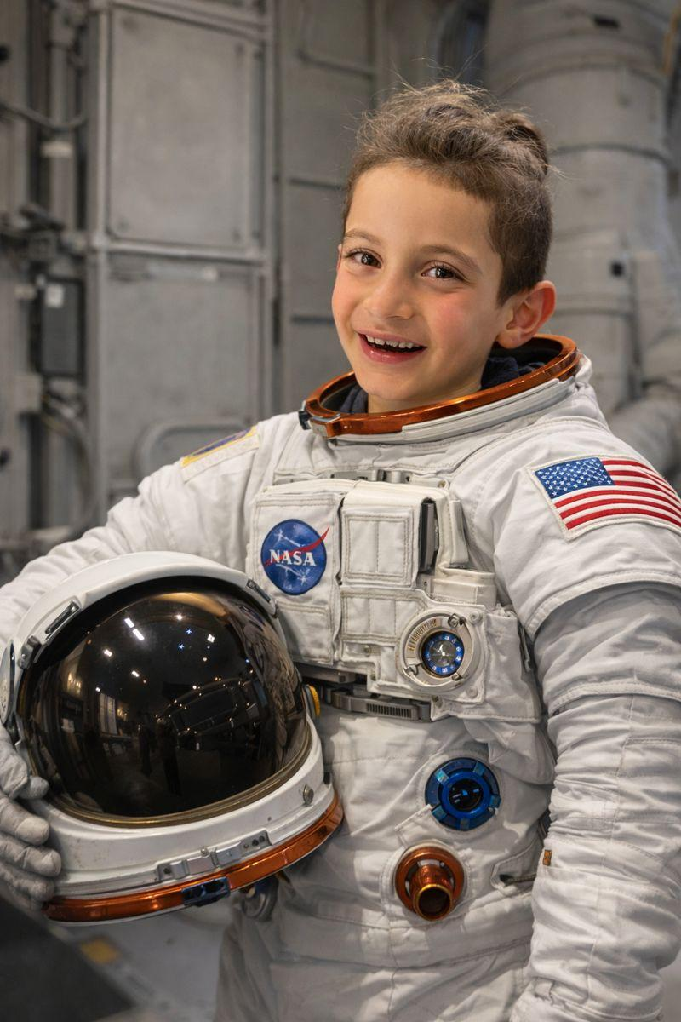
What I will do :
I will go to the moon.
I will study space.
I will help others learn about planets.

Slide 4
Why I like this job:
I love space.
I like science.
I want to discover new things.

Slide 5
My Dream
Thank you for listening

