Slide 1
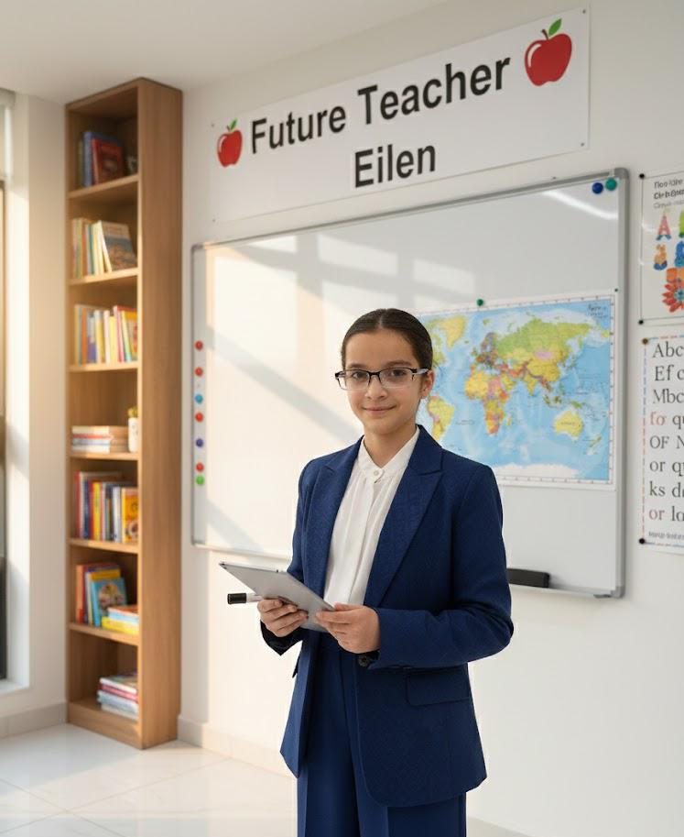
My Future Job
My name is Eleen.
Today I will talk about my future job.
I want to be a teacher.

Slide 2
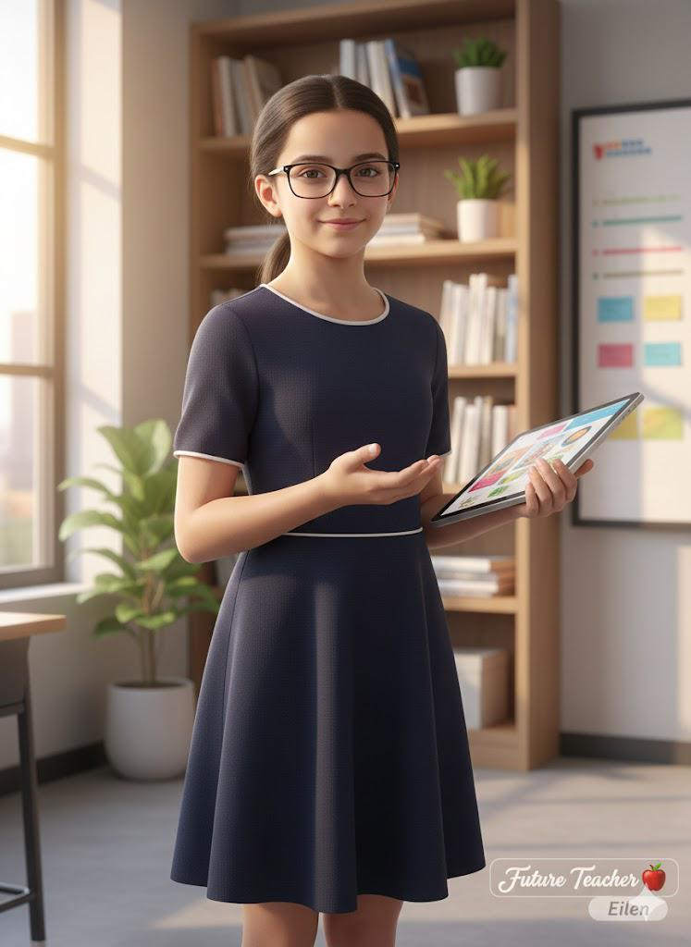
What is a Teacher
A teacher helps students learn.
A teacher explains lessons.
A teacher cares about children.

Slide 3
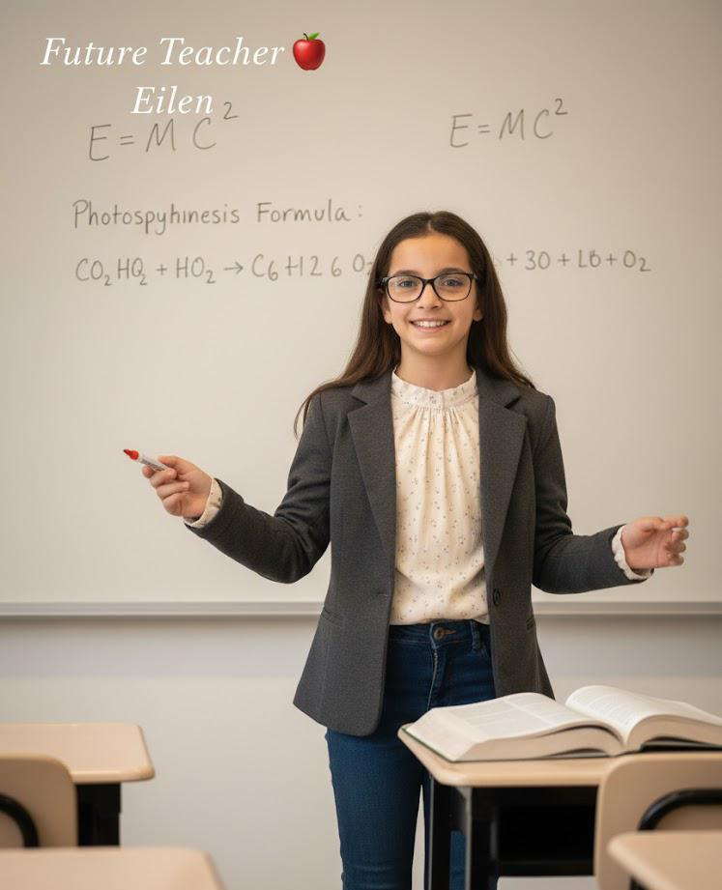
What I will do :
I will teach reading.
I will teach writing.
I will help students succeed.

Slide 4
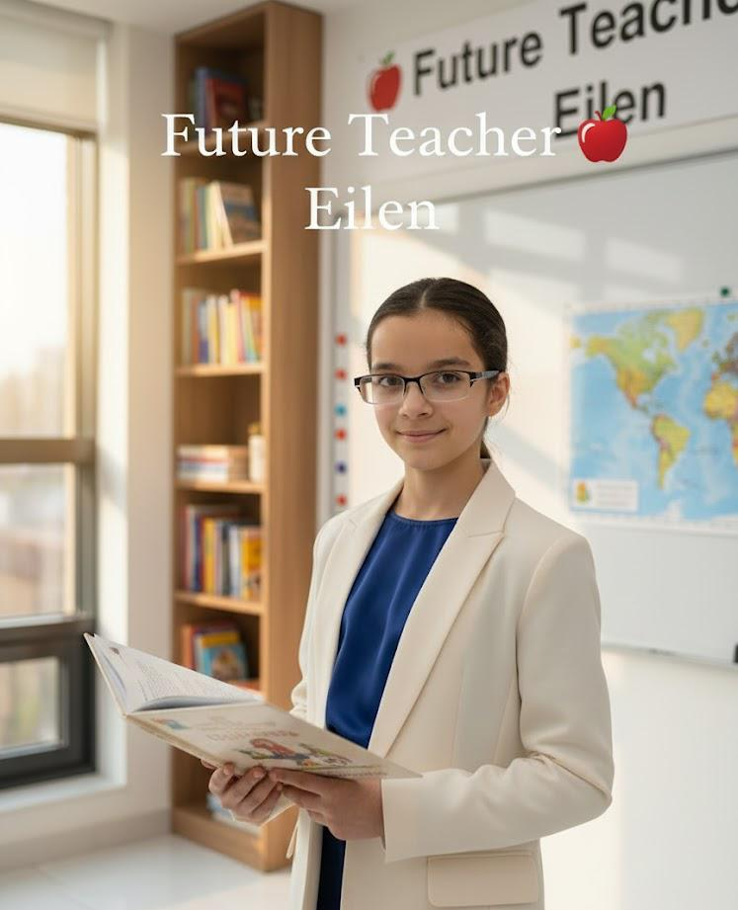
Why I like this job :
I love helping people.
I like children.
I like teaching.

Slide 5

My Dream Job
I will work very hard.
I will be kind.
I will be a great taecher.

