Slide 1
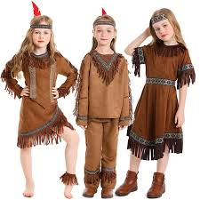
NATIVE AMERICAN CULTURE
By: Joury Amr

Slide 2
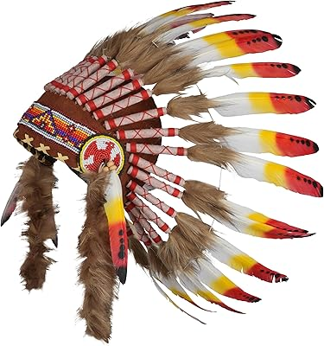
INTRODUCTION
Hello everyone.
Today I will talk about
Native American Culture.

Slide 3
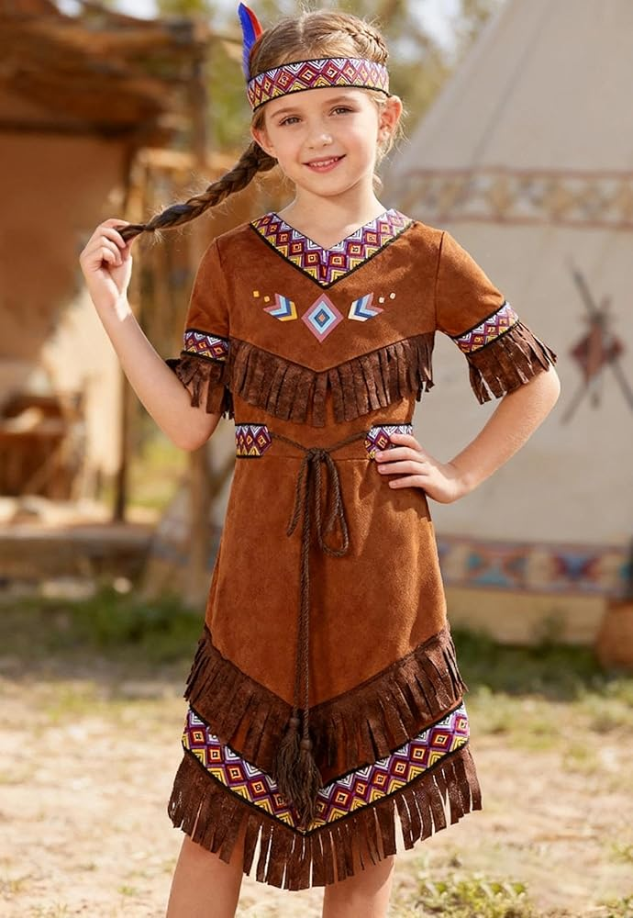
CLOTHES
Native American made their clothes by hand.
They used materials from nature.
They used leather, feathers, and beads.
My outfit today is inspired by their clothes.

Slide 4
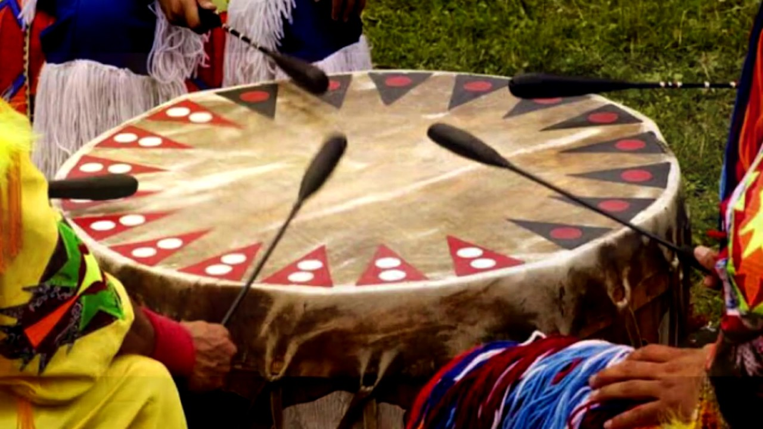
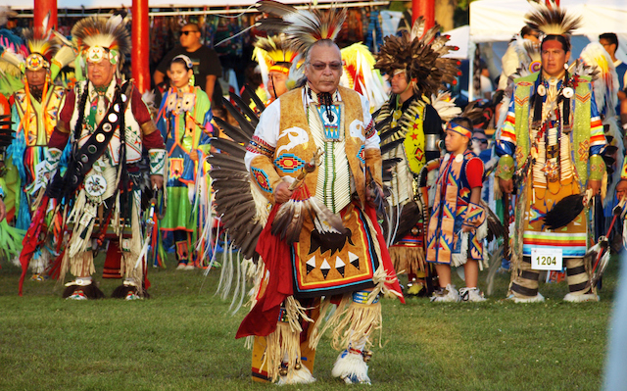
Music
Music is very important to Native American culture.
It brings people together.
They play drums and dance as part of celebrations and Powwows.

Slide 5
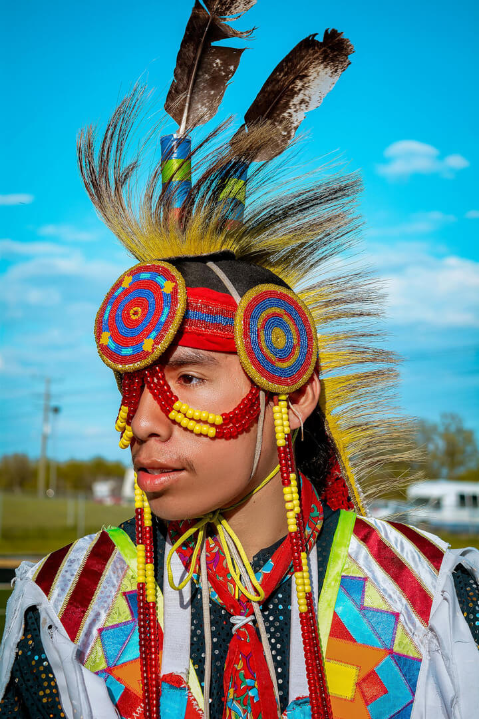
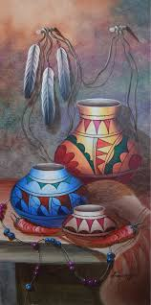
ART
Native Americans make handmade art.
They used beads, pottery, and patterns.
Art tells stories about their culture and traditions.
It shows their history and beliefs.

Slide 6
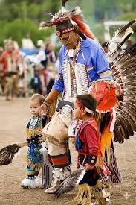
I learned a lot about Native American culture.
Their clothes, music, and art
are beautiful and full of meaning.

Slide 7


