Slide 1

Mapping the world

Slide 2
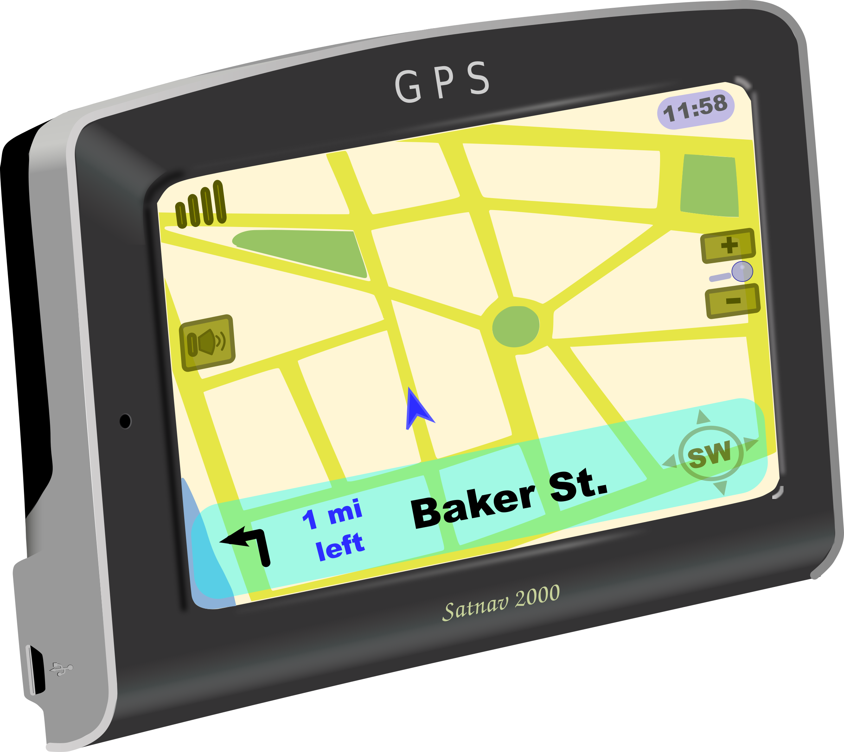
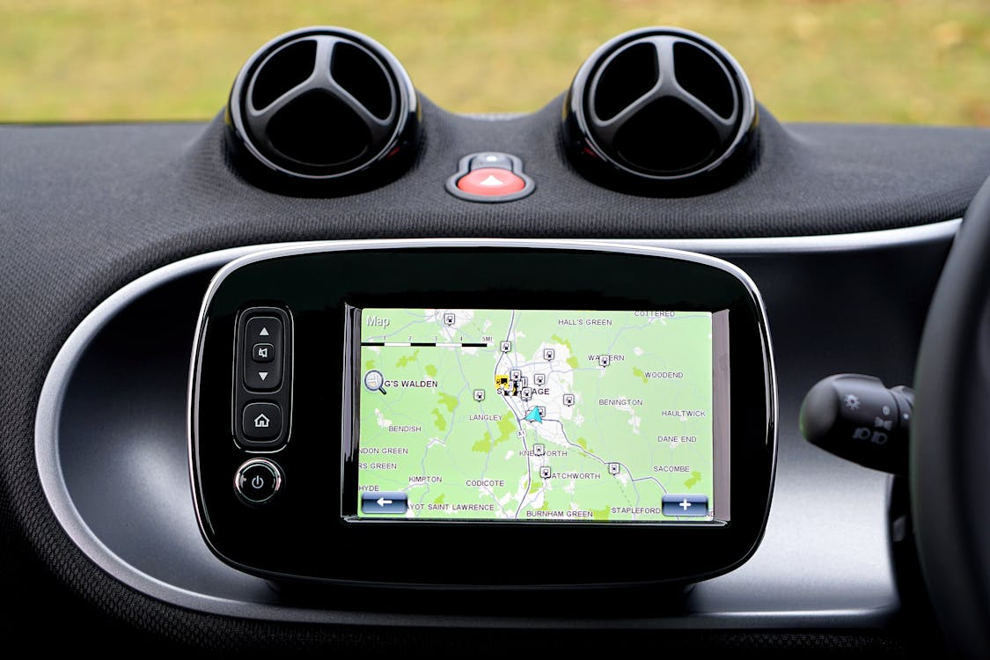
*In today’s modern age , many people use GPS (Global Positioning system )on electronic devices to get directions . Even though this technology is helpful , it’s still important for people to know how to read and understand maps .

Slide 3
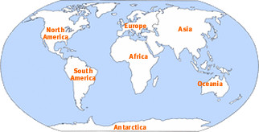
*Why are maps important ?
1- They allow us to see our location in relation to the rest of the world .
2-They are like a bird’s-eye view of Earth showing us where towns , cities , countries , continents , and oceans are located .
This Photo by Unknown Author is licensed under CC BY

Slide 4
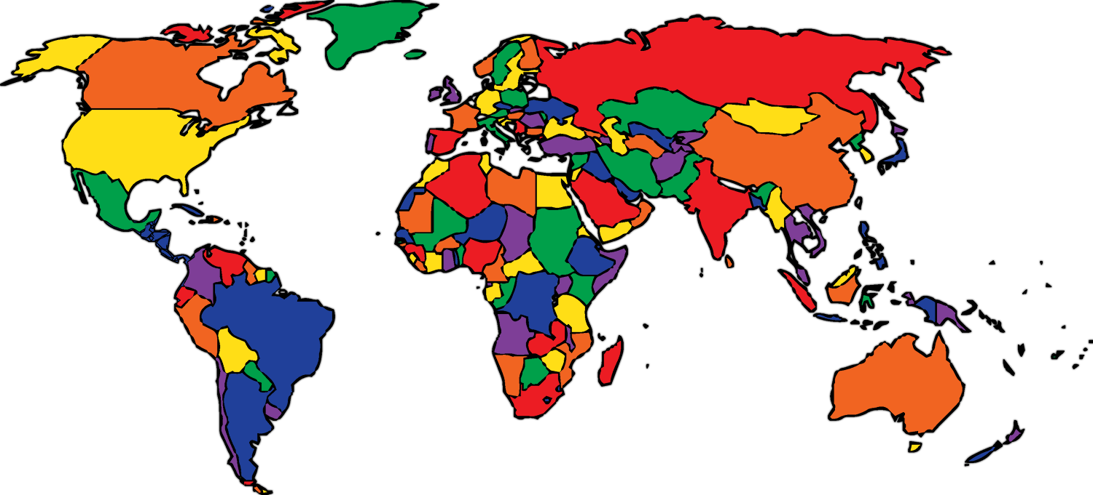

3-Maps let us view things from above , which allows us to see the planet and everything with a new perspective or understanding .
4- This new perspective shows how Earth’s continents fit together like a big jigsaw puzzle .
This Photo by Unknown Author is licensed under CC BY-NC
This Photo by Unknown Author is licensed under CC BY-SA

Slide 5
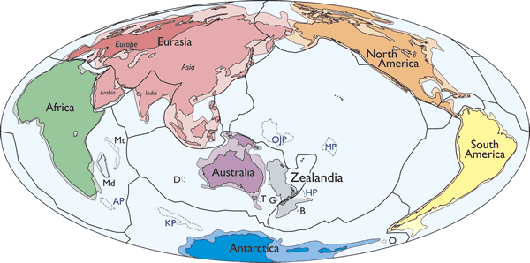
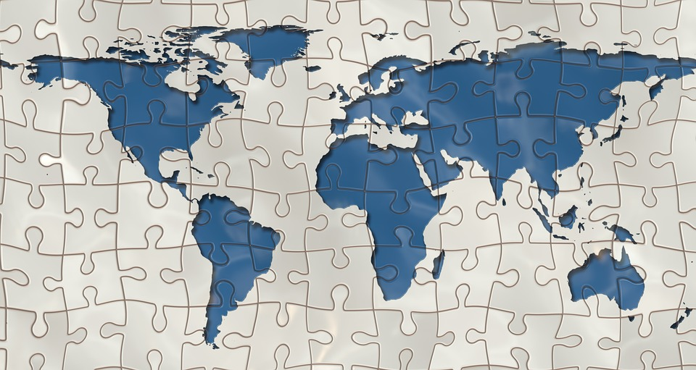
*When you look at a world map , you can see how the countries fit together onto the continents . You can see where the coast lines and oceans are located . You can figure out the direction you would need to travel to get from place to place .
This Photo by Unknown Author is licensed under CC BY

Slide 6
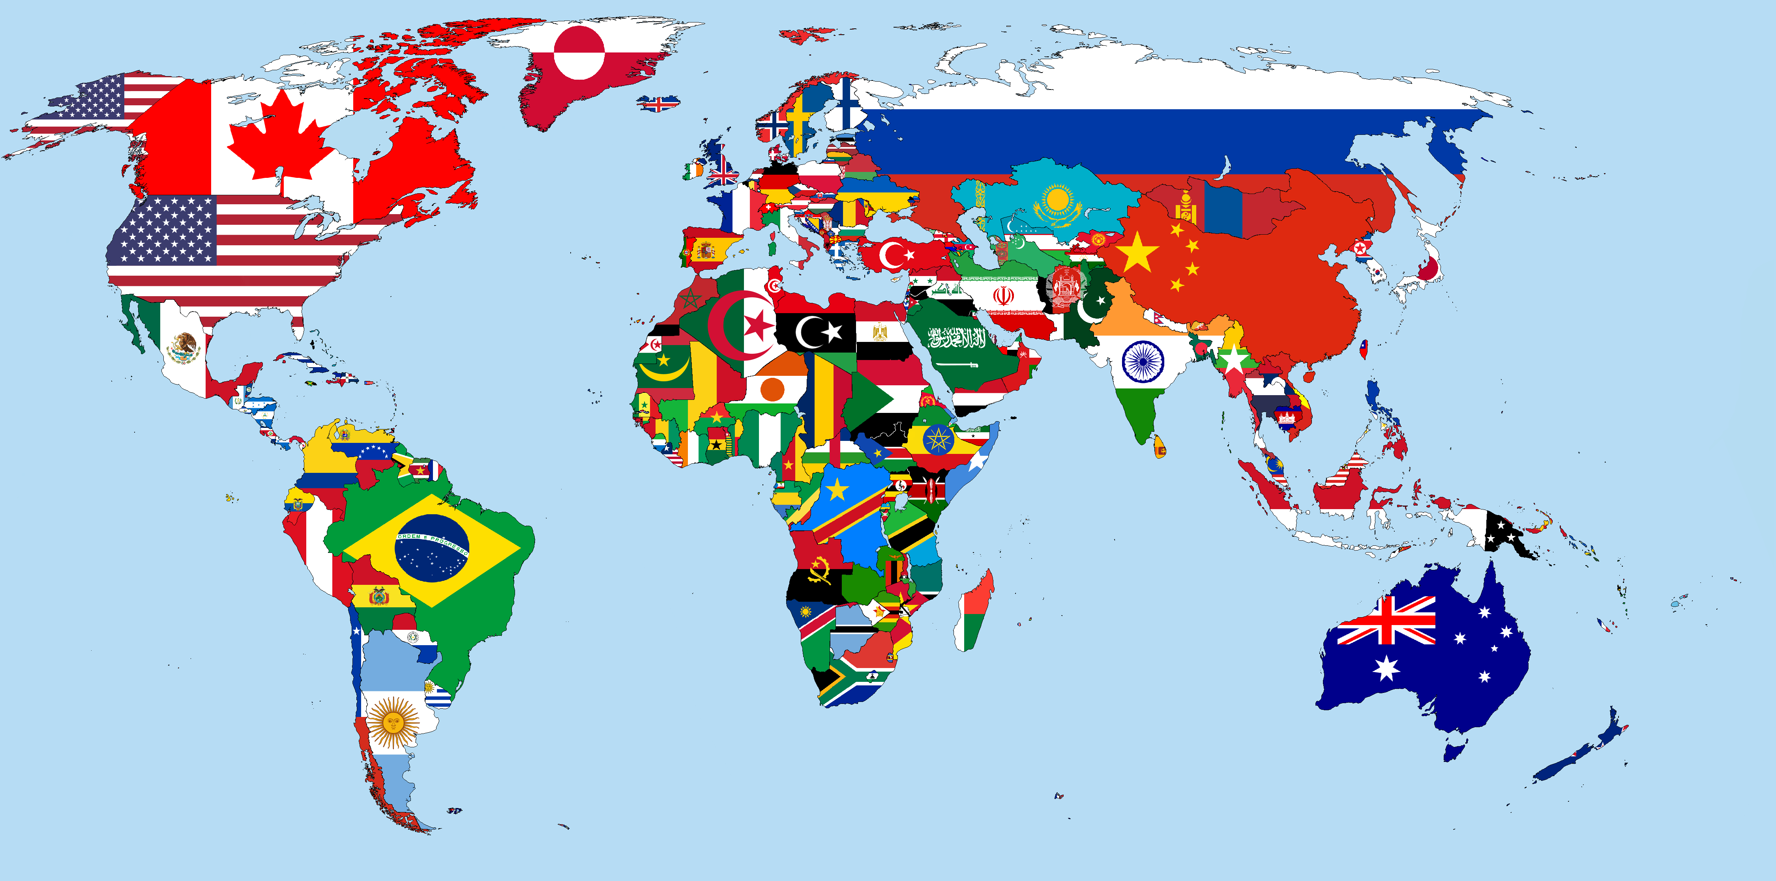
Maps help you understand how your city is connected to the rest of the world .
This Photo by Unknown Author is licensed under CC BY-SA

Slide 7
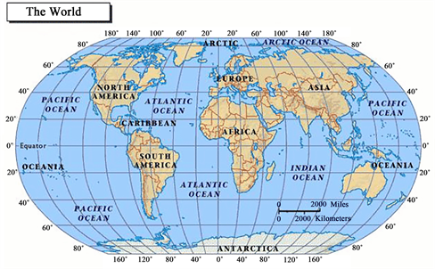
*Determining Exact Locations on a Map .
1)Long ago , cartographers or mapmakers came up with a grid system for locating places on maps .
2)The ancient maps were like the simple maps we now use .
3)As humans began exploring the planet a modern ,regular grid system was established . This system is still used .
This Photo by Unknown Author is licensed under CC BY

Slide 8
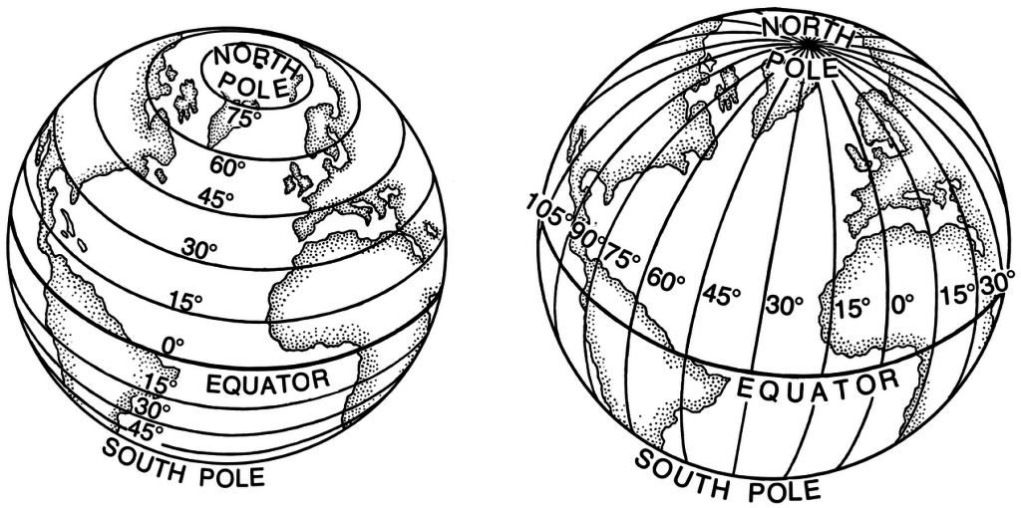
*Cartographers take a map of Earth and divide it into latitude and longitude lines .
*Longitude lines are drawn from the North Pole to the South Pole .
*Latitude lines are drawn from east to west .
*These lines help people find where a place is located on a map .
This Photo by Unknown Author is licensed under CC BY-SA

Slide 9
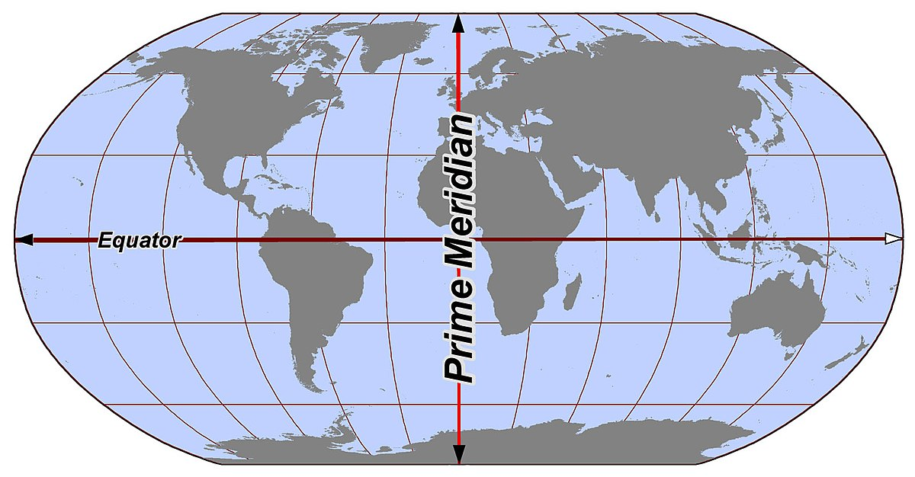
*To help find where they are , the longitude and latitude line locations are written in degrees .
*Because Earth is a sphere , it has 360 degrees . The center line of longitude is called the prime meridian .
Meridian means middle .
This Photo by Unknown Author is licensed under CC BY-SA

Slide 10
*The prime meridian of longitude is located at 0 , or zero degrees , longitude .
The center latitude line is the equator . Its location is
0 latitude .
Question :
1)Which lines on a map go from North Pole to the South Pole ?
……………………………………..
This Photo by Unknown Author is licensed under CC BY-SA

Slide 11
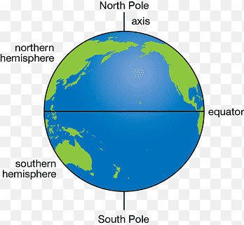
*Dividing the Planet : Did you know that earth can be divided into hemispheres , or half spheres ?
Lets imagine earth is cut exactly in half at the equator .The half above the equator is where the North Pole is located .So , it is called the Northern Hemisphere .
The half below the equator is where the South Pole is located , so it is called the Southern Hemisphere .

Slide 12
*Now , let’s say Earth is cut exactly in half at the prime meridian . Everything to the east of the prime meridian is called the Eastern Hemisphere . Everything to the west is called the Western Hemisphere .
Just as every place on Earth has a pair of longitude and latitude coordinates , they also have a pair of hemisphere markers .
This Photo by Unknown Author is licensed under CC BY-NC

Slide 13
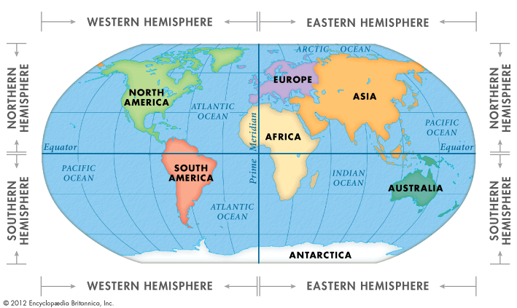
*Locate Australia on the Map . Is it in the Northern or southern Hemisphere ? Is it in the Western or Eastern Hemisphere ?

Slide 14
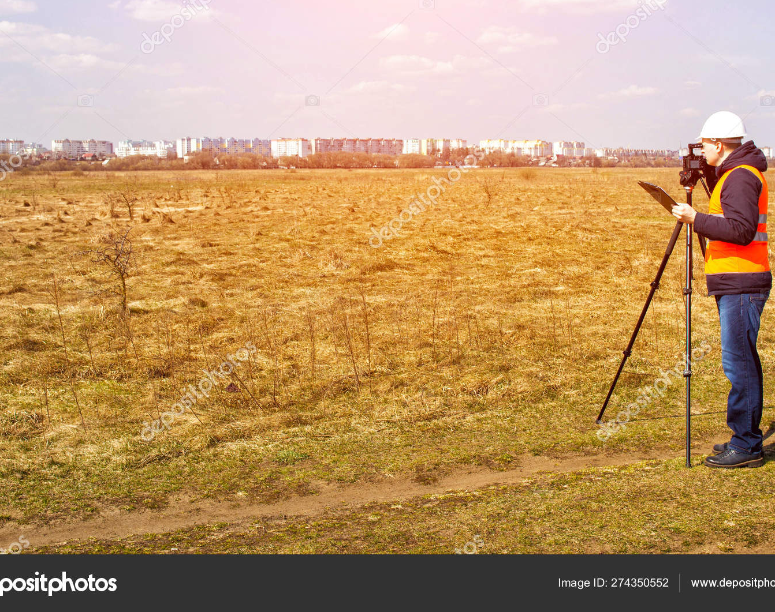
*Satellite’s –Eye View : Before humans began using satellites , maps were made by taking the most exact measurements possible with the technology they had .Workers called surveyors would use special tools to find the distance between places and other important information about the land . That information would be used to make maps .

Slide 15
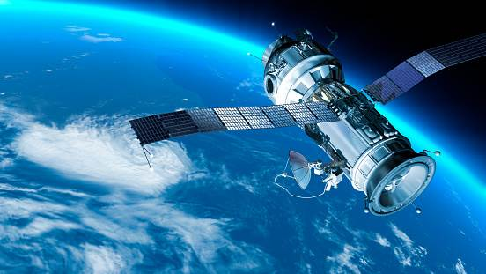
*Maps can still be made that way .But modern technology , such as satellites , make the most accurate maps . Satellites are human-made spacecrafts that orbit , or go around , Earth . Some satellities have high – powered cameras that can take very detailed images . The images they send back to Earth are even better than a bird’s-eye view .

Slide 16
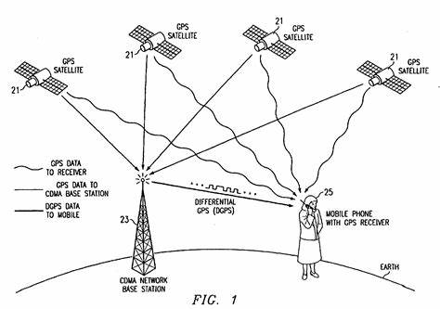
*Some satellites do not have cameras . Instead they send signals back to a receiver on Earth . GPS works using these geospatial signals , or signals that carry mapping data about specific locations ,collected by satellites .

Slide 17
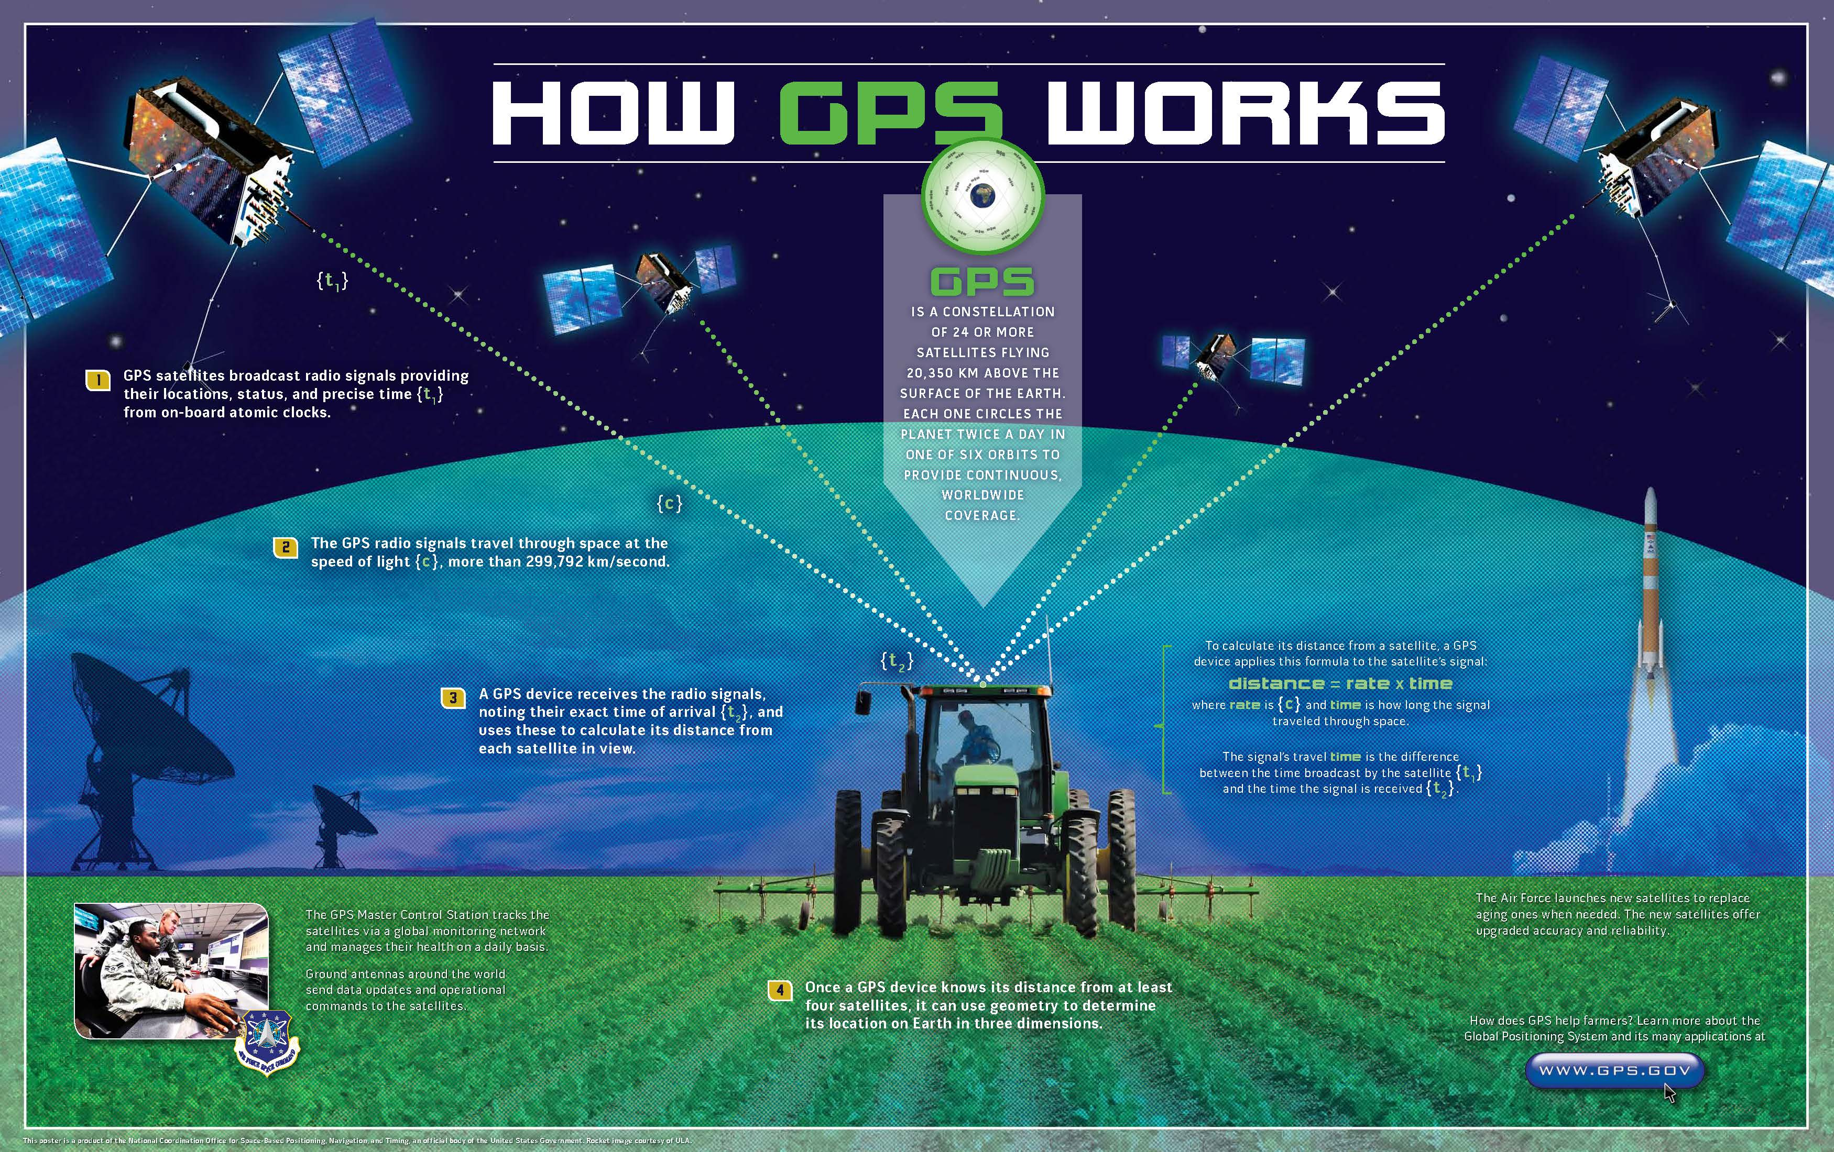
*GPS receivers collect data from at least 3 satellites to determine exact positions on Earth . That makes geospatial data very helpful for getting directions from place to place .
This Photo by Unknown Author is licensed under CC BY

Slide 18
The End

