Slide 1


Math
1.1
Multiplication using repeated addition and arrays

Slide 2
Agenda
Number Talk
Review Question
Multiplication using arrays and repeated addition

Slide 3
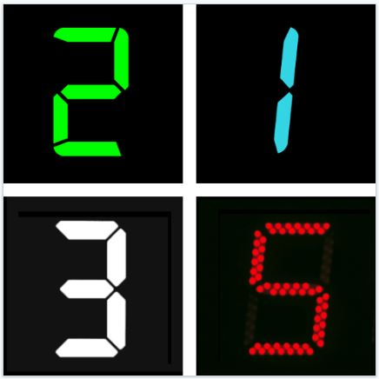
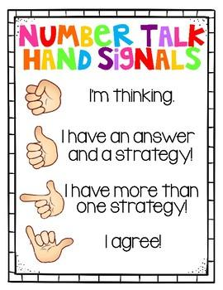
Number Talks
Which one doesn’t belong?

Slide 4
Review Question:
What place value is the 7 in 87,019

Slide 5

We can recognize multiplication using arrays and repeated addition.
Objective
CCSS: 4.OA.A.1

Slide 6
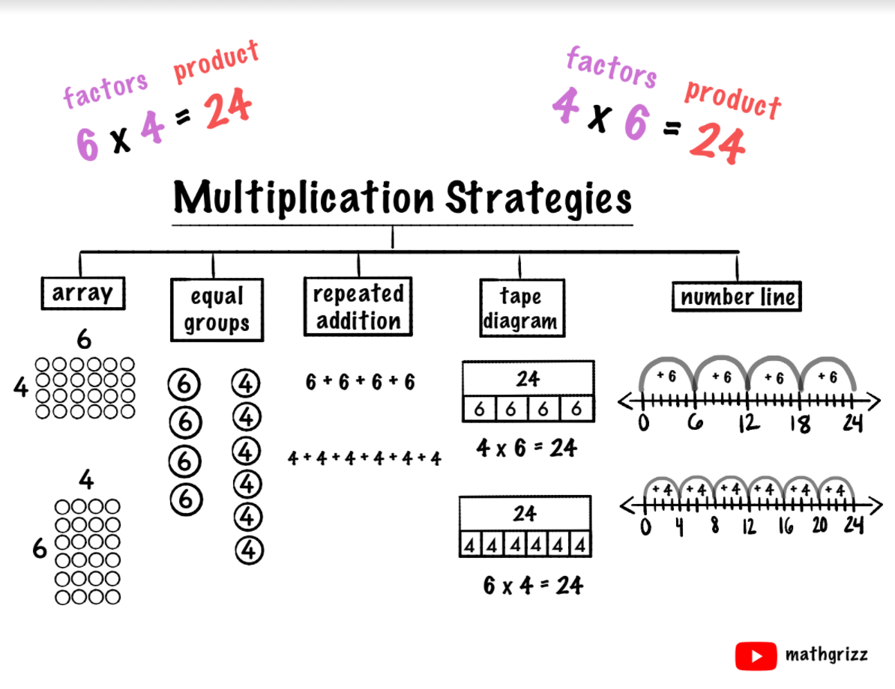

Slide 7
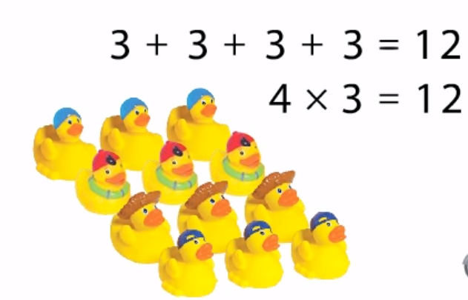
Vocabulary
Definition The arrangement of rows and columns. | Characteristics
Examples: To find the number of items in an array, multiply the number in each row by the number of rows.
Array
Notes:
These will go in math notebooks

Slide 8
Vocabulary
Definition The answer to a multiplication problem. | Characteristics 3 x 5 = 15
Examples: The answer 15 is the product of 3 x 5.
Product
Notes:
These will go in math notebooks

Slide 9
Vocabulary
Definition The numbers multiplied together to find the product. | Characteristics 3 x 5 = 15
Examples: 3 and 5 in 3 x 5 = 15 are the factors.
Factor
Notes:
These will go in math notebooks

Slide 10
Factor
Factor
Product
3 x 6 = 18
Total number of groups
Number of objects in each group

Slide 11
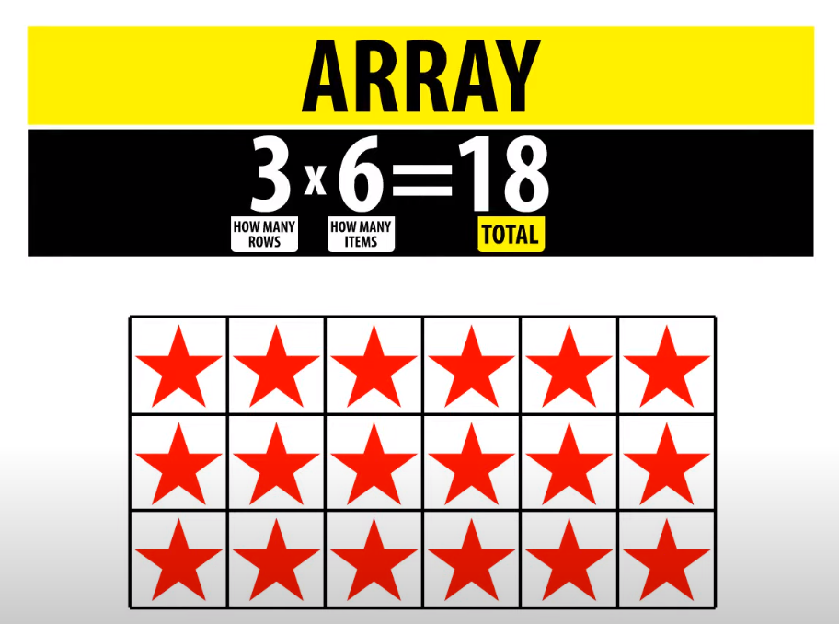
Concept Development

Slide 12
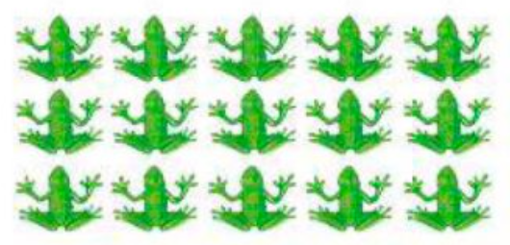
Concept Development
Using an Array to help Multiply
How many frogs are there in 5 rows of 3?
To find the number of items in an array, multiply the number in each row by the number of rows.

Slide 13
Concept Development
Using an Array to help Multiply
How many frogs are there in 5 rows of 3?
To find the number of items in an array, multiply the number in each row by the number of rows.
3 x 5 = 15

Slide 14
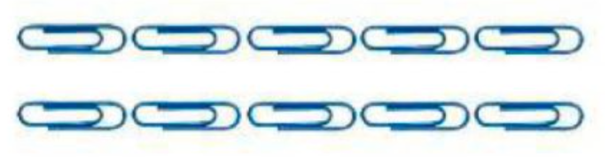
Write a multiplication equation for the array below
Model
Guided

Slide 15
Write a multiplication equation for the array below
Model
Guided
2 x 5 = 10

Slide 16

Write a multiplication equation for the array below
Guided
Guided

Slide 17
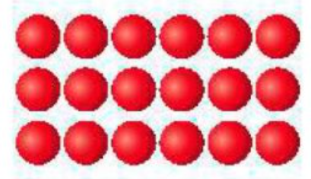
Write a multiplication equation for the array below
Guided
Guided

Slide 18
Create an array to solve
Model
Guided
4 x 5 = x

Slide 19
Create an array to solve
Guided
Guided
5 x 5 = x

Slide 21
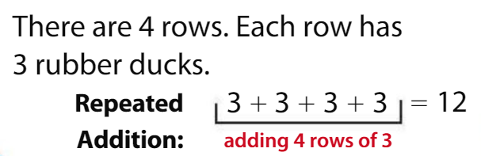
Concept Development
Using Repeated Addition to help Multiply

Slide 22
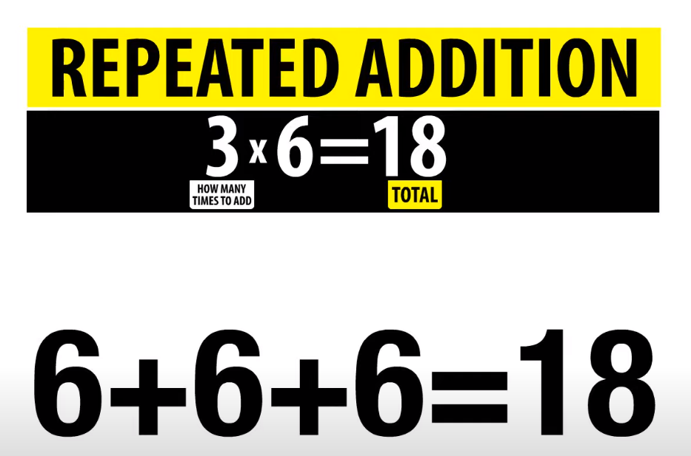
Concept Development

Slide 23

Write a repeated addition equation for the following array
Model
Guided

Slide 24
Write a repeated addition equation for the following array
Model
Guided
3 + 3 + 3 = 9

Slide 25

Write a repeated addition equation for the following array
Guided
Guided

Slide 26
Solve using repeated addition
Model
Guided
4 x 4 = x

Slide 27
Solve using repeated addition
Guided
Guided
4 x 6 = x

Slide 28
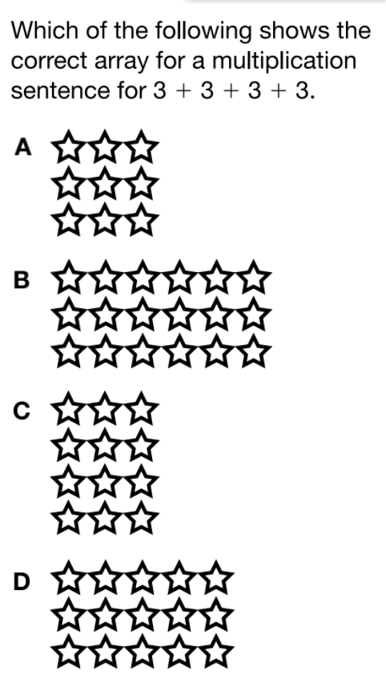
Guided
Guided

Slide 29
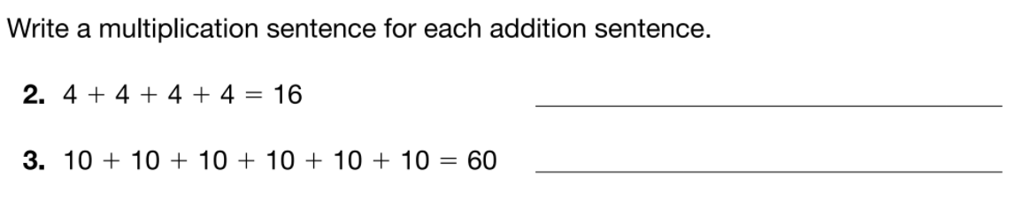
Guided
Guided

Slide 30
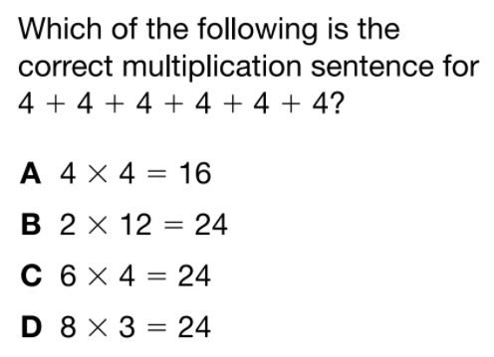

EXIT TICKET
White boards!

