Slide 1
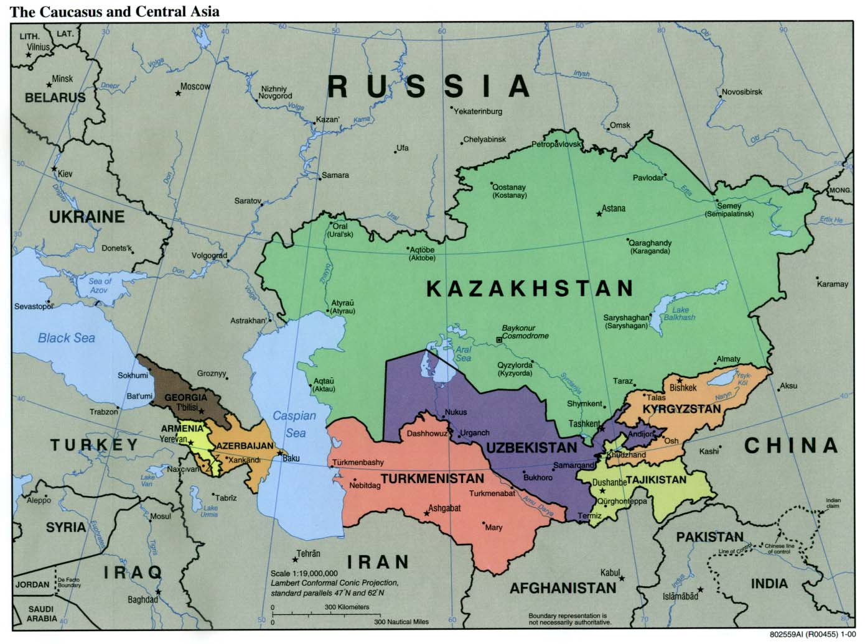
Types of Maps
This Photo by Unknown Author is licensed under CC BY-SA

Slide 2
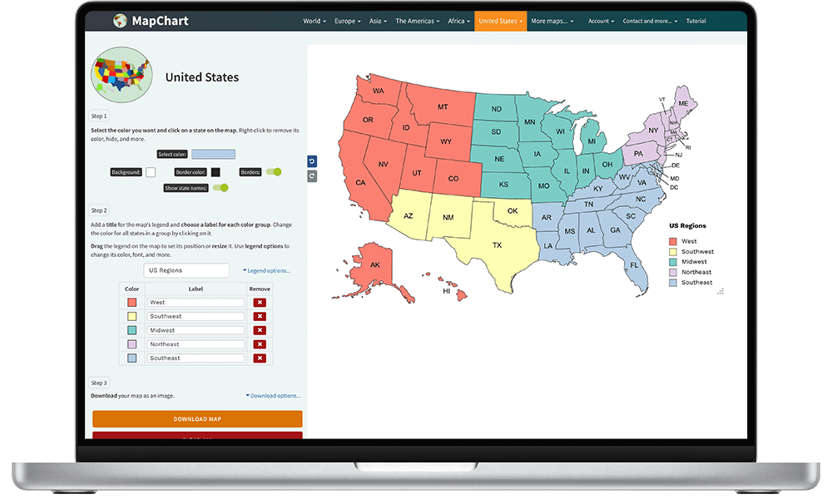
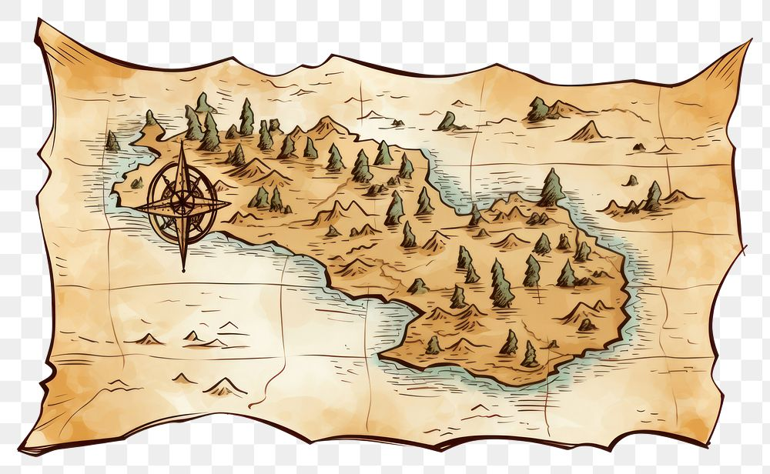
*Maps have been used for thousand of years to represent our world . *They help people find their way across oceans and countries .
*Some maps are drawn on paper , while others are digital .
This Photo by Unknown Author is licensed under CC BY-SA

Slide 3
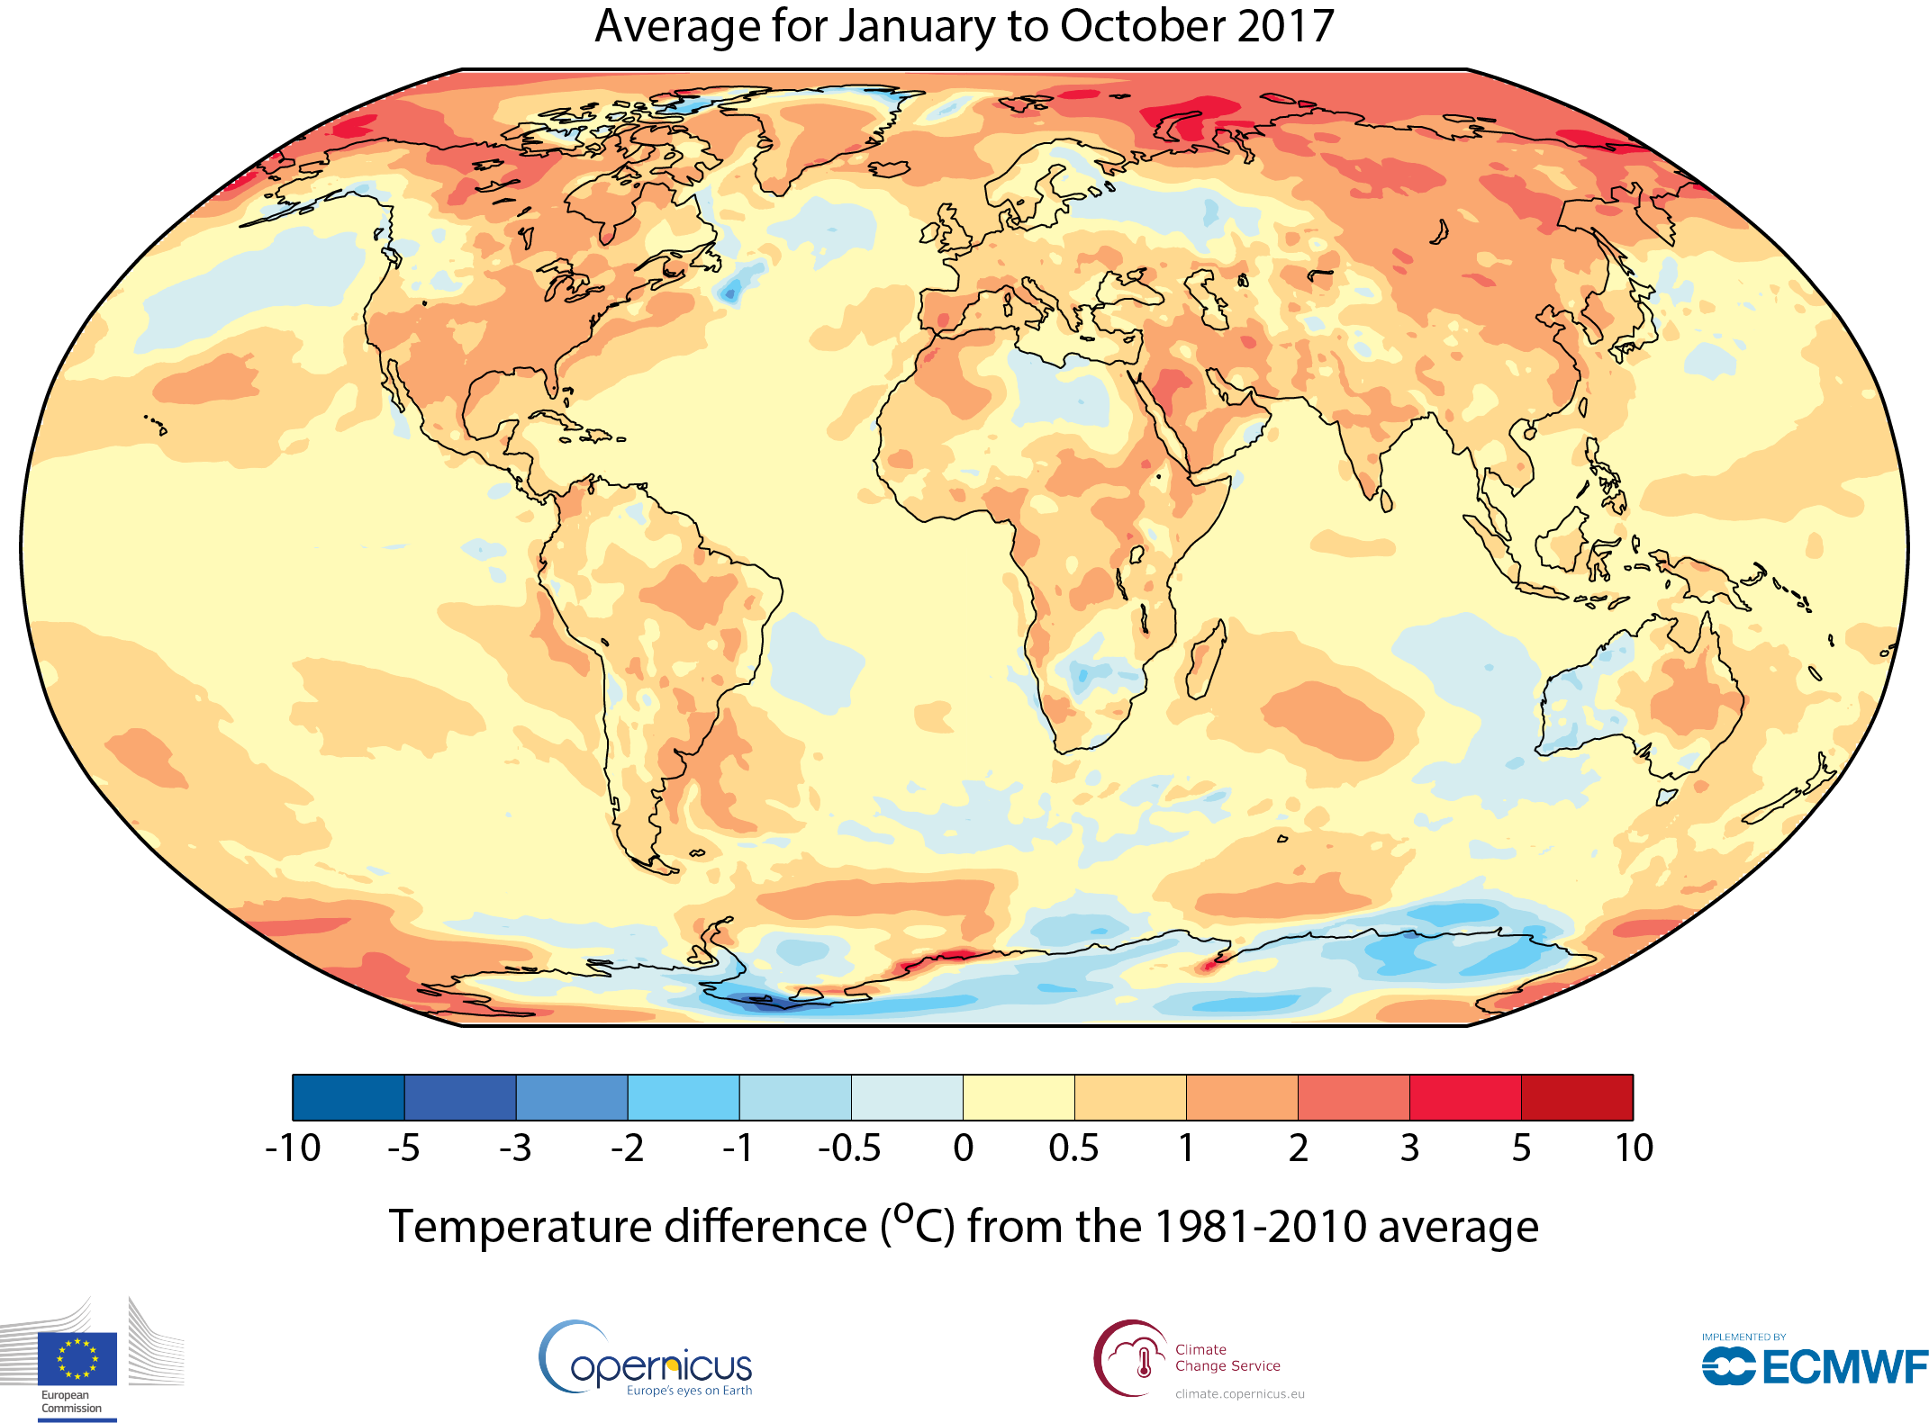
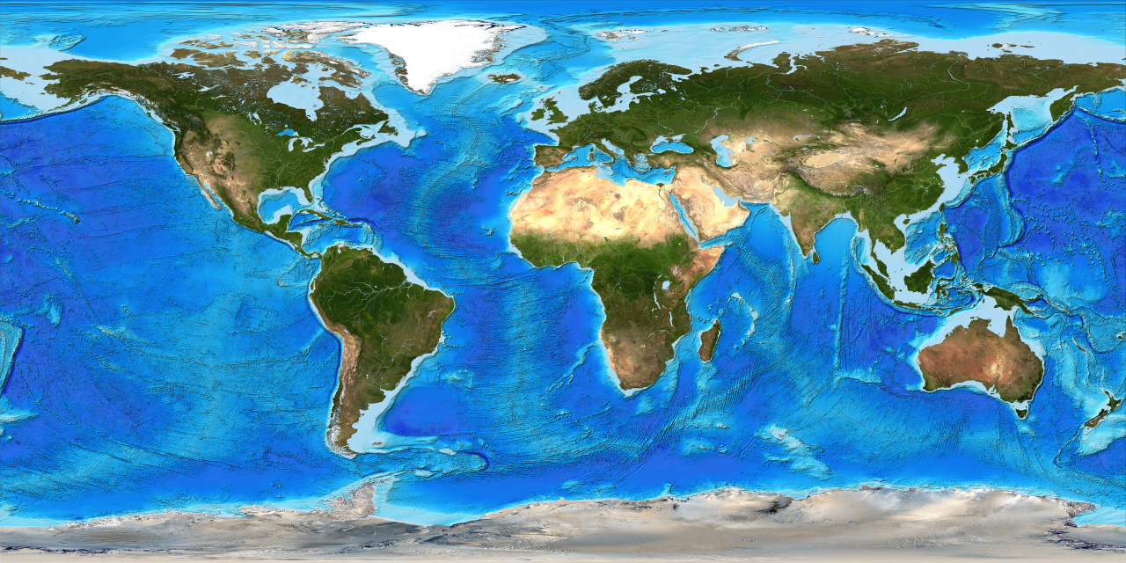
*Whatever the format , maps have some features in common . For example , most maps have a key and a compass rose .
*Maps also have differences based on their type and purpose . The information included on a map shows its type .
This Photo by Unknown Author is licensed under CC BY-SA-NC
This Photo by Unknown Author is licensed under CC BY-NC

Slide 4
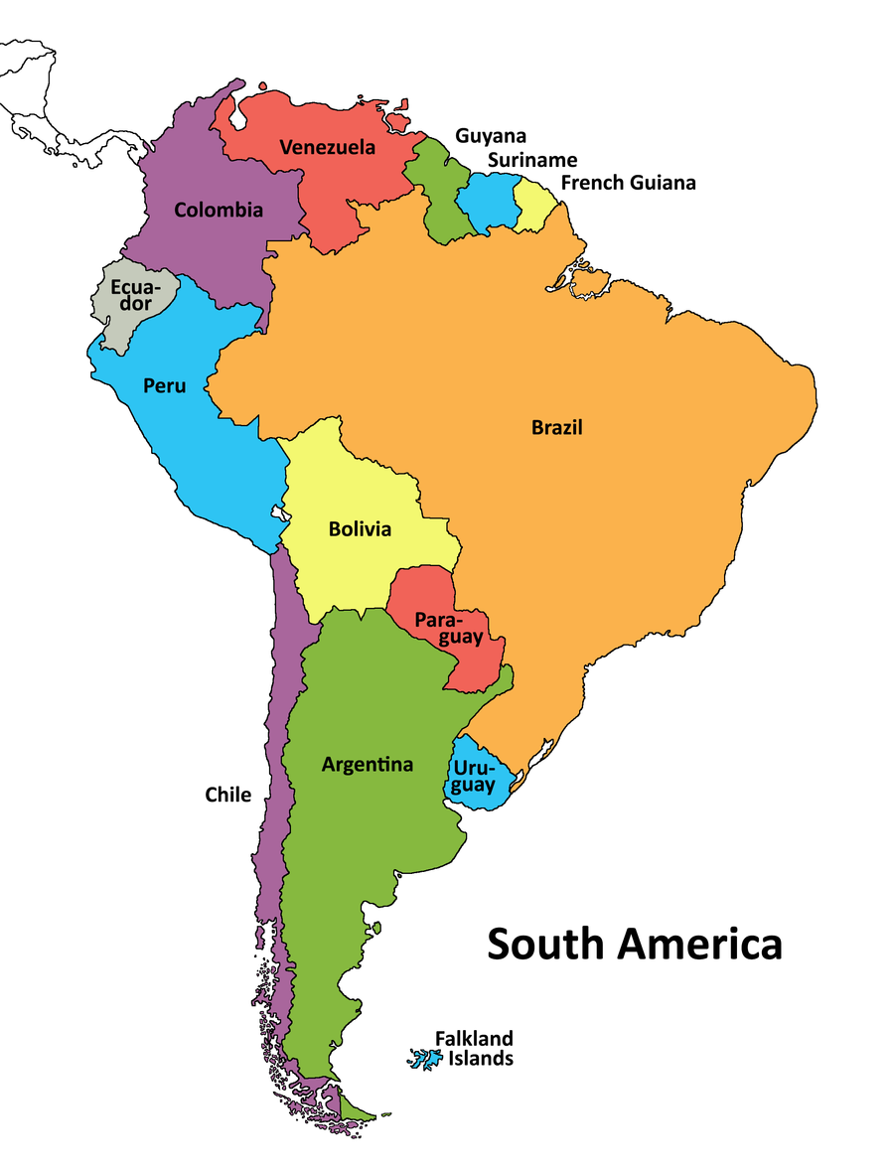
*There are three types of maps : Political , physical , and thematic :
*Political maps : include country names , borders , and the capital cities of each country . Political maps of smaller areas can show states and towns
This Photo by Unknown Author is licensed under CC BY-SA

Slide 5
*Physical maps : show natural features on the surface of Earth , such as mountains , oceans ,and rivers .
This Photo by Unknown Author is licensed under CC BY-SA-NC

Slide 6
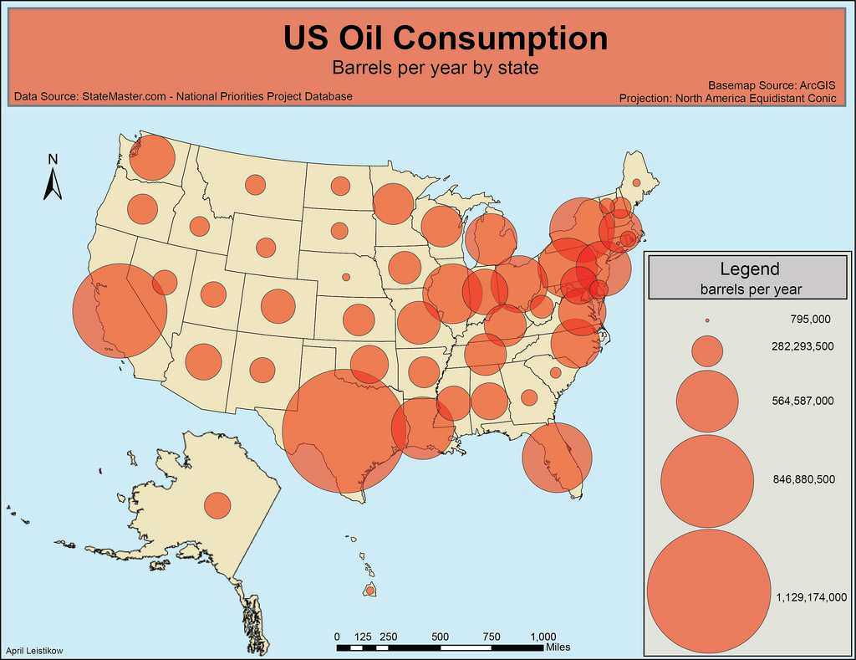
*Thematic maps :present information about a particular subject or theme . For example : there are maps that show time zones , climate , population , or economic activity . Some maps show countries that have won the world cup!
This Photo by Unknown Author is licensed under CC BY-NC-ND

Slide 7
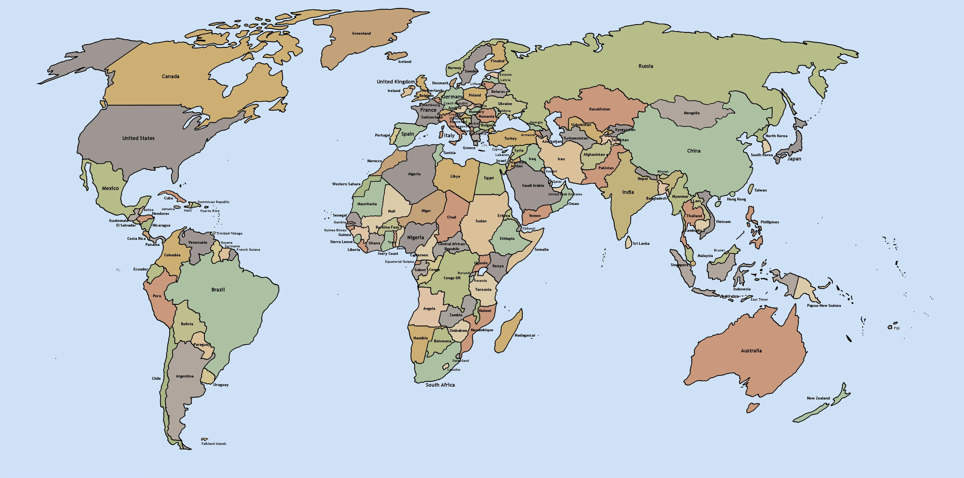
*Maps can present a lot of information . Knowing how to read a map can help you learn about the place you live . You can learn about its position and location within the world .
This Photo by Unknown Author is licensed under CC BY

Slide 8
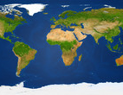
*Physical Maps : show landforms and natural features on Earth’s surface . Some examples are mountains , valleys , deserts oceans , rivers , and lakes .
*Physical maps can use color to show elevation , or the height above sea level (the average level of Earth’s water bodies ). A physical map is used because it shows the features and shape of a place . A physical map shares many features with other maps .

Slide 9
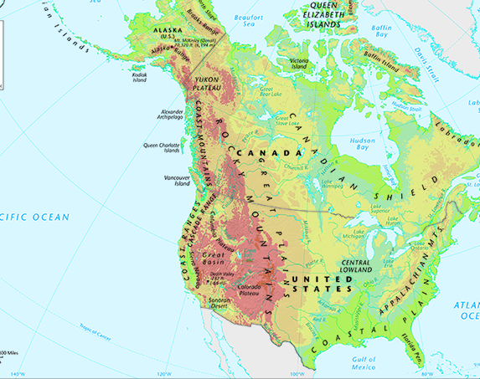
*Lines of latitude and longitude are imaginary lines on maps and globes to help mark exact locations . Lines of longitude are horizontal , while lines of latitude are vertical .
*A map scale tells how the distance on the map relates to the actual distance in the real world .
* Like many maps , a physical map uses colors and shades to help convey , or give , information .
This Photo by Unknown Author is licensed under CC BY-SA-NC

Slide 10
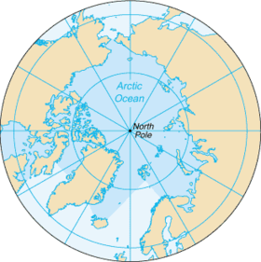
*Hydrographic Maps : measures the physical features in water bodies like oceans , seas , lakes , and rivers , and in costal areas . Machines measure water levels , tides , currents , and water temperature to make hydrographic maps .
Sometimes people use an autonomous underwater vehicle (AUV) to collect data . Someone on a boat or on a land controls the AUV remotely .
This Photo by Unknown Author is licensed under CC BY-SA

Slide 11

*There are many ways to use hydrographic maps . Scientists use them to predict weather patterns and to make charts for sailors to use .
These are important tools for safe navigation , or the way to find direction while moving . They can also help scientists and environmentalists with water management and conservation .
They use them to determine locations for fishing or under water mining .
This Photo by Unknown Author is licensed under CC BY-NC-ND

Slide 12
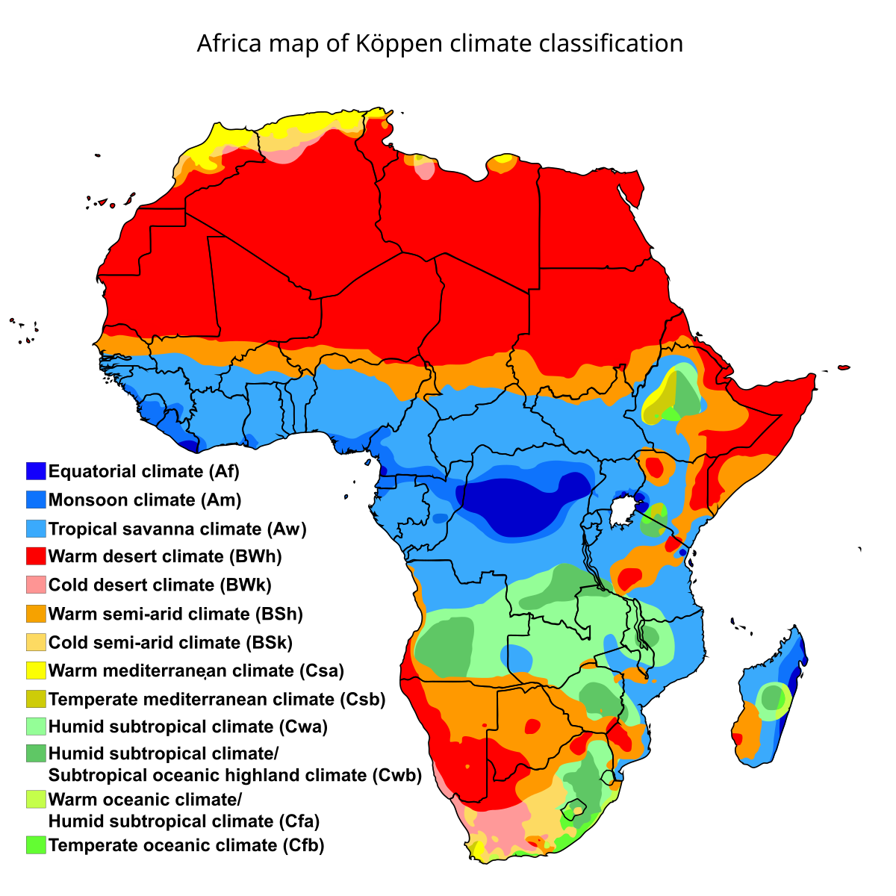
Climate maps : is the general weather pattern in an area over a long period of time . It includes temperature , precipitation (how much rain or snow falls ), humidity (how much moisture is in the air ), and the average wind speed . Climate is different from weather . Weather tells us how it feels outside at a specific moment in time .
This Photo by Unknown Author is licensed under CC BY-SA

Slide 13
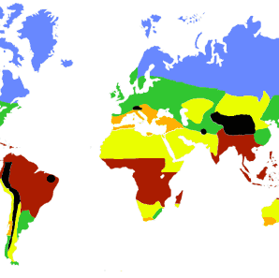
A sunny day , a cloudy evening , or windy nights are all description of weather . People measure climate over a longer period of time . There are five main types of climates :
1- tropical :hot , humid , wet
2-dry :always very little moisture or precipitation
3- temperate : warm , stormy summers and mild winters .
4- continental :warm or cool summers and very cold winters .
5-polar : always extremely cold .
This Photo by Unknown Author is licensed under CC BY-NC

Slide 14
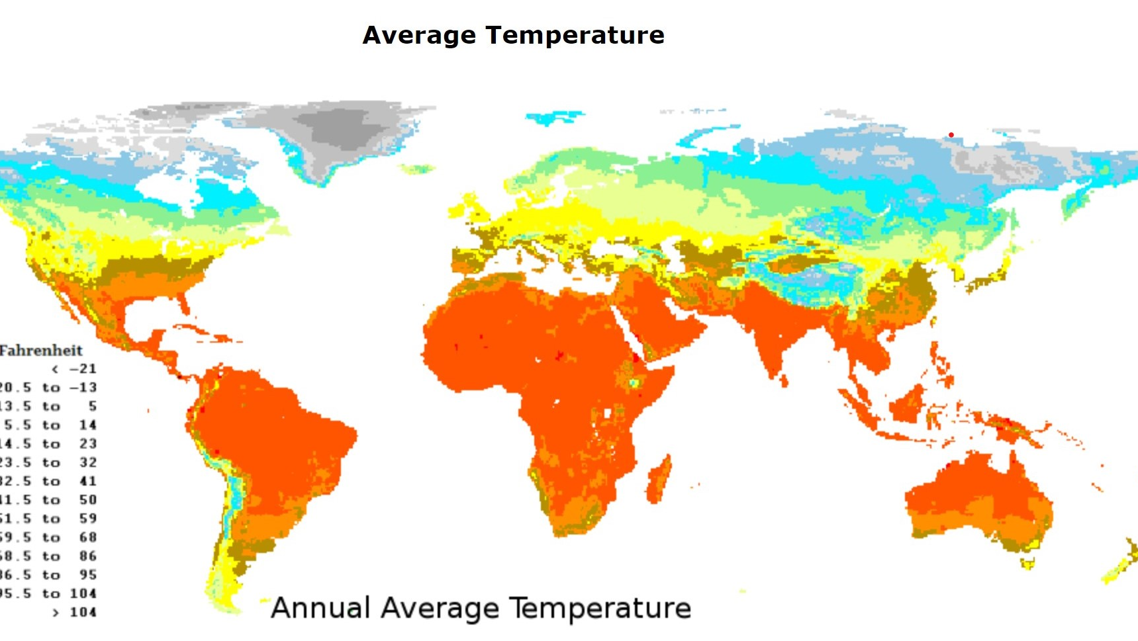
*Climate can be divided into subcategories , such as the tropical rainforests of South America or the tropical savannas of central Africa .
Scientists use a climate map to show the different types of climate zones across the world . These maps uses colors to represent different climate zones . Such maps can show one or more climate conditions , in one region or the whole world . The most common type of climate map shows temperature and precipitation .
This Photo by Unknown Author is licensed under CC BY

Slide 15
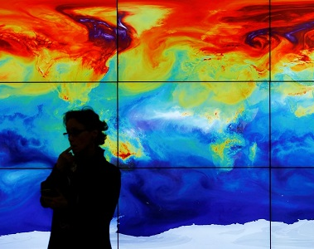
*It is important to be able to read climate maps because they help us to compare the climates in different places . Scientists use them to observe changes over time . They also use these maps to make predicitions about future changes in the climate . Understanding how climate changes can help us find ways to reduce the harmful effects of global warming .
This Photo by Unknown Author is licensed under CC BY

Slide 16
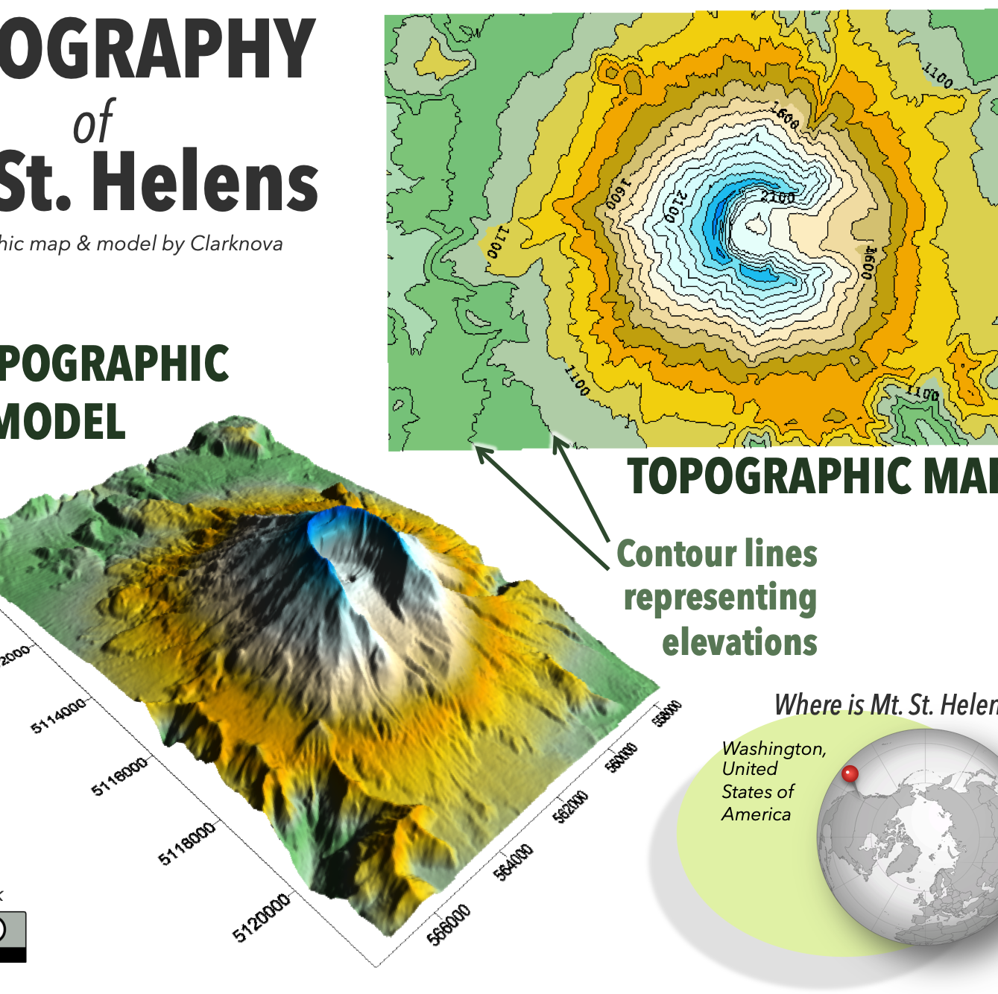
*Topographic Maps : has many lines called contour lines . These lines show features such as landforms and elevation . Contour lines join points on the map that show areas of land that are at the same height above sea level .
The closer together the lines , the stepper the slope . The farther apart the lines , the gentler the slope .Contour lines make it possible to use a two-dimensional map to show the three dimensional surface of Earth .
This Photo by Unknown Author is licensed under CC BY-SA-NC

Slide 17
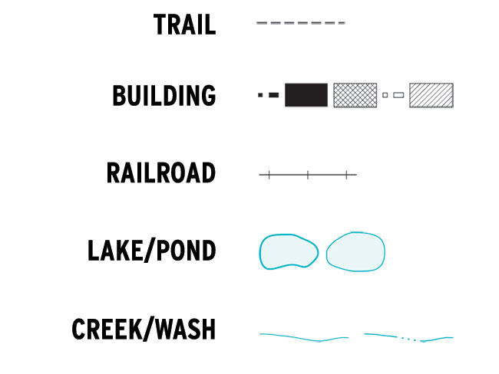
*Topographic maps use symbols and colors to show common features . Some symbols look like real objects , such as a tent to show where there is a campsite . Often , the symbols are simple shapes .The colors on a topographic map also give information . For instance , the contour lines are always brown , rivers and likes are always blue . Minor roads are black , and major highways are usually red .Forest areas and regions of vegetation are green .The key on the map can explain the meaning of the symbols and colors .

Slide 18
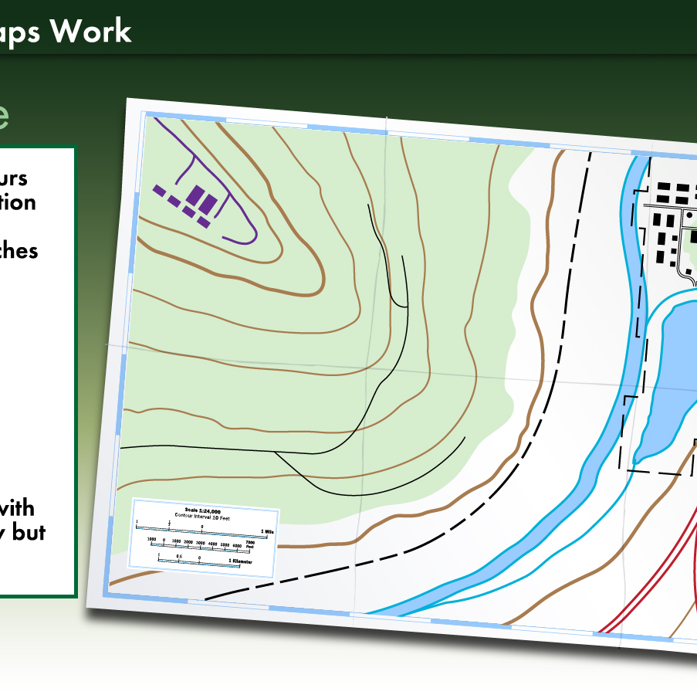
*Even though topographic maps are physical maps , they contain information about human-made features such as roads and highways . What do people use topographic maps for ?
People often use them in activities like rock climbing or hiking . Airplane pilots use them for navigating safely near mountains . Governments use topographic maps while drawing borders .

Slide 19
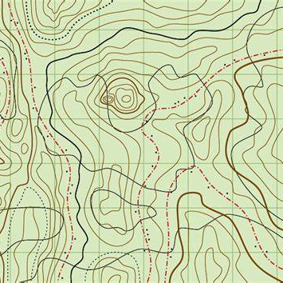
They also use them when planning towns and cities . Organizations and companies use them for mining and agriculture and to help conserve the environment .
They are even helpful for predicting weather . The natural features of a place , such as mountains , valleys , and lakes , often affect weather patterns .

Slide 20
*Historical and Historic Maps : another example of a thematic map is a historical map that shows a historical era , event , or place from the past .
A historical map is different from a historic map ,a historic map is a map that was made in the past .
Historic maps are primary sources . They were created by people living in the earlier times . Such maps provide valuable information about how people studied geography and traveled the world in those days . Some of these early maps look different from the maps made today .One example is the earliest Map of the world ,or the Imago Mundai . It was created around 600 BCE and is carved into a clay tablet .

Slide 21
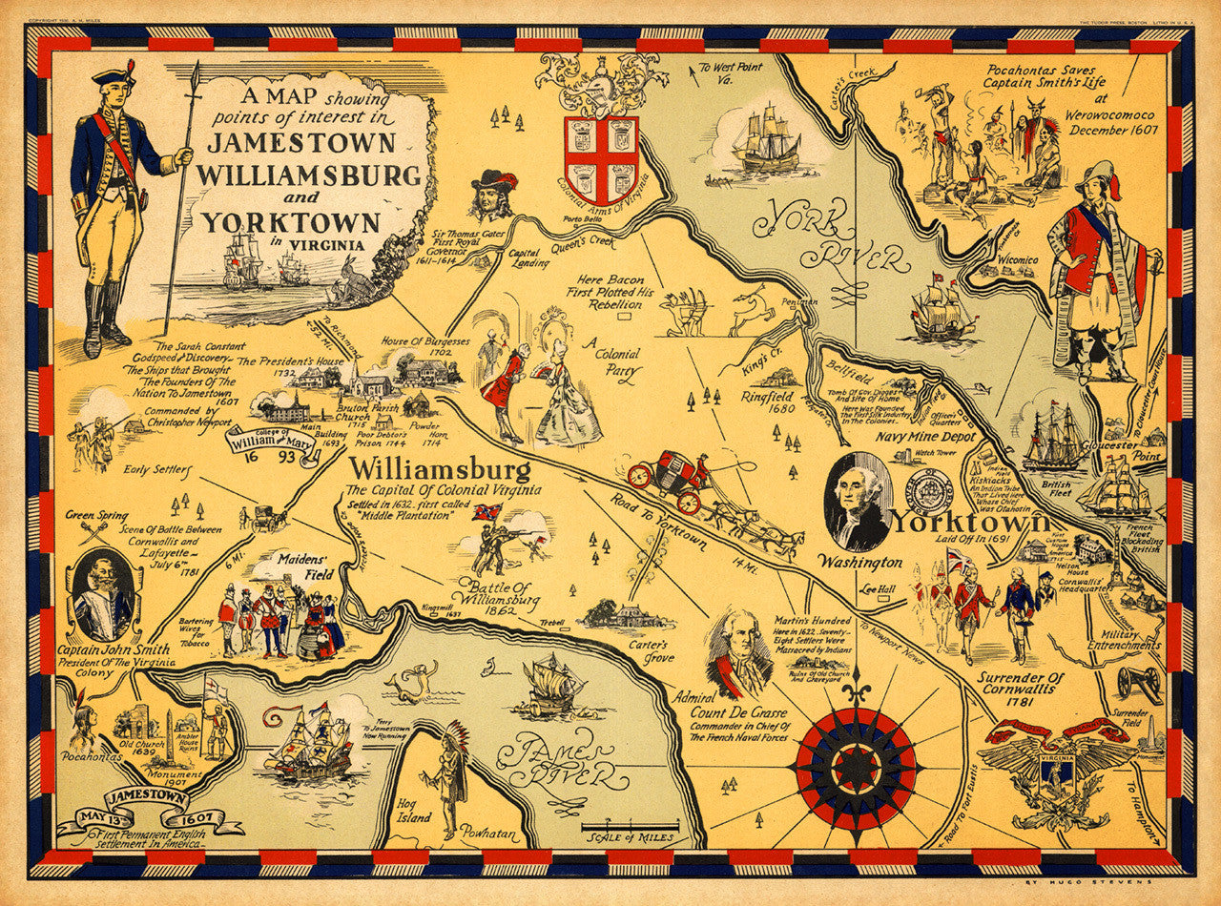
*Historical maps were not made at the time they show .Shading and labels are added to modern world map to make a historical map .
A historical map shows information about something that was true in the past . An example is the modern map above . It shows the size of the Roman Empire when it was at its strongest .

Slide 22
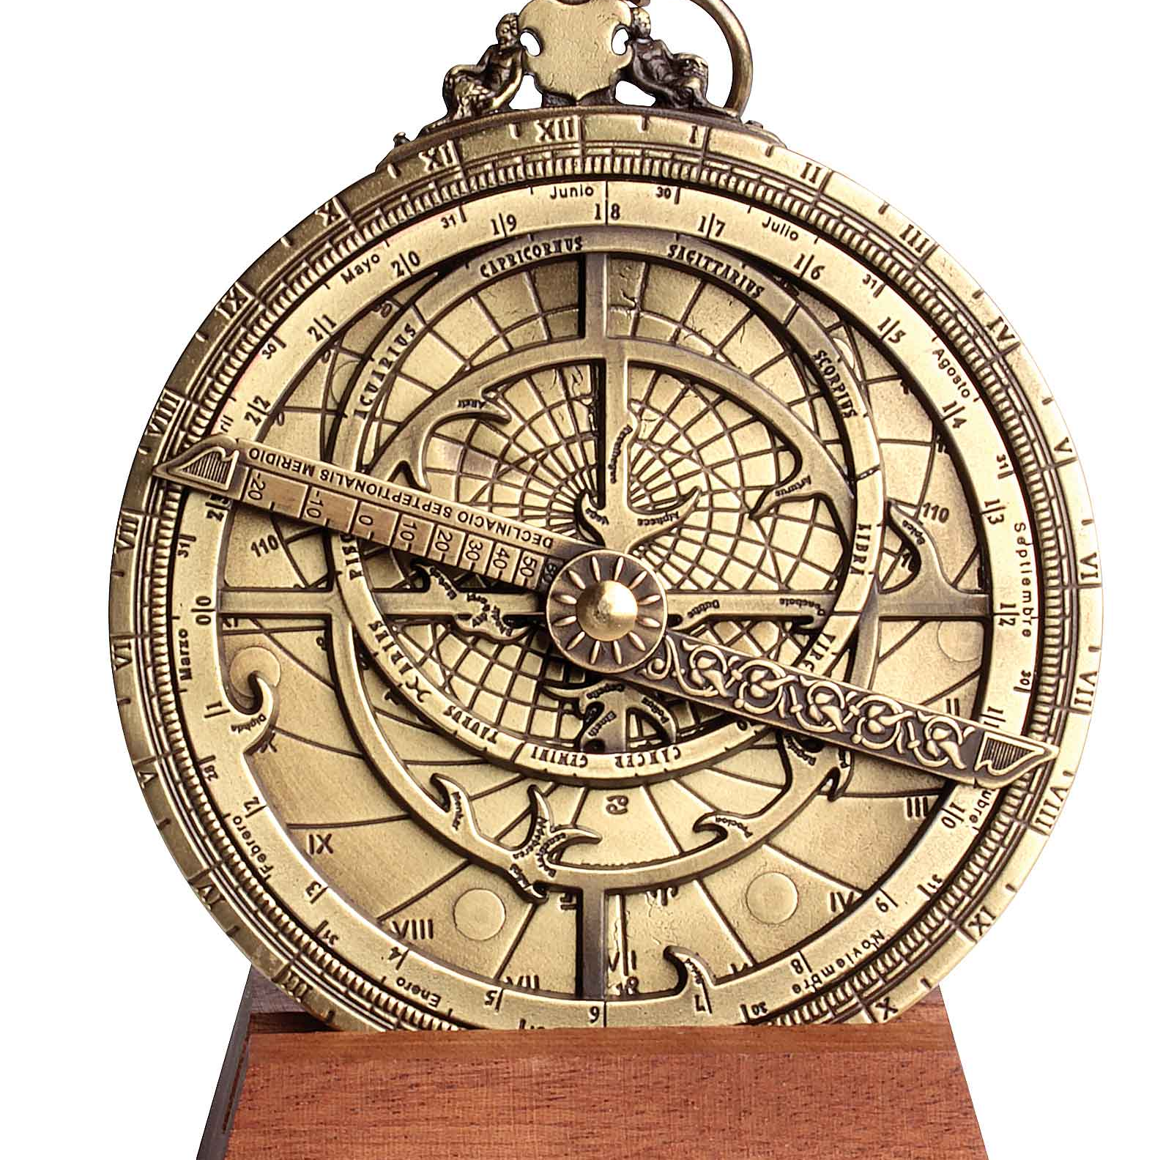
Map Technology : includes tools used to make and understand maps , from old inventions like compasses to modern digital software .
Cartography : is the science or art of making maps .
It has changed over time as technology has advanced .An early tool for navigation was the astrolabe .
Astrolabe : is a physical model of physical or celestial features , such as stars and planets .

Slide 23
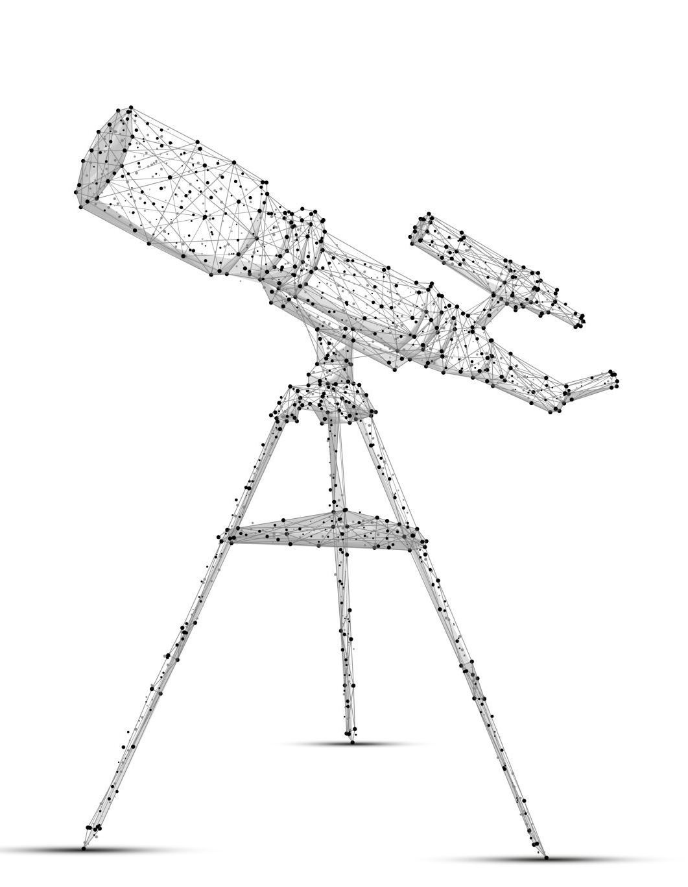
*Another advancement was the invention of the compass around the eleventh century CE .
The telescope , invented in 1608 ,improved the science of cartography even more . People called surveyors used different tools to collect information as they traveled around . They brought back this information to cartographers for map creation .

Slide 24
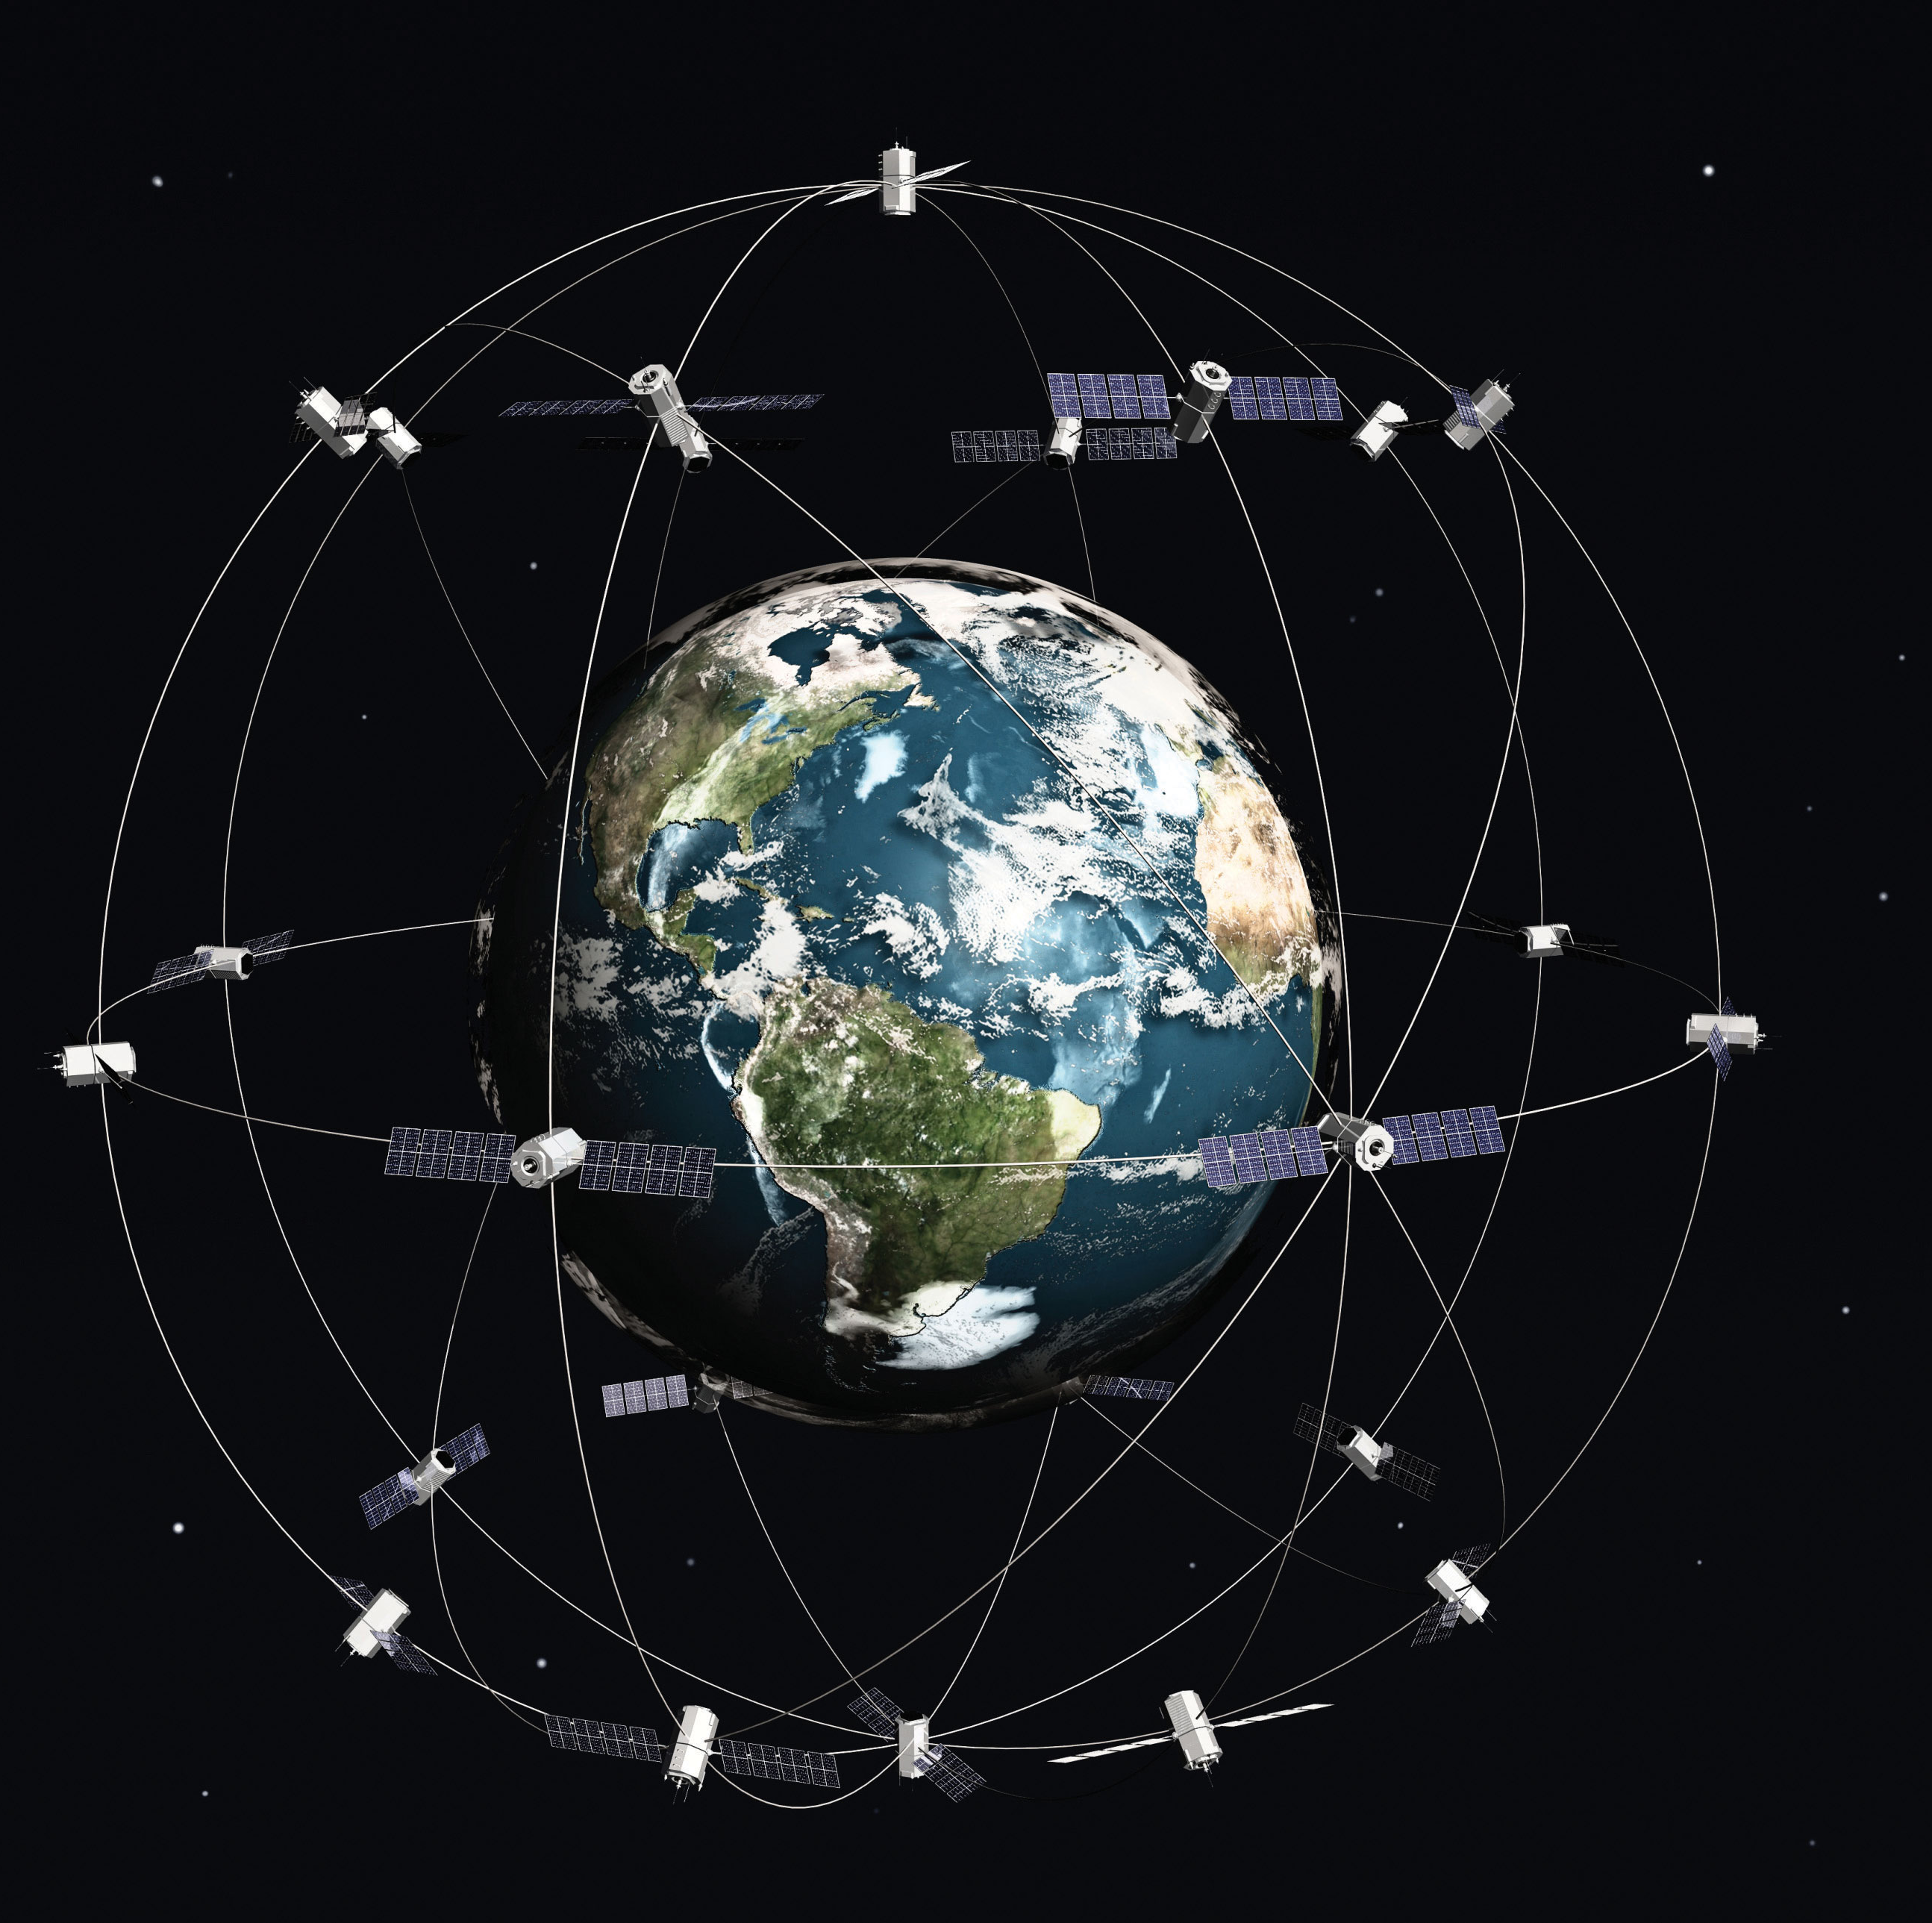
*Today, maps are made with aerial (from the sky )and satellite (from space )photos . Cartographers make modern maps using data from technology such as Light Detection and Ranging (LiDAR) images .
These are photographs taken from an aircraft using special lasers that map the topography of an area .
The lasers send beams of light to the ground .

Slide 25
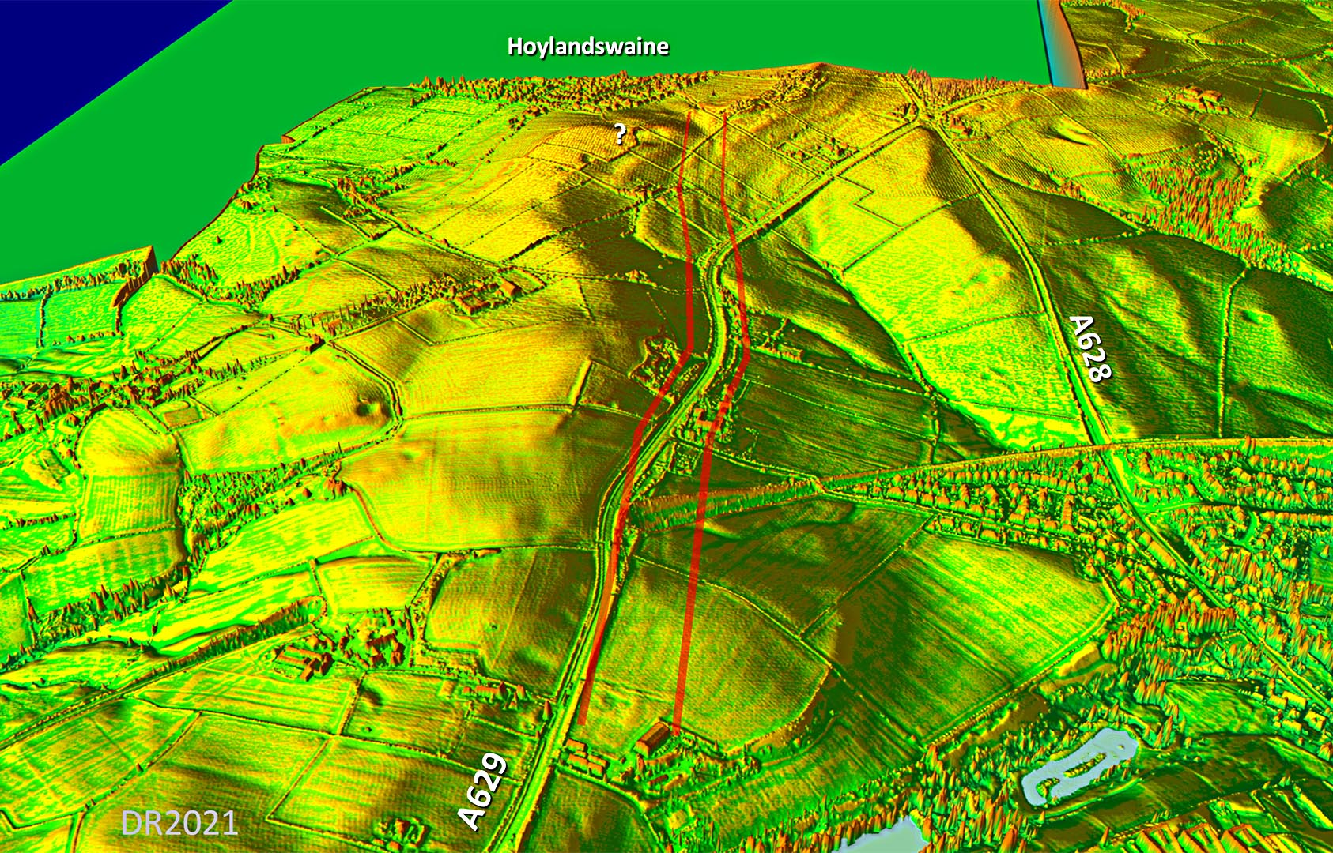
*When the beams are reflected ,their travel time is used to figure out the distance between the laser and the ground .
(LiDAR) maps are extremely accurate .
Another new way of making maps is with a Geographic information system (GIS) .GIS technology can gather , analyze , and show geographic information in a digital format .

Slide 26
The End

