Slide 1
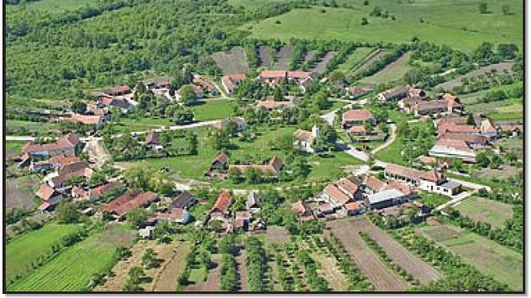
Understanding Settlements
This Photo by Unknown Author is licensed under CC BY

Slide 2
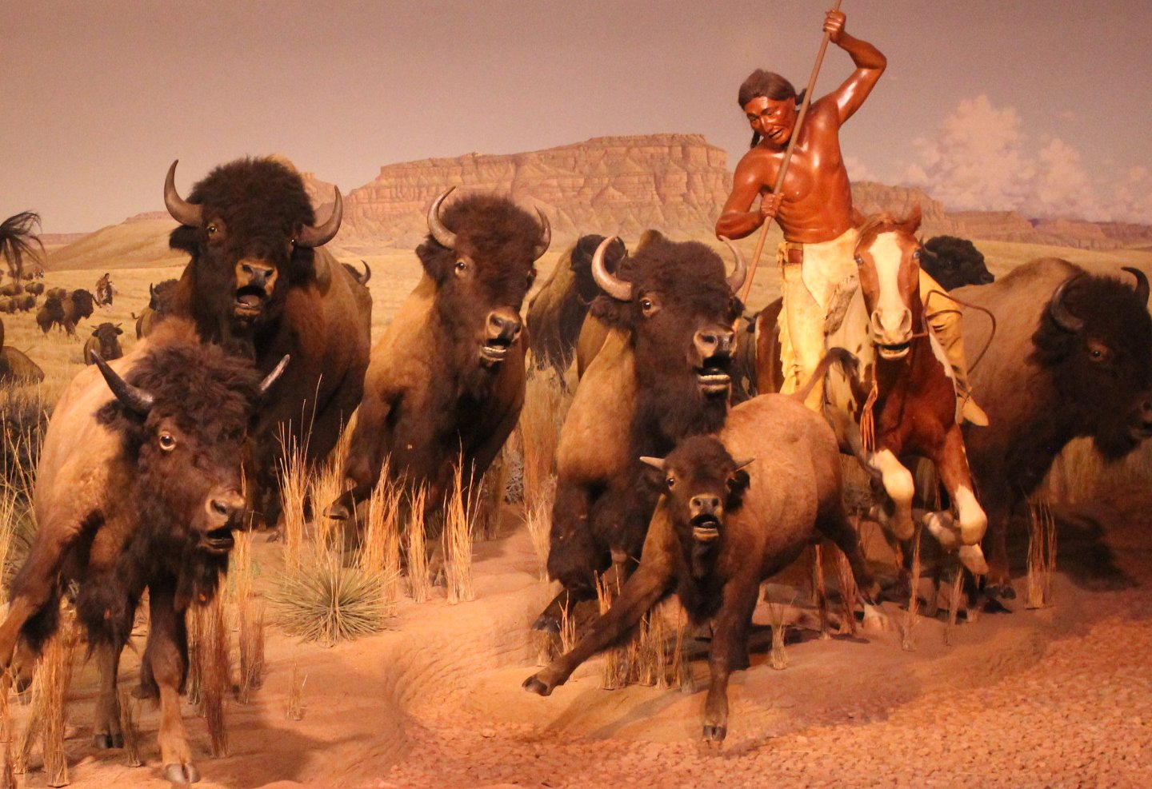
*For thousand of years , humans have moved from place to place . They traveled to 1- Find food ,often following the animals they hunted .They gathered other types of food . Over time , they begin to settle and build permanent homes .

Slide 3
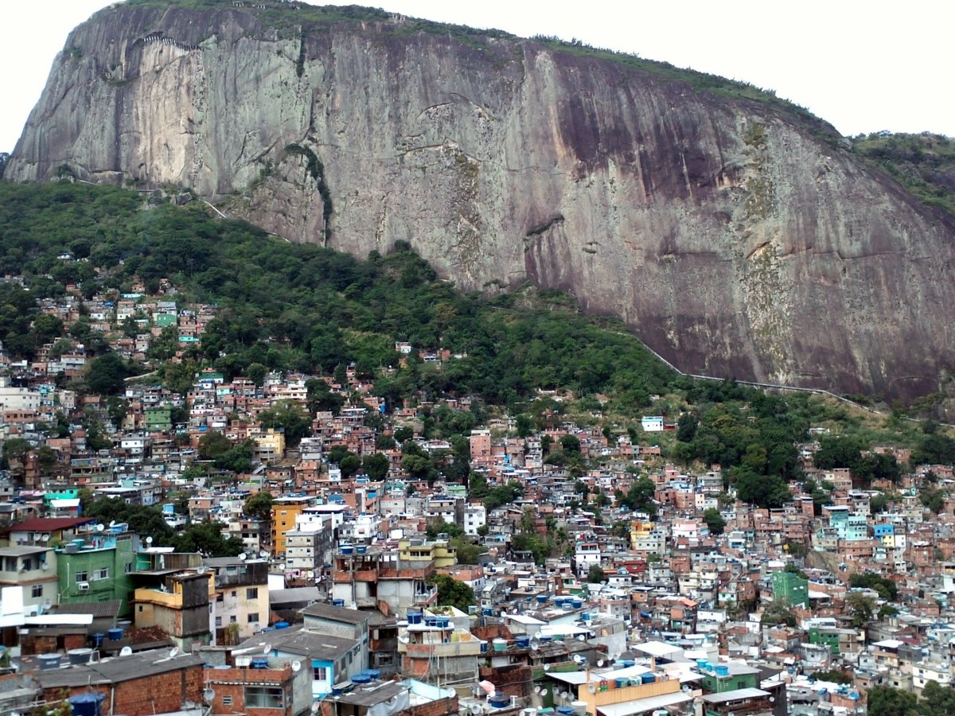
*Human geography : considers why people settle in some places and not others . It includes the study of the relationship between people ,places , and the environment and how this relationship impacts where people settle .
This Photo by Unknown Author is licensed under CC BY-SA

Slide 4
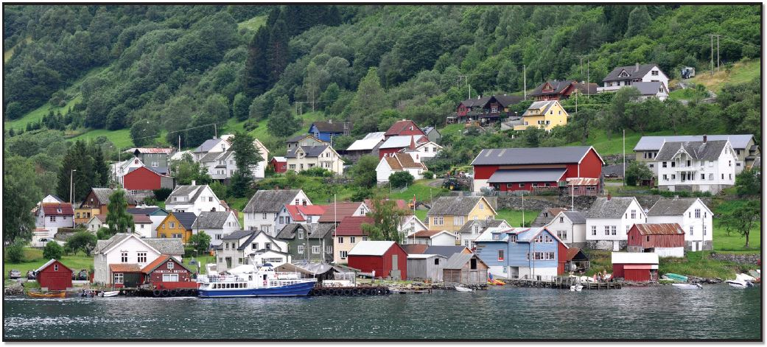
*A settlement : is an area where people have built places to live .Different factors affect where group of people choose to locate their settlements . For example : These could be physical factors , such as settling by the side of a mountain to get shelter from the weather . Settling near a lake or river supplies a source of water and food .
This Photo by Unknown Author is licensed under CC BY

Slide 5
* This lesson will explore the different types of settlements and the locations in which people choose to settle .
*Features of settlements :
1- pattern : settlements have shapes called settlement patterns. Some patterns are based on natural features of their area . For example : a town built beside a river will have a long pattern that follows the river bank .

Slide 6
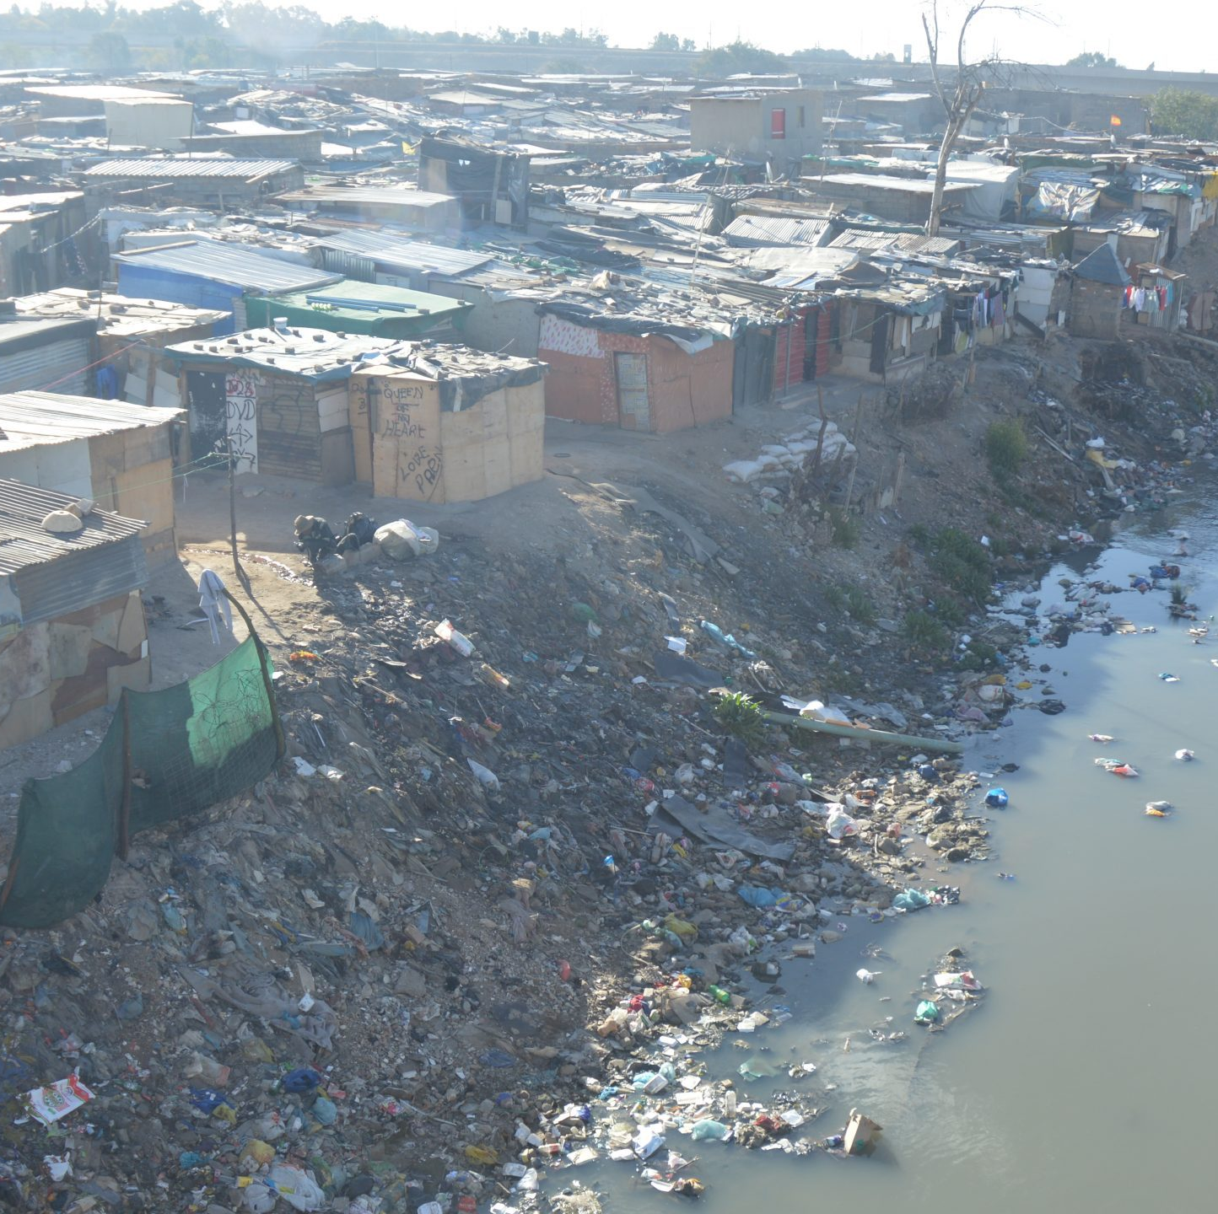
2-Size : A settlement’s size is measured in terms of its population . Population is the number of people who live in a town ,area , or country .
3- Density : population density is the measurement of how many people live within a certain space .Density =the number of people in a settlement /the total land area of the settlements .
This Photo by Unknown Author is licensed under CC BY-NC

Slide 7
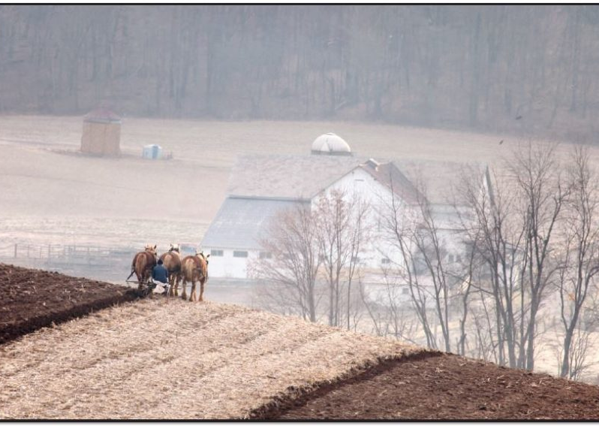
*Isolated Settlements : some people live in isolated settlements made up of single homes or a few buildings far from other settlements . These settlements are often farms in rural , or country , areas .Residents usually need space to raise animals or grow crops . Sometimes , mountains ,deserts , or other land features can cause barriers that isolate communities
This Photo by Unknown Author is licensed under CC BY

Slide 8
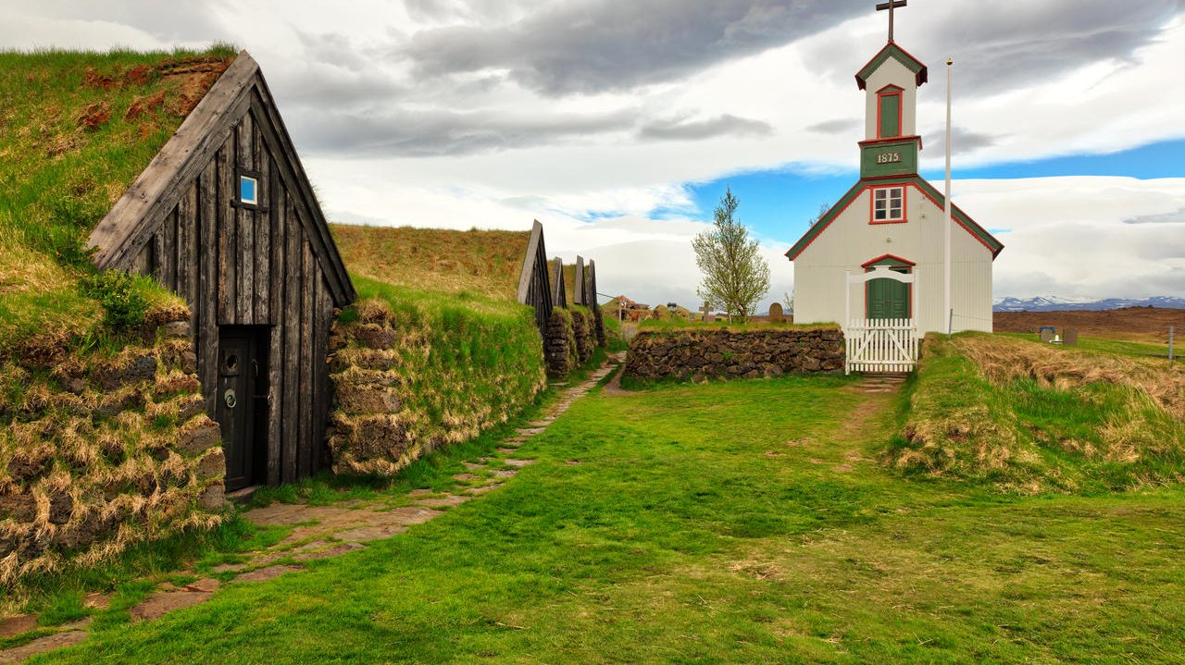
*Isolated settlements : have limited services . Residents might have to travel far to the nearest grocery store or hospital .. Living far from a town or city can affect economic opportunities , making it more difficult to find a job and reach school . Overall , fewer services can impact the quality of life for some residents . But others enjoy having their own spaces
This Photo by Unknown Author is licensed under CC BY

Slide 9
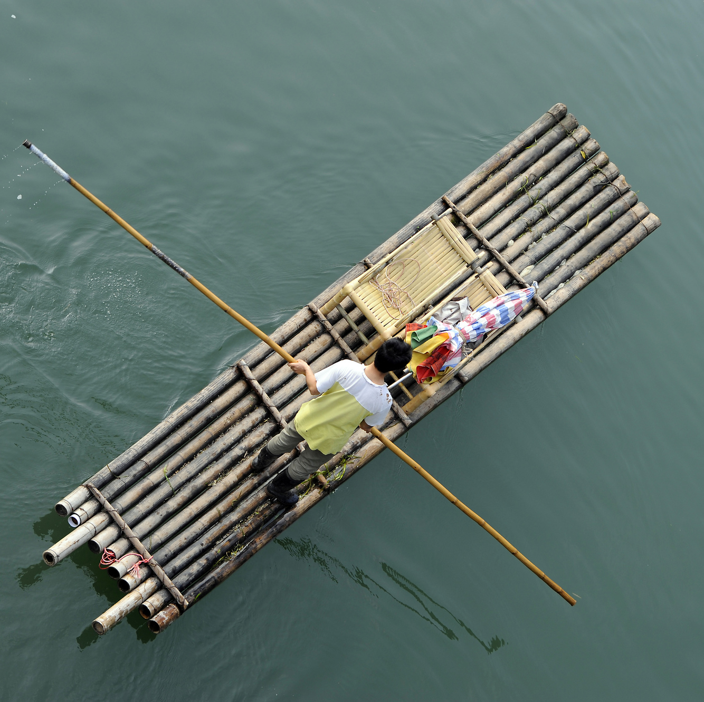
*Throughout history ,people in isolated settlements have found ways to connect to neighboring areas or the border of the world . Here are 2 examples :
*Around 50,000-60,000 BCE , humans used simple rafts to move across the water to connect isolated communities . In Southeast Asia and other places , people still built rafts . They use long sticks to push them through the water .
This Photo by Unknown Author is licensed under CC BY-NC

Slide 10
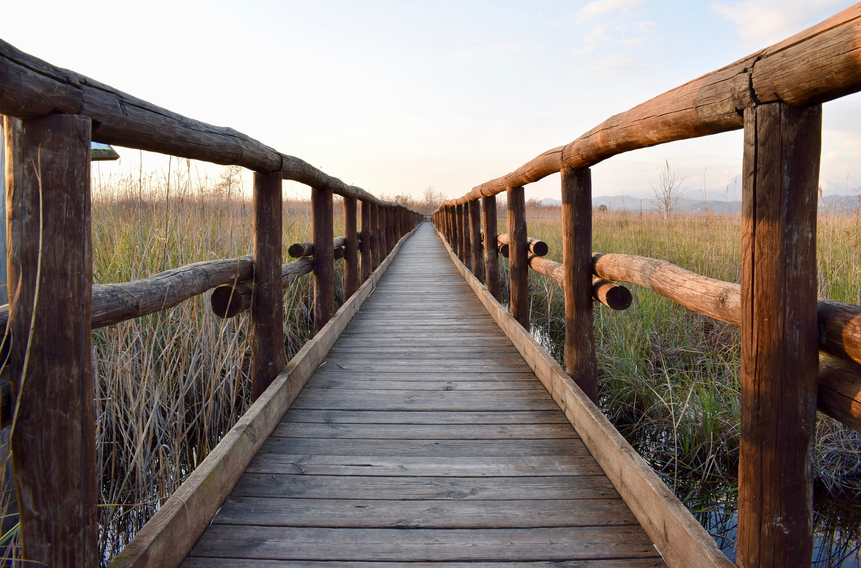
*In around 3807 BCE , people built a wooden bridge in modern-day Somerset , England . The narrow walkway , known as “The sweet Track “ connected isolated areas that a large marsh blocked , especially in rainy weather .

Slide 11
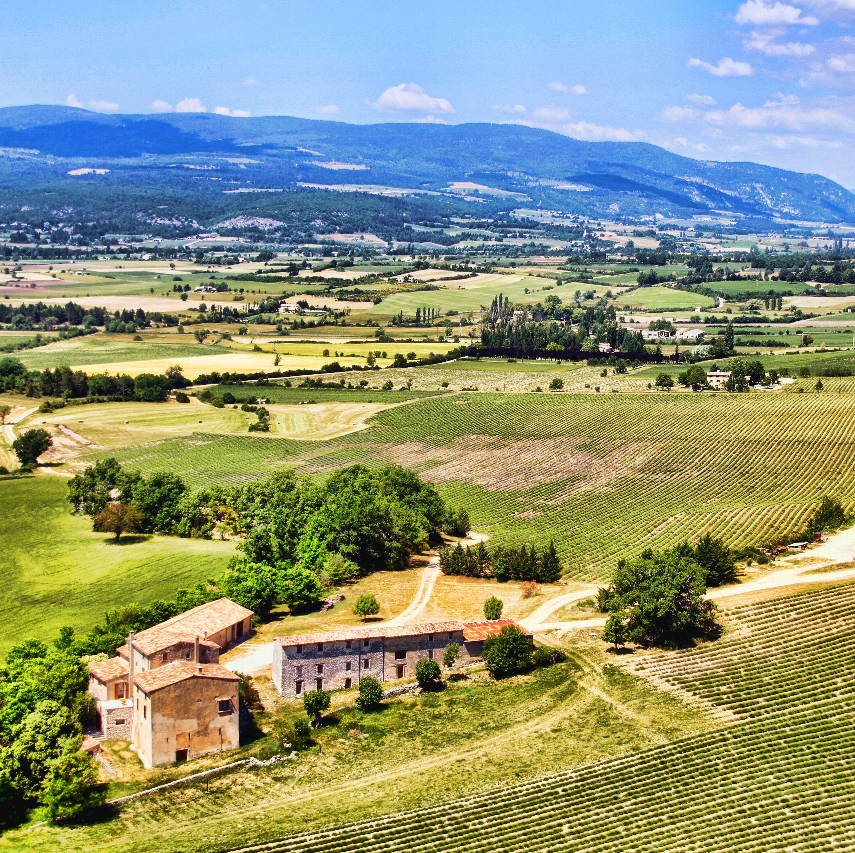
*Dispersed Settlements : houses are spread far apart and are not close to a city or town center. Because land separates the homes , dispersed settlements have low population density .
However , the homes are close enough to belong to the same community .
People in dispersed settlements might live and work on a ranch or in the forestry or lumber industry .
These industries require a lot of land .People who find jobs in them may build homes in a dispersed settlement pattern .

Slide 12
*A dispersed settlement will have more services than an isolated one . However, people still live far from the services commonly found in a town or city . For example , people may have access to a public library , but may have to drive for an hour or more to reach it .
*People in dispersed communities may also have limited access to meeting places , like movie theaters , museums , or restaurants .
*This could impact social development or culture practices .

Slide 13
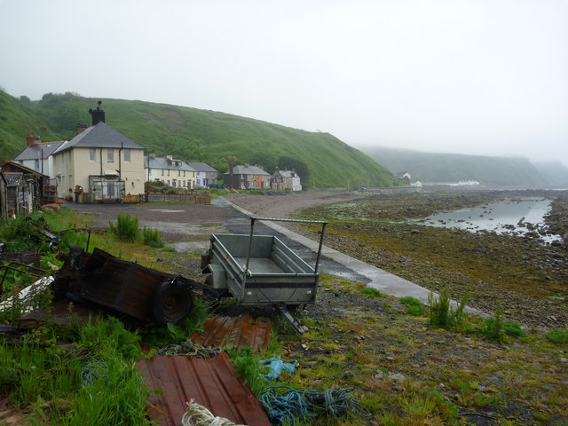
*Living in a dispersed settlement can be a challenge for people . For some who enjoy meeting and spending time with others , living so far from your neighbors can be lonely .
This Photo by Unknown Author is licensed under CC BY-SA

Slide 14
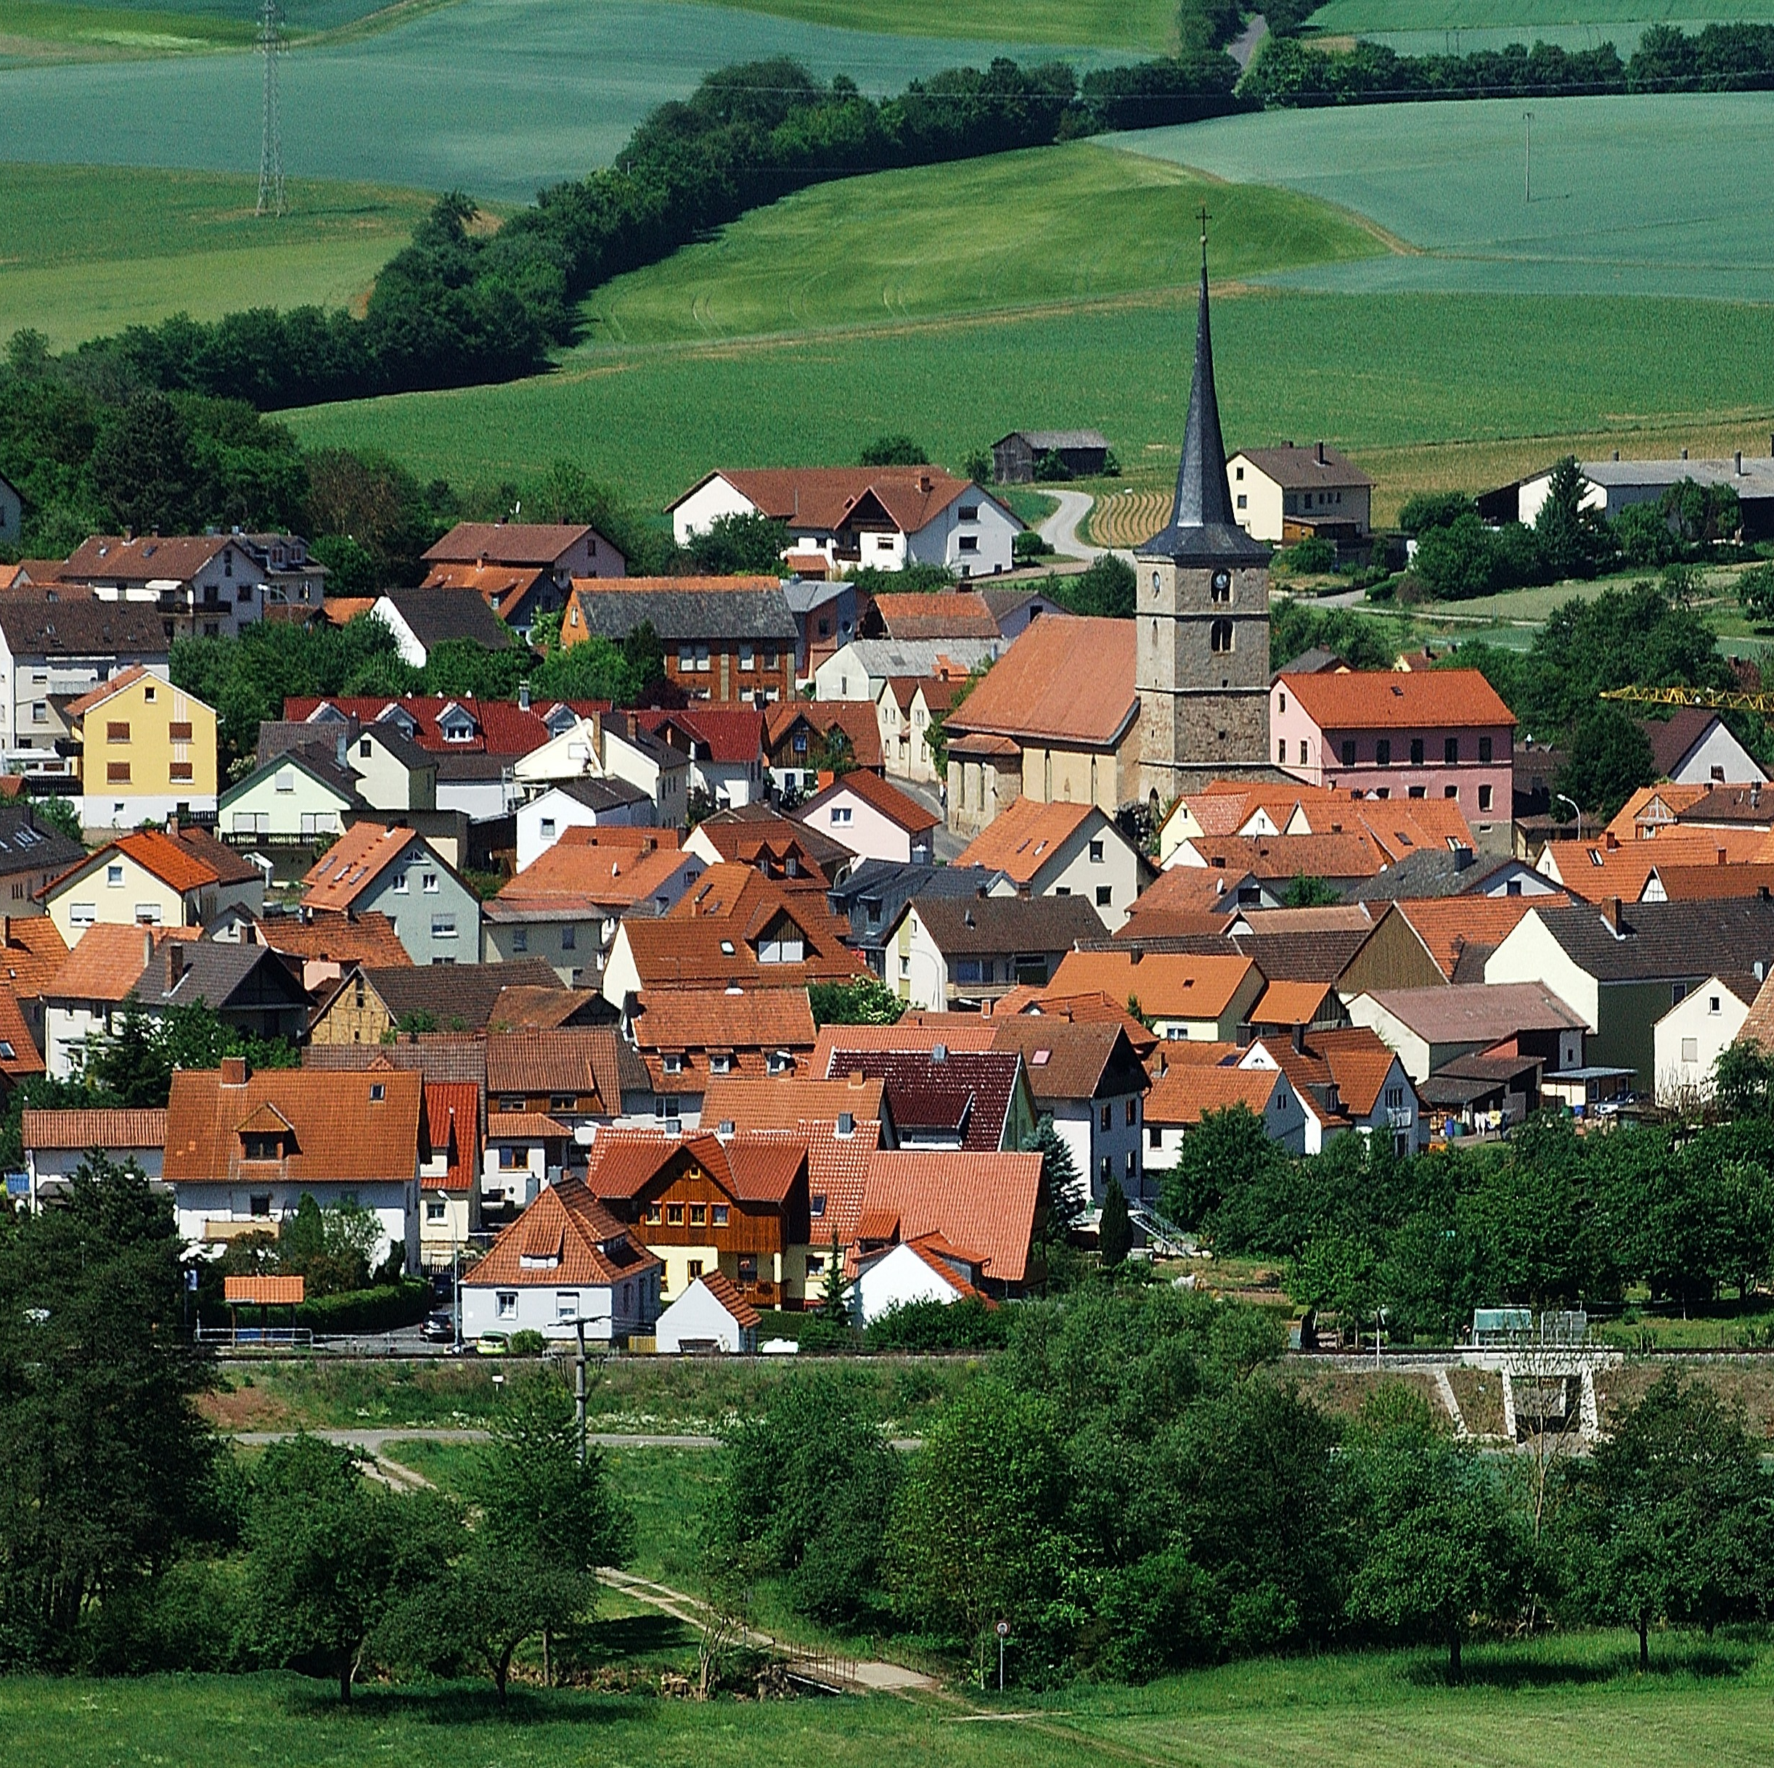
*Clustered Settlements : Unlike isolated and dispersed settlements , clustered settlements have many buildings that are close to one another .
*The buildings center around an important area for the community , such as a market ,port , or government building .
*Clustered settlements promote community involvement and shared resources .

Slide 15
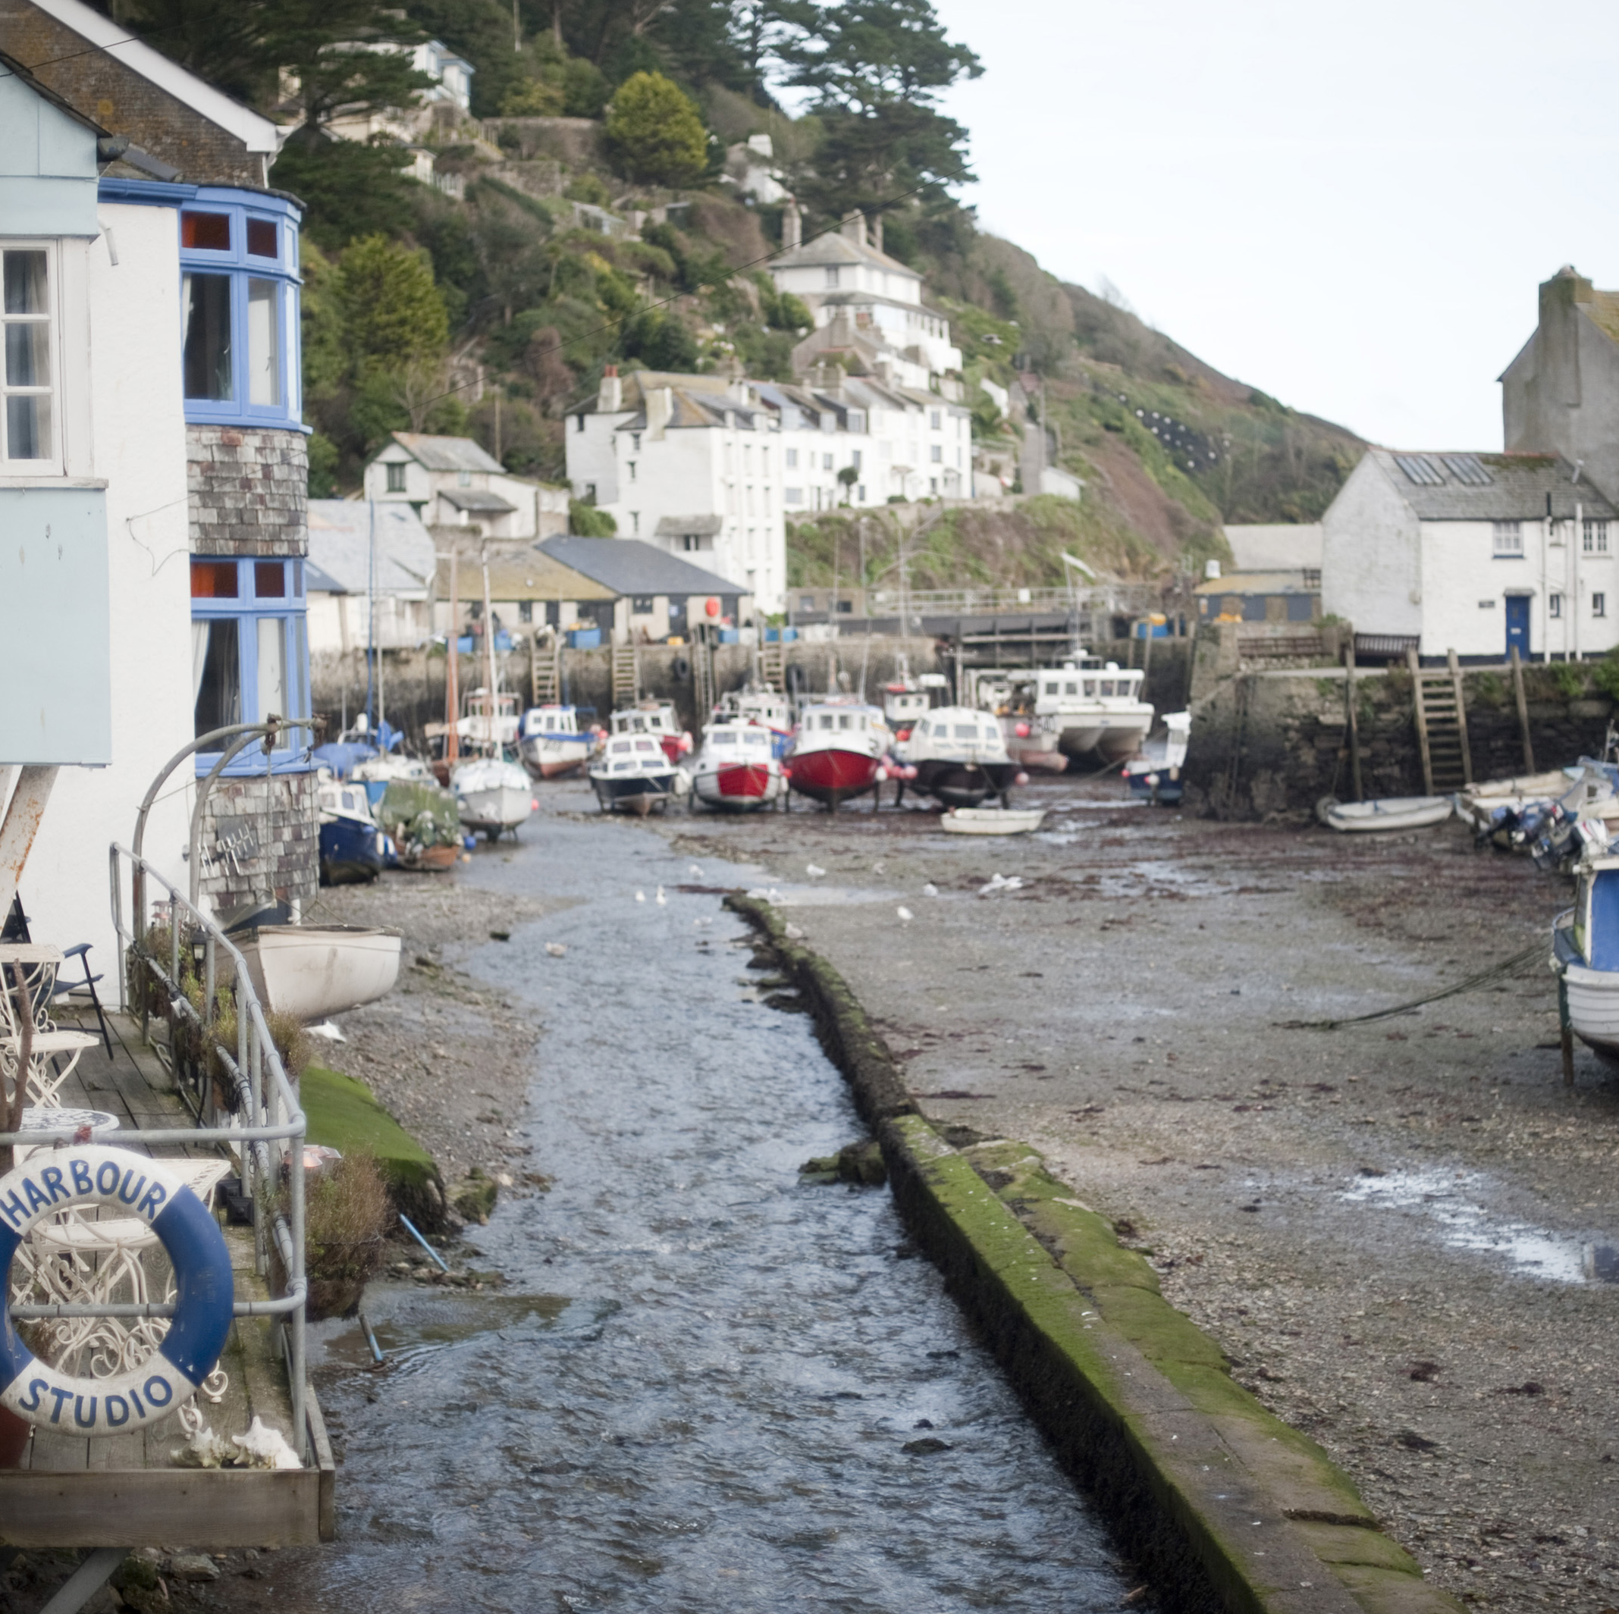
*These settlements in the past , people built houses close to each other for safety reasons .
Today clustered settlements can have different functions that contribute to people’s job and quality of life .
Fishing villages –In coastal areas , clustered settlements might start as fishing villages and then grow into larger communities .
This Photo by Unknown Author is licensed under CC BY

Slide 16
*Port cities –In these settlements, boats arrive and depart with cargo onboard . This leads to trade . Residents from other areas may travel to these settlements to shop .
Towns near cities –Residents live in smaller clustered settlements and travel to a nearby city for work .
However , as settlements grow , challenges grow.

Slide 17
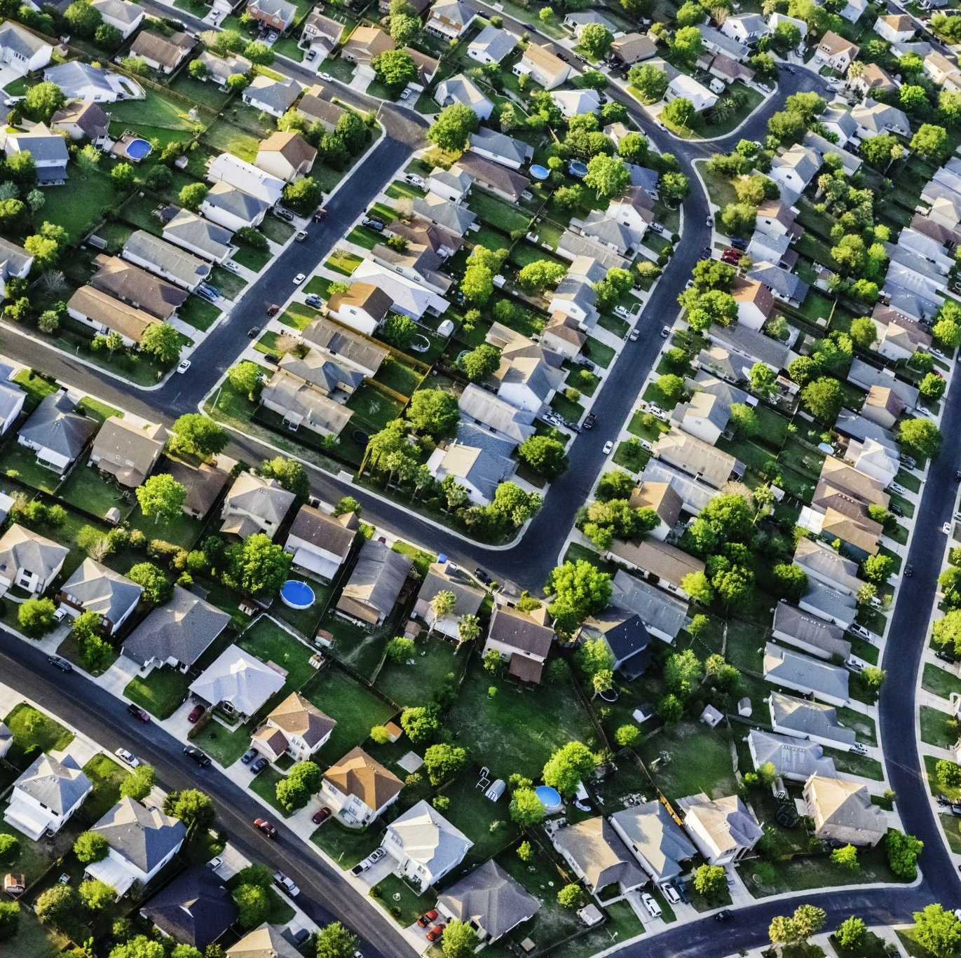
*What are the disadvantages of living in (Clustered Settlements ) ?
As more people come to the area , they may experience increased traffic and pollution .
There may also be less space between homes .

Slide 18
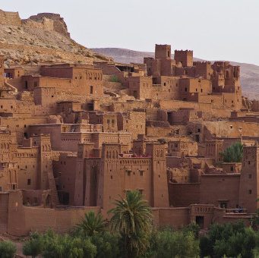
*Rural Settlements of different patterns :They come in different shapes and sizes . These areas remain rural due to their agricultural nature and lower population density .
These settlements support more people because of environmental conditions , such as fresh water supply , fertile land , and an economy based on agriculture or fishing .

Slide 19
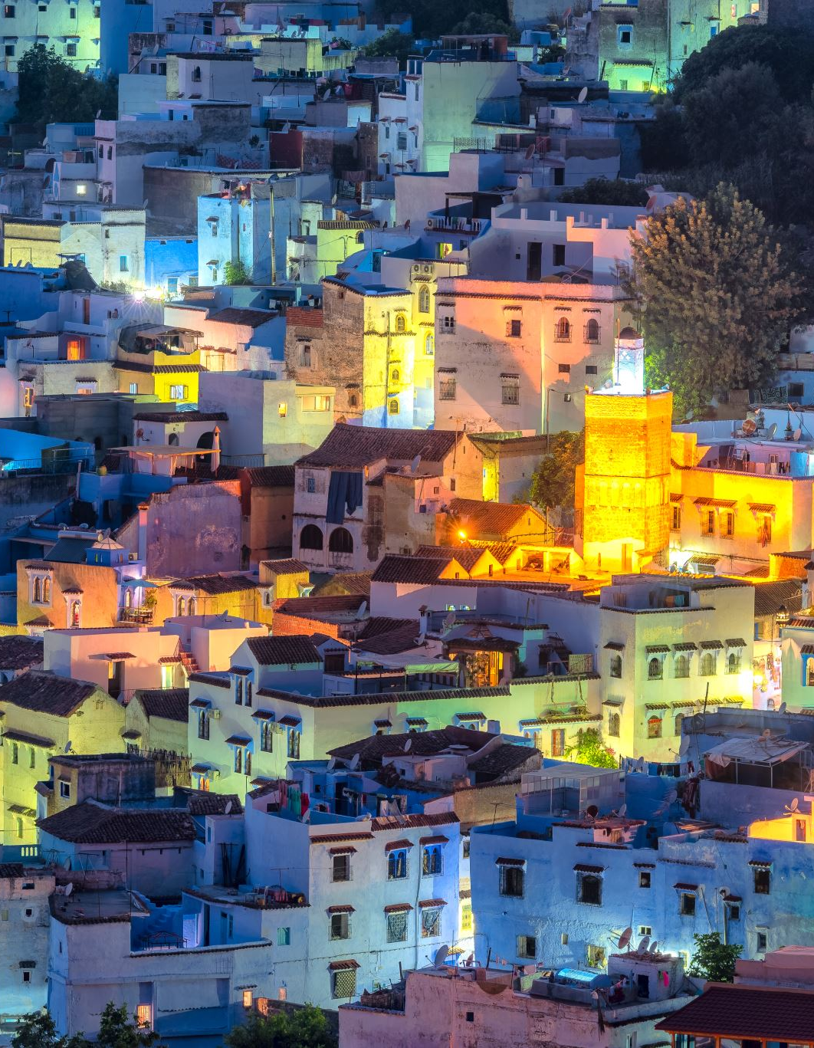
*The kingdom of Morocco in North Africa has rural settlements with different patterns .These settlements are often shaped by the landscape .
Ardouz is a tiny village in the High Atlas region . The isolated settlement has one gravel road , apple trees , and a small schoolhouse . It was one of many remote villages that needed aid following an earthquake in 2023 .

Slide 20
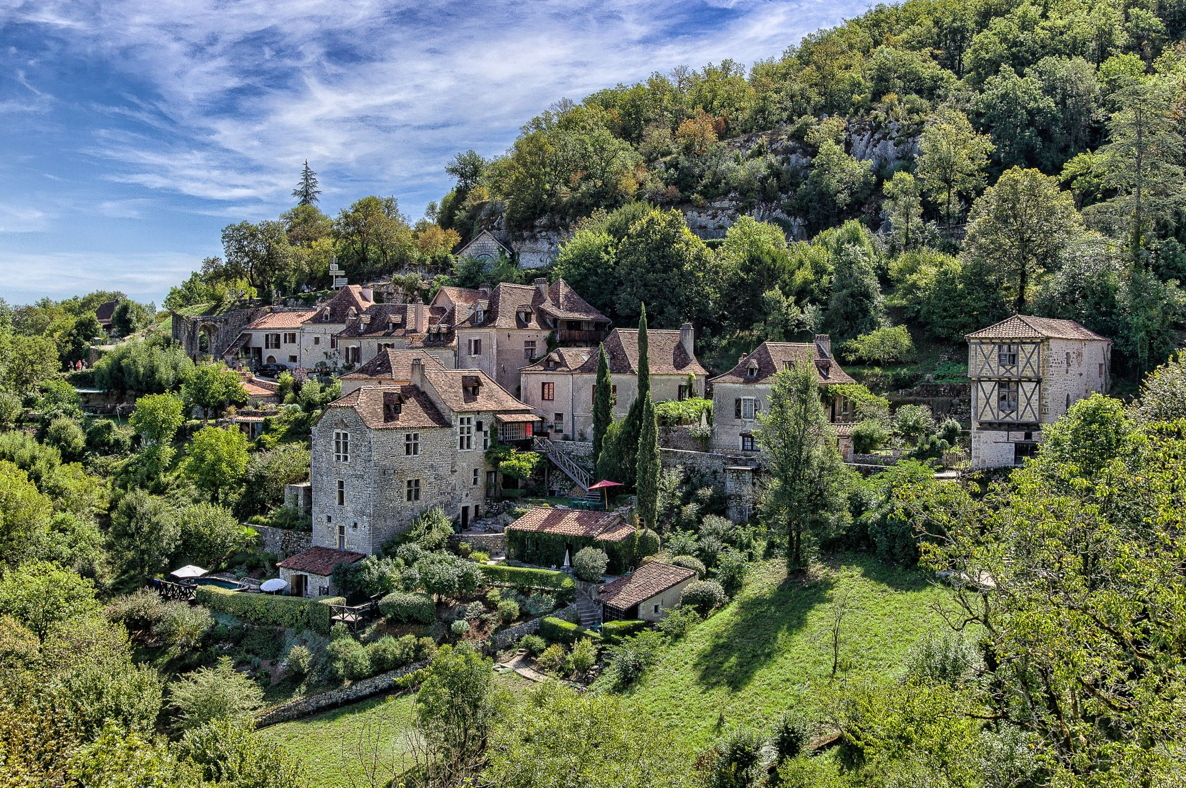
There are many larger villages and small towns in this mountainous region . Rugged terrain and valleys separate these settlements .
Though dispersed , the buildings and homes remain connected over a wide area . This keeps the overall population density low .

Slide 21
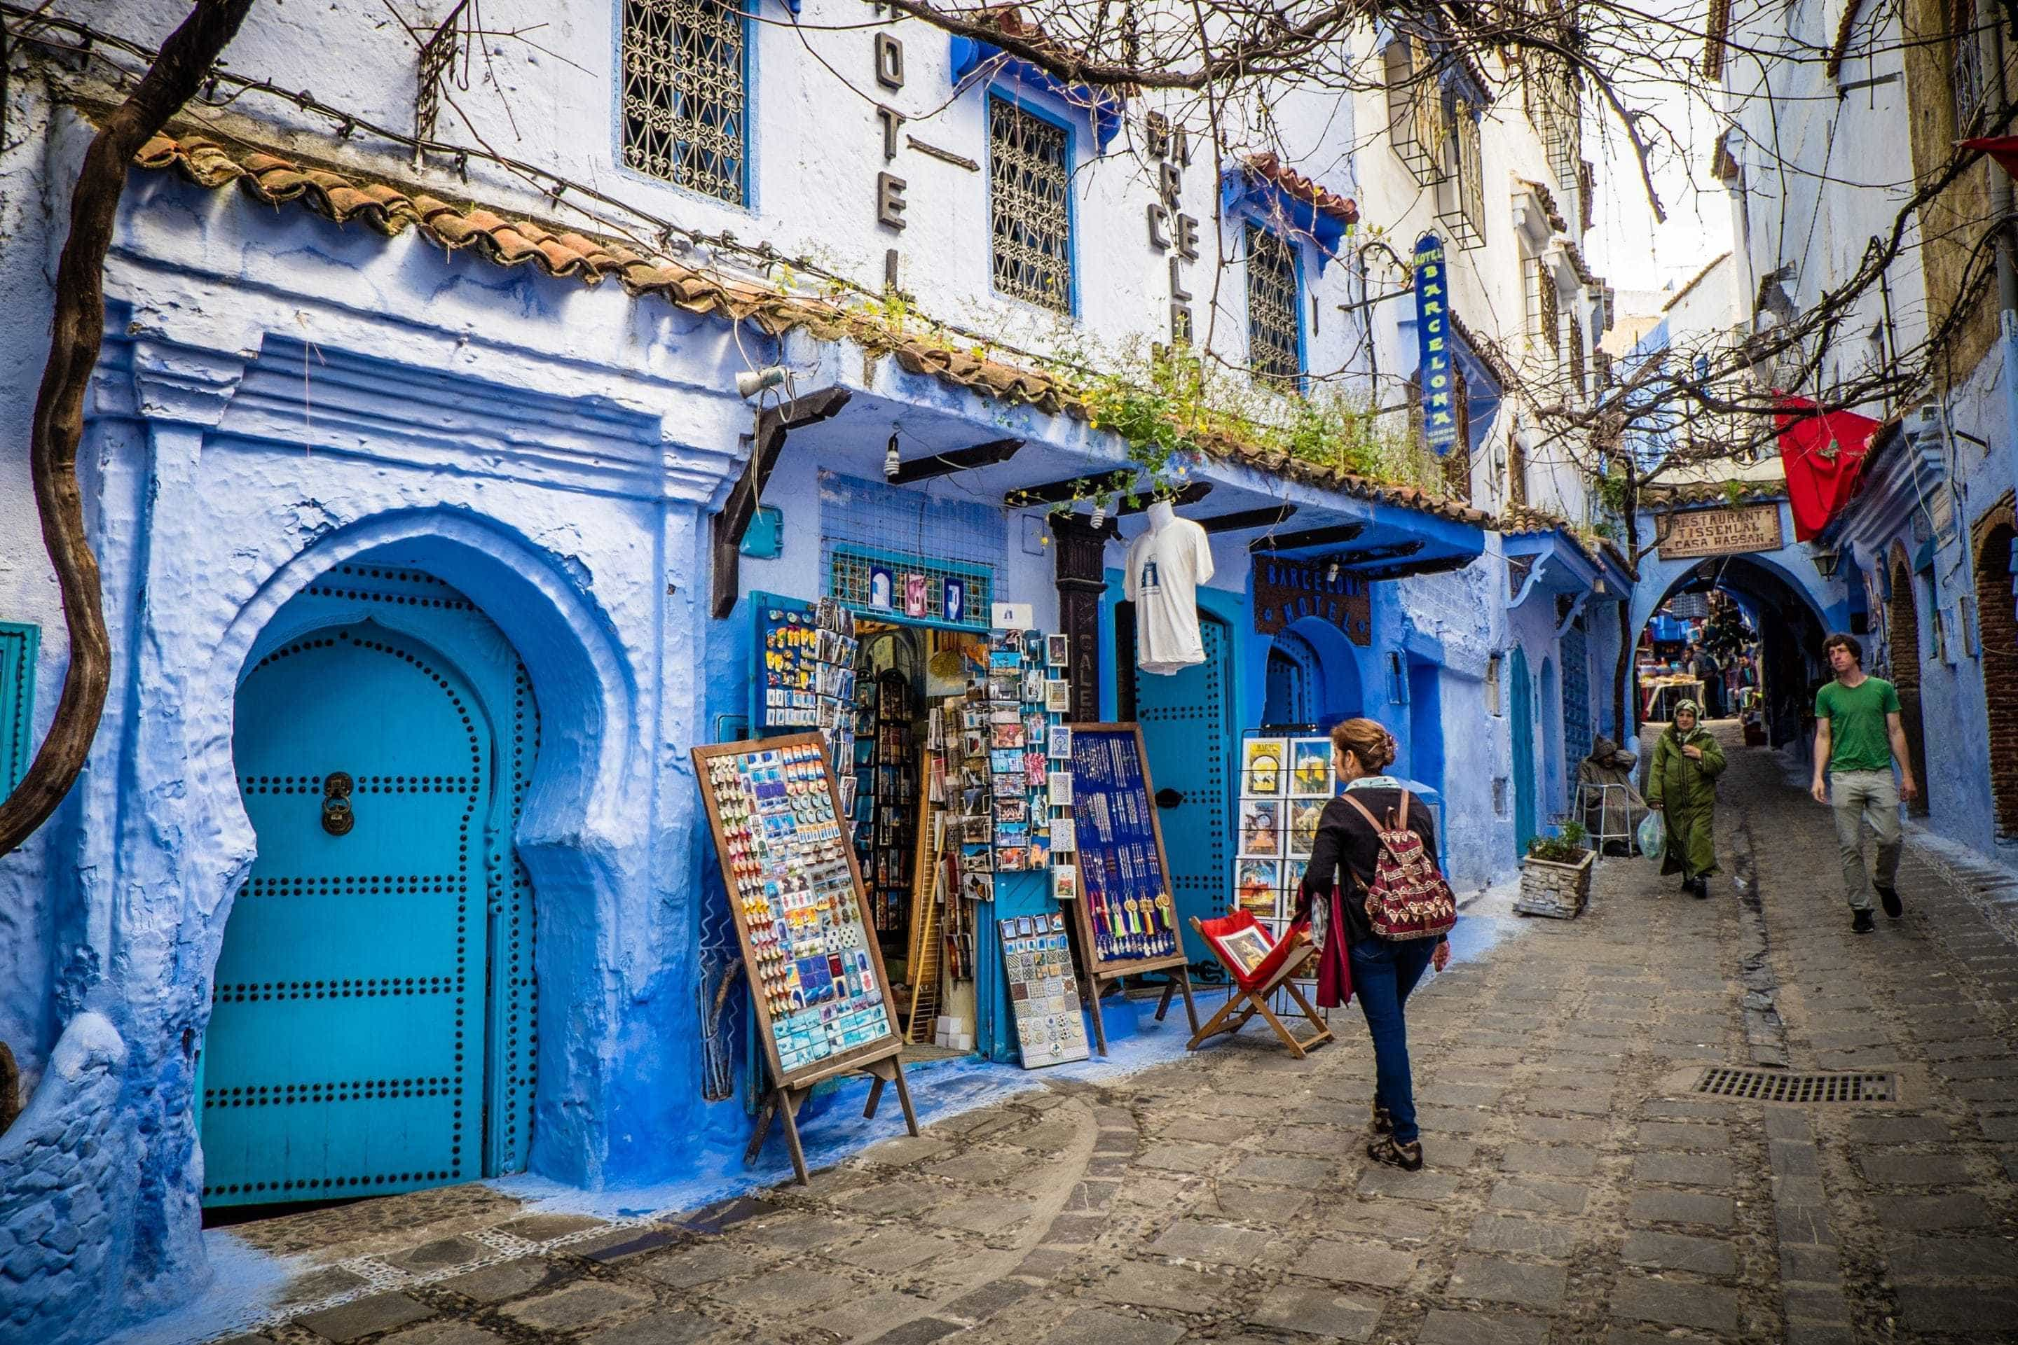
*The city of Chefchaouen in the Kingdoms Rif Mountains is an example of a rural clustered settlement .
It has many buildings squeezed into narrow streets centered around a plaza or square .
It has food markets selling traditional dishes and historic architecture dating back to the 15 century .

Slide 22
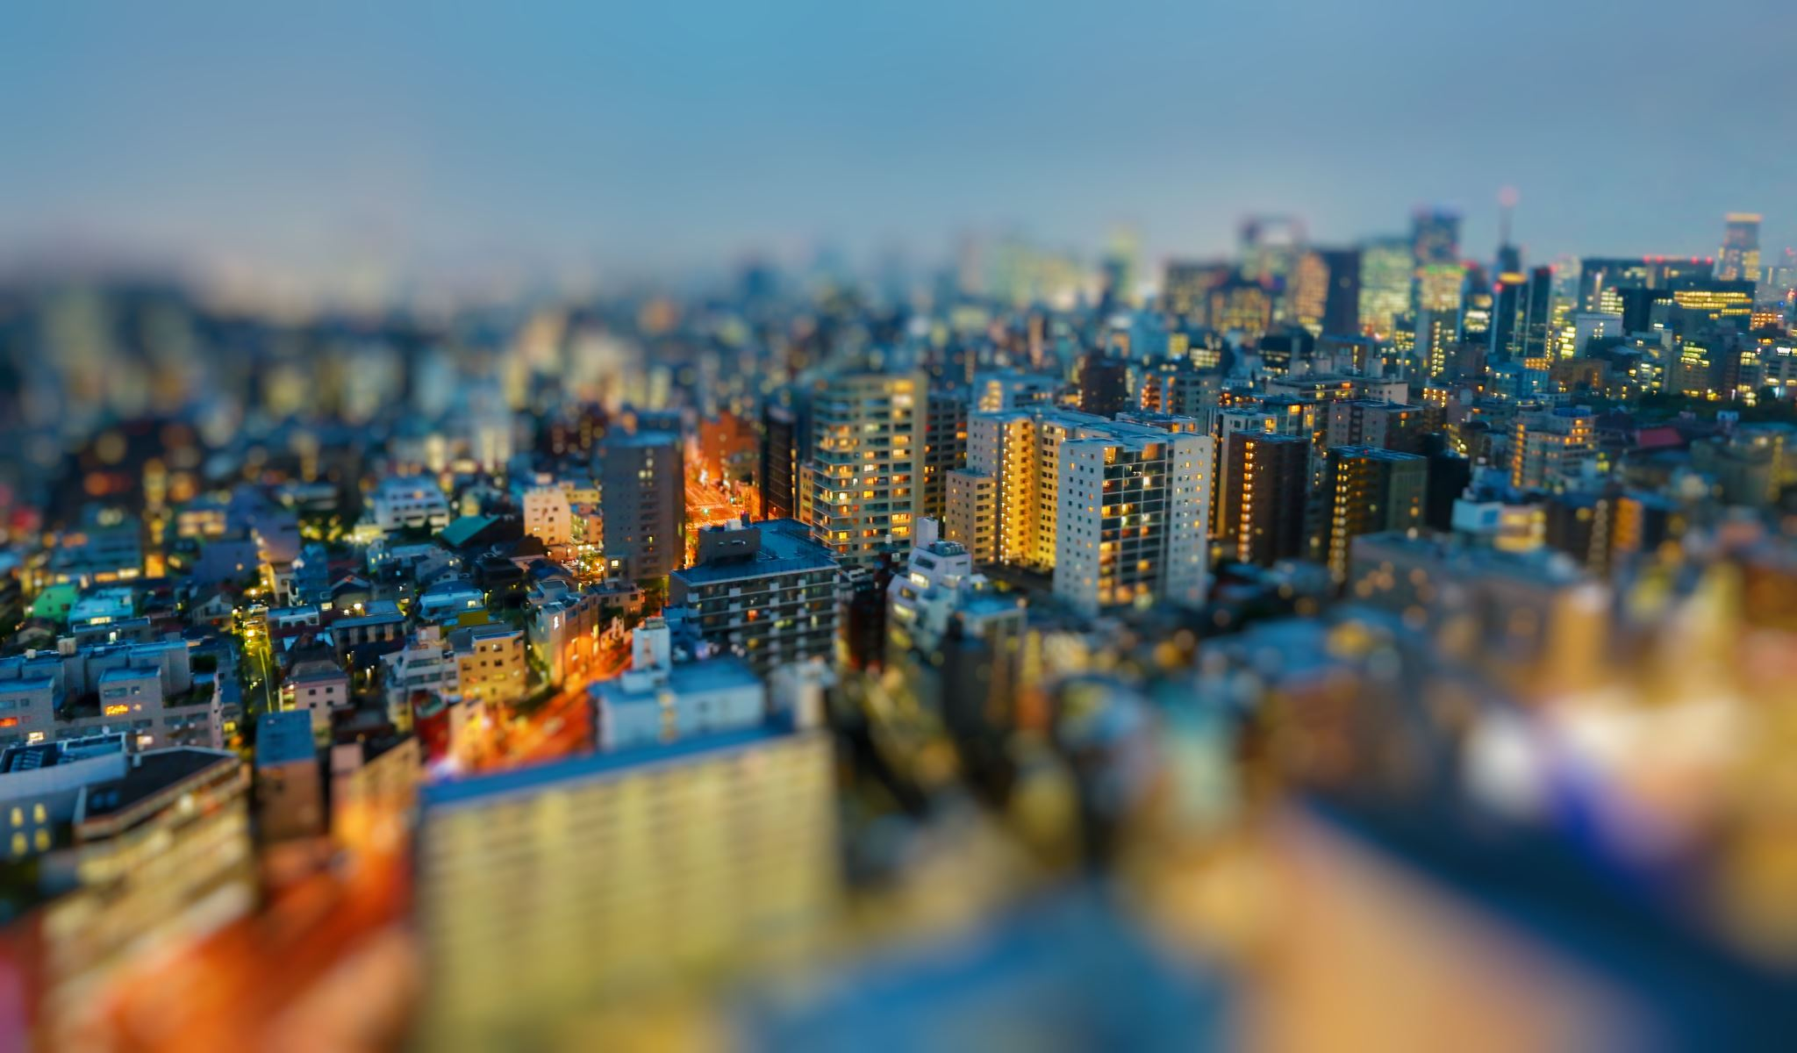
*Tokyo , Japan : Tokyo is the capital city of Japan .It began as a fishing village in the flat plains , near Mount Fuji . Tokyo has a complex settlement pattern .
The city changed over time due to geographic , economic , and historical events .

Slide 23
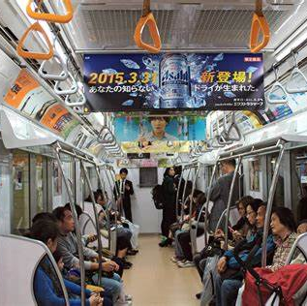
*Public transportation is vital to the people of Tokyo . Japan is famous for its train system and many residential areas grew around its stations .Trains help the large population get to and from work and school .
The Imperial Palace sits at the center of the city of Tokyo . Walls , moats , and gardens surround the palace , which is the home of Japan’s emperor .

Slide 24
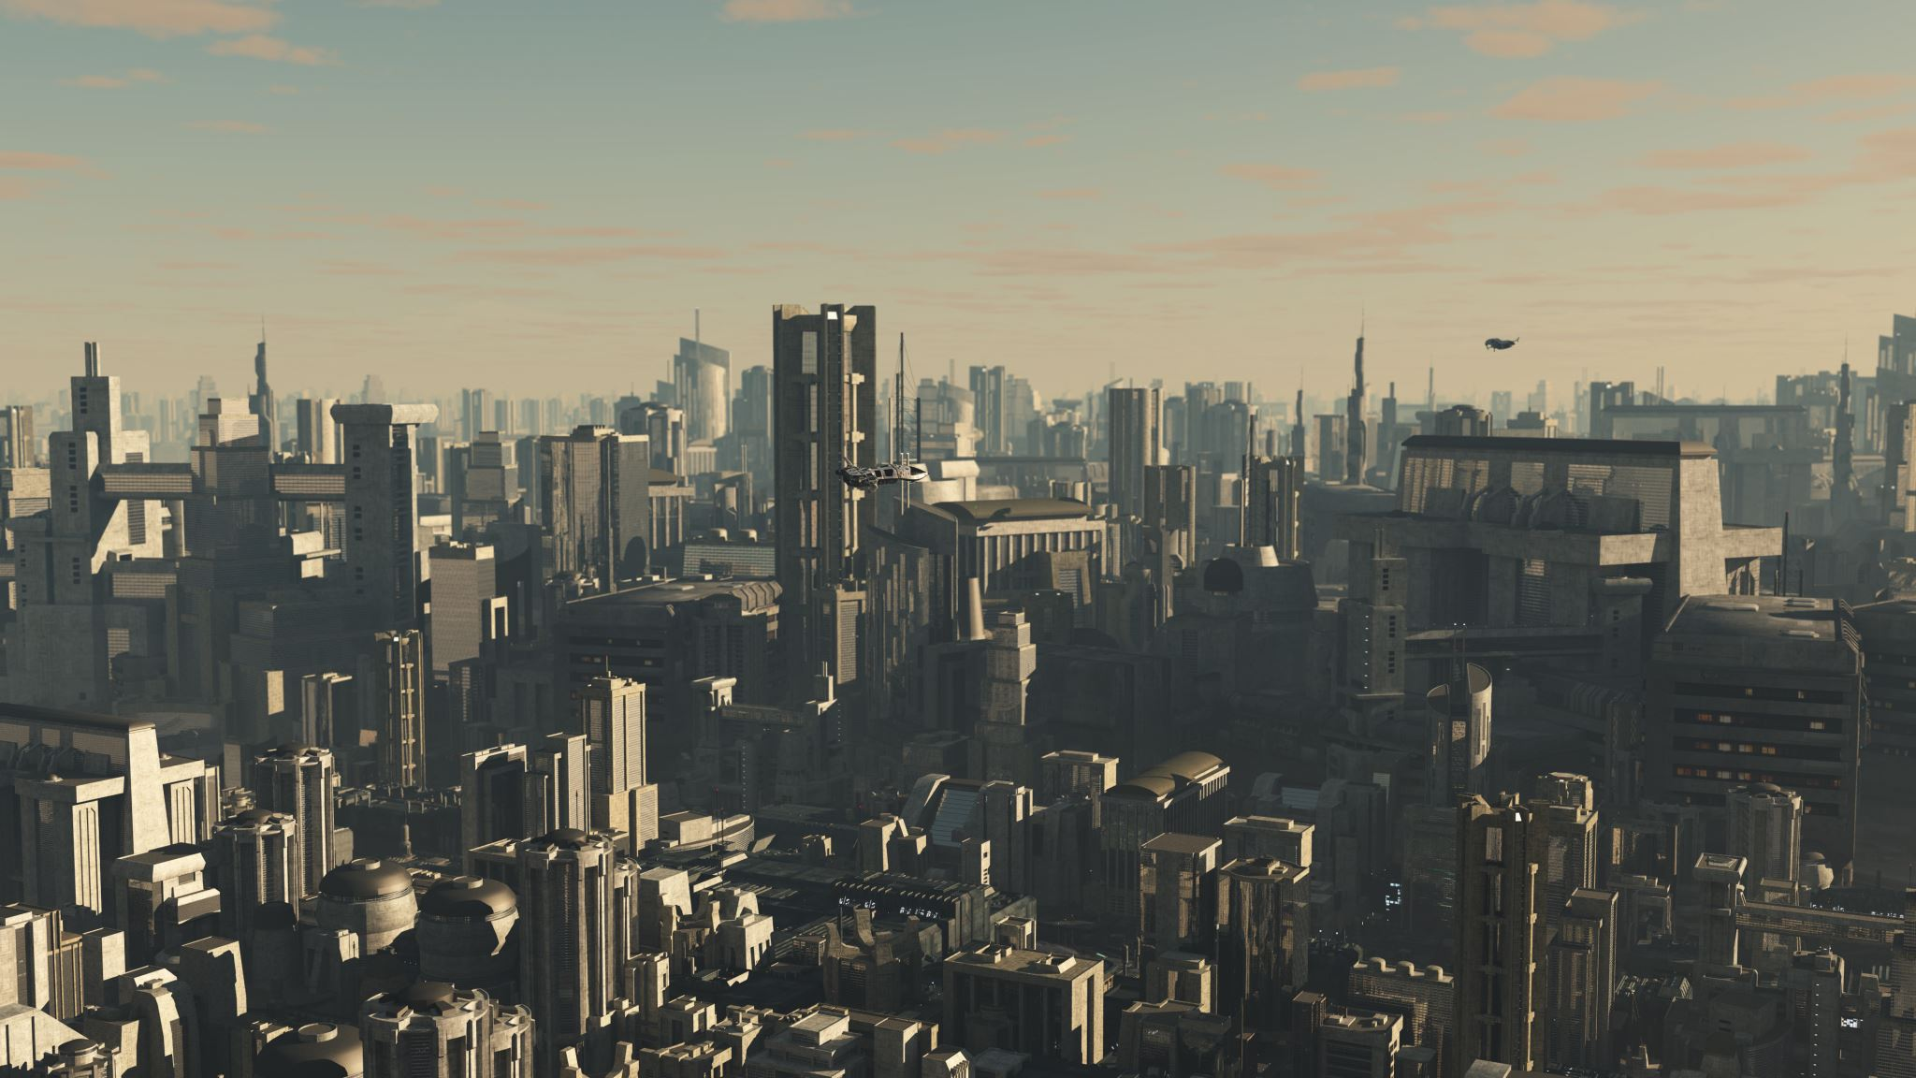
*The parliament and other national government offices are near the palace . In the past , many smaller urban centers surrounded Tokyo . Gradually Tokyo has many residential suburbs and industrial areas . It is a tightly packed city with one of the highest populations in the world .

Slide 25
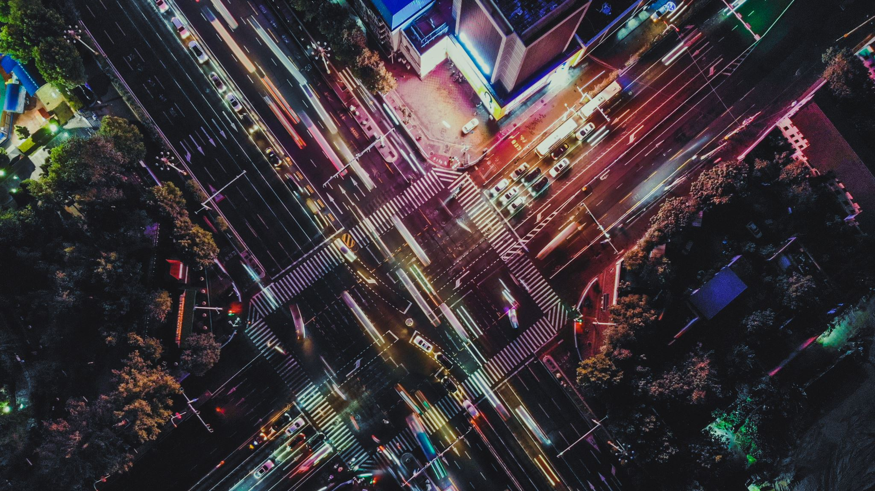
*Like most settlements , Tokyo’s weather impacts its development . The region regularly has (Typhoons ), large tropical storms that bring high winds and heavy rains . Typhoons affect both the city and the country during the warmer seasons of the year .

Slide 26
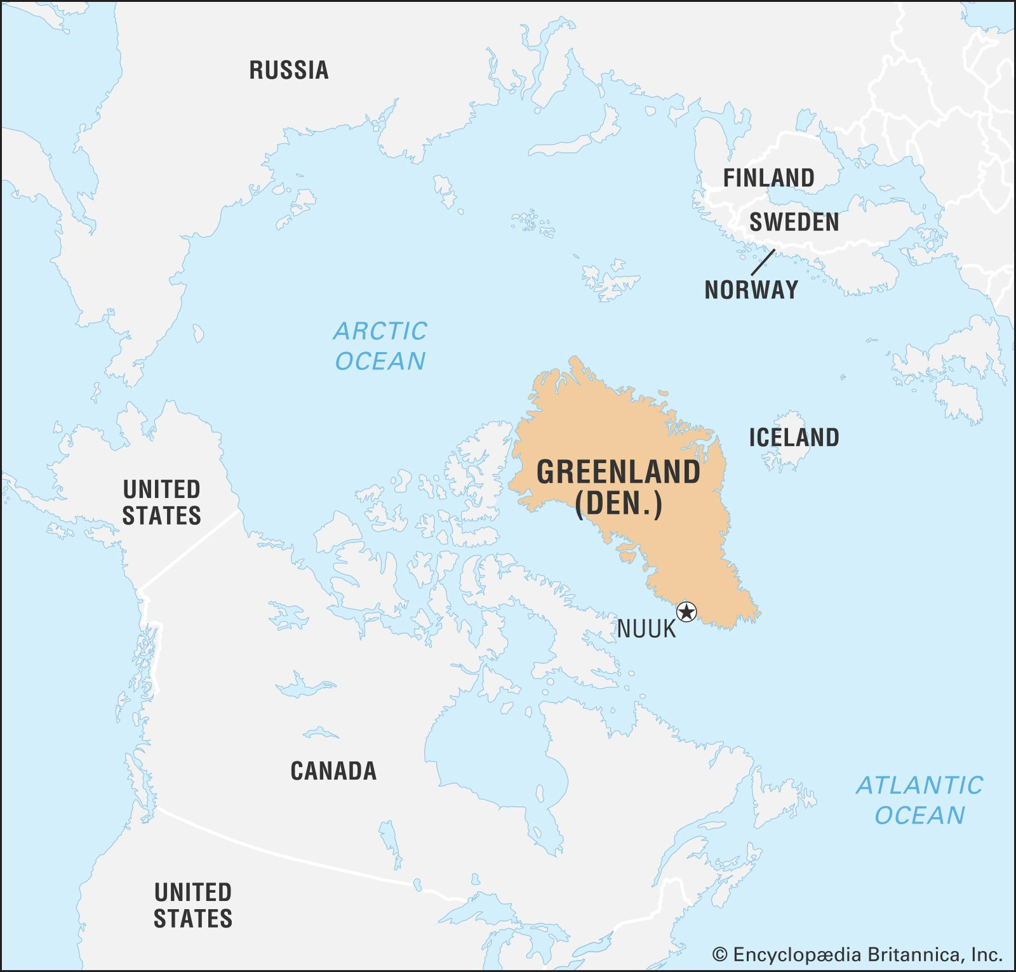
*Ittoqqortoormiit , Greenland :The remote village is pronounced (it-ockor-tormit)is situated on the east coast of Greenland . It is located between a large national park and a long , deep (body of water )that flows inland .
In 1925 , 80 native settlers from the western area of Greenland officially founded (Ittoqqortoormiit ). They traveled to the remote area on a ship . However , scientists have discovered that native people have lived in this area for many years .

Slide 27
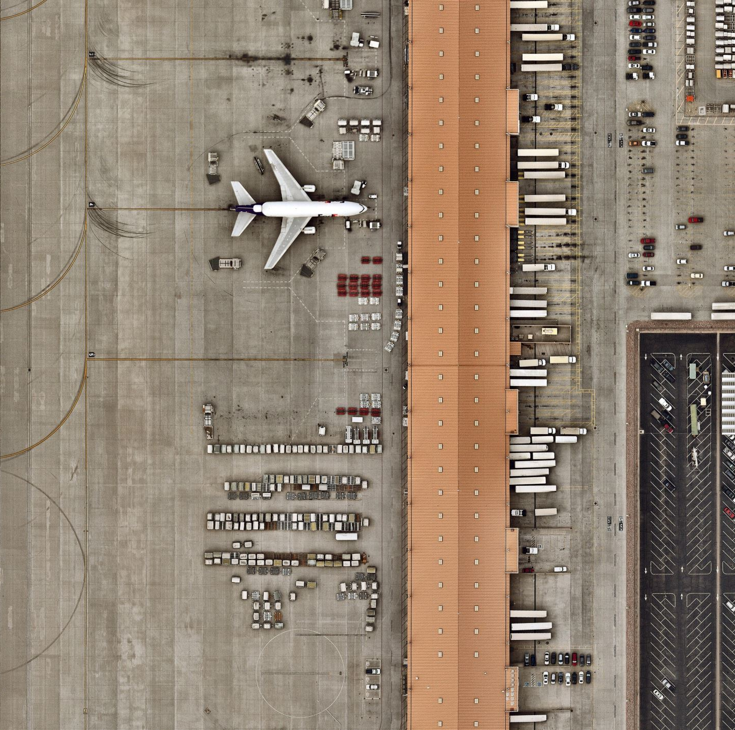
*Today , fewer than 500 people call this settlement home .Residents live in colorful wooden houses built around a small area with a general store and a post office .
There are no paved roads . To reach the rest of the world , residents must travel by water or air .
Water routes only open when they thaw , which does not happen often .
People have to take a helicopter flight to reach the nearest , airport , which is 25 miles away .

Slide 28
*Conclusion : Several factors influence people’s decision about where to settle. Whether prople live close together in a small village or spread out along a major road , geography , history , and economics all affect settlement patterns .
Clustered , dispersed , and isolated settlements exist all over the world , sometimes even with multiple settlement patterns combined into one.
Learning about these patterns helps people better understand the variety of the world’s cultures ,jobs, and lifestyles . This provides an insight into why communities look and work the way they do .

Slide 29
The End

