Slide 1
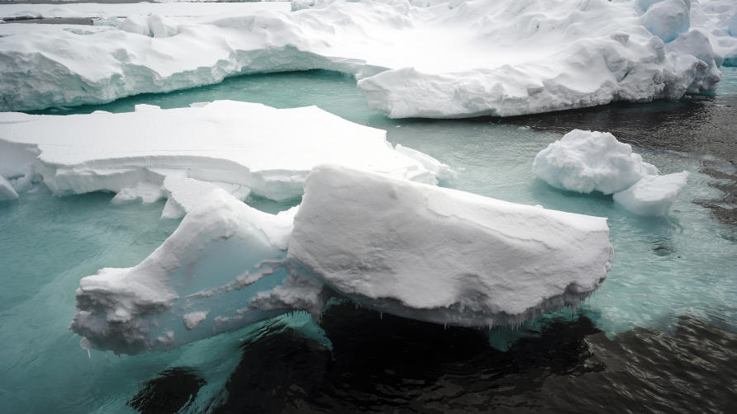
Climate Challenges
This Photo by Unknown Author is licensed under CC BY-ND

Slide 2
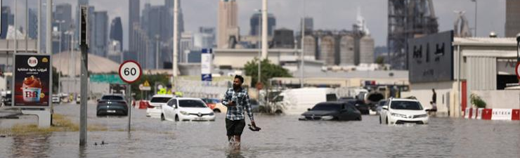
*Climate change might make you think of melting glaciers or flooding in Dubai in 2024 .
These events are evidence that climate change does not just mean a few hotter days or more rainy weekends .
This Photo by Unknown Author is licensed under CC BY-SA-NC

Slide 3
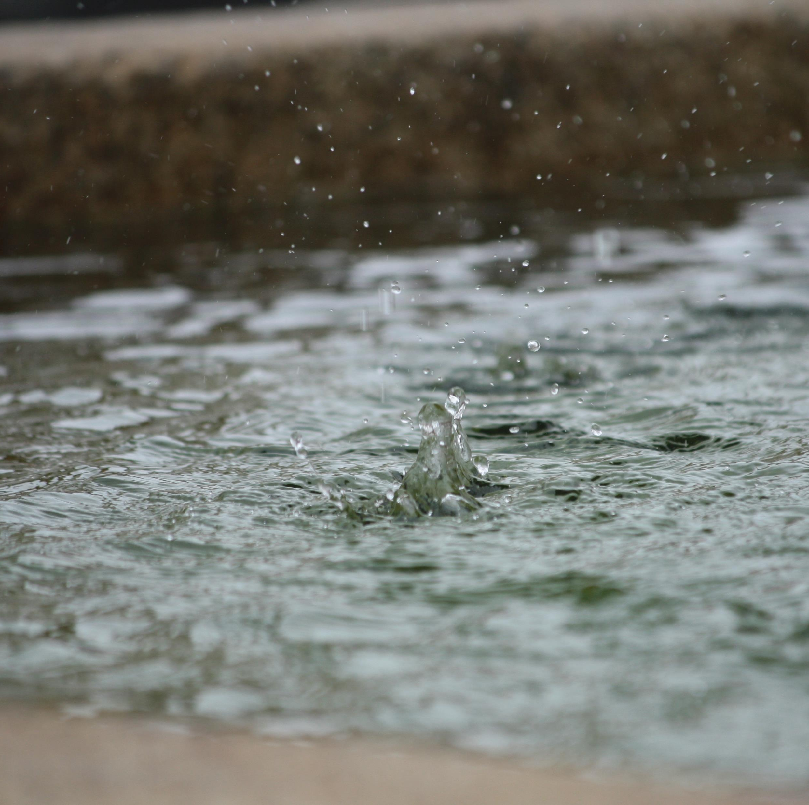
*Climate Change looks at Earth’s long term weather patterns .
How have average temperatures , rainfall amounts , and the frequency of extreme weather events shifted over decades or centuries ?

Slide 4
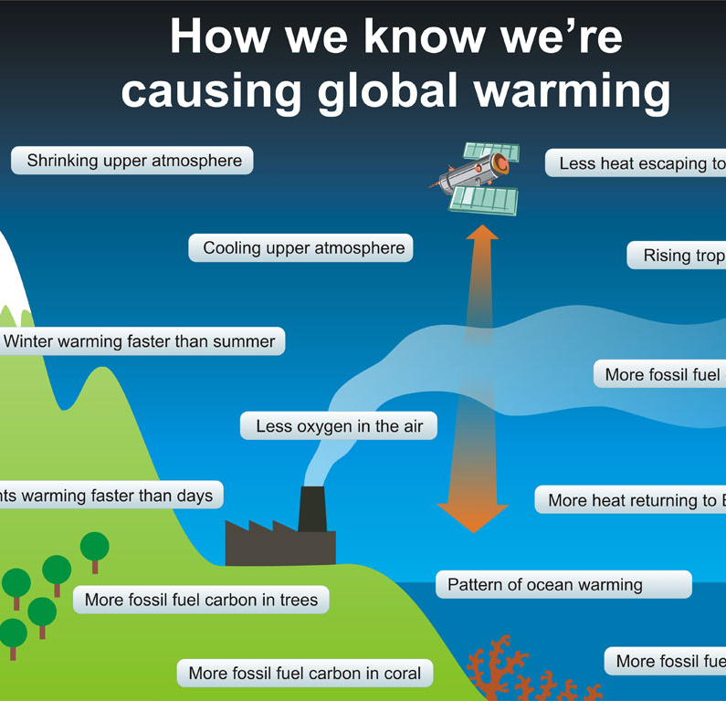
Scientists around the globe carefully study these changes . They are increasingly confident that human activities play a major role in climate change .
This Photo by Unknown Author is licensed under CC BY

Slide 5
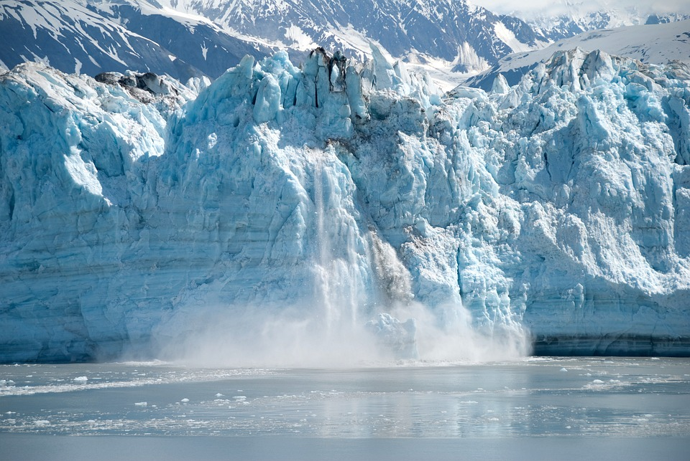
*This lesson explores how human actions impact the climate , land , water , and air . It also looks at long-term weather patterns . Understanding climate change may bring the world one step closer to a solution .
*Climate change has led to rapidly melting glaciers at the Earth’s poles .

Slide 6
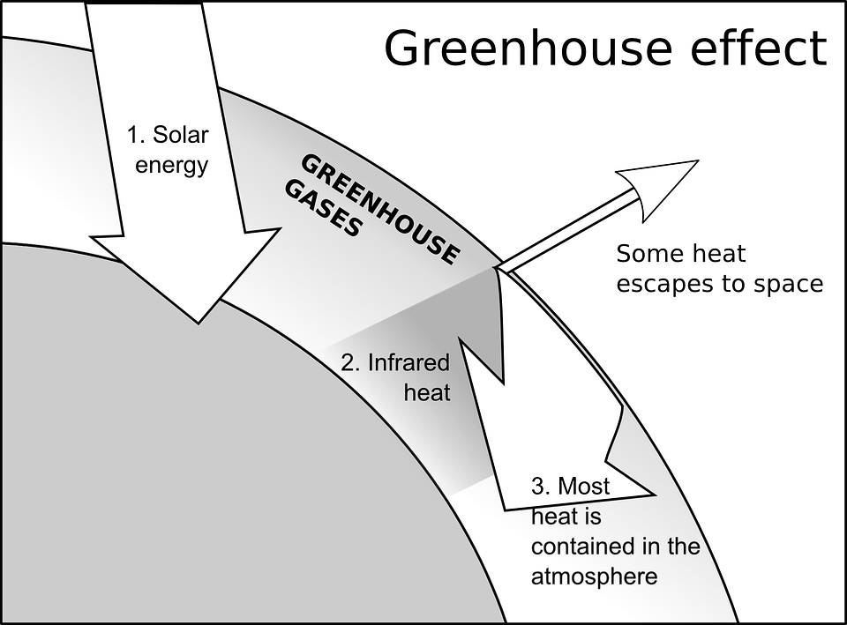
*Human and the Greenhouse Effect : Earth has a natural greenhouse effect . This happens when certain gases act like a blanket , trapping some Sun’s heat in the air surrounding Earth , its atmosphere . Greenhouse gases involved in this process . However , over the past century , human activities have greatly increasd the levels of greenhouse gases in the atmosphere . The main cause is the burning of fossil fuels by humans to power their homes , industries ,and vehicles .
This Photo by Unknown Author is licensed under CC BY-NC-ND

Slide 7
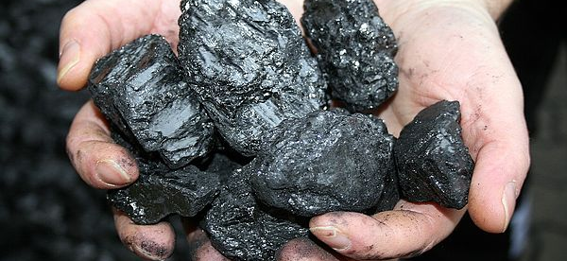

*Fossil fuels , such as coal and oil , are nonrenewable energy sources
*They are created from the remains of ancient plants and animals . Nonrenewable means that people will eventually use up these fuels .
This Photo by Unknown Author is licensed under CC BY-NC
This Photo by Unknown Author is licensed under CC BY-SA

Slide 8
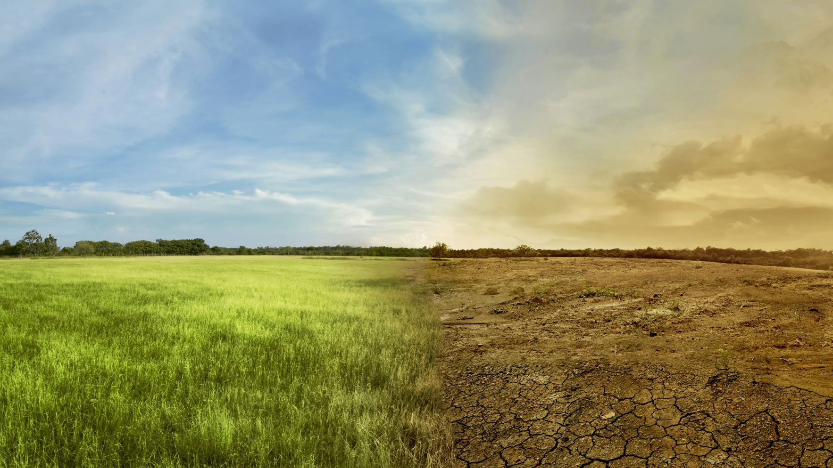
When soil covered ancient plants and animals , heat and pressure changed them into fuel . This process took years . When humans burn these fuels , they emit , or release , enormous amounts of carbon dioxide , a gas , into the air . This released gas thickens Earth’s atmosphere , causing more heat to be trapped than normal .

Slide 9
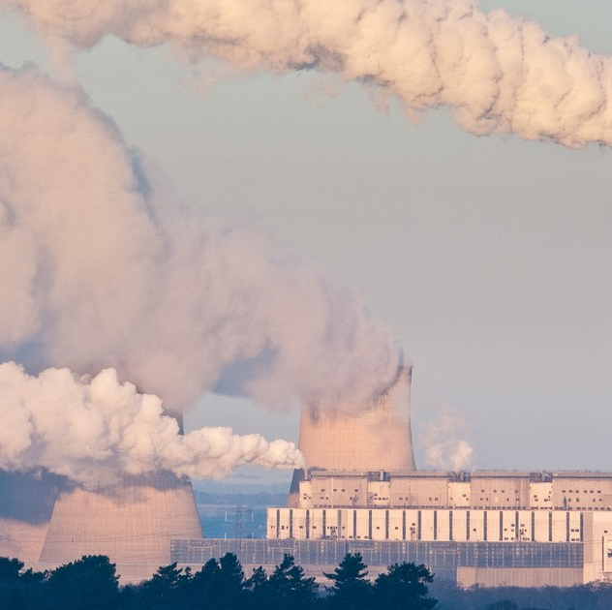
*As with all other places where people live , the Middle East and North Africa (MENA)region contributes to a warmer world .
Several countries in the region have industries serving the sale of oil and gas .
These industries are important for drilling , refining , and transporting fossil fuels . These processes also release huge amounts of greenhouse gases .
This Photo by Unknown Author is licensed under CC BY

Slide 10
*The population of MENA countries is growing . This means an increased demand for electricity . Fossil fuels are used to run power plants . This leads to further emissions of greenhouse gases .
Critical thinking :
Which is a greenhouse gas ? Circle all that apply .
A- Carbon monoxide B-gasoline
C- methane D- oxygen .

Slide 11
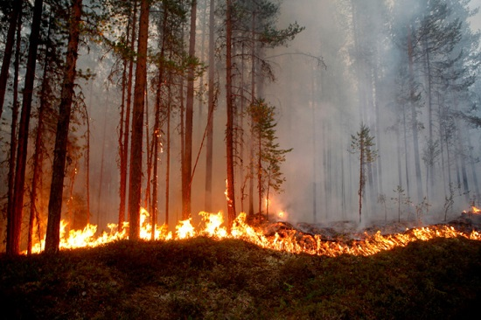
*Climate Change-more than just warming .
When people think about climate change , they often focus on rising temperatures .
However, the impact extends far beyond hotter weather . One major effect is the disruption of natural systems .
This Photo by Unknown Author is licensed under CC BY

Slide 12
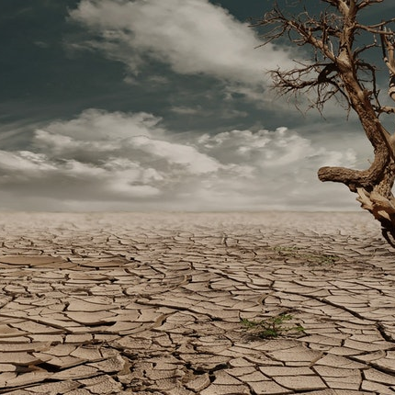
*What have changes in precipitation patterns led to ?
1-It has led to severe droughts in many places .
2-Droughts reduce water supplies .
3-It also affects agriculture .
4-and lead to wildfires .
This Photo by Unknown Author is licensed under CC BY-SA-NC

Slide 13
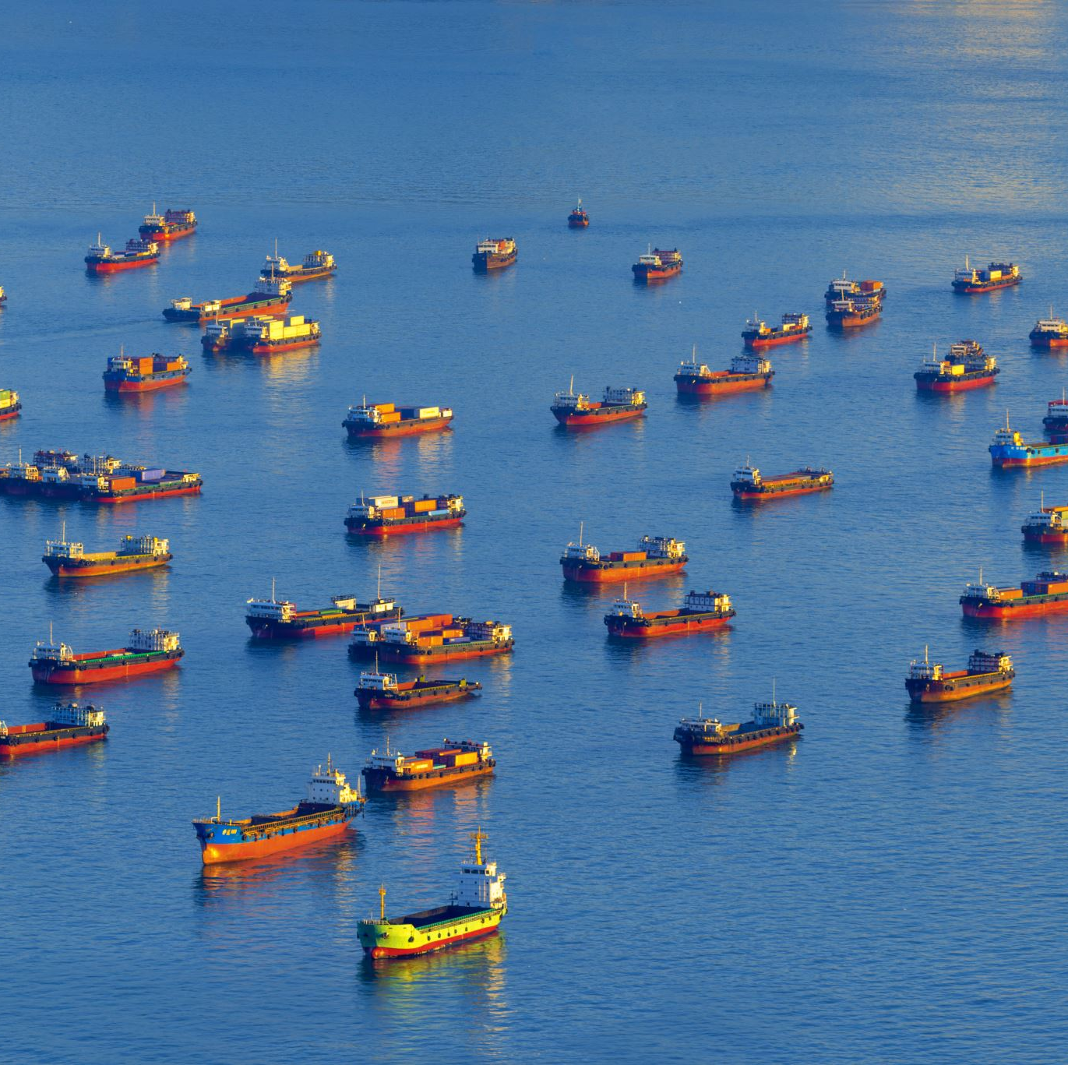
*A hotter Earth is melting glaciers and ice sheets .This adds to rising sea levels .Coastal areas are beginning to flood regularly .
*Cities such as Alexandria in the Arab Republic of Egypt are especially at risk .
*Similarly , low-lying island nations in the Pacific Ocean face a significant threat from rising sea levels .

Slide 14
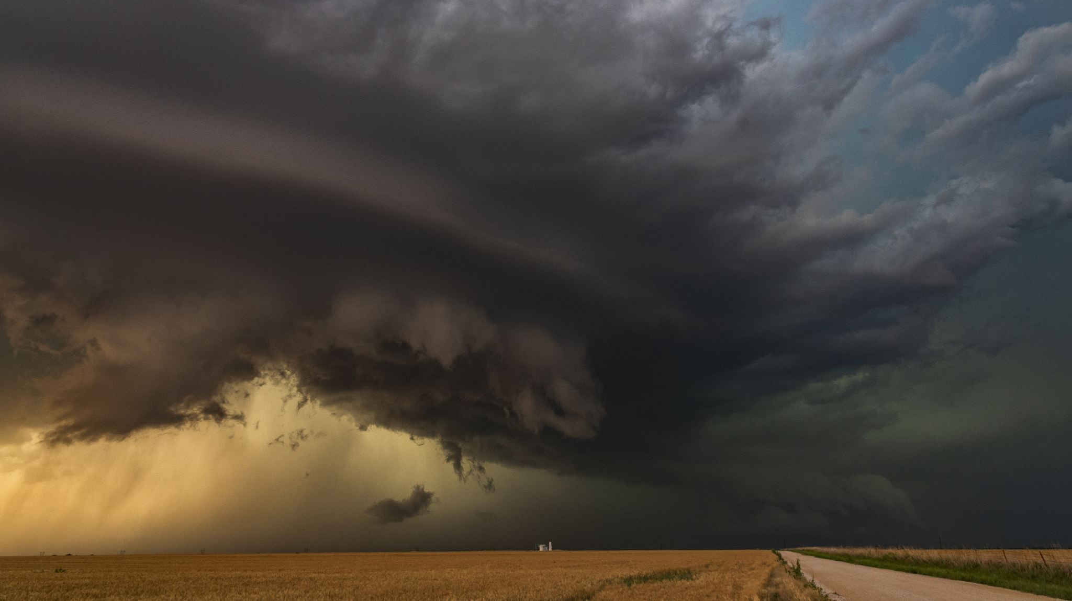
*Precipitation includes rainfalls and snowfalls. Changes in precipitation patterns have led to severe droughts in countries such as the Syrian Arab Republic and the Hashemite Kingdom of Jordan .

Slide 15
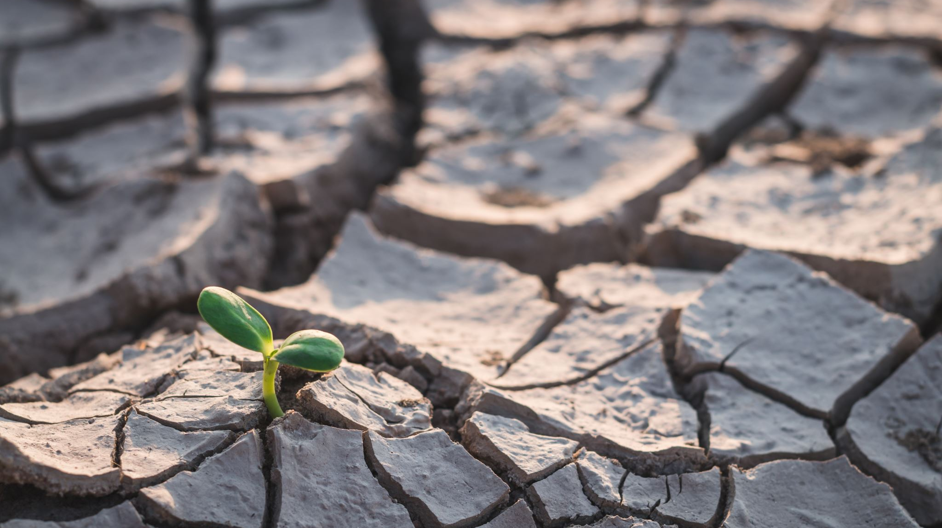
What does droughts mean ?
They are long periods without precipitation .

Slide 16
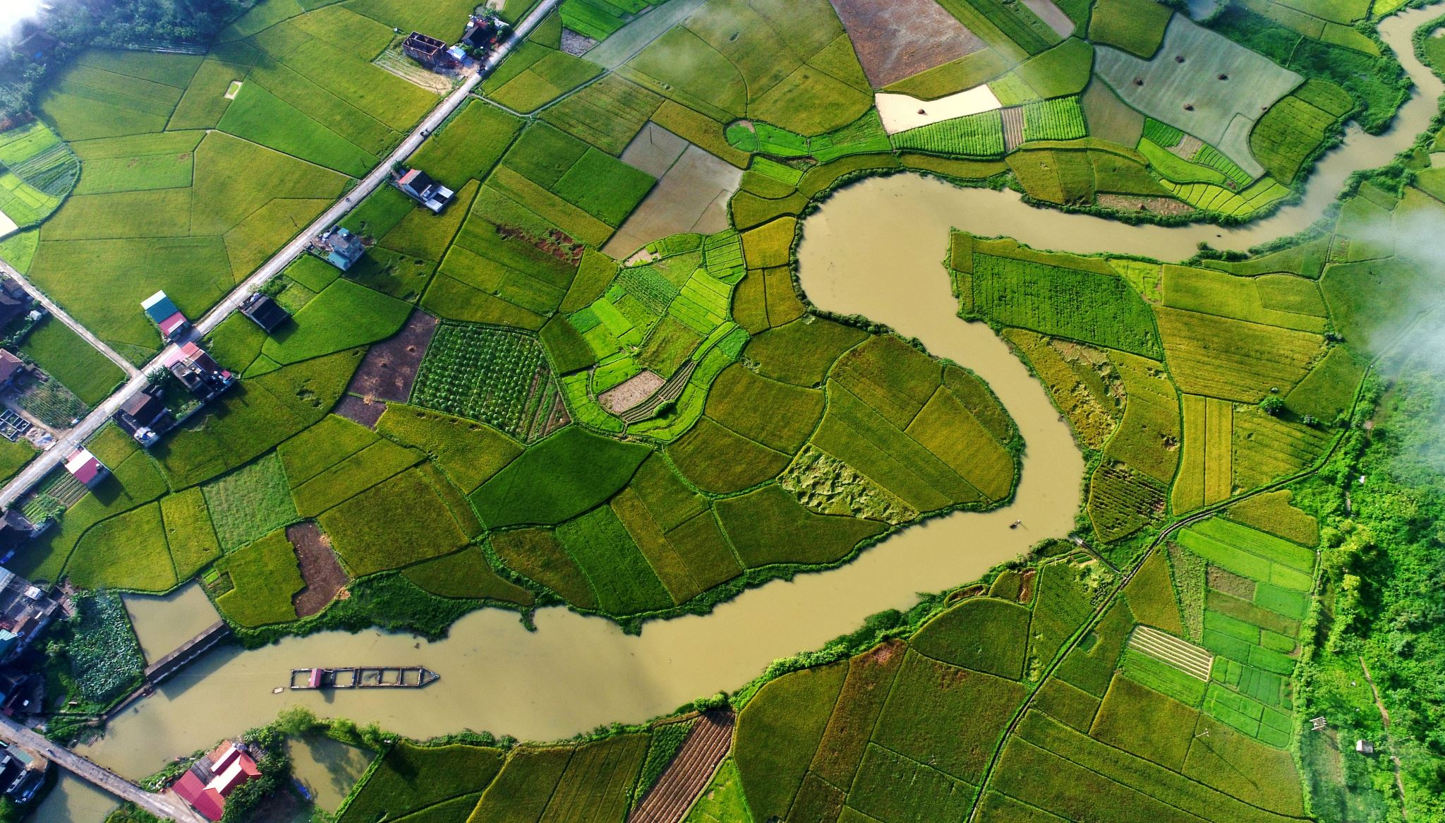
What are the impacts droughts have on the world ?
1-They impact agriculture and threaten standing water supplies , such as lakes and wells .

Slide 17
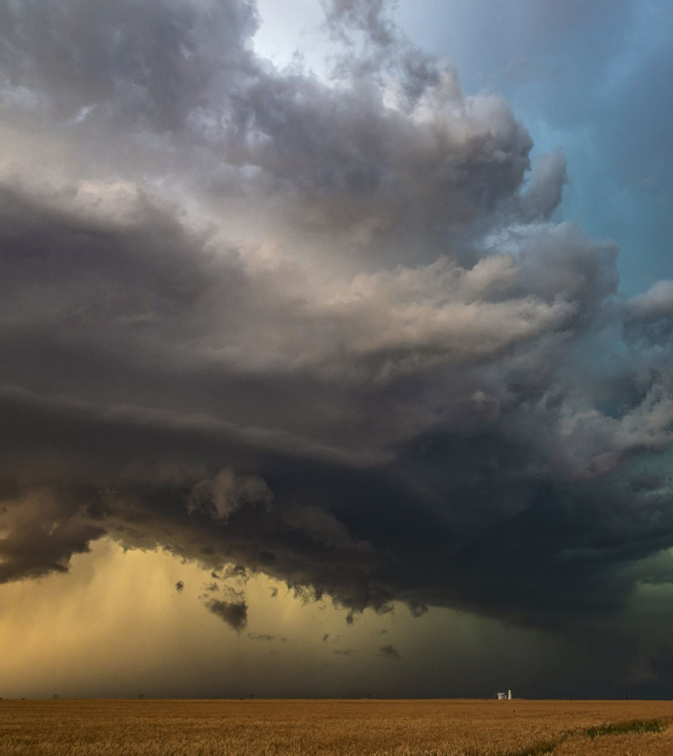
*Other regions experience unpredictable and intense floods . The amounts of rainfall has become harder to predict .This poses problems for farmers globally .
*Extreme weather events , including heatwaves and powerful storms , are becoming more destructive . They have caused severe damage to nations in the Arab world . Droughts have led to massive wildfires in Australia and California , showing that the effects of climate change are global concern .

Slide 18
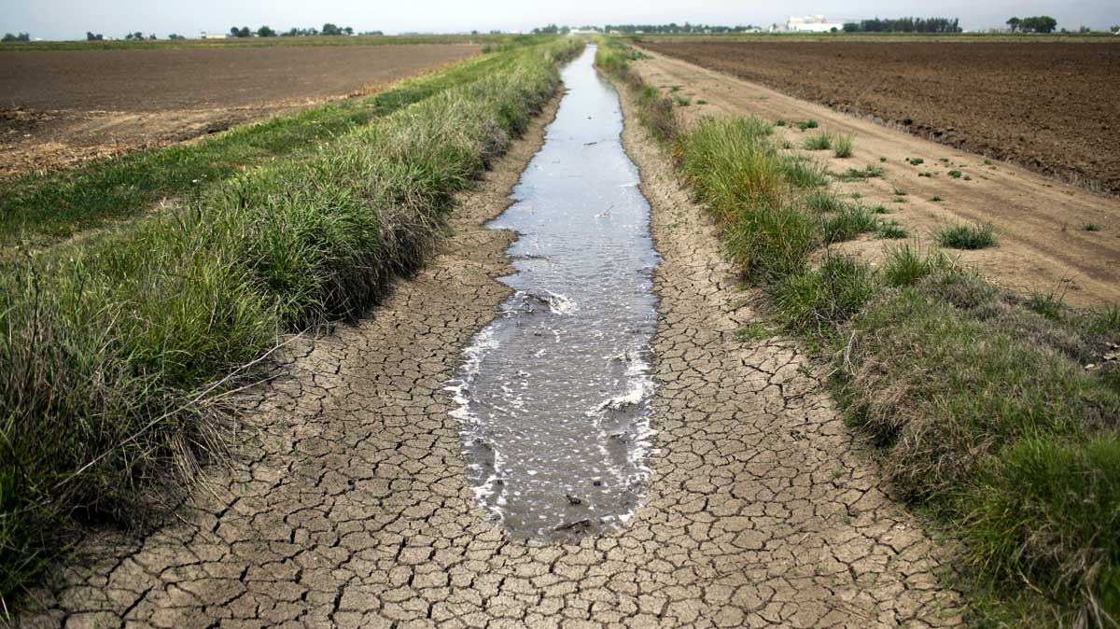
Impacts on Water and Agriculture :
Water scarcity refers to a limited availability of fresh water . This is a growing concern globally .It is a particular worry in many countries across the MENA region .
Lower rainfall in some areas due to climate change makes the problem even worse .
Rivers and lakes needed for agriculture and drinking water are shrinking in hot climates .
This Photo by Unknown Author is licensed under CC BY-NC-ND

Slide 19
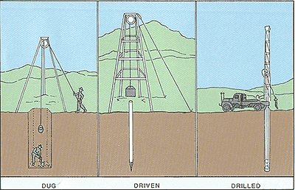
*To cope with water shortages , some (MENA)farmers are drilling deeper wells to access ground water .
(MENA)farmers are drilling deeper wells to access groundwater . However , this is just a temporary fix .

Slide 20
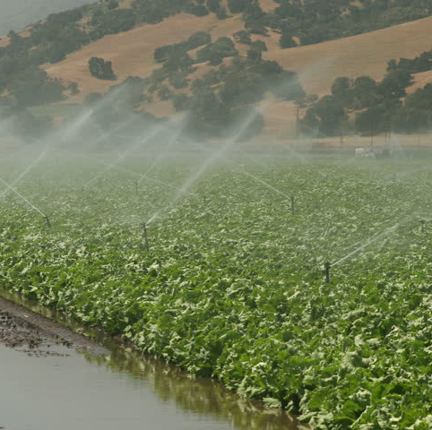
*Soil Salinity : or the increase of salt content in soil , poses a threat to farming .
When water evaporates in hot climates , it can leave behind salt deposits .
These salt deposits make the land less fertile , and hinder plant growth .
This is a challenge in areas that are prone to droughts and those relying on irrigation from increasingly salty water sources .

