Slide 1
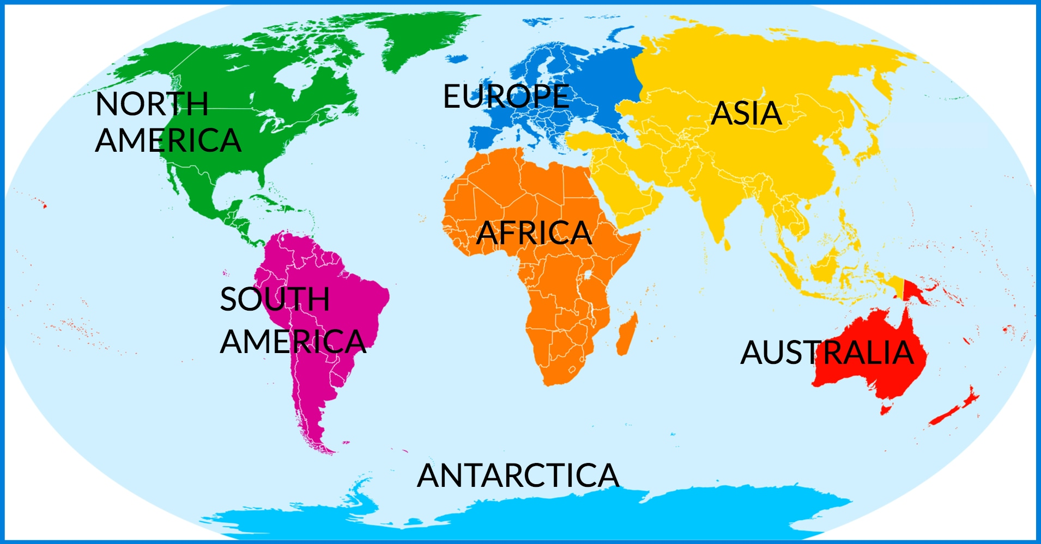
Geography Basics

Slide 2
Geography is the study of the human and nonhuman features of Earth, our home planet. Geographers try to answer two basic questions: Where are things located? Why are they there? To answer these questions, geographers study oceans, plant life, landforms, countries, and cities. Geographers also study how Earth and its people affect each other.

Slide 3
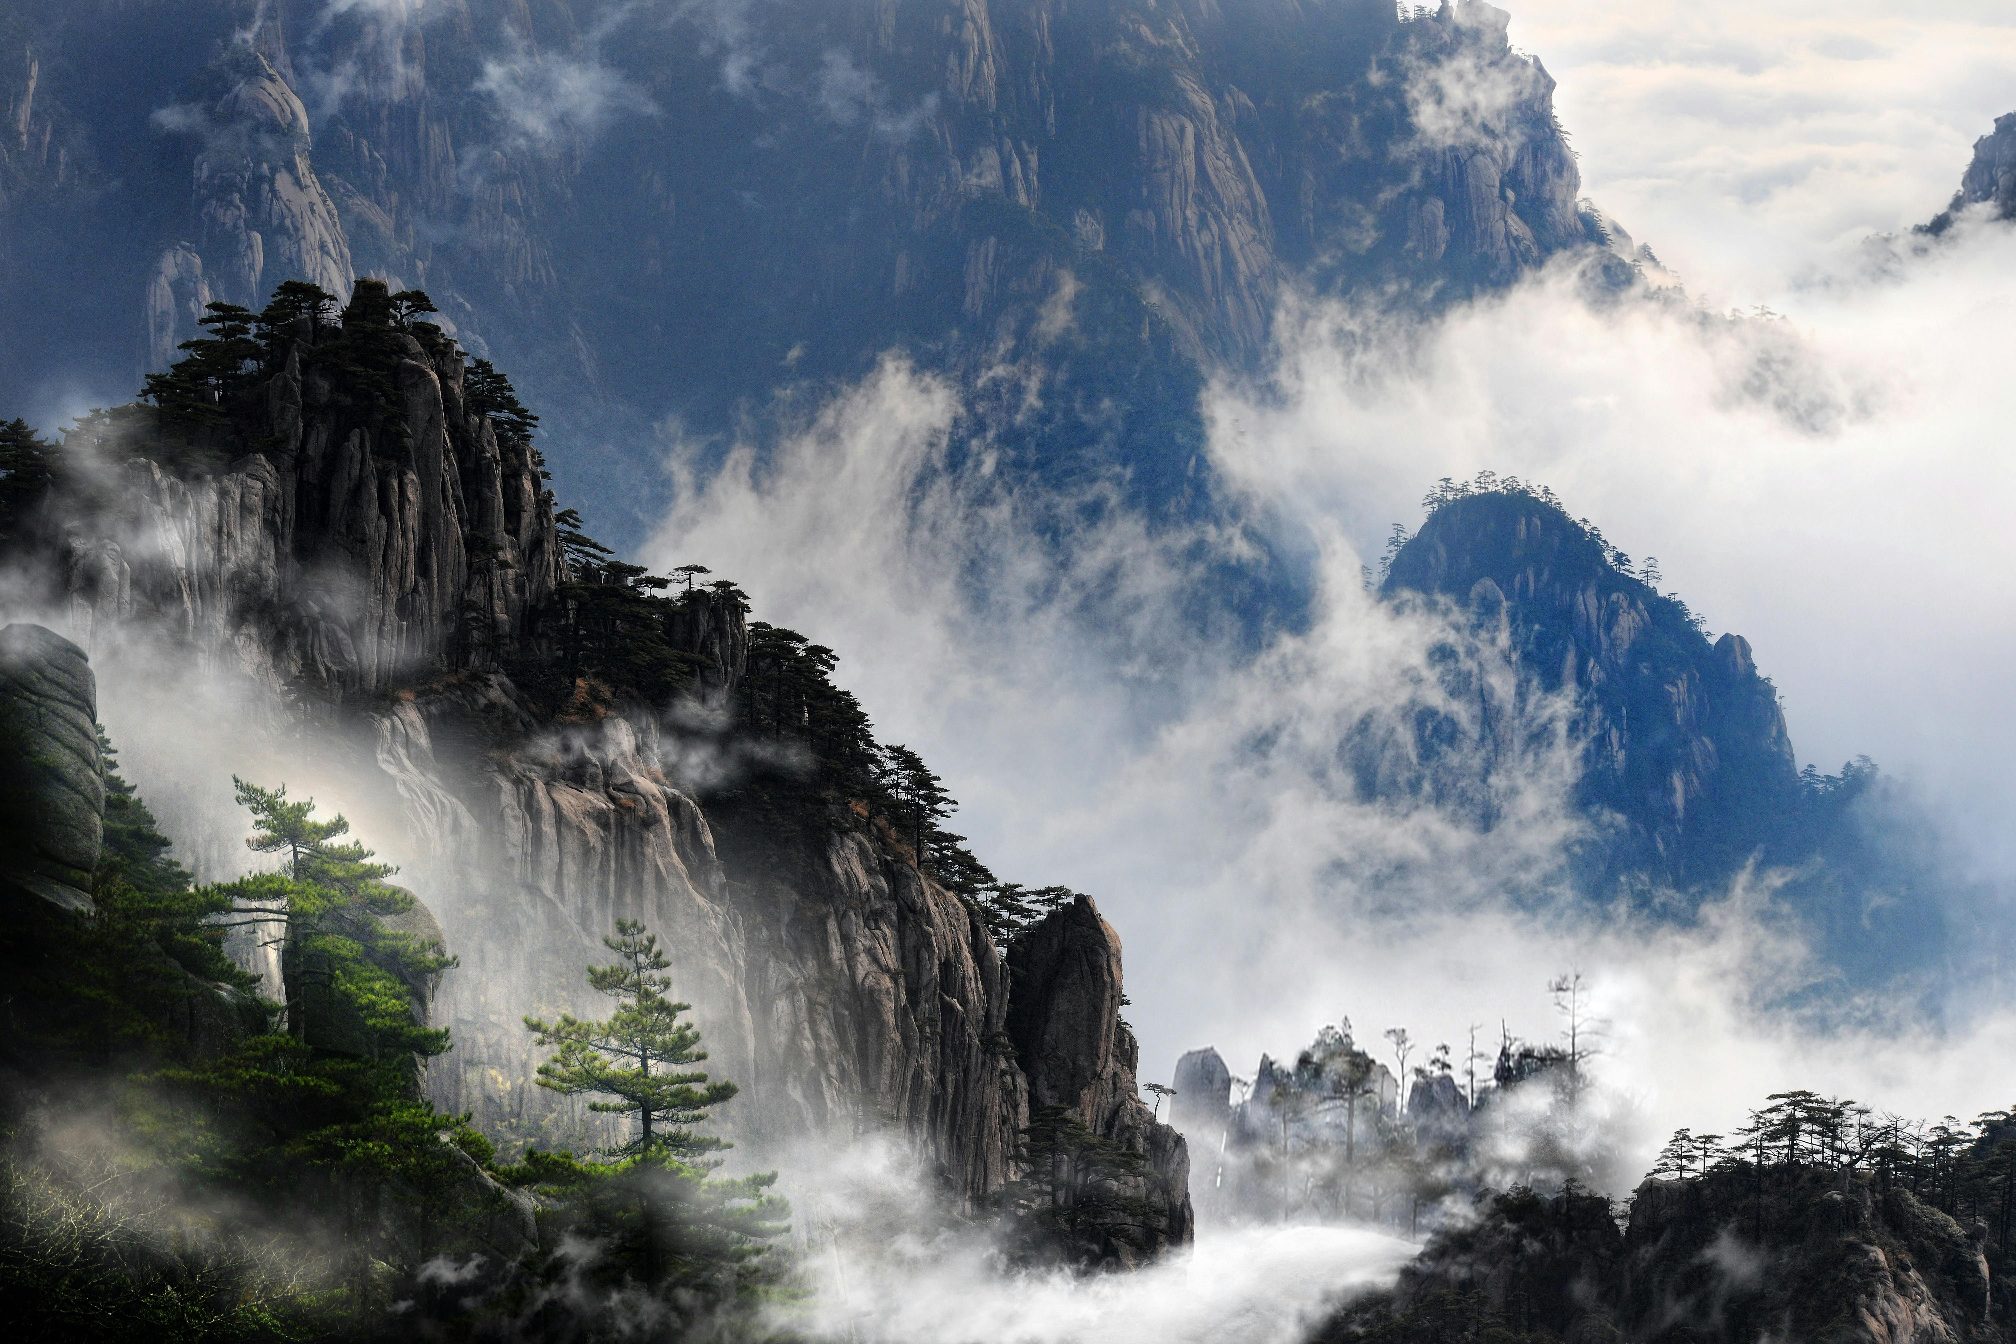
*What does it suggest about the ways geographic features can shape life on earth ?or how does physical features affect a human’s life ?

Slide 4
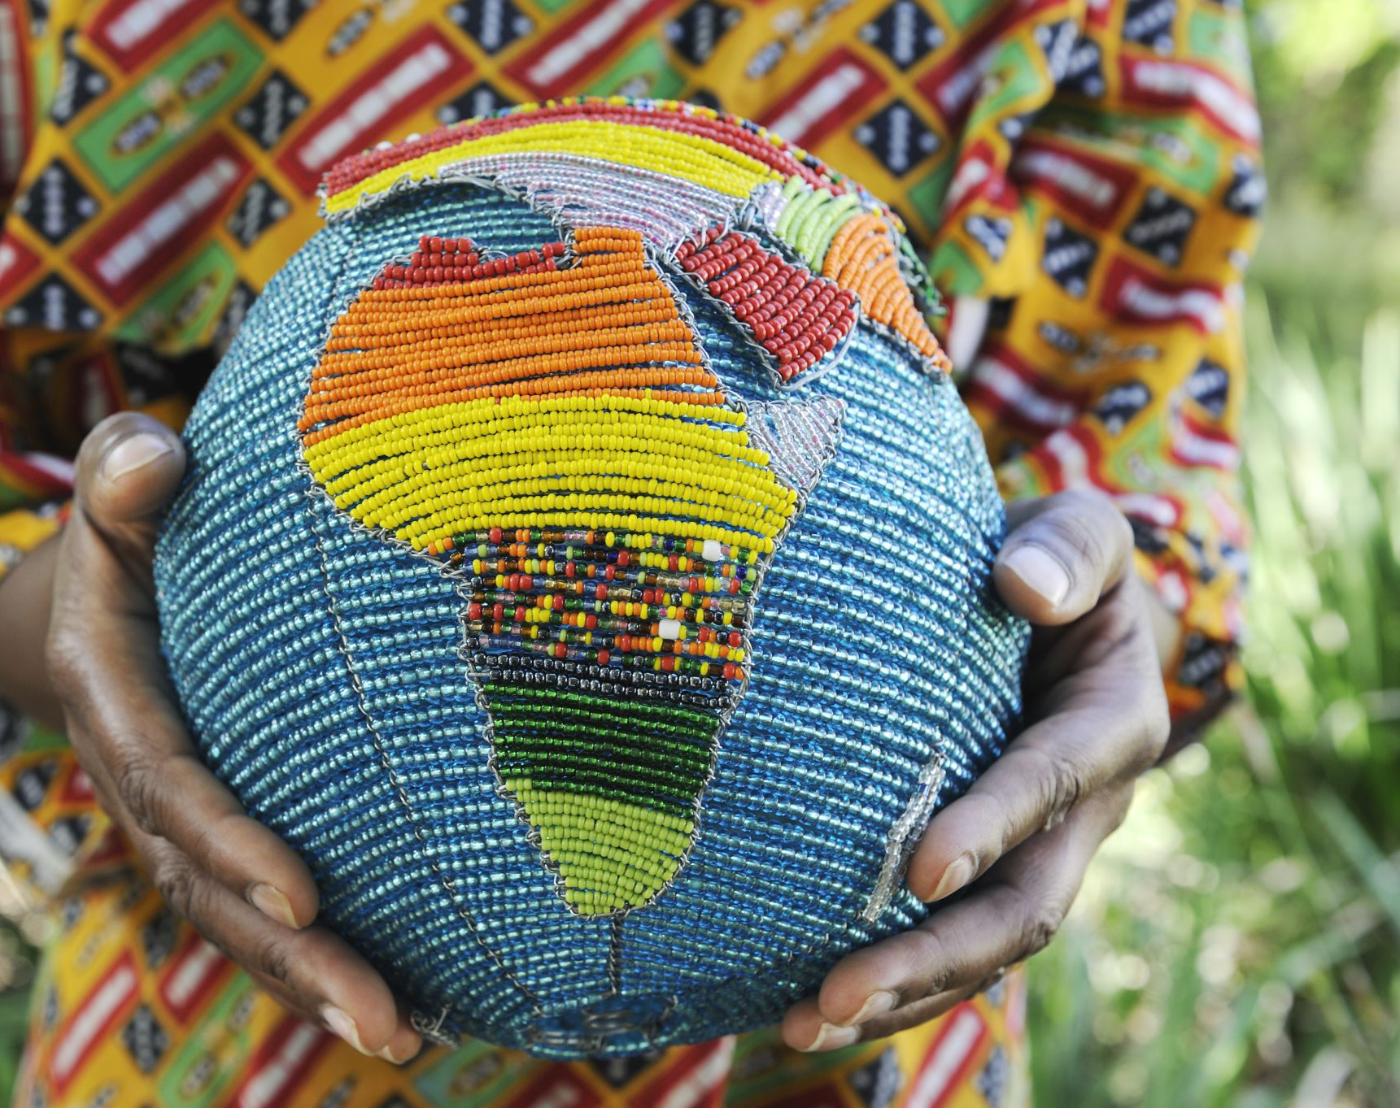
Geography doesn’t just determine whether humans can live in a certain area or not , it also determines people’s lifestyles , as they adapt to the available food and climate patterns .

Slide 5
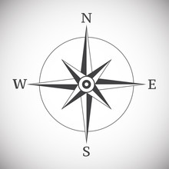
1-Geography : study of the human and nonhuman features of Earth .
2- Cardinal direction : North , East , South ,and west .

Slide 6
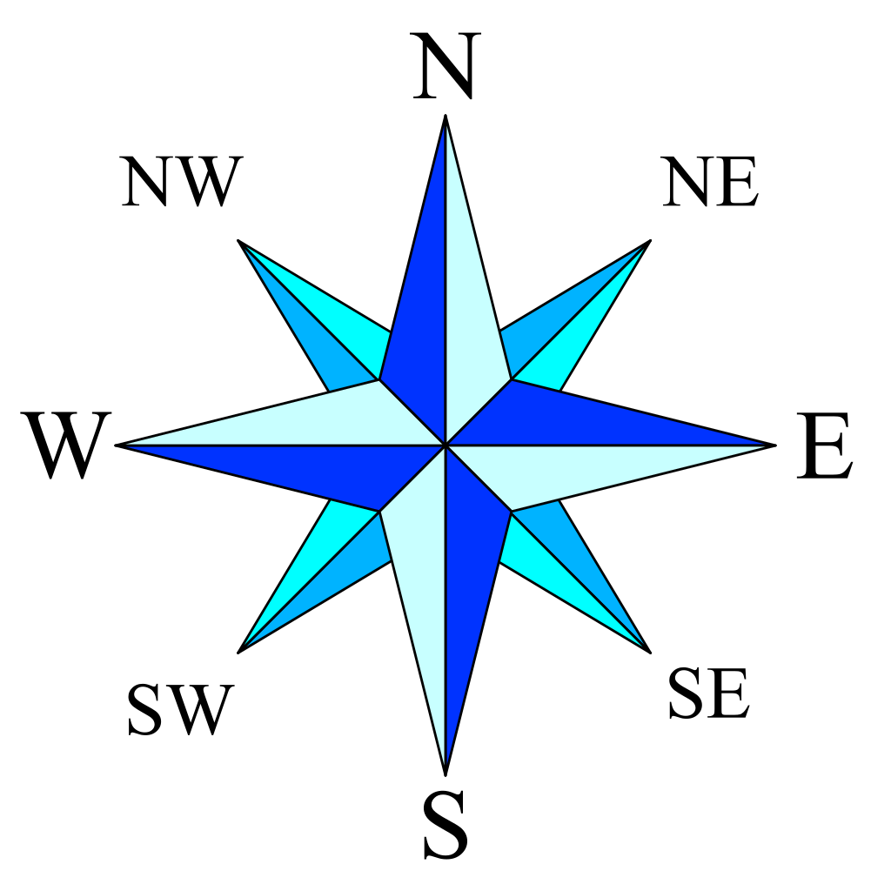
3-Intermediate direction : a compass direction that lies between the cardinal directions , such as northeast .
This Photo by Unknown Author is licensed under CC BY-SA

Slide 7
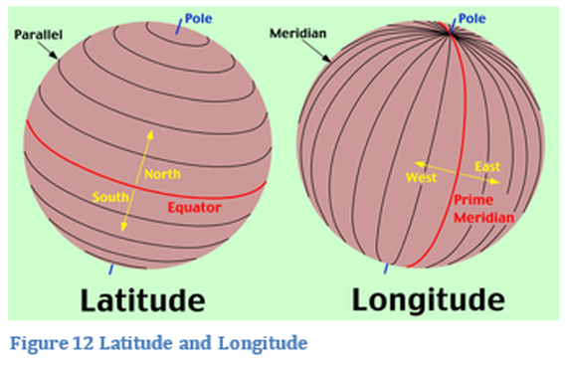
4-Latitude line : the position north or south the Equator measured in degrees . (horizontal line ).
This Photo by Unknown Author is licensed under CC BY-ND

Slide 8
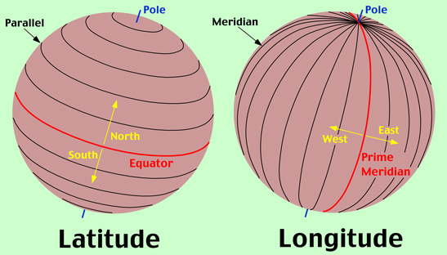
5-Longitude line : the position in degrees east or west of the Prime Meridian . (vertical line ).
This Photo by Unknown Author is licensed under CC BY-SA

Slide 9
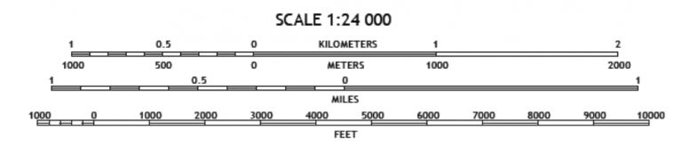
6-Scale :relative size .
This Photo by Unknown Author is licensed under CC BY-SA

Slide 10

7-Interaction : two or more things affecting each other .
This Photo by Unknown Author is licensed under CC BY-NC

Slide 11
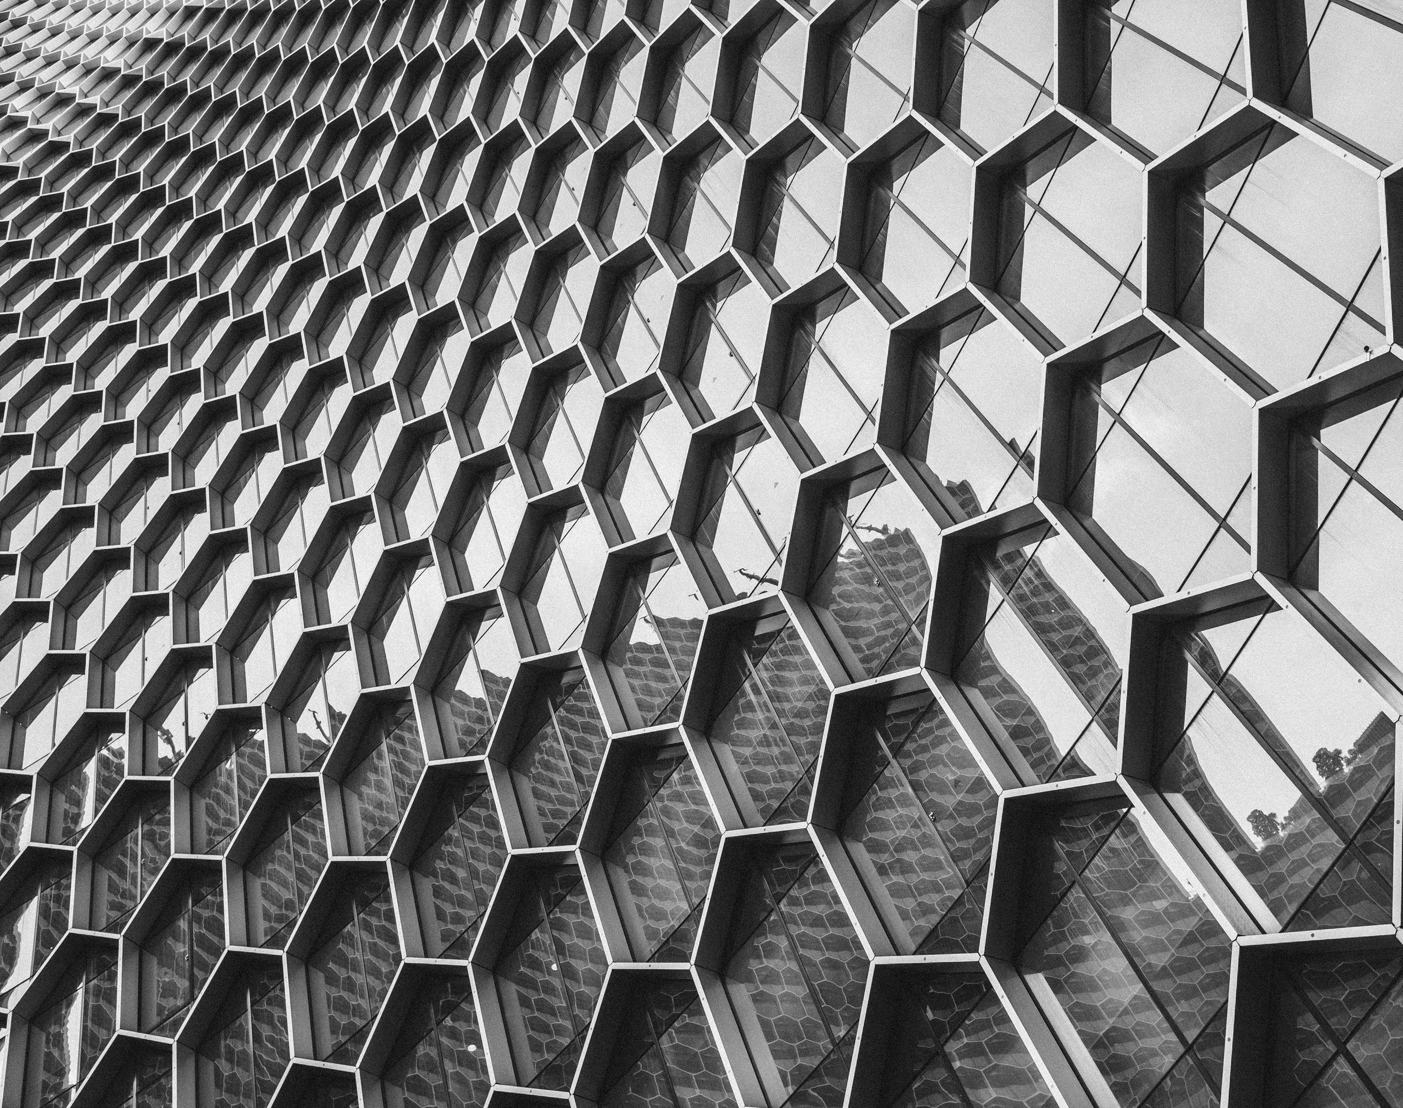
8-Pattern :the organized spread of features in a space .

Slide 12

9-Distortion :loss of accuracy .

Slide 13
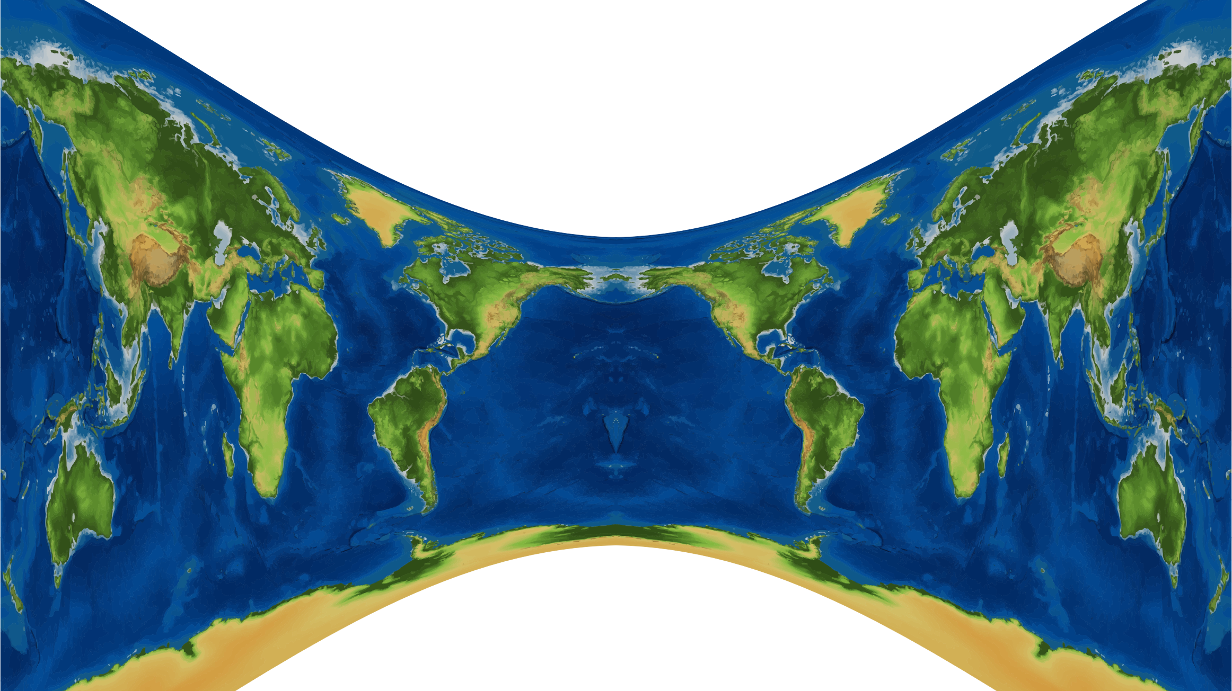
10-Projection :way to map Earth on a flat surface .

Slide 14
*Describing Locations : When someone asks you what happened yesterday , you respond easily by retelling the day’s events . You don’t stop to consider that the idea of yesterday is a human invention , one of the ideas that we use to measure when events take place .
*Geographers use human inventions to discuss where things are located on Earth . One of those inventions is the concept of direction .Another is the imaginary lines geographers draw on Earth to locate objects precisely .

Slide 15
*Directions : In order to study Earth , geographers need to measure it and locate points on its surface . One way to do this is with directions .
*Geographers use both cardinal and intermediate directions . The cardinal directions are north , east , south , and west .
*Intermediate directions lie between the cardinal direction .For example , northwest is halfway between north and west .

Slide 16
*Latitude line : Earth is an almost perfect sphere , or round-shaped body . Geographers have drawn imaginary lines around Earth to help locate places on its surface .
One of these is the Equator , a line drawn around Earth halfway between the North and South Poles . The Earth marks zero degrees (0) of latitude .
Latitude is the position north or south the Equator .It is measured in degrees .

Slide 17
*Degrees are units that measure angles . Lines of latitude are divided into 180 degrees , 90 north of the Equator and 90 south of it .
Each degree can be further divided into (60) minutes ,and each minute can be divided into (60)seconds .
*Lines of latitude form east-west circles around the globe . Lines of latitude are also called parallels , because they are parallel to one another . That means they never cross .

Slide 18
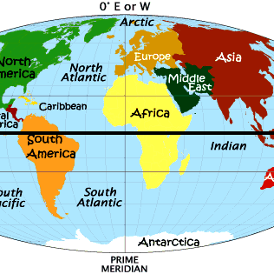
*The Equator divides Earth in half . Each half of Earth is called a hemisphere . The half of Earth is called a hemisphere .
The half of Earth north of the Equator is known as the Northern Hemisphere .
The half of Earth south of the Equator is the Southern Hemisphere .
This Photo by Unknown Author is licensed under CC BY

Slide 19
*Longitude : Geographers have also drawn imaginary north-south lines that run between the North Pole and the South Pole on Earth’s surface .
One of these lines is the Prime Meridian , which passes through Greenwich , England .
The prime Meridian and the other north-south lines measure longitude , or the position in degrees east or west of the Prime Meridian . Lines of longitude are also called meridians .

Slide 20
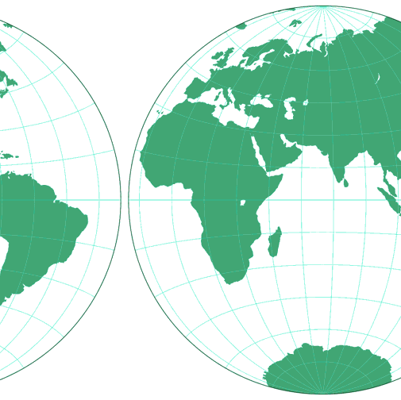
*The half of Earth east of the Prime Meridian is known as the Eastern Hemisphere .
*The half of Earth west of the Prime Meridian is the western Hemisphere . There are 360 degrees of longitude , which are divided into (0)to (180)east and(0)to (180)west .
This Photo by Unknown Author is licensed under CC BY-SA

Slide 21
*Global Grid : Latitude and longitude form a global grid .
You can describe the location of any point on Earth’s surface using degrees of longitude and latitude . For example , Greenwich ,England , is located at 0 longitude and about 51degrees north latitude .

Slide 22
*Summarize :
Why are latitude and longitude useful to geographers ?

Slide 23
The End

