Slide 1
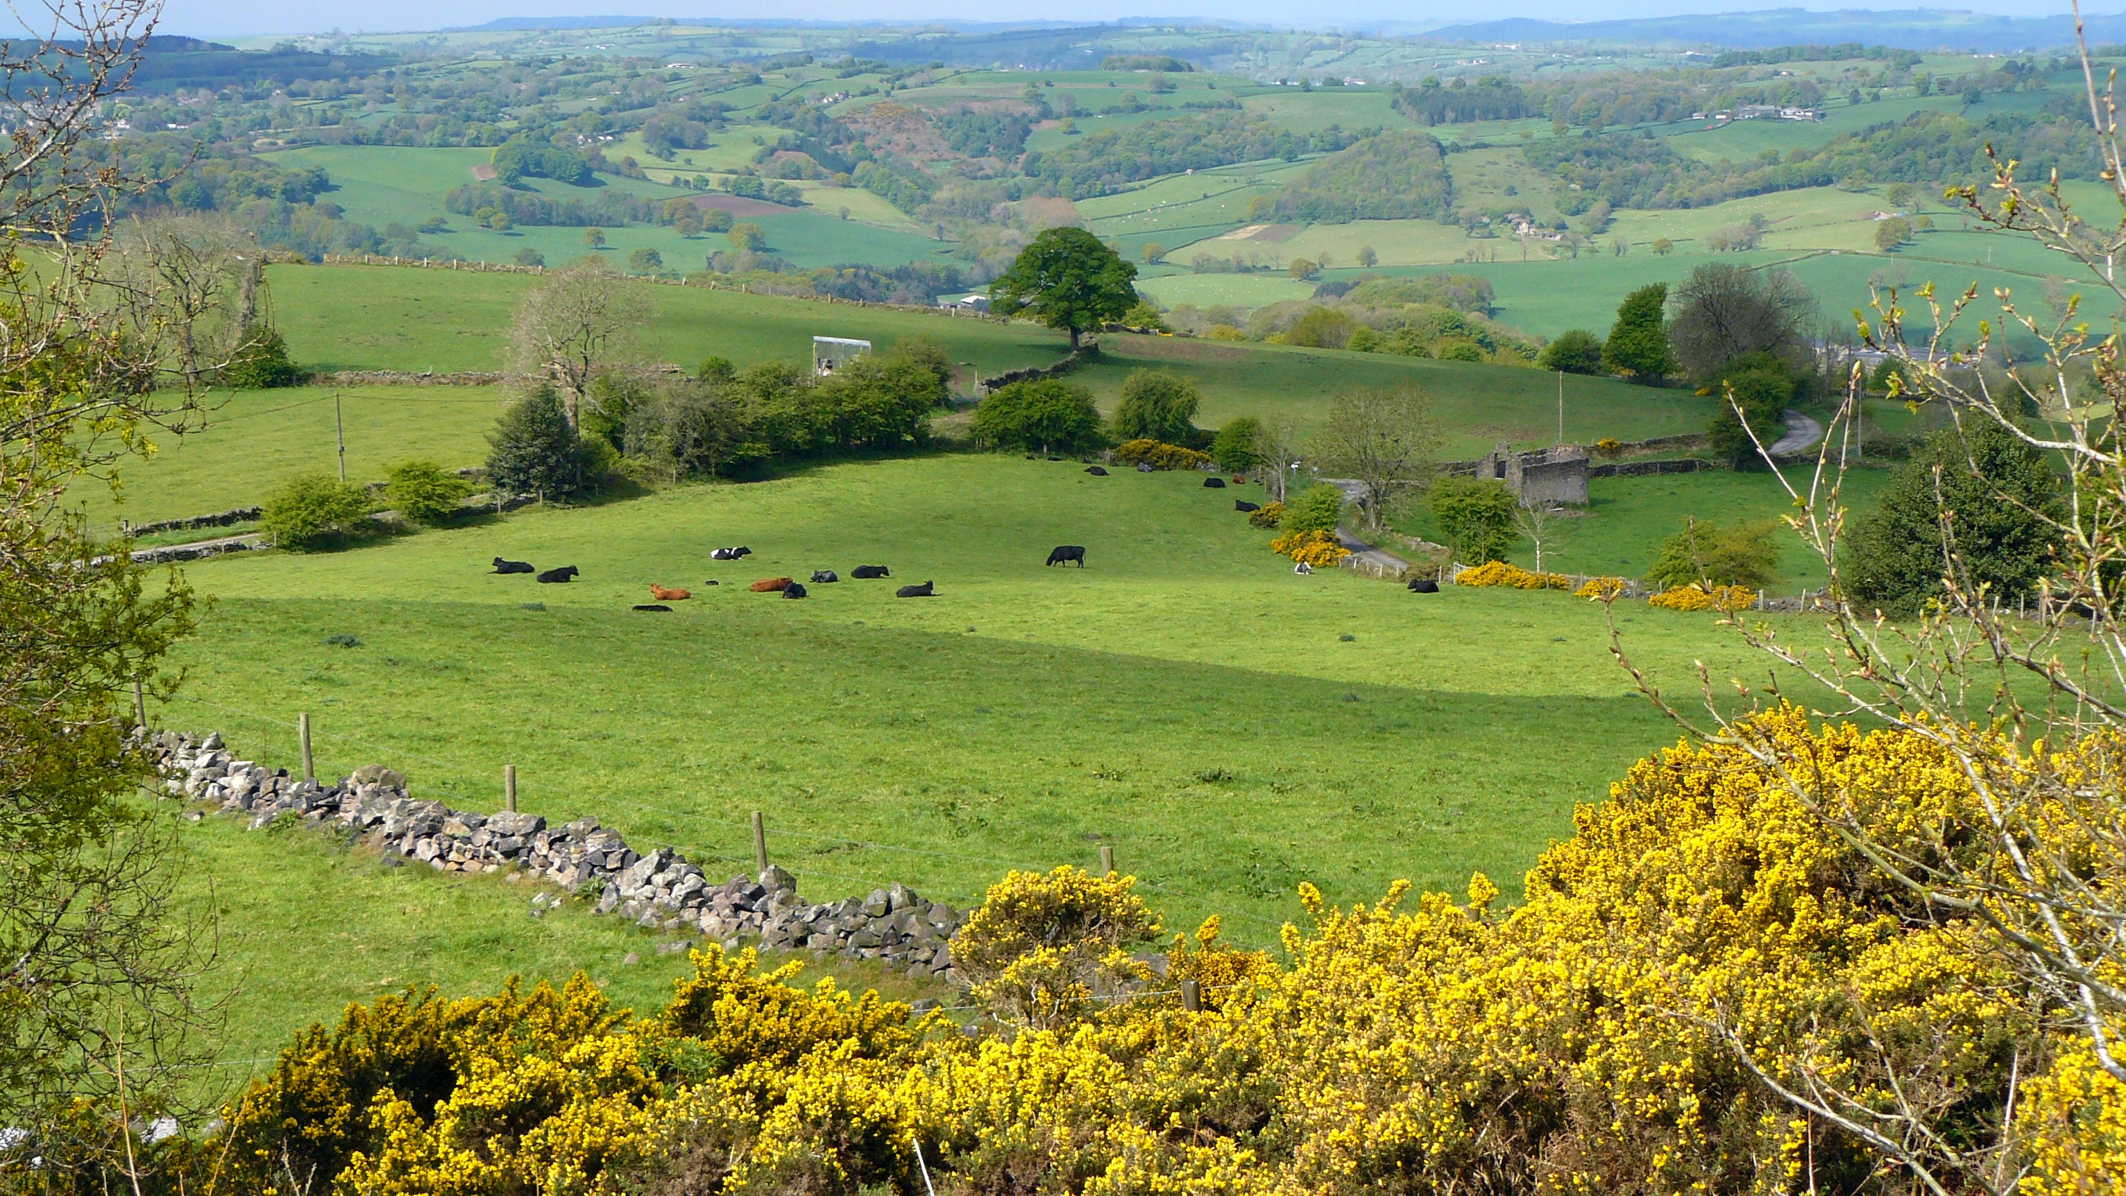
Vegetation Regions

Slide 2
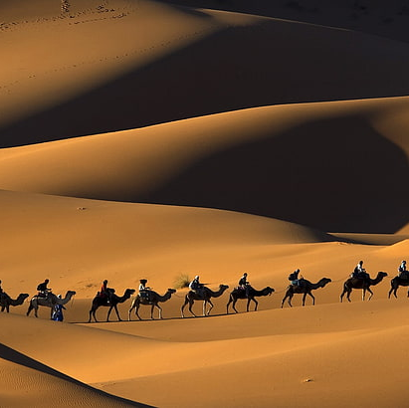
*Geographers divide the land on Earth into vegetation regions , or areas with specific types of soil , plants , and weather patterns .
They can be sorted into five major categories : forest , desert , grassland , tundra , and icesheet .
People can learn about the climate , soil type , and other physical features of an area from its vegetation .
Vegetation also impacts the animal life in a particular area .

Slide 3
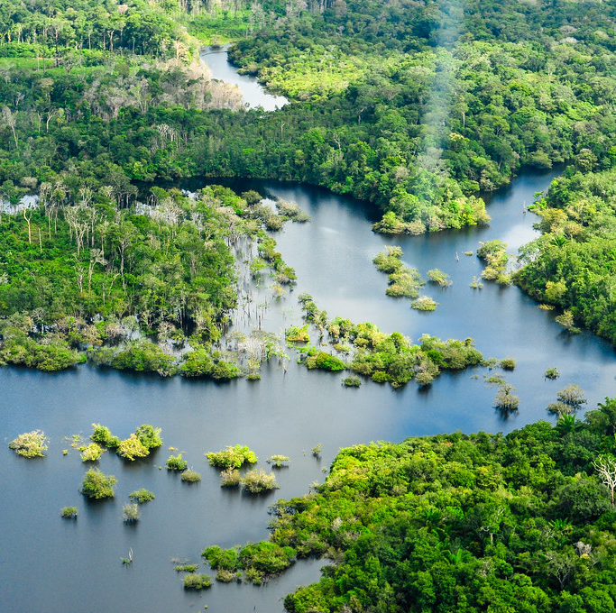
*Regions with less vegetation have fewer animals . Understanding the pattern of vegetation in a region can help keep soil healthy and vegetation growing .
Vegetation regions contribute to human life in many ways . For instance , vegetation can help fight climate change .
The Amazon Rainforest is a great example of this. It is the largest rainforest in the world . It is sometimes called the (Lungs of the world ).
This Photo by Unknown Author is licensed under CC BY-NC-ND

Slide 4
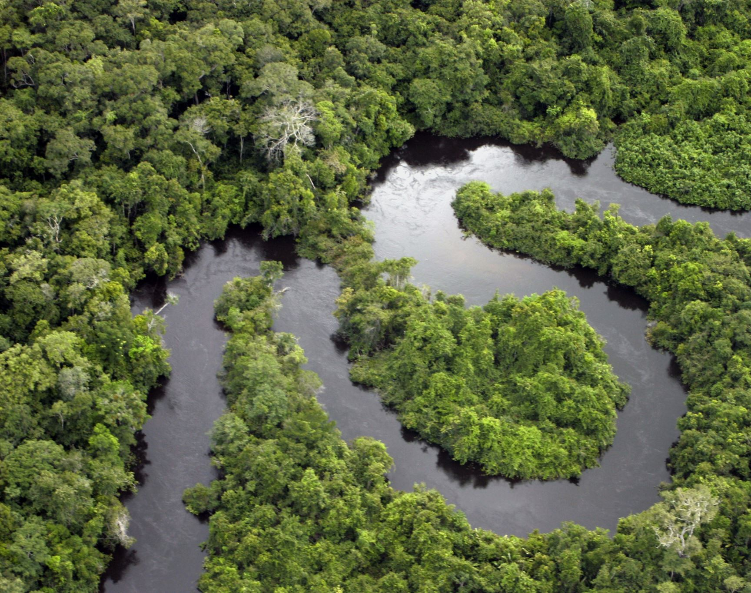
* Why is the (Amazon Rainforest )called lungs of the world ?
Because , the trees trap a lot of the world’s carbon dioxide and produce a grat amount of oxygen .

Slide 5
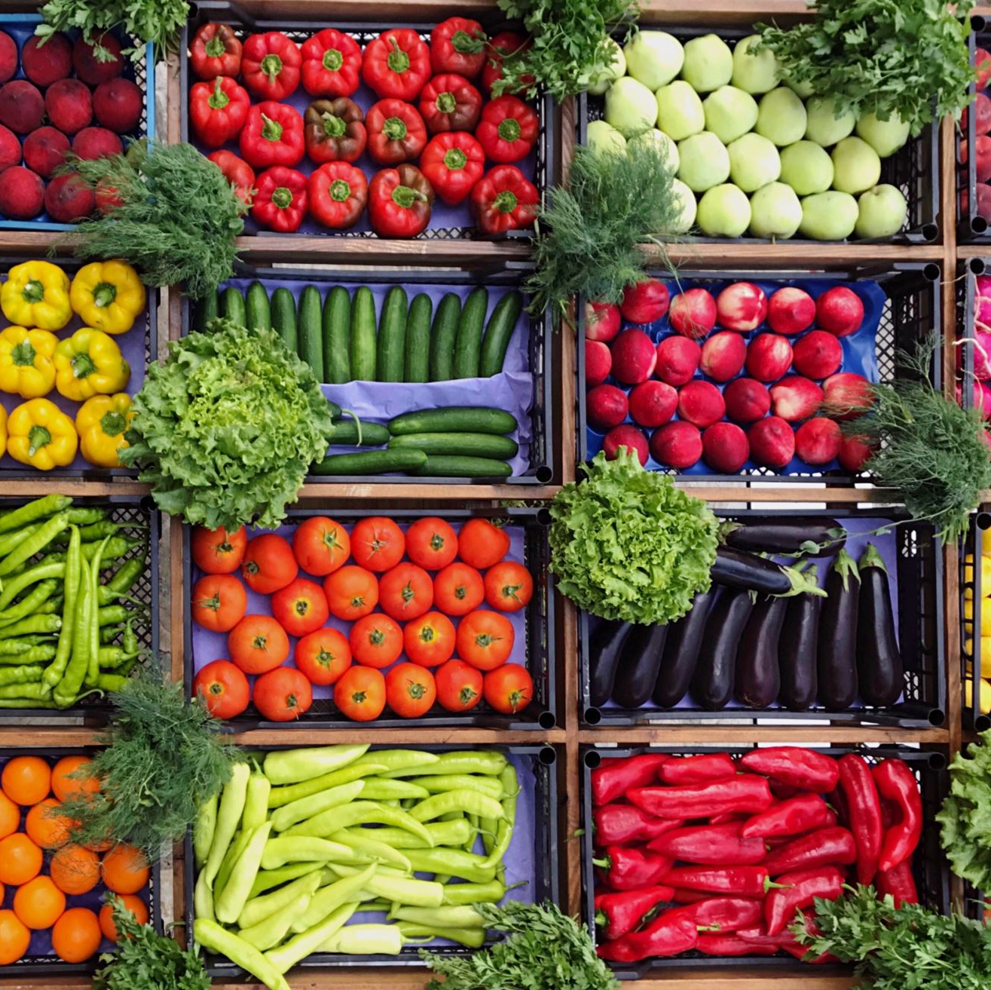
*Also humans depend on products made from vegetation . For example : people use timber for building , and people eat vegetables and fruit from many plants .
Moreover , people can do a variety of activities in these regions . They can go hiking , camping , or boating .

Slide 6
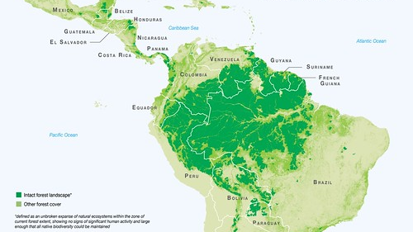
South America
This Photo by Unknown Author is licensed under CC BY-SA-NC

Slide 7
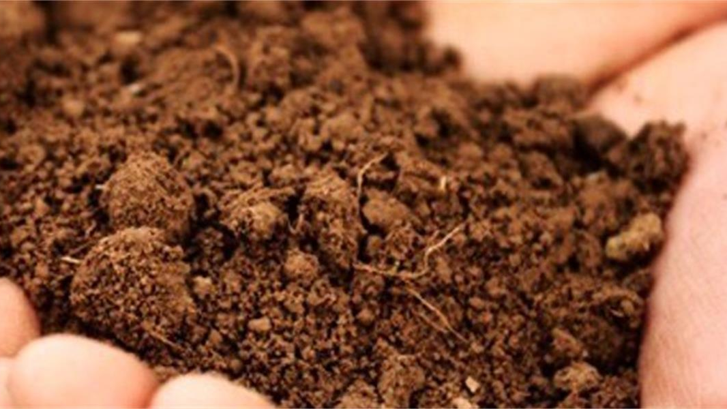
*Features of Vegetation : The main feature of vegetation regions is their plant life . Many factors affect the growth of plants in a particular place .
Such factors include topography , wind patterns , soil quality , water , and sunlight .
For example :some plants grow well in sandy soil , while others need heavier soil with more clay .
This Photo by Unknown Author is licensed under CC BY

Slide 8

*Each type of soil has its own set of nutrients . Plant nutrients are substances that plants need to live , stay healthy , and produce energy .
The nutrients in each type of soil determine the kinds of plants that grow in that soil .
Precepitation and temperature also pay an important part in determining what types of plants grow in a vegetation region .

Slide 9
*Geographers look at the type of ………………..,the type of ……………….,and the climate of a place to decide its vegetation region .

Slide 10
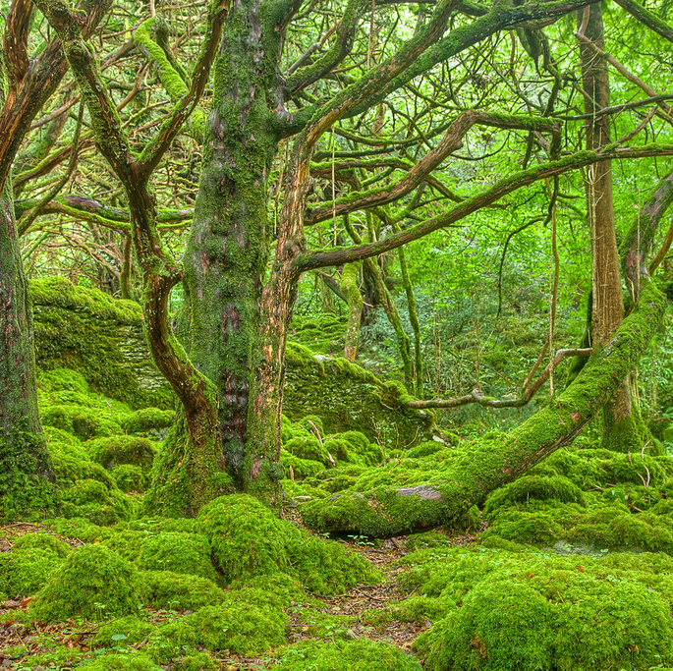
*Forest :are places where trees are grouped closely together and shade a large part of the ground . There are many kind of forests .
In places with warm temperature and high rainfall and humidity , like Brazil , there are tropical rainforests .
Northern Europe is much cooler and drier , so it cannot support tropical plants . In this region , the temperature can vary greatly from day to night . Here you will and temperate forests .
This Photo by Unknown Author is licensed under CC BY

Slide 11
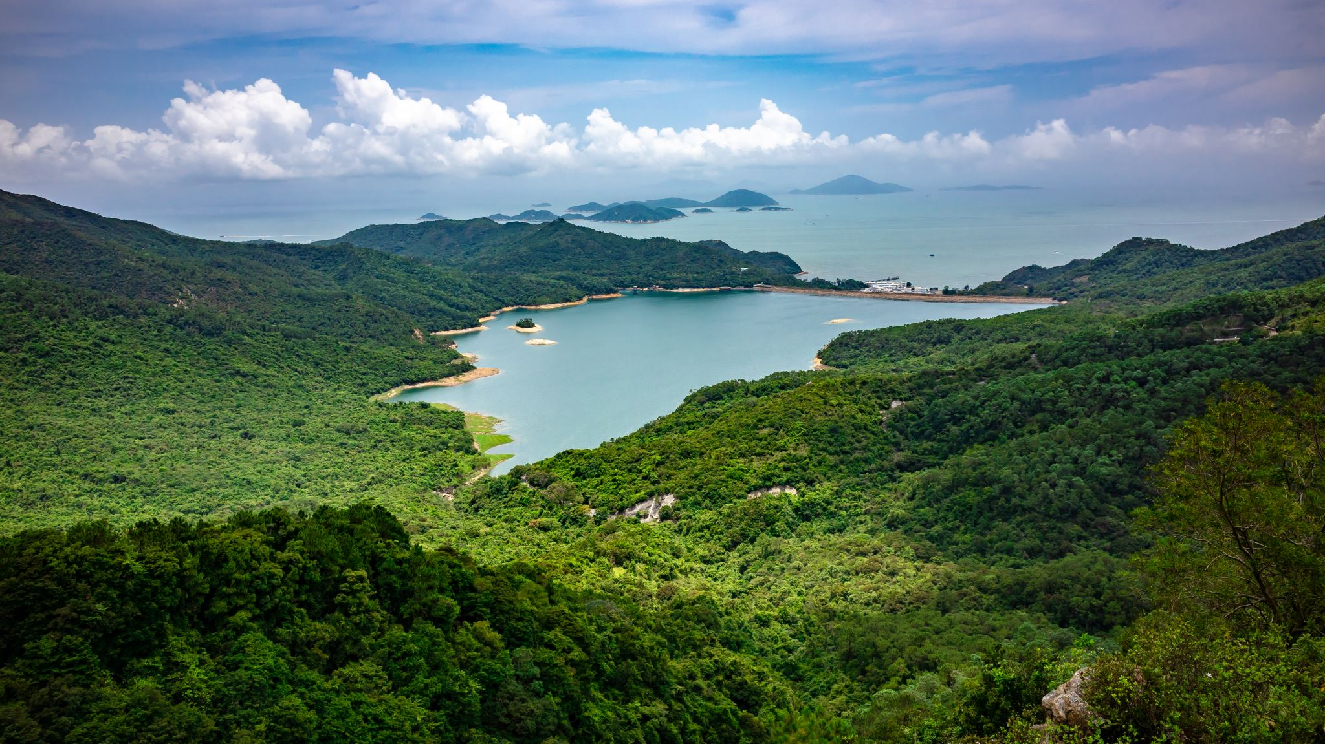
*Along a coastline , like in the Fujian and Guangdong provinces of China , forests might include plants that can live in salt water , like mangroves .

Slide 12
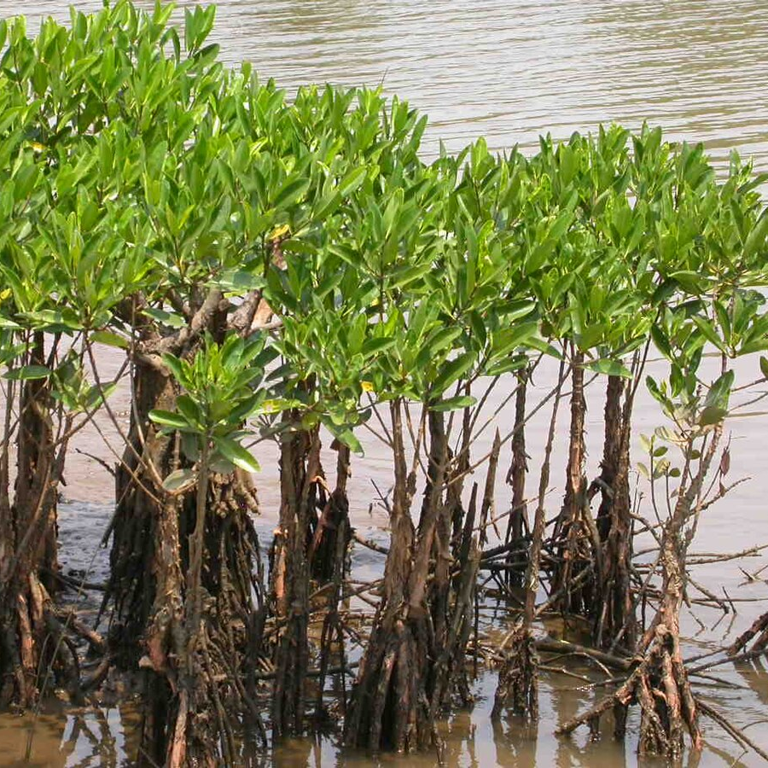
Mangroves
Trees can even grow at high elevations , such as the alphine forests of Tibet . Alphine forests have trees that can grow in rocky soil .They can also survive extreme cold and harsh winds .
This Photo by Unknown Author is licensed under CC BY-SA

Slide 13
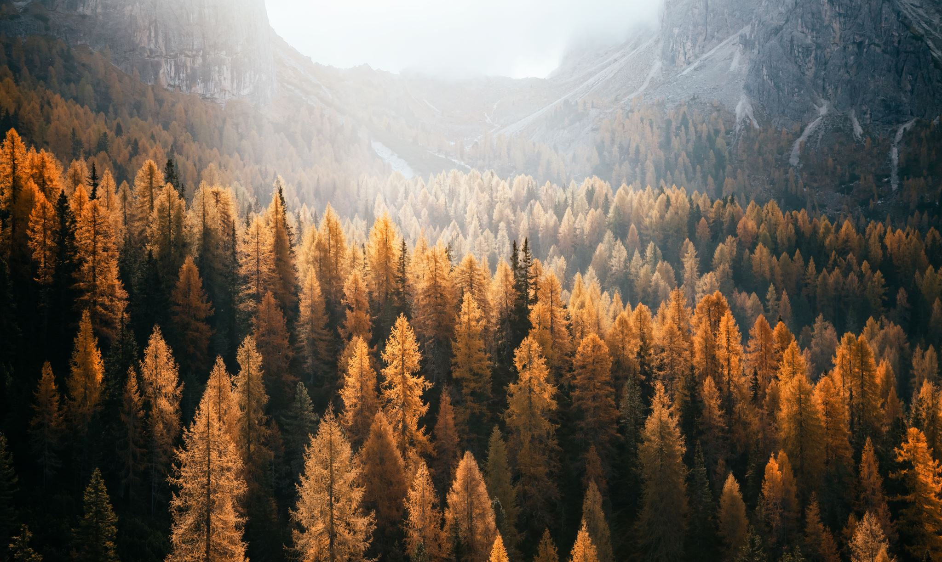
*Forests can also be sorted by the type ofleaves the trees have . For example , some have needles instead of leaves , while others have large leaves that fall in the autumn . Healthy forests can support a variety of plants and animals . They have well-drained soil with many nutrients .

Slide 14
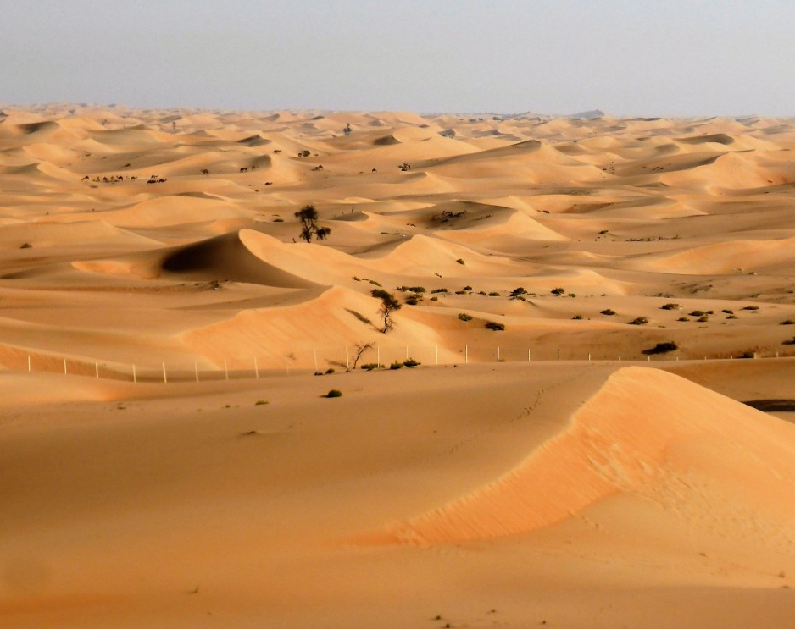
*Desert : Desert regions can be found all over the world , from the Sahara Desert in Africa to the Atacama in South America to the Arabian Desert in the Middle East .

Slide 15
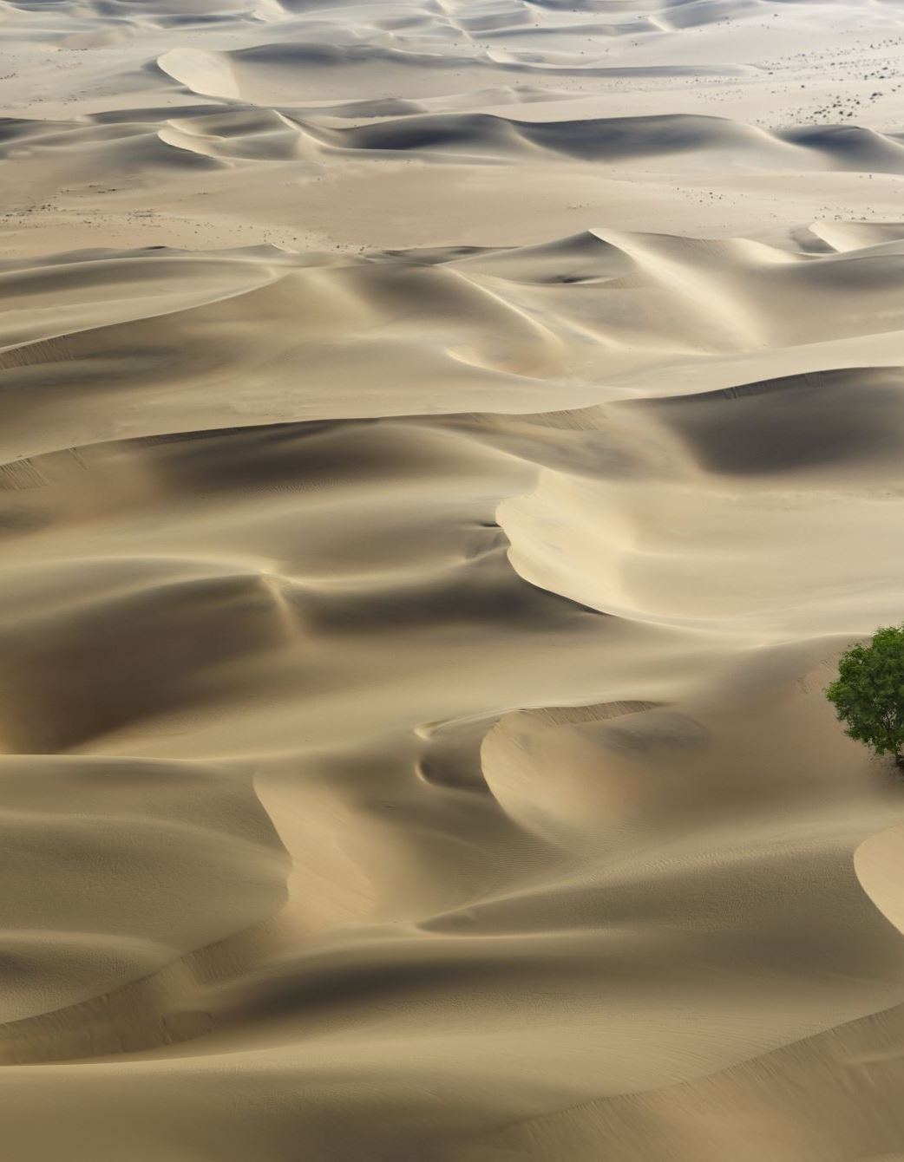
*Deserts are vegetation regions that get less than 10 inches (25.4)of precipitation per year .
Deserts cover 20 percent of Earth’s surface . In addition to being able to survive in dry weather , plants in desert regions need to handle big changes in temperature , from very hot days to cold nights .

Slide 16
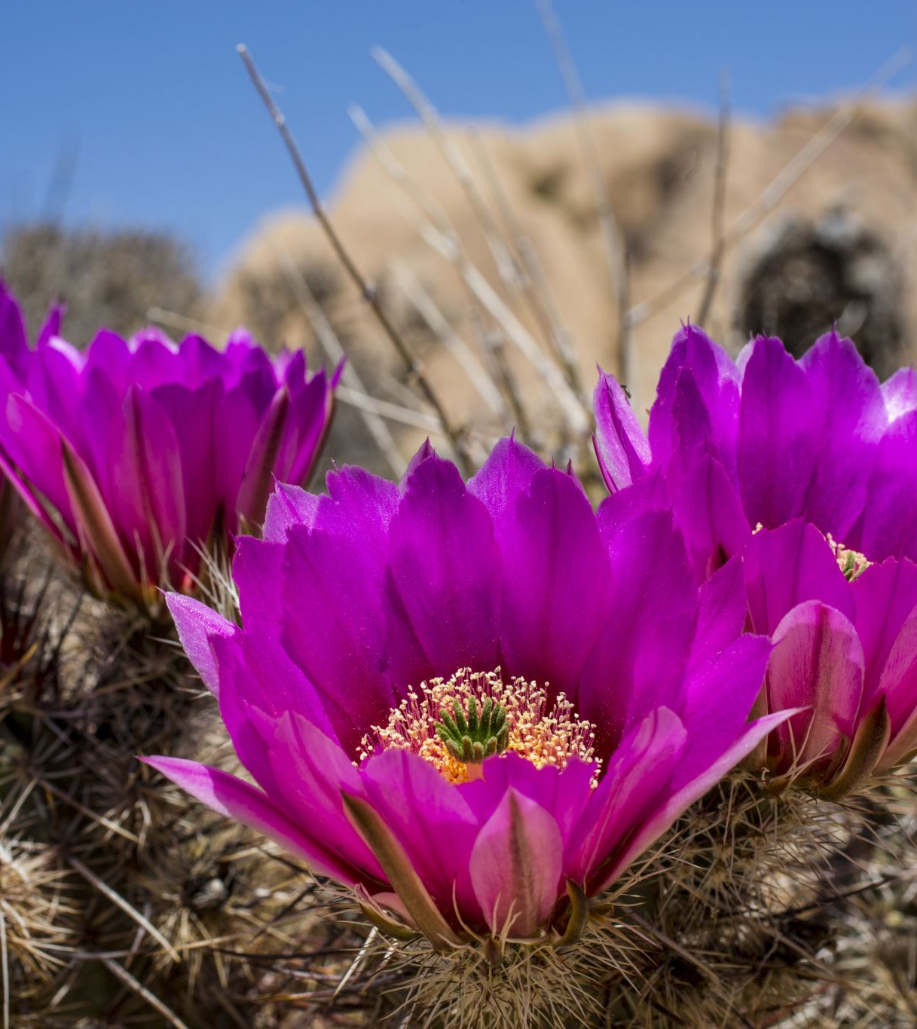
*Desert soil is usually sandy , but not always . For instance , the cold Antarctic Desert has no soil at all . It is just ice on top of rock .
Plants in hot deserts have adapted to sandy and rocky soils . For example , they have roots that grow deep into the ground to find water and keep the plants in place . They also have smaller leaves that lose water very slowly . Infact , many desert plants , such as cacti , have tissues that allow them to store water .

Slide 17
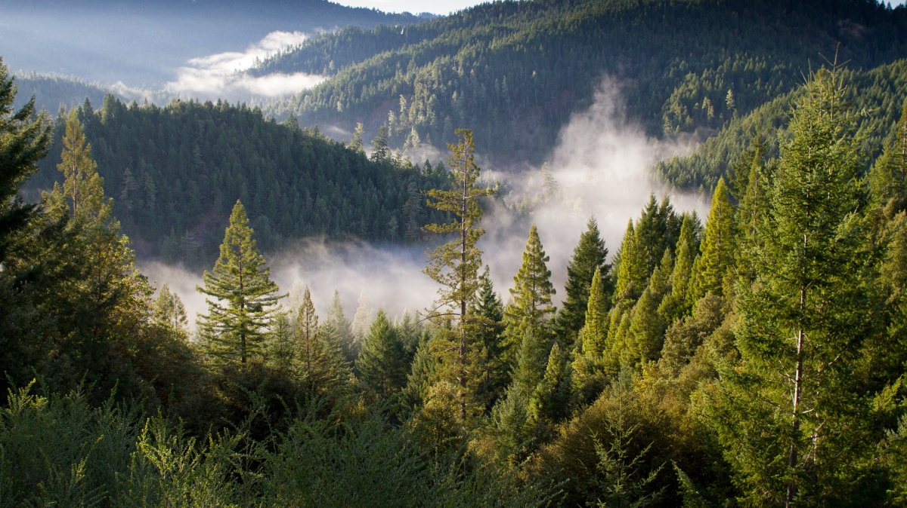
Critical thinking : Compare a desert with a temperate forest . What is one thing they have in common ?Is the feature they have in common related to soil , plants , or climate ?

Slide 18
Answer :
In a temperate forest , you can expect to find rivers and lakes . In a desert it is rare to find these land forms .
In the desert , there is very little to no vegetation and the land in deserts can be mountainous or flat .

