Slide 1
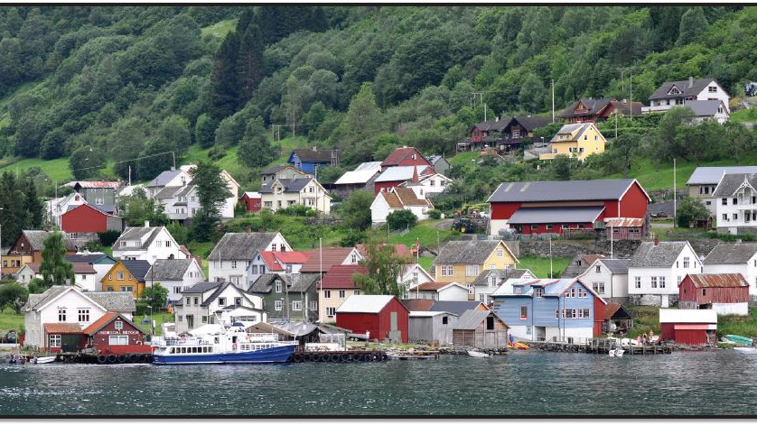
Rural Settlements
This Photo by Unknown Author is licensed under CC BY

Slide 2
*Rural Settlements are far away from cities .More than 40 percent of the world’s population lives in rural areas .
People usually build rural settlements near a body of water , such as a lake ,food , and transportation .
The land around them is often fertile and well-suited for agriculture . In addition to geographic factors , people choose to live in rural settlements due to economic factors .

Slide 3
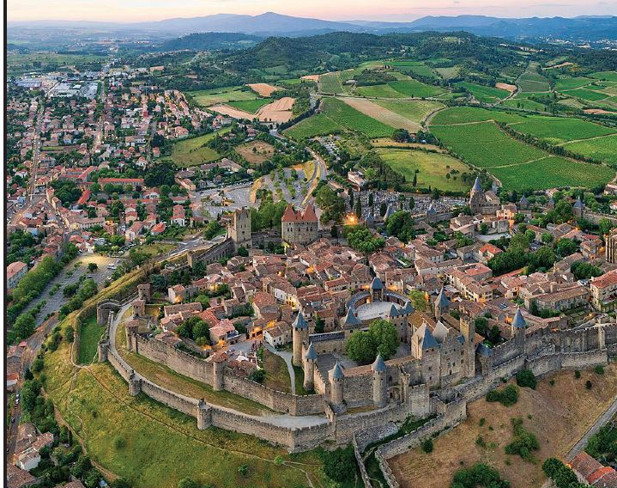
*Geographers categorize rural settlements into main groups –clustered and dispersed . Each group has additional characteristics that help people understand the diversity of rural settlements
This Photo by Unknown Author is licensed under CC BY

Slide 4
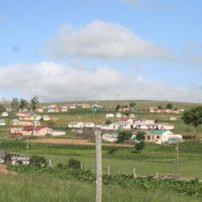
Were you surprised to learn that over 40 percent of the world lives in rural areas ? Explain in one sentence why or why not .
This Photo by Unknown Author is licensed under CC BY-SA-NC

Slide 5
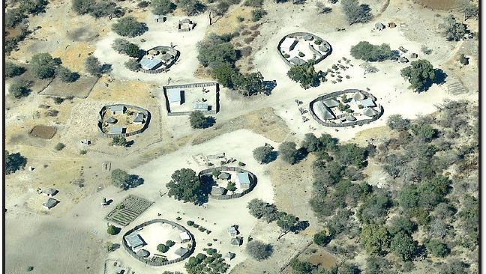
Clustered Patterns : In a clustered rural settlement , several families live near each other . Their homes are often near fields used for agriculture .
The layout depends on historical ,geographic and economic factors but can vary in shape and size .
This Photo by Unknown Author is licensed under CC BY

Slide 6
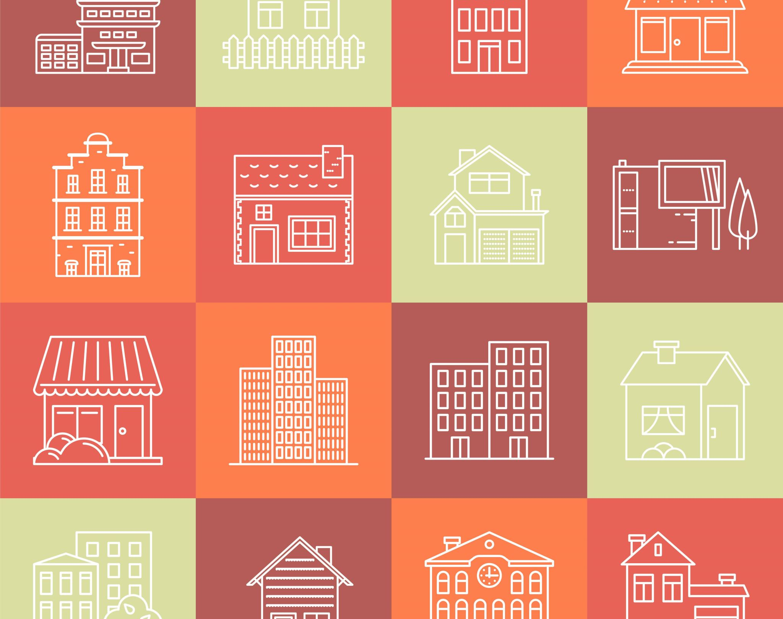
*Compact rural settlent : in this pattern , the centre of the settlement has public buildings , such as community centers , banks , and schools . The houses and field are outside of this center .

Slide 7
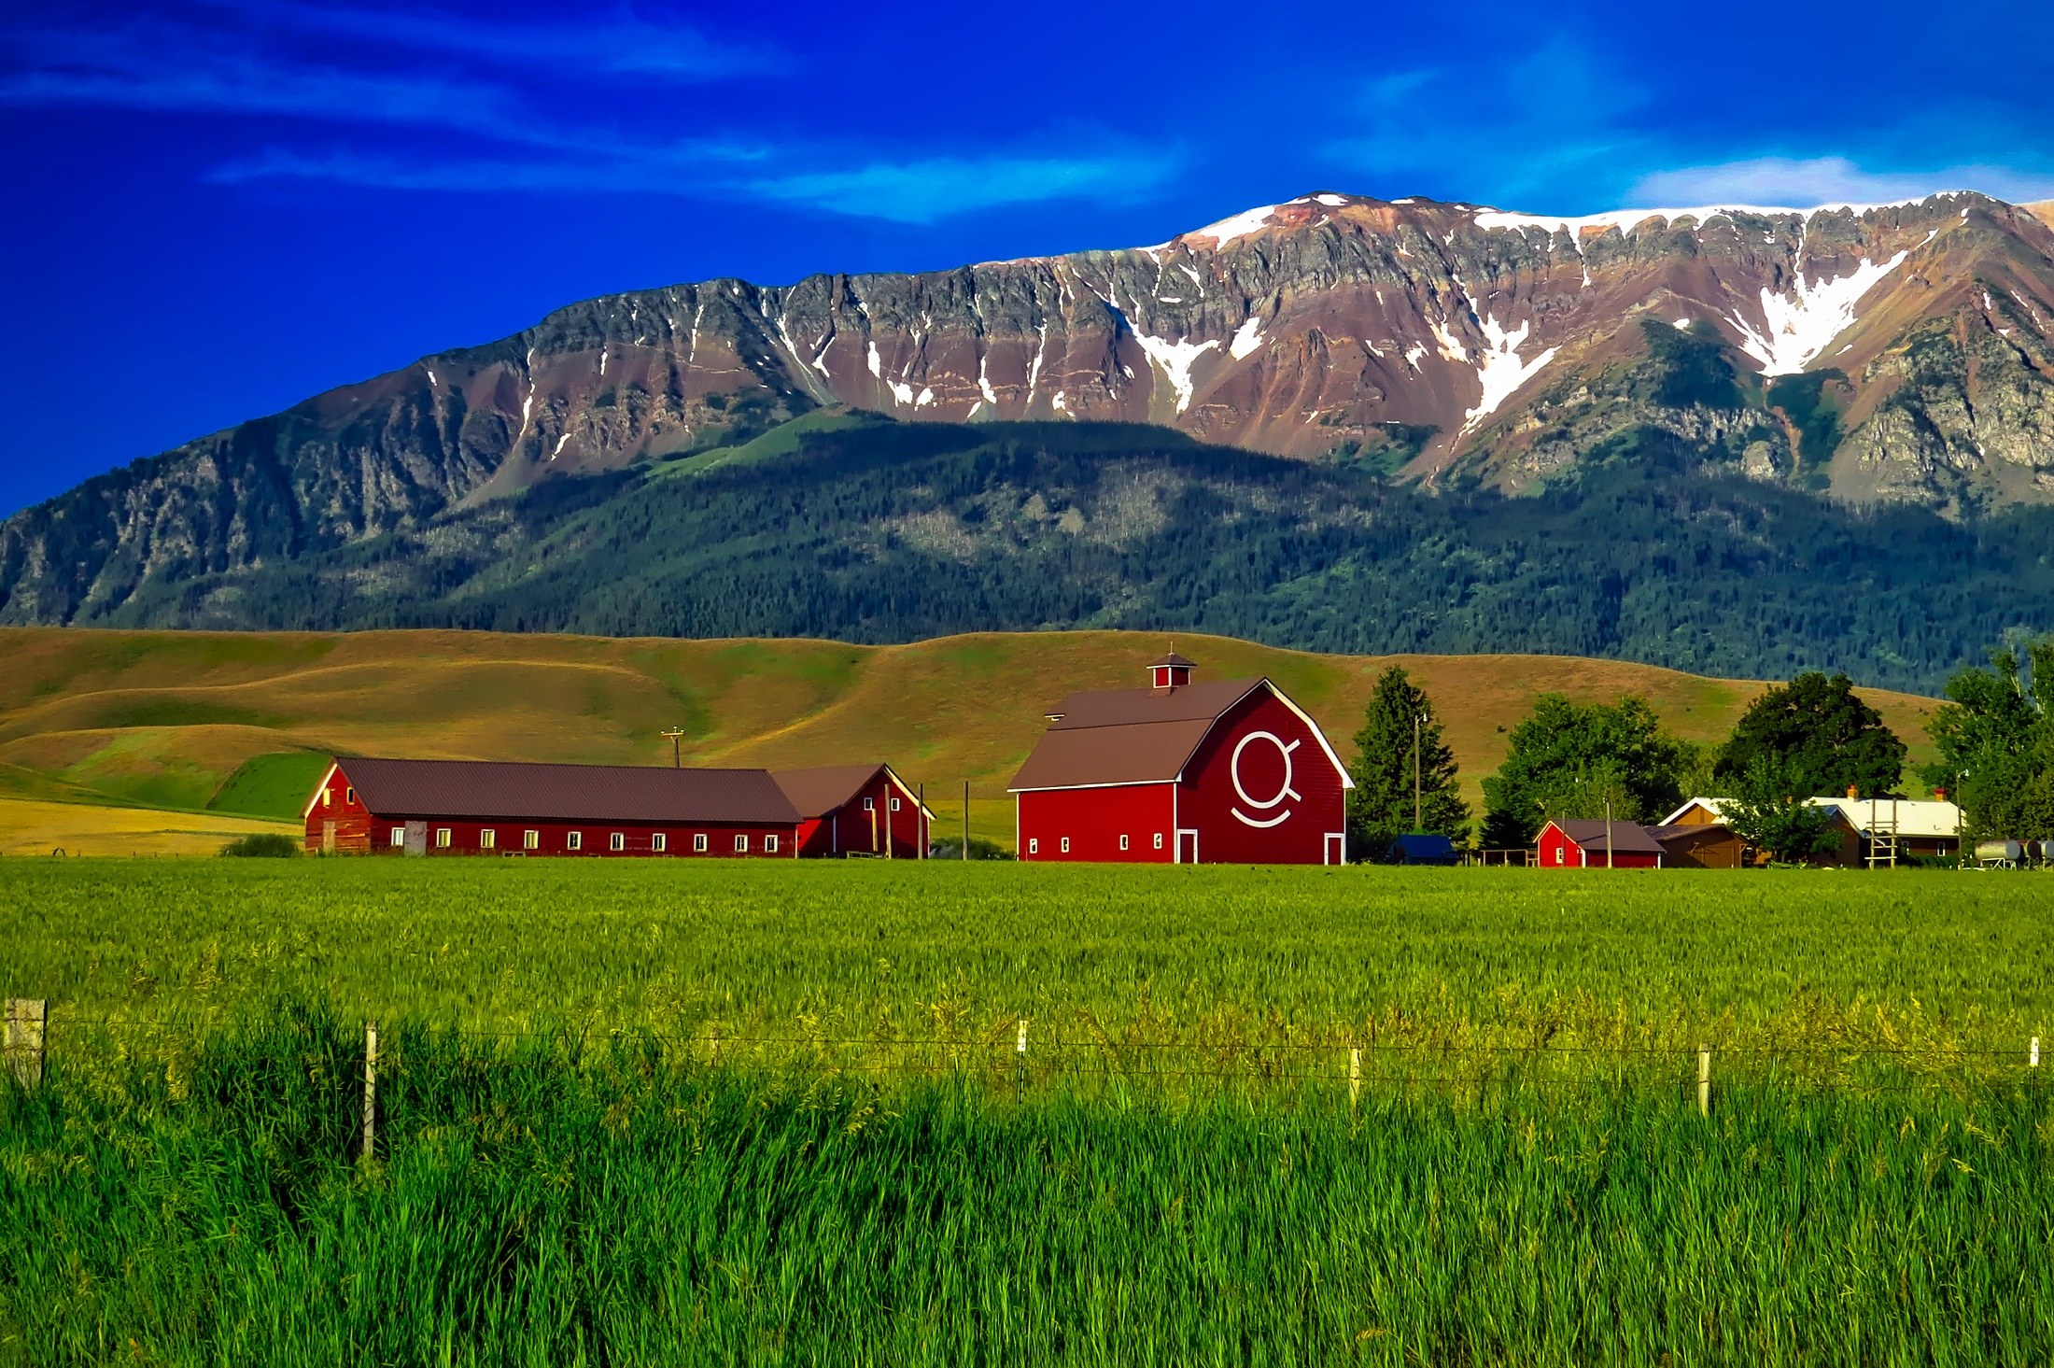
*Linear rural settlement “:This pattern describe settlement along a road , river , or coastline . In this pattern , people usually position their agricultural land behind their houses .

Slide 8
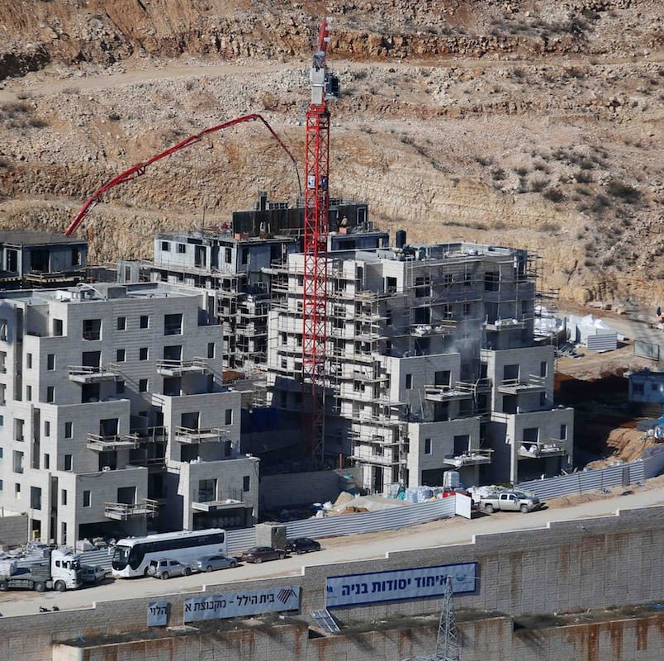
*Dispersed Patterns : Compared to compact rural settlements , buildings in dispersed rural settlements are more spaced out .
There are two main types of dispersed rural settlements :
People set up scattered rural settlements on foothills and areas with mountains and very high ground .
This Photo by Unknown Author is licensed under CC BY-SA-NC

Slide 9
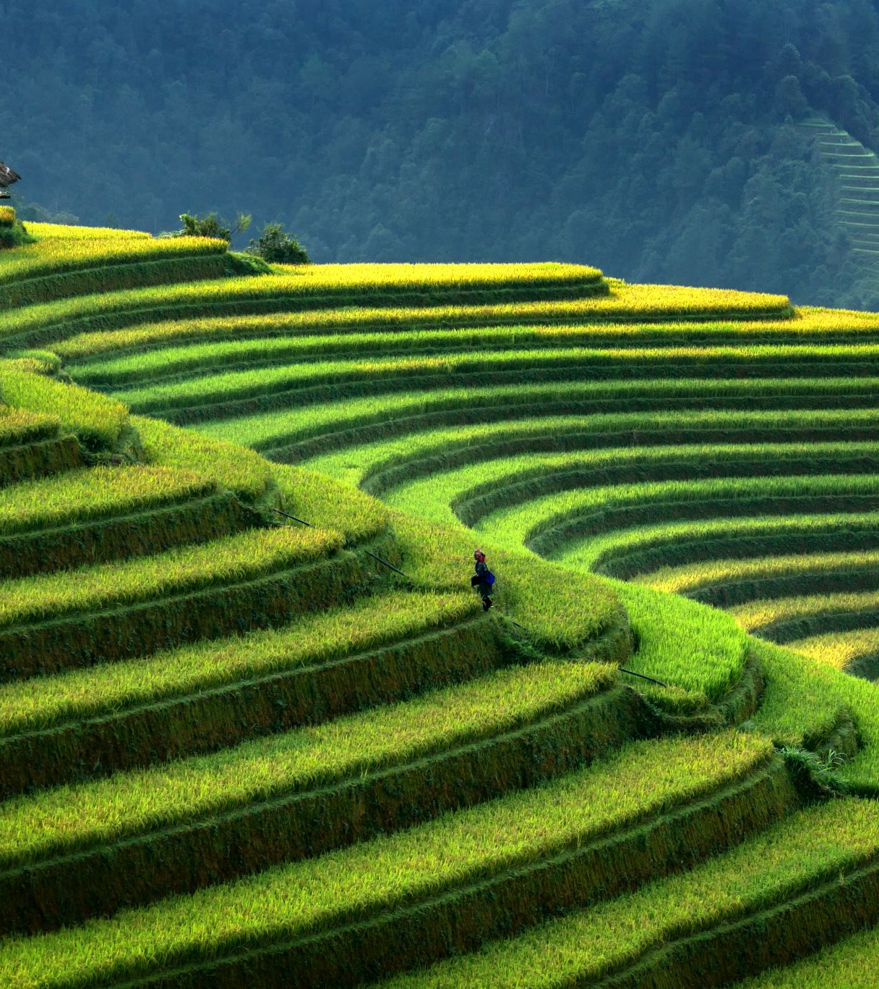
*These settlements often keep their traditional architecture , dress , and social customs .
For example , in China , some rural villages have chosen to preserve their cultural heritage .
The major economic activites in this type of settlement include agriculture , raising livestock , and mining .

Slide 10
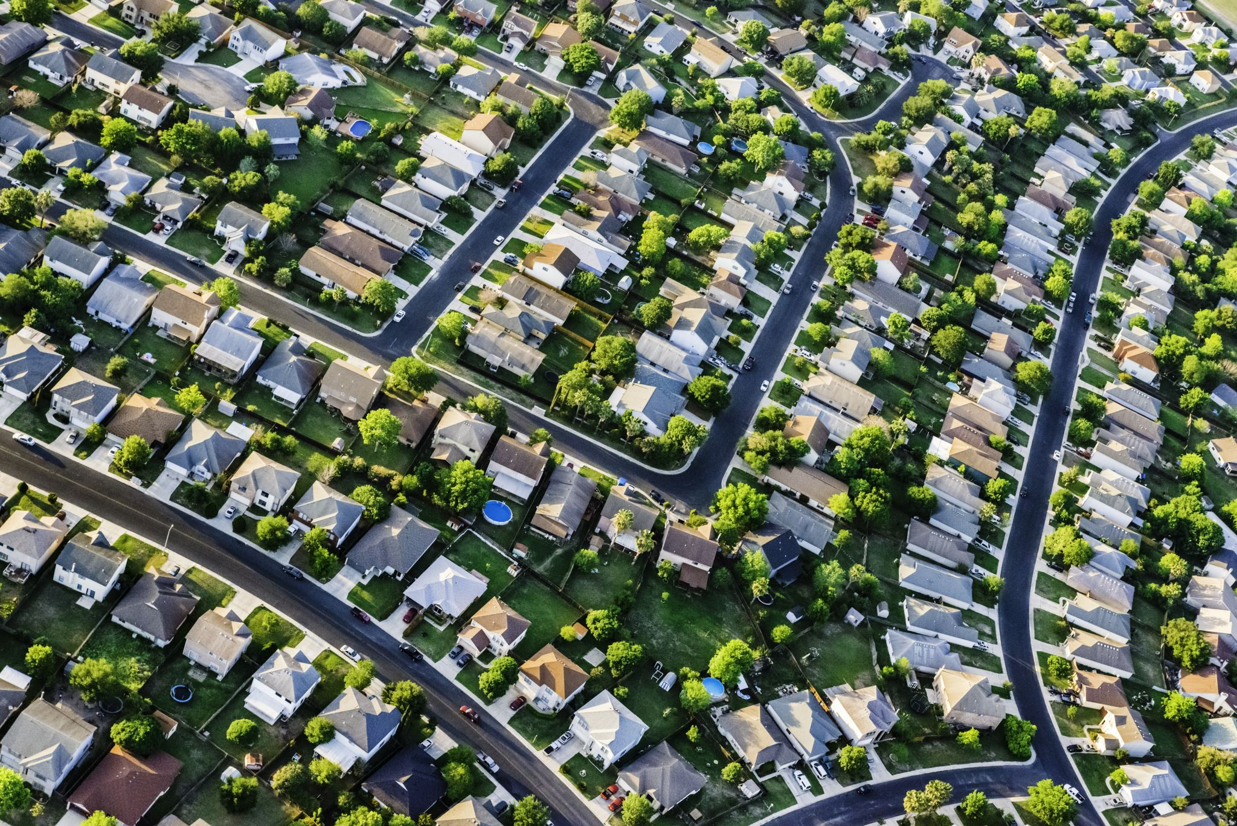
*Scattered rural settlements may have some services , such as school , but may lack others , such as a bank or post office .
In contrast to the scattered pattern , isolated rural settlements are even more dispersed or spread out . There are no tracks or roads connecting the houses .

