Slide 1
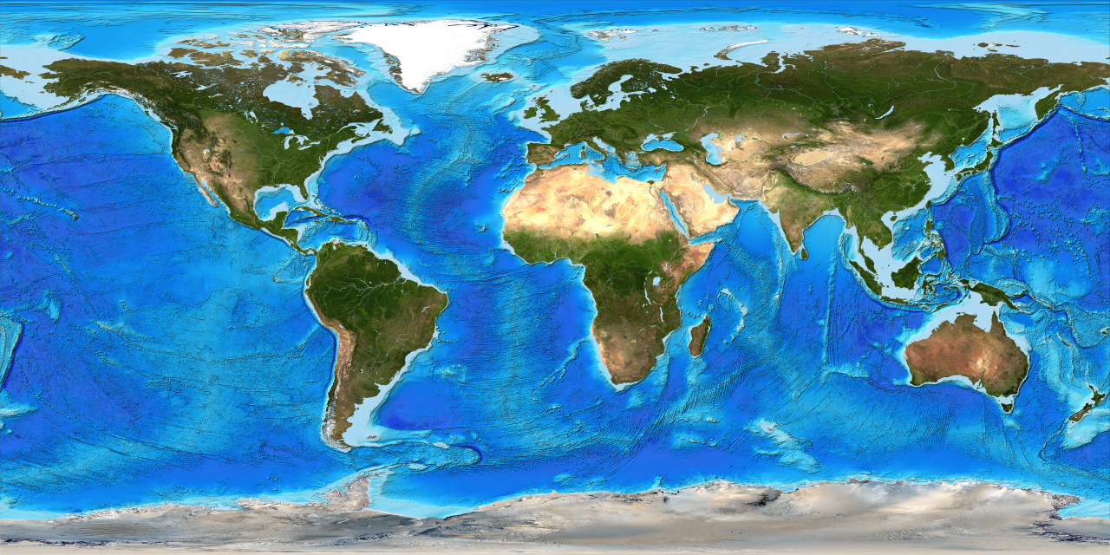
Geography and maps
This Photo by Unknown Author is licensed under CC BY-SA-NC

Slide 2
What does the word geography mean ?
The study of places and the relationships between people and their environments .
The study of the lands ,features , inhabitants , and phenomena of earth .

Slide 3
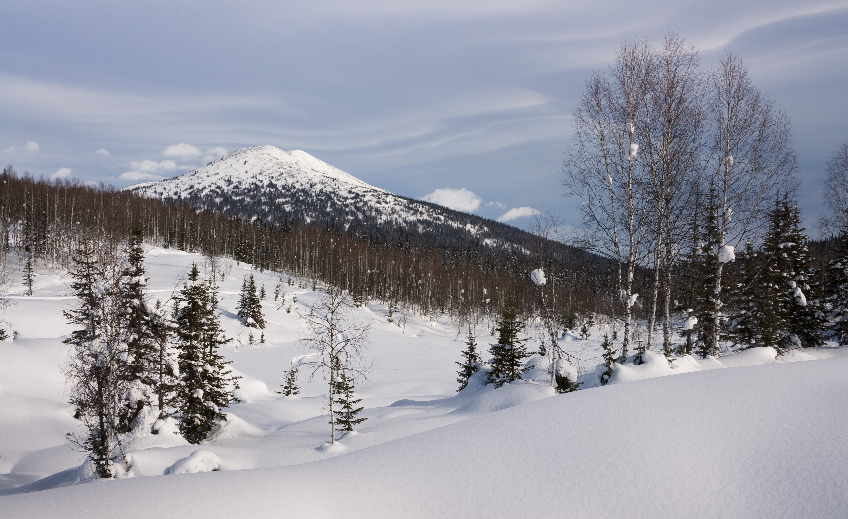
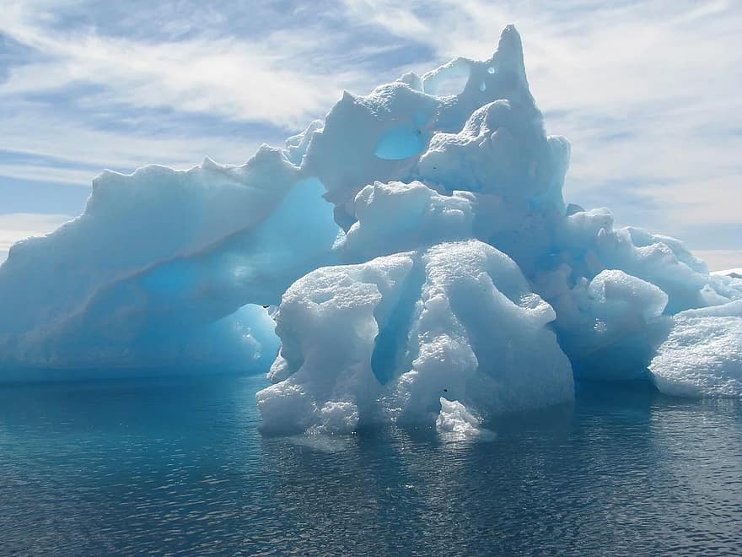
Give me an example of an environment , and how do organisms adapt to that specific area?
1- Tundra and polar environment : are found in the earth’s latitudes and are characterized by cold temperatures and a limited growing season.

Slide 4
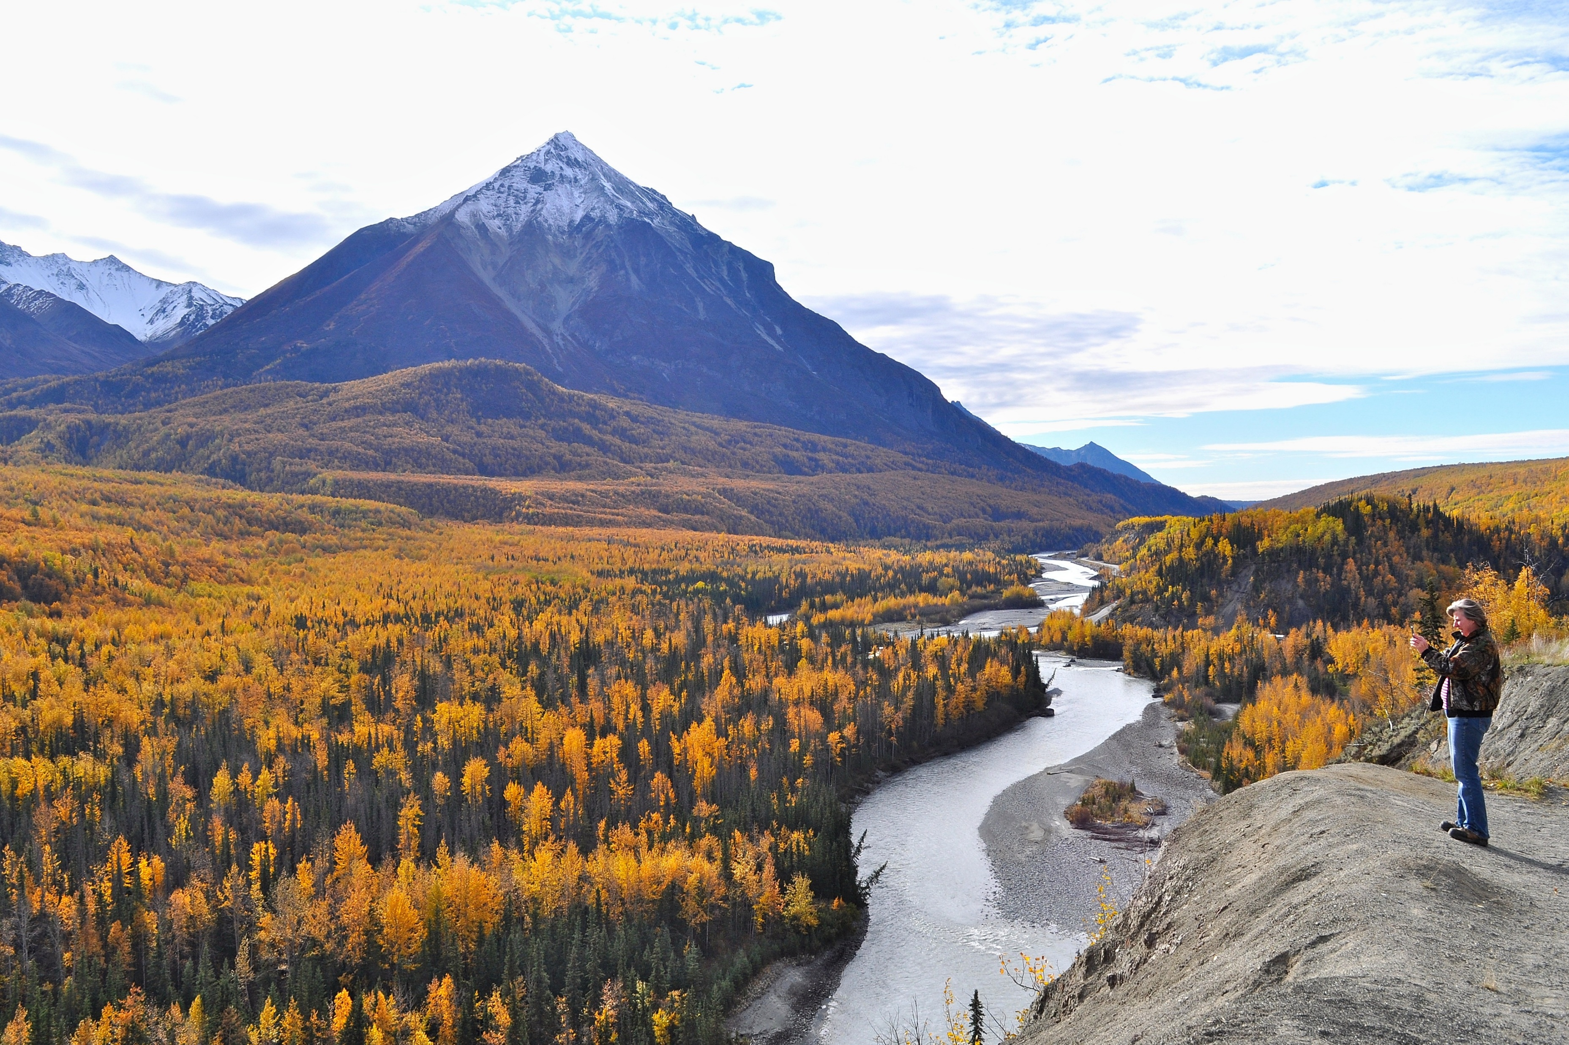
2- People have adapted to living in the tundra by wearing large thick coats called parkas with thick boots to keep warm in the tundra’s icy weather , along with hoods , hats , mitts , and other protaction .

Slide 5
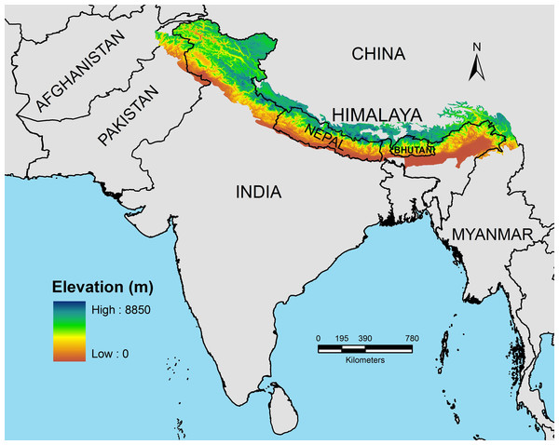
*Topographic Maps : according to the American heritage , the word “topography ’’ is defined as the surface features of a place or region .
A topographic map is a two-dimensional representation of a three dimensional land surface . It is also a summary of the landscape and show important physical (natural and man-made )features in an area .
These maps offer detail information on any particular area .
This Photo by Unknown Author is licensed under CC BY

Slide 6
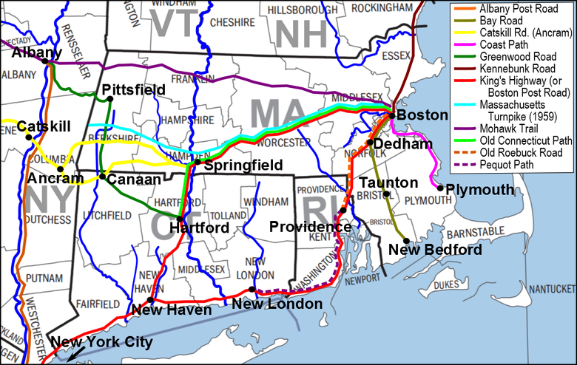
These maps portray different man-made features , for example :
This Photo by Unknown Author is licensed under CC BY-SA

Slide 7
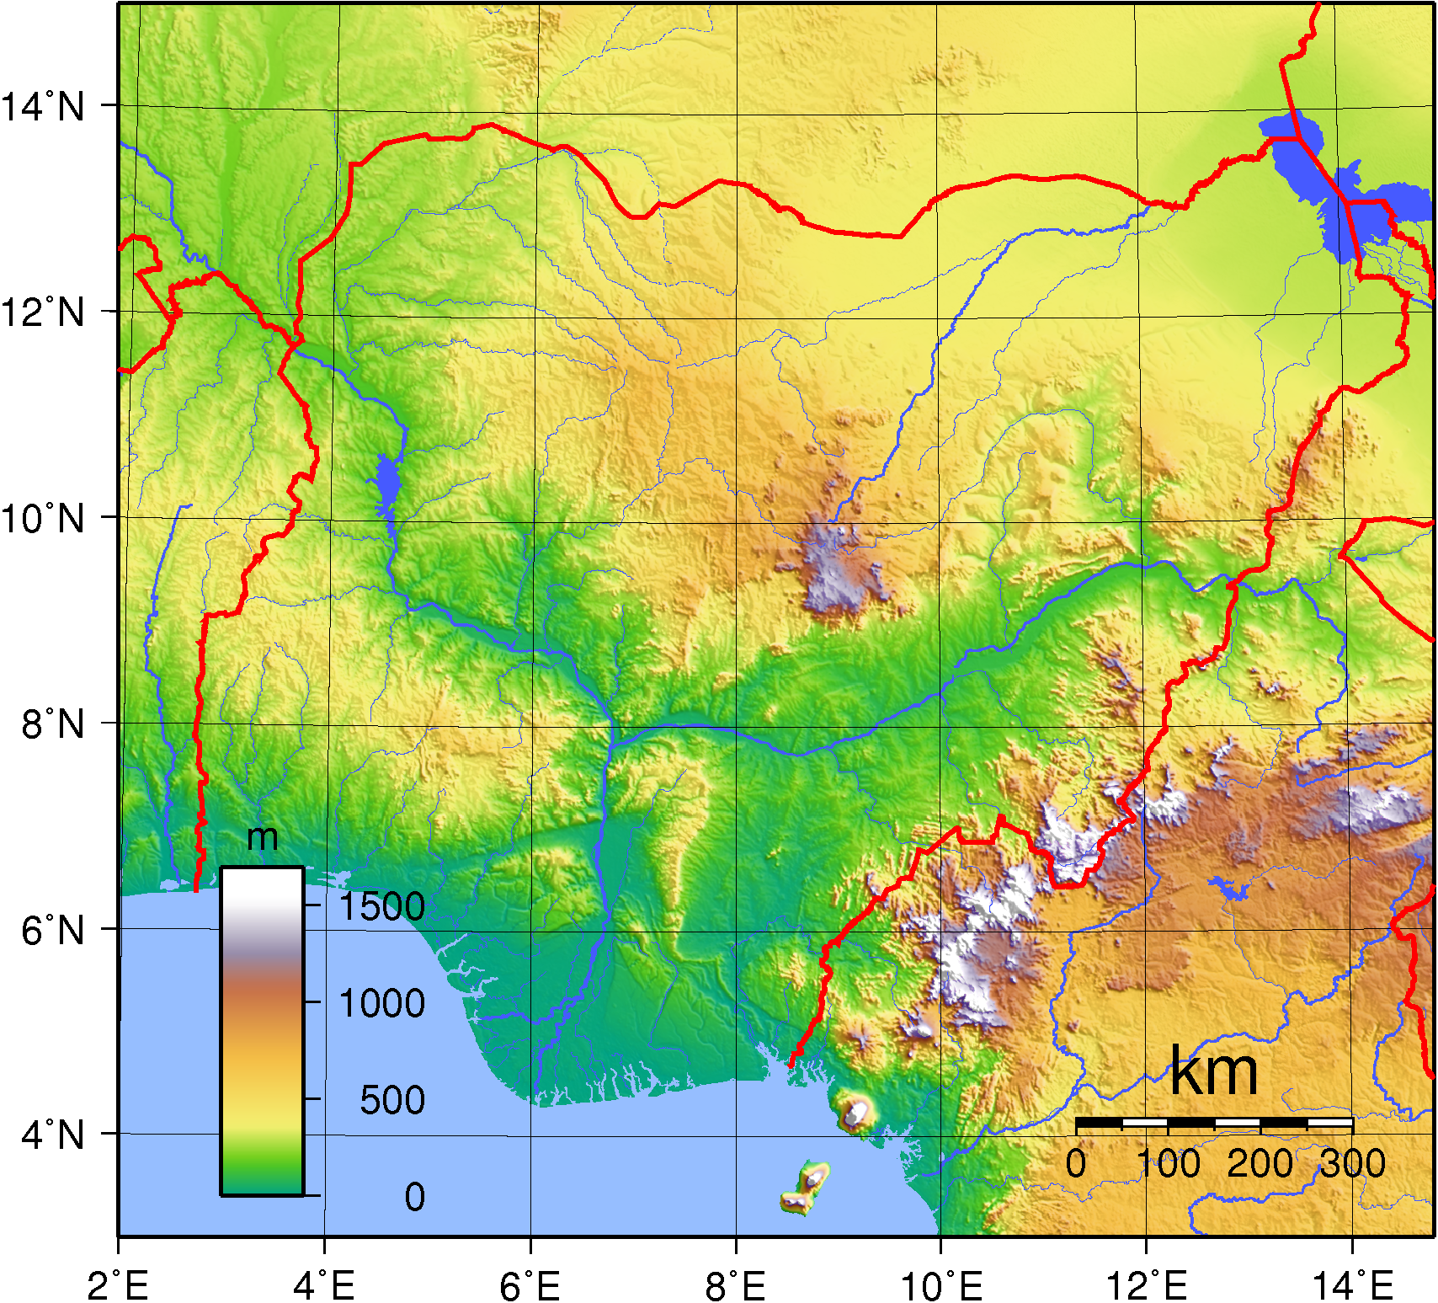
What are the characteristics of Topographic Maps ?
1- They show elevation using lines which join points of equal elevation above sea level .
This Photo by Unknown Author is licensed under CC BY-NC

Slide 8
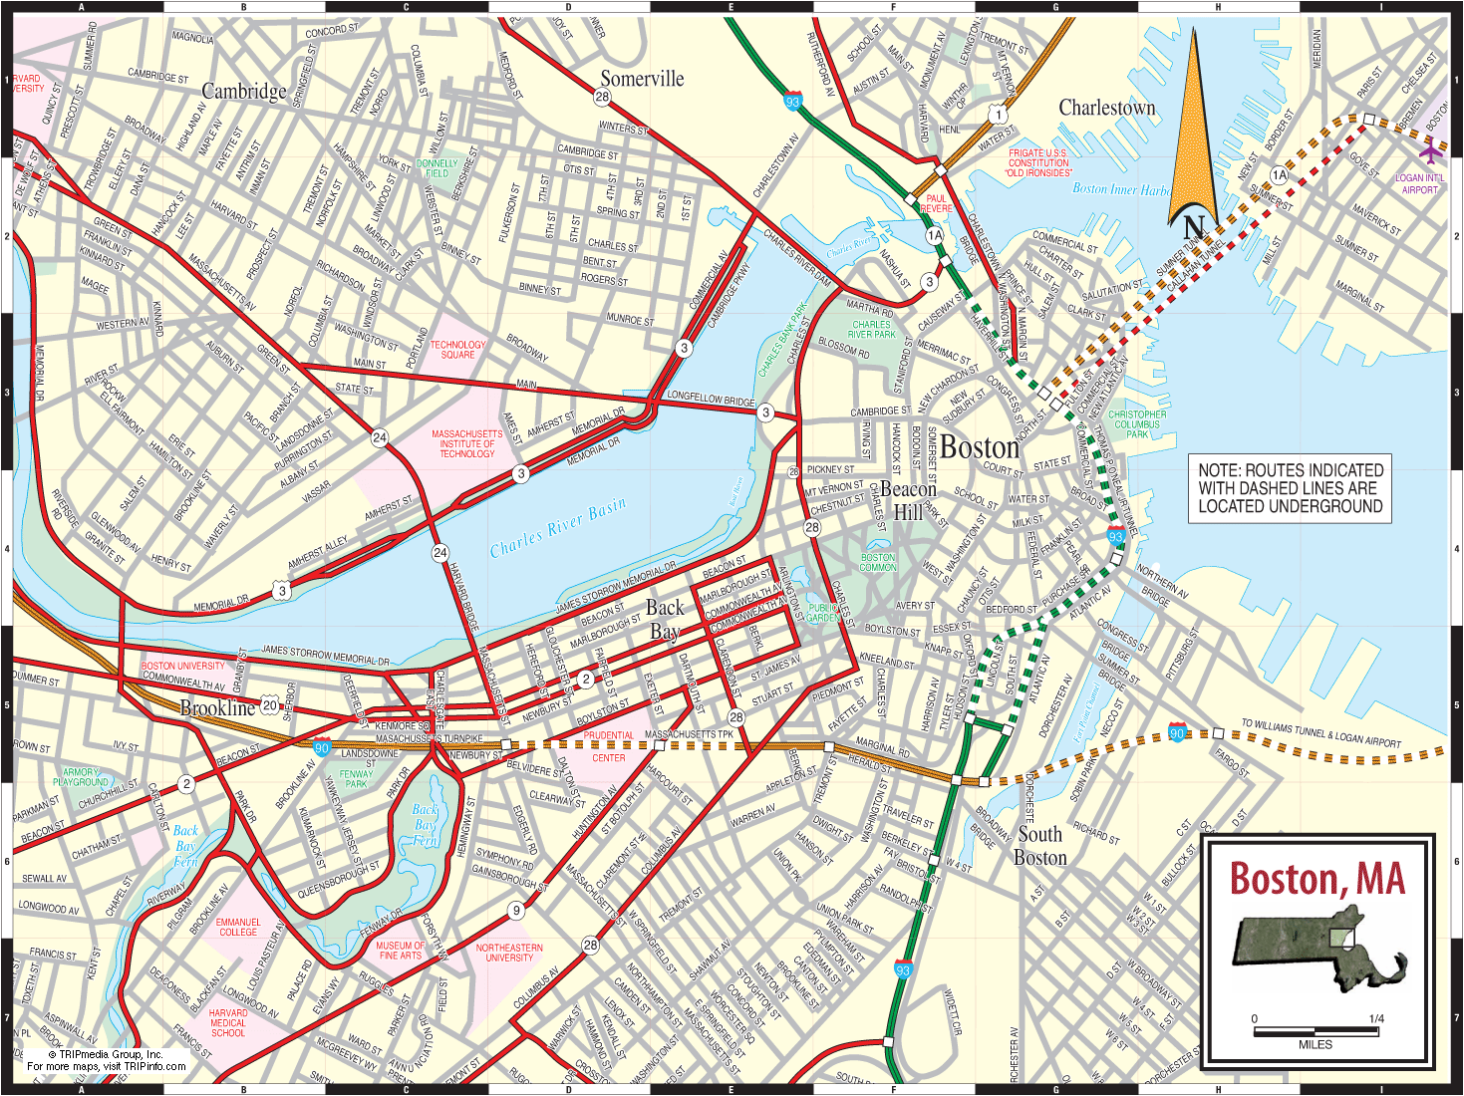
2- They have an emphasis on showing man-made features such as roads and cities , but also include thematic information such as vegetation or the boundaries of national parks .

Slide 9

3- They are typically produced by government agencies .

Slide 10
*Types of information you can find on a Topograhic Map :
1- Culture : roads , buildings , boundaries and railways .
2-Water : lakes , rivers , streams , swamps and rapids .
3-Relief : mountains , valleys , slopes .
4- Toponymy : names of places , names of water features and highway names .

Slide 11
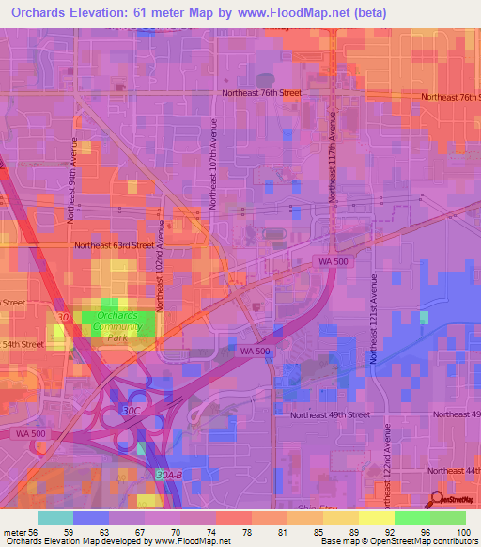
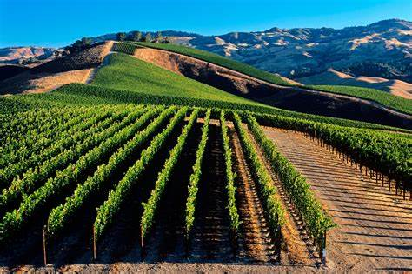
5-Vegetation : wooded and cleared areas , vineyards and orchards .

Slide 12
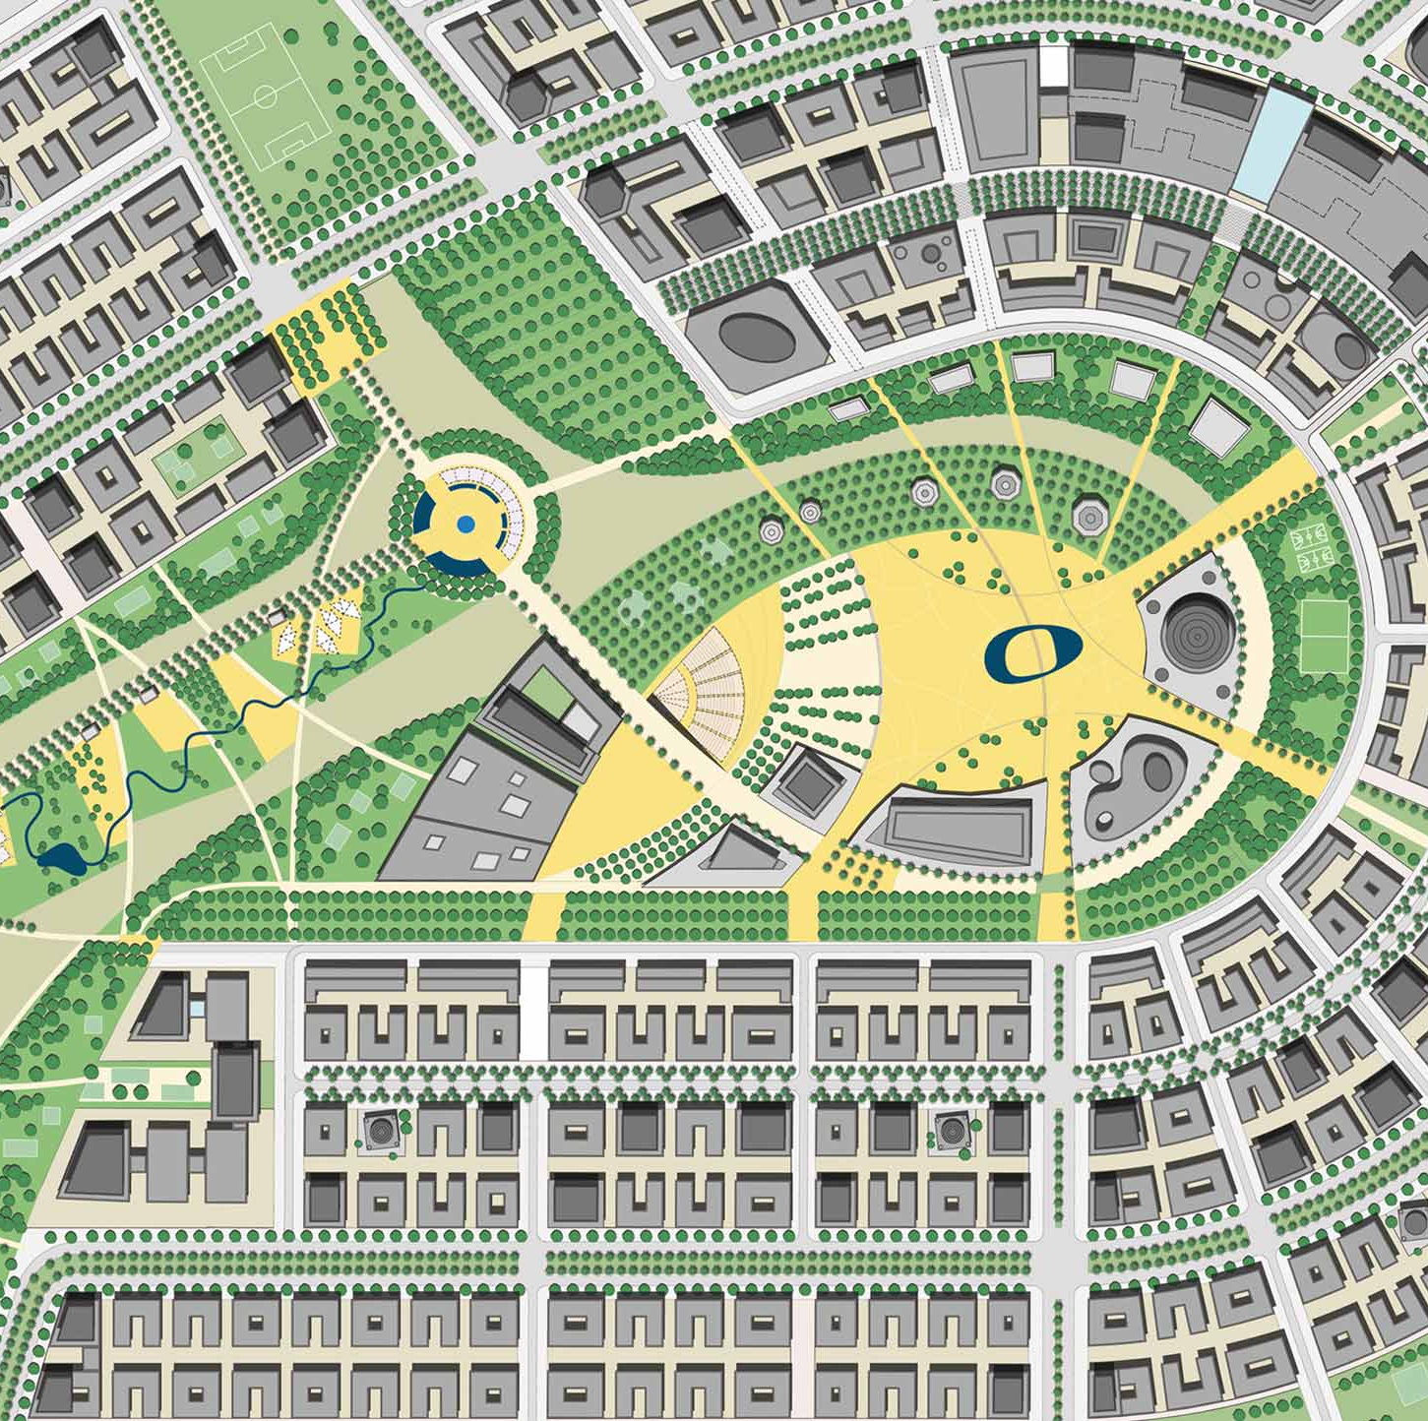
*The importance of Topographic Maps :
No other map has a wider application in modern society than a topographic map .
These maps are used for canoeing , camping , hunting and fishing , to urban planning , resource development and surveying .

Slide 13
*These maps are important to different sectors , institutions and individuals :
1- Governments use topographic maps to :
a)Study the distribution of plants and animals , rainfalls ,or soil types .
b) Determine safe places to build factories , communication towers or houses .
c)Plan the best uses of land .

Slide 14
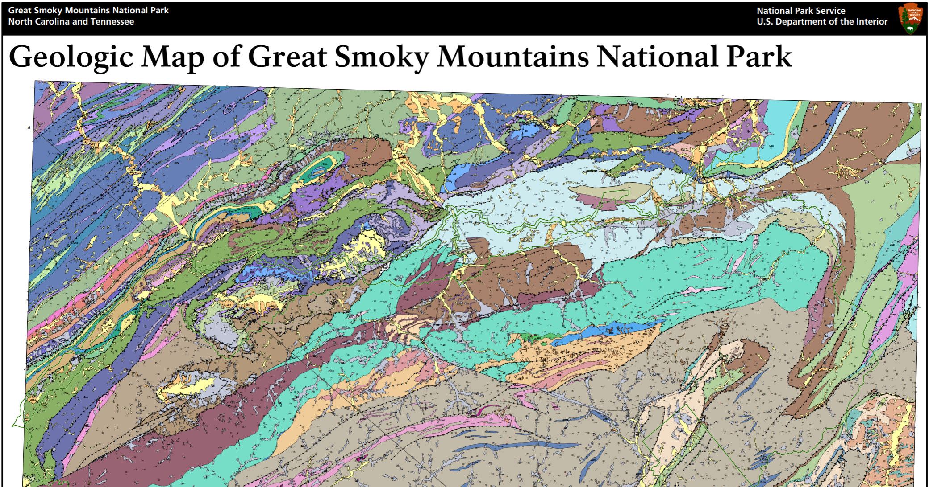
2-Geologists : use topographic maps to make geologic maps , which show what rocks and geologic structures (e.g., faults )are exposed at the surface .

Slide 15
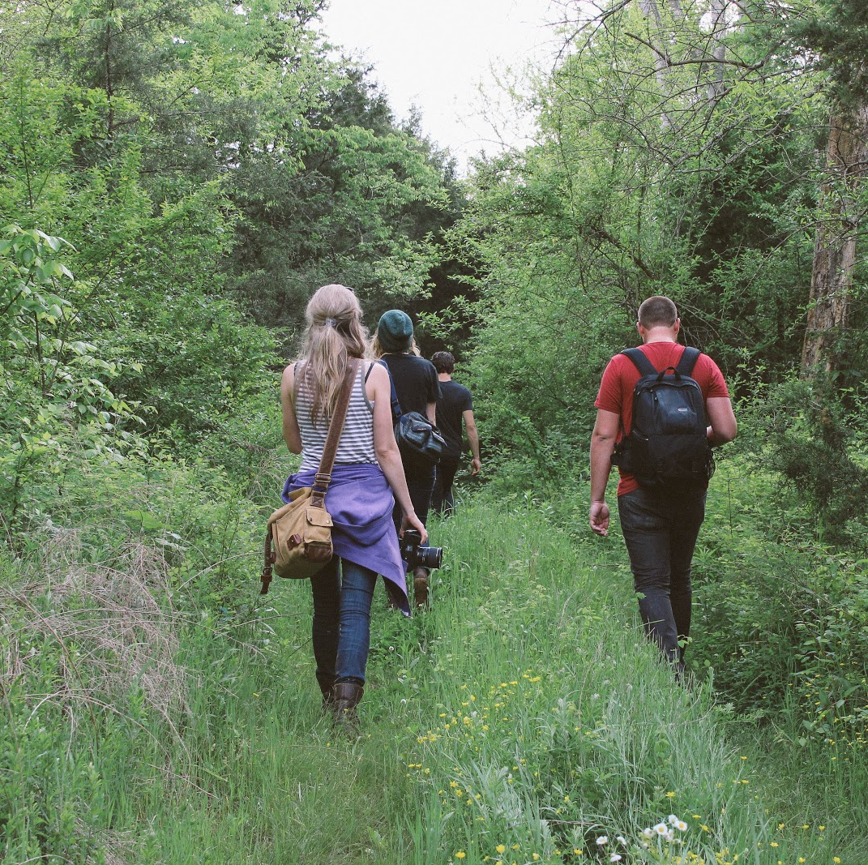
3-Adventurers use topographic maps when trekking , hunting and mountain climbing to :
A) Find their way on a backpacking trip or hike .
B)Find appropriate places for mountain biking or rock climbing .
C) Determine how extreme the conditions will be .

Slide 16
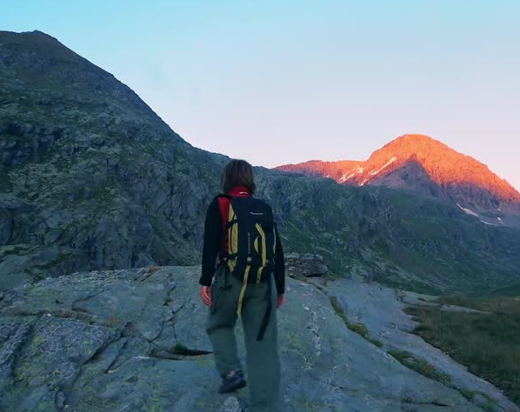
*Explain : Topographic maps help make your outdoor adventures enjoyable and safe ?

