Slide 1
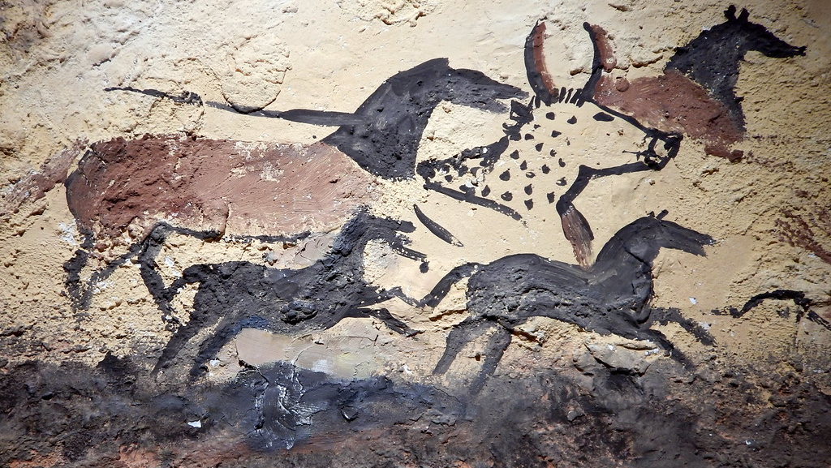
Origins of Civilization
(Prehistory-300 B.C )
This Photo by Unknown Author is licensed under CC BY

Slide 2
*Why is culture important ?
It allows us to connect with our history, values and beliefs .
They provide us with a sense of identity , community , and belonging .
They influence how we interpret events and how we make decisions . For instance : in some cultures , people believe that the supernatural is a powerful force that can influence events in the world .

Slide 3
*Connections to Today :
Where does your food come from ?Have you ever stopped to think of the complicated journeys food takes from farm fields to your table ?In the modern world , machines often collect crops from fields , then trucks take them to factories to be processed into packaged foods .

Slide 4
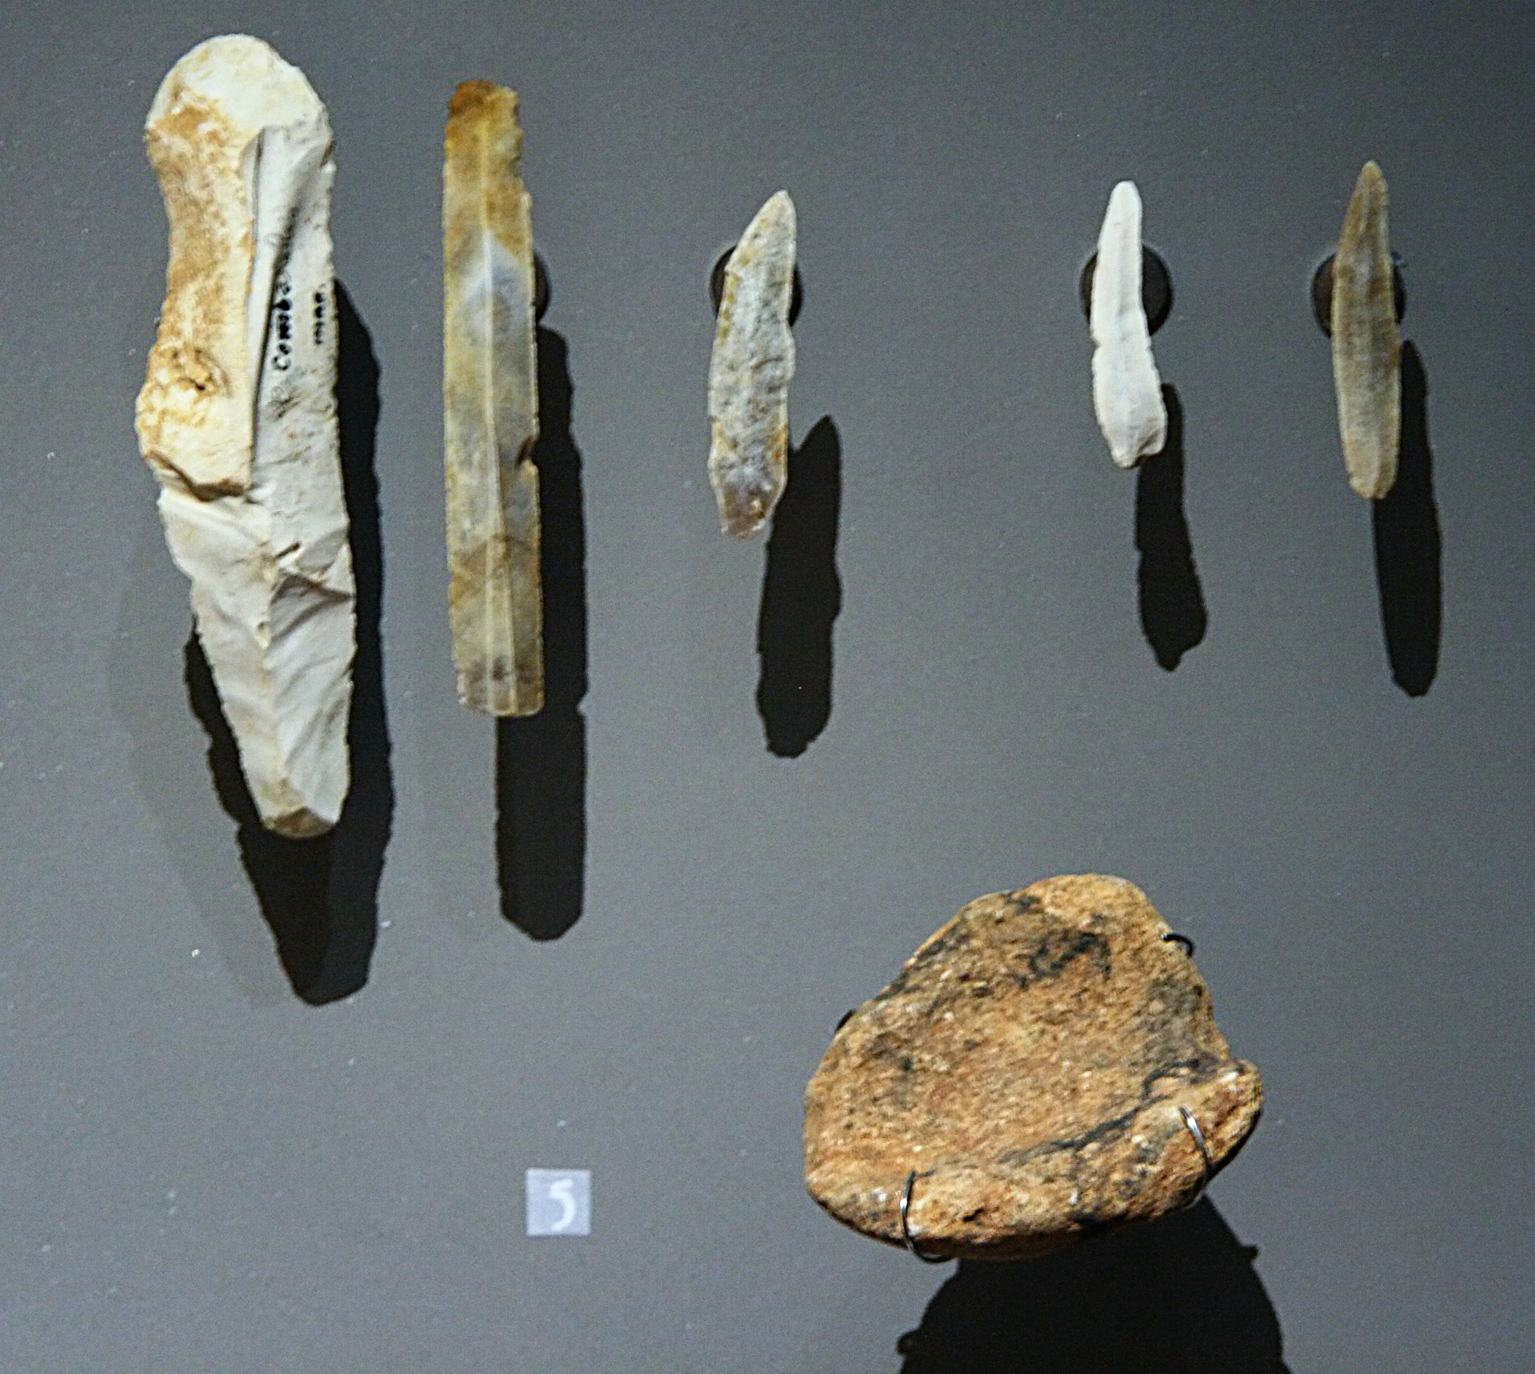
In this lesson , you will learn about early humans and the development of civilization , including human migration ,early tool making , farming , and settlement in river valleys
This Photo by Unknown Author is licensed under CC BY-SA

Slide 5
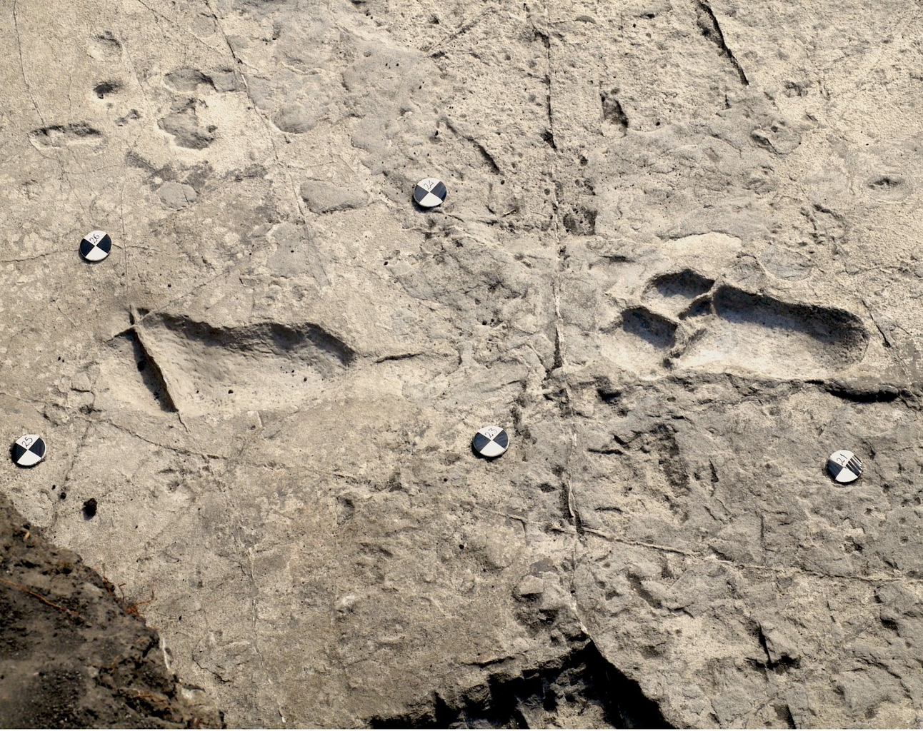
*Studying ancient footprints is one way scientists can learn about the past . These footprints , preserved in volcano ash , were made in Tanzania 3.5 million years ago .
This Photo by Unknown Author is licensed under CC BY

Slide 6
*Learning About our Past :
More than 5,000 years ago , groups of people in different parts of the world began to keep written records . The development and use of writing marked the beginning of recorded history . Humans and their ancestors , however , had lived on Earth for many tens of thousands of years before recorded history .The long period of time before people invented writing is called prehistory .

Slide 7
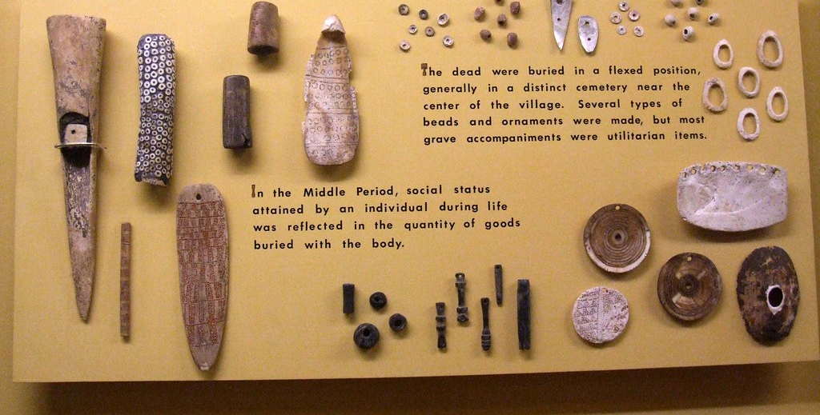
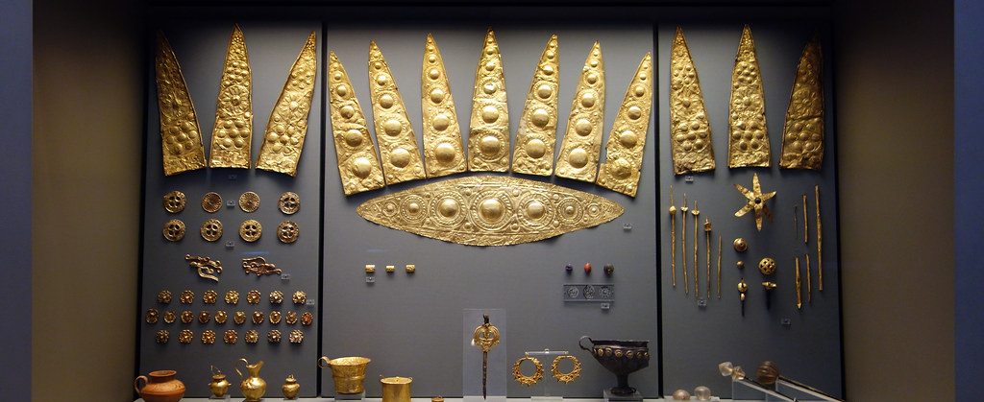
*Studying Prehistory :Understanding our past
Historians are experts in the study of how people lived in the historical past .
Historians study artifacts , or objects made by humans . For example : clothing , coins , artwork , and grave sites are all types of artifacts .
This Photo by Unknown Author is licensed under CC BY-SA-NC
This Photo by Unknown Author is licensed under CC BY-NC

Slide 8
However , historians rely even more on written evidence , such as letters or tax records .
Historians of the recent past also study such evidence as photographs or films .
Sometimes historians have a wealth of written records . They can study diaries , official histories , birth and death records , and eyewitness accounts . At other times , they have relatively few records , or records that merely list a name or date .

Slide 9
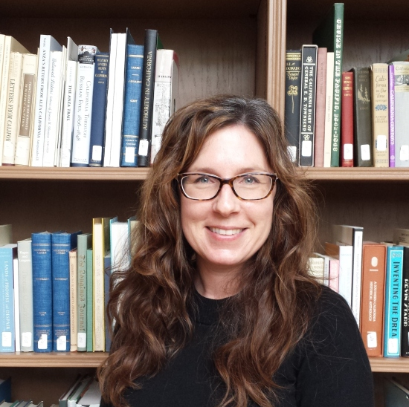
*Like a detective , a historian must evaluate all evidence to determine if it is reliable .For example:
Do records of an official meeting tell us exactly what was said ?Who took notes ? Historians try to find the answers to questions like these .
This Photo by Unknown Author is licensed under CC BY-NC-ND

Slide 10
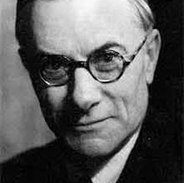
*Historians must then interpret the evidence and explain what it means .
*Often , the historian’s goal is to determine the cause of a certain event , such as war or an economic collapse .
By explaining why things occurred in the past , historians can help us understand current events and , possibly , what might happen in the future
This Photo by Unknown Author is licensed under CC BY

Slide 11
*Generally ,historians try to give a straightforward account of events . However ,personal experiences , cultural backgrounds , or political opinions affect their interpretations .
*Other times , historians disagree with one another about what the evidence proves . Such differences can lead to lively debates .
*The first historians began writing thousands of years ago . Early historians wrote mostly about the deeds of well-known people , such as kings and queens , or about great battles . Their histories were about political events .

Slide 12
*Today , historians still write about political events . Yet other historians study the lives of ordinary people . They study social or economic history at the local level .
For instance : How did workers earn a living ?What was family life like ?How were women or children treated ?The answers to these questions increase our understanding and knowledge of the past .

Slide 13
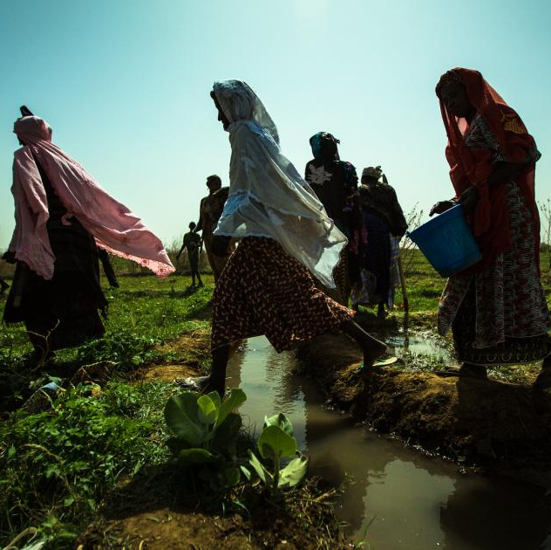
*Critical thinking :What kinds of evidence do historians use to study the past ?
This Photo by Unknown Author is licensed under CC BY-NC-ND

Slide 14
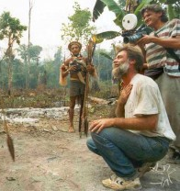
*Investigating Prehistory : The study of prehistory began in the 1800s , when scholars and scientists started to investigate the age of Earth and the life it supported . They developed fascinating new fields of study that shed light on people and their lives , from prehistoric times to the present .
The Field of Anthropology : since ancient times ,people have been interested in the study of their own and other societies .
By the mid-1800s, thinkers had begun the organized study of antropology , or the study of humans ,past and present .
Anthropologists wanted to learn about the origins and development of people and their societies .
This Photo by Unknown Author is licensed under CC BY-SA

Slide 15
*Anthropology includes all aspects of human life in all parts of the world . This field of study is so huge that modern anthropologists specialize .
For example :some anthropologists study the bones of our ancestors to understand how physical traits changed over time . Others focus on the characteristics of human culture .
In anthropology , culture refers to the way of life of a society , which includes its beliefs ,values, and practice . Culture is handed down from one generation to the next through learning and experience .

