Slide 1
LOOK BOTH WAYS
Preview Vocabulary

Slide 2
PREVIEW VOCABULARY
left
right
guard
crosswalk

Slide 3

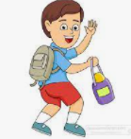
left
opposite of right
past form of “leave”
I sleep at the left side of the bed.
I left my bag in the class.

Slide 4
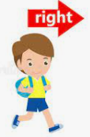

right
opposite of left
correct
I sit at the right side of the mat.
You are right!

Slide 5
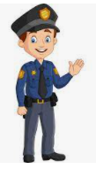
guard
a person who keeps watch
The guard in the mall helps me.

Slide 6
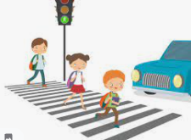
crosswalk
a marked part of the road where people can safely cross
Cars stopped before the
crosswalk.

Slide 7
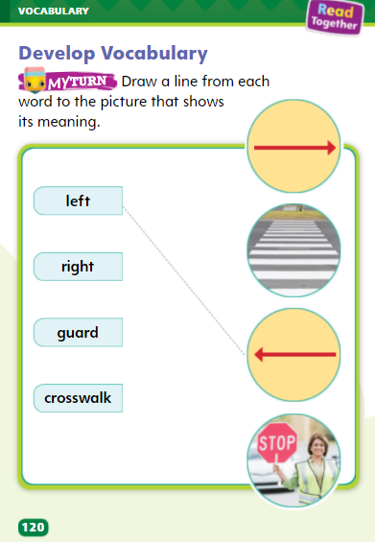
PREVIEW VOCABULARY

Slide 8
Let’s practice!
1. I must circle the (left, right) answers in the exam.
2. You (crosswalk, left) this book yesterday when you went home.
3. A (guard, crosswalk) is standing near gate.
4. I write using my (guard, right) hand.
5. The opposite of right is (left, guard).
6. That guy who is wearing brown uniform is the (left, guard) of this mall.
7. The boys are sitting on the right side of the playground, while girls sit on the (left, crosswalk) side.
8. (Guard, Crosswalk) are made in the road to keep us safe.

