Slide 1

Ivy’s Journal

Slide 2
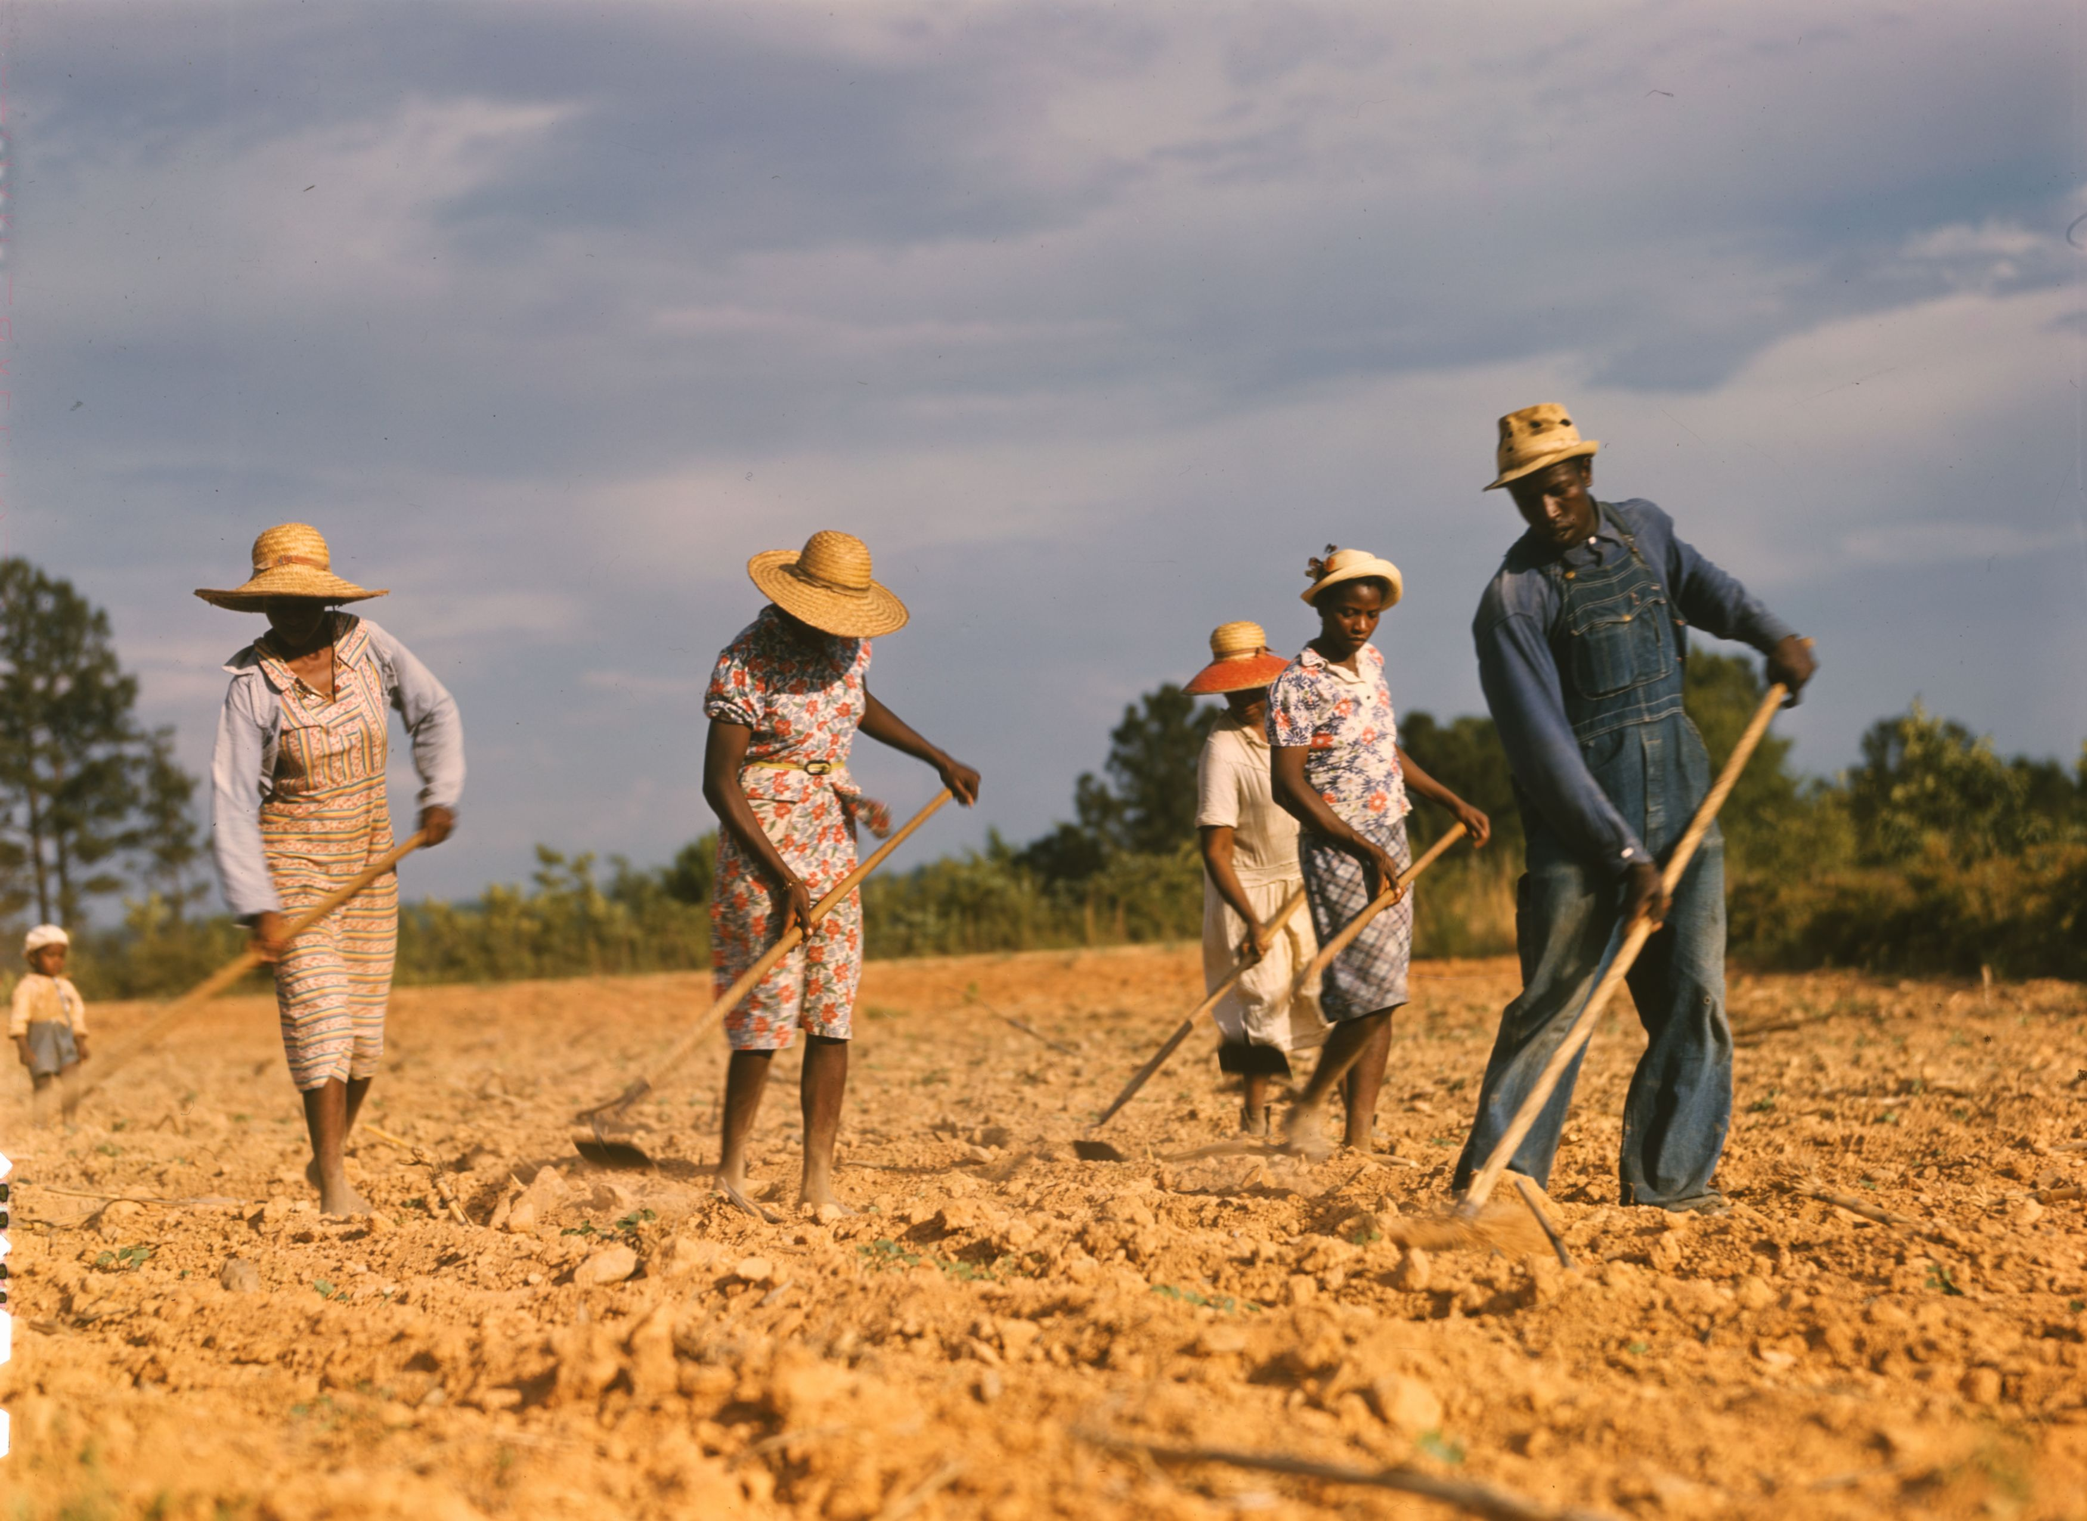
*Vocabularies :
1- Sharecroppers : farmers who pay for the land they rent with a percentage of the crop .
This Photo by Unknown Author is licensed under CC BY-SA

Slide 3

2- War effort : the pulling together of people and resources to support the military during a war .

Slide 4
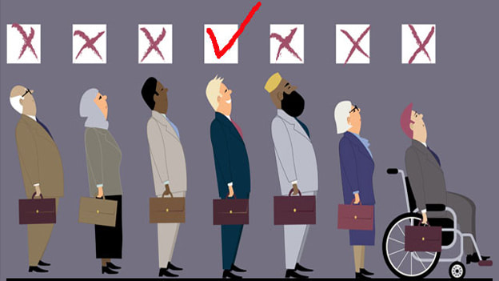
3- Discrimination : the unfair treatment of a group of people based on certain categories , such as race .
This Photo by Unknown Author is licensed under CC BY-SA-NC

Slide 5
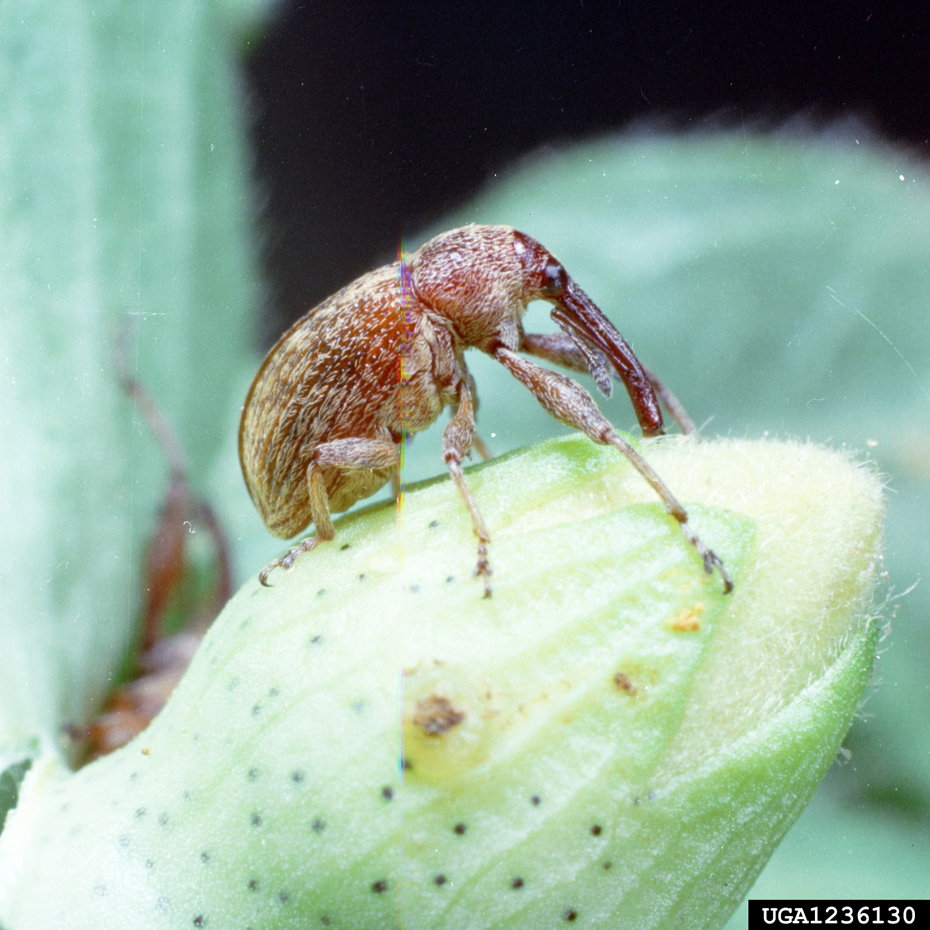
4-Boll weevils : small insects that feed on the fiber of cotton plants .
This Photo by Unknown Author is licensed under CC BY

Slide 6

5- Integrated : no longer subject to segregation . يدمج

