Slide 1
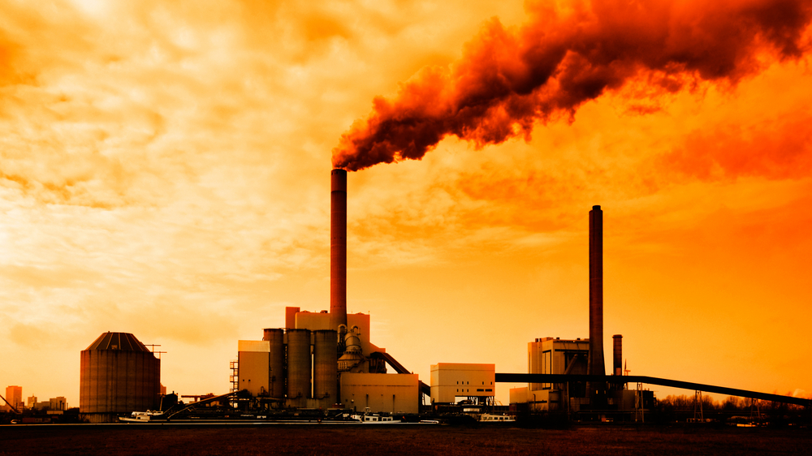
Our Environment :Threats and Solutions .
This Photo by Unknown Author is licensed under CC BY-ND

Slide 2
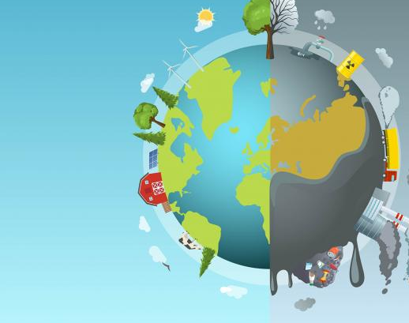
*In this lesson , you will learn more information about the threats posed by changes to our environment and offer some of the possible solutions .
This Photo by Unknown Author is licensed under CC BY-SA

Slide 3
*Shifting Sands : In the 1930s , a severe drought hit the Great Plains of North America .
For many years , this region had been developed by farmers to grow wheat .But then it stopped raining .Crops failed . The soil turned to dust .
Wheat has shallow roots , and the roots were exposed during the heavy winds of the drought .
These heavy winds picked up the dust and carried it across the land in thick clouds .

Slide 4
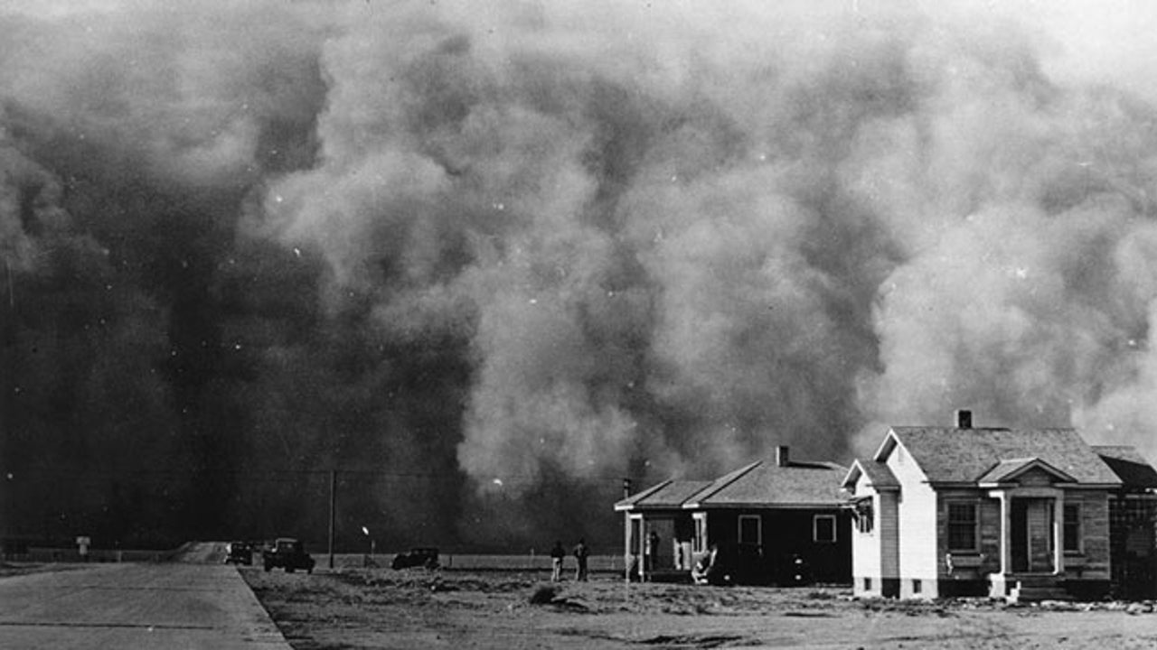
*Farmers in the United states and Canada called them “Black blizzards “. During this time , this region was called the Dust Bowl .
This Photo by Unknown Author is licensed under CC BY-SA

Slide 5
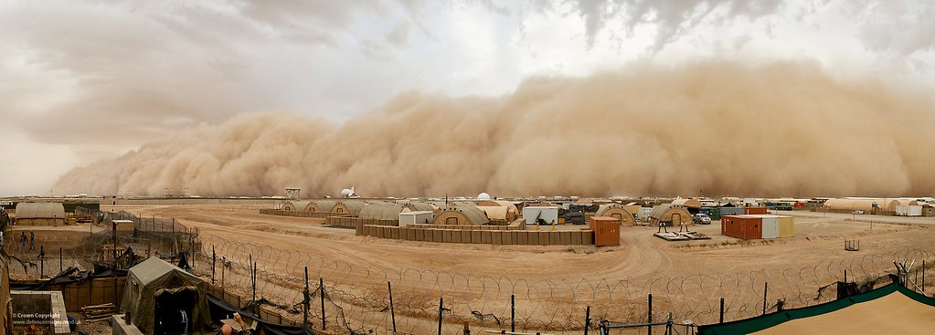
*Scientists now know that the Dust Bowl was an early sign of climate change , which is a change in the average climate of a region over a long period of time .
This Photo by Unknown Author is licensed under CC BY-NC-ND
Earth is warming and that is causing many problems .Natural weather events , such as sand storms called haboobs , have taken place regularly in desert regions for thousand of years , but today they are much more intense , or powerful . Scientists believe this change is due to increased use of fossil fuels to generate power worldwide .

Slide 6
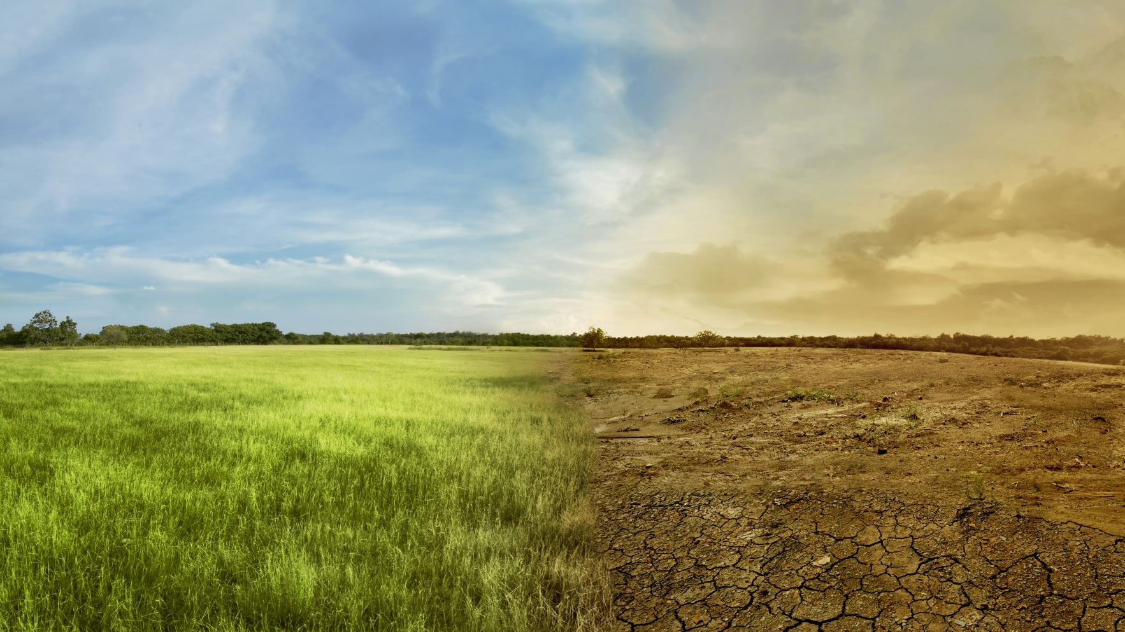
*Three things are necessary for a haboob to form . First , there needs to be an area of land with a lot of loose sand or soil . Next ,conditions need to be very dry . Finally , there needs to be a strong wind to pick up the sand or soil and move it . These conditions occur more often in desert regions , but as Earth’s temperature warms , they are taking place over wider areas .

Slide 7
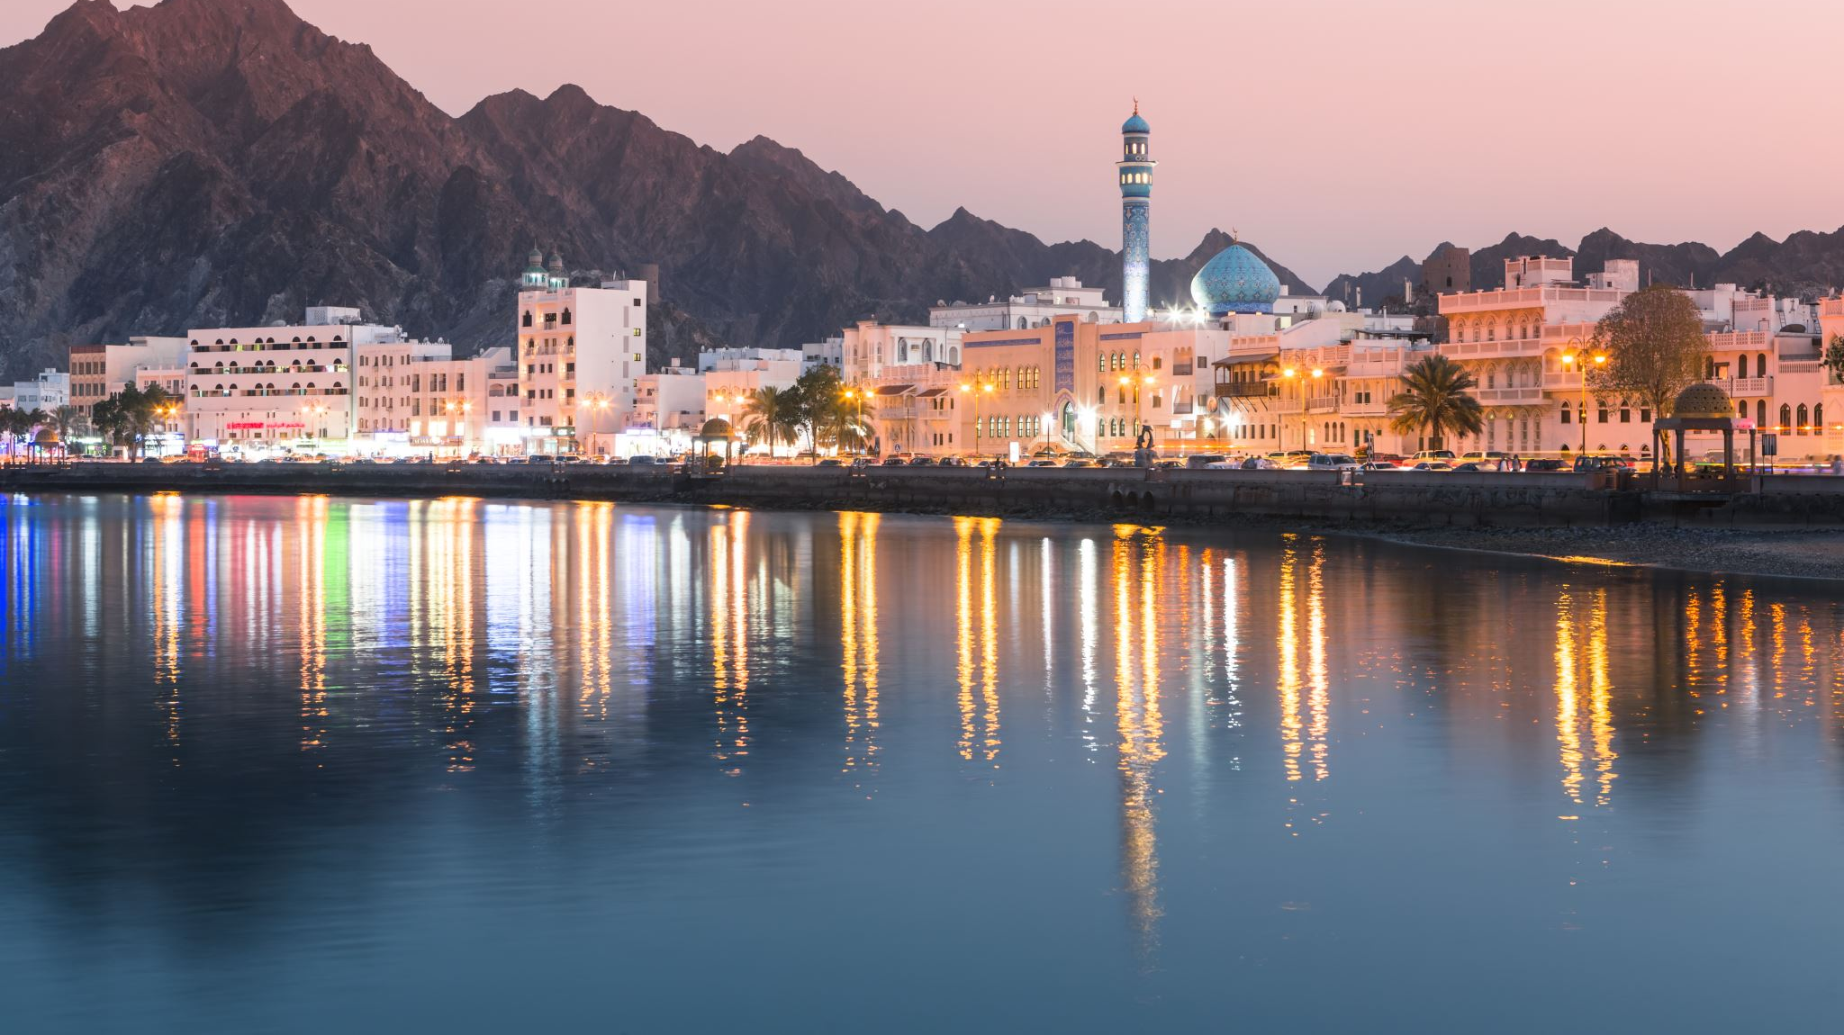
*In May 2022 , an enormous haboob spread over the Arabian Peninsula and reached the Red Sea . It lasted for days , and more than 1,000 people went to the hospital with breathing problems and other illnesses .

Slide 8
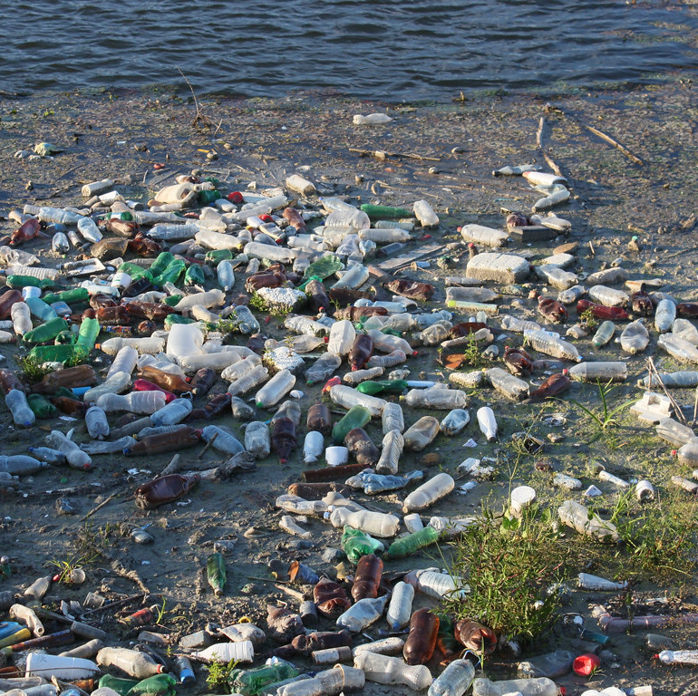
*Pollution and Depletion : Humans have always changed our environment by pilling up or burying our trash .
Now that there are so many humans on the planet , we have many sources of trash and other substances that contaminate , or cause harm to , our planet .
Pollution has become major global problem . Trash and chemicals are dumped into streams , harming wildlife and making our water unsafe to drink .
This Photo by Unknown Author is licensed under CC BY

Slide 9
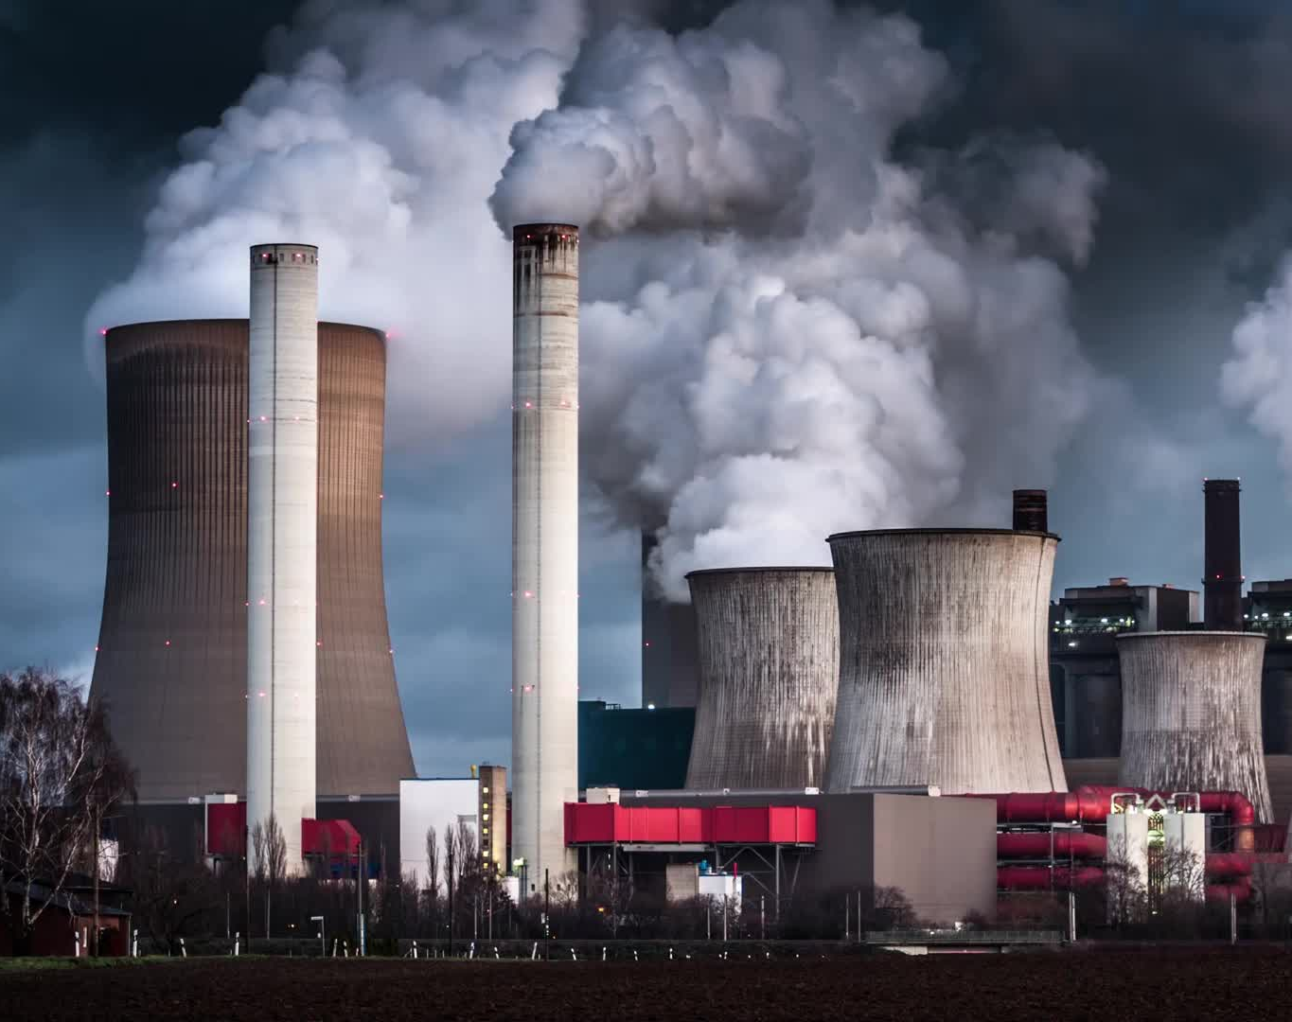
*Factories and gas –powered vehicles release chemicals into the air , making it safe to breathe . This pollution can spread far and wide .

Slide 10
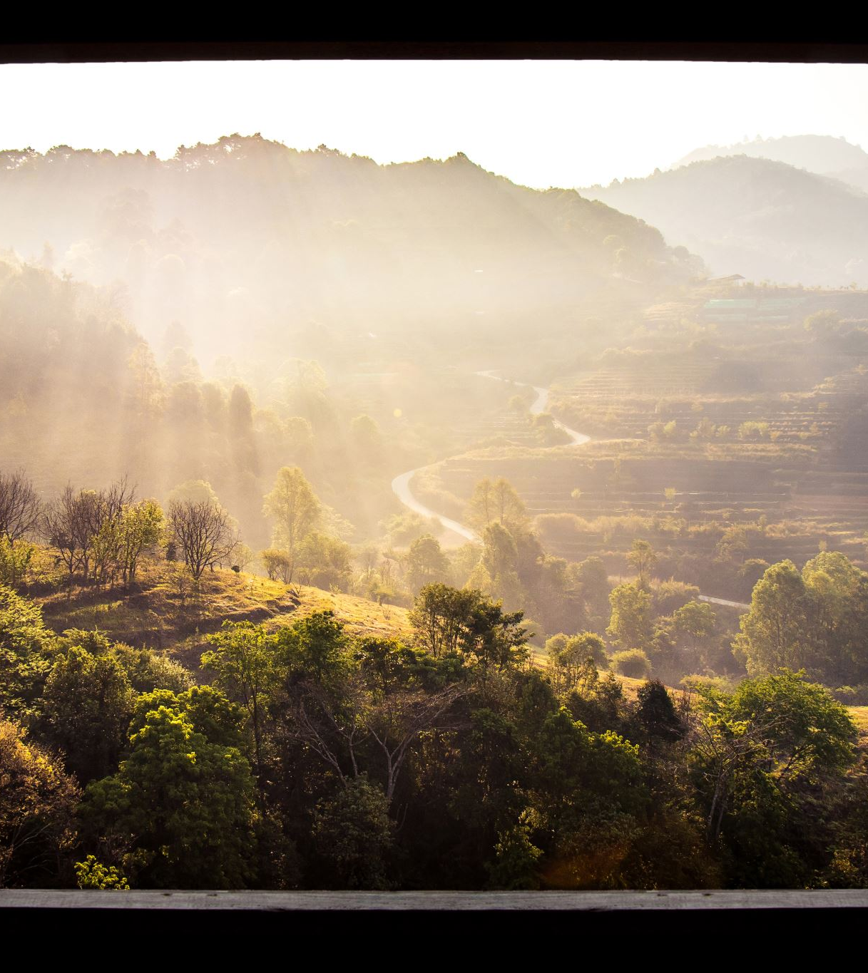
*Depletion is another negative , or bad , way humans have affected the environment .
Depletion is the act of reducing the amount or quality of something .
Human activity can cause the depletion of many natural resources .
Deforestation and soil erosion by cutting down forests and not using the best agricultural practices are types of depletion .

Slide 11
*Critical thinking : What are three sources of pollution in your community ?

Slide 12
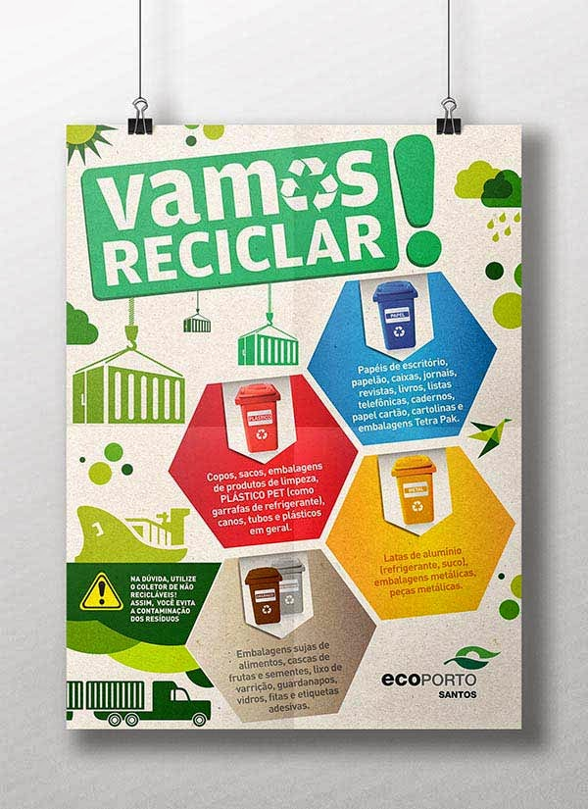
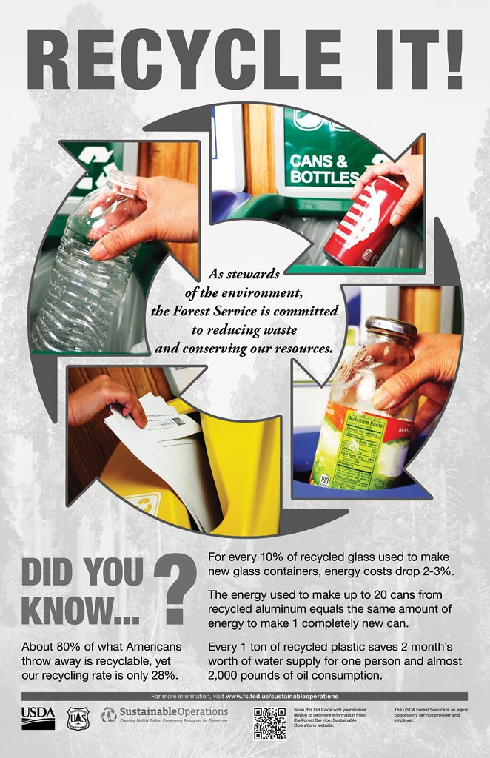
*Solutions and Sustainability : The problems seems overwhelming , but there are solutions .
People can reduce their use of plastic , recycle, plant garden , and grow trees . Many countries use wind farms to generate electricity . These are all examples of sustainability .
This Photo by Unknown Author is licensed under CC BY

Slide 13
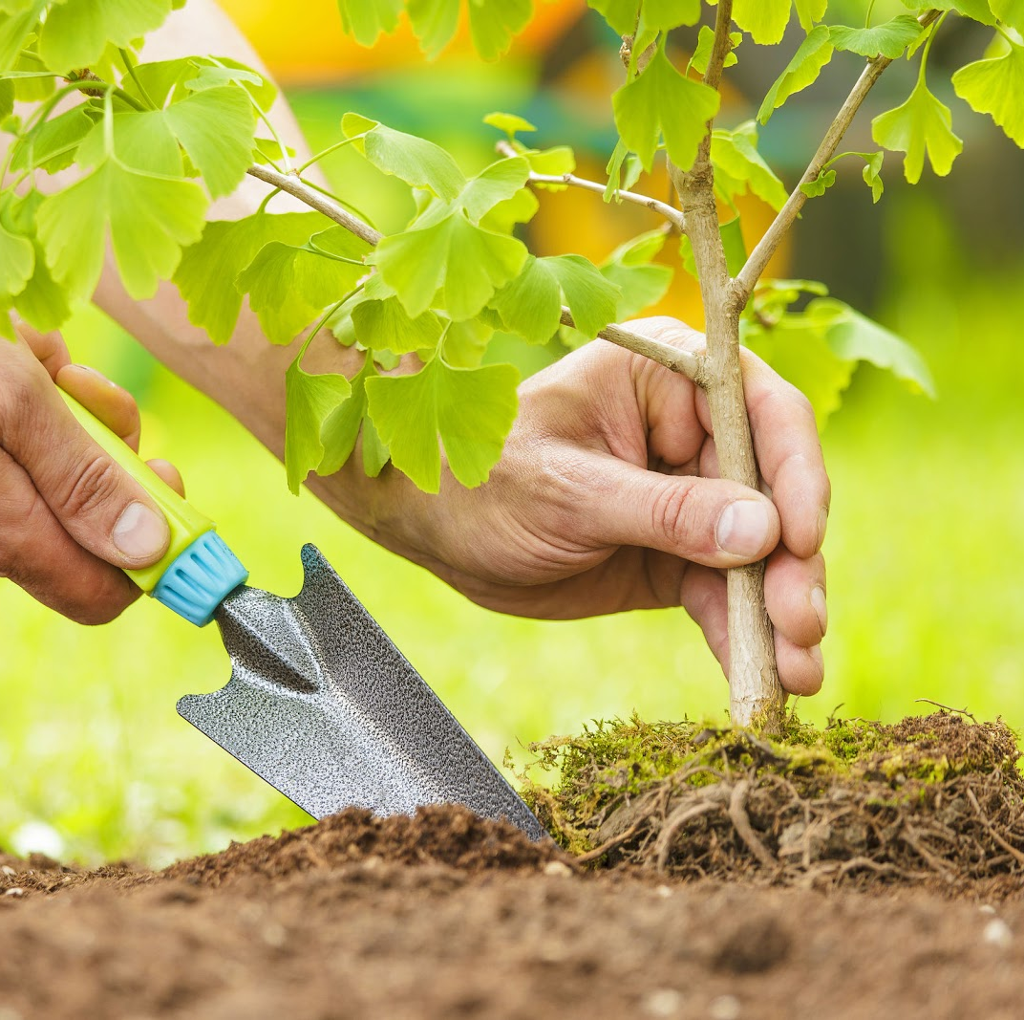
*Sustainability is the idea that people must protect natural resources so they will be around for people in the future to use .
People can work to keep water clean and use less of it . Trees can be replanted to protect forests . By using sustainable practices , people can make sure they have a positive impact on the environment .
This Photo by Unknown Author is licensed under CC BY-ND

Slide 14
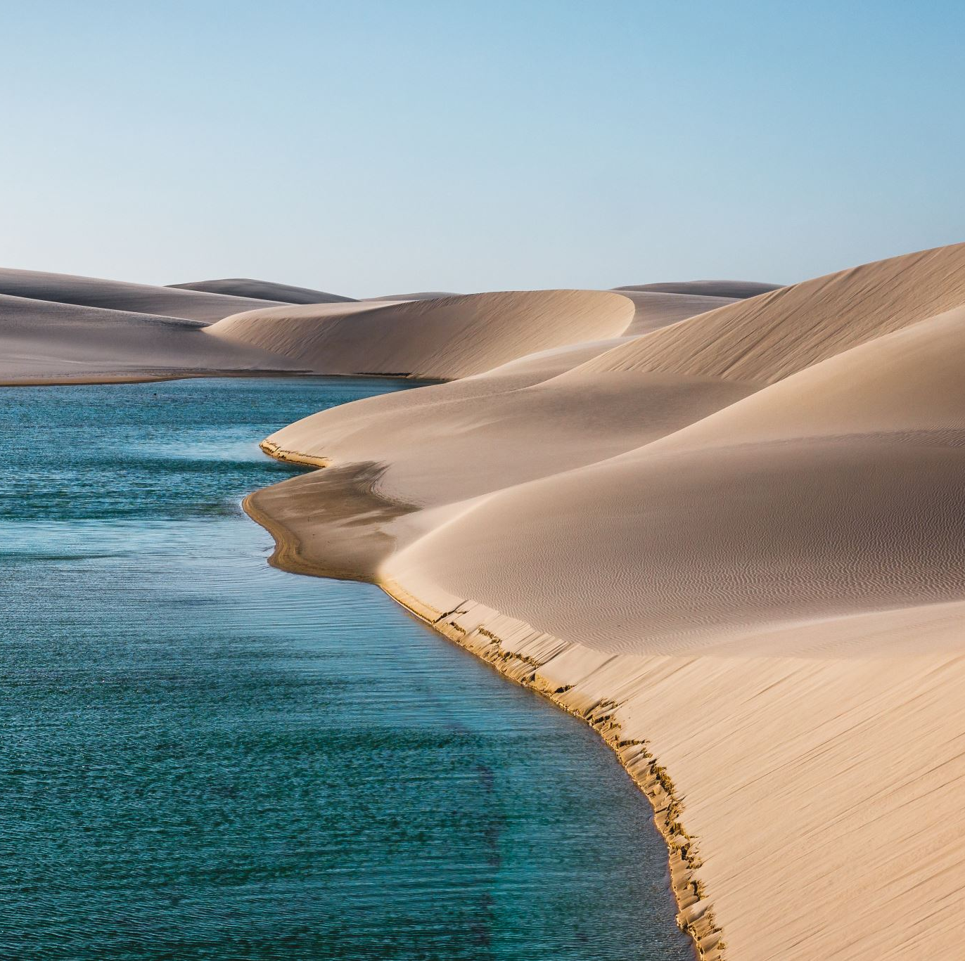
Many countries in the Middle East use desalination to remove salt from sea water to make fresh water .
National parks help sustain the environment ns can protect threatened resources through their national park systems by setting aside areas of land and habitats from development and depletion .
People can visit and enjoy the land , plants , and animals in the parks . These parks help sustain the environment .

