Slide 1
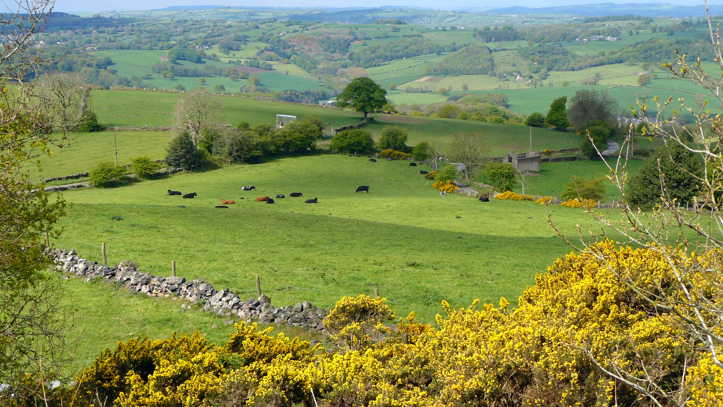
Vegetation Regions

Slide 2
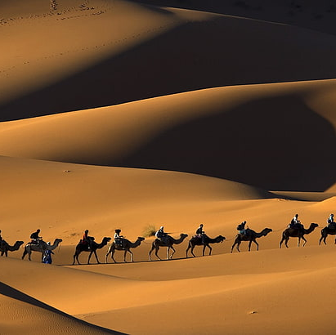
*Geographers divide the land on Earth into vegetation regions , or areas with specific types of soil , plants , and weather patterns .
They can be sorted into five major categories : forest , desert , grassland , tundra , and icesheet .
People can learn about the climate , soil type , and other physical features of an area from its vegetation .
Vegetation also impacts the animal life in a particular area .

Slide 3
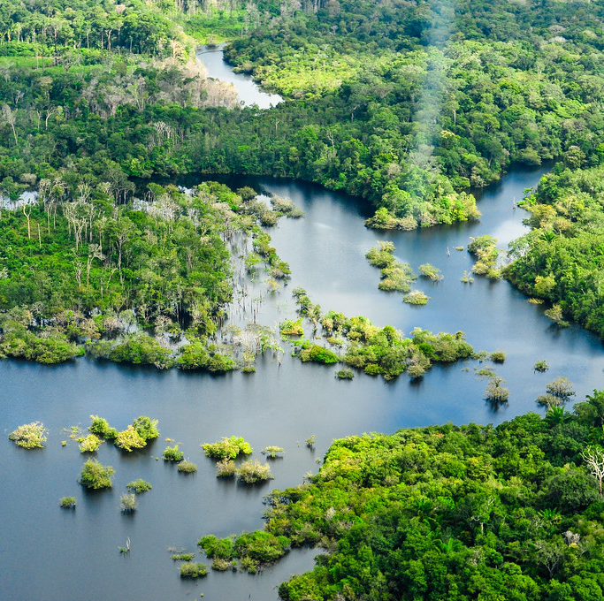
*Regions with less vegetation have fewer animals . Understanding the pattern of vegetation in a region can help keep soil healthy and vegetation growing .
Vegetation regions contribute to human life in many ways . For instance , vegetation can help fight climate change .
The Amazon Rainforest is a great example of this. It is the largest rainforest in the world . It is sometimes called the (Lungs of the world ).
This Photo by Unknown Author is licensed under CC BY-NC-ND

Slide 4
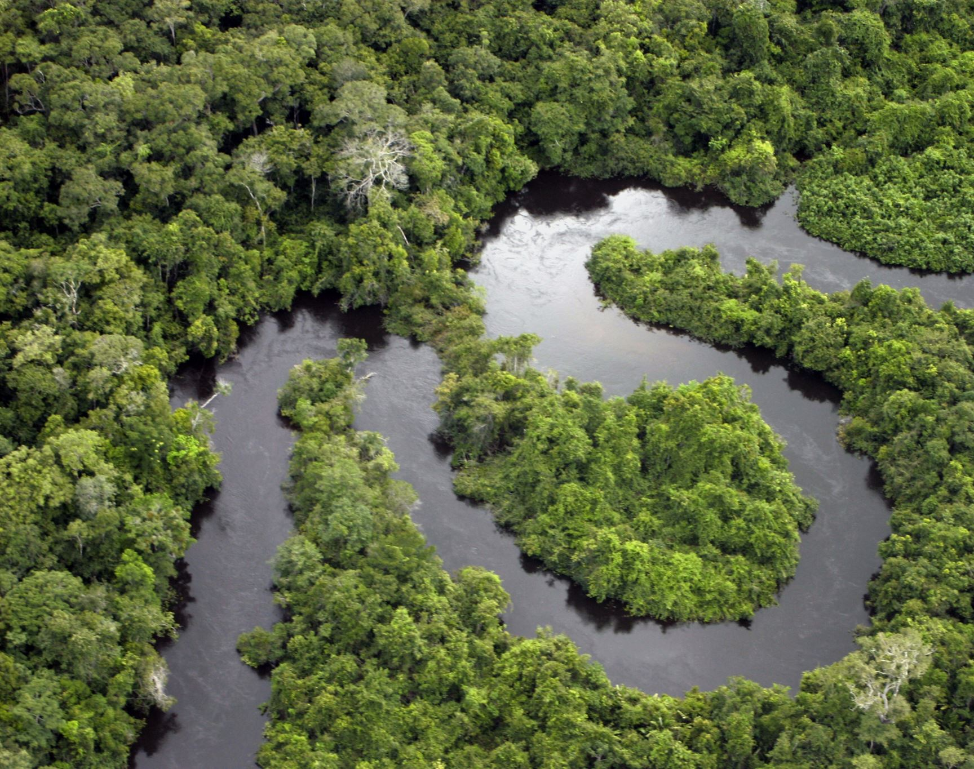
* Why is the (Amazon Rainforest )called lungs of the world ?
Because , the trees trap a lot of the world’s carbon dioxide and produce a grat amount of oxygen .

Slide 5
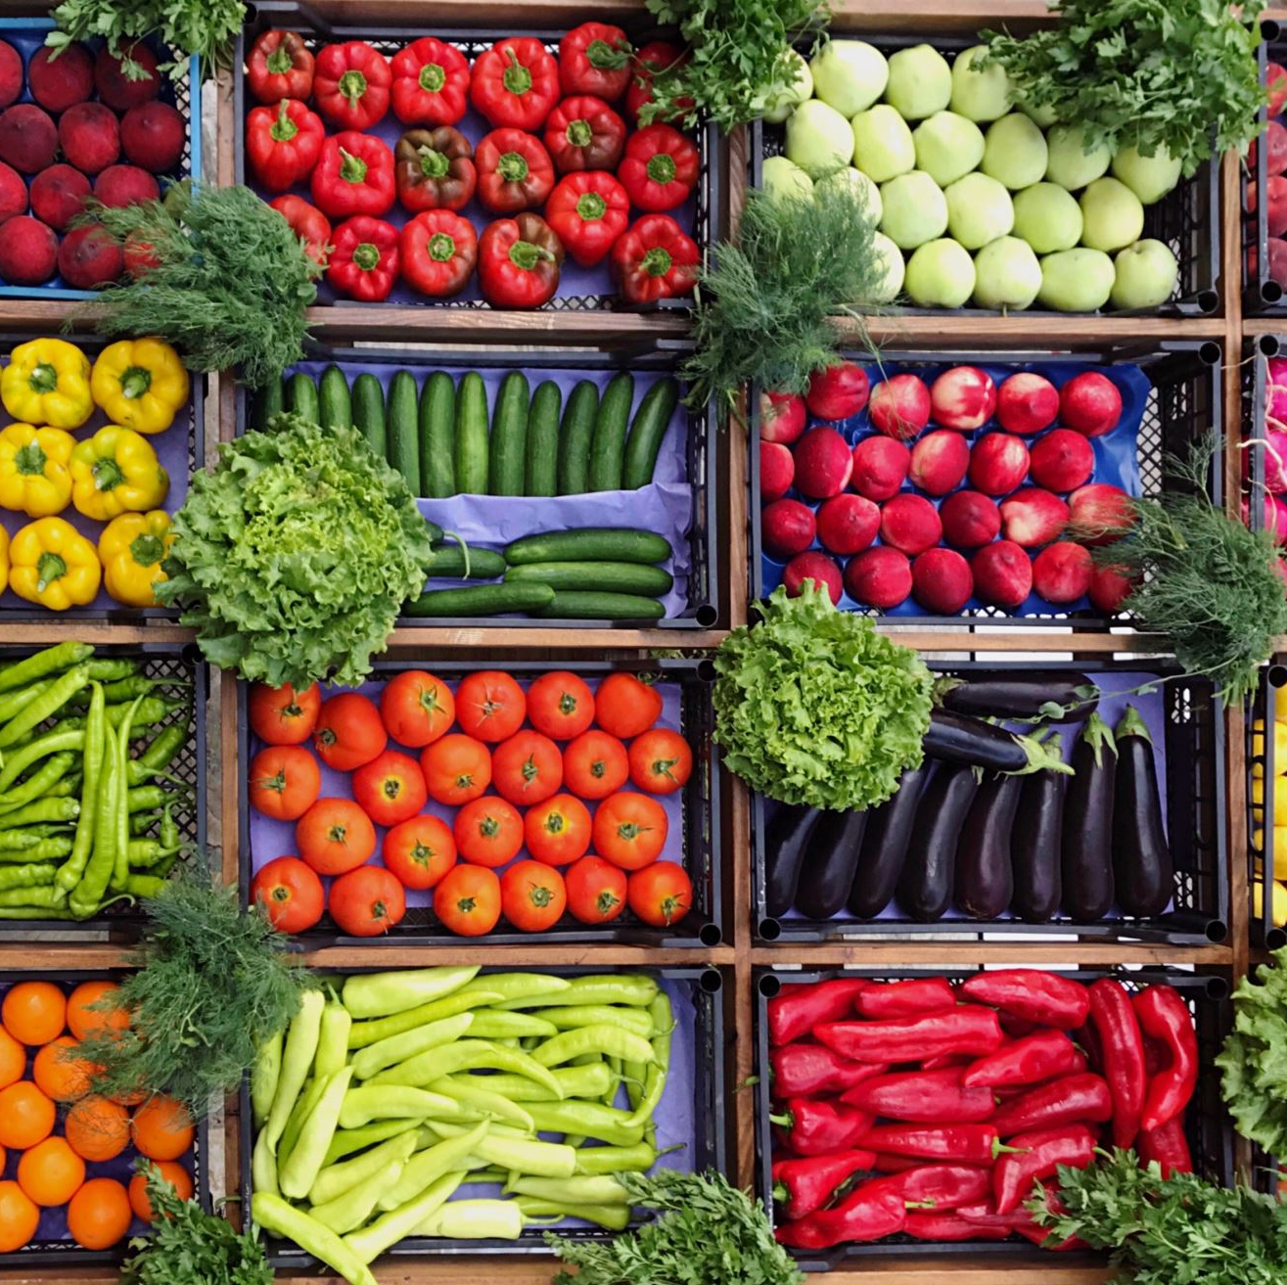
*Also humans depend on products made from vegetation . For example : people use timber for building , and people eat vegetables and fruit from many plants .
Moreover , people can do a variety of activities in these regions . They can go hiking , camping , or boating .

Slide 6
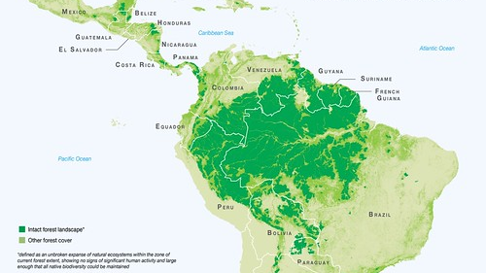
South America
This Photo by Unknown Author is licensed under CC BY-SA-NC

Slide 7
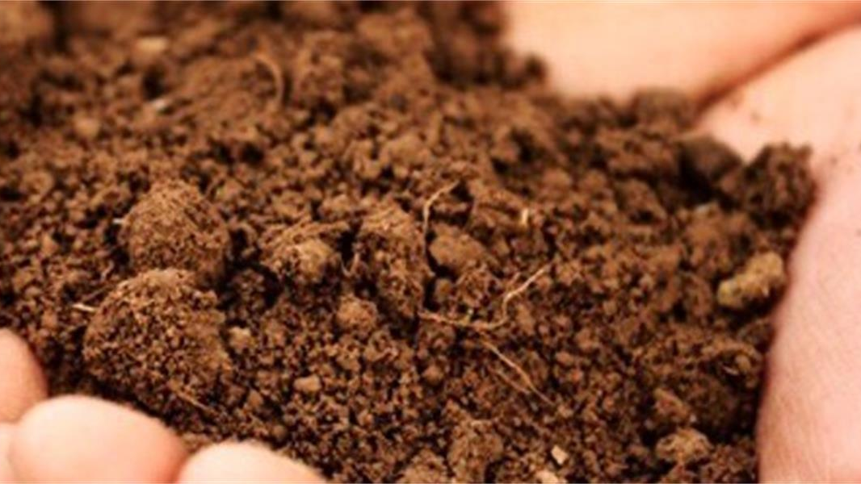
*Features of Vegetation : The main feature of vegetation regions is their plant life . Many factors affect the growth of plants in a particular place .
Such factors include topography , wind patterns , soil quality , water , and sunlight .
For example :some plants grow well in sandy soil , while others need heavier soil with more clay .
This Photo by Unknown Author is licensed under CC BY

Slide 8
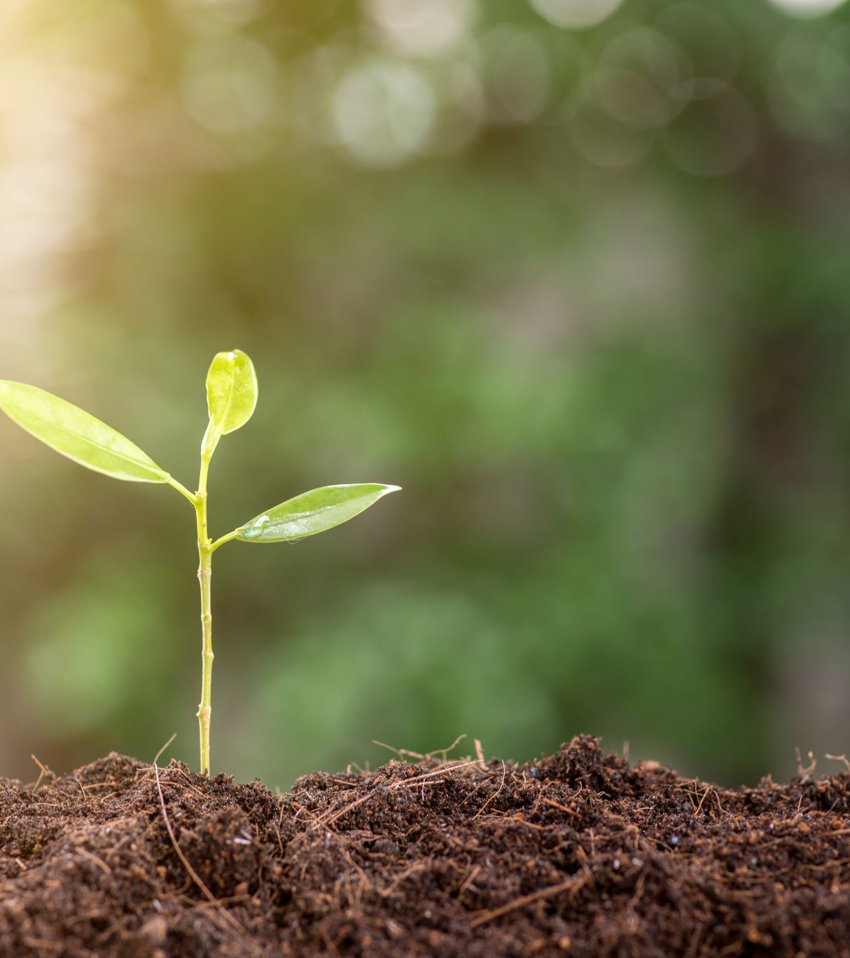
*Each type of soil has its own set of nutrients . Plant nutrients are substances that plants need to live , stay healthy , and produce energy .
The nutrients in each type of soil determine the kinds of plants that grow in that soil .
Precepitation and temperature also pay an important part in determining what types of plants grow in a vegetation region .

Slide 9
*Geographers look at the type of ………………..,the type of ……………….,and the climate of a place to decide its vegetation region .

Slide 10
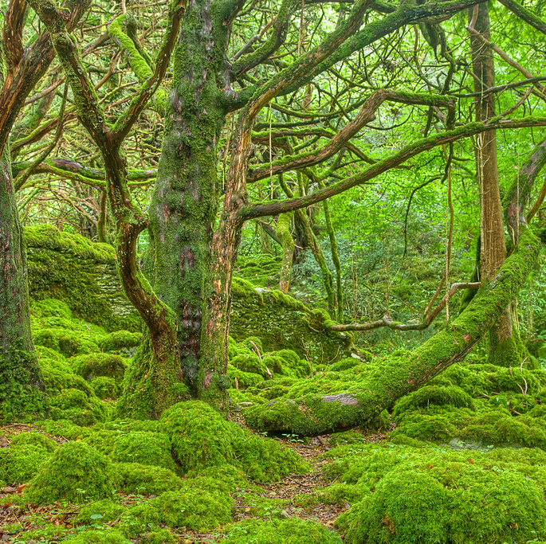
*Forest :are places where trees are grouped closely together and shade a large part of the ground . There are many kind of forests .
In places with warm temperature and high rainfall and humidity , like Brazil , there are tropical rainforests .
Northern Europe is much cooler and drier , so it cannot support tropical plants . In this region , the temperature can vary greatly from day to night . Here you will and temperate forests .
This Photo by Unknown Author is licensed under CC BY

Slide 11
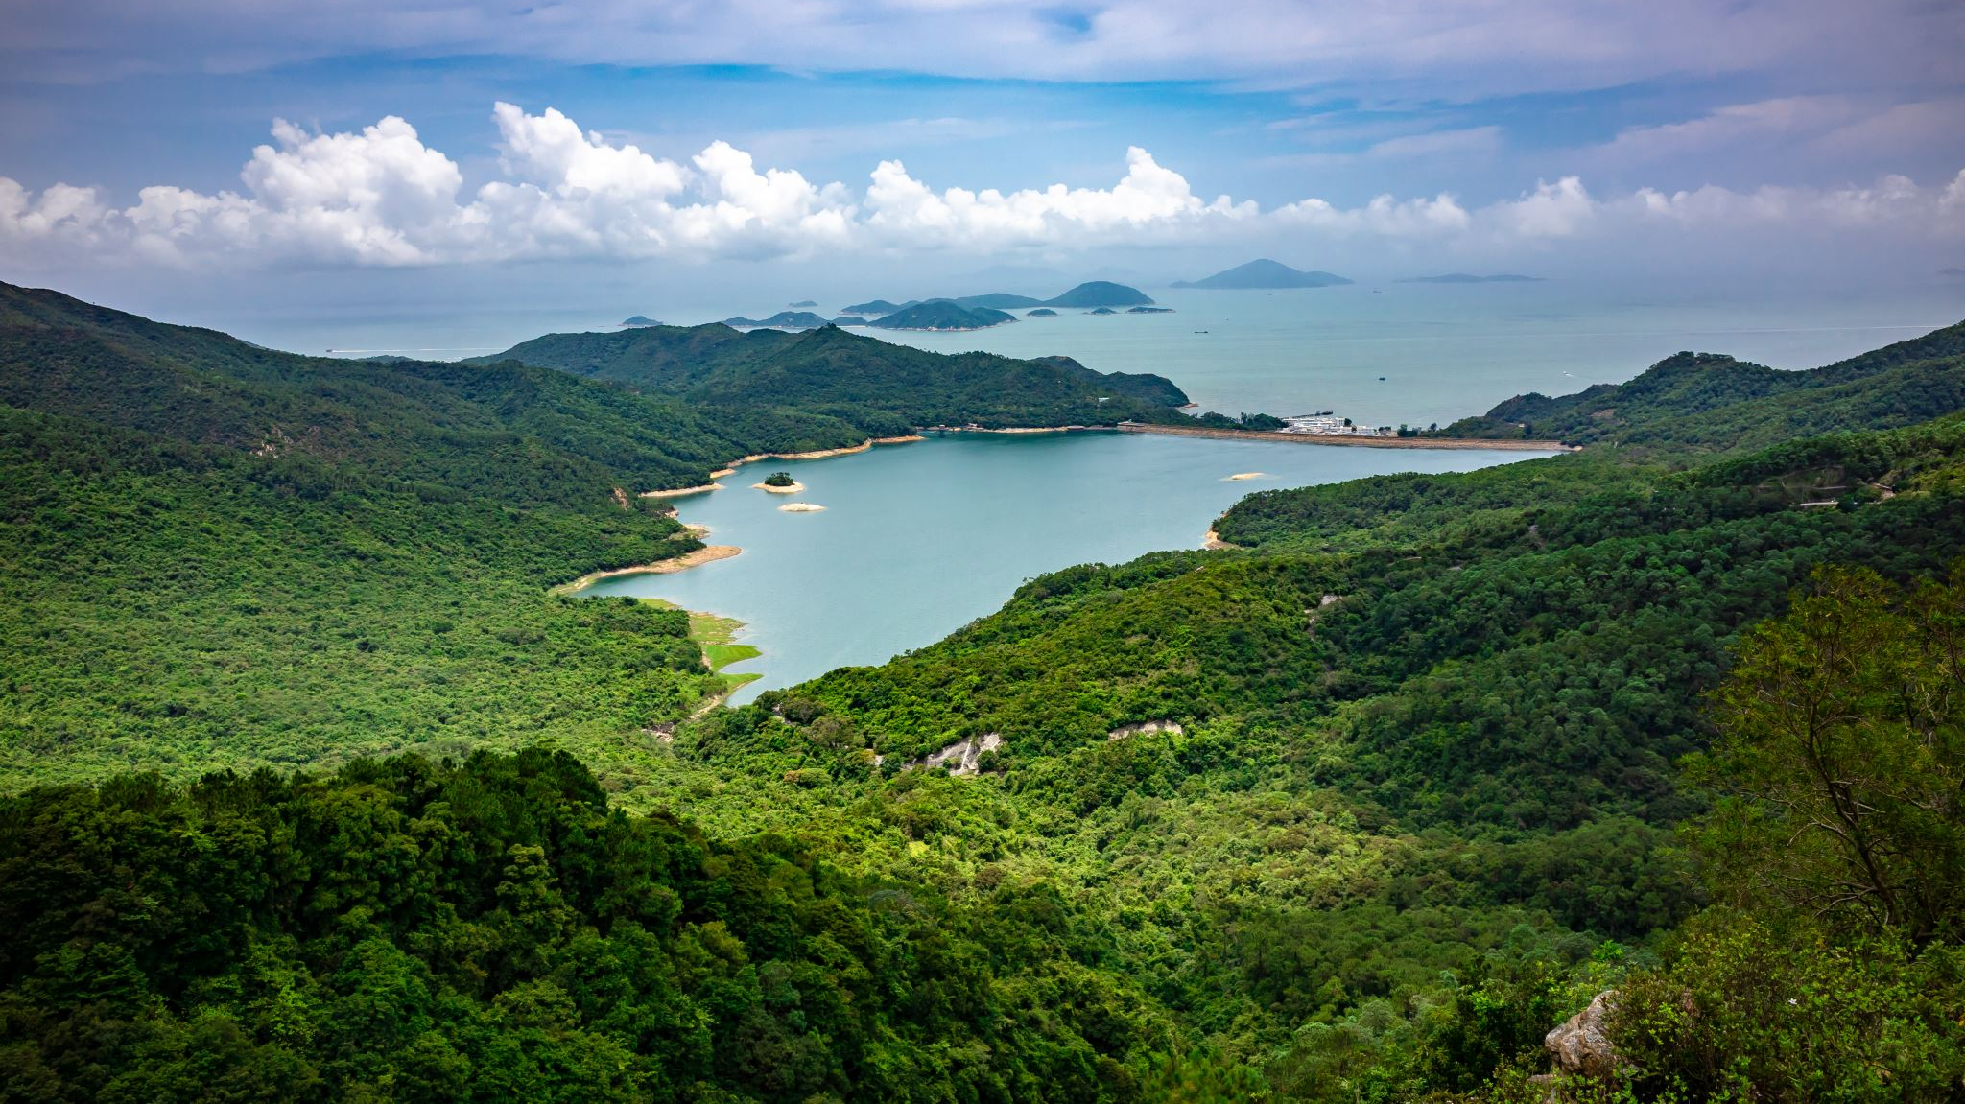
*Along a coastline , like in the Fujian and Guangdong provinces of China , forests might include plants that can live in salt water , like mangroves .

Slide 12
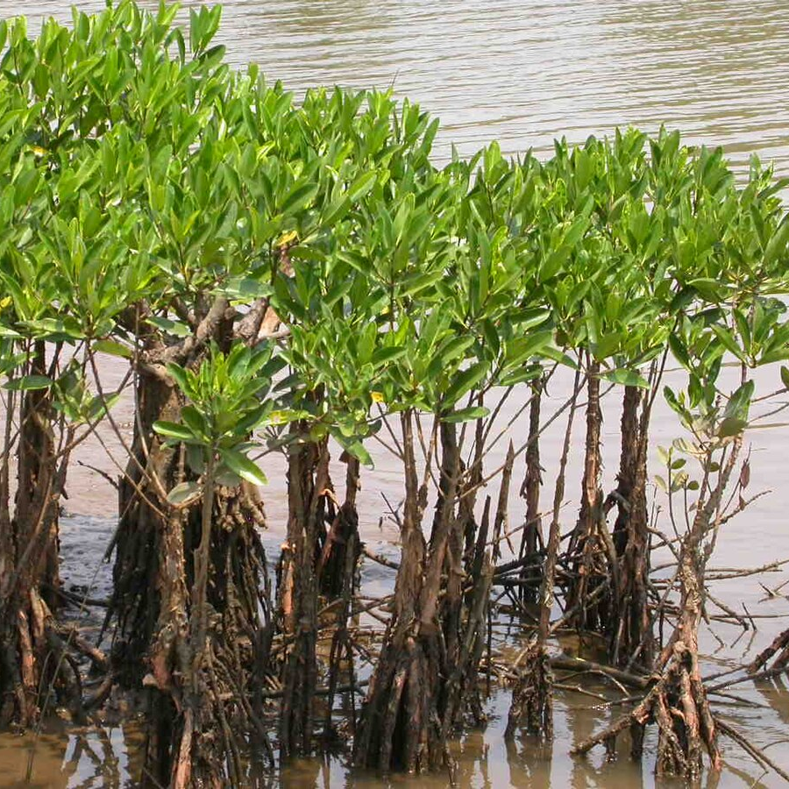
Mangroves
Trees can even grow at high elevations , such as the alphine forests of Tibet . Alphine forests have trees that can grow in rocky soil .They can also survive extreme cold and harsh winds .
This Photo by Unknown Author is licensed under CC BY-SA

Slide 13
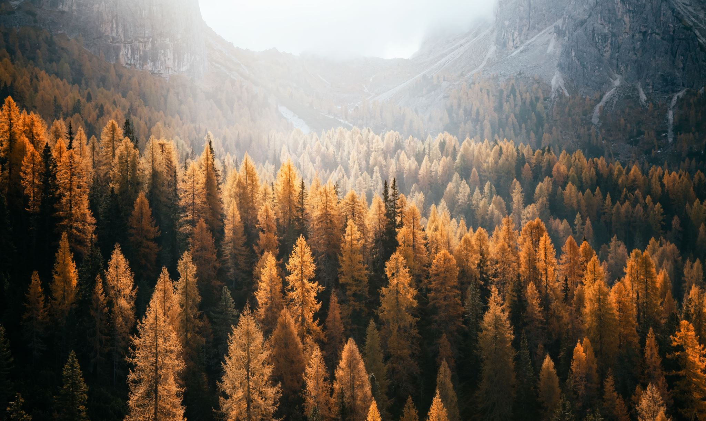
*Forests can also be sorted by the type ofleaves the trees have . For example , some have needles instead of leaves , while others have large leaves that fall in the autumn . Healthy forests can support a variety of plants and animals . They have well-drained soil with many nutrients .

Slide 14
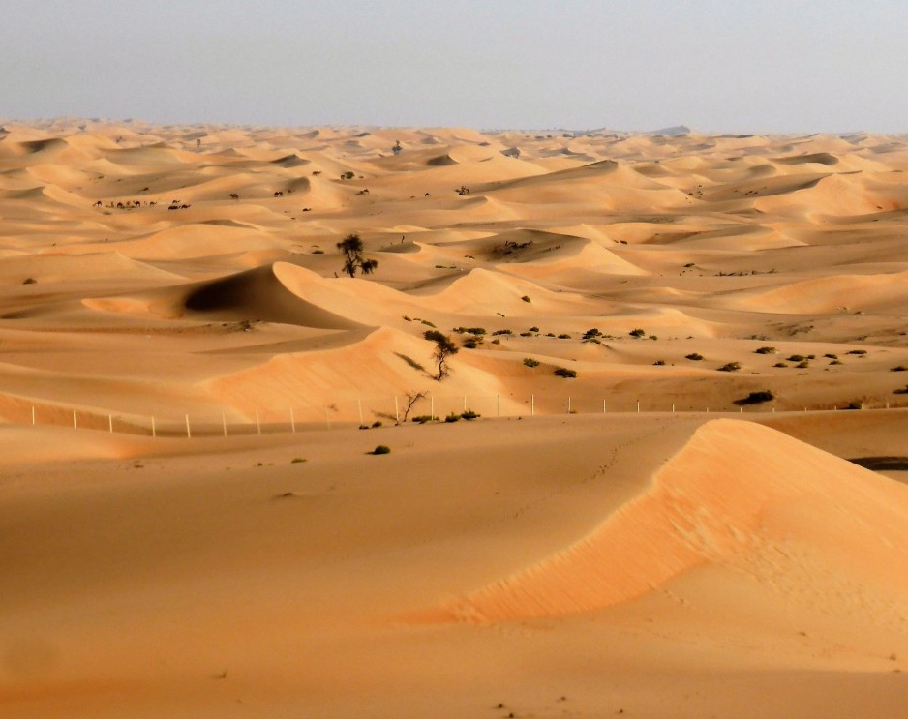
*Desert : Desert regions can be found all over the world , from the Sahara Desert in Africa to the Atacama in South America to the Arabian Desert in the Middle East .

Slide 15
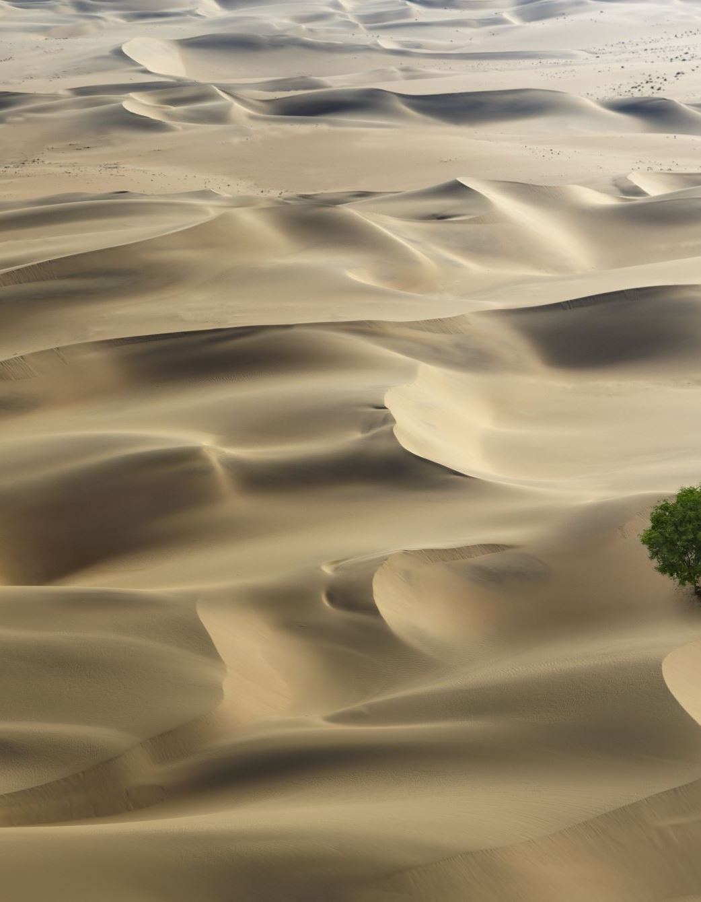
*Deserts are vegetation regions that get less than 10 inches (25.4)of precipitation per year .
Deserts cover 20 percent of Earth’s surface . In addition to being able to survive in dry weather , plants in desert regions need to handle big changes in temperature , from very hot days to cold nights .

Slide 16
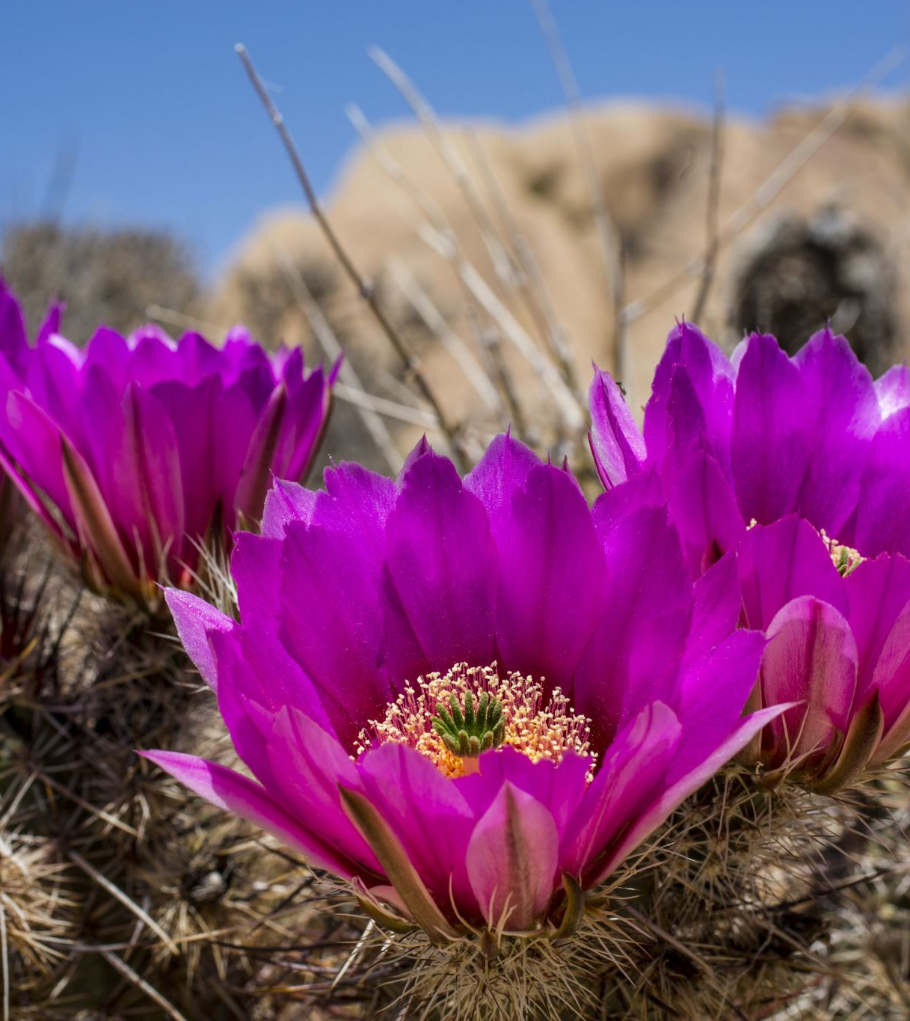
*Desert soil is usually sandy , but not always . For instance , the cold Antarctic Desert has no soil at all . It is just ice on top of rock .
Plants in hot deserts have adapted to sandy and rocky soils . For example , they have roots that grow deep into the ground to find water and keep the plants in place . They also have smaller leaves that lose water very slowly . Infact , many desert plants , such as cacti , have tissues that allow them to store water .

Slide 17
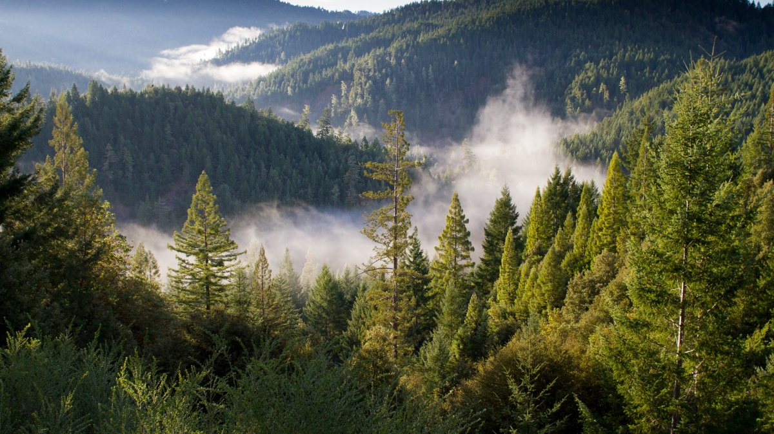
Critical thinking : Compare a desert with a temperate forest . What is one thing they have in common ?Is the feature they have in common related to soil , plants , or climate ?

Slide 18
Answer :
In a temperate forest , you can expect to find rivers and lakes . In a desert it is rare to find these land forms .
In the desert , there is very little to no vegetation and the land in deserts can be mountainous or flat .

Slide 19
*Grassland : can be found in every continent on Earth except Antarctica . They are areas that are flat , open , and covered with grass .
There are many types of grasslands with different types of grass .
In places with cooler weather , like northeastern Europe , the grasses are hardy or strong , and grow all year round . Oats are an example of vegetation that does well in this region .

Slide 20
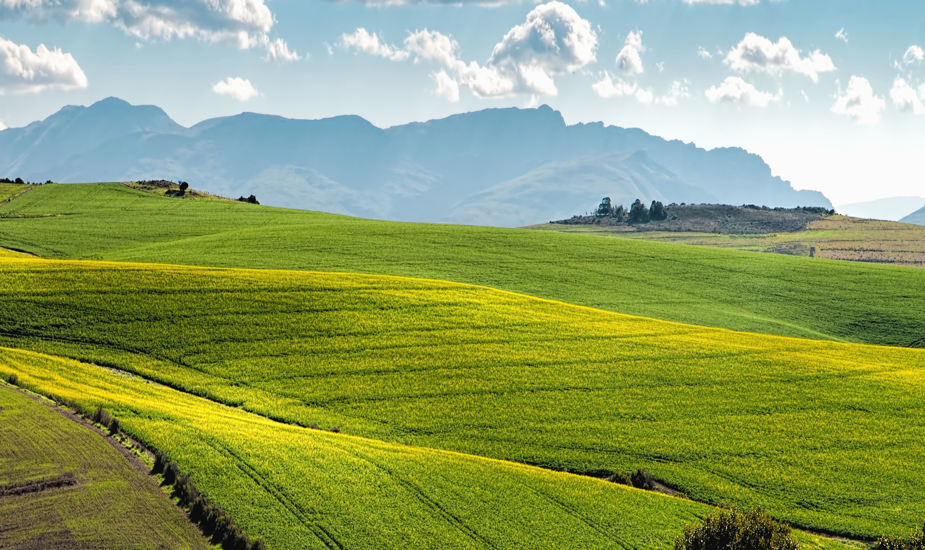
There are temperate grasslands in places where the weather varies with each season , such as South Africa and the United States of America .

Slide 21
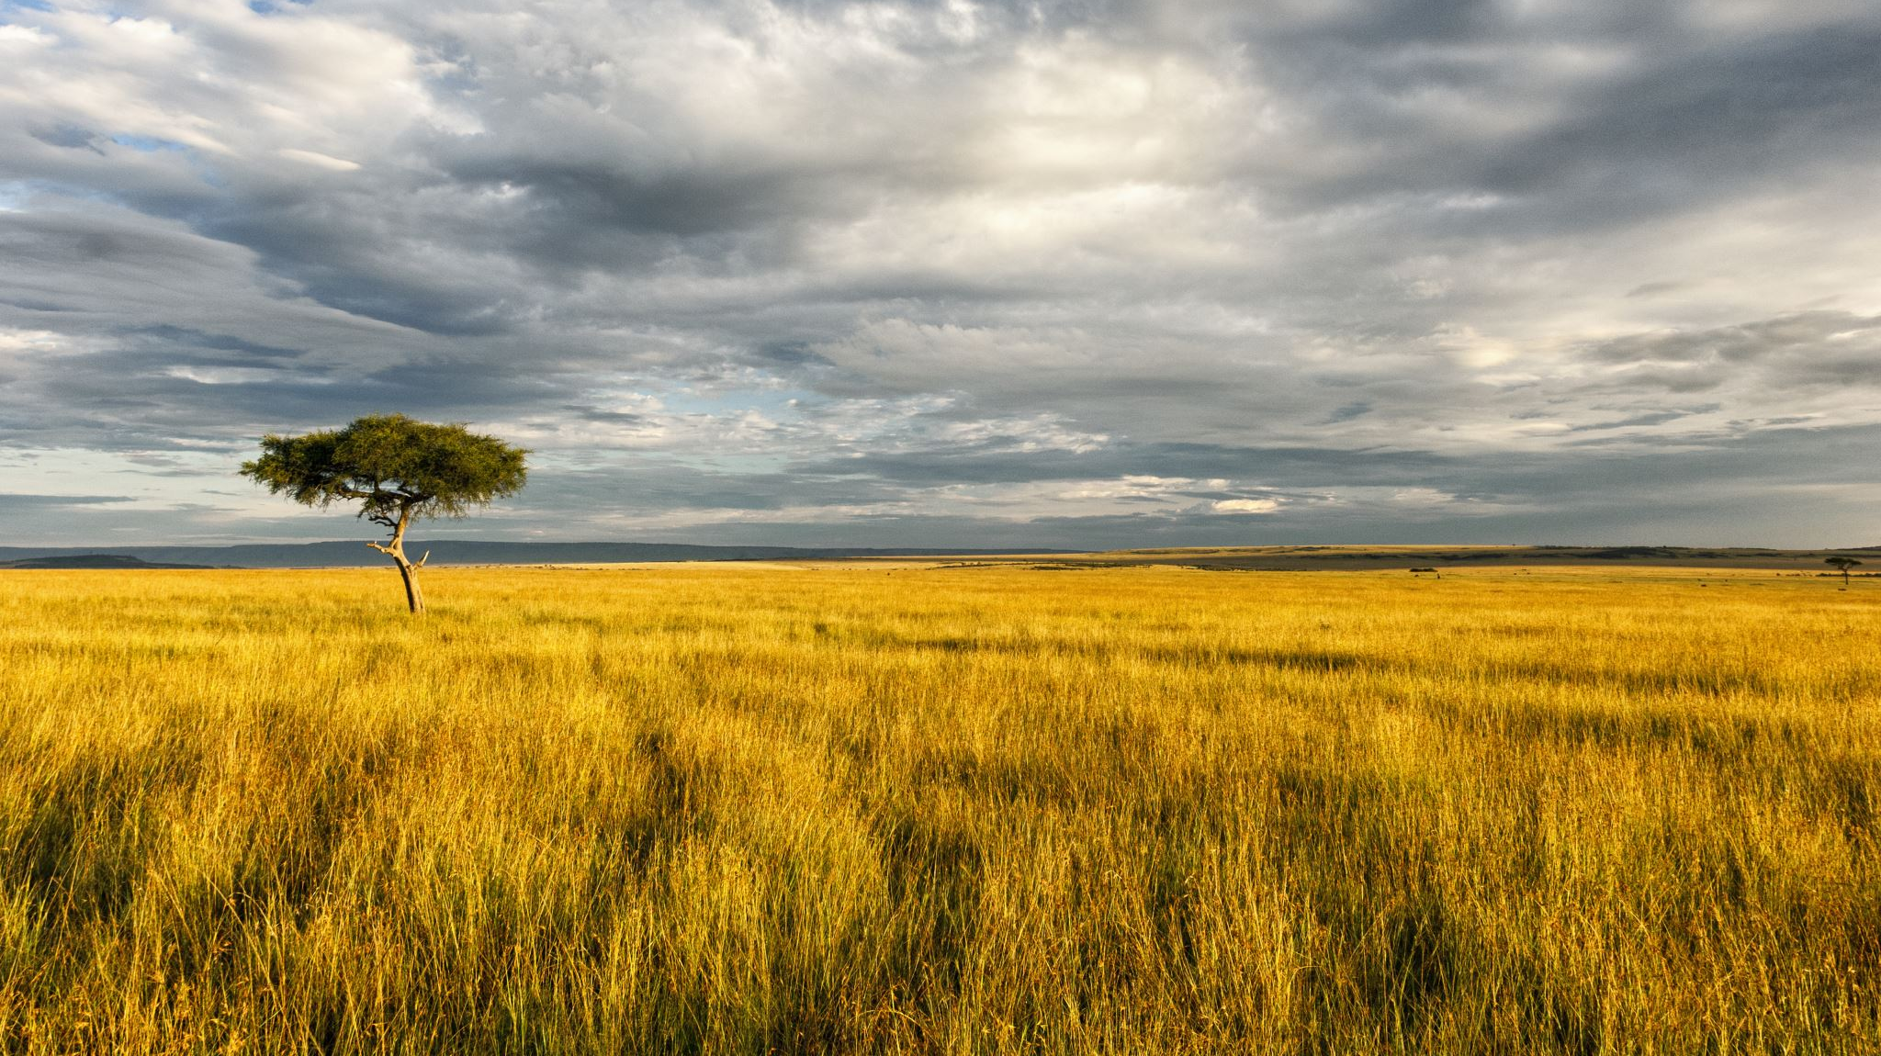
These places have hot summers and cold winters . However , a tropical grassland , called a savanna , needs warm temperature and dry conditions all year round to thrive .

Slide 22
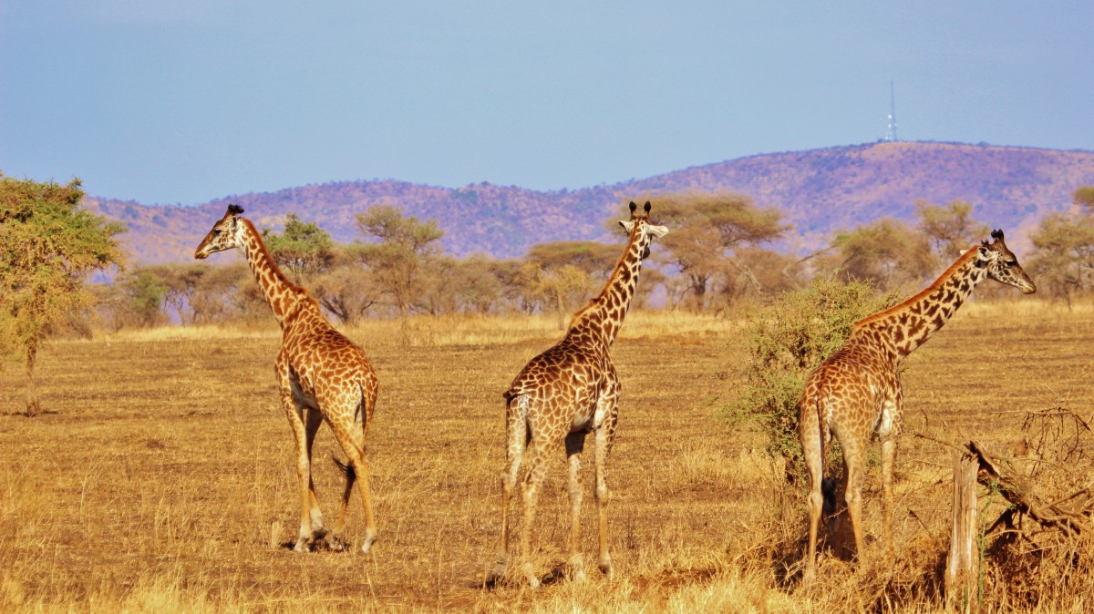
An example of this Tanzanla’s seregeti National park , where three different types of tropical grasses grow .
Grasses grow best in soils that drain well and are rich in nutrients . The nutrients contain a lot of organic matter, such as leaves or decaying insects .

Slide 23
*Critical Thinking :
Compare between deserts and grasslands ?

Slide 24
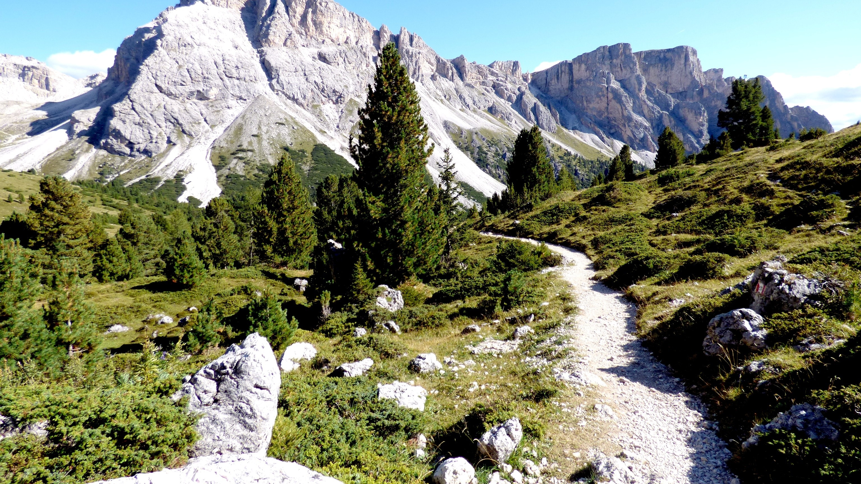
*Tundra : it has very few trees because of cold weather and other harsh conditions like strong winds . The only plants that survive in a tundra are shrubs , mosses , and some grasses .
*There are two kinds of tundra : Arctic and Alphine .

Slide 25
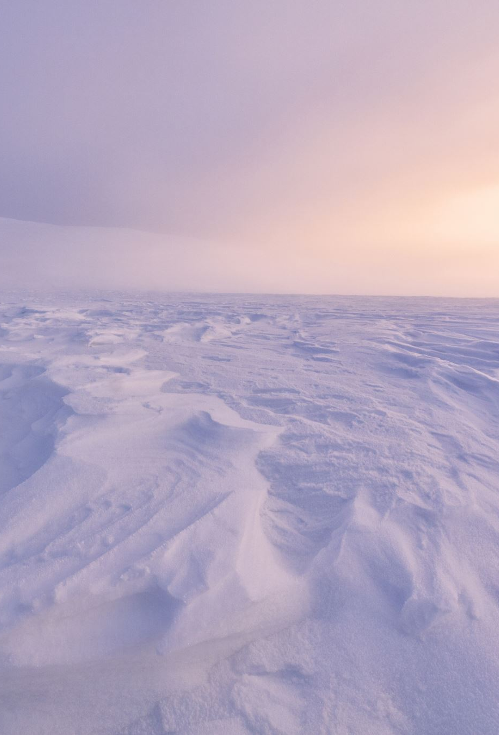
*In Arctic tundra , the temperatures are very cold . The soil is frozen almost all year round and is called permafrost .
During summer , the top layers of permafrost might melt just a little . This allows some plants and insects to survive for a short season . The Arctic tundra is in the Northern Hemisphere .

Slide 26
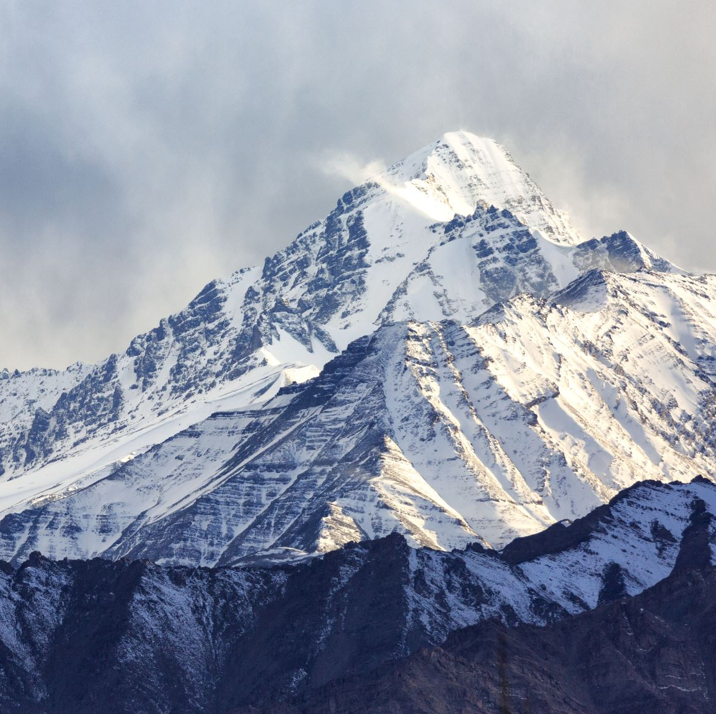
*An alphine tundra is also very cold and often snowy and windy . Alphine tundras are located at high elevations , such as the Tibetan Plateau ,which stretches across China , India , and Tibet .
Because there are few plants in a tundra region , it has far few animals than other vegetation regions .

Slide 27

*Which vegetation region is most like tundras based on how well things grow there ?
A - rainforest
B - grassland
C - desert

Slide 28
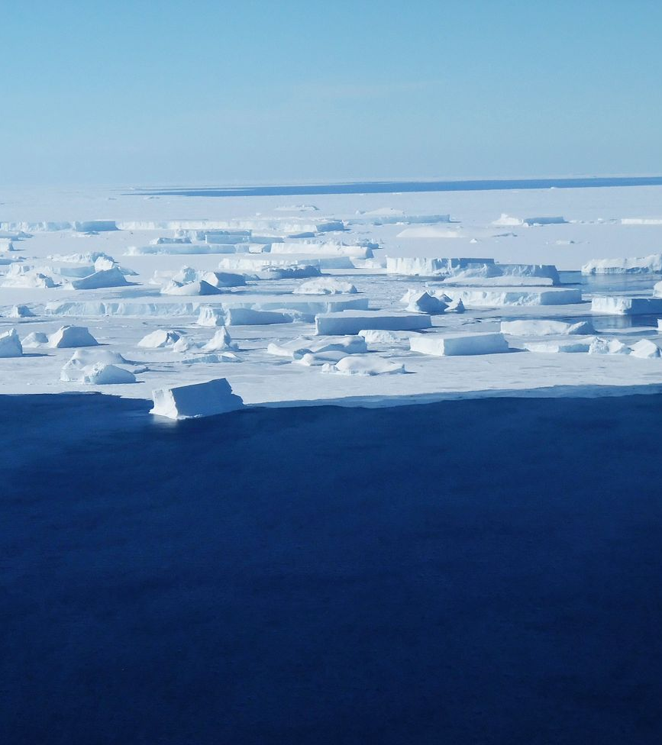
*Ice Sheet : perhaps the strangest vegetation is one where no plants grow .
An ice sheet is an area of glacier ice that is more than 50,000 square kilometers (20, 000 square miles ). There is little or no soil . The weather is very cold and windy .

Slide 29
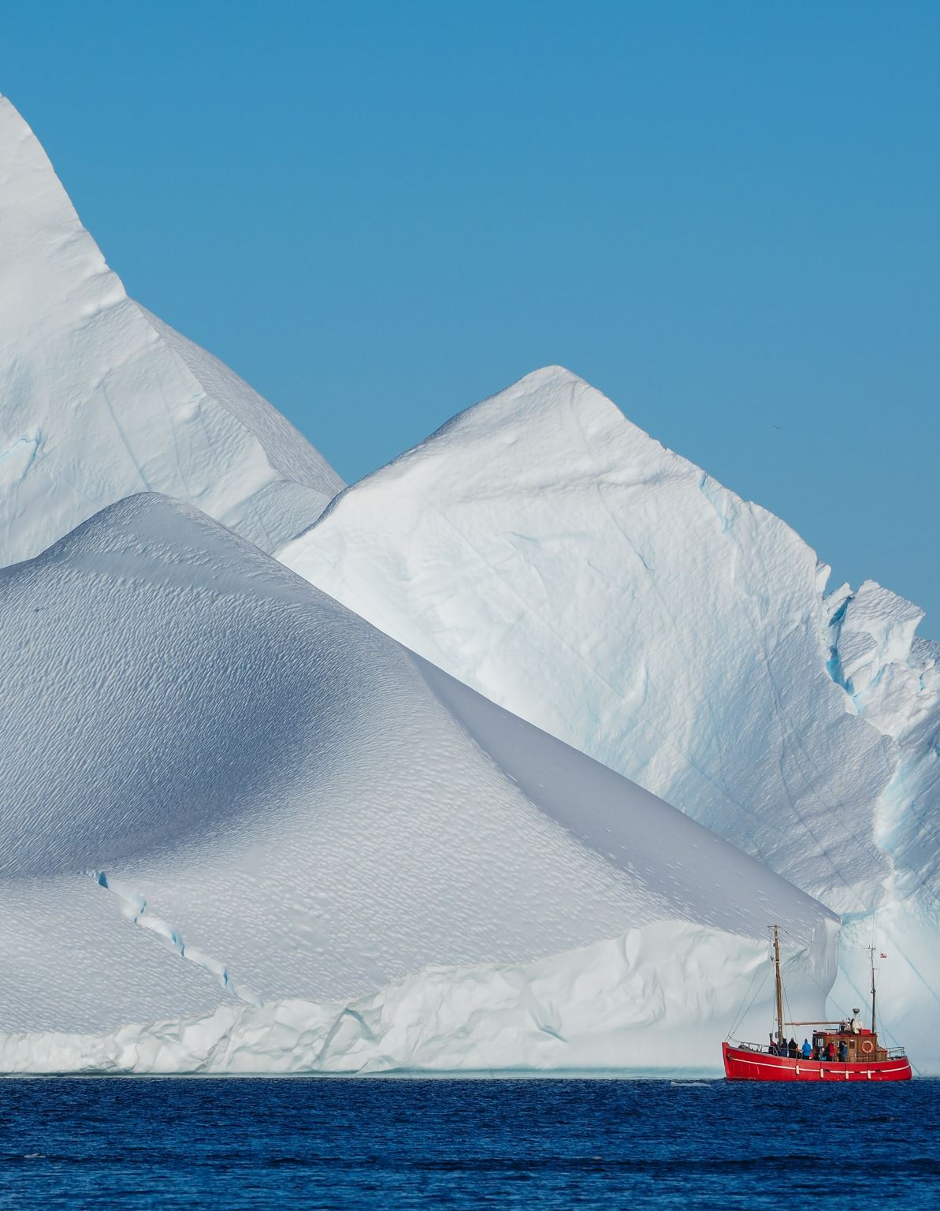
*There are only two ice sheet regions on the planet . They are called the polar ice caps , and they cover the North Pole and the South Pole .
The Antarctic ice sheet , at the South Pole , is over 14 million square kilometers (5.4 million square miles ) . Much of the Arctic ice sheet at the North Pole floats on the ocean , but one of its largest parts covers Greenland .

Slide 30
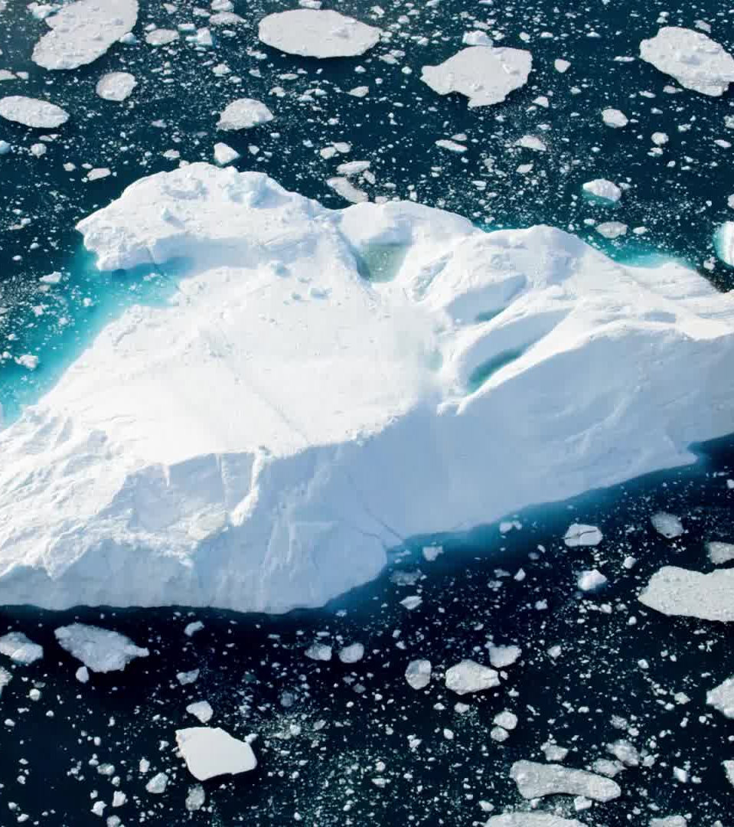
*The Greenland ice sheet is smaller than the Antarctic ice sheet . It is only 1.7 million square kilometers (656,000 square miles ).
Both these icesheets are heavy and have caused the land underneath to sink below sea level .
In fact , the ice sheet of Greenland is so massive that if it melted , Greenland would no longer be the world’s largest island !
It would turn into a small chain of islands called an archipelago .

Slide 31
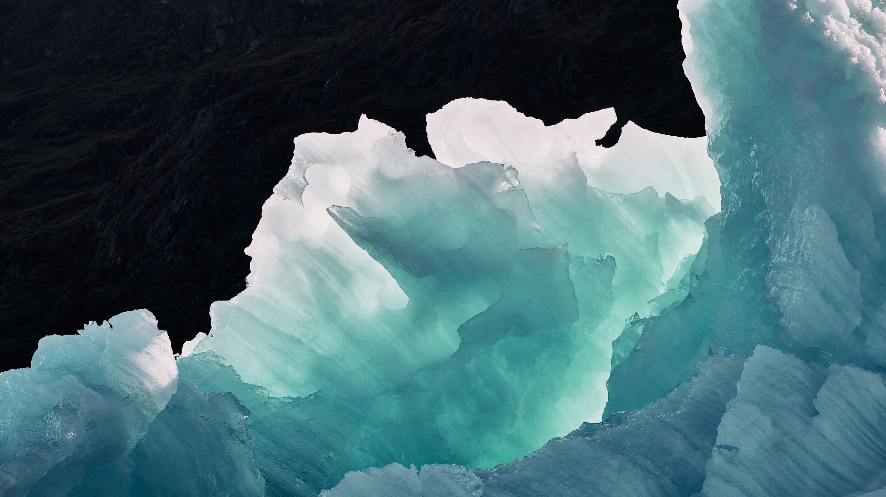
*The ice sheet regions of the world are important places for scientists to do research . They can look at air bubbles in layers of ice to learn about things such as air pollution .
They can measure how quickly the ice caps are melting to help understand climate change .

Slide 32
*Each vegetation region is unique because of the combination of soil , plants , and weather there .
They each support different types of animals .
Unfortunately , human behavior can negatively affect vegetation regions . For example: clearing forests for farming and burning fossil fuels causes changes to climate .
Reducing greenhouse gases , improving water management , and practicing sustainable land use .

