Slide 1
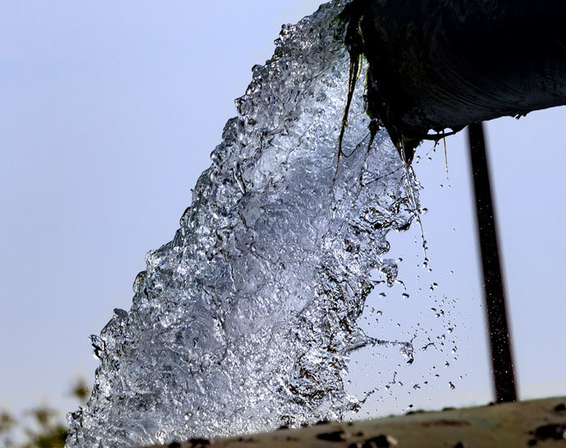
Climate Solutions :
Desalination
This Photo by Unknown Author is licensed under CC BY-ND

Slide 2
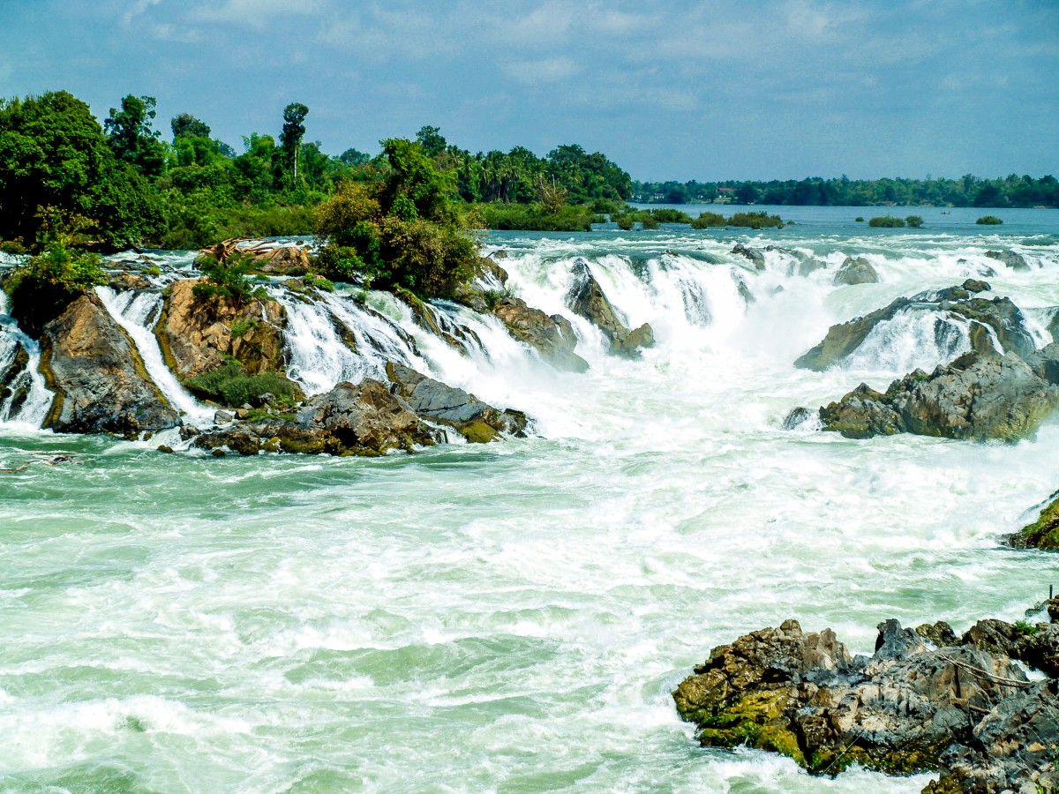
*Water is a resource that every person needs .Yet , across the world it’s availability is under threat .
Climate change alters rainfall to droughts .
Droughts have a great impact on regions with limited water sources , such as the Middle East and North Africa region .

Slide 3
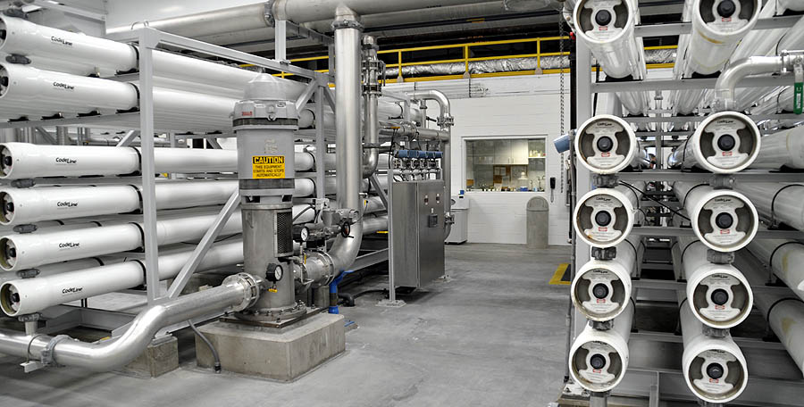
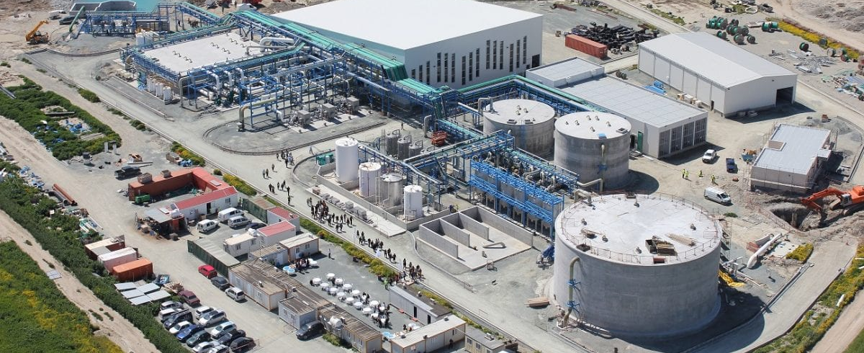
*A future without a solution to drought could mean cities with water taps running dry .
Farmers might have to abandon parched fields .
Desalination : is a technology that turns salt water into freshwater , offers a potential solution .
But , like every solution , it raises questions and challenges .
Like most solutions , there are Pros and Cons .
This Photo by Unknown Author is licensed under CC BY-SA-NC
This Photo by Unknown Author is licensed under CC BY-SA-NC

Slide 4
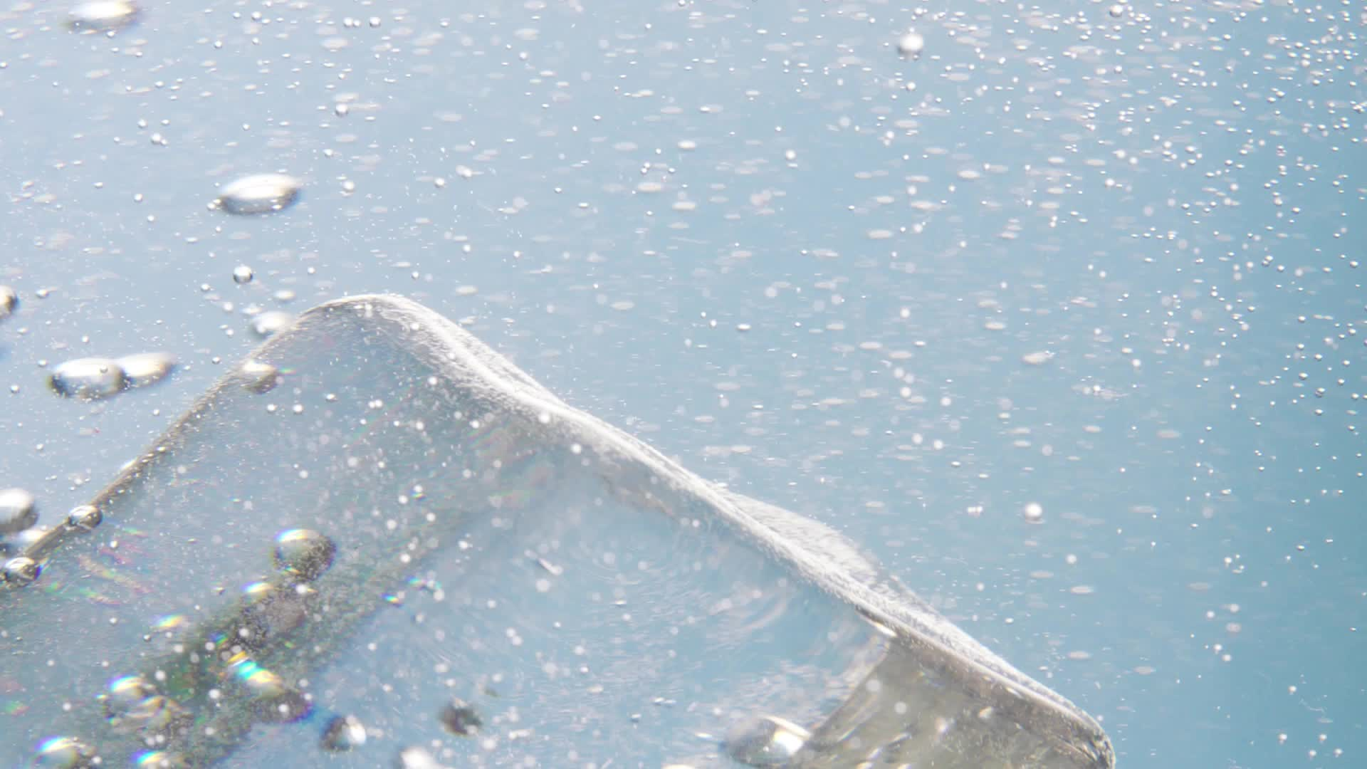
*How does desalination work ? Can it be a sustainable tool in the in the fight against water scarcity ?

Slide 5
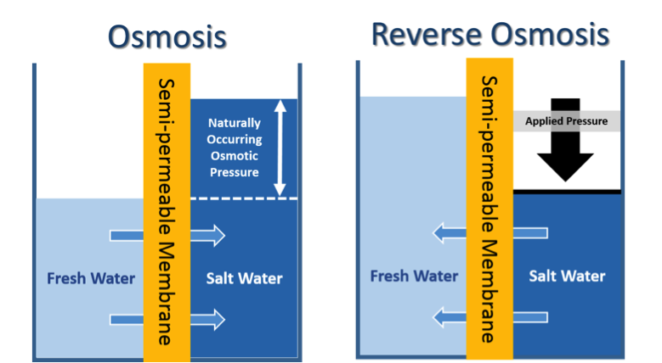
*The Process of Desalination : Think of desalination as the opposite of adding a bit of salt to a glass of water .
It is the process of removing salt , making seawater useable to drink .
There are two main types of desalination , reverse osmosis and thermal desalination . However , both types have problems :
This Photo by Unknown Author is licensed under CC BY-SA-NC

Slide 6
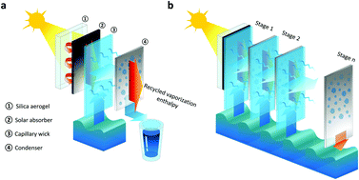
*Thermal desalination : involves heating seawater until it turns into steam . This steam collects and condenses into fresh water . This leaves salt behind . The problem is that this uses a lot of energy .
This Photo by Unknown Author is licensed under CC BY-NC

Slide 7
*Reverse osmosis : in this process , seawater is pumped into a desalination plant at high pressure . This seawater goes through special membranes , which are thin layers of material that act as filters .
This Photo by Unknown Author is licensed under CC BY-SA-NC
Tiny holes allow water molecules to pass . But the holes are small enough that they block the larger salt molecules . While effective , reverse osmosis can also use a lot of energy .

Slide 8
* How does thermal desalination process use heat to remove salt ?
A – by freezing water , making it easier to remove salt .
B- by turning seawater to steam , and condensing it

Slide 9
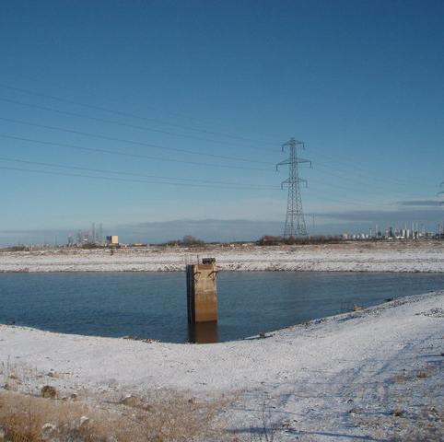
*Environmental Impacts : Desalination offers a lifeline for water –stressed regions . But it is not a perfect solution .
One major concern is brine – the leftover and super-salty solution created in the process .
When dumped back into the ocean , brine can hurt marine life near the desalination plant .
This Photo by Unknown Author is licensed under CC BY-SA

Slide 10

* This is especially worrying in areas such as the Arabian Gulf .
Shallow waters and limited circulation make the ecosystem –marine life and plants –sensitive to increased saltiness . This also affects jobs in the fishing industry .

Slide 11
*Another environmental challenge is energy consumption . Traditional desalination plants often rely on fossil fuels .
These release greenhouse gases that contribute to climate change . This can then create more water scarcity in many regions .

Slide 12
The good news is that renewable energy could change this .
Countries such as the Kingdom of Saudia Arabia and the United Arab Emirates have invested heavily in solar –powered desalination plants .
A goal of energy consumption is to reduce what is called the carbon footprint . This is the amount of greenhouse gases (including carbon dioxide and methane )that are generated by human activity .

Slide 13
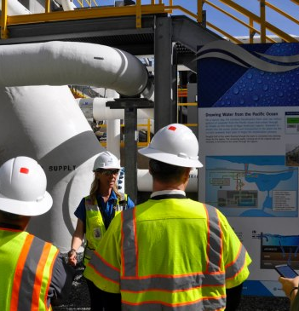
*Costs and Benefits of Desalination : Desalination presents a trade-off . It can increase the supply of fresh water . Farmers can irrigate crops in even the driest regions . Cities across the Arabian Peninsula can support growing populations .
Yet building desalination plants is costly . Running these plants is also costly in terms of the energy they demand . This impacts the price of desalinated water . Poorer communities could find this too expensive .
This Photo by Unknown Author is licensed under CC BY-SA-NC

Slide 14

*Beyond financial cost , desalination also creates long-term risks to the environment . If not managed carefully , the problem of water scarcity could worsen . With easier access to fresh water , there is a risk of overusing this new supply .

Slide 15

*Increased water usage could disrupt the natural water cycle . There needs to be a focus on water conservation and new irrigation methods .

Slide 16
*Critical thinking : Imagine being a community leader in a hot and dry region . Explain 2 factors you would consider before investing in a large –scale desalination plant ?

Slide 17
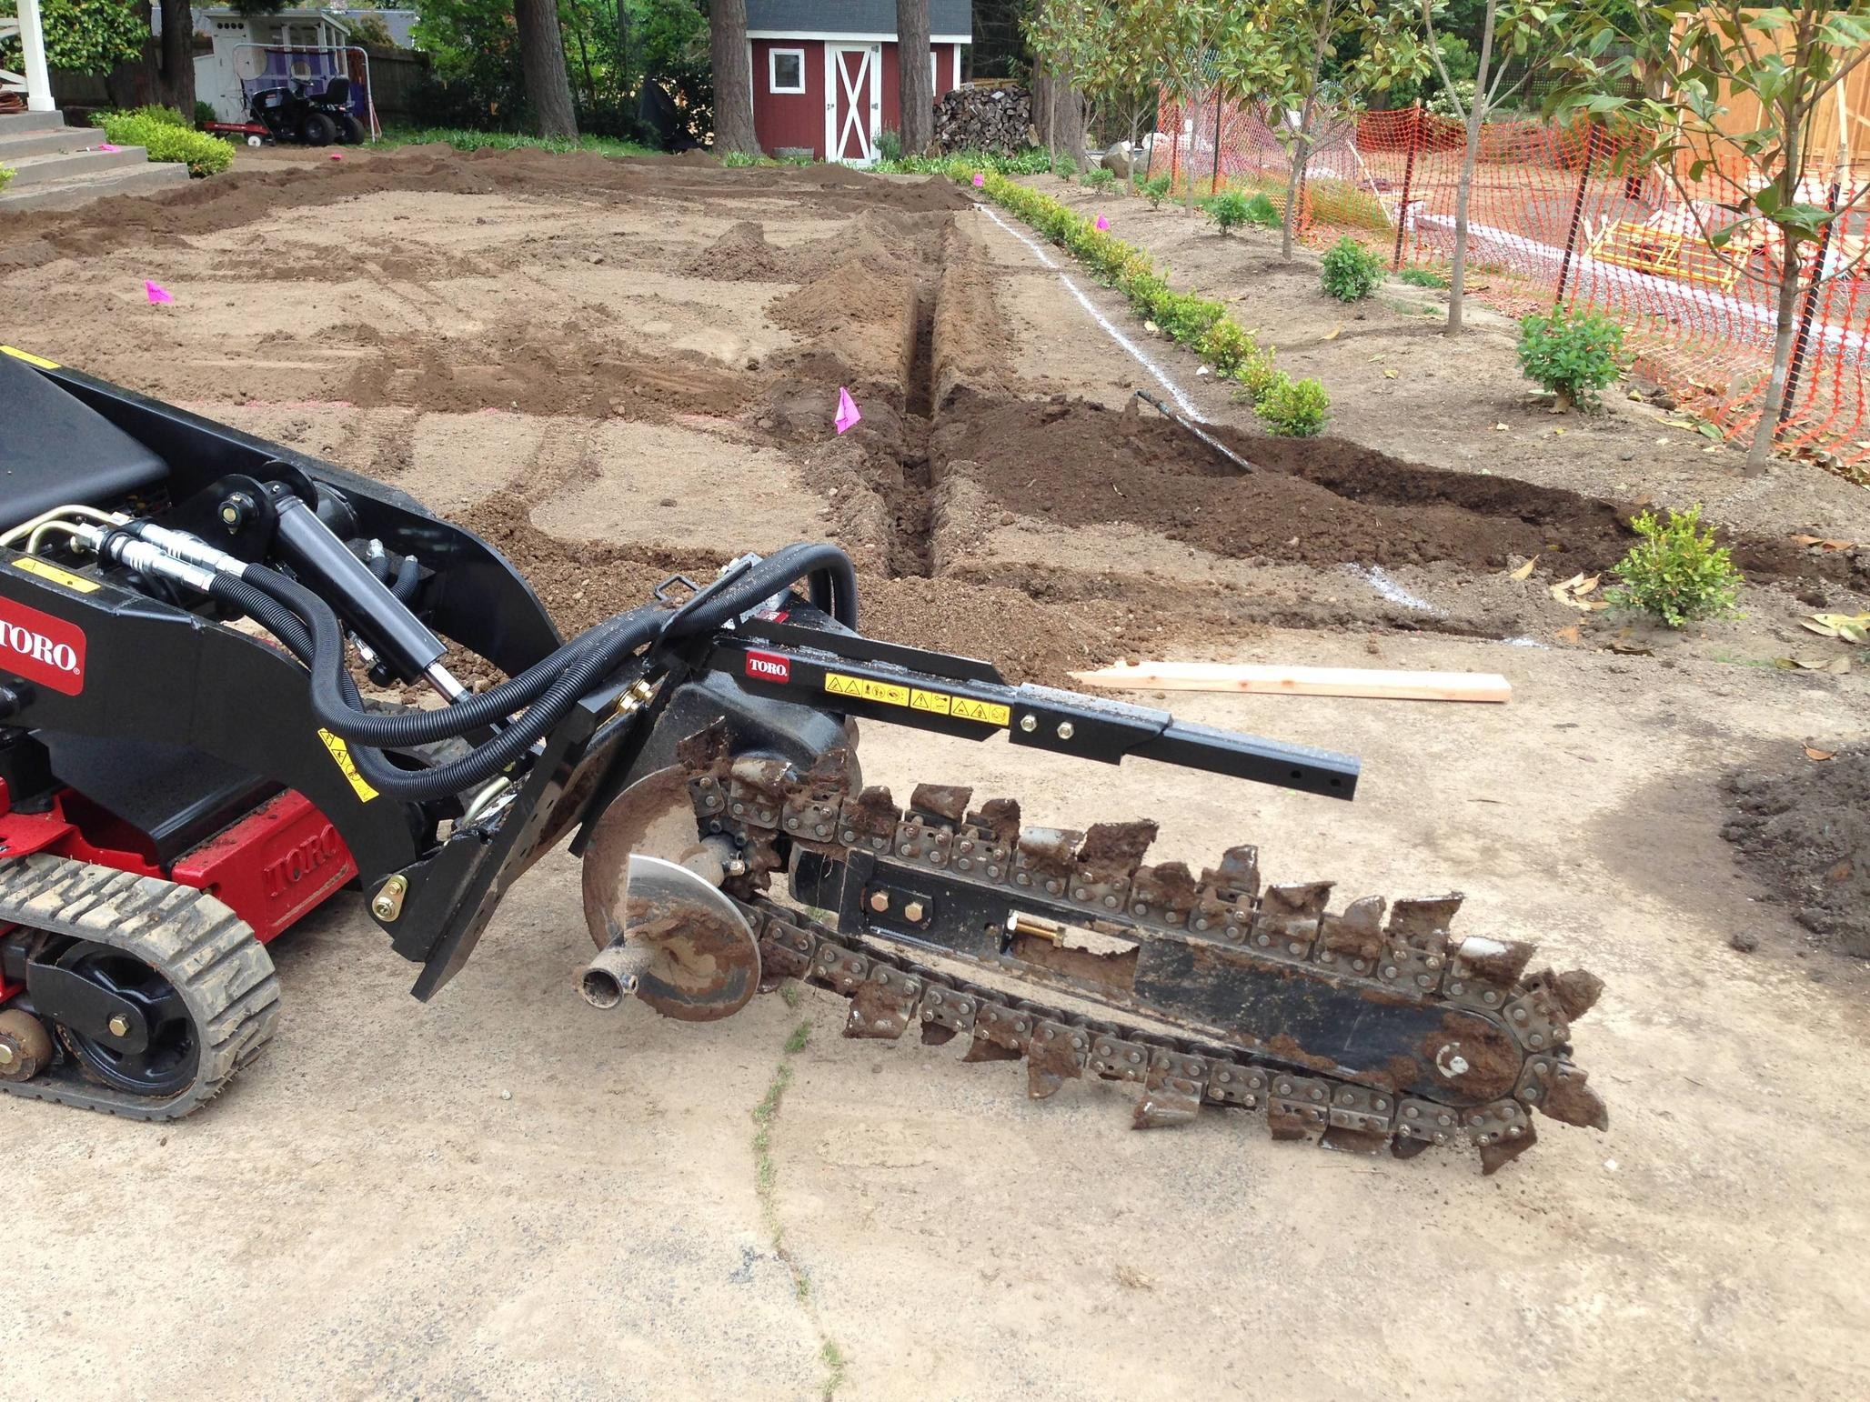
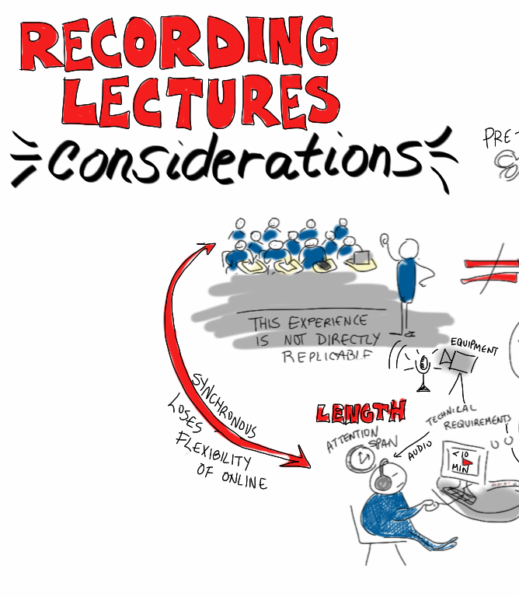
*Traditional Wisdom for the Modern World : water scarcity is an age-old challenge .Historically , societies in the Middle East and North Africa have developed smart methods to conserve and manage water resources . Joining traditional expertise with modern technology helps (MENA) communities work toward sustainable water management .
This Photo by Unknown Author is licensed under CC BY-SA

Slide 18
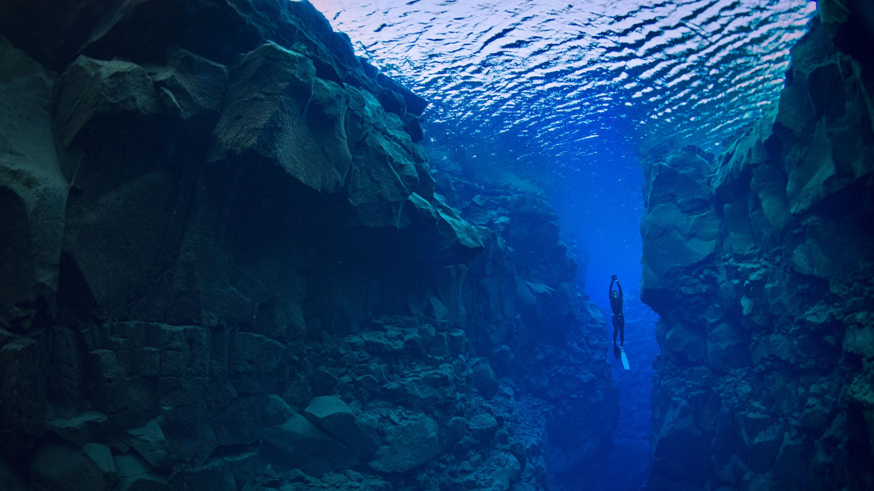
One example is the qanat system of the ancient Middle East . In the qanat system , a network of tunnels ,underground carries water to dry areas . Since the water is traveling in tunnels , very little evaporates .Qanats rely on gravity to move water efficiently .

Slide 19

*Today ,engineers are using this ancient wisdom in designing irrigation systems . Techniques such as drip irrigation deliver water directly to plat roots . It is much more efficient than flood irrigation .Water soaking soaking and I wasteful . Drip
irrigation reduces water waste

