Slide 1

Poetry Anchor Chart

Slide 2
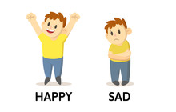
*What is the purpose of writing poetry ?
To express ideas and feelings .

Slide 3
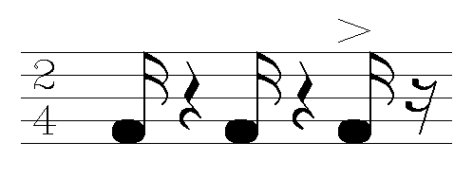
1- Rhythm : the beat of a poem’s words and syllables .
This Photo by Unknown Author is licensed under CC BY-SA

Slide 4
2- Sound effects :
Rhyme : words that have the same end sound . For example : book , look , and took .
Onomatopoeia : words that imitate sounds or a word that actually looks like the sound it makes , and we can almost hear it . For example : honk , crash and whisper .

Slide 5
3- Text structure :
Lines : lines in a poem . For example :
I’m memorizing oceans ,
tracing rivers .
Stanzas : groups of lines . For example :
I’m memorizing oceans ,
tracing rivers .
learning mountain ranges
I’m memorizing capitals ,
tracing countries
learning crops and industries .

Slide 6
4- Figurative Language :
1) Simile : compares unlike things using like or as . For example : He was as quiet as a mouse .
2) Metaphor : Compares unlike things .
He was a quiet mouse .

Slide 7
*Simile example : Bob is as brave as a lion .
* Metaphor example : Bob is a lion .
*Simile example : Life is like a dream .
*Metaphor example : Life is a dream .

