Slide 1
Living in deserts
Vocabulary

Slide 2
Vocabulary words
Shield
Lack
Exposure
Nomadic
Landscape

Slide 3

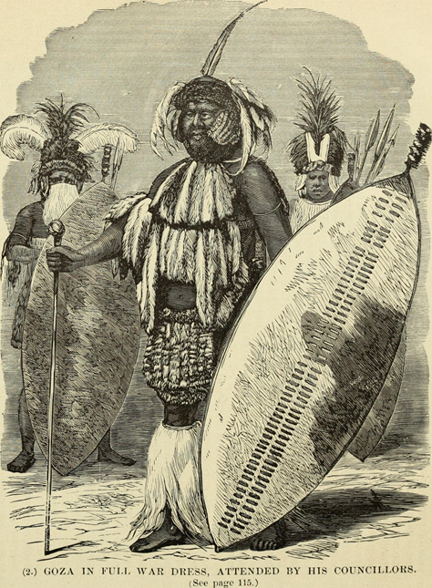
Shield
a person or thing providing protection.
E.g "a coating of grease provides a shield against abrasive dirt"
Notice
THINK ALOUD

Slide 4

Lack
THINK ALOUD
the state of being without or not having enough of something.
E.g “the novel lacks imagination"

Slide 5
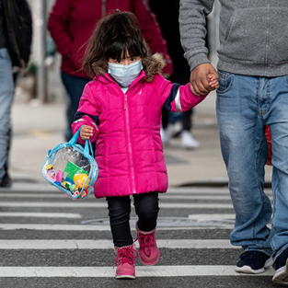
Exposure
Connect
THINK ALOUD
state of having no protection from something harmful.

Slide 6
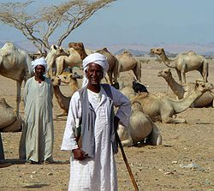
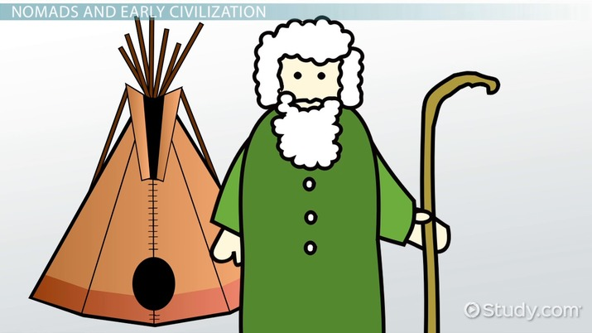
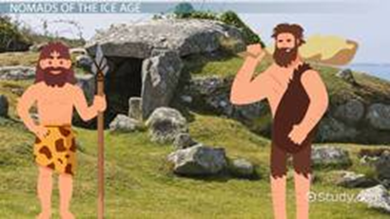
Nomadic
roaming about from place to place aimlessly, frequently, or without a fixed pattern of movement a nomadic hobo.
Close Read
Make Inferences

Slide 7
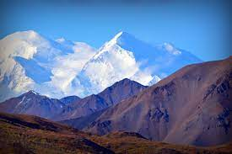
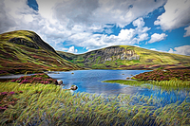
Landscape
all the visible features of an area of land,
E.g "the site has been tastefully landscaped"
Close Read
Vocabulary In Context

