Slide 1
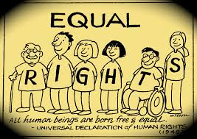
Citizenship , Rights , and Responsibilities .
This Photo by Unknown Author is licensed under CC BY-NC-ND

Slide 2
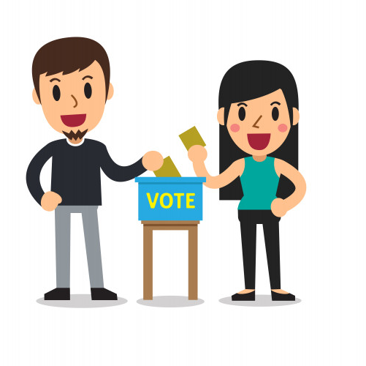
*Citizens and Citizenship :
People rush to help after a terrible earthquake . Citizens ask officials to act on climate change .
An 18-year-old votes for the first time in an election .
A school group raises money to build a new playground .
This Photo by Unknown Author is licensed under CC BY-SA

Slide 3
*All these situations may seem different , but all have something in common .
Each is an example of citizens helping their community .
What does a citizen mean ?
A resident of a city , state , or country .
Citizens have responsibilities to their towns , countries , and the entire world .

Slide 4
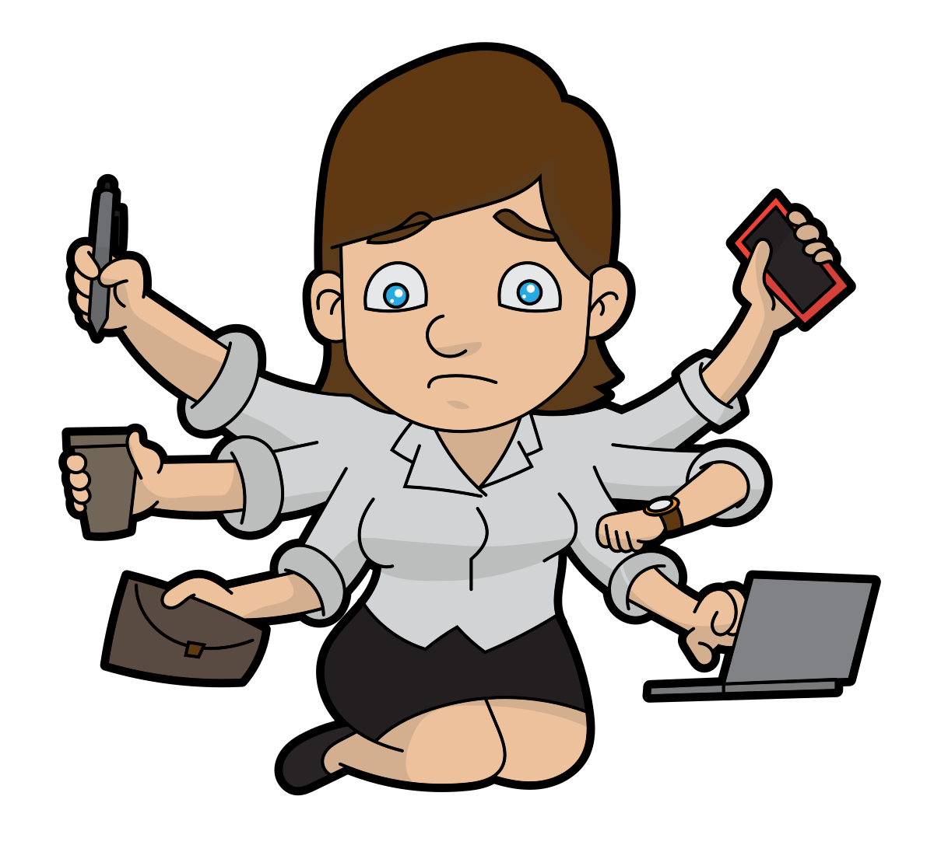
What does responsibility mean ? A duty .
People are usually citizens of the country they were born in .
Citizens can also be naturalized –or get citizenship even though they were born in another country .
This Photo by Unknown Author is licensed under CC BY-SA

Slide 5
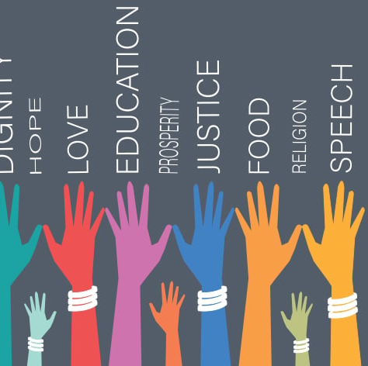
*What does citizenship mean ? Is the legal status of belonging to a country .
Having citizenship allows people to enjoy certain rights .
Those rights are clearly spelled out by law .
*What does right mean ?
A freedom protected by that country’s law .
This Photo by Unknown Author is licensed under CC BY-ND

Slide 6
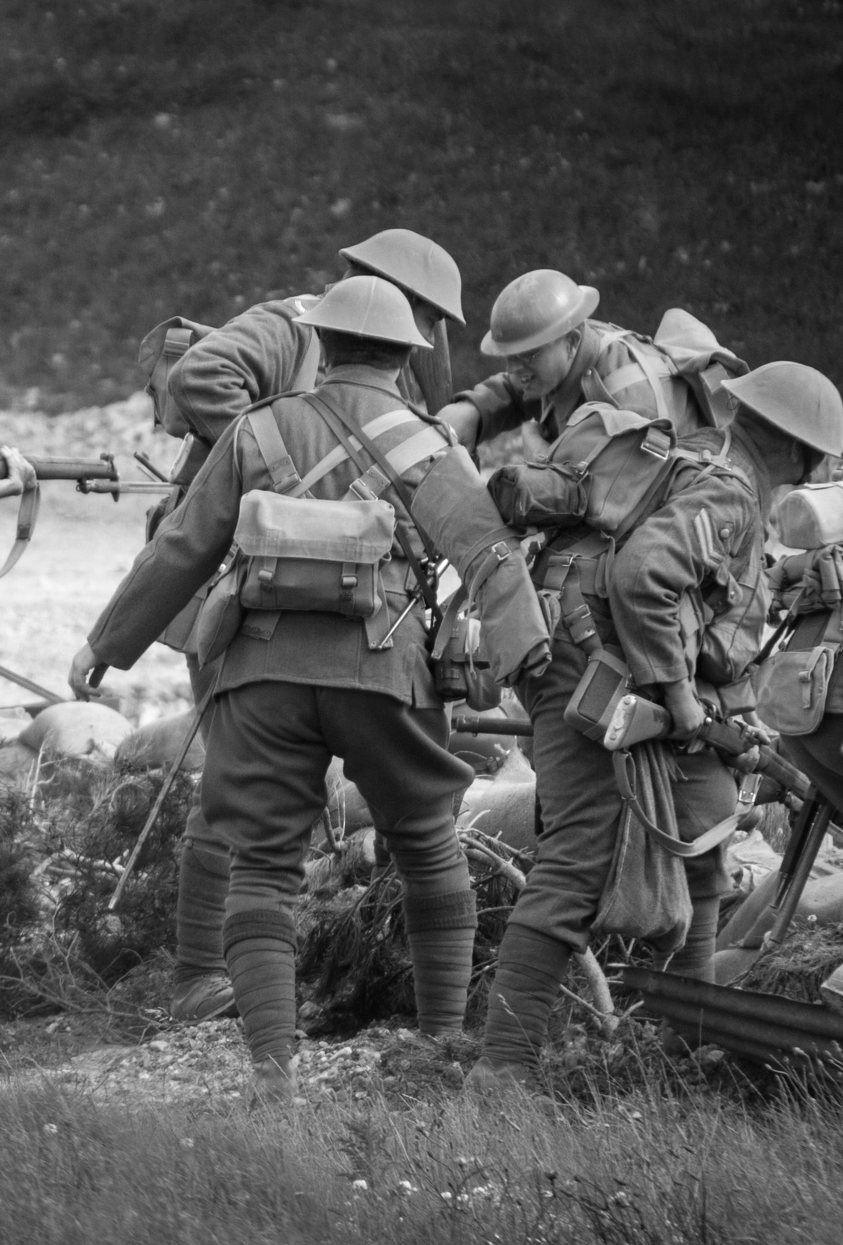
*Rights of Citizens .
In 1945 , the world was rebulding after world war ll (1939-1945) . The war had destroyed and harmed many nations .
Because of the war , the world’s governments created the United Nations (UN) . One of the ideas behind the UN was to stop wars before they began .
There was something else the UN also wanted to do . It wanted to spell out the rights of people everywhere .
This Photo by Unknown Author is licensed under CC BY-SA-NC

Slide 7
*The United Nations General Assembly in 1948 wrote the Universal Declaration of Human Rights .
It stated the basic rights of every human .
These rights include :
1 freedom from being arrested for no good reason .
2 the ability to move freely in one’s own country
3 the ability to own property
4 the ability to work
5 the ability to get an education

Slide 8
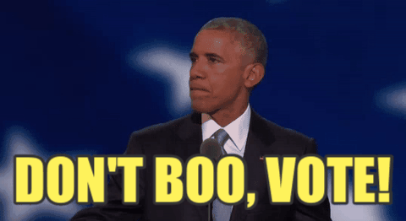
*For the most part , it is the government’s job to protect the rights of its citizens .However , countries have different types of governments .
How they protect citizen’s rights is left up to them .
In many nations , voting is a basic right . Governments often protect that right by making laws to fix election problems .
This Photo by Unknown Author is licensed under CC BY-NC-ND

Slide 9
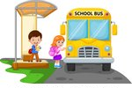
*The Responsibility of Citizens : citizens protect their rights by using them . Every time students go to school , for example , they are protecting their right to an education .
Every time nurses go to work , they are protecting their right to work .

Slide 10
*However , being a citizen is more than enjoying rights . The responsibilities of citizenship are just as important . Each person has a duty to the community . We can make the community a better place by performing our duties responsibly .
Responsibilities can include voting or wearing a mask to prevent the spread of disease .
Being involved in a community is a big part of being a citizen . Sometimes it involves a group of teenagers planting a tree to preserve the natural environment or picking up litter to keep their neighborhood tidy . Other times it involves people voting in an election .

Slide 11
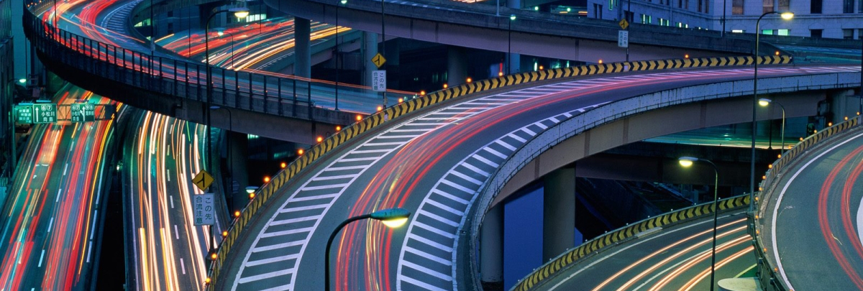
*Staying informed : One important responsibility is to know about issues that affect people . When citizens pay attention to issues , it helps leaders make public policy .
What does policy mean ?
Is a plan or action a government takes .
Policies cover many different areas .One area is how a country gets along with other countries . Another is whether a new road should be built .

Slide 12
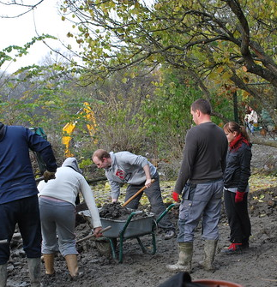
It is also a citizen’s responsibility to obey the law and pay taxes . Taxes are money people have to pay to the government . They help pay for such things as schools , roads , and hospitals .
Volunteering is also a responsibility of citizenship . Volunteering means helping people without getting money for doing so .
People can volunteer at hospitals , schools , and many other places . In addition , a good citizen is sometimes asked to make personal sacrifices for the good of the community .
This Photo by Unknown Author is licensed under CC BY

Slide 13
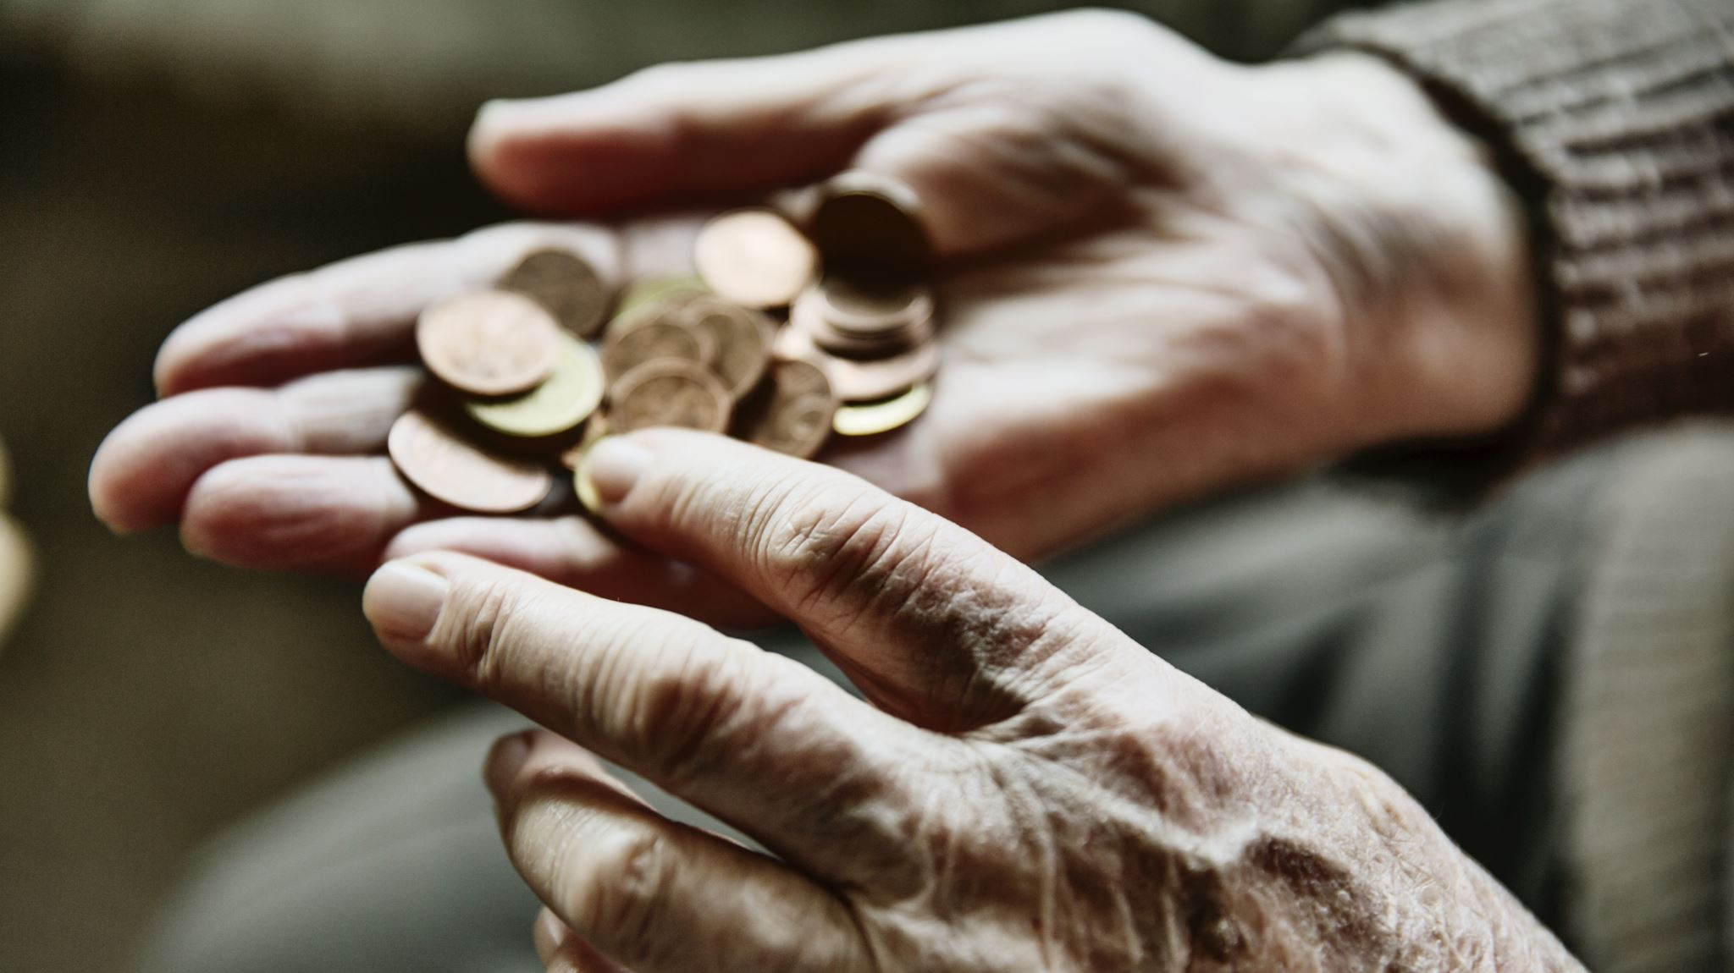
*A personal sacrifice is when you give up something to help others . Examples of personal sacrifices are volunteering your time or giving money to help others instead of spending it on yourself .

Slide 14
Public servants : is a responsibitlity for all citizens . People help their community when they volunteer or help others . Some people are public servants whose jobs are doing services for their community .
*Give me examples on public servants who work for the government ?
1 police officer 2 mayor 3 firefighters 4 social studies teacher . 5 doctors 6 nurses .

Slide 15
The End

