Slide 1
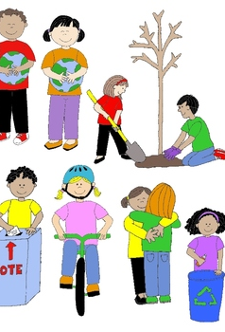
Responsible Citizenship
This Photo by Unknown Author is licensed under CC BY-ND

Slide 2
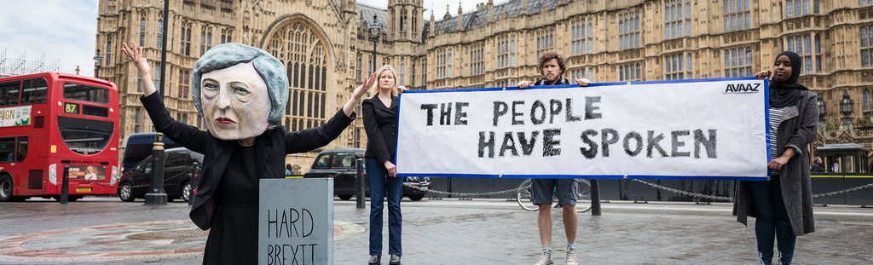
*People belong to many communities during their lifetime . People are members of families , schools , and neighborhoods .
People also belong to their larger community as citizens .
A citizen : is a legal resident of a city , state , or nation .
Citizens have rights and responsibilities specific to their communities .

Slide 3
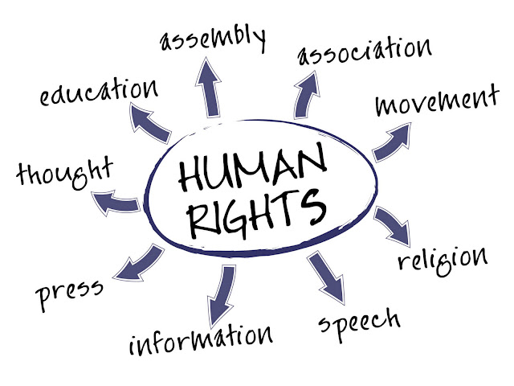
*A right : is a freedom protected by a country’s laws .
Citizens have rights to education , access to healthcare , and clean water .
In some countries people can vote for the people who will lead them .
This Photo by Unknown Author is licensed under CC BY-NC-ND

Slide 4
*A responsibility : is a duty that citizens have to perform for their nation , state , or local community .
Citizens across the globe have important responsibilities , such as obeying the law .
Sometimes , citizens might serve on juries or join the military
There are many ways for citizens to take an active part in their communities .
A country’s founding documents and laws often explain the rights and responsibilities of citizens in many countries .

Slide 5
*Responsible Citizenship : Rights come with responsibilities . Individuals have the responsibility to use their rights respectfully and safely .
This is an important part of being a responsible citizen
Responsible citizenship means being involved in your community by using your rights and doing your duties.
Responsible citizenship can look different in different places .
Some rights have corresponding legal responsibilities , such as voting and serving on a jury .

Slide 6
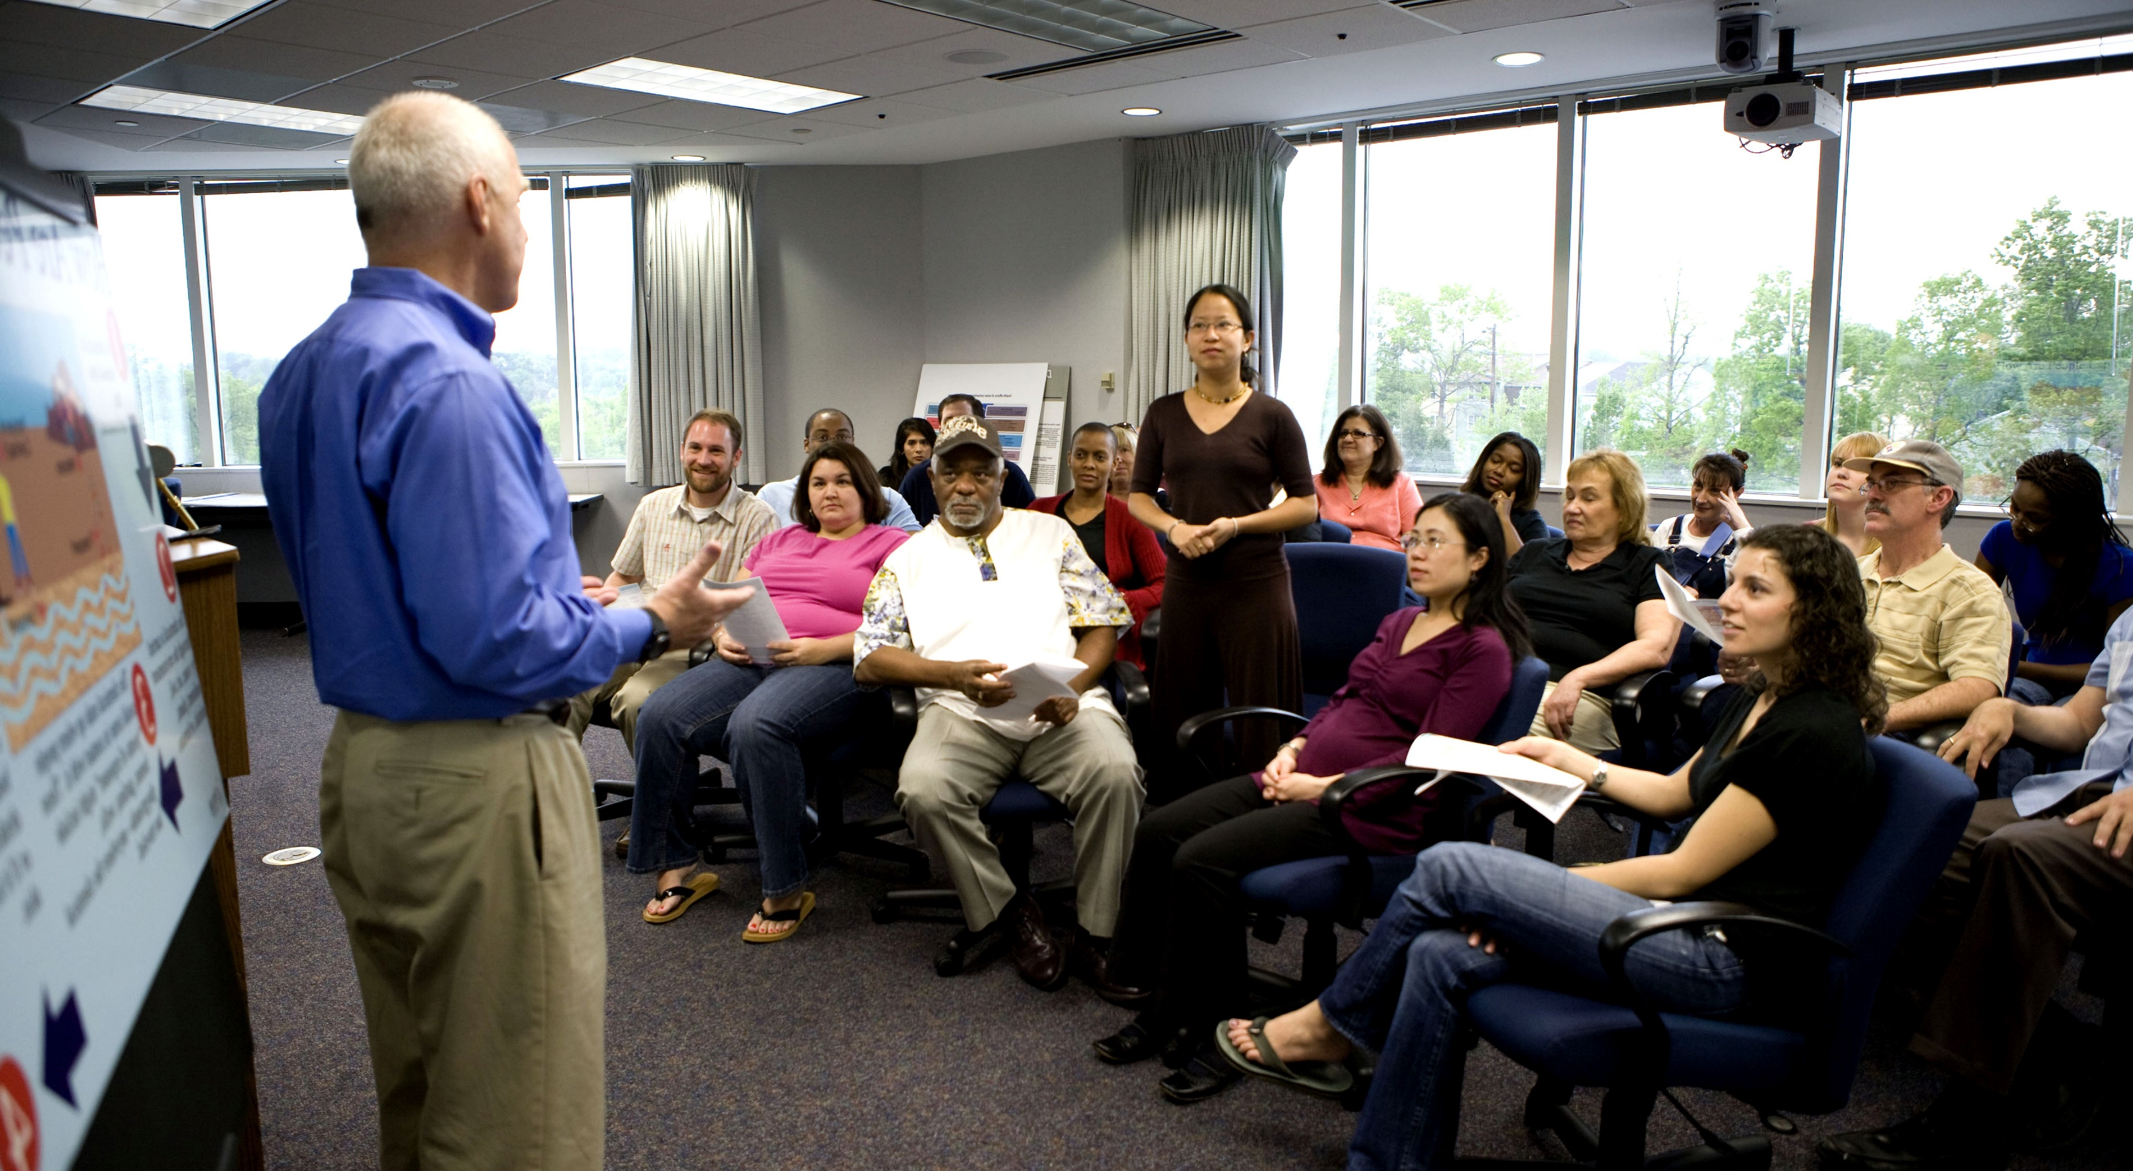
*By fulfilling these responsibilities , citizens actively participate in their communities and help maintain a safe and fair society .
Citizens of all ages have roles to play . Children and youth have the right to participate in their communities .
The United Arab Emirates prioritizes helping young people take part in civic and community life .
One way they do this through the Parliament for Emirati Children , where youth can talk to government leaders about important issues .
This allows government councils to hear youth voices when making decisions .

Slide 7
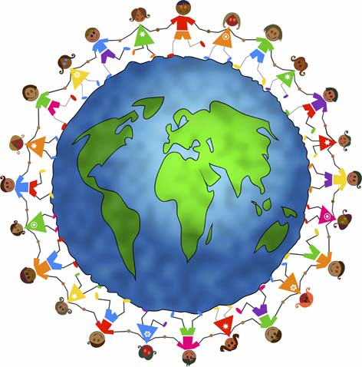
*The United Arab Emirates provides other ways for children to get involved , such as youth council and circles .
In these , young people discuss social , economic , environmental topics with leaders .
These efforts show the government’s commitment to include youth in decision –making . This helps young people become become responsible citizens of their communities .
This Photo by Unknown Author is licensed under CC BY

Slide 8
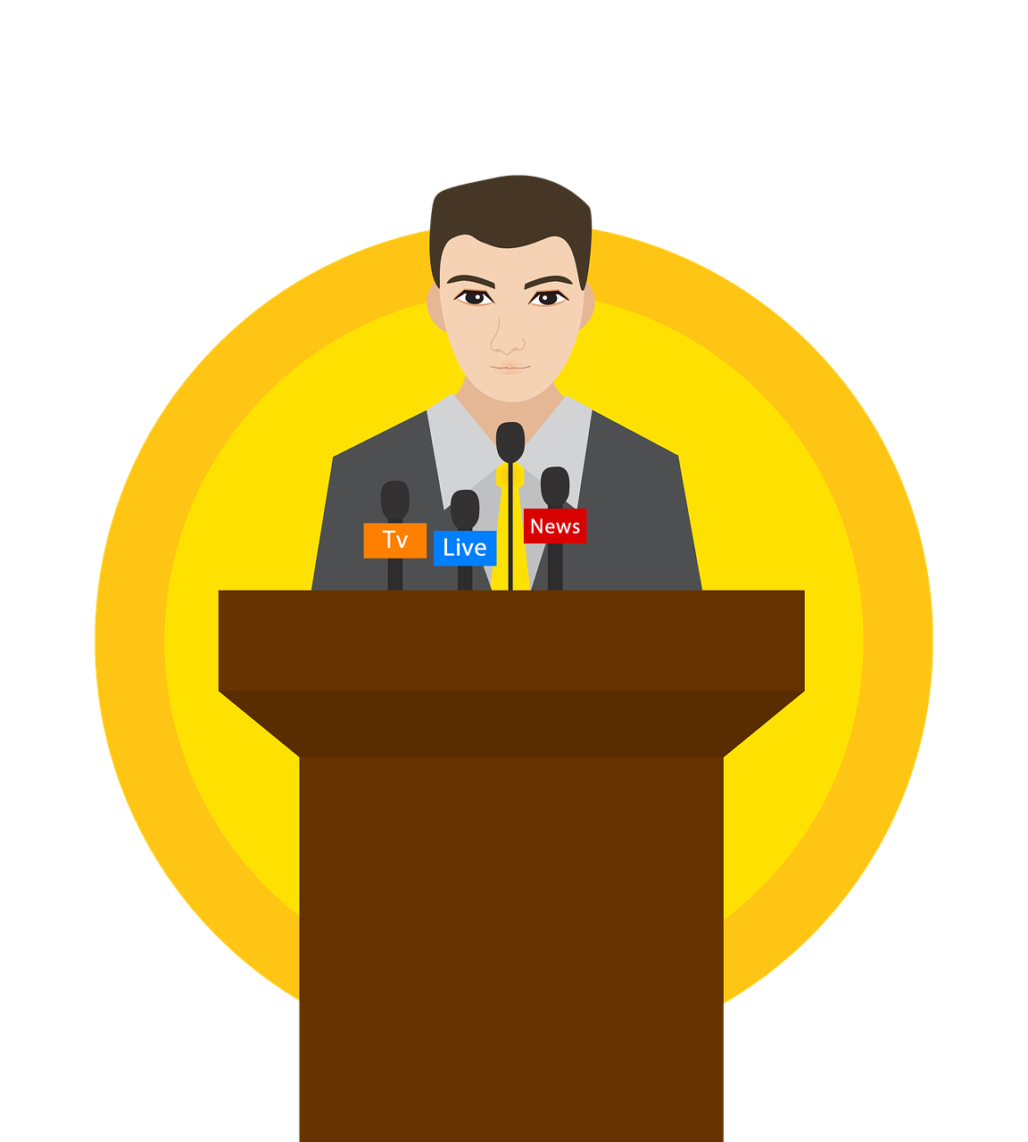
*Voting : a right and a Responsibility .
In many nations , citizens have a voice in who leads them in some government roles .These citizens have the right to vote
Vote : means choosing between two or more options in an election or a decision-making process .
Voting is both a right and a responsibility .Voters , or people who vote , need to learn about the candidates and choose who they think will best serve the people .

Slide 9

*Some countries have had voting since their founding , while others have introduced electing officials more recently .
This helps officials understand the needs of the people and increase citizen involvement .
The United Arab Emirates has held 5 elections for the federal National Council (FNC) .
The first election was in 2006 . More people voted in each of the next three elections .The number of women voters and women elected to the FNC also increased . In 2023 , the United Arab Emirates became the first country to hold a fully digital election .

