Slide 1
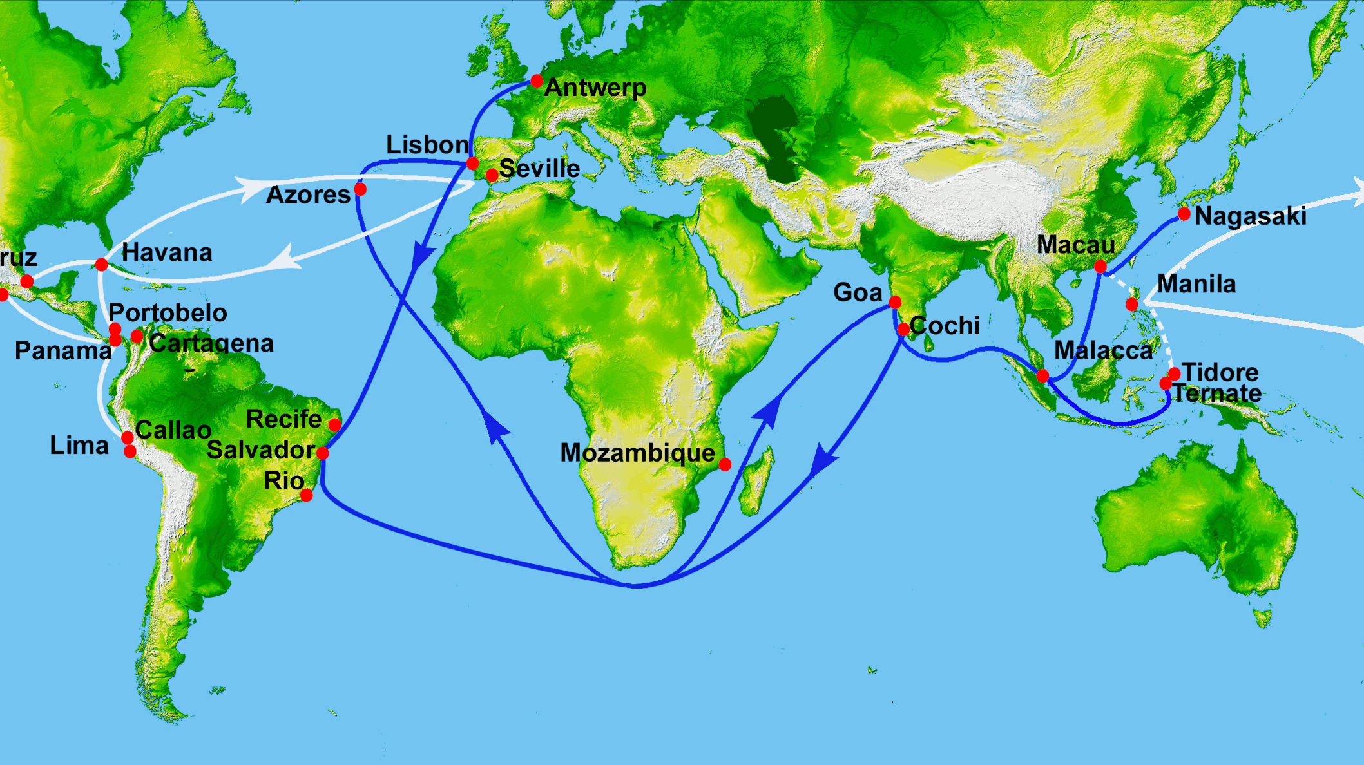
Trade and Geography
This Photo by Unknown Author is licensed under CC BY-SA

Slide 2
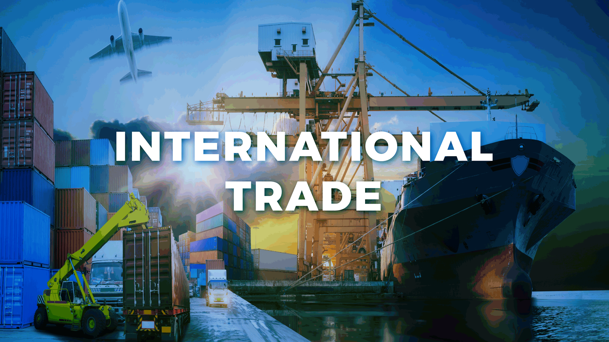
*You have learned how the supply chain impacts individuals and learned about the relationship between individual consumers and sellers .
Often the buying and selling happens between two companies or nations , or even a company and a nation . Economic geographers call this trade .
What does trade mean ?
The buying and selling of goods and services .
This Photo by Unknown Author is licensed under CC BY-ND

Slide 3
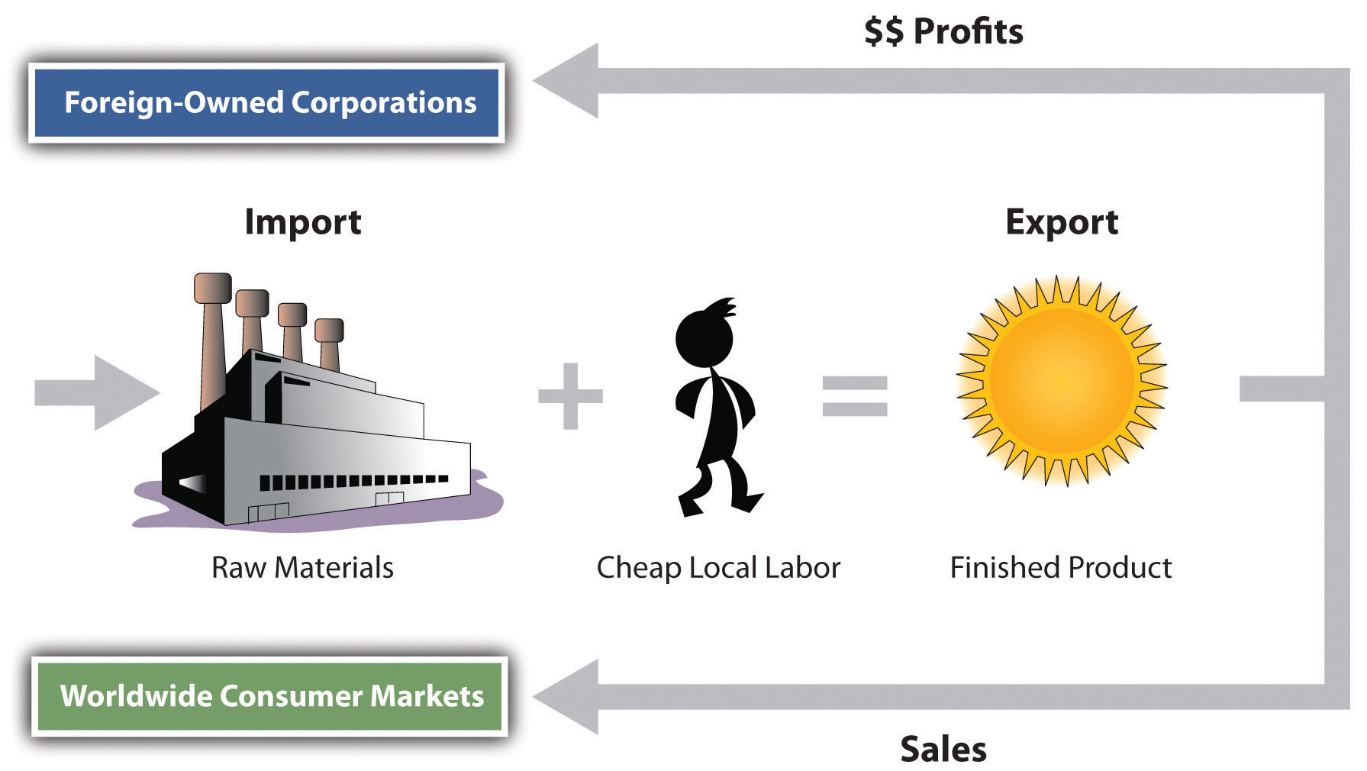
Trade is an important part of any economy .The geography of a place –its resources ,landscape , and location –can affect how much trade happens and what gets traded .
Economic geographers study the connections between trade , geography , and people .
They look at factors like what each country is especially skilled at making , how people transport the goods , and the trade agreements countries make .
By understanding this , economic geographers can see how trade and geography impact people and places .
This Photo by Unknown Author is licensed under CC BY-SA-NC

Slide 4
*Globalization : In today’s world , when people talk about trade , they also talk about globalization .
What does globalization mean ? It describes how countries have become more closely connected by trade and technology .
Globalization goes beyond buying and selling goods . It also involves the exchange of ideas , cultures , and even how governments run countries .
Globalization is not a new idea . The silk Road , a network of trade routes that existed between roughly 50 BCE and 250 CE gives us an example from history .

Slide 5
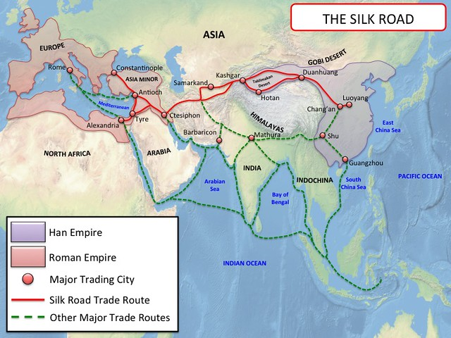
*The silk road connected China , Europe , and other parts of Asia and Africa .
Merchants traveled these routes , carrying goods like silk ,spices , and precious metals . This exchange brought new products to different regions .
It also promoted the sharing of ideas and cultural practices .
This Photo by Unknown Author is licensed under CC BY-NC

Slide 6

*Today , globalization occurs much faster than it did on the Silk Road . Technology , such as airplanes and the internet , allows for quicker movement of goods , information , and people .
This can have both positive and negative effects . As a result , globalization has made the world feel much smaller and more interconnected

Slide 7
*Benefits and Challenges of Globalization :
Globalization has major benefits and serious challenges . It has led to some countries becoming wealthier than others . The wealthier countries can provide aid that helps poorer countries develop .
It also enables you to access and enjoy products from different cultures worldwide . This builds greater sense of global community .
This closeness is important for addressing big problems such as natural disasters that affect many people .

Slide 8
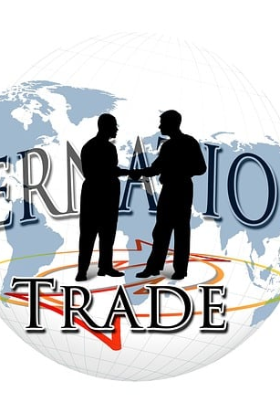
*In the past , the demand for more , cheaper products contributed to environmental damage .
Now , many organizations , such as the United Nations , focus on protecting the environment from further damage . However , some people say globalization has too many negative effects .
Others believe that free trade encourages poor working conditions . In some cases , workers get paid lower wages in some countries than in others .

Slide 9
*All countries have the responsibility to help make the world a better place . This is the real spirit behind globalization .
*What does free trade mean ? Is a movement attempts to help workers in the global economy .
This is especially important for those from developing countries .

Slide 10
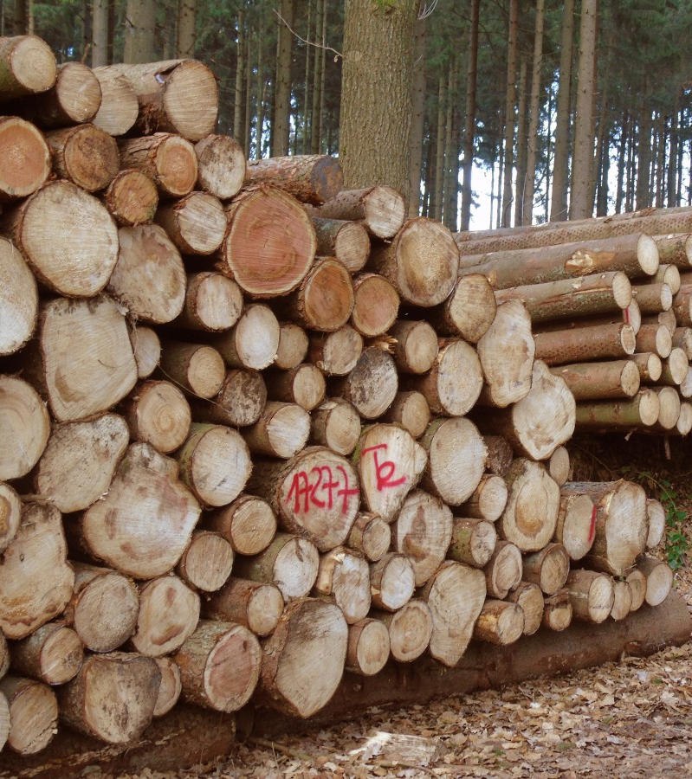
*Geographic Specialization : To specialize means to focus on doing one thing very well Geographic specialization means that countries or regions focus on producing one or a small number of key products .
The products may be raw materials , such as precious metals .In the Middle East , countries like the Kingdom of Saudia Arabia , the United Arab Emirates , and the State of Qatar have vast underground reserves of oil and natural gas . This has made them experts in extracting and exporting these natural resources . The resources have transformed their economies and made them important countries in the global energy market .

Slide 11
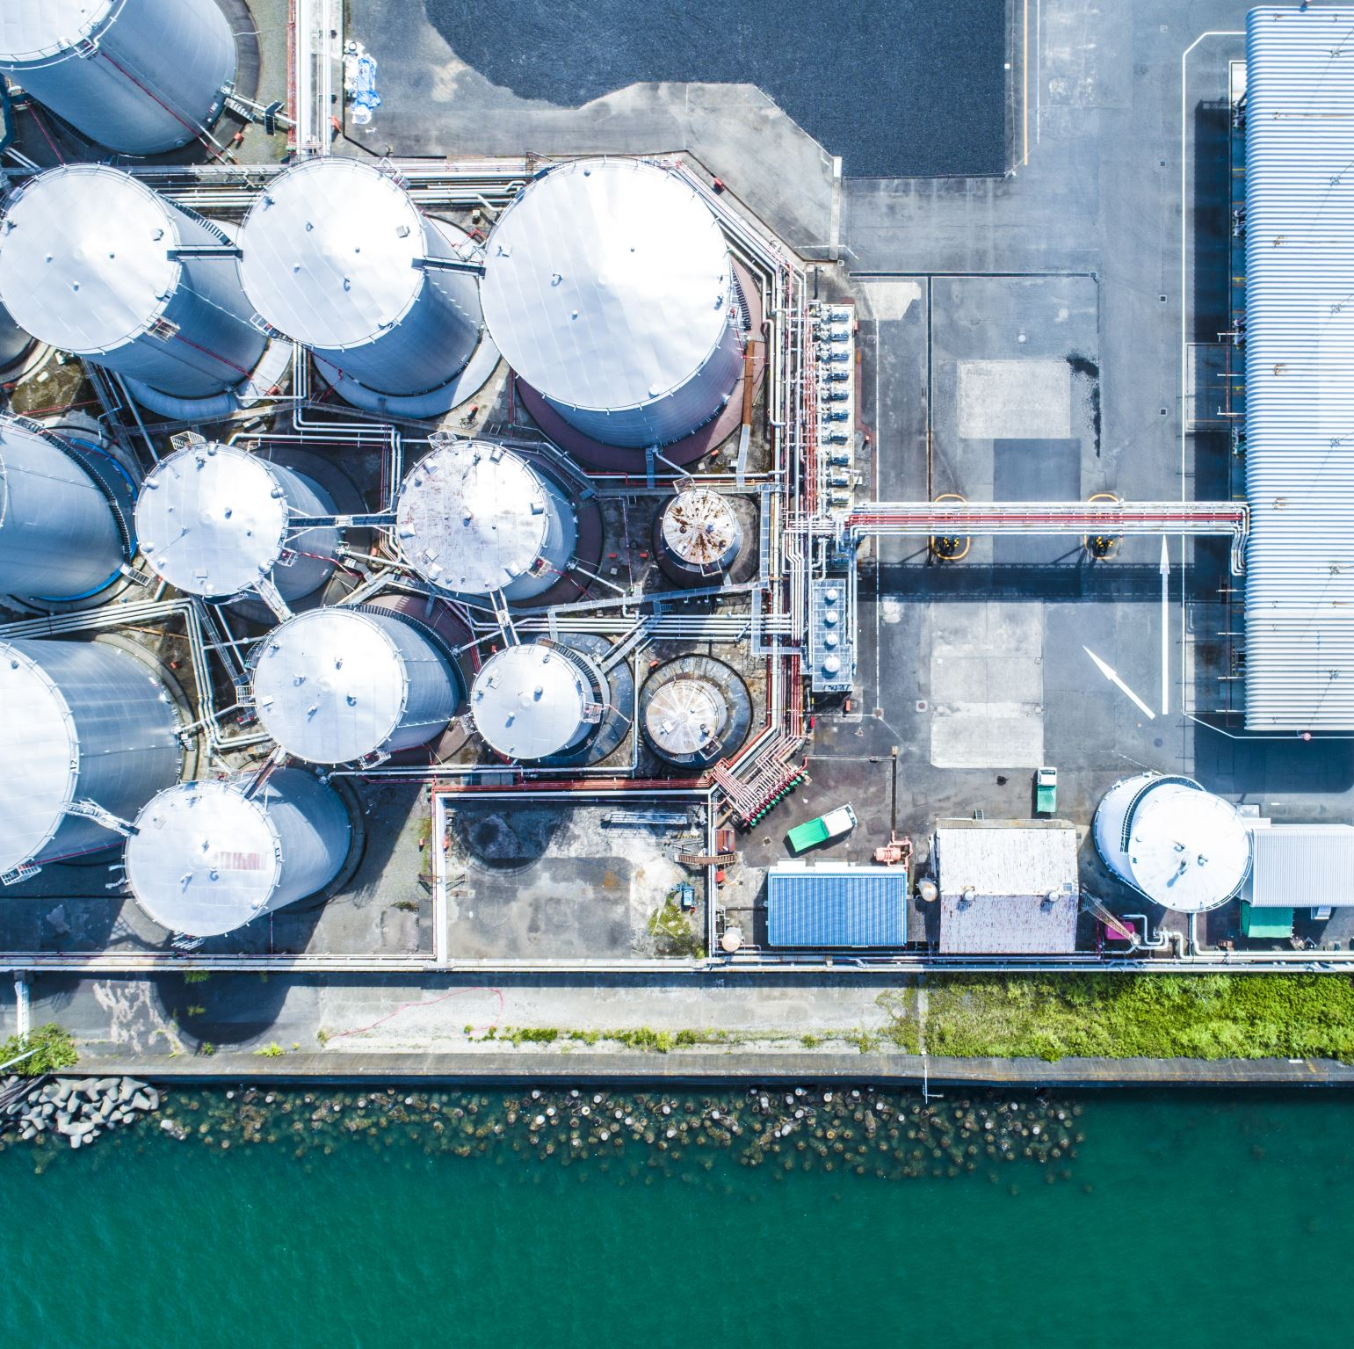
*To trade oil and gas with other countries , these nations have built networks of pipelines , ports , and shipping routes . This development has dramatically altered the Middle East’s landscape .
The Middle East’s huge oil and gas reserves also give the region significant influence in the world , both in terms of trade and international politics . This shows the powerful link between a region’s geographic specialization and its role in global trade .

Slide 12
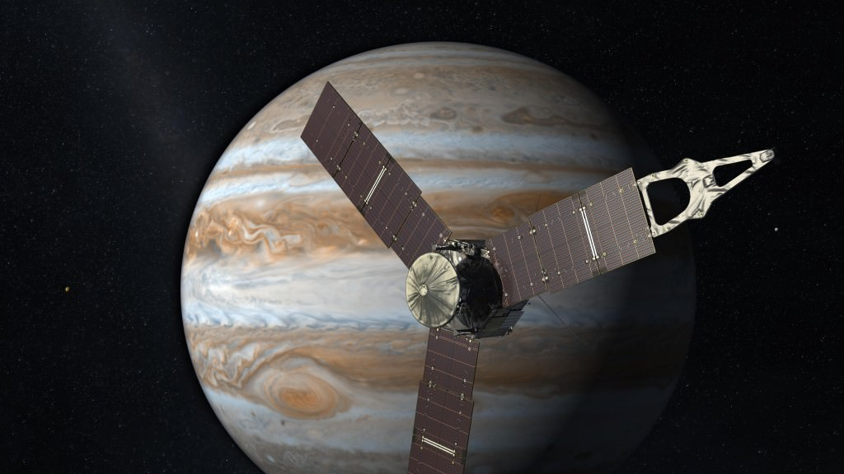
*Technology Transfer : Trade does not only involve exchanging goods . It can also mean sharing technology and knowledge between countries .
An example is the relationship between the United States and China . Even though these countries are far apart , trade connects them .
China has become a major destination for technology exports from the United States . This means American companies often choose to manufacture their products or conduct research in China , a concept called outsourcing .
This Photo by Unknown Author is licensed under CC BY

Slide 13

*Several factors contribute to companies outsourcing to China .
Lower labor costs : Companies can spend less money hiring workers in China than in the United States .
Large , skilled workforce : China has a high number of workers in manufacturing and technology . This provides companies with skilled people needed to produce complex products .
Speed of transportation : China has spent a lot of money building roads , ports , and airports . This makes it easier and faster to move goods .

Slide 14

*Strong manufacturing industry : China offers access to factories , suppliers , and knowledge .
Location : China provides a route to other large market in Asia , which is very attractive for companies that want expand .
The flow of technology between the United States and China shows how interconnected trade and geography shape the global economy .
American companies benefit from lower production costs in China , while China gains knowledge and technology .

Slide 15
*Transportation Networks :Imagine a giant web connecting countries across the globe . Shipping routes , airplanes , railways , and highways make up this web .
They all work together to move goods and people around the world . These transportation networks are the backbone of the global economy . They allow countries to trade with each other no matter how far apart they are .

Slide 16
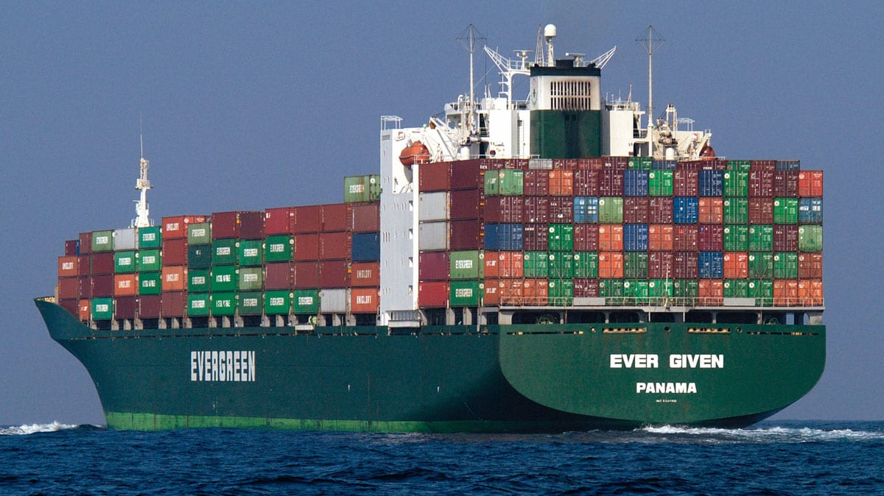
*An example of this story of the giant container ship , the Ever Given , that got stuck in the Suez Canal in 2021 .
The Suez Canal is an important waterway that enables ships to travel between Europe and Asia faster . When the Ever Given got stuck , it prevented other ships from using the canal . This caused delays in getting goods where they needed to go , affecting businesses around the world .
This event shows the importance of transportation networks . Nations need to maintain these networks and have plans in place for when things go wrong . Good transportation , along with smart planning , helps keep trade flowing smoothly and the global economy operating .
This Photo by Unknown Author is licensed under CC BY-SA-NC

