Slide 1


Title Capitalization
Hey!

Slide 2

CAPITAL LETTER
Use a capital letter to begin a sentence .
The book is red. It’s on the table.
My name is Lara.

Slide 3



We use a capital letter for the personal pronoun
What can I say?
He is Pablo, I am Cintia.
Always capitalized, no matter where it falls in a sentence.

Slide 4

Use a capital letter for days of the week, months
of the year, holidays
Monday, Friday...
April, May...
Easter, Christmas...

Slide 5

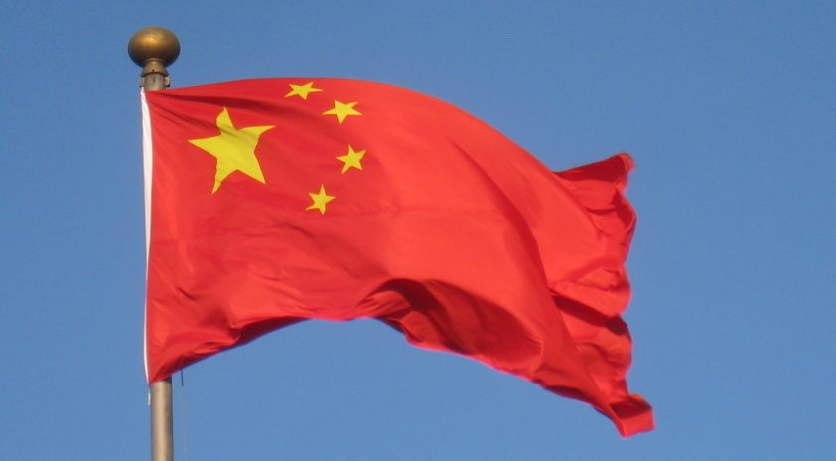
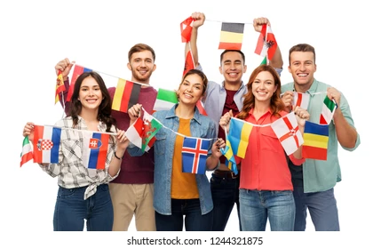
COUNTRIES, LANGUAGES and NATIONALITIES
China, France, Argentina.
Japanese, English.
Peruvian, Chilean.

Slide 6
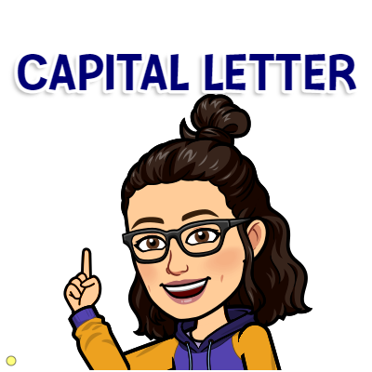
Use a capital letter for people's names, surnames and titles
He is Lionel Messi.
King Henry VIII
Dr Smith.
Hello, Mr. President.

Slide 7
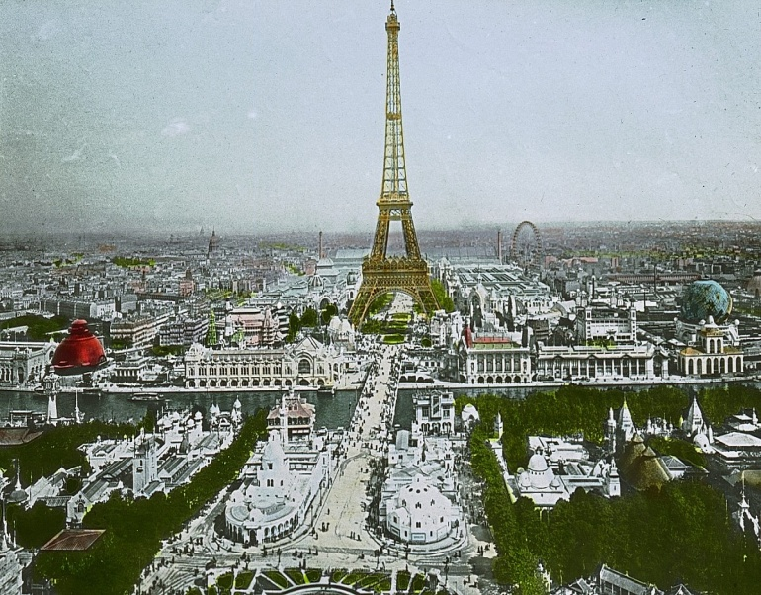
Use a capital letter for places and monuments
Paris, Buenos Aires, Cipolletti.
St Paul London's Cathedra.
Andes mountains, Machu Picchu.
Names of the street too!
Tomas Orell Street.
Belgrano 190.
The Eiffel Tower in Paris.

Slide 8
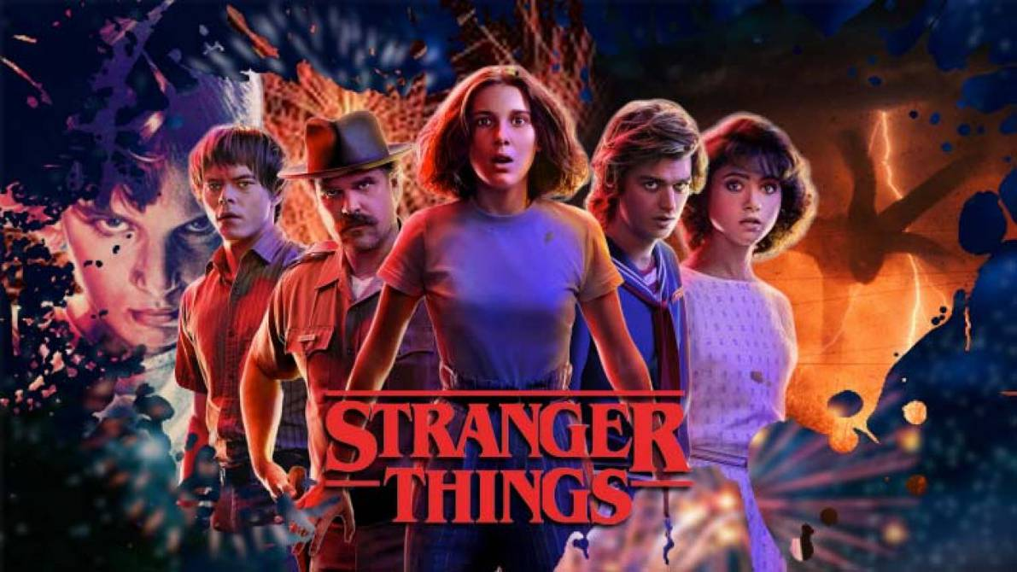

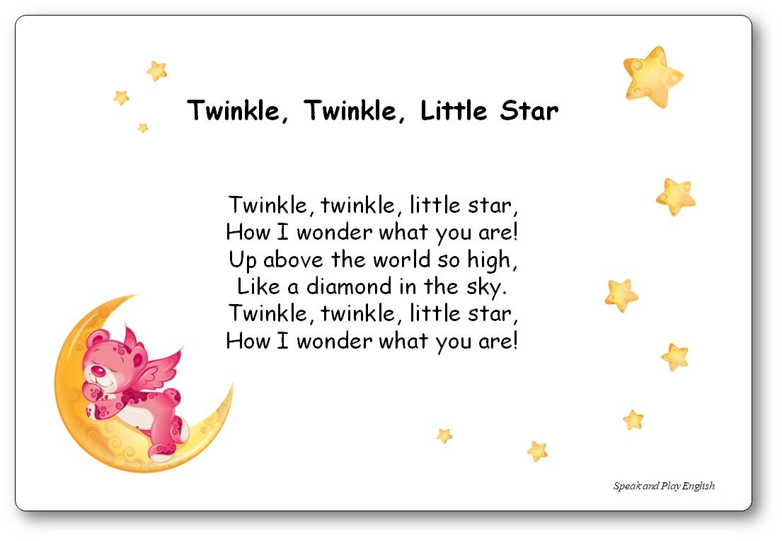
Use a capital letter for titles of:
Movies, Tv Programmes
Books
Poems
Songs
Stranger Things
The Secret Life of Pets
Harry Potter and the prisoner of Azkaban
Twinkle, Twinkle Little Star.
Shake it off by Taylor Swift.

Slide 9
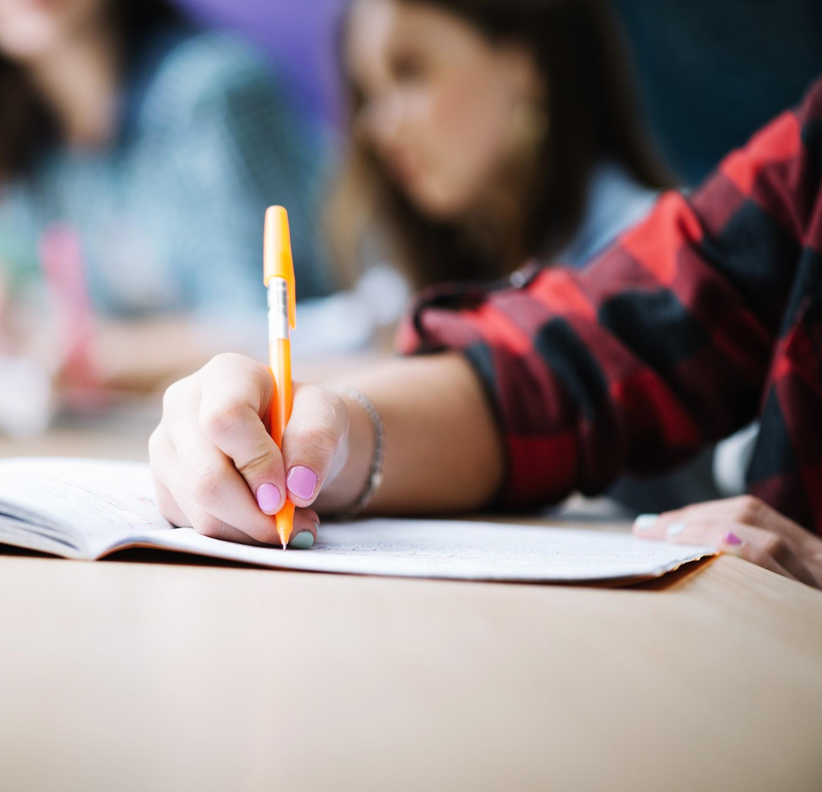


Greeting and closing of a letter or e-mail!
Dear Judy,
How are you?...
Love, Anna.
Your friend, Pablo.
See you soon.

Slide 10
eiffel tower is the most famous monument in france
my brother is a Singer
¿where are you from
you look bad are you ill
we Are in our home
tomas is A smart boy
Eiffel Tower is the most famous monument in France.
My brother is a singer.
Where are you from?
You look bad, are you ill?
We Are in our home.
Tomas is a smart boy.

Slide 11
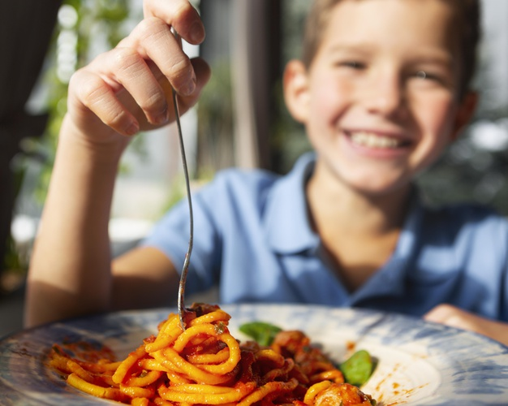
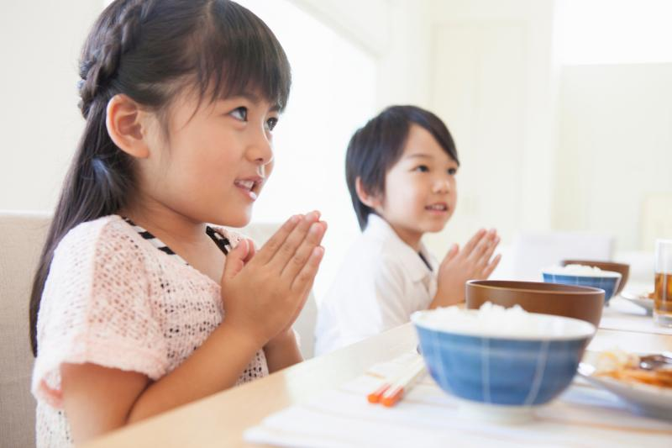
Correct the capital letter and punctuation
my Name is kamiko. i’m from japan. i’m Seven year old and i have a brother His name is rion we live in a City called nara. i love to sing and the colour red
My names ken, i am from the united States. I am eleven years old i live with my mum, my dad and my sister. her names lisa. my favourite sport is Football i love pasta

Slide 12
Game time
https://wordwall.net/resource/10393658/english/capitalization
https://wordwall.net/resource/10395752/english/capitalization

Slide 13
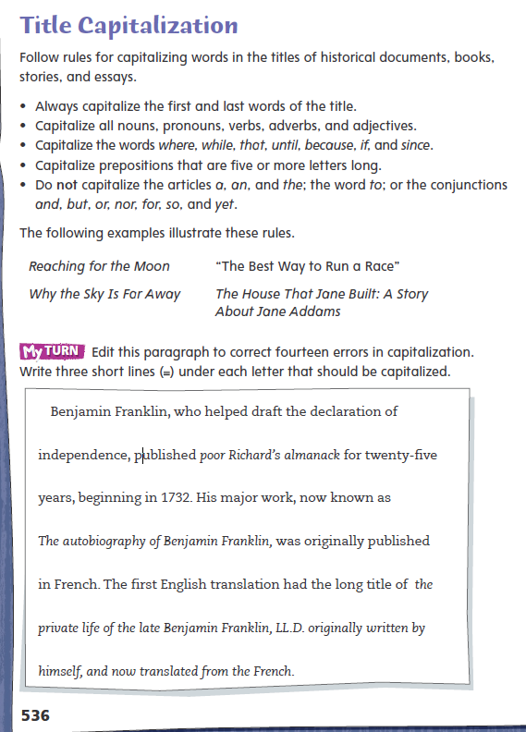

Slide 14
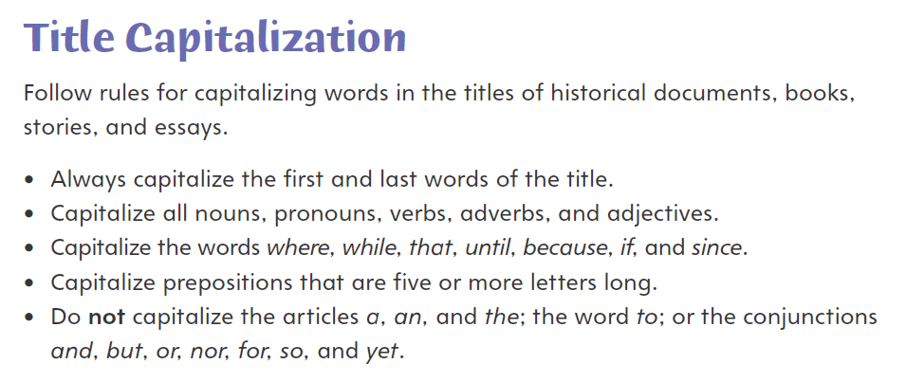

Slide 15
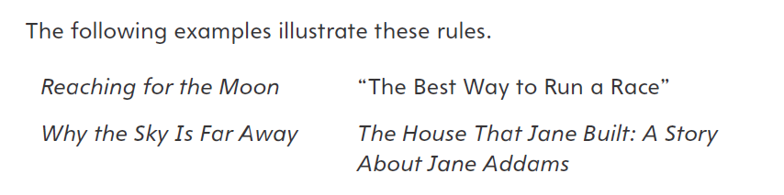

Slide 16
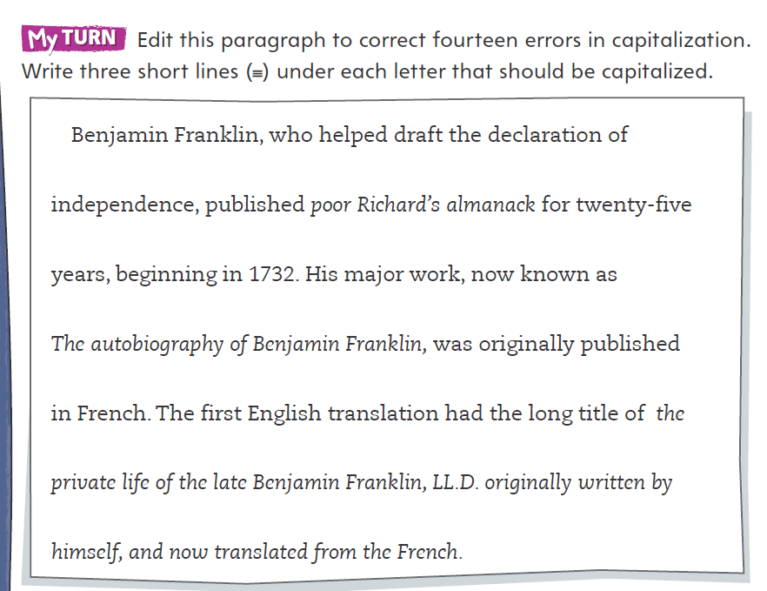


Slide 17
Informational text, week 7
Write an informational text about Volcanoes.

Slide 18




