Slide 1
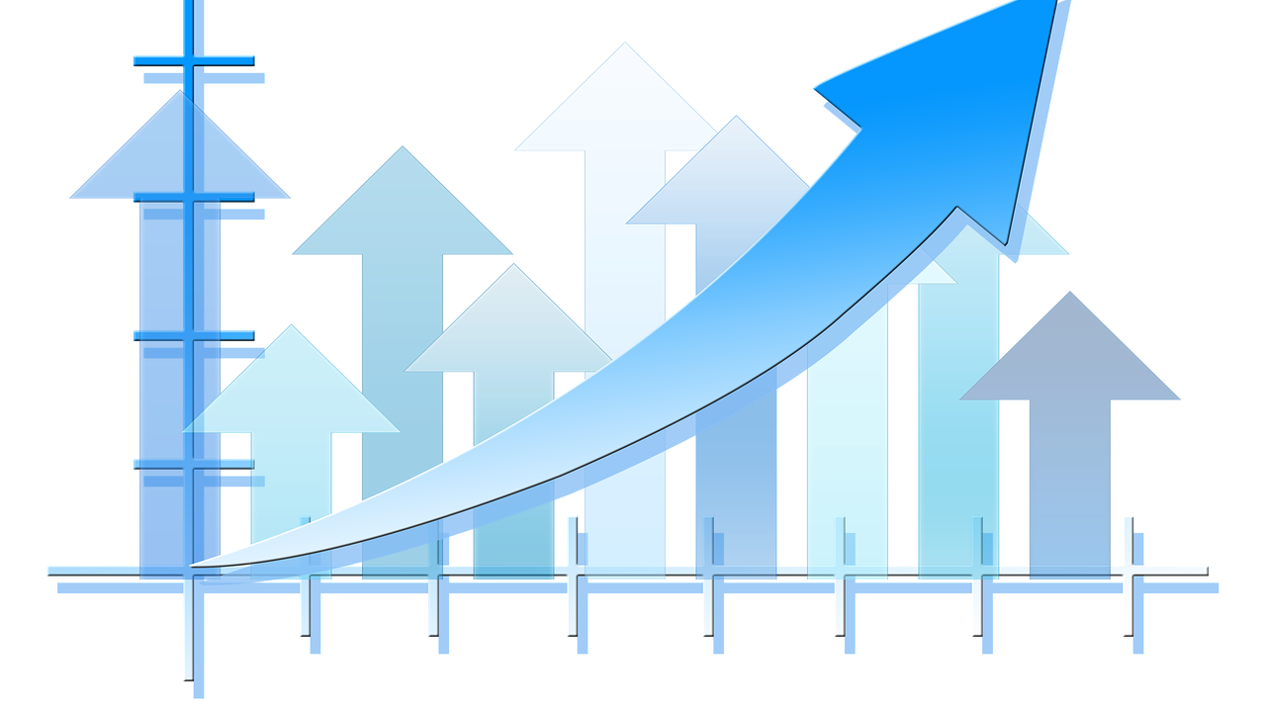
Economic Issues in Societies

Slide 2
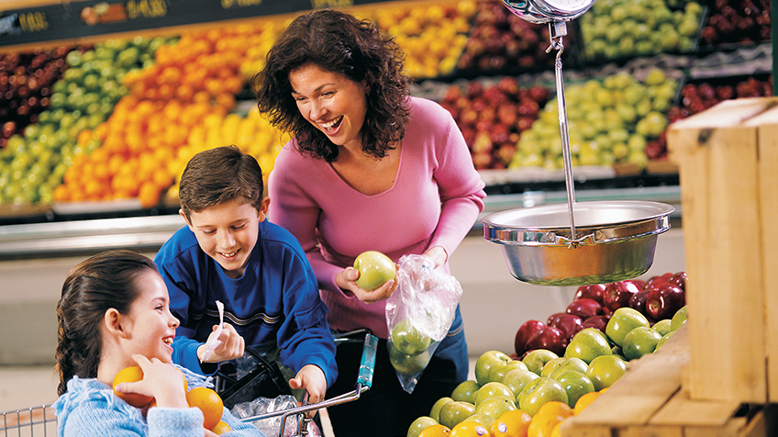
*One word that should come to mind when thinking about social studies is connection.
Almost everything that occurs in the world connects to other people , systems , or events . A key connection is that of the economy and society .
The economy is a vital part of society. As it applies to daily life , the economy concerns on how people make and spend money . These activities also contribute to status – a person’s position in society .
This Photo by Unknown Author is licensed under CC BY-SA

Slide 3
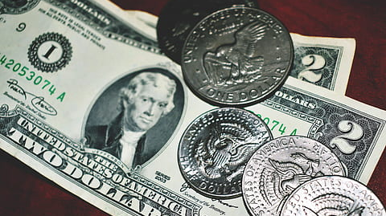
Money determines a lot of the social decisions you and your family make . It affects where you live , what you eat , and the things that you buy . Often , social status is determined by how much money families have , where people live , and their professions .
Social change and economic change are tied together . Economists call the study of how economics and society interact socioeconomics . Socioeconomic status covers many different parts of social and economic life .

Slide 4
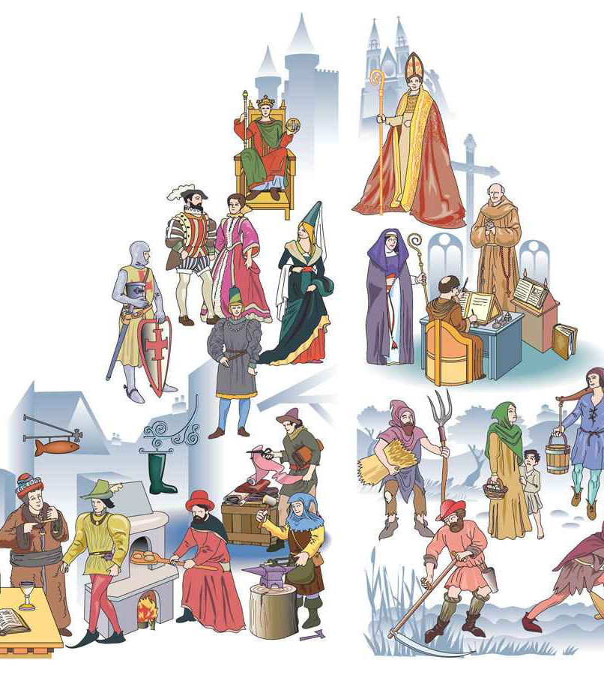
Socioeconomic Status : One way economist study socioeconomics is by looking at social classes
Society often organize people based on their economic status .This practice has been happening since the time of ancient civilizations . The classes have varied from era to era and from place to place .
Today , socioeconomic classes in most places are divided into three major groups : upper class , middle class , and working class . However , it is not always clear who belongs to which class .
This Photo by Unknown Author is licensed under CC BY-NC-ND

Slide 5
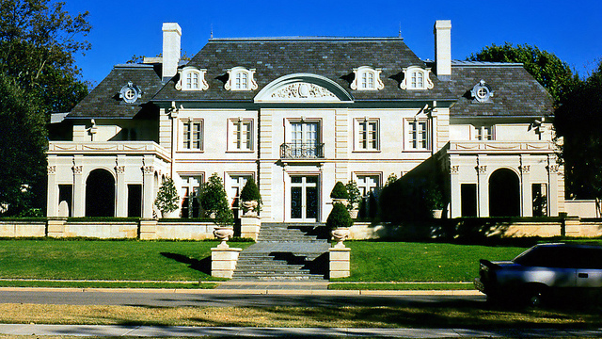
*The Upper Class : In modern times , the upper class is the wealthiest group in the society . It is also the socioeconomic group with the fewest members .
Often , those in the upper class have a family history of wealth . However , through hard work and good investments , others can rise to reach this economic status .
Those in the upper class have different access to different parts of society . For example , more people in the upper class attend college and graduate school compared to those in other socioeconomic classes . In the United States ,88 percent of millionaires earn college degrees .
This Photo by Unknown Author is licensed under CC BY-SA-NC

Slide 6
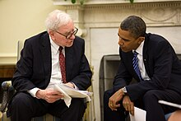
The upper class can also impact the economic success of the middle and working classes . Upper-class business owners can hire workers , determine pay , and donate to charities , thereby improving the quality of life for all .
This Photo by Unknown Author is licensed under CC BY-SA
Question : True or false : Those who are in the upper class often had ancestors who were also in the upper class .

Slide 7
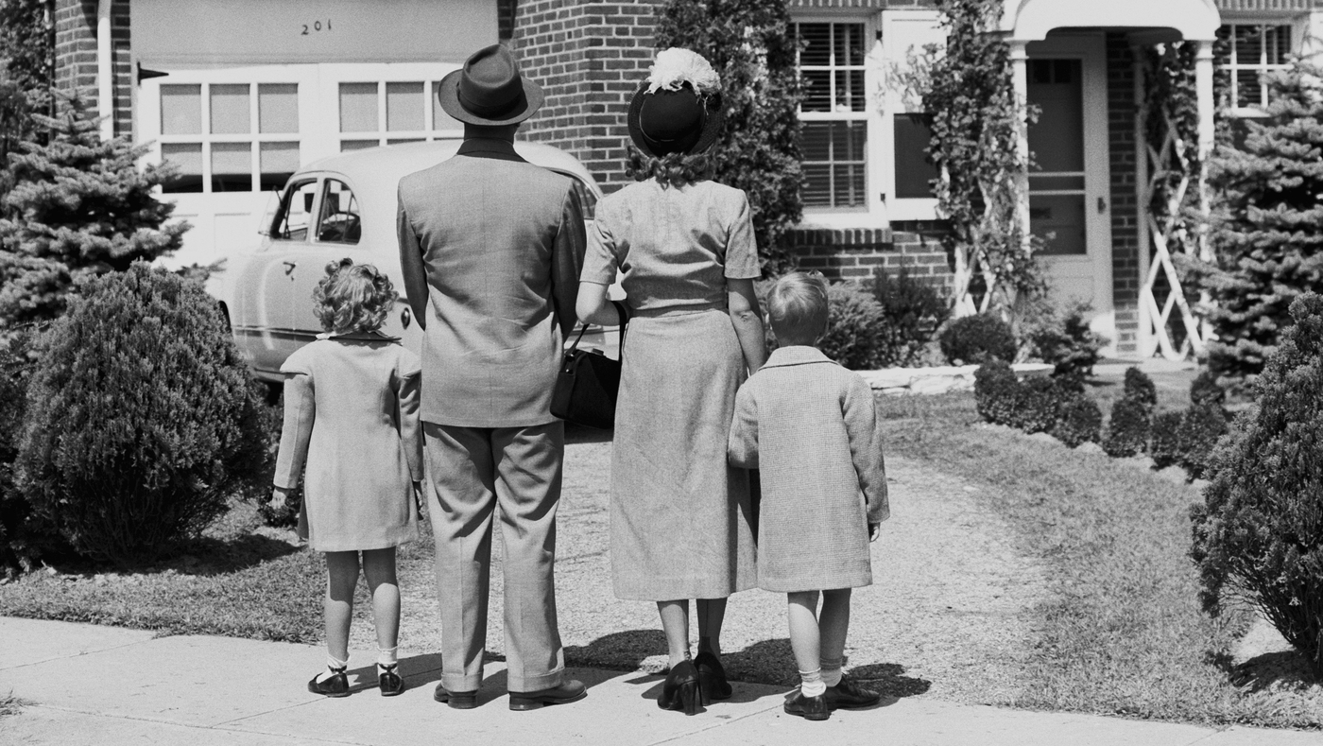
*The Middle Class : The industrial Revolution increased the standard of living for many through technological innovation .
Opportunities through innovations increased . This led to a growing middle class . The middle class is the socioeconomic group of people between the working and upper classes . The term working class may be confusing because people from all classes work . People in the middle class often differ from people in the working class by the types of jobs they have .
The upper class and lower middle class are subdivisions of the middle class .The middle class contains a diverse group of people with a variety of jobs , economic interests , and family sizes .
This Photo by Unknown Author is licensed under CC BY-SA

Slide 8
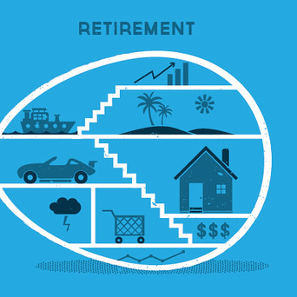
Those in the middle class are often concerned with their financial future . They are likely to have enough extra income to save for the future and retirement .
Retirement : is when a person chooses to permanently stop working .
Retirement money is the money that someone sets aside for that time . When they stop working ,they use these savings for the rest of their lives .
Retirement is a financial concern for all socioeconomics classes .
Members can afford to purchase cars , dining out ,and even buy a home . The middle class is also the largest spending group of all social classes .
This Photo by Unknown Author is licensed under CC BY-SA

Slide 9
*Socioeconomic class population and their total spending in 2020 :
Socioeconomic class | Number of people in class | Total spending in trillions
Upper class | 200 million | $ 14 trillion
Middle class | 3.5 billion | $ 44 trillion
Working class | 4 billion | $ 5.7 trillion

Slide 10

*The Working Class : the working class includes individuals who have less financial security than middle and upper class .
Many working class jobs require manual labor , technical skills , and can be serviced based .
Often , there are lower educational requirements for working class jobs and positions .
Plumbers ,electricians , and farmers are working class jobs .
Today , these working class jobs can provide more income than desk jobs .
Some economist place working class jobs in middle class because of their economic wealth and the skills needed based on technological tools and process .
This Photo by Unknown Author is licensed under CC BY-SA-NC

Slide 11

*Those in the working class may have difficult time paying their bills . They may find it hard to save money due to the cost of daily life .
Members of the working class may struggle to achieve financial security : the condition of living comfortably , saving for the future , and being prepared for financial emergencies .
Though a family may currently be in the working or middle class , some things can help them move to a higher class . This is called social mobility .
*Examples of social mobility :
College education , owning property ,and learning new skills .
This Photo by Unknown Author is licensed under CC BY-SA-NC

Slide 12
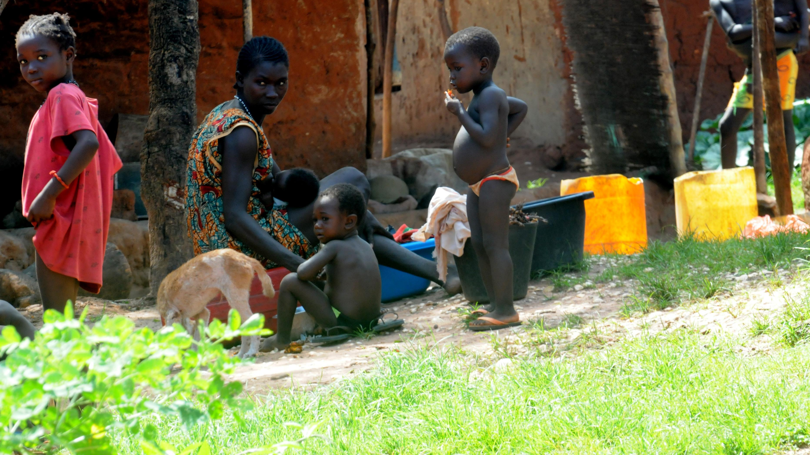
*Poverty : occurs when a household lacks the money to pay for the basic needs of life , such as food and shelter .
Poverty line : the amount of money a person needs to stay out of poverty depends on where that person lives .
For example : the poverty line for an individual in the United States is $24.55 per day . In Ethiopia , its $2.04 per day .
Where someone lives can impact an economic factor .

Slide 13
*Poverty tends to lead to other problems : lack of nutrition , and a high rate to get ill .
Nations are working together to reduce poverty .
Global poverty is a major concern for many international economic organizations , such as the world bank .
The number of poverty is declining . Important progress has been made , but there is still a long way to go to reduce or get rid of poverty .

Slide 14

*Economic Events : Events sometimes affect different socioeconomic classes in different ways .
For example : The COVID-19 pandemic had a great economic event on many socioeconomic groups .
The pandemic shutdown reduced the size of the global upper class by 62 million people . The middle to 36 million , and the working class to 21 million people .
Households had to change the economic decisions they made . For example : a rise in the unemployment in the working class impacted the business owners of the middle and upper classes .
There was a decreased demand for their goods and services , and their income , in turn , went down . These changes have long-term effects that economist still are studying today .
This Photo by Unknown Author is licensed under CC BY-NC-ND

Slide 15

*Economic Futures : Socioeconomic factors are complex . They include education , location , and family size .
Economists have to consider these factors when they make predictions or decisions about the economy .
When major events occur , the socioeconomic status of people can change for better or worse . For some households ,finding the path to financial security is a goal . For others , it is moving up in society by working hard and earning more money

Slide 16
The End

