Slide 1
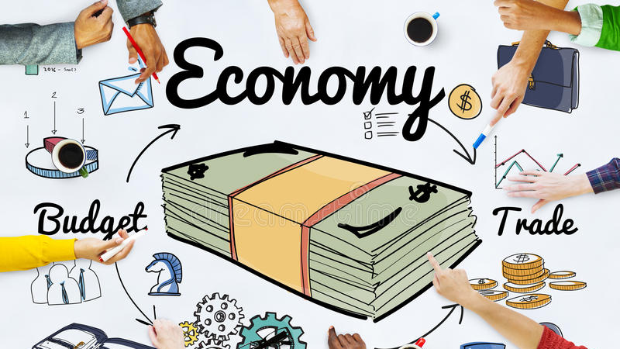
Individuals and Economics
This Photo by Unknown Author is licensed under CC BY

Slide 2
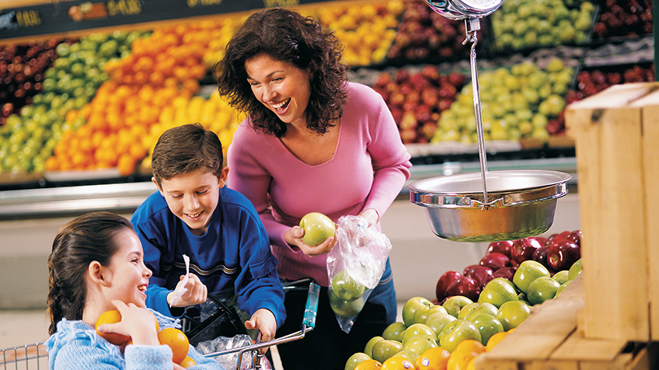
*Money is important in the everyday life of most people . People think about money when they make decisions . From buying groceries to saving money for a house or a car , almost everyone makes decisions based on how much money they have .
Those personal decisions impact more people than just the person making them . Individual economic decisions help drive local communities .The economic health of local communities can affect the economy of a country and even the world ! The economy depends on how people spend and earn money .
This Photo by Unknown Author is licensed under CC BY-SA

Slide 3
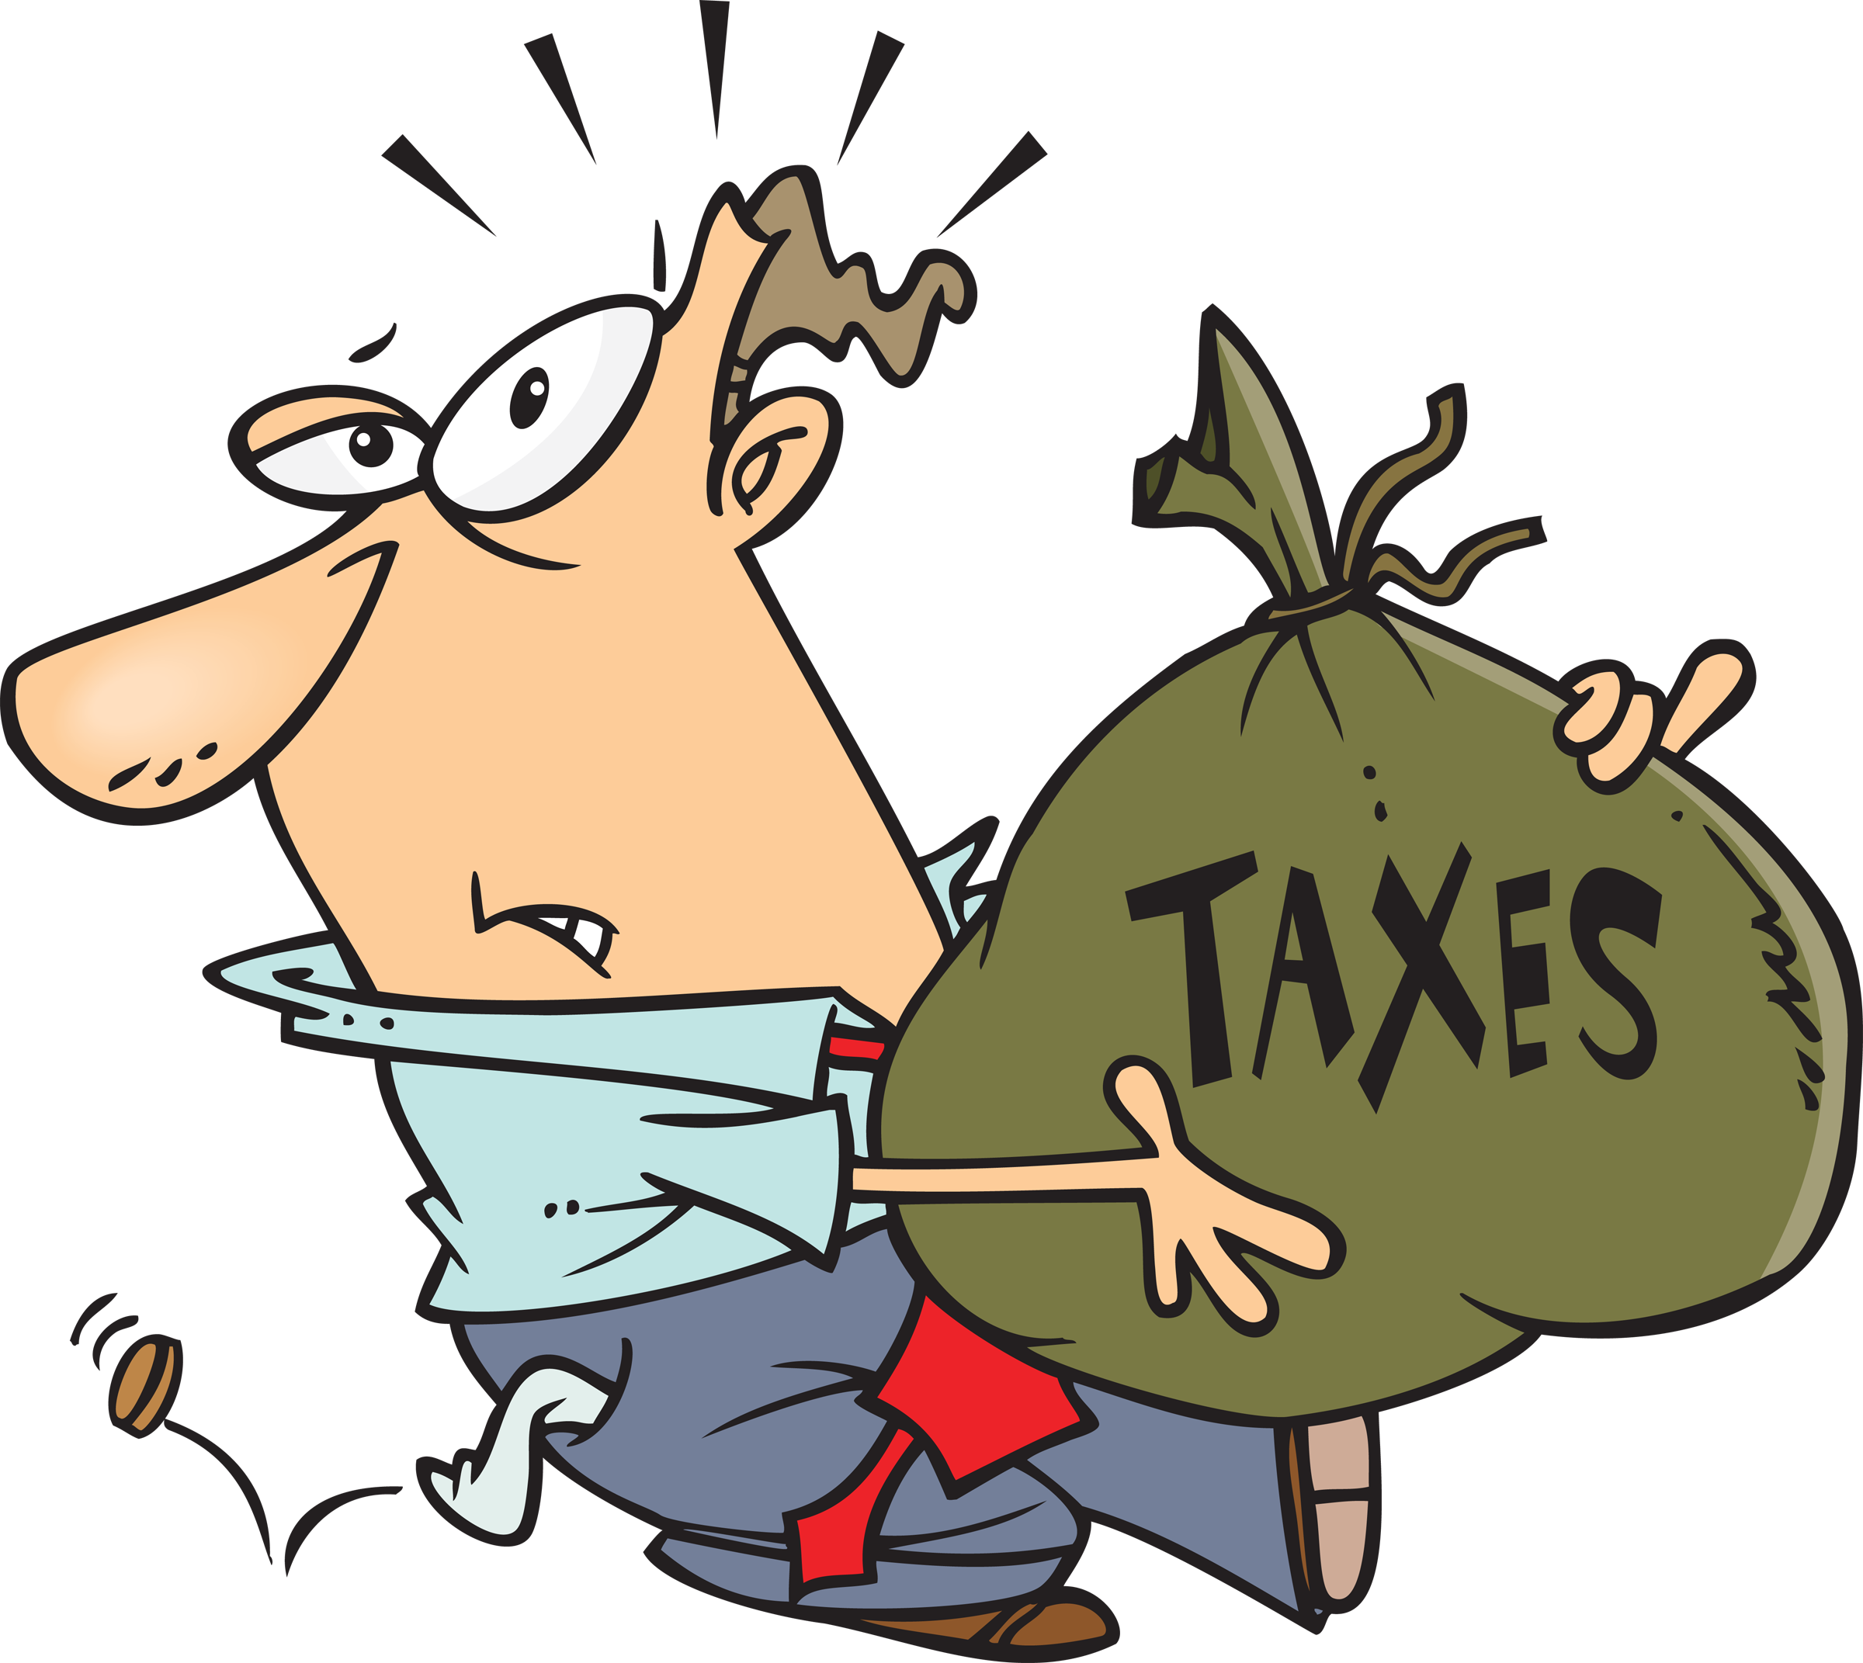
*Scientists who study the economy look at the connection between the individual and the economy .
Personal finances : means individuals and households managing their money by budgeting , spending wisely , and saving for future needs .
Personal finance includes decisions about how people pay taxes , and buy things .
People work hard to earn a living . They should spend their money very carefully .
This Photo by Unknown Author is licensed under CC BY-NC

Slide 4
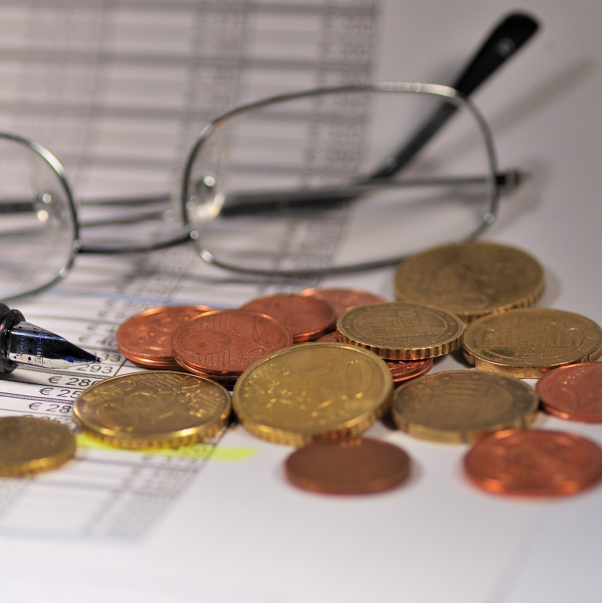
*Budgeting : is planning how to use the money that comes in and goes out of a household .
Budgeting helps families and individuals plan how to spend their money on things like food , clothes , and school supplies . It helps people decide how to best use their money . The more people practice wise personal finance , the greater the positive impact on the community .

Slide 5

*Economic Decision –Making : People have a few choices when it comes to using the money they earn .
One choice is to spend money . Spending money means buying goods you need , such as food , clothing , and paying for transportation , which are important parts of daily life . People split their spending between their wants and their needs .
This Photo by Unknown Author is licensed under CC BY-NC-ND

Slide 6
2- the second choice is to save money . Saving your money can be important for emergencies or for big purchases you want to make someday .
3- the third choice is to share or donate money . Donating money helps other people . If people donate in their community , it will benefit the community as a whole . Donations support community members in need .
4- To invest the money . Investing is another way to save money . The money you invest grows over time . Many people invest by buying stocks or bonds .

Slide 7
*Spending Money : It is lunchtime ! Today , you might have the choice between eating a home-cooked meal or going out to eat as a treat . When you make that decision , you take part in the economy of your community .
Consumer spending : is how much money an individual or a household spends on goods and services .
Spending can range from daily needs , like food and housing , to fun items that you want but do not need .

Slide 8
*Consumer spending matters to businesses and communities because it can lead to profit .The more money people spend , the more the economy benefits .
Economists are people who study the economy and how it affects the community .
They keep close track of consumer spending to understand how a country is performing economically .

Slide 9
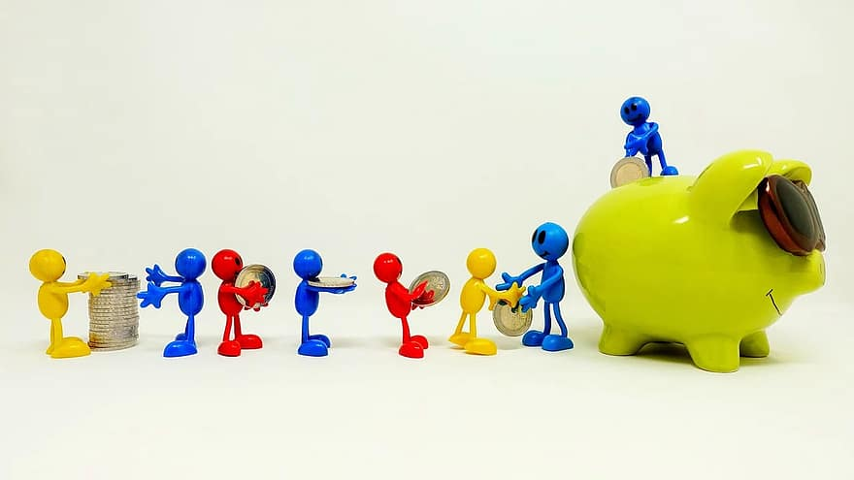
*Saving Money : saving money involves preparing for the future . Sometimes family members save for items they want , like a computer or a gaming device .
Many times , people save for things they need to improve their lives , like a house or a car . In addition , savings help people be prepared for an emergency . Having savings can help you feel safe if anything goes wrong .
Saving money can help countries and people .
The community needs a balance of consumer saving and spending . When people spend too much , the economy grows very quickly . This can cause problems and lead to a financial disaster . However , if people save too much money , then the economy can slow down and start to become weak .

Slide 10
*When an economy stays steady , with no unexpected changes , it has economic stability .
All countries and households have the goal of economic stability . Economic stability happens when people balance saving and spending money .
Money In , Money out :
People can make their community better by sharing their money with the community . One way is by paying taxes .

Slide 11
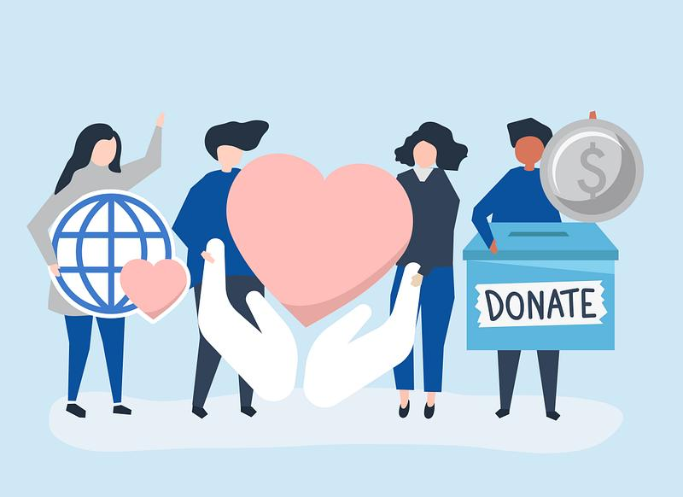
*Governments take a share of wages –what people earn at their jobs –as taxes . Governments then use some of these taxes to improve the community .
Citizens may not have a choice when it comes to paying taxes . However , people can choose to donate , or give , extra money to the community . Charitable donations help build a sense of community .
Donations help support economy growth . For example , donating to a charity helps education and helps create more jobs . Having more jobs usually leads to an increase in economic activity , which has a positive impact on the community .

Slide 12
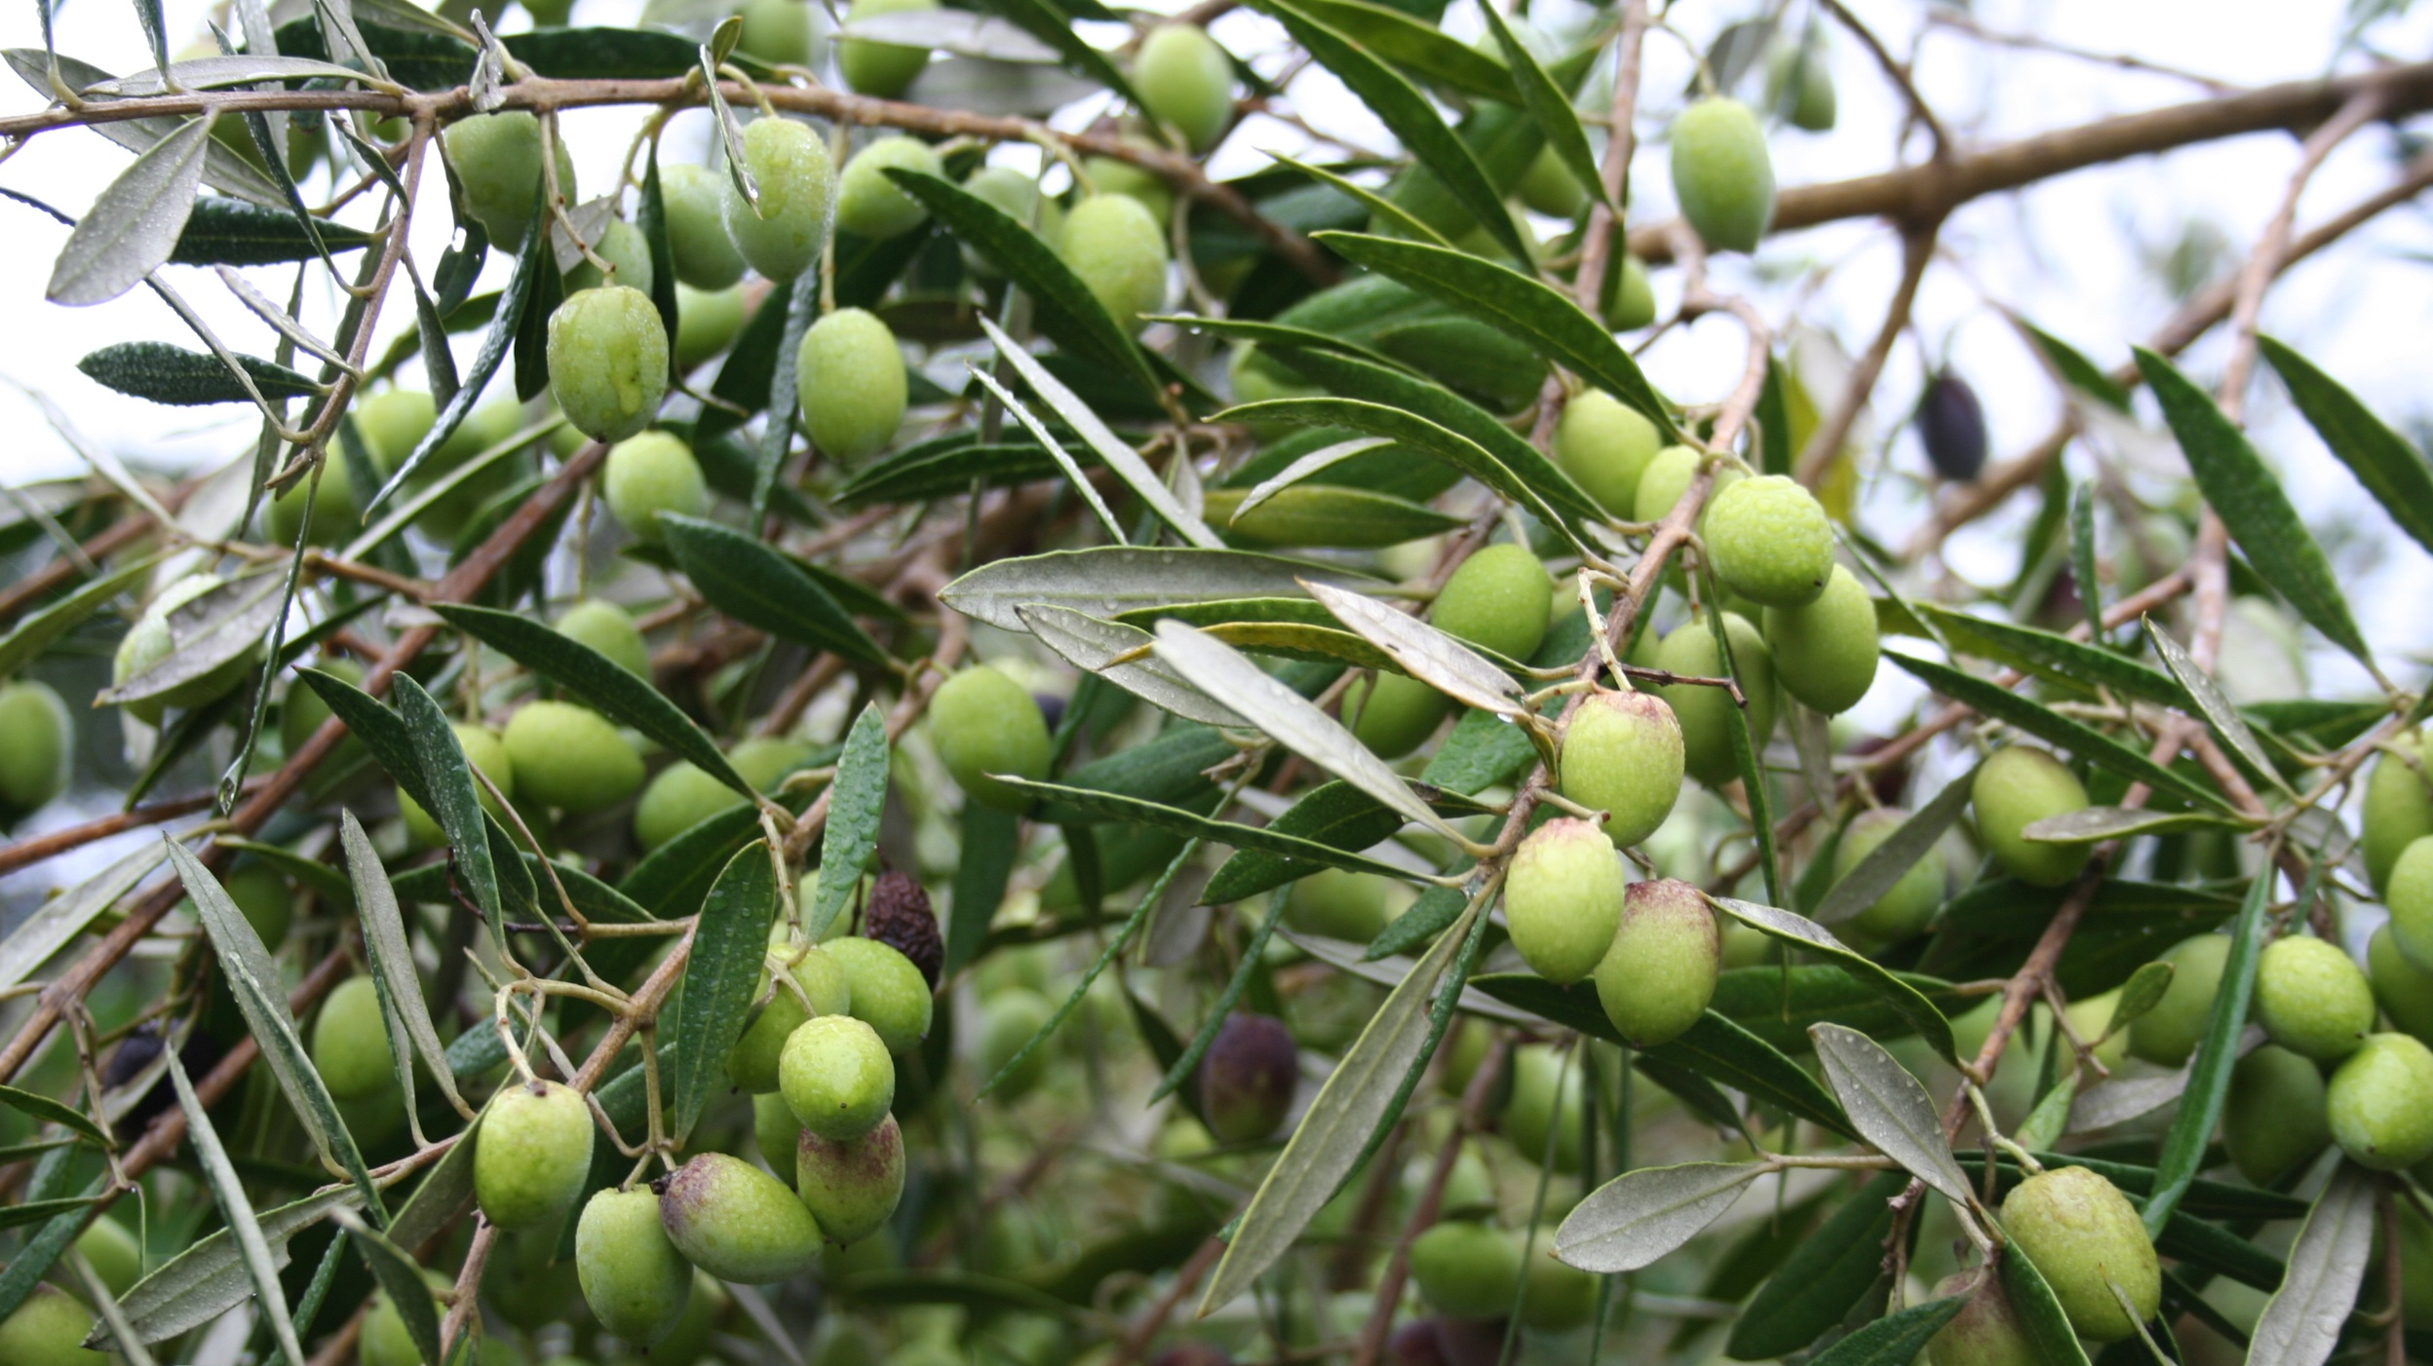
*From Commodity to community : A farm to a restaurant uses food provided by local businesses ,such as farms and ranches . This type of business shows a direct link between individuals and the economy of a community .
Restaurant owners buy many supplies , such as olive oil . On the coast of Syria , olive farmers are important to local restaurants owners .Every season , farmers harvest olives for olive oil , which they process and put into bottles .
These olives are commodity : something useful that is bought and sold .

Slide 13
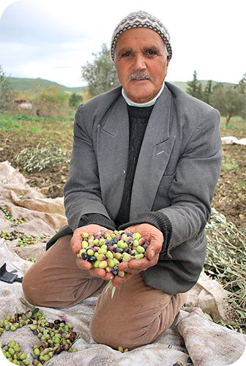
*A farmer brings his olive oil to a market and sells it to a restaurant owner . The farmer makes a profit selling this commodity .
The restaurant owner then gives the olive oil to his chefs , who use it to cook in the kitchen . People eat at the restaurant , and the restaurant owner makes a profit .
The farmer impacts the community by supplying the restaurant owner with fresh olive oil , and the restaurant owner impacts the farmer by buying olive oil from his farm . At the end , both of them will spend the profit and put some of the money in the community .
This Photo by Unknown Author is licensed under CC BY-SA-NC

Slide 14
The End

