Slide 1


Technology and Trade
This Photo by Unknown Author is licensed under CC BY-NC-ND

Slide 2
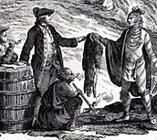
Trade in the Middle Ages brought two main benefits . It made people wealthy and spread different cultures .This spread of cultures led to the development of new technology .
The sharing of these new technologies led to rapid growth in trade . The places where these new technologies came from became more influential or important .
Historians have two main ideas about how new technology appeared and spread during the Middle Ages .
This Photo by Unknown Author is licensed under CC BY-SA

Slide 3
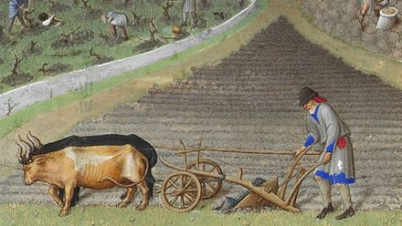
1-They think societies created technology to solve problems . For example , the invention of the heavy plow in medieval Europe helped farmers work the heavy soil . This new tool made it easier to turn the soil over .This method of soil preparation helped plants grow better and made farms more successful .
2-They think technology moved from east to west . For instance , papermaking technology from China reached Europe through trade routes . This happened because people traded goods and ideas along these east-to-west routes .
This Photo by Unknown Author is licensed under CC BY-SA

Slide 4
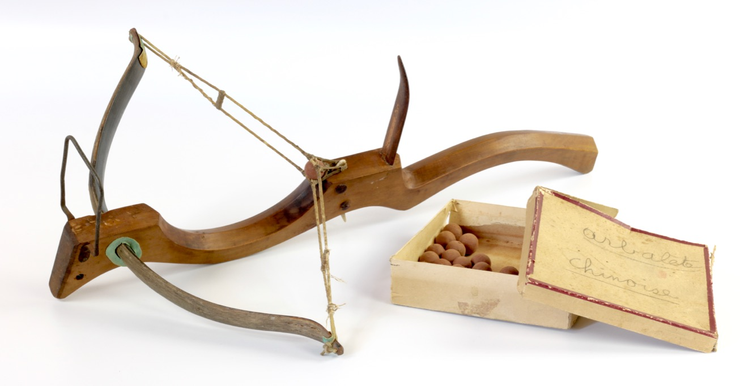
History shows that technology positively affected the world during the Middle Ages . It is important to remember that there were adverse effects , too .
For example , the invention of the crossbow made wars more deadly . This shows that technology can bring benefits but can also cause harm .
This Photo by Unknown Author is licensed under CC BY

Slide 5
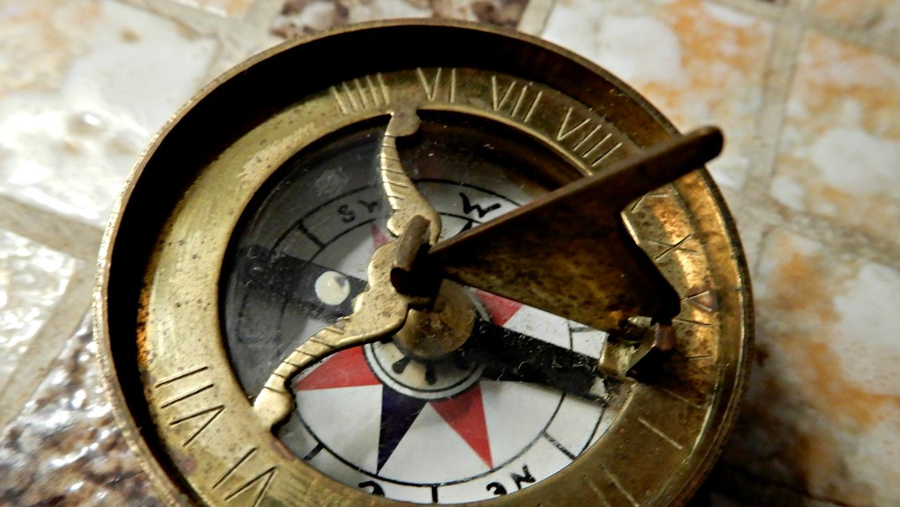
*Navigational Technology –The Compass :Technological innovations related to trade had a significant impact on the way trade worked . For example , the Chinese developed the magnetic compass during the Han Dynasty of 206 BCE through 220 CE . Explorers discovered that a magnetic metal always points to the north or south poles .
They created a magnetic compass : an instrument that finds direction using a needle that always points to magnetic north . Being able to determine north helped navigators find the direction in which they wanted to travel .
This Photo by Unknown Author is licensed under CC BY-NC-ND

Slide 6

The original spoon shaped design was heavy and difficult for travelers to carry . As travelers and traders used these compasses , they improved the technology . Over time , the design became smaller and a better shape for travelers and traders .
Smaller compasses allowed traders to navigate the oceans more accurately than the original compass technology .
Many societies and civilizations used the invention. This usage led to some unexpected events . Travelers created new routes to the far East that led to the discovery of new lands . One positive effect of finding these new areas was that some people became wealthy . However , this sometimes led to conflict between traders and people settled in the region .

Slide 7
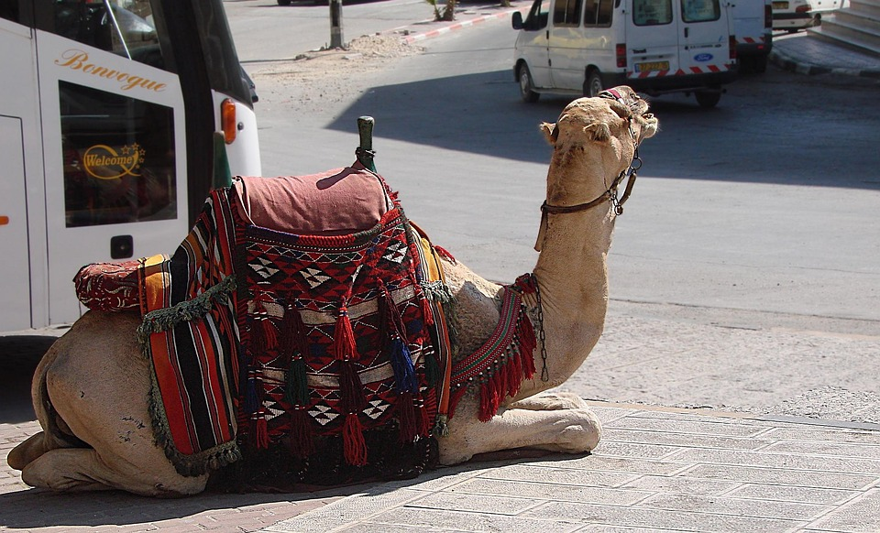
*Technology by Land –The Camel Saddle : Some inventions made travel more comfortable and efficient for traders during the Middle Ages .
One such invention was the camel saddle . The Silk Road and the Trans –Saharan Trade Route crossed desserts , and camels bore the burden of carrying riders , goods , and materials . The camel saddle helped travel by :
1)making it more comfortable to ride over long distances .
2) balancing the weight of people and goods so the animals could carry more .

Slide 8
*The use of camel saddles spread through Islamic lands and became a common feature of caravans across trade routes .
Different regions produced different styles and designs of the saddle . For instance , traders from the deserts of the Arabian Peninsula and North Africa decorated the saddlebags they attached to the saddles . The designs featured tassels that could chase away flies . In places such as central Asia , people designed saddles to fit onto Bactrian camels , which have two humps .
These examples highlight how different cultures adapted technology to meet their needs .

Slide 9
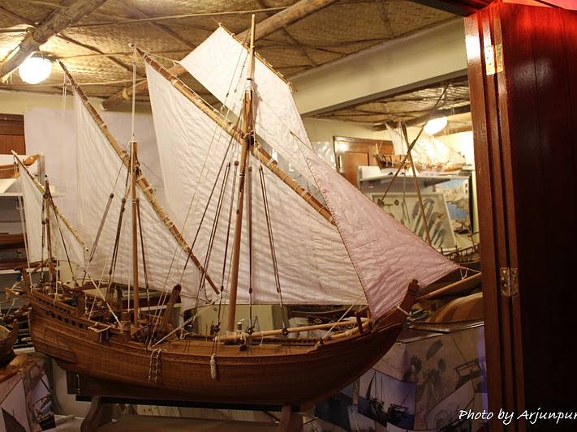
*Technology by Sea –Shipbuilding : trade routes crossed land and sea . Travelers used astrolabes and compass to find their way on both . However , for trade across the oceans to grow and become efficient , new inventions in shipbuilding were needed .
Medieval shipbuilders wanted fast ships that could hold a lot of goods . To meet this need , Arab sailors created a new kind of ship called a dhow . They constructed dhows out of wood. These ships had high ,curved front section or prow .Dhows also had triangle –shaped lateen sails that could catch wind from all directions , thus making ships move faster .Arab sailors built these ships in many sizes and for many different uses . Dhow ships sail even today in many parts of the Arabian Sea .
This Photo by Unknown Author is licensed under CC BY-SA-NC

Slide 10
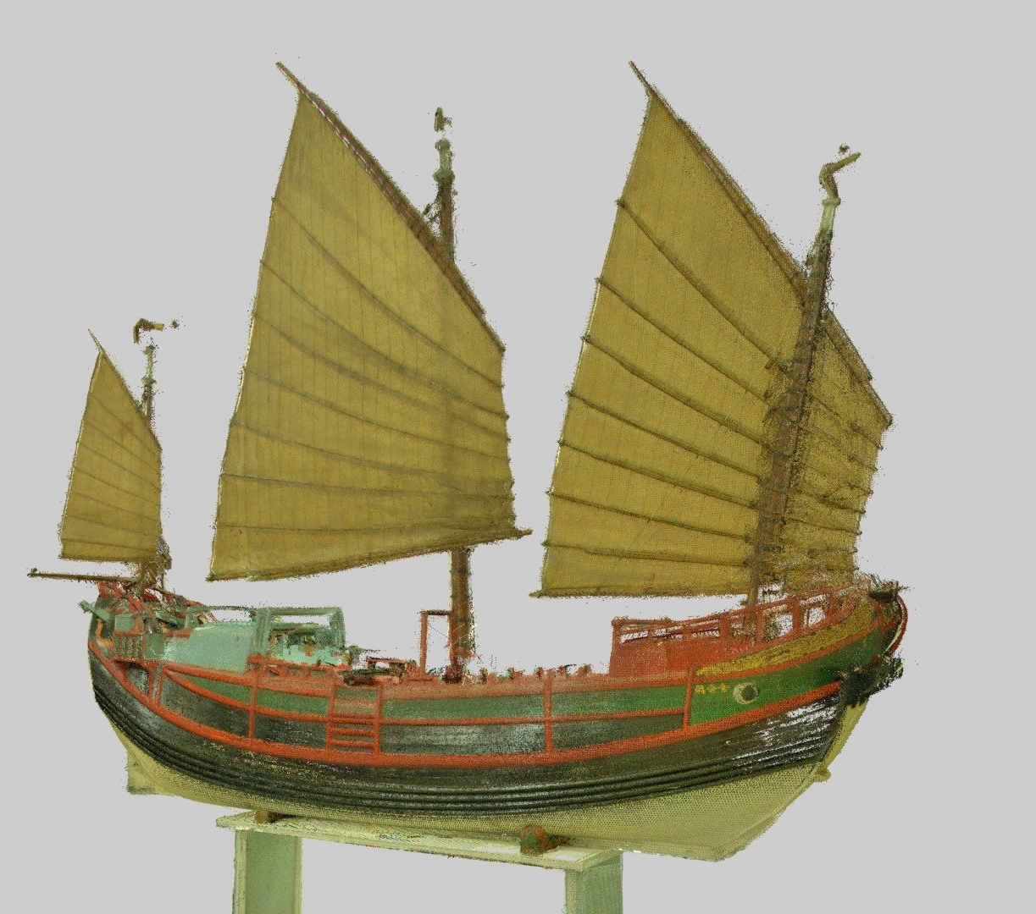
*Chinese shipbuilders built ships known as junk ships . These ships had flexible sails that made them easier to steer and navigate .
The Chinese shipbuilders adapted Oceania’s ships and smaller river boats into junk ships .The magnificent ships of Zheng He’s (Treasure Fleet ) were junk ships .
Camels , long adapted to the African environment , became more integral to trade with the involvement of Arab and Berber traders , facilitating cross-desert journeys .

Slide 11
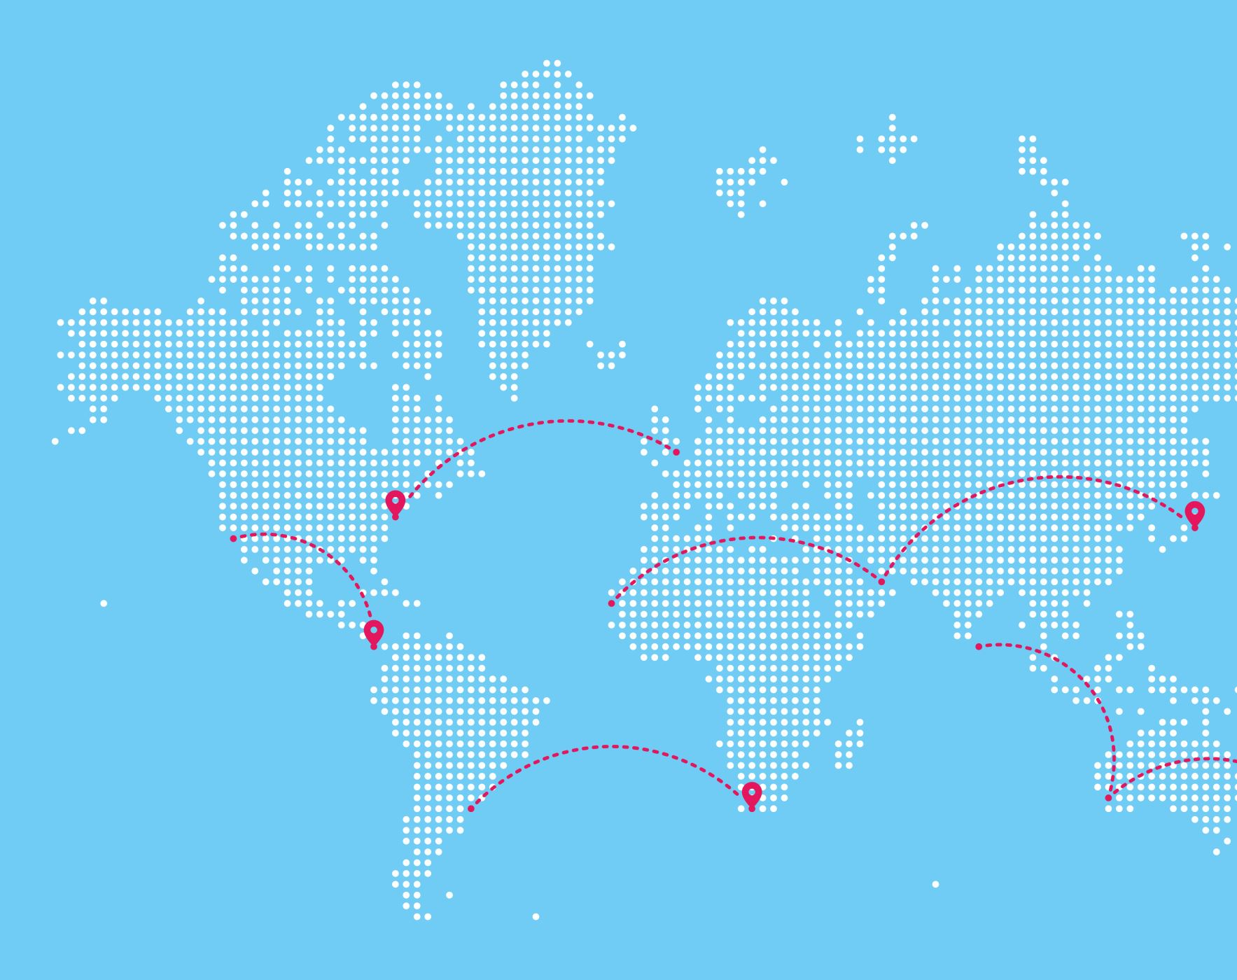
As cultures interacted through trade , they searched for ways to develop the fastest , more effective travel . They wanted to travel further and continue to benefit from the wealth the trade routes created .

Slide 12
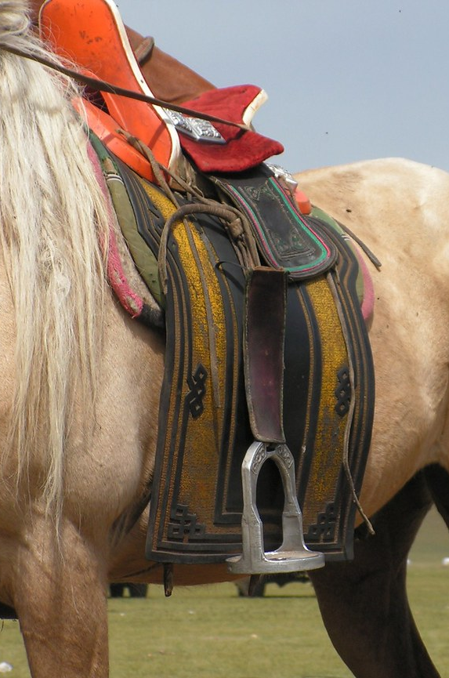
*Technological Innovation –the Stirrup : Medieval civilizations employed camels and other animals . People also widely used horses to travel between places .
One invention that led to historical change along trade routes was the stirrup .A stirrup is a loop attached to both sides of a saddle where riders could put their feet .
Historians believe people first made stirrups in India around the second century CE .Over time , different civilizations replaced fabric stirrups with leather .Leather , metal replaced leather .
This Photo by Unknown Author is licensed under CC BY

Slide 13

*The stirrup was an important invention for two reasons :
1) it made it easier for the rider to mount the horse .
2)it made the rider more secure in the saddle and able to ride faster .
As people traveled and shard technology , the use of the stirrup spread from Asia to Europe and everywhere else , people rode horses .

Slide 14

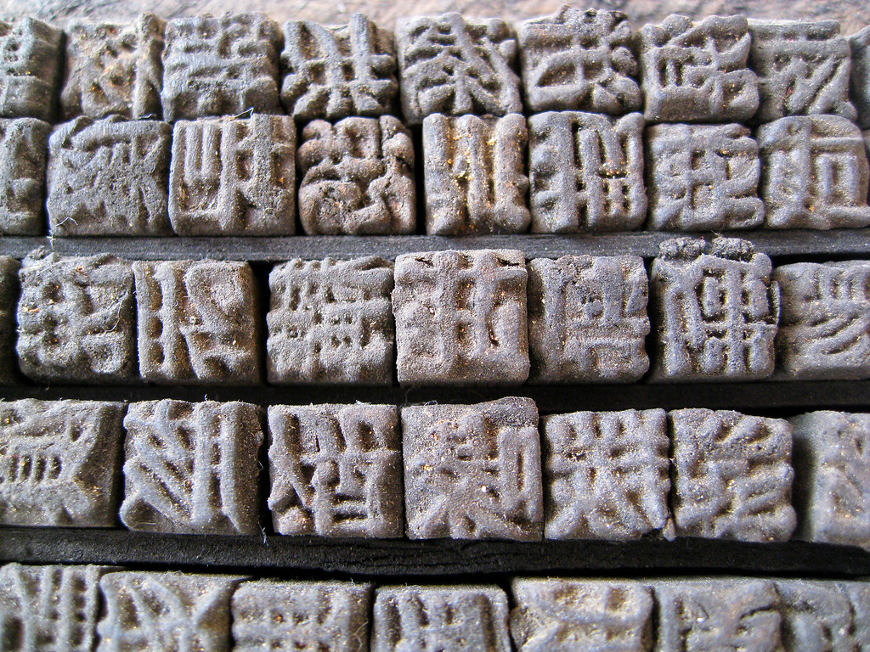
*Technology of Communication –Printing : As you learned earlier , Chinese artisans started making paper before the Abbasid Caliphate spread the technology . Around 868 CE , during dynasty (618-907 CE ) , the Chinese created the first known printed book . So it appears that China may have created the first printing presses , too !
This Photo by Unknown Author is licensed under CC BY-NC

Slide 15
*Chinese artisans used a woodblock printing method .This involved several steps .First they carved characters onto wooden blocks , a full scroll or page at a time .Then they inked the blocks and printed them onto papers .
This method allowed for the production of many copies of a text .Woodblock printing made it possible to share books and documents more easily . This helped to spread knowledge and ideas .

Slide 16
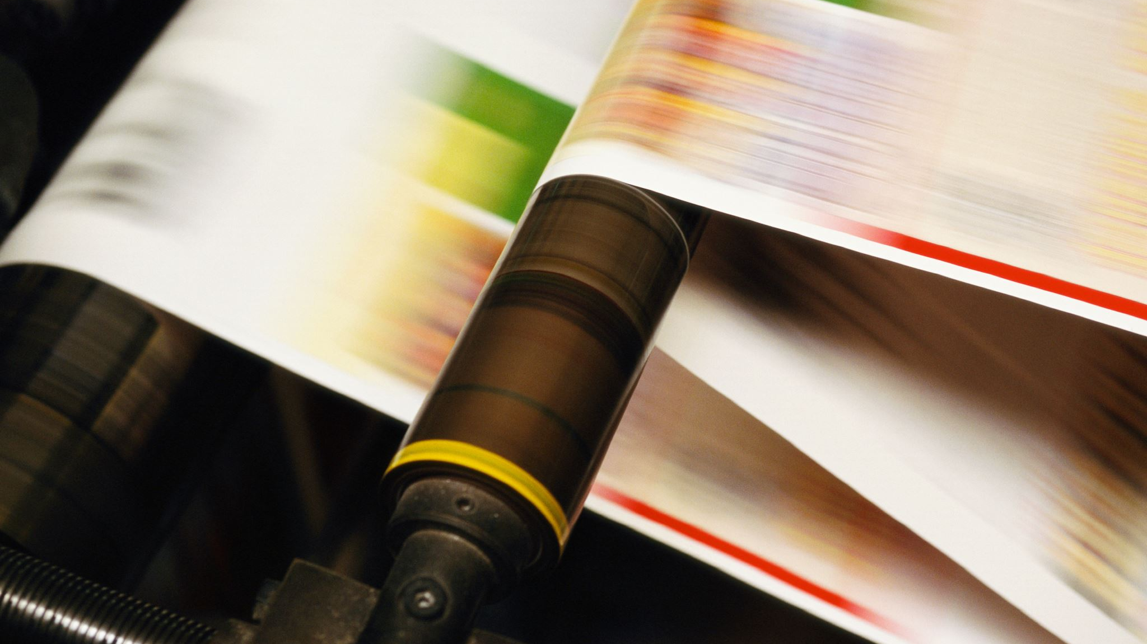
Later , during the Song Dynasty (960-1279CE),Chinese inventors developed a better printing method called (moveable type printing ).
Instead of carving whole pages , they made individuals characters that could be rearranged and reused .
This made printing much faster and more efficient .The invention of printing in China was crucial for education and communication .It promoted the spread of literature , science ,and technology within China and eventually around the world

Slide 17
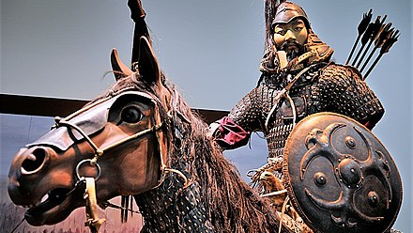
The Mongols : in central Asia , nomadic tribes called Mongols traveled on horseback to different lands . In 1211CE , Genghis Khan united these tribes as their ruler .
He quickly expanded the Mongol Empire to become the largest land-based empire ever .
Genghis Khan made communication a priority .He built bridges and roads to connect the territory . The empire adopted one common language using the Uyghur alphabet .Another important communication development was a postal relay network .
This Photo by Unknown Author is licensed under CC BY-SA

Slide 18
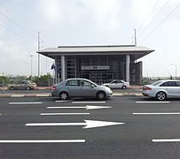
The Yam system included relay stations every 20 to 30 miles . These stations had lodging , food, and rested horses . Riders could hand over the messages they carried to the next rider or they could grab a new horse and food and go .
The Yam system made communication much faster . It also improved trade and increased the spread of culture and technology . The presence of Mongol riders and leaders made the Silk Road trade routes safer .Safer roads meant more trade , major goal of Genghis Khan . Trade expanded between Asia , the Middle East , and Europe .
This Photo by Unknown Author is licensed under CC BY-SA

Slide 19

*In addition , the Mongols learned paper and printing technology that started in China . With that skill , the Mongols introduced paper currency backed by silk and precious metals .
This meant people could exchange the paper money for its worth in other items . With paper currency , Genghis Khan and his son transformed the way commerce took place .
These are just some of the advancements that strengthened the Mongol empire and also benefited the rest of the world .

Slide 20
The End

