Slide 1
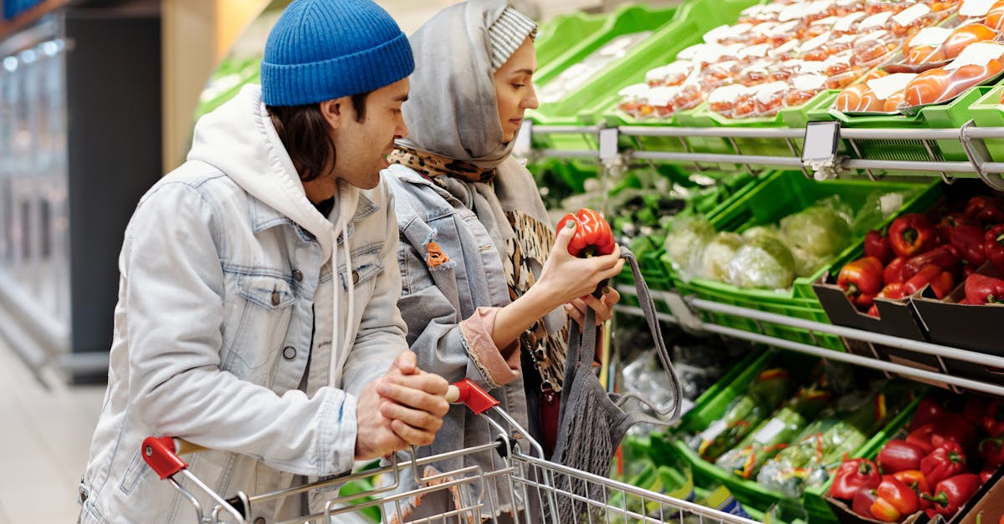
Supply and Demand

Slide 2
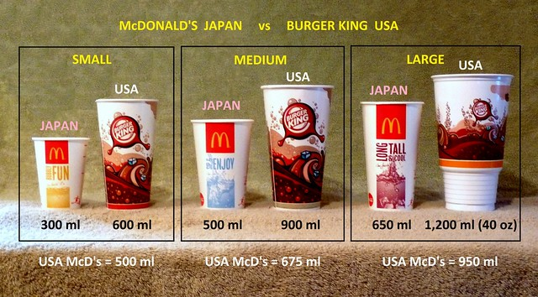
*In daily life , people are concerned about the costs of the goods and services they need . When costs rise , people struggle to pay for daily needs ,like housing and food .
This can affect the quality of people’s lives . So, who decides how much things cost ?
The answer to the question is not who but what . There are many reasons for the fall and rise of prices .
Economists agree on some basic laws to explain changes in prices .
This Photo by Unknown Author is licensed under CC BY-SA-NC

Slide 3
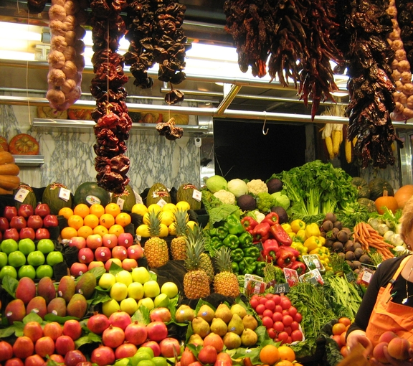
*Supply and Demand : The rules of supply and demand control how prices are set . Supply is the total amount of goods that are available to consumers .
Supply can be anything from raw materials , like bushels of wheat , to products , like pairs of sneakers .
The law of supply states that if a product costs more , stores will try to sell more of that product .
This Photo by Unknown Author is licensed under CC BY-SA

Slide 4
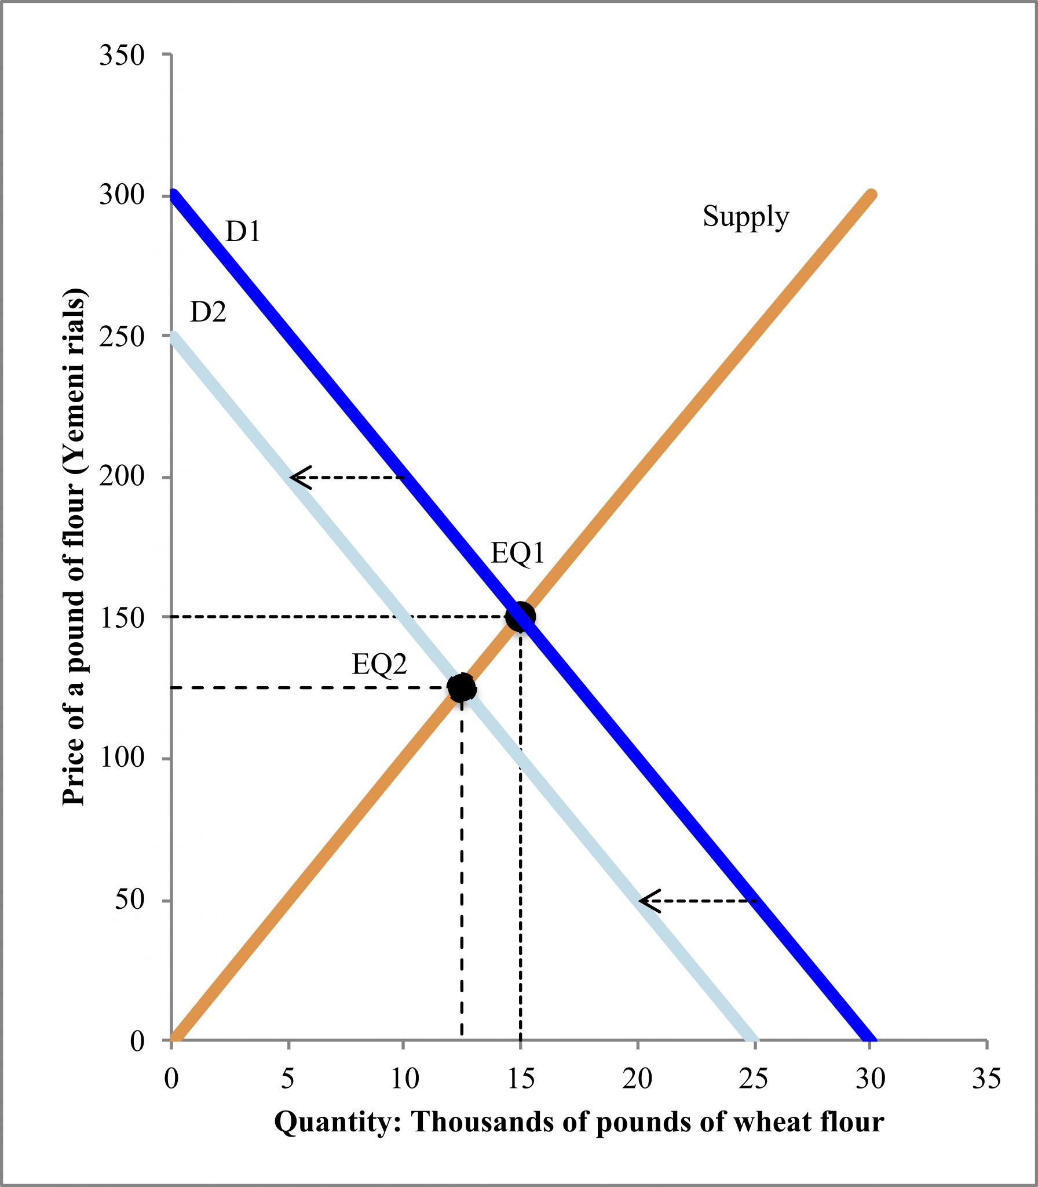
*Supply is closely linked to demand .Demand is the amount of a product that people want to buy at a given price .
The law of demand : states that if something costs more , people will usually pay less .
The law of supply relates to decisions made by businesses .
The law of demand are decisions made by consumers .
This Photo by Unknown Author is licensed under CC BY-SA

Slide 5
*How do consumers and businesses respond differently to rising prices ?Explain the reasons behind their different reactions .
Business increases their supply when prices increase because they want to maximize profits . Consumers buy fewer goods when the prices increases because their buying power decreases .

Slide 6
*Changes in Supply and Demand : Economic has four laws that explain how supply and demand set the price of a product .
************** | Changes in Supply | ************
Demand for product stays the same . | Supply of product increases | Product prices go down
Demand for product stays the same | Supply of product decreases | Product prices goes up

Slide 7
These 4 laws apply to price changes in everything , including goods , services , and even money . Market equilibrium : is when the supply of a product matches the demand for the product . This is the goal of every business .
********** | Changes in demand | ************
Demand for product increases | Supply of product stays the same | Prices go up
Demand for product decreases | Supply of product stays the same | Product price goes down

Slide 8
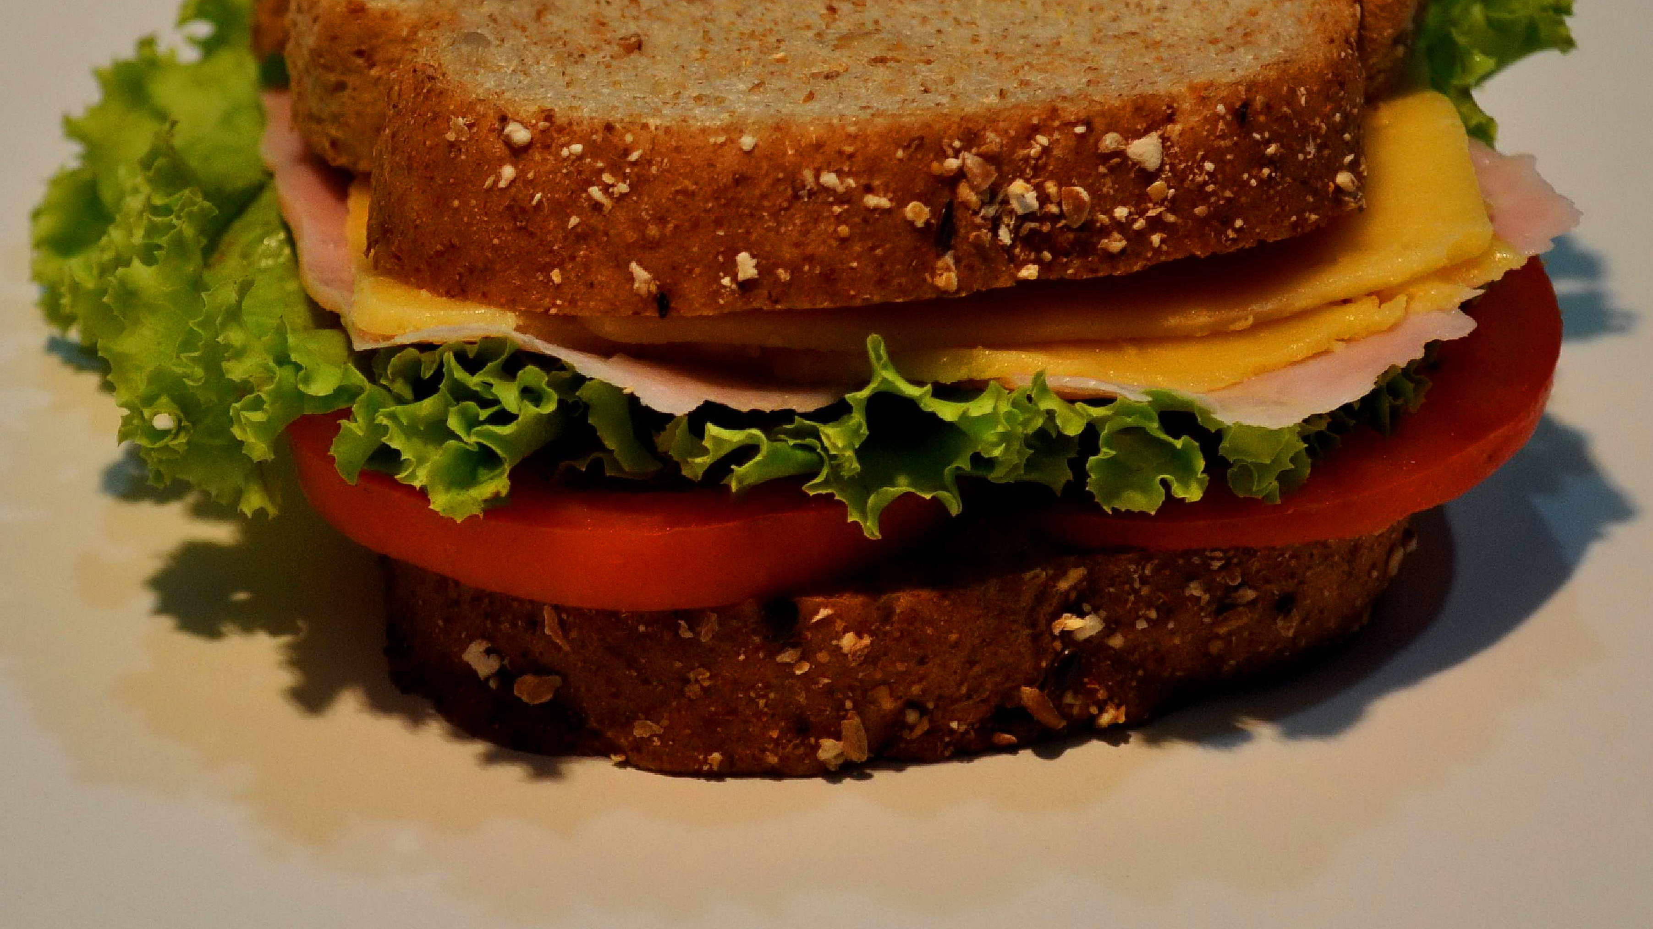
*How will increasing the number of sandwiches that have my secret special sauce impact the price?
If we lower the price , it will be easier to sell , and because the sandwiches aren’t unique , they will no longer be worth the high price .
*How will the price change if only one is left ?
It will increase . Because , there is a scarcity , which makes things cost more .

Slide 9
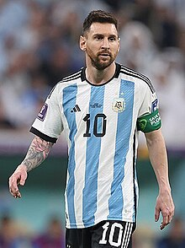
*Supply and Demand in Action : Events in the world influence supply and demand . The world of sports provides an example of how supply and demand work .
The footballer Lionel Messi is a popular player. Several businesses produced jerseys with his number on them . People bought these jerseys and helped the businesses that sold them .
Some may claim this as an example of market equilibrium . The demand for his jersey matched the supply . As a result , the price of the jerseys did not change .
This Photo by Unknown Author is licensed under CC BY-SA

Slide 10
*However , in 2022 , Lionel Messi played for Argentina during the Fifi World Cup , and they won.
After the world cup ended , official jerseys with his name and number sold out online within a minutes .
When the demand increased for official jerseys , the supply quickly ran out .
As the supply decreased and the demand stayed high , the prices went up .

Slide 11
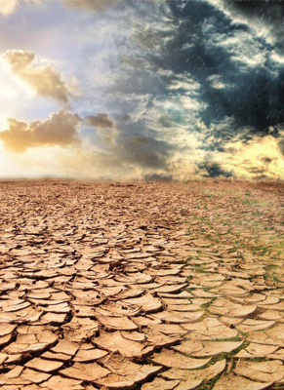
*Scarcity : is when there are not enough resources to meet every one’s needs and wants .
This problem can affect all kind of resources like workers , or even time . It can also have a huge impact on the world .
For example , some countries have no natural rivers or lakes and have a dry climate .
In these areas , the demand for water is higher than the supply .
Water scarcity impacts food supplies and raises costs .It can even cause population migration . The people who move use the resources of the countries they migrate to .
This can impact the new country’s economy .
This Photo by Unknown Author is licensed under CC BY

Slide 12
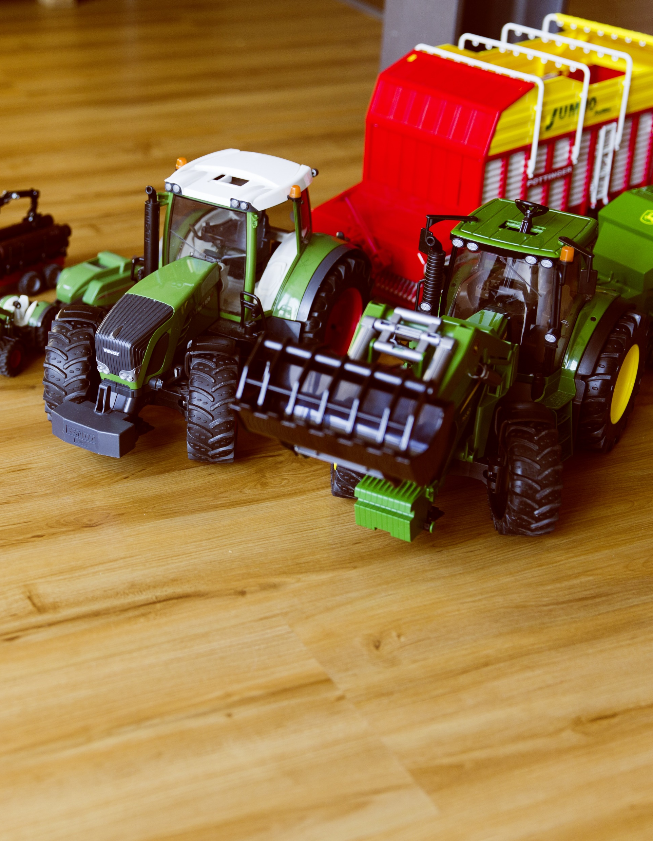
*Scarcity and Opportunity Cost : When you think about supply , demand , and scarcity , you should also think about costs .
Opportunity costs : is what you miss out on when you choose one thing instead of another .
For example : a person has wanted a new bicycle for months . The person might decide not to buy a bicycle . Instead , they decide to save their money .
The bicycle they didn’t buy –and the time exercising or biking with friends –is the opportunity cost .
They gave it up to save for something else .

Slide 13
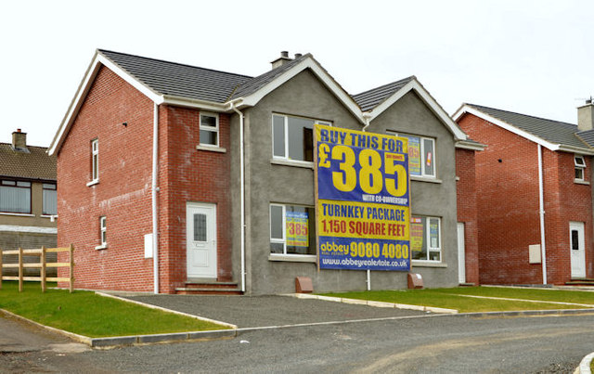
*Opportunity costs and scarcity help individuals , businesses , and governments to make careful decisions about how to use their resources .
Another factor that influences the prices of goods and services competition .
Competition : occurs when different sellers provide similar products .
Each seller looks for ways to attract customers .
This Photo by Unknown Author is licensed under CC BY-SA

Slide 14
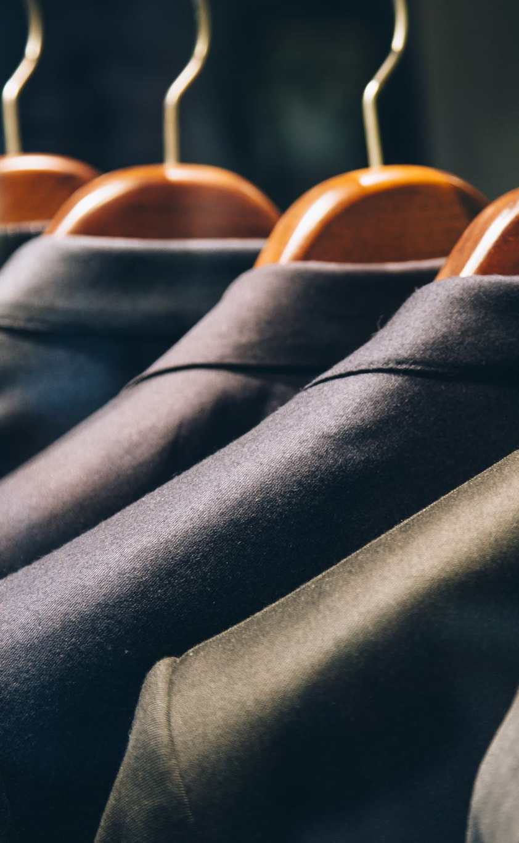
Competition keeps prices down .For example , two sellers offer the same shirt .
One seller offers it for half the price of the other .
If the two products are the same ,there is no reason to buy the expensive shirt . The seller who offers the shirt for less will get more business . The other seller might lower his prices for future sales . Price competition can lead to lower costs for consumers .

Slide 15
The End

