Slide 1
Vowels V
a e i o u

Slide 2
Short vowels (cvc pattern)
Consonant =C
Vowel = V
CVC= consonant vowel consonant
CAT

Slide 3

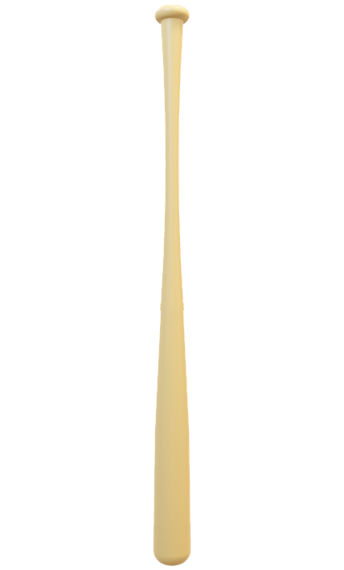
VOWEL A
SHORT A BAT
LONG A GATE

Slide 4
VOWEL E

