Slide 1



Unit 1: Week 1
Grade 2

Slide 2
Copyright © Savvas Learning Company LLC. All Rights Reserved.
This publication is protected by copyright, and permission should be obtained from the publisher prior to any prohibited reproduction, storage in a retrieval system, or transmission in any form or by any means, electronic, mechanical, photocopying, recording, or otherwise. For information regarding permissions, request forms, and the appropriate contacts within the Savvas Learning Company Rights Management group, please send your query to:
Savvas Learning Company LLC, 15 East Midland Avenue, Paramus, NJ 07652
or
k12learningpermissions@savvas.com
myView Literacy® is an exclusive trademark of Savvas Learning Company LLC in the U.S. and/or other countries.

Slide 3
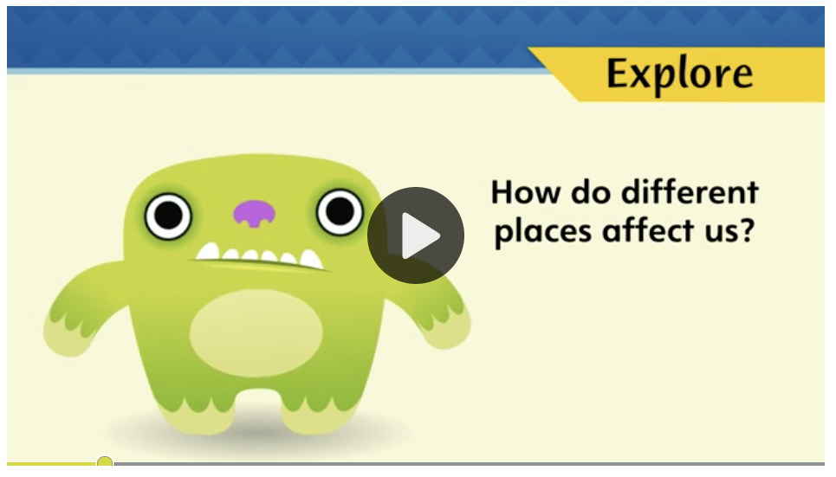


Page 8
Introduce the Unit
Essential Question:
How do different places affect us?
What did you notice about these places?
Describe the key ideas you learned.
Notes:
Introduce the Essential Question for Unit 1: How do different places affect us? Tell students that they will read many texts to learn about the ways that different places affect us. Explain that reading texts in a variety of genres is important because each author gives a different perspective on the topic.
Tell students that a video is a multimodal text because it features both visuals and sound. Have students pay attention to the different places that they see and hear about as they watch the video. Click Path: Table of Contents -> Unit 1: You Are Here -> Unit 1: Introduction
Have partners discuss what they noticed about the places they saw in the video. Guide discussion with these questions::
What did you notice about some of the places you saw?
How might some of the places affect people differently?

Slide 4
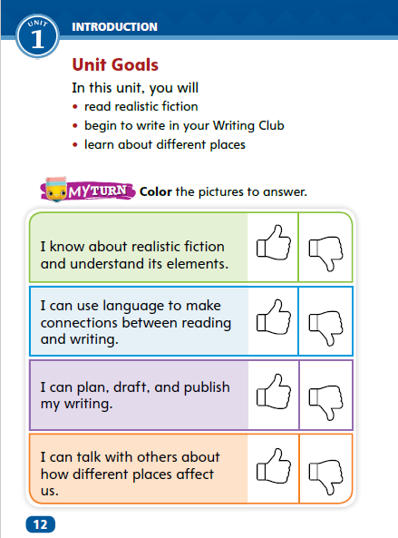
Page 12
Unit Goals
Turn to page 12 in your
Student Interactive.
Color the “thumbs up” if you have already accomplished this goal, or “thumbs down” if you have more to learn.
Notes:
Read aloud the Unit Goals on p. 12 in the Student Interactive.
Have students color the “thumbs up” if they feel they have already accomplished the Unit Goals, or the “thumbs down” if they think they have more to learn. Students will revisit their ratings in Week 6.

Slide 5
Page 13
Academic Vocabulary
Expand: The dry weather will affect the plants.
Ask: What are some ways that rain will affect the flowers?
Expand: When something is different, it is not like the others.
Ask: What are some examples of different animals?
Expand: We compare items to discover what is the same or not the same about them.
Ask: What do you notice when you compare winter and summer?
Expand: We need to know the location of the birthday party.
Ask: Can you tell me the location of our school?
Expand: A region is an area where most things are the same.
Ask: What types of animals live in a cold region?
Notes:
Academic vocabulary is language used to talk about ideas. Explain that as students work through the unit, they will learn and use these academic words to talk about different places. Read aloud the paragraph on p.13 in the Student Interactive. Then use the Expand and Ask questions for each word. Have students respond using the newly acquired academic vocabulary as appropriate.
Have students use the academic vocabulary words as they talk about the pictures with a partner.

Slide 6
Lesson 1

Slide 7
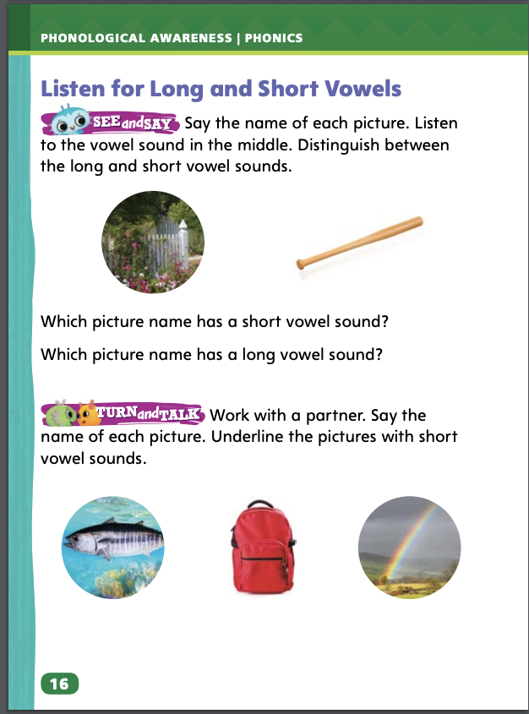
Page 16
Phonological Awareness
Turn to page 16 in your Student Interactive.
Notes:
Guide students’ attention to the first two pictures on p. 16 in the Student Interactive. Say: Name each picture and listen for the sound in the middle of the word. Ask students to name which picture word has the short vowel sound and which has the long vowel sound.
Tell students you want them to listen for the vowel sounds as you say two words. Say: big and bite. Ask students to repeat the words. Say: I will say the words again. I want you to clap once if you hear the short vowel and clap twice if you hear the long vowel. Say big and bite as students listen and clap. Then repeat with the words lap and tape.
Explain that longer words also contain short vowel sounds and long vowel sounds. Say: gateway and picnic. Have students repeat the words and tell you which one has long vowel sounds and which one has short vowel sounds.
Finally, say pathway and have students repeat the word part that has a short vowel sound.
Have students turn to p. 16 in the Student Interactive and work with a partner to underline the pictures with short vowel sounds.

Slide 8
Phonics
big
bike
cup
bake
Notes:
This week students will be identifying long and short vowel sounds and decoding CVC words. Say the word big. Ask students to repeat it and tell what vowel sound they hear. Repeat with the word bike.
Write the words big and cup. Say: These words have three letters. There is a vowel between two consonants. These words are called consonant/vowel/consonant words or CVC words. The vowel sound in CVC words is usually a short sound. Write CVC over the letters in big and cup. Have students sound out the words with you.
Write and say the word bike and have students repeat it. Ask: When I say bike, what vowel sound do you hear me saying? Then replace the /ī/ in bike with /ā/ to form the word bake. Circle the vowel and e in bike and bake. Ask: When you see that e at the end of the word, what does that tell you? Students should recognize that it is an indicator that the vowel will be long.

Slide 9
High-Frequency Words
w | h | i | c | h
 | e | a | c | h
 | t | h | a | n
Notes:
Create a chart on the board with each letter of the high-frequency words inside a box.
Then ask students to say each word and repeat after you the letters each word contains.

Slide 10
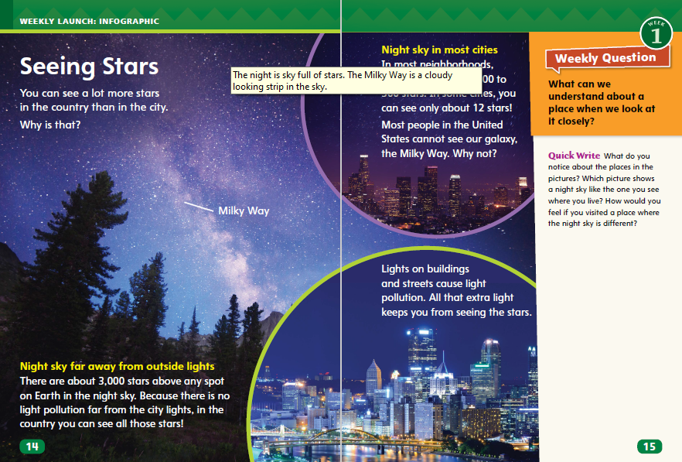
Page 14, 15
Interact with Sources
Underline facts and information that show the difference between seeing the stars in the city and the country.
Notes:
Remind students of the Essential Question for Unit 1: How do different places affect us? Point out the Week 1 question: What can we understand about a place when we look at it closely?
Have students follow along in their Student Interactive, pp. 14–15 as you read aloud “Seeing Stars.” Then organize students into small groups and have them use the pictures to share information about how different places affect us. During the group discussions, encourage students to underline facts and information that show the difference between seeing the stars in the city and the country.
Use the following questions to guide the group discussions:
Which facts about looking at stars in the country and the city surprised you?
Why can you see more stars in the country?
What other facts do you know about the night sky?
What do these facts suggest about the differences between places?
Read the Week 1 Question: What can we understand about a place when we look at it closely? Tell students they just learned a few ways places can be different. Explain that they will learn more ways this week.

Slide 11
Listening Comprehension
Realistic Fiction
Setting | Details
Notes:
Tell students you are going to read a realistic fiction story aloud. Have students listen as you read “The Sandcastle.” Explain that students should listen actively, paying careful attention to the setting of the story as you read. Prompt them to ask questions to clarify information and to follow agreed-upon discussion rules.
Have students listen closely to identify elements of realistic fiction.
READ the whole passage aloud without stopping.
REREAD the text aloud a second time. This time stop and model Think Aloud strategies related to the genre and the characters in the story.
Use a T-chart to help students name the setting and add details from the story that describe it.

Slide 12
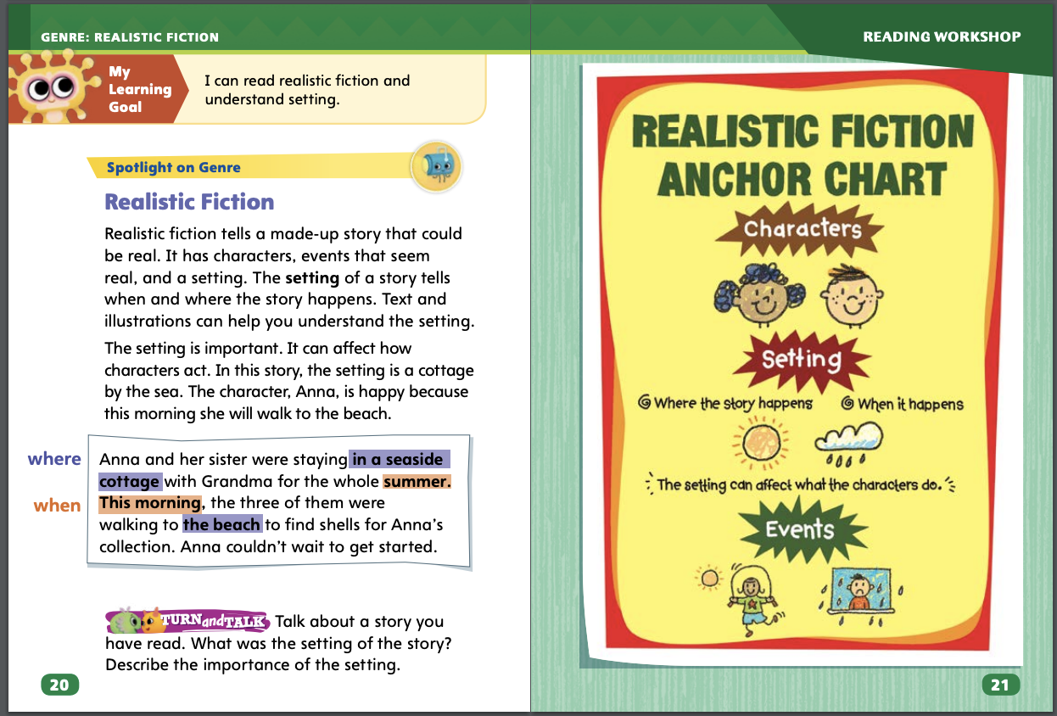
Page 20,21
Realistic Fiction
Turn to page 20 in your Student Interactive.
Notes:
Tell students that realistic fiction is a type of story that is made up but has characters and settings that are like people and places in real life. Explain that the events in a realistic fiction story could really happen. Tell students they can ask themselves the following questions about a story to tell if it is realistic or not.
Do the characters act, talk, and look like people in real life?
Think about the problem the characters are facing. Could the problem happen in real life? How would you feel or react in the same situation?
Is the setting a real place and time? Why is it important to the story?
Explain that the setting of a story is when and where the story takes place. In realistic fiction, the setting has to be a realistic time and place.
Model using the questions to determine whether "The Sandcastle" is a realistic fiction story. I ask myself if the characters in the story “The Sandcastle” are like real people. Yes, they are. I ask whether they do things together that real friends would do. Yes, they do. The waves washed away their castle. This story problem could really happen. I ask myself if the setting is realistic. Yes, it is. A beach is a real place, and the things that Matt and his friends did at the beach are things real people might do. I believe “The Sandcastle” is an example of realistic fiction.
Editable Anchor Chart Click Path: Table of Contents -> Reading Anchor Charts -> Unit 1 Week 1: Editable Reading Anchor Chart

Slide 13
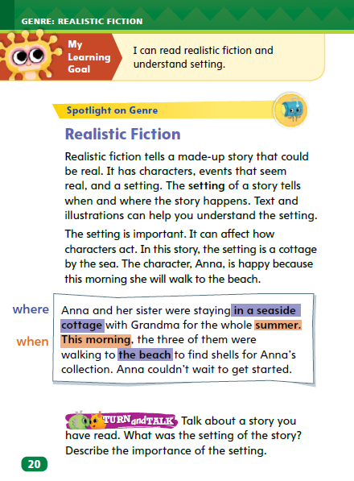
Page 20
Apply
Talk with a partner about the setting of a story you have read. Describe the importance of the setting.
Notes:
Have students use the strategies to identify realistic fiction.
Have students work with a partner to complete the Turn and Talk activity on p. 20 of the Student Interactive. Provide support as needed.

Slide 14
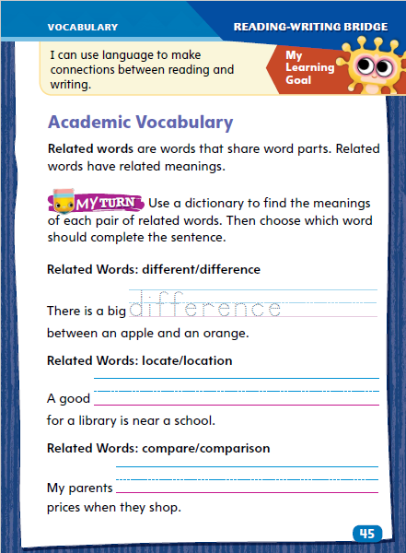
Page 45
Academic Vocabulary
Turn to page 45 in
your Student
Interactive and complete the activity.
Notes:
Related words share the same roots or word parts. Their meanings are related, but may differ based on their parts of speech or how they are used. Knowing related words can help readers understand unfamiliar words, such as academic vocabulary.
• When you come across an unfamiliar word, notice its word parts.
• Think about the meaning of the word parts and whether you have seen them in words you already know.
• Ask yourself if the word part gives you clues to the meaning of the unfamiliar word.
• Use a dictionary to check the meaning of the word and related words.
Model this strategy using the Academic Vocabulary in the first sentence on p. 45 in the Student Interactive: If I saw the word difference in a text, I would realize that I already know the word different. I can use this information to figure out that difference is related to different and means “the way something is not the same.” I can use a dictionary to check the meaning of these related words.
Have students apply this strategy to another word from page 45.
Have students complete the activity on p. 45 in the Student Interactive.

Slide 15

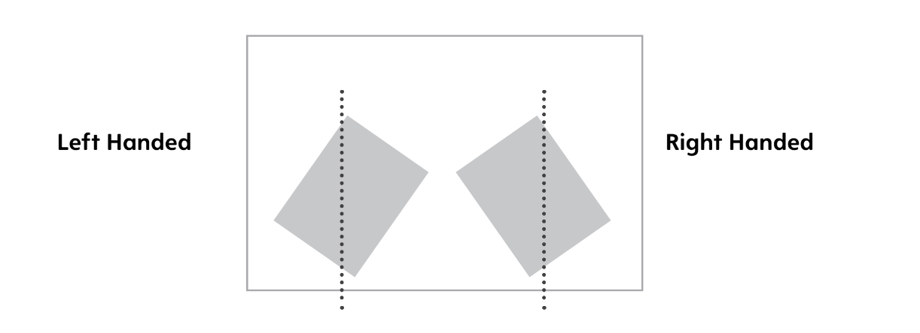
Handwriting
Proper Sitting Position
Proper Paper Position
Notes:
Sit upright with both feet on the floor, paper placed at an angle.
Model sitting upright in a chair with both feet flat on the floor. Tell students to think of the uppercase letter L—their back is the upright position of the L and the tops of their legs are the bottom part of the letter.
Tell students how to place their paper at a 45° angle toward the writing-arm side of the body, with the non-writing hand on the top corner of the paper to hold it in place.
Have students use Handwriting p. 13 in the Resource Download Center to practice sitting in a proper position with their paper placed at an angle on their desk.
Click path: Realize -> Table of Contents -> Resource Download Center -> Handwriting Practice -> U1W1L1 Handwriting Practice

Slide 16
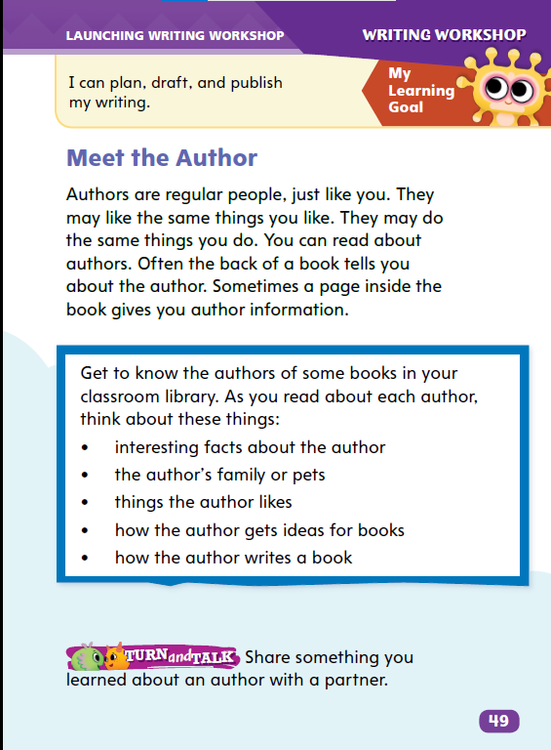
Page 49
Writing – Launching Writing Workshop
Turn to page 49 in your Student Interactive.
Notes:
Authors share personal details on an inside page or back cover of their books. These details often include
interesting facts about the author
names of the author’s family and pets
how the author finds inspiration
steps in the author’s writing process
Direct students to p. 49 in the Student Interactive. Read aloud the “Meet the Author” paragraph. Tell students that they will get to know some authors over the next few days. Today, they will focus on how authors share personal details.
Hold up a book from the stack. Point out and read the author’s name on its cover. Authors shares things they like, things they do, and other details about themselves on the back cover or inside of a book. Locate and point out the author information. This is where (name of author) shares personal information with readers.
Read aloud the bulleted points on p. 49. This is the type of information we will learn about (author name). Let’s read to find out more about (author name).
Read the author information with the class. After reading, ask students what they learned. Follow the same routine with other books, pointing out different locations for author biographies.

Slide 17

Independent Writing
Choose a new text and look for author information. Write down facts that you find.
Share the most interesting author details that you found.
Notes:
Tell students to choose a new text and look for author information, writing down facts they find. If students have difficulty, help them find the information they should record.
If students have difficulty, help them find the information they should record.
MODELED Choose a book from the stack and do a Think Aloud to model where to find information about the author.
SHARED Have students choose books from the stack. Prompt students to find author information in each book.
GUIDED Point out an author biography and ask students what they learned from it.
Students who show understanding should investigate other texts to find author information.
Have students share the most interesting author details they found.

Slide 18
Spelling
I have six goldfish.
We like to play tag.
Can you find a rib on the skeleton?
We looked at the U.S. map.
She was sad that it rained.
He made a mess with the paint.
They drew a dot on the poster.
There was mud on the carpet.
Did you know that a hen lays eggs?
It is very hot today.
Which book is your favorite?
I like dogs better than cats.
Notes:
(Note: Move the orange boxes to cover each bold spelling word before you read aloud the words and sentences.)
Read aloud the words and sentences. Have students spell each word with initial consonant blends and the two high-frequency words.
1. I have six goldfish.
2. We like to play tag.
3. Can you find a rib on the skeleton?
4. We looked at the U.S. map.
5. She was sad that it rained.
6. He made a mess with the paint.
7. They drew a dot on the poster.
8. There was mud on the carpet.
9. Did you know that a hen lays eggs?
10. It is very hot today.
11. Which book is your favorite?
12. I like dogs better than cats.
Reveal the spelling word and have students check their work.

Slide 19
Language and Conventions
Nouns | What the Noun Does
The _______ draws a __________.
artist
picture
Notes:
Review with students that a sentence contains a noun, which is a person, a place, or a thing. A sentence also contains a verb, or an action word. A complete sentence also tells something about a noun. Invite volunteers to list examples of nouns and verbs under the categories Nouns and What the Noun Does.
Display this frame for the sentence: The _____ draws a _____. Insert the words artist and picture. Have students read the complete sentence aloud as you underline the noun. Then have volunteers suggest other nouns to use in the frame and write these sentences on the board. Ask: What is the noun? (artist) What does the noun do? (draws a picture) This is a simple sentence that tells a complete thought.
Have partners create simple sentences of their own, using a noun and words to tell something about the noun. Ask them to underline the nouns and circle what the noun does in their sentences.

Slide 20
Lesson 2

Slide 21
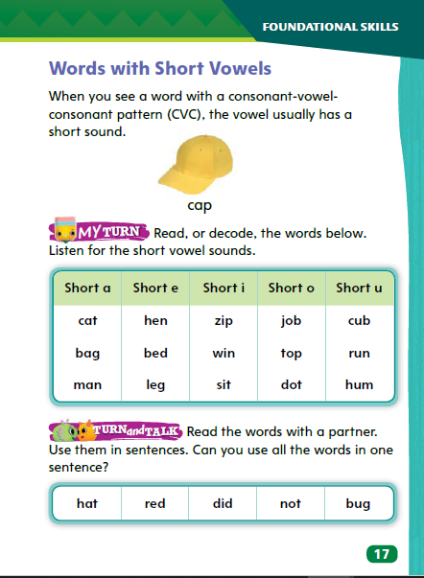
Page 17
Phonics
Turn to page 17 in the Student Interactive.
Notes:
Remind students that vowels can have long and short sounds. Explain that they are going to decode words with short vowel sounds.
Write cut. Say: I know this is a CVC word because there is a vowel between two consonants. I know that in a CVC word, the vowel sound is usually short. Knowing this helps me sound out this word: /k//u//t/ cut. Write: mat, pet, did, box, and cup. Point to the vowel in each word. Have students name the vowel, tell whether it is long or short, and then decode the word with you.
Have students apply phonetic knowledge by decoding the words in the chart on Student Interactive p. 17. Remind them that CVC words such as these have short vowel sounds.
Direct students to the chart at the bottom of SI p. 17. Ask them to read the words with a partner and then use the words in oral sentences.

Slide 22
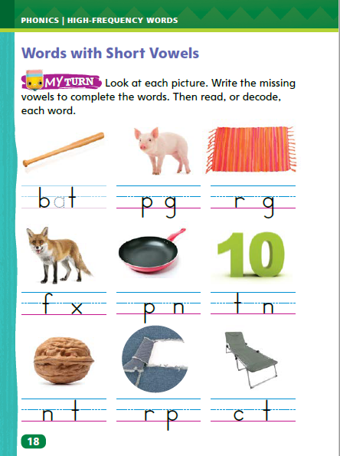
Page 18
Apply
Turn to page 18 in your Student Interactive.
Use the strategies for decoding words with short vowels.
Notes:
Explain to students that they can spell CVC words. They know that a CVC word has a short vowel sound in the middle. They need to listen to the sounds and write the letters that stand for the sounds.
Point to the first picture on p. 18. Say: This is a bat. I hear the short vowel sound /a/ in the middle of the word bat. I know that
the letter a stands for the /a/ sound in bat. I can write the letter a to spell the word bat. Point to the picture of the pig. Ask students to say the word and tell what vowel sound they hear. Have them add the letter i. Then sound out pig with them. Repeat with the word rug.
Have students use these strategies for decoding words with short vowels.
Have students complete p. 18 in the Student Interactive.

Slide 23
High-Frequency Words
which
each
than
Notes:
Write which, each, and than. Read each word with students.
Randomly point to each word and have students say the word as quickly as they can. Repeat several times.
Erase the letter i in the word which, leaving a space. Ask students to tell which letter is missing. Write in the letter I and ask students to read the word. Conduct a similar activity with the words each and than.

Slide 24
Page 22
Preview Vocabulary
backyard
treehouse
searchlights
daylight
Notes:
Introduce the vocabulary words on p. 22 in the Student Interactive and define them as needed.
backyard: a yard in the back of a house
treehouse: a little house in a tree
searchlights: lights used to search for things
daylight: light in the day
Say: These words will help you understand the setting in How Many Stars in the Sky? As you read, highlight the words when you see them in the text. Ask yourself what they convey about where and when the story takes place.

Slide 25
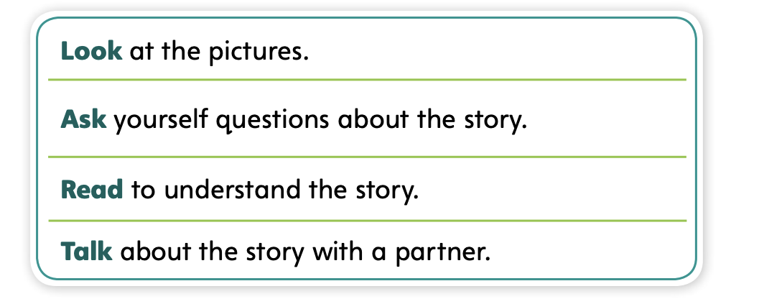
Page 22
First Read Strategies
Notes:
Discuss the First Read Strategies. Prompt students to establish that the purpose for reading this selection is for understanding and enjoyment.
LOOK Direct students’ attention to the illustrations to help them understand what the text is about.
ASK Help students generate questions about parts in the story that are unclear to them.
READ Help students connect the story to their own lives and experiences to help them better understand the text.
TALK Encourage students to talk about the text with a partner.
Students may read independently, in pairs, or as a class. Use the First Read notes to help them connect with the text and guide their understanding.

Slide 26
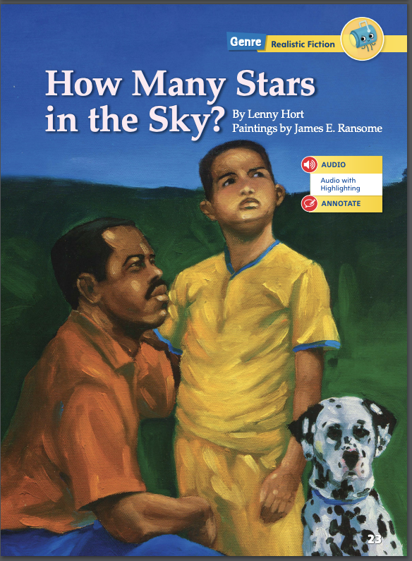
Page 22
First Read – How Many Stars in the Sky?
Notes:
Read together.

Slide 27
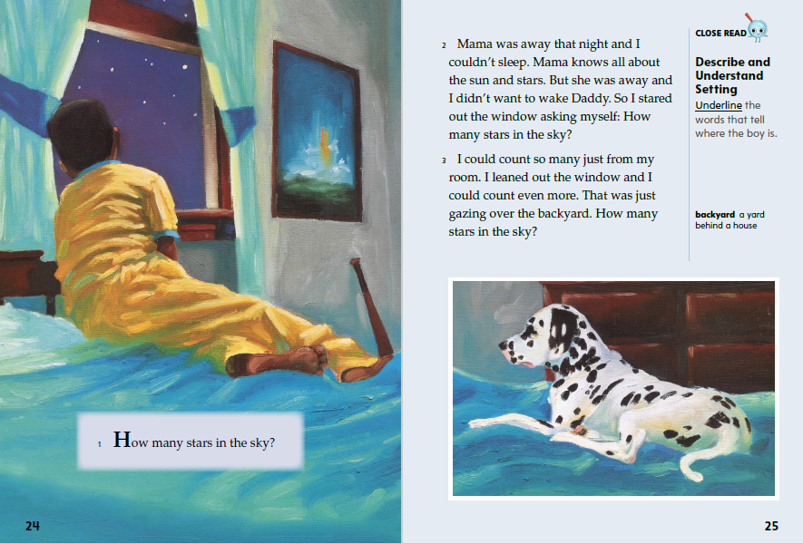

Page 24,25
First Read – How Many Stars in the Sky?
Notes:
Read together.
THINK ALOUD At the beginning of the story, I learn that a young boy is awake and wondering about how many stars are in the sky. I want to keep reading about why he is awake and why he is interested in the stars in the sky.
THINK ALOUD I notice that the boy’s dog is with him on his bed. This tells me that the boy is in a bedroom. He is trying not to wake his father and the dog sits quietly with him.

Slide 28
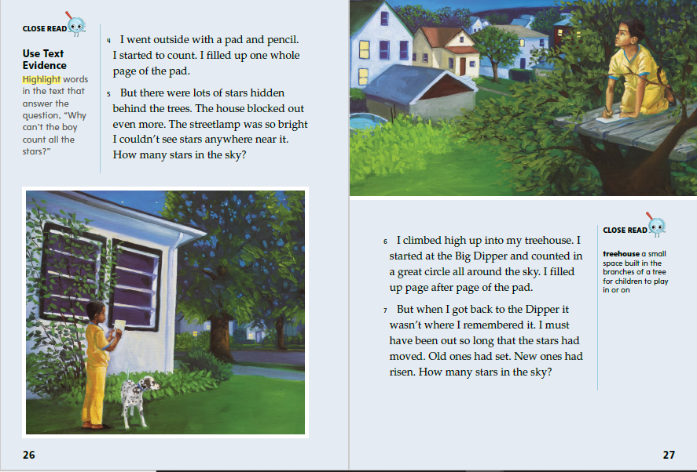
Page 26,27
First Read – How Many Stars in the Sky?
Notes:
Read Together.
THINK ALOUD As I read about the boy's actions, I think of questions I have about the stars. The boy goes outside to try to count the stars. I want to know more about how to count the stars. Where is the best place to go? I highlight information in paragraph 5 that tells me the boy’s backyard is not the best place to count stars. I’ll keep reading to see if I can answer my question.
THINK ALOUD The boy seems very interested in the stars and very determined to count them. I read that he “filled up page after page” counting stars. He had “been out so long that the stars had moved.” I can imagine the boy is so interested in what he's doing that he doesn't even notice what happens around him. I feel that way sometimes when I'm working on a project. I talked with a partner to find out if other people have these same kind of feelings.

Slide 29
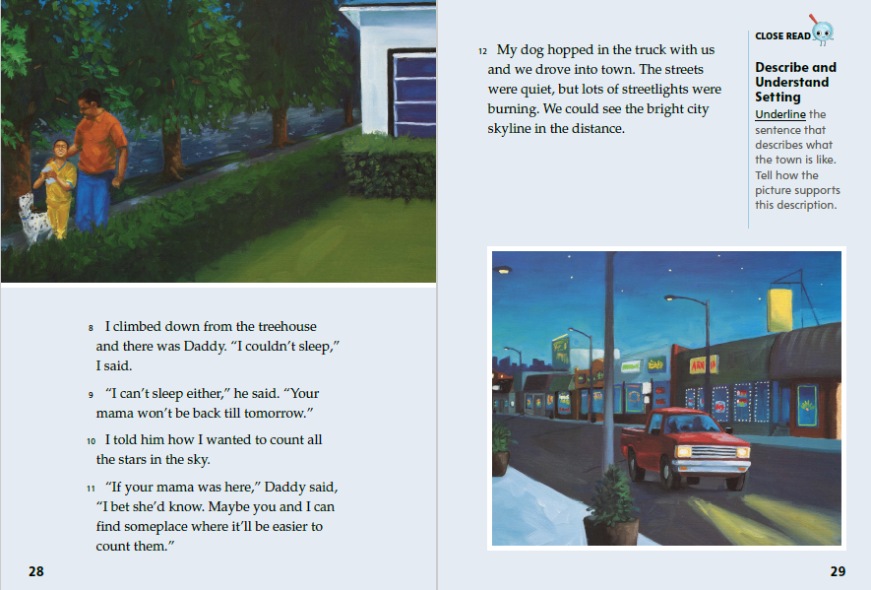
Page 28,29
First Read – How Many Stars in the Sky?
Notes:
Read together.
THINK ALOUD I can look at what characters say to help me learn more about them. Sometimes, what characters say to each other tells me about another person in the story. We haven’t met the boy’s mom in the story, so we learn about her through the boy and his father. I think of questions I have about the boy’s mom as I read. Why does she know about the stars? Do the boy and his mom often try to count the stars together? As I read, I’ll look for hints and clues that might help me answer these questions.
THINK ALOUD I read that the boy and his father are going into town. The boy’s father said on p. 28 that they could “find someplace where it'll be easier to count” the stars. The text tells me that the city is “bright” with “lots of streetlights.” I wonder if they will be able to see the stars with all the light in the town.

Slide 30
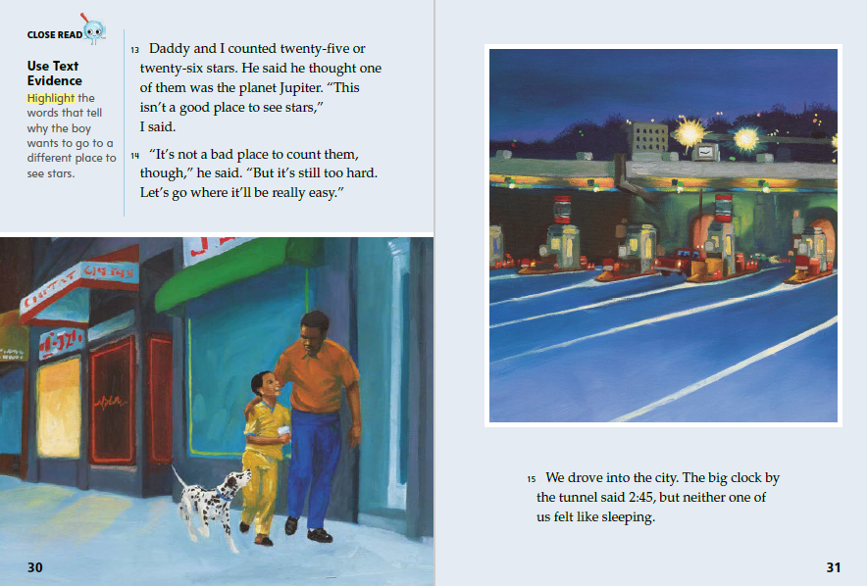
Page 30,31
First Read – How Many Stars in the Sky?
Notes:
Read together.
THINK ALOUD I read that the boy and his father counted “twenty-five or twenty-six stars.” I think that sounds like a lot of stars. But the boy says that “this isn’t a good place to see stars.” I think back to what I read earlier in the story. In his backyard, the boy “filled up page after page” in his notebook counting stars. That sounds like more than twenty-five or twenty-six. So the boy knows they should keep traveling to find a better place to see the stars.
THINK ALOUD The clock says 2:45, and the illustration shows that it is the middle of the night. It's late, but neither the boy nor his father feels like sleeping. This reminds me of how I feel when I am very excited about something. Have students talk briefly with a partner about how the boy and his father must feel right now.

Slide 31
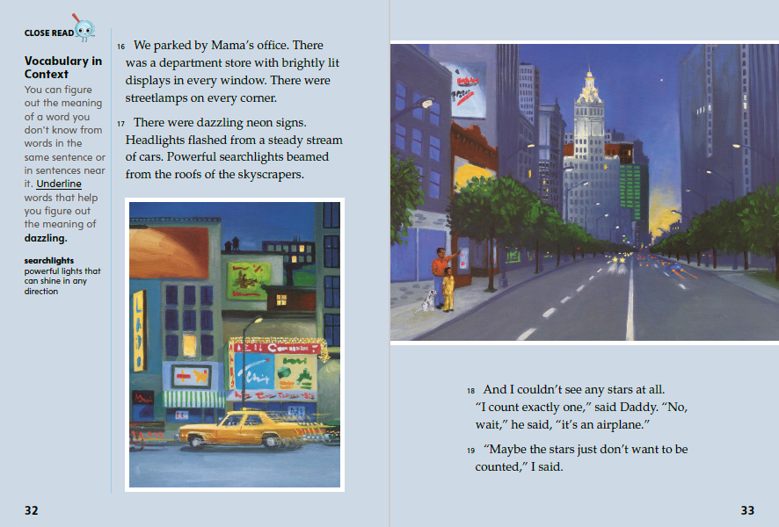
Page 32,33
First Read – How Many Stars in the Sky?
Notes:
Read together.
THINK ALOUD As I read the words on the page, I try to picture what the writer describes. When I read the words neon, headlights, and flashed, I imagine bright lights all around. I think it would be difficult to see the stars when the lights are so bright.
THINK ALOUD The illustration on p. 33 shows the city buildings with their lights. I can understand how the boy and his father do not see any stars in the sky. There are so many bright lights from the city. There are also tall buildings in the illustrations. The buildings are probably getting in the way of the boy’s view of the sky. This reminds me of how the boy’s house blocked his view of the sky when he was in his backyard.

Slide 32
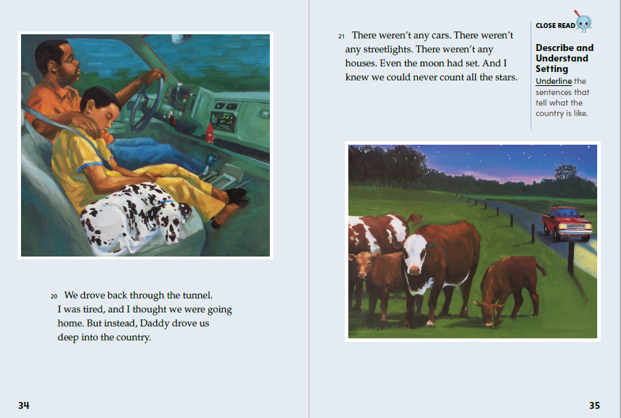
Page 34,35
First Read – How Many Stars in the Sky?
Notes:
Read together.
THINK ALOUD The boy is tired now, and he thinks he is going home. I notice that this is a change from how the boy felt before, when he and his father did not feel like sleeping even though it was late. I wonder why the boy's feelings have changed. I think he might want to give up, or he might be feeling frustrated that they have not been able to see and count the stars.
Have students compare the illustrations on p. 33 and p. 35. Ask: How are the two illustrations different from each other? What do the illustrations show about the different settings? Possible Responses: Students should point out the bright lights and buildings in the illustration on p. 33 and the field and the clear sky with stars on p. 35. Students should point out that without cars, streetlights, and buildings, it is easier to see the sky in the country.

Slide 33
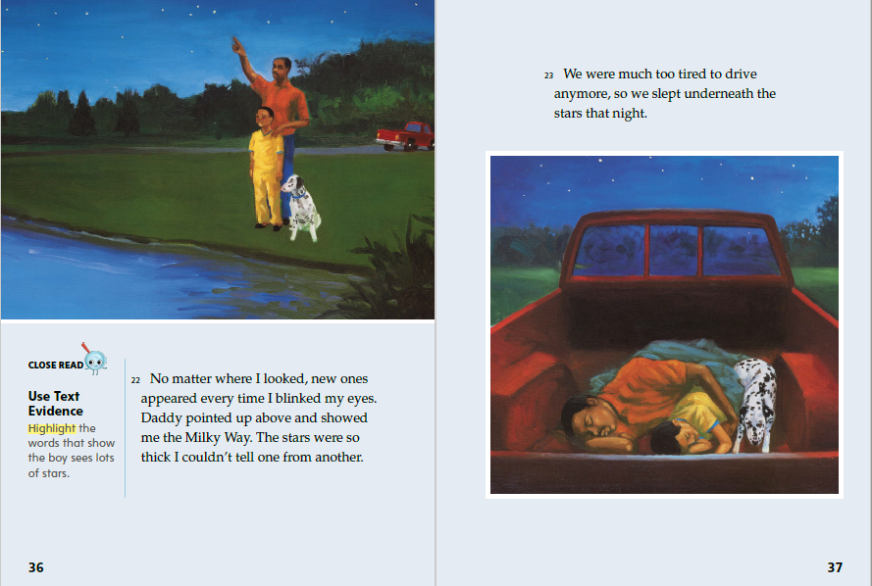
Page 36,37
First Read – How Many Stars in the Sky?
Notes:
Read together.
THINK ALOUD As the boy and his father arrive at each new place, I look for clues in the text to tell me whether they can see the stars. Here, out in the country, the boy says that new stars “appeared every time I blinked my eyes.” This tells me they must be in a place where they can see lots of stars.
THINK ALOUD I can use the illustrations to help me figure out the characters’ feelings and how they relate to the setting. The text tells me that the boy and his father were “much too tired to drive,” so they sleep in the truck under the stars. Looking at the picture, I think it must be peaceful to sleep under the stars, without the bright lights and loud noises of the city.

Slide 34
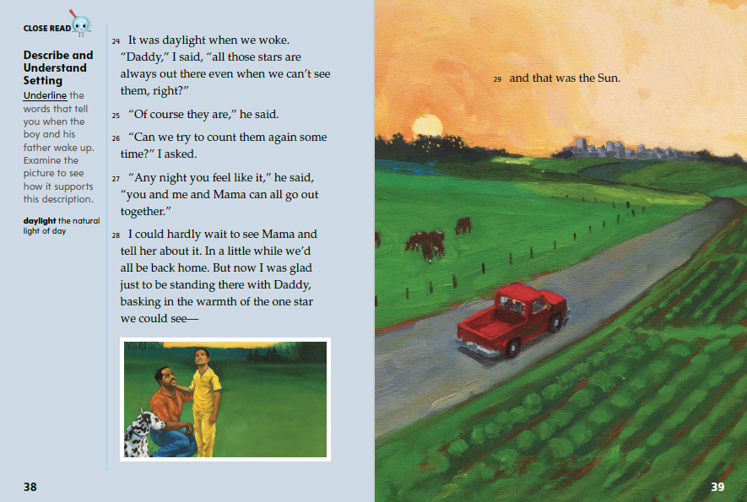
Page 38,39
First Read – How Many Stars in the Sky?
Notes:
Read together.
THINK ALOUD A lot of time has passed since the boy and his father left their house. I notice that the boy can’t see the stars anymore, even though they are out in the country. They are still in the right place to see the stars, but it is no longer night. The boy explains that the stars are always there, but he can only see them when he is in the right place at the right time of day.
THINK ALOUD After I read the last page, I think about questions I still have. I might read parts of the story again to help answer my questions. For example, is the boy happy at the end of the story even though he wasn’t able to count all the stars? Why is the boy so interested in counting the stars? Do the stars remind him of someone?

Slide 35
Respond and Analyze
Brainstorm What else could the boy have done to see stars?
Discuss The boy tries to see stars in his backyard, then goes up into his treehouse to see stars. What things have you done to help you solve a problem?
Notes:
Use these suggestions to prompt students’ initial responses to reading How Many Stars in the Sky?
Brainstorm What else could the boy have done to see stars?
Discuss The boy tries to see stars in his backyard, then goes up into his treehouse to see stars. What things have you done to help you solve a problem?

Slide 36
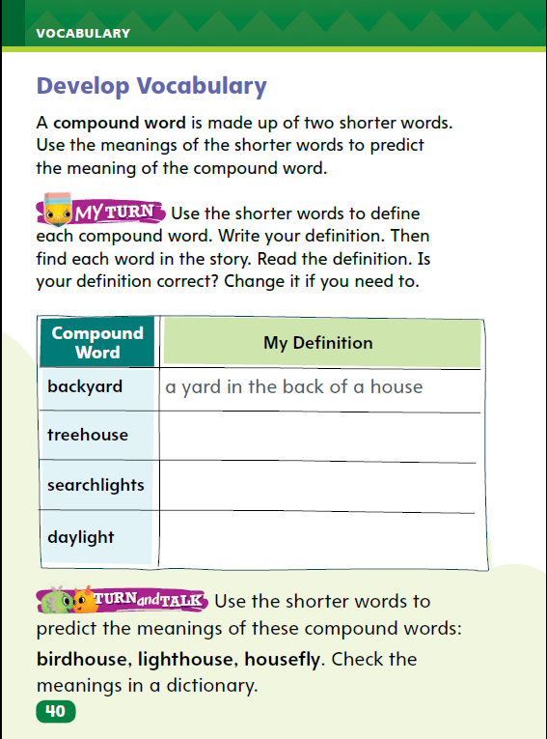
Page 40
Develop Vocabulary
Turn to page 40 in your Student Interactive and complete the activity.
Notes:
The vocabulary words backyard, treehouse, searchlights, and daylight tell us about the settings in How Many Stars in the Sky?
Remind yourself of the word’s meaning based on the two shorter words of each compound word.
Ask yourself what the author is trying to convey about the setting.
Model filling out the chart on p. 40 using the word backyard.
In the story, the boy goes outside, in back of his house. Our first word begins with the shorter word back.
Have students use the strategies for developing vocabulary.
Have students complete p. 40 of the Student Interactive and respond using newly acquired vocabulary. They should use the meanings of the two shorter words of each compound word in their answers.

Slide 37
Check for Understanding
What makes this text realistic fiction?
Why do you think the author has the boy and his dad try to look at the stars from different places?
Why can they see so many more stars in the country?
Notes:
Have students complete p. 41 of the Student Interactive.

Slide 38
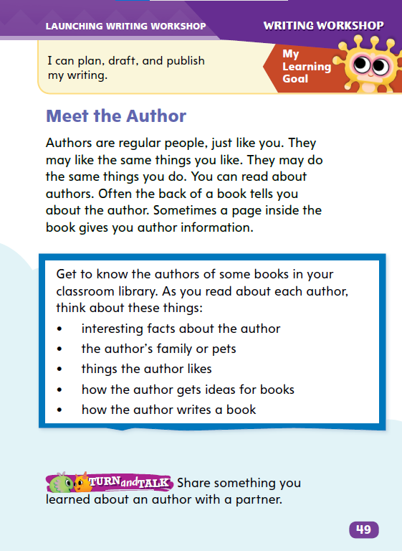
Page 49
Writing – Launching Writing Workshop
Turn to page 49 in the Student Interactive.
Notes:
Authors share details about themselves in their books, and readers can relate to these details. For this reason, new writers think of details they would like to share with their readers.
Direct students to p. 49 in the Student Interactive. Read the first three sentences of “Meet the Author.” Ask: How are authors like you? Pause for student responses. Authors live in homes, like many different things, and have families and pets.
Read the author biographies from two stack texts. Point out any similarities or differences between authors. Say: In some ways, these authors are like people we know.
Ask: What is an interesting detail about you? Allow each student to give one answer. Remind students that as writers they will share interesting details about themselves.
Read the author biographies from a few other books. After they listen, allow students to silently free-associate more interesting details about themselves.

Slide 39
Independent Writing
Read about more authors from the stack of books. Then list biographical details about yourselves in your writing notebooks..
Give a quick autobiographical report.
Be sure to listen and share common interests with your classmates.
Notes:
During independent writing time, students should read about more authors from the stack.
Ask tentative writers which of their own interests are reflected in authors’ biographies.
MODELED Choose a book from the stack and do a Think Aloud to model the discovery of a fact that compares an author to yourself or students.
SHARED Prompt students to develop questions that they would ask an author.
GUIDED Ask students questions about an author’s bio.
Students who show understanding may begin listing biographical details about themselves in their writing notebooks.
Ask students to give a quick autobiographical report. Tell students to listen and share common interests.

Slide 40
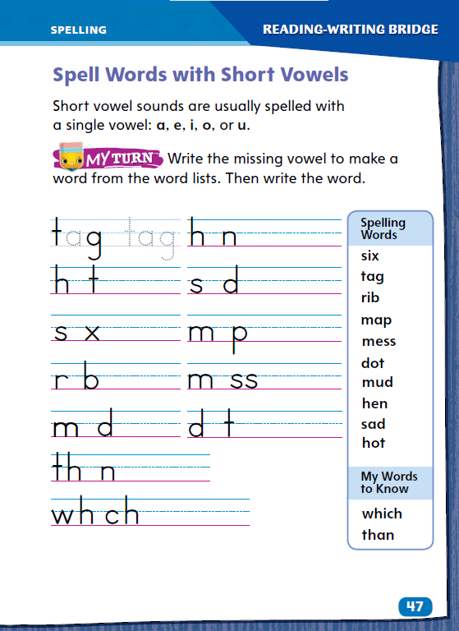
Page 47
Spelling
tap
leg
win
mop
cup
Turn to page 47 in your Student Interactive and complete the activity.
Notes:
Explain that words with short vowel sounds are usually spelled with the single vowels a, e, i, o, or u.
Display tap, leg, win, mop, cup. Say each word aloud. Discuss that these are words with short vowel sounds and one syllable, which is closed.
Have students complete Student Interactive p. 47 to practice spelling words with short vowels. Use the leveled supports on p. T336 for ELLs.

Slide 41
Language and Conventions
Work with your partner to create sentences that include one complete thought.
Identify the subject and what it does.
The dog barks.
Notes:
Explain to the class what a simple sentence is: A simple sentence has a subject and predicate. Say: The subject is who or what the sentence is about. The predicate is what the subject does.
Display this sentence: The dog barks. Ask: What is the subject? (dog) What does the subject do? (barks) This is a simple sentence that tells a complete thought.
Have partners work to create oral sentences that include one complete thought. Have partners share their sentences with the class. Ask the class to identify the subject and then tell what the subject does. Repeat this process to check that students have composed complete sentences and understand their parts.

Slide 42
Lesson 3

Slide 43
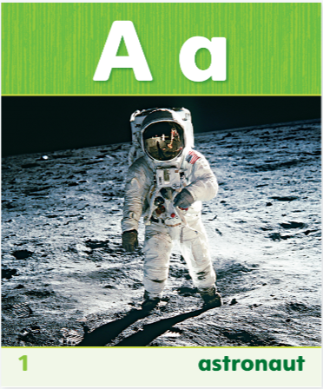
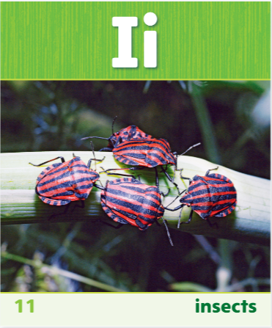

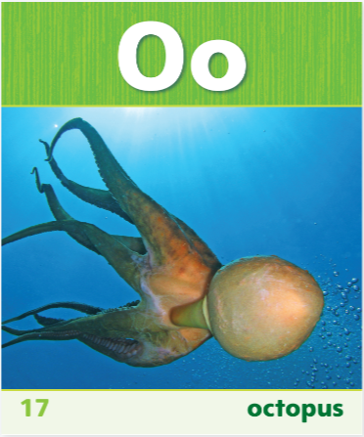
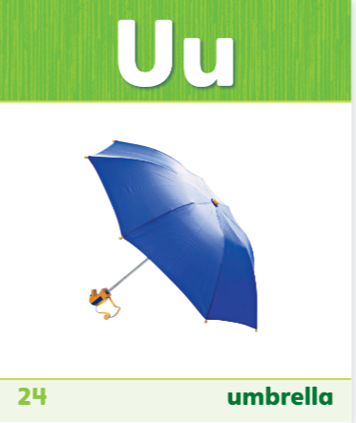
Phonics
m
a
t
Notes:
Show students the Sound-Spelling Cards for the short vowels. Hold up each card and ask students to say the short vowel sound of the letter.
Tell students they are going to write words with short vowel sounds. As you model, write each letter on the board. I want to spell the word mat. I listen to the first sound: /m/. I know the letter m stands for the /m/ sound, so I write m. I hear /a/ in the middle of mat. I know the letter a stands for the /a/ sound. I write the letter a. I hear /t/ at the end of mat. I know the letter t stands for the /t/ sound so I write t. Now I sound out the word to make sure I have the correct letters: /m/ /a/ /t/
Say additional words for students. For each word, help them name the sound for each letter as they write the word. Then write the word and ask students to check their spelling. Some words to use are: sun, tap, men, hop, and fit.
Give pairs of students vowel letter cards and have them take turns saying a word with a short vowel sound while their partner holds up the letter card with the vowel that stands for the sound in the word.

Slide 44
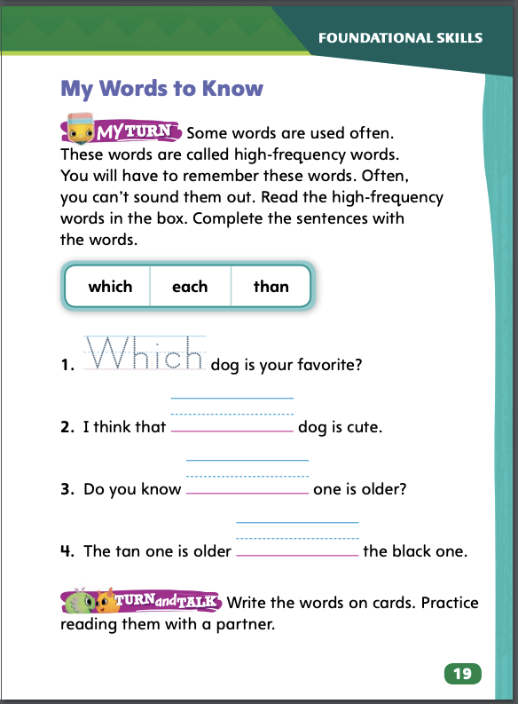
Page 19
High-Frequency Words
Turn to page 19 in your Student Interactive and complete the activity.
Notes:
Explain that some words appear frequently in texts. Identifying these words will help them read more fluently.
Say each high-frequency word. Ask students to identify and read the words on SI p. 19. Read sentence 1 without saying the missing word.
Ask students to identify, read, and write the boxed word that makes sense in the sentence.
Ask students to complete the sentences with a partner. Remind them to print each word legibly
Ask partners to take turns naming one of the words while the other says a sentence using that word.
Remind students that high frequency words are words that they will hear or use more often than other words. Write which, each, and than. Call on different students to take turns being the teacher. Ask the student to point to one of the words while the other students read it. Then have the student point to another student and ask him or her to say a sentence that uses the word.

Slide 45
Page 22
Describe and Understand Setting
Not sure if you want the title page on this same slide?
Notes:
Readers learn about setting by noticing where and when a story happens and why those details are important. Say: Think about the details in the text that describe the setting. Pay attention to details in the pictures. Ask yourself why the settings are important to the story.
Model locating details about the setting.
Which details give descriptions of the setting? In paragraph three, the boy is thinking, “I could count so many just from my room.” I am going to underline my room and write “It’s night; the room has a bed and a window.” This shows where and when the story began. It shows that it’s night, so the boy can see the stars.
Have pairs of students choose another paragraph and underline details about the setting. Then have them write why that setting is important to the story. Ask pairs to share their answers with the class.

Slide 46
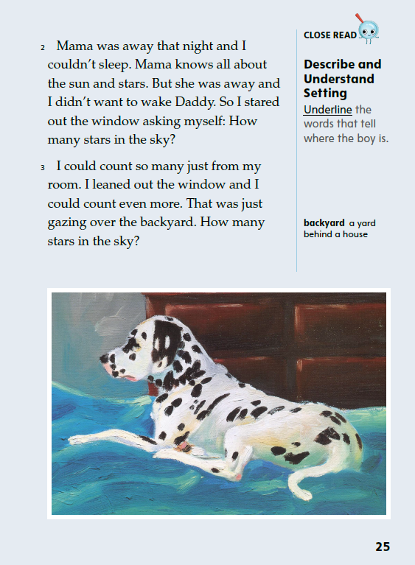
Page 25
Close Read – Describe and Understand Setting
Turn to page 25 in your Student Interactive.
Notes:
Explain that when they begin to read a text, readers should look for information about where and when the story takes place. This is called the setting. Ask: Look at the illustrations. Where is the boy? Then direct students to underline words in paragraph 3 that describe where the boy is. See student page for possible response.
What is the time of day? How do you know? Possible Responses: The words ‘‘couldn’t sleep’’ and ‘‘stars in the sky’’ tell me that it is night. The words ‘‘my room,’’ ‘‘my window,’’ and ‘‘backyard’’ tell me that the boy is in his room looking through a window that faces the backyard. DOK 2

Slide 47
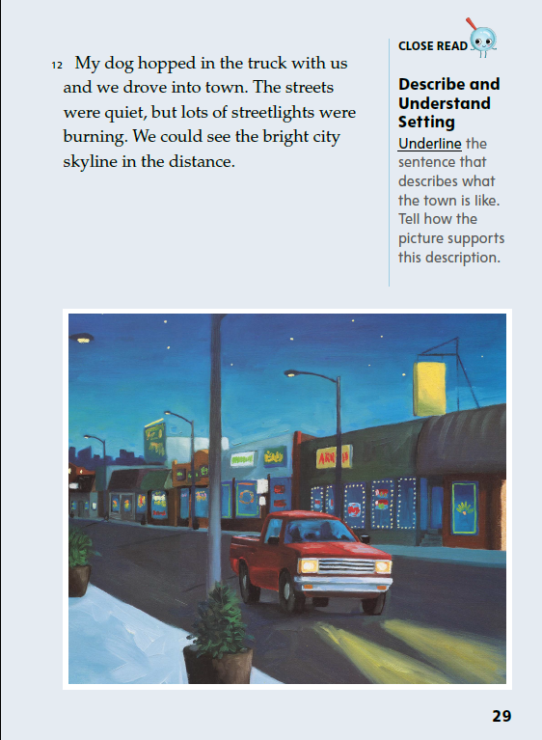
Page 29
Close Read – Describe and Understand Setting
Turn to page 29 in your Student Interactive.
Notes:
Remind students that setting is when and where a story takes place. Have students scan paragraph 12 to underline a sentence that describes the setting. See student page for possible response.
Explain that students can use both the illustration and the words on the page to describe the town. Say: The text tells us that there are “lots of streetlights” in town. How does the writer describe the streetlights? (They are “burning.”)
Ask: What does the city skyline look like? (It is “bright.”) Help students connect these ideas to the text on p. 26 (“the streetlight was so bright I could not see any stars near it.”).
Ask: Do you think they will see the stars while they are in the town? Why or why not? Possible response: They will not see the stars because it is too bright. DOK 2

Slide 48
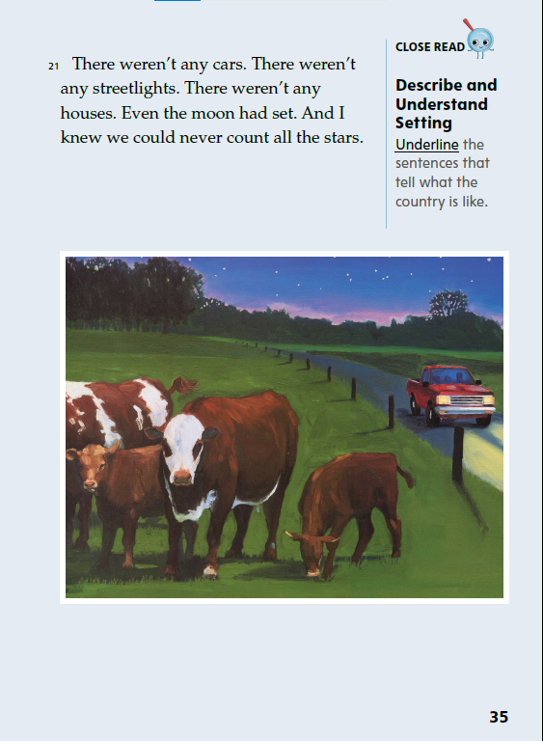
Page 35
Close Read – Describe and Understand Setting
Turn to page 35 in your Student Interactive.
Notes:
Have students underline the sentences that describe the country. See student page for possible responses.
Ask: How does the country differ from the city? Which setting lets the boy and his father see more stars, and why? Possible Response: There weren’t any cars in the country. In the country, there weren’t lights from cars and buildings lighting up the sky and making it hard to see the stars. They could see more stars in the country because there was nothing blocking their view. DOK 2

Slide 49
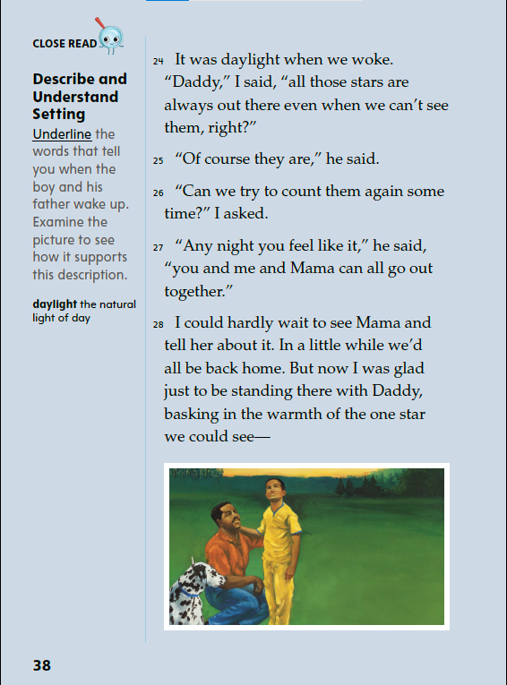
Page 38
Close Read – Describe and Understand Setting
Turn to page 38 in your Student Interactive.
Notes:
Remind students that setting includes where and when events in a story take place. Have students read paragraph 24 and underline words that describe when the boy and his father wake up. See student page for possible responses.
Point out that the setting has changed throughout the story. Say: Name the different places you’ve seen in the story. Where are the boy and his father now? What time of day is it? How do you know?
Have students consider how the story would be different if the characters had stayed in one place. DOK 2

Slide 50
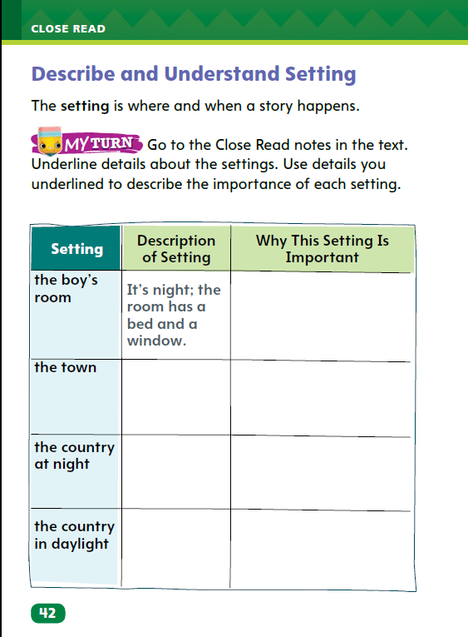
Page 42
Describe and Understand Setting
Turn to page 42 in your Student Interactive and complete the activity.
Notes:
Readers learn about setting by noticing where and when a story happens and why those details are important. Say: Think about the details in the text that describe the setting. Pay attention to details in the pictures. Ask yourself why the settings are important to the story.
Model locating details about the setting.
Which details give descriptions of the setting? In paragraph three, the boy is thinking, “I could count so many just from my room.” I am going to underline my room and write “It’s night; the room has a bed and a window.” This shows where and when the story began. It shows that it’s night, so the boy can see the stars.
Have pairs of students choose another paragraph and underline details about the setting. Then have them write why that setting is important to the story. Ask pairs to share their answers with the class.
Have students use the strategies for describing and understanding setting.
Have students annotate the text using the other Close Read notes for Describe and Understand Setting and then use the text evidence from their annotations to complete the chart on p. 42.

Slide 51
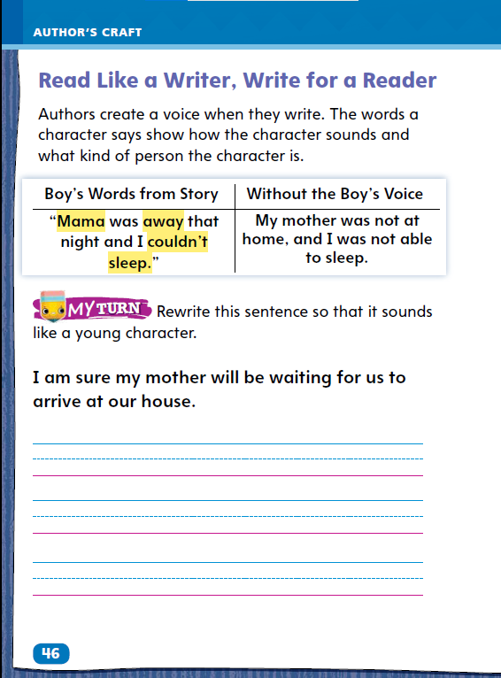
Page 46
Read Like a Writer, Write Like a Reader
Turn to page 46 in the Student Interactive and complete the activity.
Notes:
Authors bring characters to life through the words the characters use. This is called voice. Voice is also the characteristic speech and thought patterns of the narrator in a work of fiction.
Authors choose words carefully to portray a character.
Readers understand characters through the words they use and how they speak.
Model to show students how the writer’s word choice reveals who the character is, using the example on p. 46 in the Student Interactive. In the sentence, “Mama was away that night and I couldn’t sleep,” the author uses the words Mama, away, and couldn’t sleep to help us understand that the character is a child who is upset because his mother is not home.

Slide 52
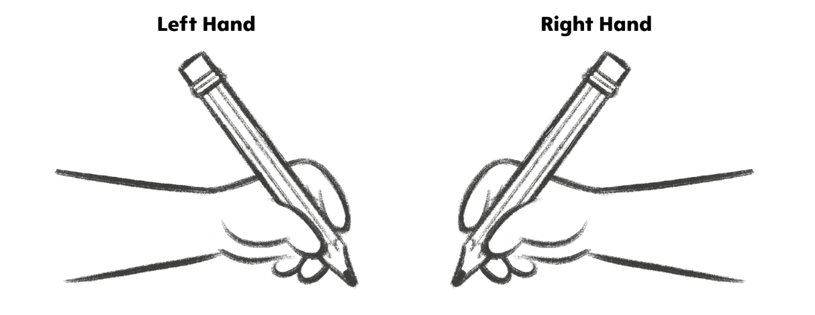
Handwriting
Proper Pencil Grip
Notes:
Grasp a pencil using the thumb, index finger, and middle finger.
Model placing a pencil between the thumb and index finger. Then add the middle finger to the underside of the pencil. Have students hold their pencil using the thumb, index, and middle finger and tell them to hold it firmly enough to keep the pencil upright without holding it too tight.
Have students use Handwriting p. 14 in the Resource Download Center to practice using proper pencil grip. Click path: Table of Contents -> Resource Download Center -> Handwriting-> U1 W1L3 Handwriting Practice

Slide 53
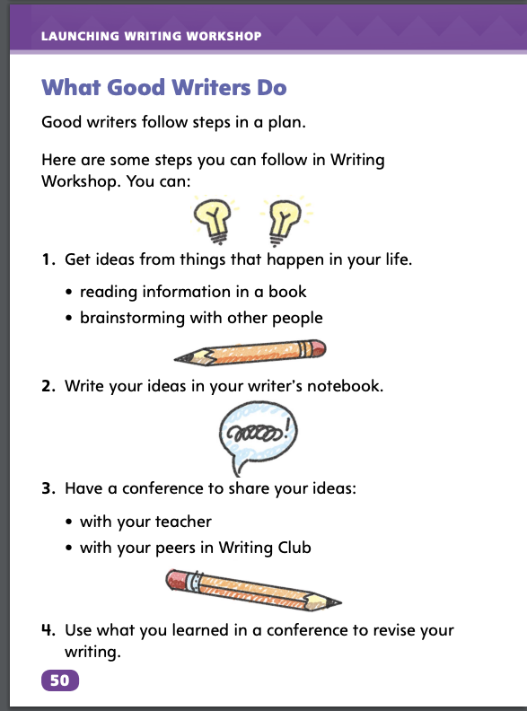
Page 50
Writing – Launching Writing Workshop
Turn to page 50 in the Student Interactive.
Notes:
Good writers follow certain habits. They:
find ideas from texts or while brainstorming with other people.
record ideas in a writing notebook.
share ideas with the teacher or Writing Club peers.
revise writing based on feedback from conferences.
Direct students to p. 50 in the Student Interactive. Read the opening sentences about what good writers do. Point out the numbered steps.
Read the first step. You can get writing ideas from things that happen in real life. Anything can be turned into a story or another kind of text.
Read the second step. Hold up a notebook like the ones students might use for writing ideas and drafts. You will write ideas in a writing notebook. This is so you will remember them. You can add to your ideas and explore different ways to write about them.
Read the third step. You will bring your ideas to your conferences with me and to Writing Club. Sharing ideas will help you think more deeply about them. Questions from other people can help you grow your ideas.
Read the fourth step. You will revise your writing based on the questions and thoughts you get from conferences and Writing Club.
Read a text from the stack. Point out that texts begin with ideas. Remind students that they will find ideas and record, develop, and revise them.

Slide 54
Independent Writing
Let’s look at some additional books to get to know authors and their ideas. Brainstorm in your writing notebooks, using texts to prompt ideas.
Talk about the texts you’ve read. Your classmates should ask you questions about what you enjoyed about the texts.
Notes:
Students should explore additional texts from the stack to get to know authors and their ideas.
If students cannot identify authors’ ideas, help them determine the ideas behind selected texts.
MODELED Do a Think Aloud to model arriving upon an idea and then writing it in a Writer’s Notebook so you don’t forget it.
SHARED Provide students with a writing prompt based on a text from the stack.
GUIDED Provide examples of how students might start writing about ideas in their Writer’s Notebook.
Students who show understanding should brainstorm in their writing notebooks, using texts to prompt ideas.
Ask students to talk about the texts they have read. Invite other students to ask them questions about what they enjoyed about the texts.

Slide 55
Spelling
pad
den
big
top
fun
Notes:
Remind students that words with short vowel sounds usually have a single vowel.
Have students spell these one-syllable words with closed syllables as you underline the short vowel in each word: pad, den, big, top, fun.
Have students complete Spelling p. 23 from the Resource Download Center to spell one-syllable words with closed syllables and short vowel sounds. Click path: Table of Contents -> Resource Download Center -> Spelling-> U1 W1

Slide 56
Language and Conventions
Lisa walks.
Hector smiles.
Notes:
Explain to students that a simple sentence contains one complete thought. Review that it begins with a capital letter and ends with an end mark. Remind students that in a sentence the subject and verb must agree with one another in number. Make sure they have a solid understanding of this concept, correcting any misconceptions as needed.
To reinforce simple sentences, ask volunteers to mime an action. Then create simple sentences to tell what they do. For example, Lisa walks. Hector smiles. Tell the class to identify the subject and the predicate. Then have students write the sentences using correct capitalization and end marks. Have them check the written sentences for subject-verb agreement, making any edits as needed.

Slide 57
Lesson 4

Slide 58
Phonics
van
ten
grin
job
mud
Notes:
Review the CVC vowel pattern and short vowels with students.
Write the following words for students to sound out and read: van, ten, grin, job, mud
Say: These words have a consonant-vowel-consonant pattern or CVC pattern. The vowels in CVC words are usually short. Use what you know about letters and sounds to sound out these words. Point to each letter in each word and ask students to sound out the words. Remind them that the blend at the beginning of grin stands for two consonant sounds blended together. Provide support as needed.

Slide 59
Page 22
Use Text Evidence
Notes:
Active readers use text evidence to help them understand the importance of the settings in the stories they read.
Identify the details the author uses to describe the settings.
Think about why the author chose to use these details instead of others.
Ask yourself how the story would change if the story took place in a different time or a different location.
Use the text evidence you gathered to support an appropriate response about the text.
Use the Close Read note on p. 30 of the Student Interactive to model how to annotate the text to locate evidence and use it to support a response about the importance of the setting.
What words does the author use? In paragraph 5, the text says “there were lots of stars hidden behind the trees.” I know that the boy was looking for stars and the trees were blocking his view. I can use this text evidence to support the idea that the boy’s backyard was not a good place to see stars.

Slide 60
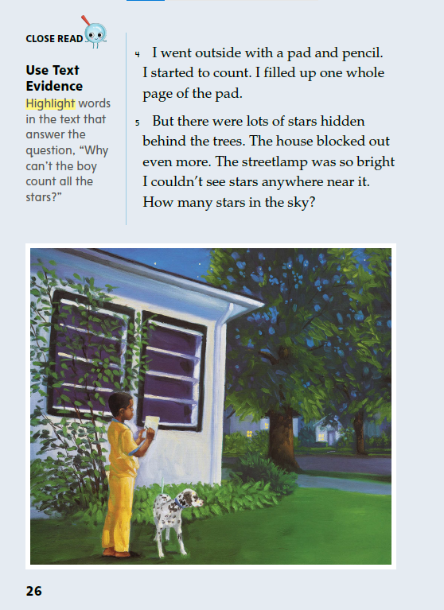
Page 26
Close Read – Use Text Evidence
Turn to page 26 in your Student Interactive.
Notes:
Explain that readers should look for answers to their questions as they read. Sometimes, this means looking for details that give more information about people, places, and things. Looking for details about setting can help readers understand the ideas in a text.
Have students read paragraph 5 to find and highlight details about where the boy is and why he can’t count all the stars. See student page for possible responses.
Ask students to consider what the reader can tell about the setting based on these details. Have students support their responses with text evidence from p. 26. Possible Response: From the details “there were lots of stars hidden behind the trees,” and “house blocked out even more,” we can tell that objects get in the way of the boy’s view of the sky. DOK2

Slide 61
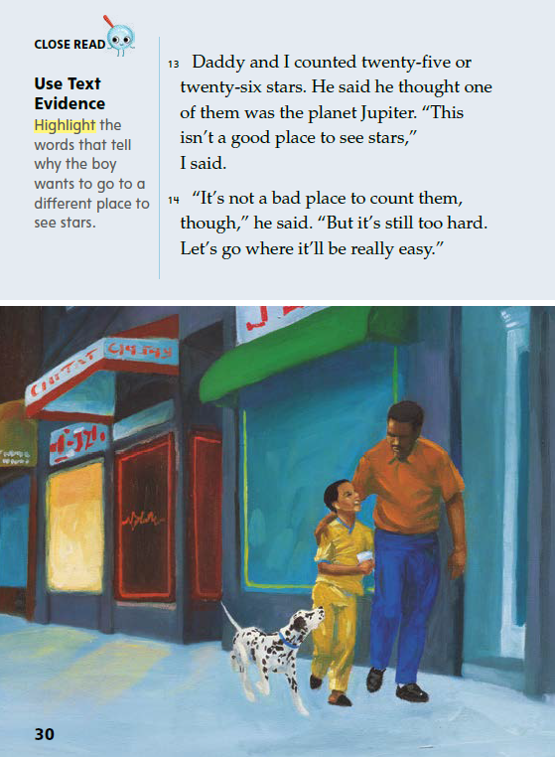
Page 30
Close Read – Use Text Evidence
Turn to page 30 in your Student Interactive.
Notes:
Explain that students should look for clues in the text about how characters think and feel. Ask: How does the boy feel about looking at the stars in town? What do you read that tells you how he feels? Does his father feel the same way?
Have students read paragraphs 13 and 14 to tell how the boy and his father feel about looking at stars in the town.
Have students use their answers to highlight words that indicate why the boy wants to go somewhere else to see the stars. See student page for possible response. DOK 2

Slide 62
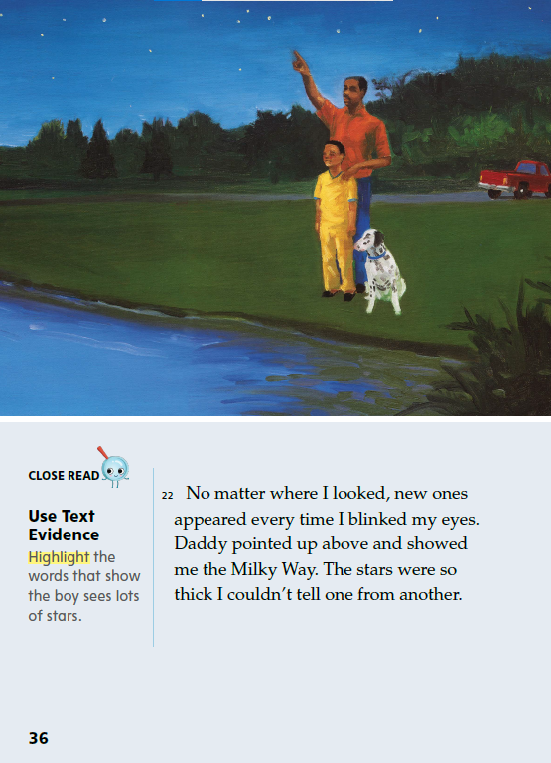
Page 36
Close Read – Use Text Evidence
Turn to page 26 in your Student Interactive.
Notes:
Have students highlight the words in paragraph 22 that provide evidence that the boy is able to see more stars in the sky. See student page for possible responses. Ask for an example of words the author chose to describe lots of stars. Possible Response: An example is “stars were so thick I couldn’t tell one from another.” The author used the word thick to tell us that there were many stars close together in the sky. DOK 1

Slide 63
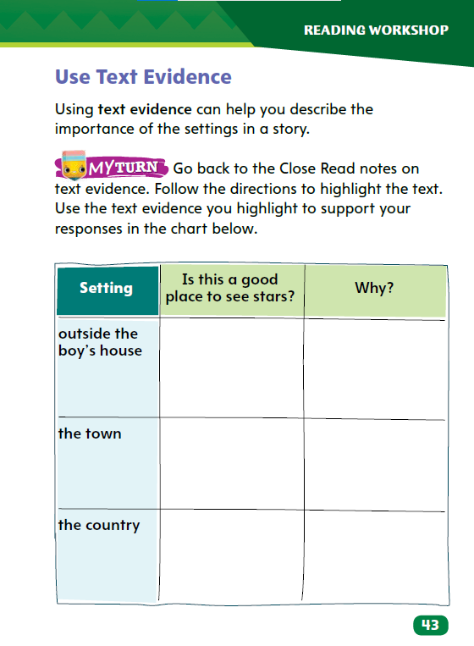
Page 43
Use Text Evidence
Turn to page 43 in your Student Interactive and complete the activity.
Notes:
Active readers use text evidence to help them understand the importance of the settings in the stories they read.
Identify the details the author uses to describe the settings.
Think about why the author chose to use these details instead of others.
Ask yourself how the story would change if the story took place in a different time or a different location.
Use the text evidence you gathered to support an appropriate response about the text.
Use the Close Read note on p. 30 of the Student Interactive to model how to annotate the text to locate evidence and use it to support a response about the importance of the setting. What words does the author use? In paragraph 5, the text says “there were lots of stars hidden behind the trees.” I know that the boy was looking for stars and the trees were blocking his view. I can use this text evidence to support the idea that the boy’s backyard was not a good place to see stars.
Have students use the strategies for using text evidence about the setting.
Have students annotate the text in response to the Close Read notes for using text evidence, and then use their annotations to complete the graphic organizer on p. 43.

Slide 64
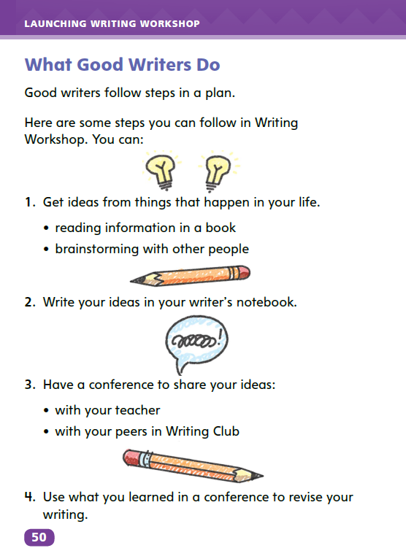
Page 50
Writing – Launching Writing Workshop
Turn to page 50 in your Student Interactive.
Notes:
When writers get inspired, they write about their inspiration, share feedback in writing communities, and use feedback to strengthen their skills.
Direct students to p. 50 in the Student Interactive. Remind students that they will follow the four steps of this plan to practice being good writers.
First, you will come up with an idea to write about. Hold up a text you have previously read to the class. Summarize what the text is about. Sometimes, writers get their ideas from texts they read.
Second, you will write about your ideas. Pause to allow students to write a one-sentence idea that the book has given them in their writing notebooks.
Third, you will talk about your writing in Writing Club and in our conferences. Today, I will show you what a conference is like. To get to know you as a writer, I will ask you about your ideas and read your writing. Choose a volunteer to model the routines of a conference with you. Prompt the student to read his or her one-sentence idea from the notebook. Respond: I would like to know more about that idea. Can you write two more sentences about it? Adding more details will help you plan your writing.
The fourth step is to take what you’ve learned in our conference and use it to revise your writing. Referring to the student volunteer, say: This person found an idea, wrote about it, and shared it during a conference. Feedback
from the conference can be used to revise the writing.

Slide 65
Independent Writing
Write two more sentences about your initial idea. When you are done, think about how you can further develop your ideas.
Share what inspired your writing ideas.
Notes:
During independent writing time, all students should write two more sentences about their initial idea.
If students need additional support, provide prompts to help develop their ideas.
MODELED Display a text from the stack and do a Think Aloud to model how to find an idea in a text.
SHARED Prompt students to verbally explain ideas they got from the text, then help students record the ideas.
GUIDED Provide explicit instruction on how to write about an idea in a sentence.
Students who finish the task should think about how they can further develop their ideas.
Ask students to share what inspired their writing ideas.

Slide 66
Spelling
hat
net
fit
not
run
Notes:
Have students review the previous spelling rules for words with the CVC pattern.
Read the following words and have students spell them: hat, net, fit, not, run.
Have pairs work together to underline the vowels and circle the consonants in hat, net, fit, not, run.

Slide 67
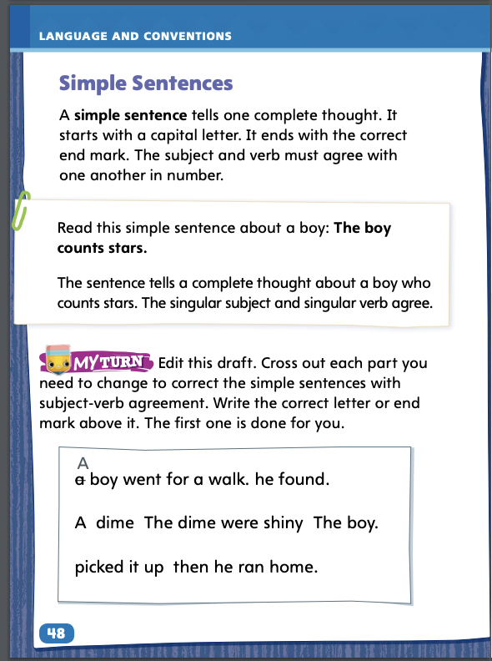
Page 48
Language and Conventions
Turn to page 48 in your Student Interactive.
Notes:
Have students complete the practice activity on p. 48 to edit drafts using complete sentences with subject-verb agreement. Use the leveled supports on p. T345 for ELLs.

Slide 68
Lesson 5

Slide 69
Phonics
bus
scrub
jump
slug
fun
Notes:
Write the letter Uu. Ask students what letter it is and what sound it stands for in CVC words. Say: The letter u stands for the short sound /u/ when it is between two consonants.
Write: bus, scrub, jump, slug, fun
Call on different students to circle the vowel in each word. Ask students to sound out and read the words with you. If necessary, provide support in decoding the blends in scrub, jump, and slug.

Slide 70
High-Frequency Words
w | h | i | c | h
 | e | a | c | h
 | t | h | a | n
which
each
than
Notes:
Remind students that high-frequency words are words that they will hear, see, and use more often than other words. Explain that recognizing these words automatically will allow them to concentrate on other less common words they will need to sound out. Point out that knowing many high-frequency words will also help them focus on the meaning of texts they read.
Ask students to review the chart. Have them say each word and repeat after you the letters each word contains. Students can then take turns being the teacher and calling on others to say a designated word and use it in a sentence.
For additional student practice with high-frequency words, use My Words to Know p. 7 from the Resource Download Center.
Click path: Table of Contents -> Resource Download Center -> High-Frequency Words-> U1 W1

Slide 71
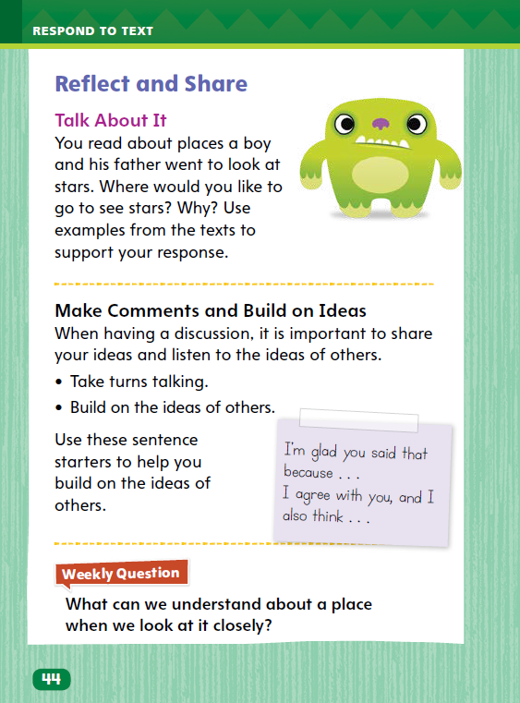
Page 44
Reflect and Share
Turn to page 44 in the Student Interactive.
Notes:
Explain to students that when they participate in discussions with other readers, they should make pertinent comments, or remarks, that build on what others say. This will allow the group to have meaningful conversations about the texts.
Before making a comment, ask yourself whether it is on-topic and related to the discussion.
Build on the comments that other people make to stay on topic and deepen the conversation. Use language such as, “I’m glad you said that because” or “I agree, and I also think” to help connect ideas.
Listen closely to others’ comments and take turns making comments, ensuring that everyone has a chance to join the discussion.
Model making pertinent comments using the Talk About It prompt on p. 44 in the Student Interactive.
I listen to my discussion partner's ideas and decide whether I agree or disagree. Then I share my thoughts. If my partner wanted to look at stars on the beach, for example, I would say, "I agree, because the beach is away from city lights, so we would see lots of stars there." Ask students what they would say if a partner wanted to look at stars from a tall city building.
Help students phrase their comments respectfully and clearly.
Have students use the strategies for making connections between texts.
Have students use evidence from this week’s texts to discuss other places where stars are visible in the night sky. If desired, distribute Collaborative Conversations tips from the Resource Download Center to help guide discussions.

Slide 72


Page 44
Apply
What can we understand about a place when we look at it closely?
Notes:
Have students use evidence from the texts they have read this week to respond to the Weekly Question. Tell them to write their response on a separate sheet of paper.

Slide 73
Spelling
1. We needed six eggs to make breakfast.
2. The tag was on the inside of the shirt.
3. Did the ball hit him in the rib?
4. Let’s look it up on a map.
5. They were sad when they lost the game.
6. Try not to make a mess in the house.
7. What is that dot on the page?
8. Be careful of the mud in the yard.
9. We need to feed the hen early in the morning.
10. Summer is a very hot season.
11. He did not know which crayon to use.
12. She is taller than her brother.
Notes:
(Note: Move the orange boxes to cover each bold spelling word before you read aloud the words and sentences.)
Read aloud the words and sentences. Have students spell each word with initial consonant blends and the two high-frequency words.
1. We needed six eggs to make breakfast.
2. The tag was on the inside of the shirt.
3. Did the ball hit him in the rib?
4. Let’s look it up on a map.
5. They were sad when they lost the game.
6. Try not to make a mess in the house.
7. What is that dot on the page?
8. Be careful of the mud in the yard.
9. We need to feed the hen early in the morning.
10. Summer is a very hot season.
11. He did not know which crayon to use.
12. She is taller than her brother.
Reveal the spelling word and have students check their work.

Slide 74
Language and Conventions
Which of the following is a simple sentence?
A. The white cat.
B. Runs fast.
C. White cat.
D. The white cat runs fast.
Notes:
Display the following question for students to answer.
Which of the following is a simple sentence?
A The white cat.
B Runs fast.
C White cat.
D The white cat runs fast.
Have students complete Language and Conventions p. 29 from the Resource Download Center. Click path: Table of Contents -> Resource Download Center -> Language and Conventions -> U1 W1

Slide 75
Unit 1: Week 1
Grade 2

