Slide 1
Properties of Matter

Slide 2
Vocabulary
Weight
Texture
Magnetic
Flexibility
Hardness
Weight: is how heavy an object is .

Slide 3
Observe Properties
We can observe the size, color, texture, and, shape of an object.
Texture is how something feels.

Slide 4
Measure Properties
Many properties can be measured :
Weight
Temperature
Length

Slide 6
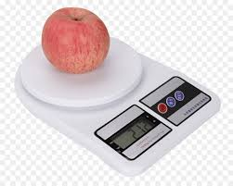
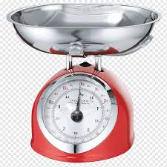
Weight is how heavy an object is.
Weight is measured by a scale.

Slide 7
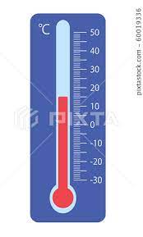
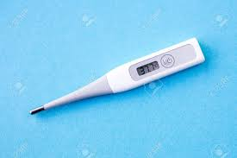
Temperature is how hot or cold something is.
Temperature is measured by a thermometer.

Slide 8
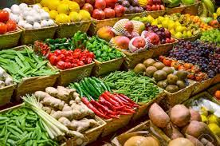
Many properties can be observed by our senses like the size, color, texture, and shape of an object.
Texture is how something feels.
An object may feel soft, smooth, rough, or bumpy.

Slide 9
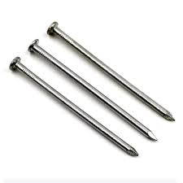
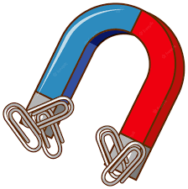
Magnetic
Magnetic: is an object that can be pushed or pulled by a magnet.
Objects that are made of
(Iron) are attracted to magnets.

Slide 10
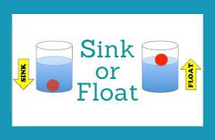
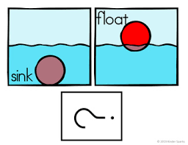
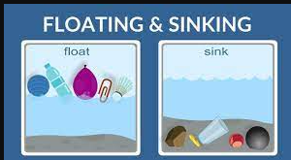
Sink and Float
Not all objects can float.
An object can float if it has air inside it or it is light and has a large surface.

Slide 11
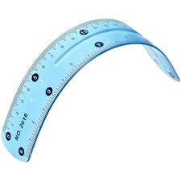
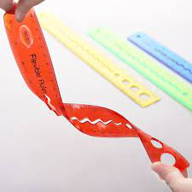
Flexibility
Flexibility: the ability to bend easily without breaking ex: plastic ,rubber

Slide 12
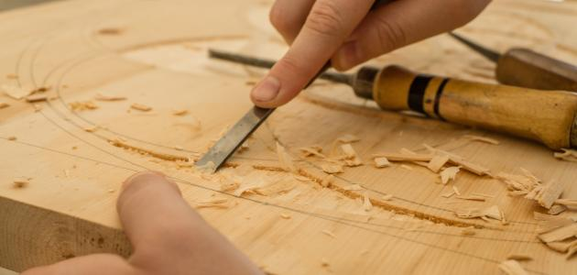
Hardness
Hardness is a property that tells how hard or solid an object is compared to other objects.
If an object can scratch another object, then it is harder than that object
ex: iron is harder than wood.
Good Luck

