Slide 1
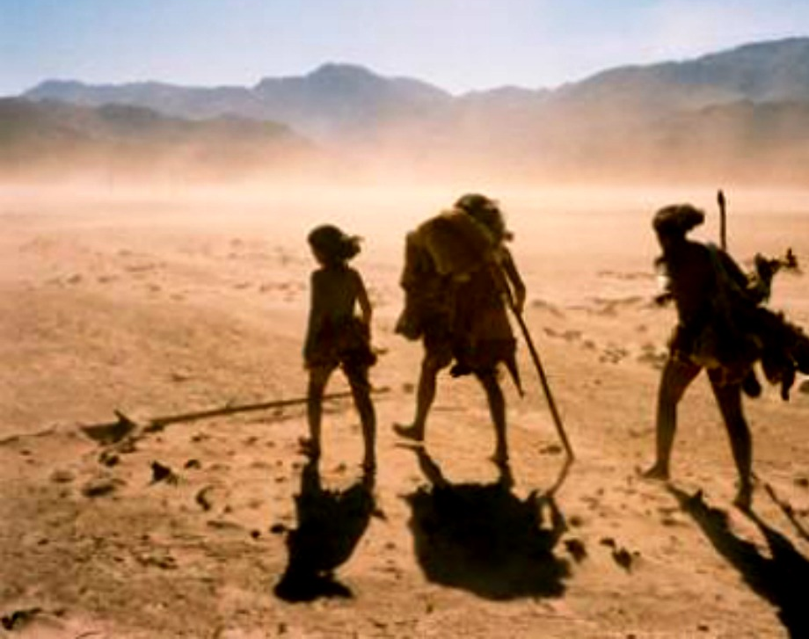
Human Movement
This Photo by Unknown Author is licensed under CC BY

Slide 2
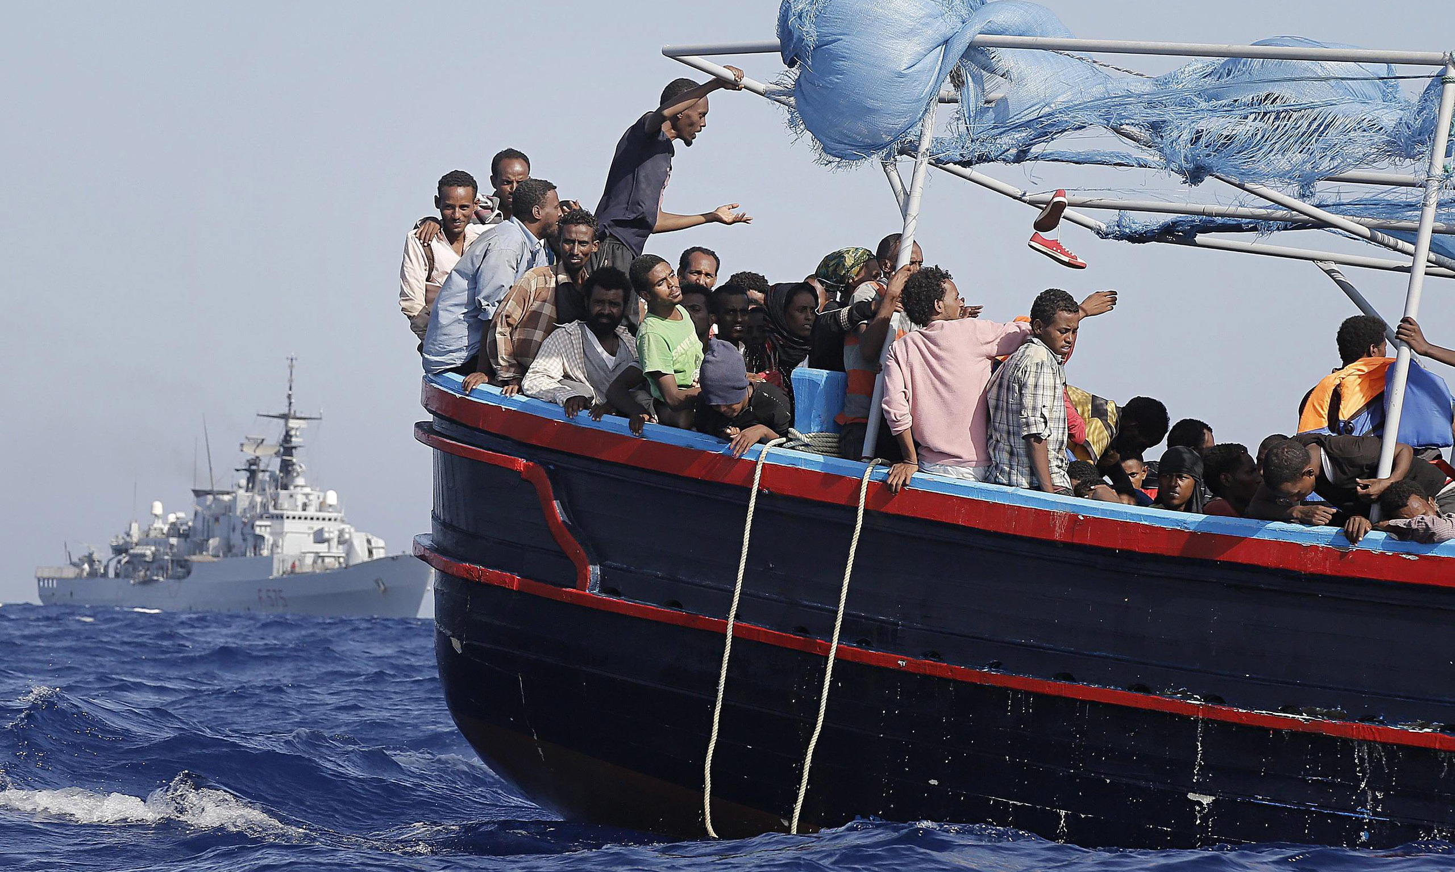
*Human geography teaches about the relationship between people , places, and the environment and how this relationship impacts where people settle .
Another important topic in human geography is human movement .
Migration is the movement of people .
People who move are called migrants .
This Photo by Unknown Author is licensed under CC BY-NC-ND

Slide 3

*Some migration is internal , meaning people move within their home country .
Other migrations are external , when people move out of one country into another .
Emigration is the act of leaving a country . Immigration is the act of moving into a country .
Migration can be permanent or temporary .
This Photo by Unknown Author is licensed under CC BY-SA

Slide 4

*Push and pull factors : In human geography , push and pull factors describe the cause of migration . People hope to improve or change something about their lives by moving .
They might migrate to escape a difficult situation , or to move towards a better one .
Pull factor : a condition that makes people want to move to a new area . For example : access to affordable housing or more work opportunities .
This Photo by Unknown Author is licensed under CC BY-NC-ND

Slide 5
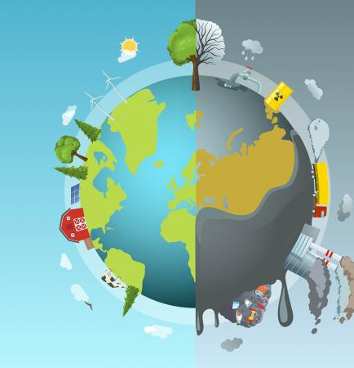
*Push factors : a condition that leads people to leave their home or areas . For example , low employment or unsafe living conditions .
There are many kinds of push and pull factors . You have read about the economic reasons like unemployment
(push)and natural disasters (push). There are also social and environmental reasons .
Social reasons include better education (pull)or inequality (push). Environmental factors include a warmer climate (pull)or pollution (push ).
This Photo by Unknown Author is licensed under CC BY-SA

Slide 6
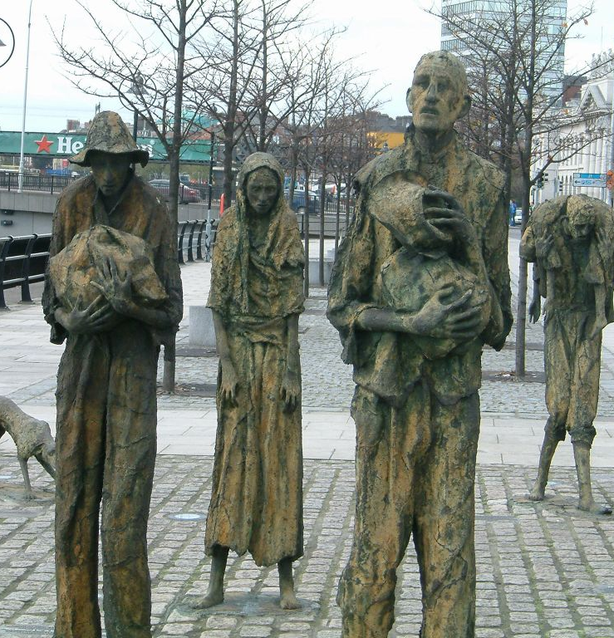
*Case Study : Irish Potato Famine :
In 1845 , Ireland experienced a famine , or a widespread lack of food . The plant disease (Potato blight ) caused the famine .
A fungus grew on potato crops and destroyed most of the harvest .
For seven years , potato crops in Ireland failed . The population at the time depended on this crop for food . Without potatoes , people –especially the poor and working –class –could not find enough food to survive .
This Photo by Unknown Author is licensed under CC BY-SA

Slide 7
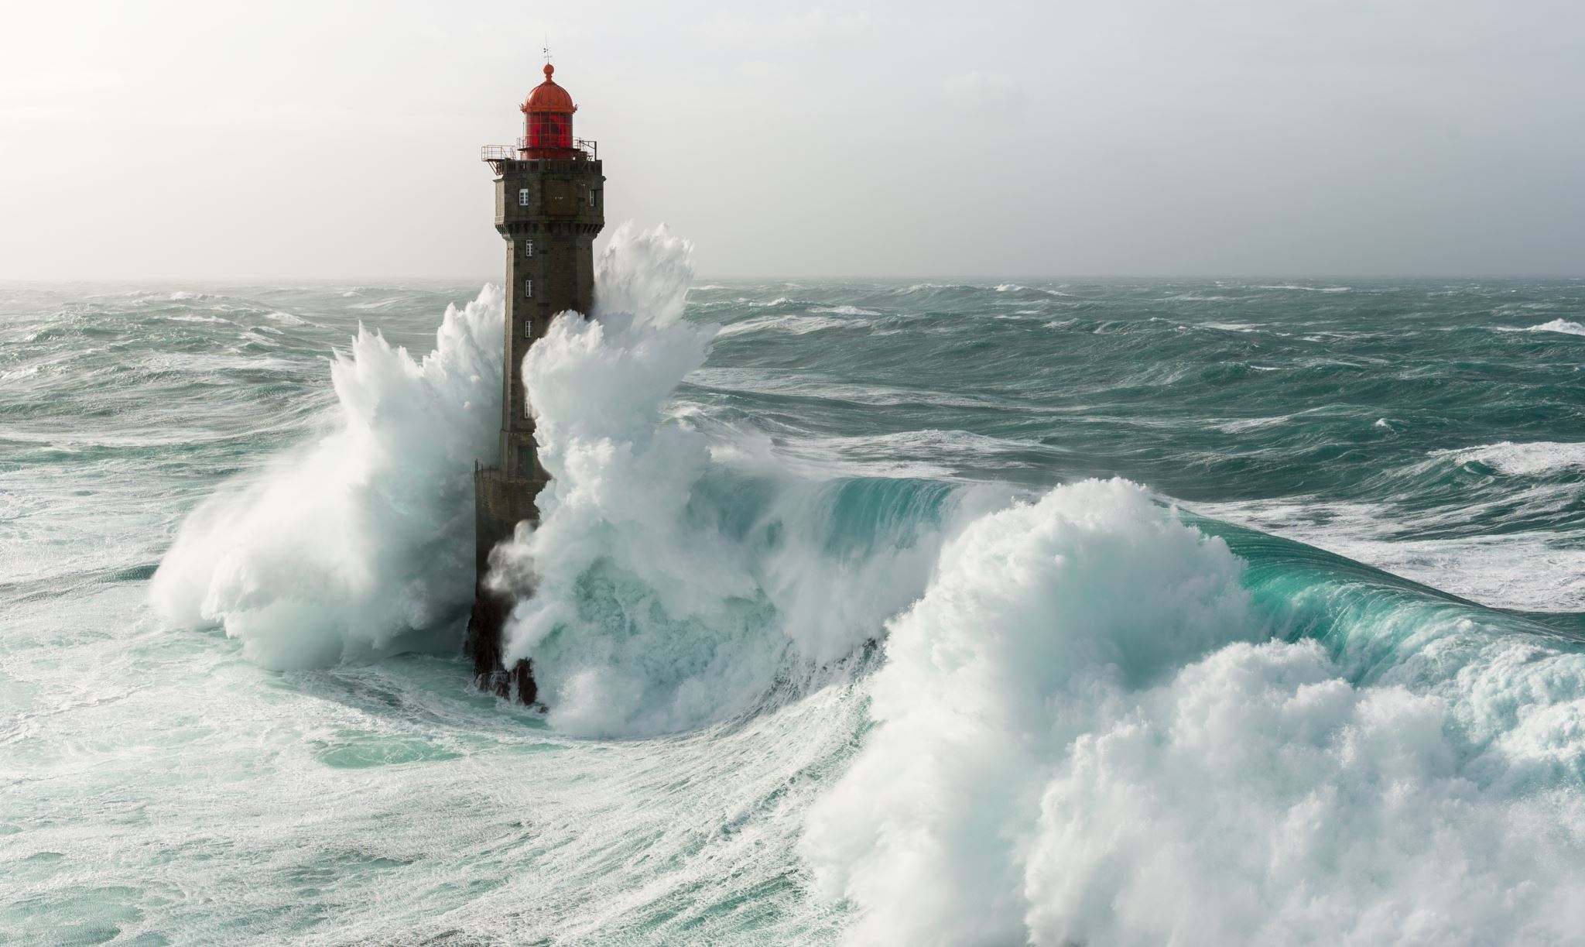
*Historians say this event caused a wave of Irish immigration to the USA . From 1846 to 1851 ,460,000 Irish immigrants made the difficult journey to the united states .

Slide 8

*In their new home , the Irish worked hard to keep their culture alive . By the 1860s,New York City had 3 Irish newspapers .
A monthly magazine focused on Irish arts , literature ,history , and music . And in 1881 ,New York City was the home of the world’s first Irish language (Gaelic)newspaper . These publications gave Irish immigrants a way to connect to home and keep Irish culture alive in their community .

Slide 9
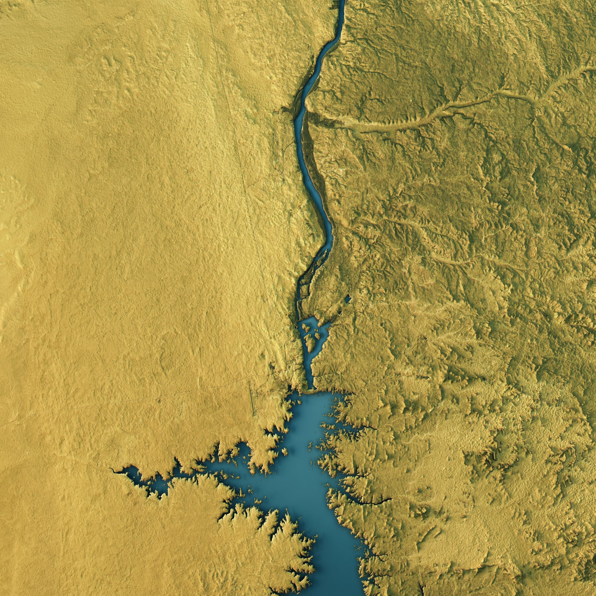
*Between the 1840s and 1900 around six million people left Ireland .
By the start of the 20th century , Ireland’s population had reduced by nearly 25 percent .
In addition to the deaths of about one million people , the famine was a push factor that led to much emigration . The loss of so many people had negative social and economic effects .

Slide 10
*For example , many Irish language speakers died or moved away . This led to decline in the language in some parts of the country .
Similarly , the loss of many of its workers caused the Irish economy to decline .

Slide 11
*High Immigration : Over the years , some countries have had a lot of immigration , and some have had less . The United States has experienced the most immigration of all countries
Around 15 percent of people who lived in the United States are foreign-born . Immigrants to the United States come from all over the world .
Germany and the Kingdom of Saudia Arabia also experience high level of immigration .

Slide 12

*The United Arab Emirates has an immigrant population of 89 percent .
This is one of the highest levels of immigrants in the world in relation to the total population .

