Slide 1
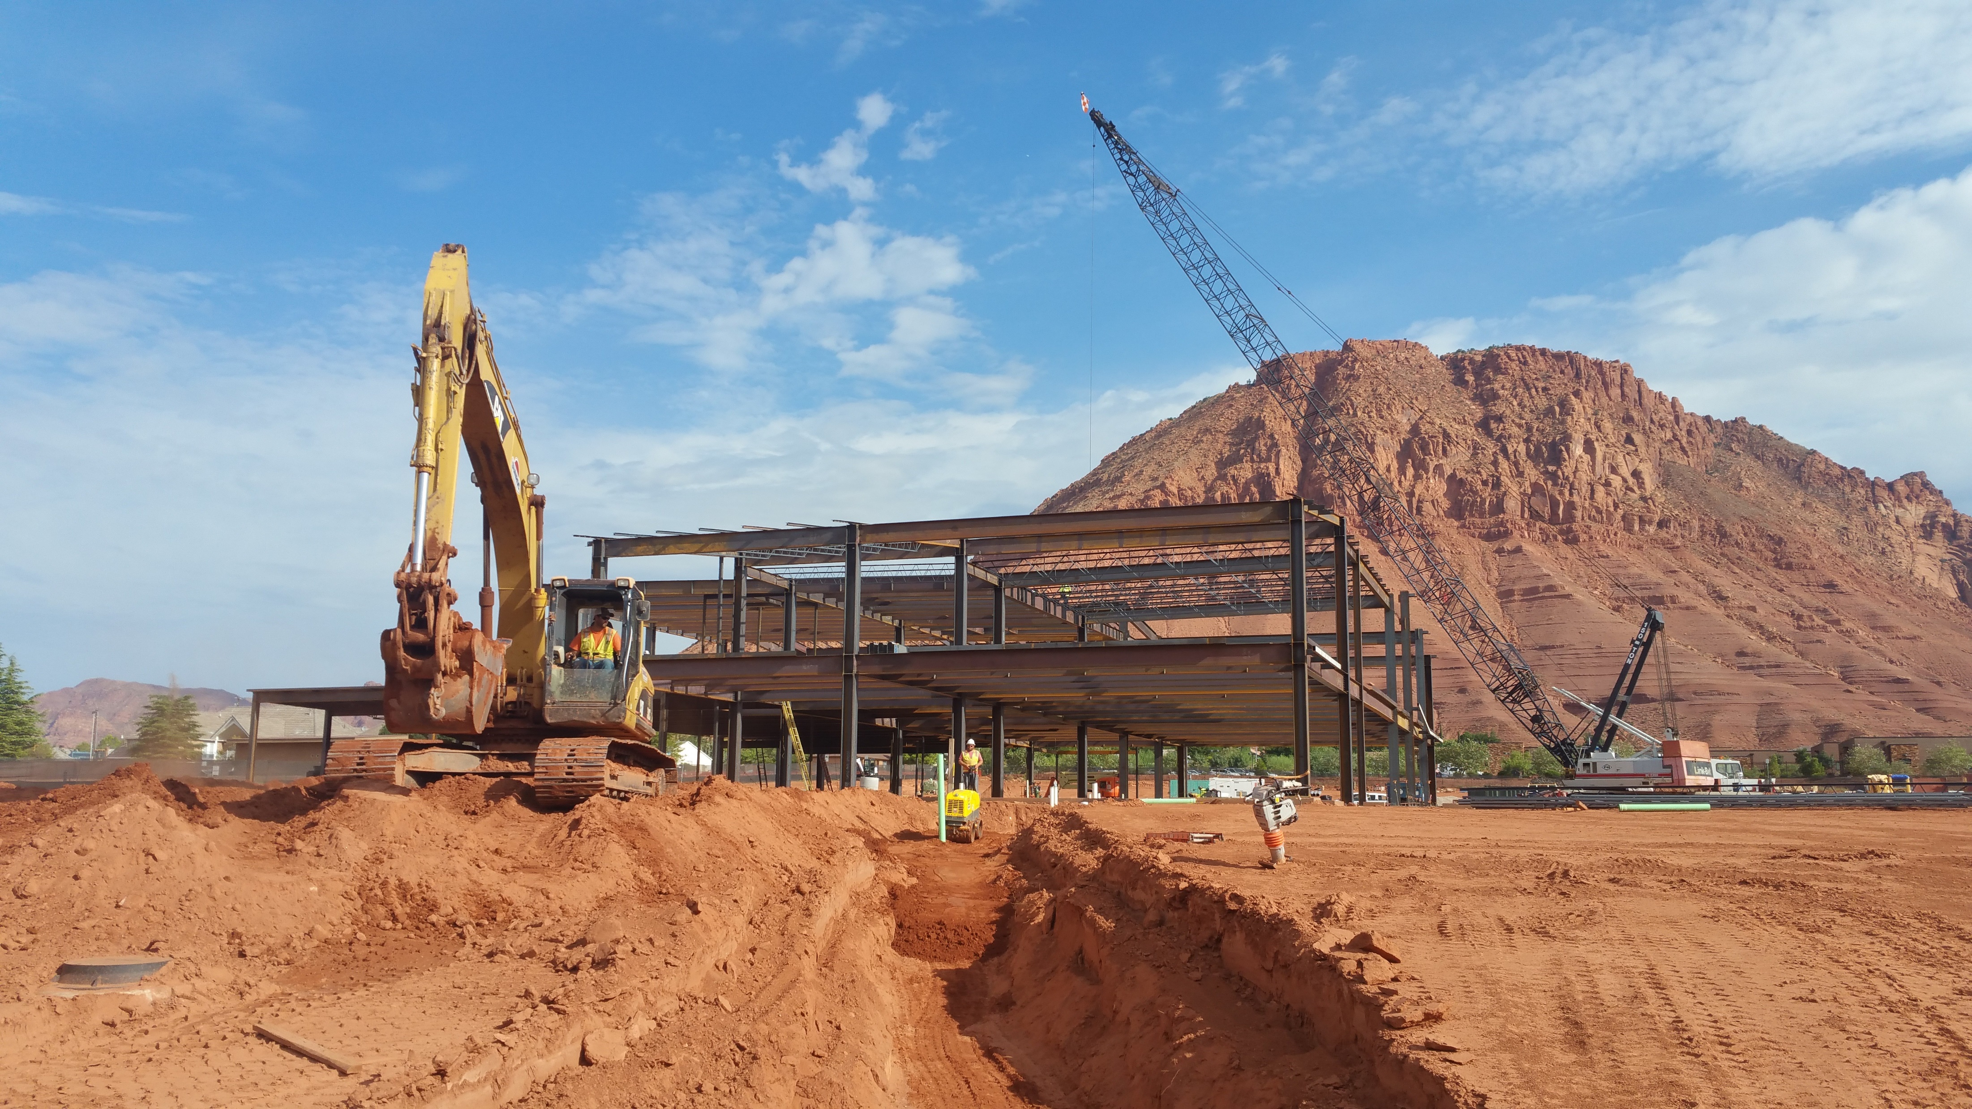
Building on Sand

Slide 2
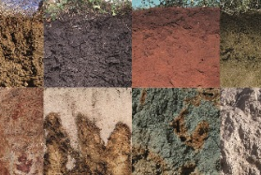
*As you learned in the previous class , soil plays an important part in deciding what type of plants can grow in an area . Soil impacts animal and human life , too . Without soil , most life on Earth would not survive .
This Photo by Unknown Author is licensed under CC BY

Slide 3
*Soil is a mixture of minerals , broken-down rocks , and organic matter . Organic matter , also called humus , is made of rotting plants and decayed animal matter in soil .
Soil is formed as wind and water break down rocks over long periods of time . Different –sized pieces of rock break off in this process .
The smallest particles , or pieces , form clay soils.
Medium – sized particles are called silt , and large particles make up sandy and rocky soils .

Slide 4
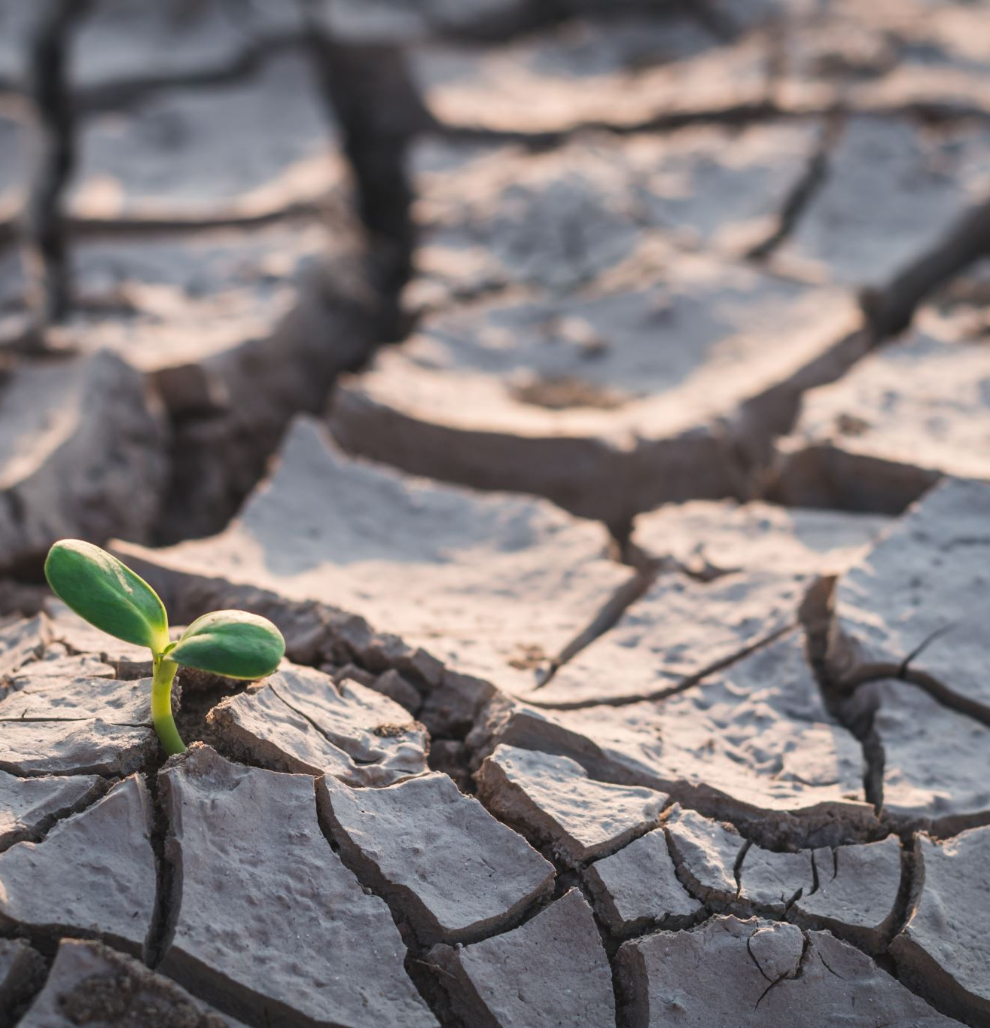
*Most soils are a mix of these three particles types .Loam is the name for soil that is a mix of clay , sand , and a slit .
Soil is important because it holds plants in place and contains nutrients and water they need to grow . It also gives many insects and animals a place to live .
Unfortunately , human activity can cause soil erosion . This is when soil is blown away by wind or washed away by water . Because soil forms very slowly , it is important that people help protect it from erosion .

Slide 5
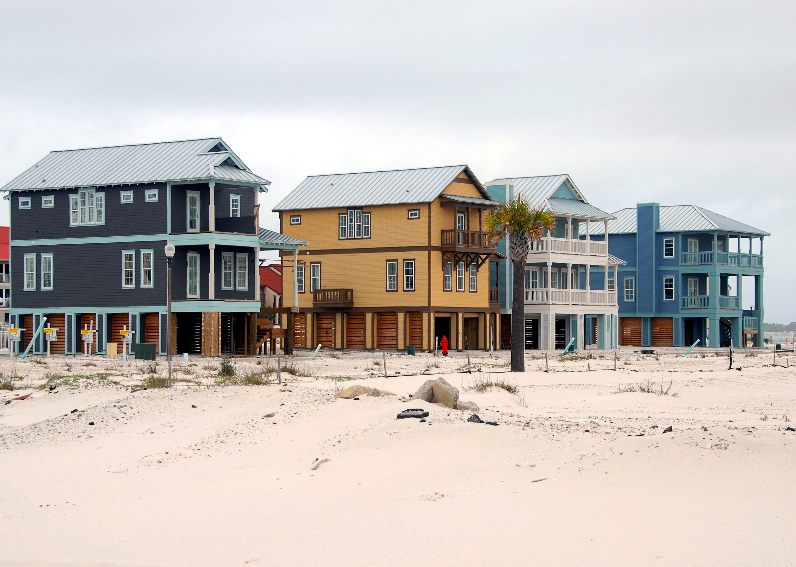
*Challenges of building on Different Soils : Different soils support different kinds of life on Earth . Each type of soil causes problems for people who want to build on it . For example , clay soil tends to hold a lot of water . The foundations , or bases , of buildings must allow water to drain away so that the clay does not become too wet . Clay soils are also likely to settle .

Slide 6
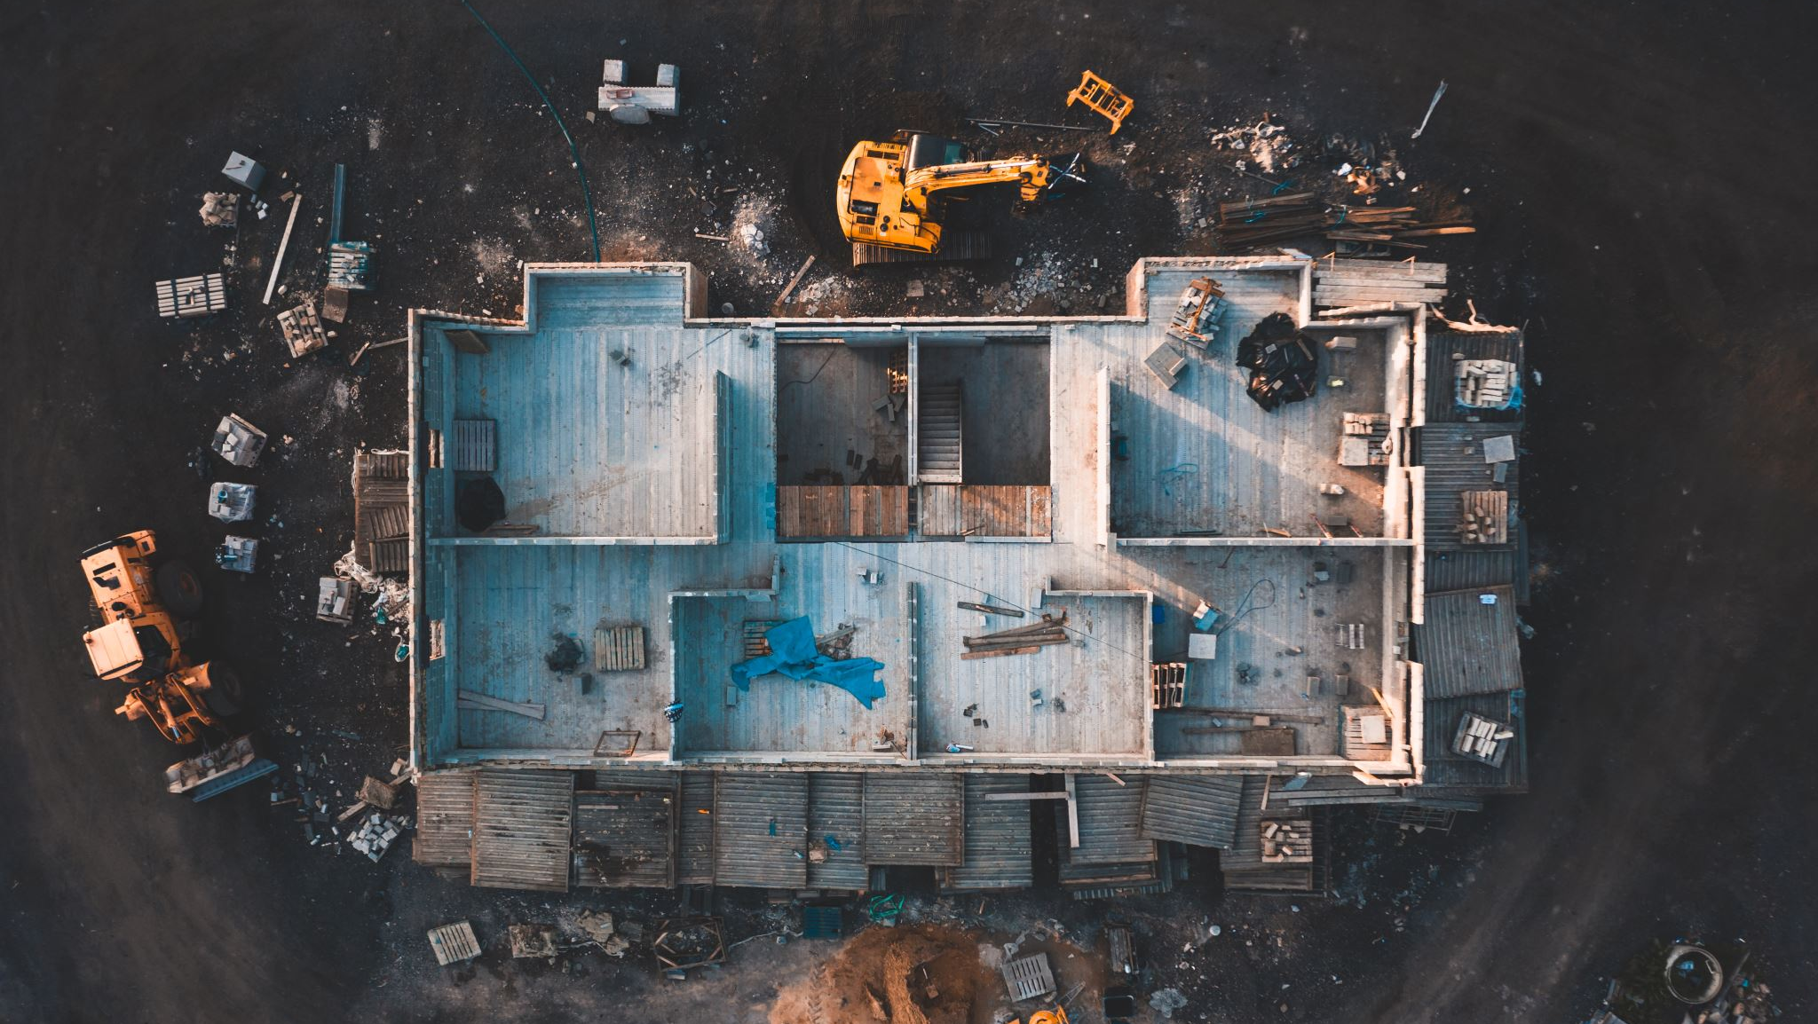
*This can cause buildings to sink over time , leading to shaky or unstable foundations . This weakens the structure of the buildings . Buildings on sand can face the same problems with foundation and structure .

Slide 7
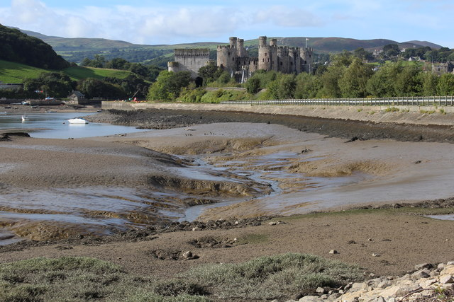
*Another soil type that can be difficult to build on is silt . Doing so can lead to landslides . Heavy rains or strong winds can lead to the shifting of this kind of soil , causing buildings to sink or fall . Frozen soil can cause problems too . When the water in the soil freezes , it expands , or gets bigger . The soil expands with it . This can damage the foundation .
This Photo by Unknown Author is licensed under CC BY-SA

Slide 8
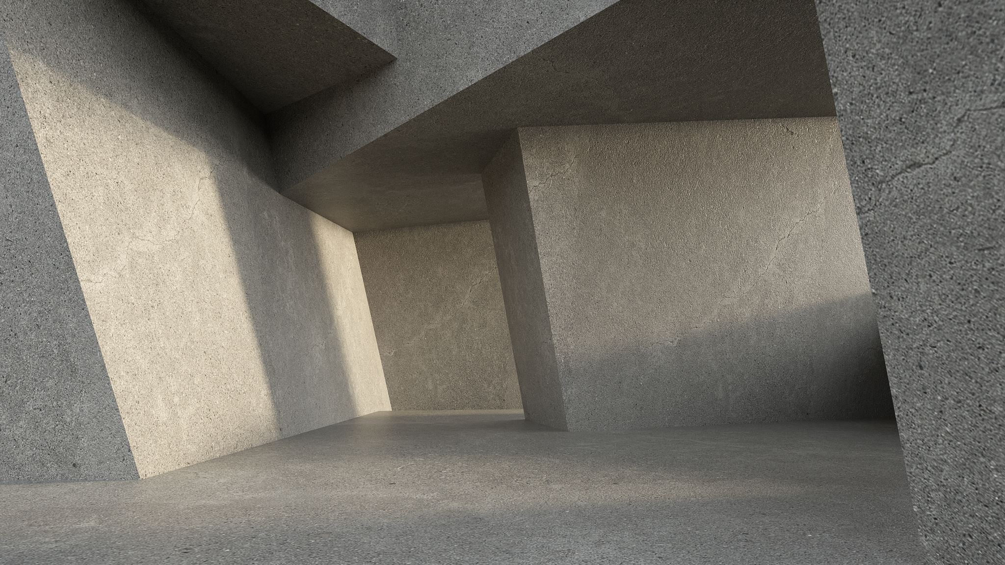
*Engineers, people who are trained in designing things to build , have figured out clever ways to solve many of these challenges . While the rest of this lesson will focus on how buildings methods have been adapted for a desert region , buildings everywhere are designed by engineers based on the soil they stand on .

Slide 9
*Designing for the Desert : One of the most difficult things about building on sand is the sand itself .
Because sand particles are much bigger compared to other types of soil particles , they are loose and move easily .
Thus , any building on sand will move too . To solve this problem , engineers have designed an anchor called a (helical pier) , which is a steel shaft , or bar , with spiral blades . It is driven deep beneath the sand , all the way to the bedrock , which is the rock underneath the sand . It is like a giant screw holding foundation of a building in place .

Slide 10
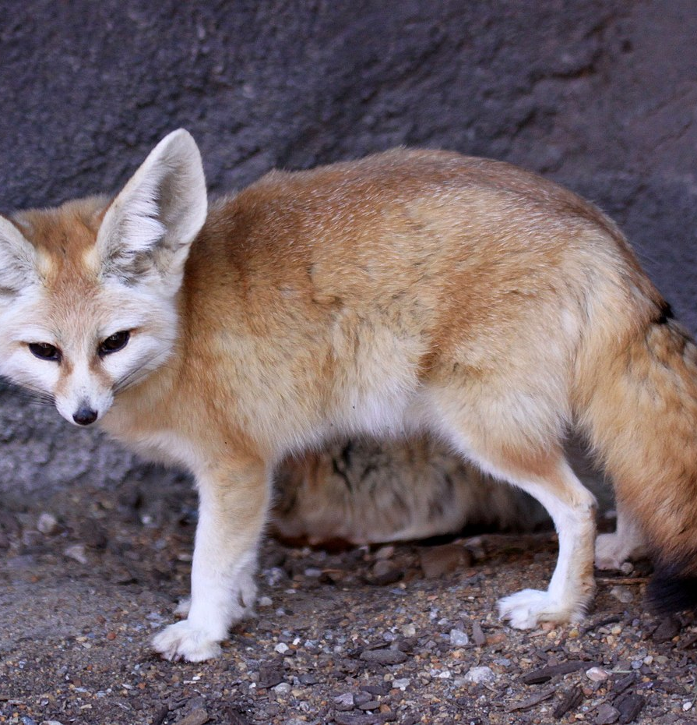
*The sandy soil is just one of the problems people face when trying to build in the desert. The desert’s extreme heat during the day and cold temperatures at night are other challenges .
It is important to create shade during the day and protection from cold at night . Building underground is an idea that people have borrowed from nature . Many desert animals , such as the fennec fox , tunnel into the sand to stay cool during the day and warm at night .
This Photo by Unknown Author is licensed under CC BY-SA

Slide 11
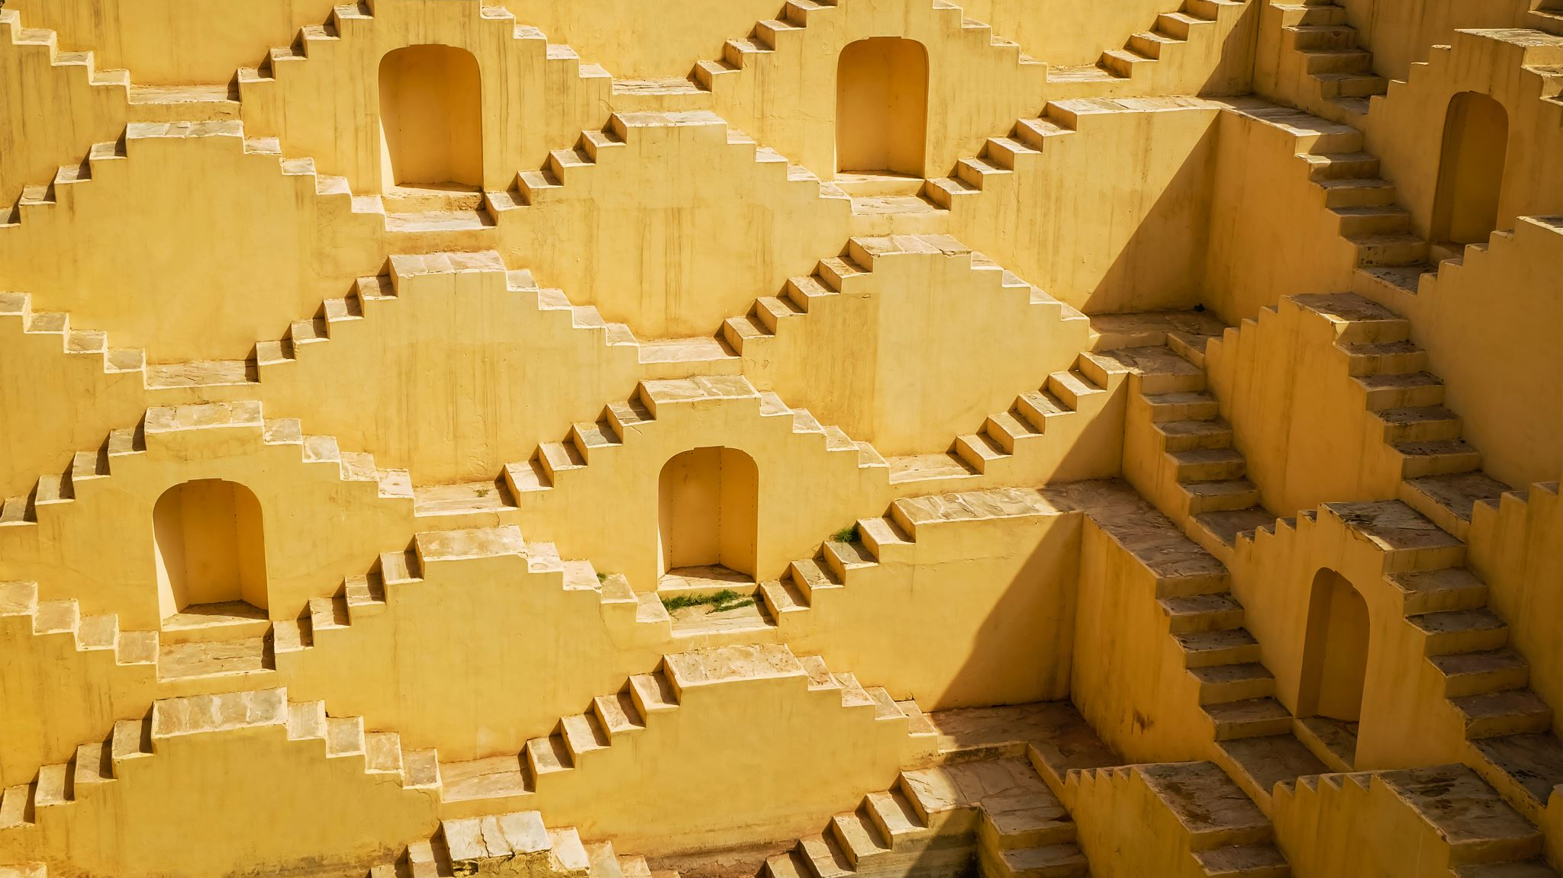
*Thick walls , courtyards with vegetation , and domes also protect buildings from extreme temperature . In the Middle East and North Africa (MENA ) region , people use a passive cooling technique called a malqaf .

Slide 12
*It is a small tower with an opening at the top .The wind blows down through the tower to cool the building below .In addition to the heat , strong sunlight can make building in the desert difficult .
Using reflective surfaces , light colors , and shades are all helpful in desert building design .
However , sunlight can also be put to good use , as it can be a reliable source of renewable energy .

Slide 13
*Critical thinking : What methods help with the effects of hot and cold temperature ?
Building underground
Thick walls
Domes
Malqaf
Reflective surfaces , and light colors .

Slide 14
Q2: What is a malqaf ? a cooling technique that uses a tower on top of a roof .
Q3: Where did people get the idea to build underground ? From animals .
Q4 : How does a helical pier help engineers build on sand ? A shaft driven into the bedrock below the sand provides stability .

