Slide 1
PART 3 WORKING WITH LISTS AND FOR LOOP
Playlist link in description
WANT TO LEARN PYTHON PROGRAMMING? (SUBTITLES)
SUBSCRIBE
TELEGRAM – FreeCodeSchool
Twitter – shivammitra4
LinkedIn – shivammitra
Link in description

Slide 2
AGENDA
FOR LOOP IN PYTHON
INDENTATION IN PYTHON
LIST COMPREHENSIONS
SLICING A LIST
COPYING A LIST

Slide 3
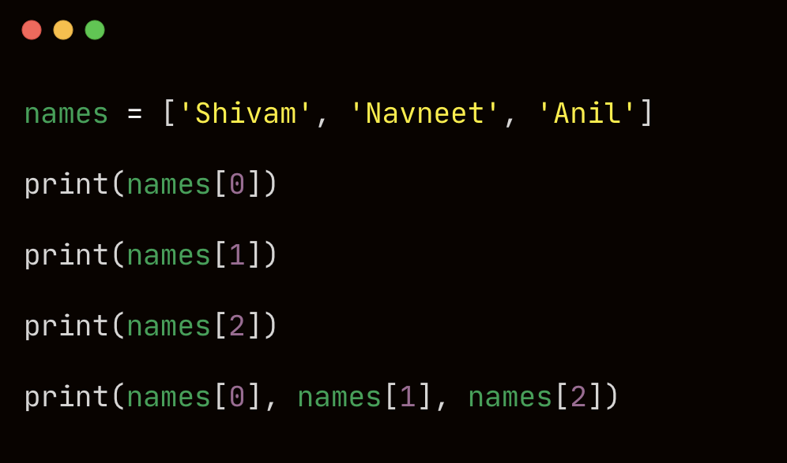
PRINT EACH NAME IN THE LIST

Slide 4
ISSUES WITH THIS APPROACH
Repetitive code
Need to change the code if the list size changes

Slide 5
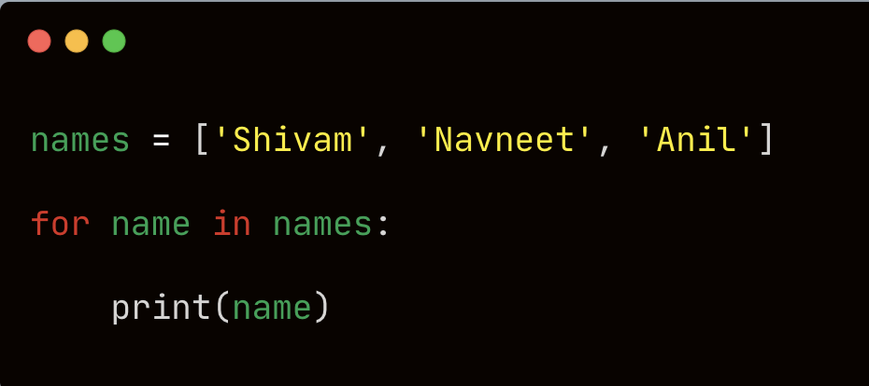
FOR LOOP FOR PRINTING THE LIST

Slide 6
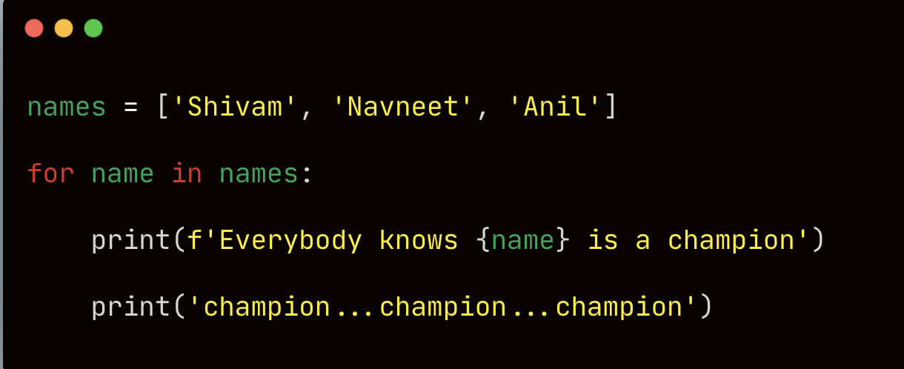

Slide 7
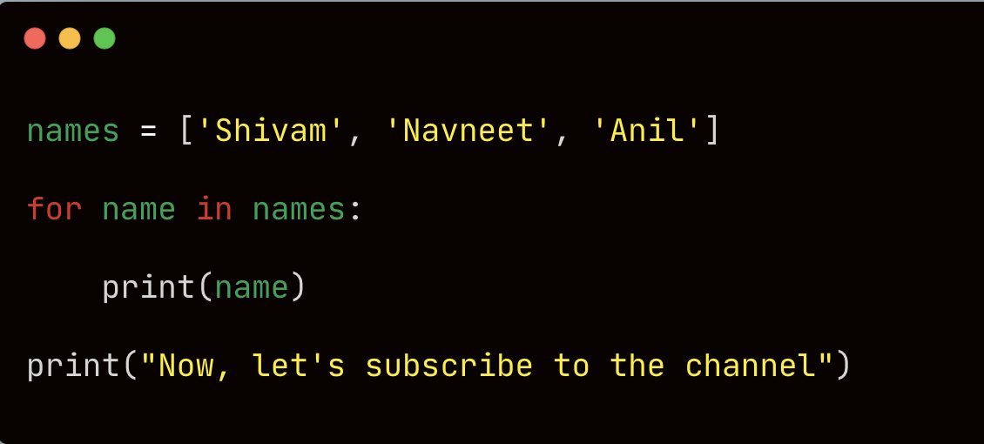

Slide 8
EXPLAINING HOW FOR LOOP WORKED

Slide 9
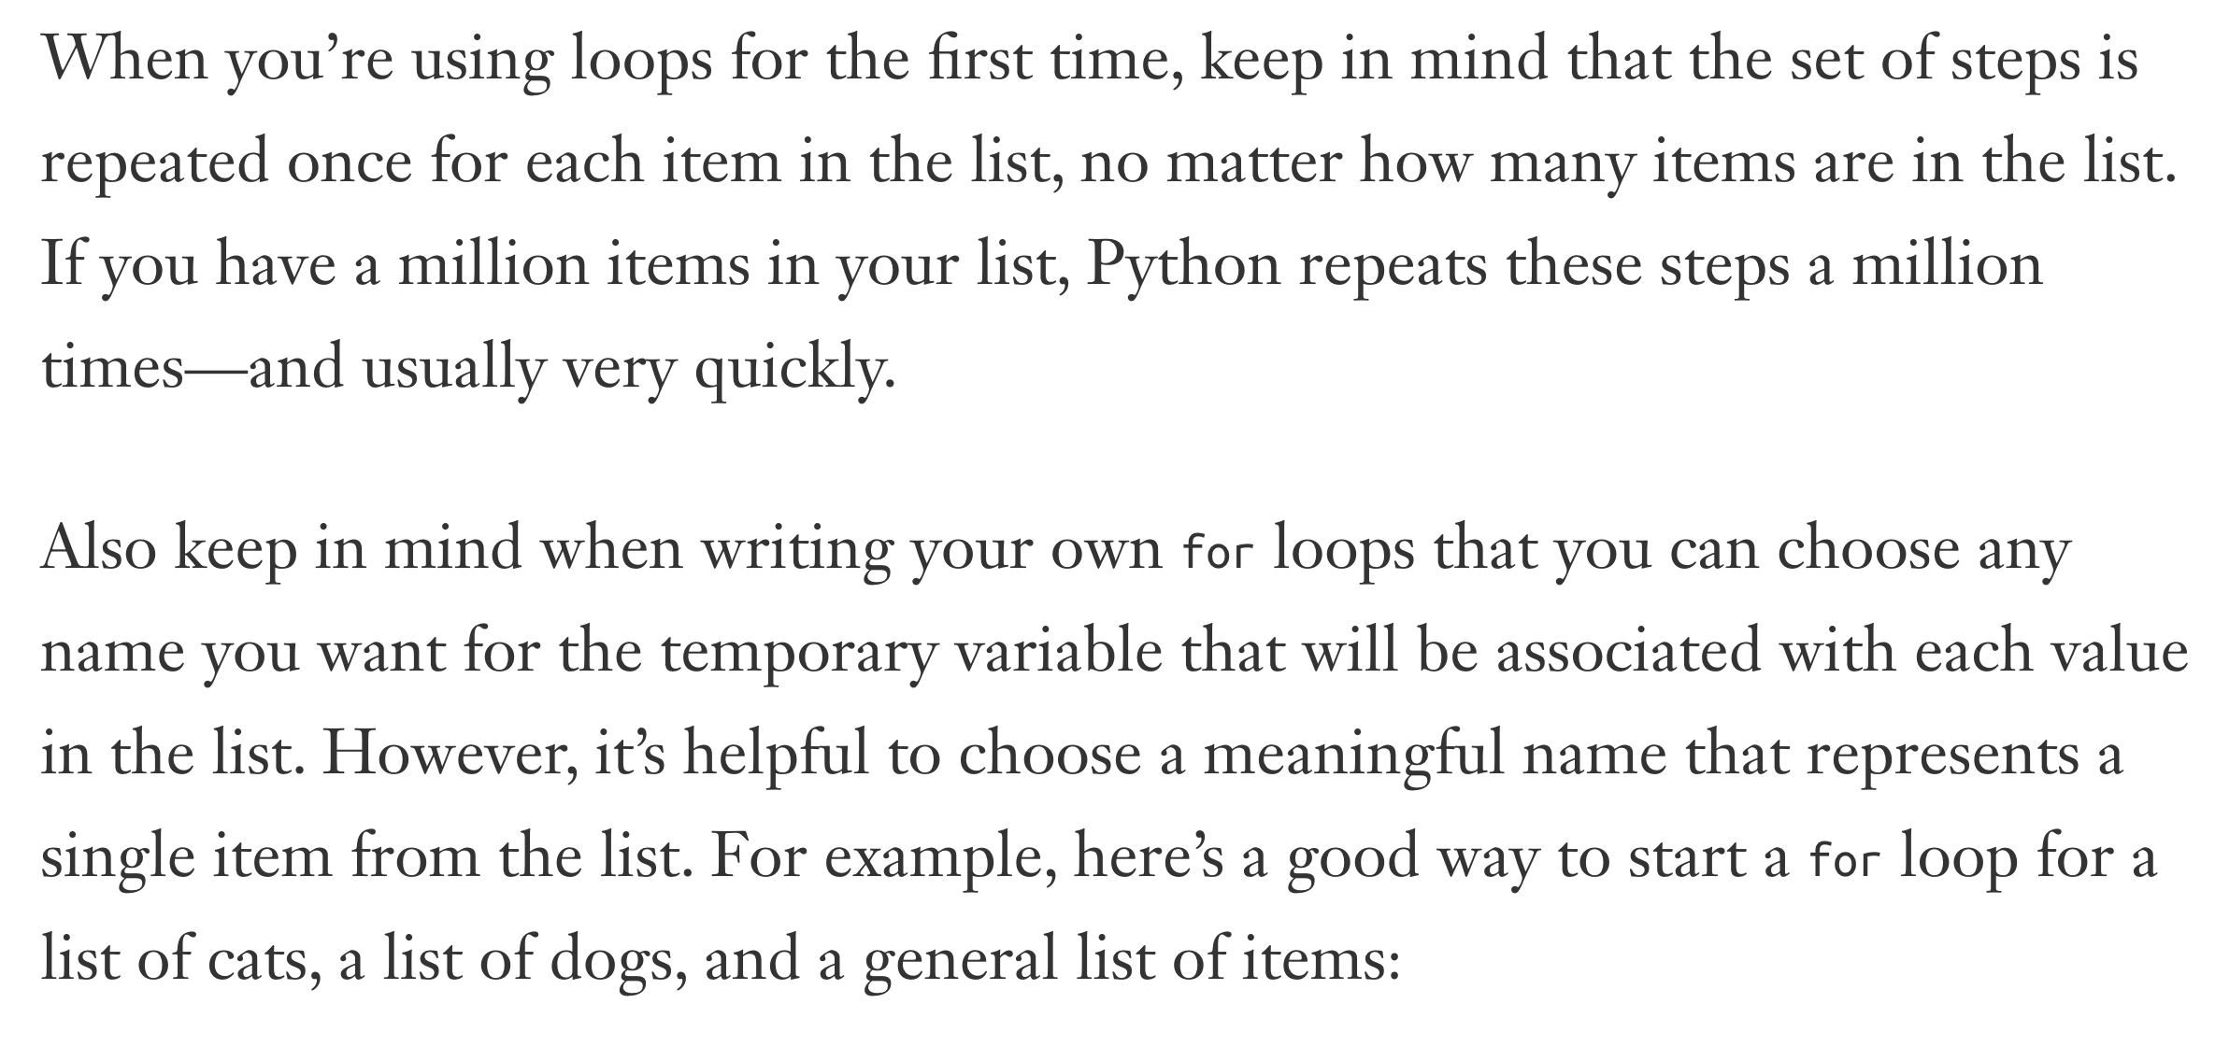

Slide 10
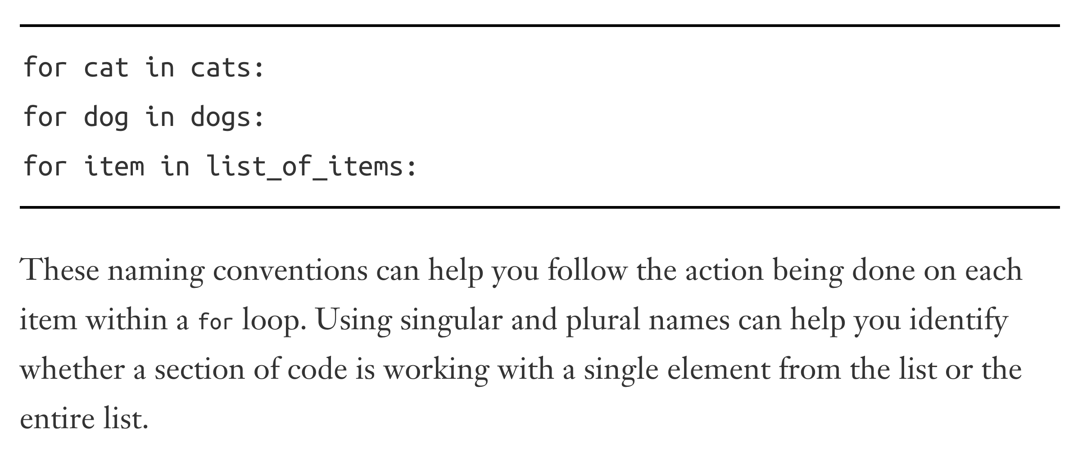

Slide 11
AVOIDING INDENTATION ERRORS

Slide 12
WHAT IS INDENTATION
Indentation is used to make code more readability easier
In languages like c, c++, python etc. , indentation is optional
In Python, it is mandatory
Python uses indentation to determine how a line, or group of lines, is related to the rest of the program.
Change indentation and the meaning of code changes

Slide 13
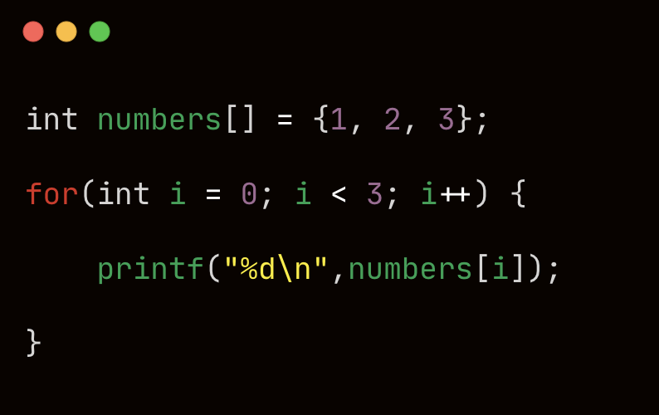
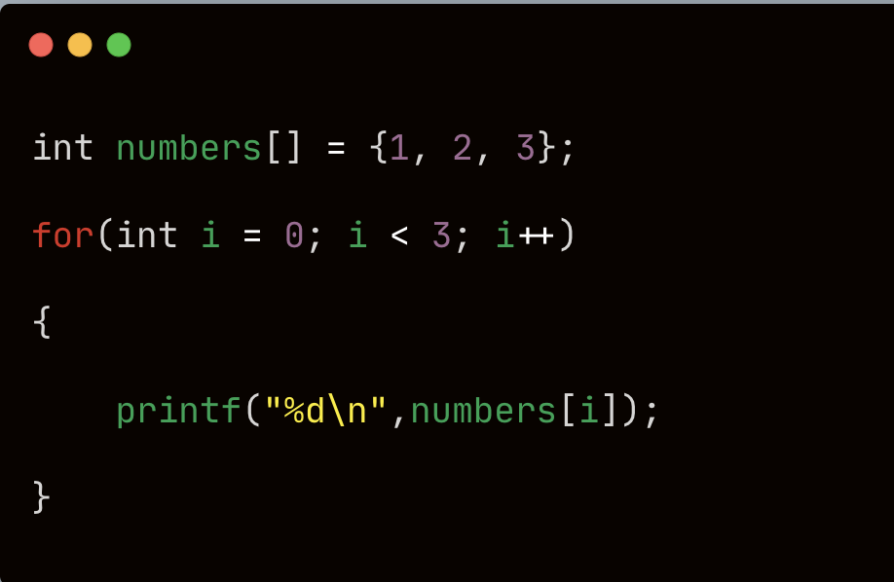

Slide 14
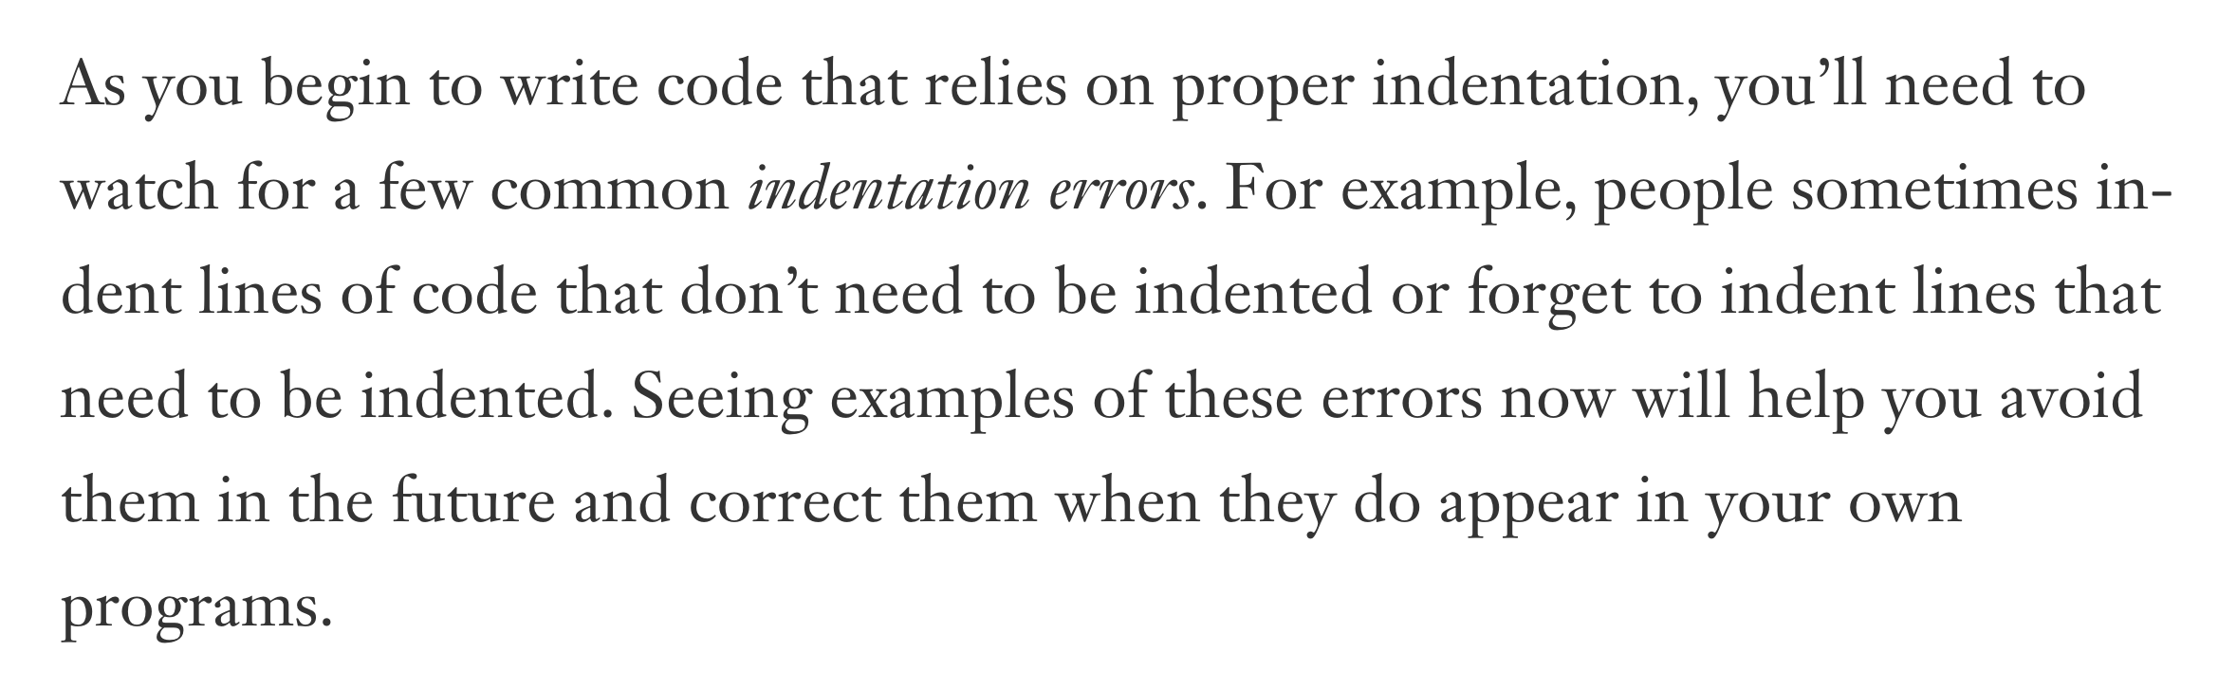

Slide 15
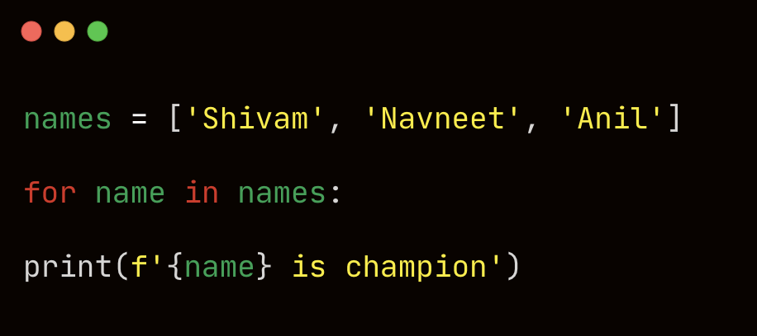
INDENTATION ERROR

Slide 16
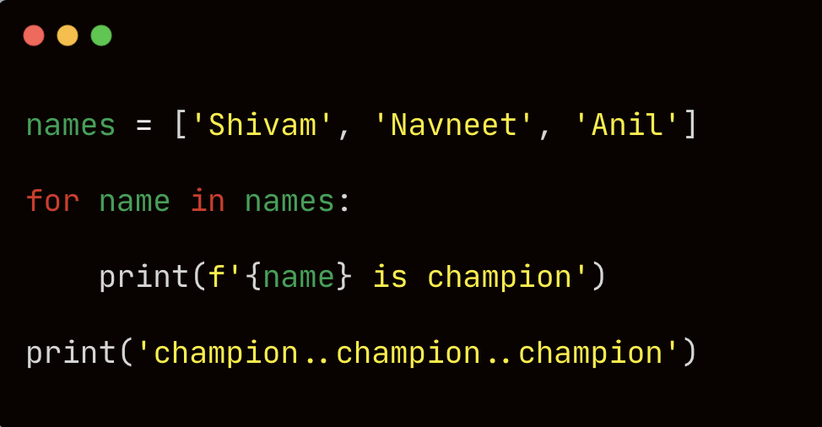
LOGICAL ERROR

Slide 17
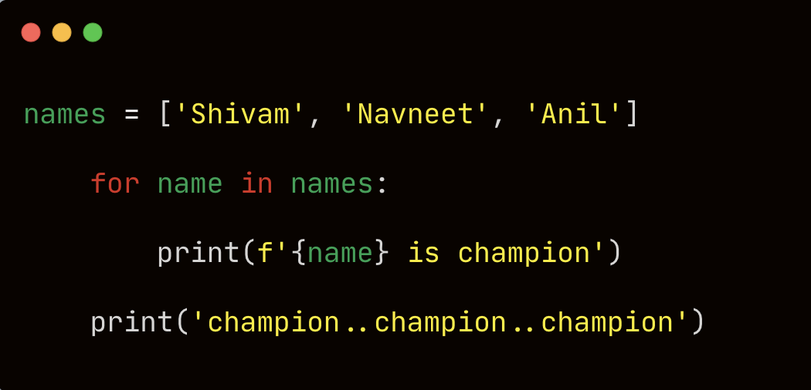
INDENTING UNNECESSARILY

Slide 18
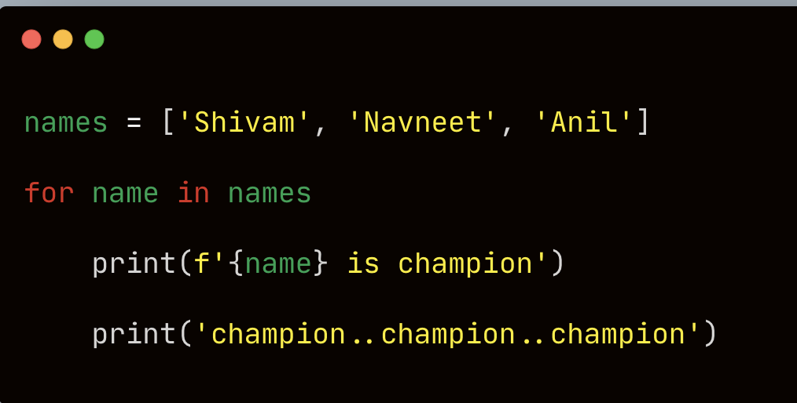
FORGETTING THE COLON ( so tough to find ☹)

Slide 19
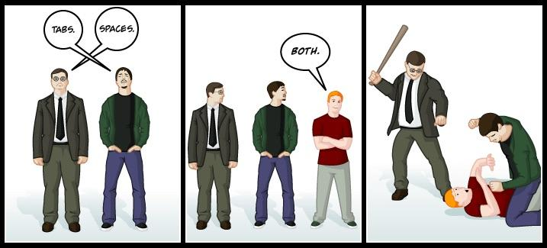
TABS VS SPACES FOR INDENTATION

Slide 20
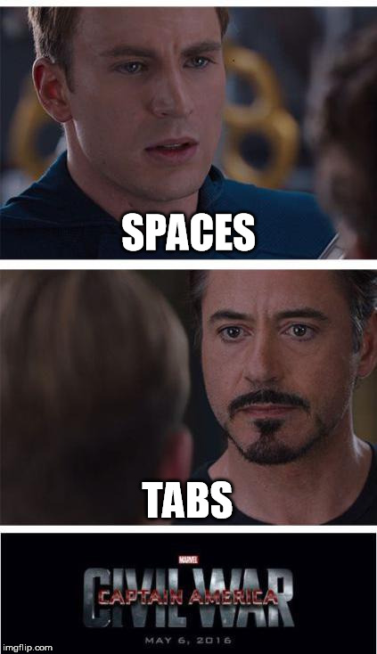

Slide 21
WHAT’S THE ACTUAL ISSUE ?

Slide 22
USING SPACES VS TABS
Spaces - consistent on every text editor
Tabs – not consistent on every text editor
Can be 4 spaces
Can be 8 spaces
Mixing tabs and spaces causes error
I prefer using 4 spaces for indentation
Do not type spaces 4 times

Slide 23
MAKING NUMERICAL LISTS

Slide 24
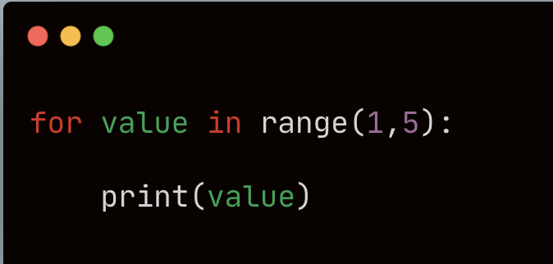
RANGE FUNCTION
Start to (end-1)
Print 1 to 6
Similar to other programming languages

Slide 25
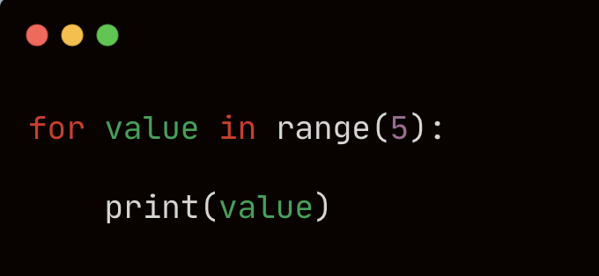

Slide 26
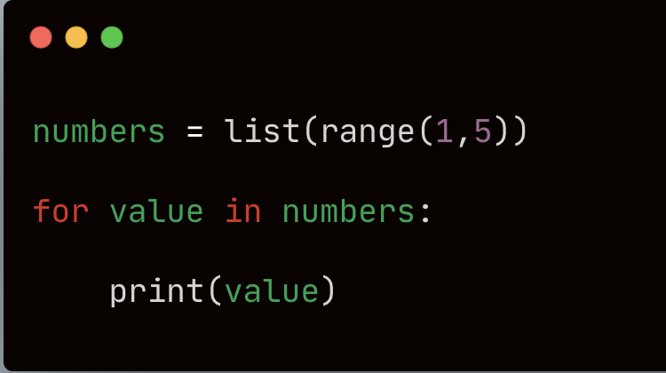
USING RANGE TO STORE A LIST OF NUMBERS

Slide 27
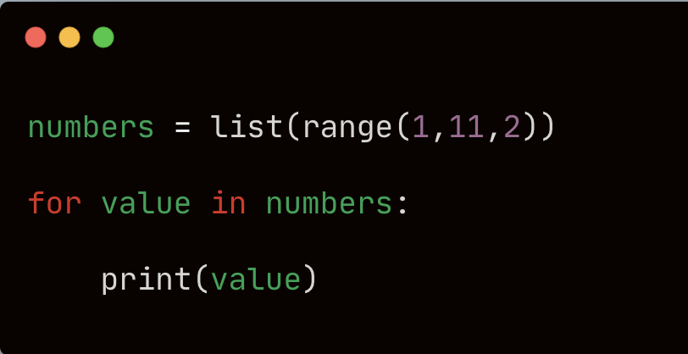
SKIPPING NUMBERS WITHIN A RANGE

Slide 28
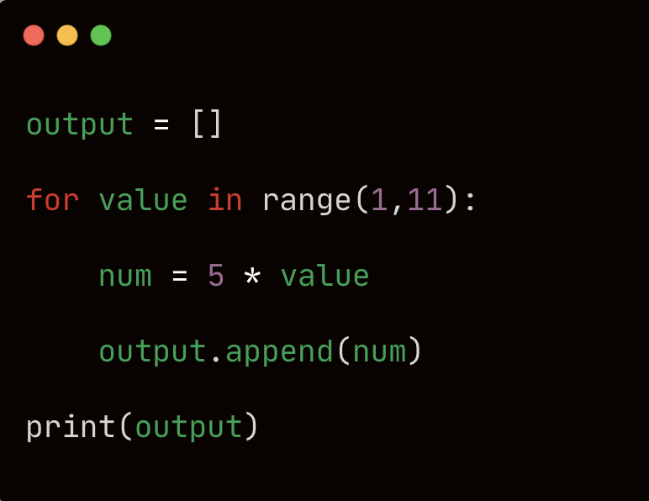
PRINT MULTIPLICATION TABLE OF 5
Output – [5, 10, 15, ……….., 50]

Slide 29
SIMPLE STATISTICS WITH A LIST OF NUMBERS
Maximum of a list
Minimum of a list
Sum of a list

Slide 30
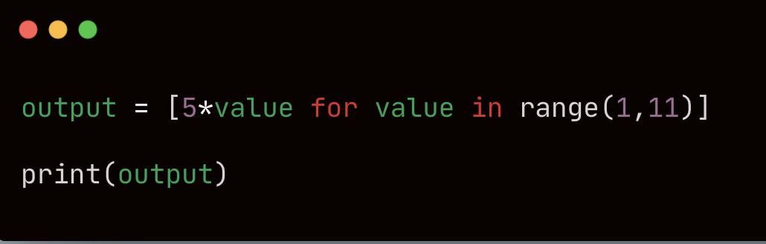
LIST COMPREHENSIONS
A list comprehension combines the for loop and the creation of new elements into one line, and automatically appends each new element.
Multiplication table in one line
Not for beginner but you will see this in others code

Slide 31
WORKING WITH A PART OF A LIST
Can we access multiple list elements at one go ?
Welcome to slice in python
Slice of pizza ?
Not present in all programming languages

Slide 32
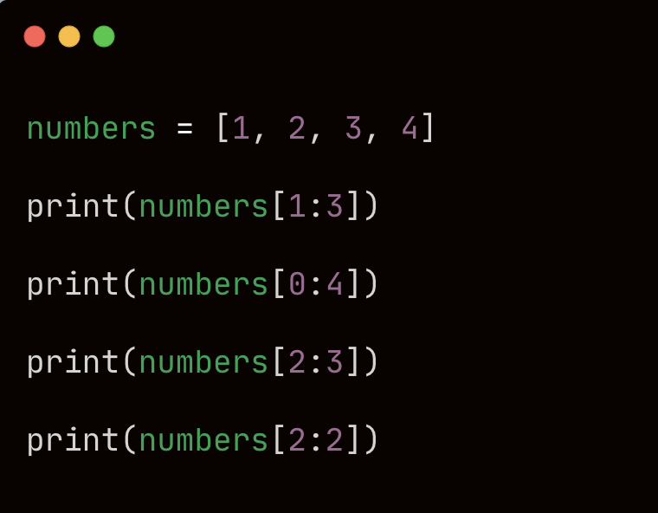
SLICING A LIST
To make a slice, you specify the index of the first and last elements you want to work with.
Like range, the last element is not considered
List can also be of strings or any data type

Slide 33
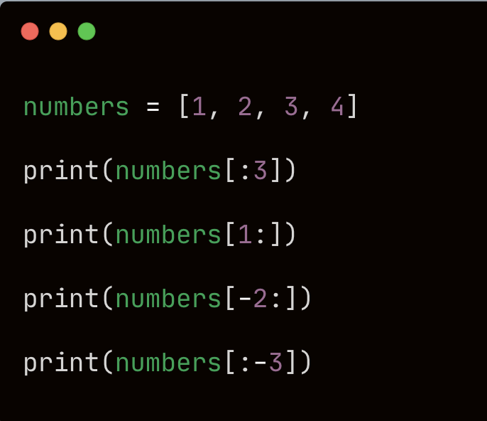

Slide 34
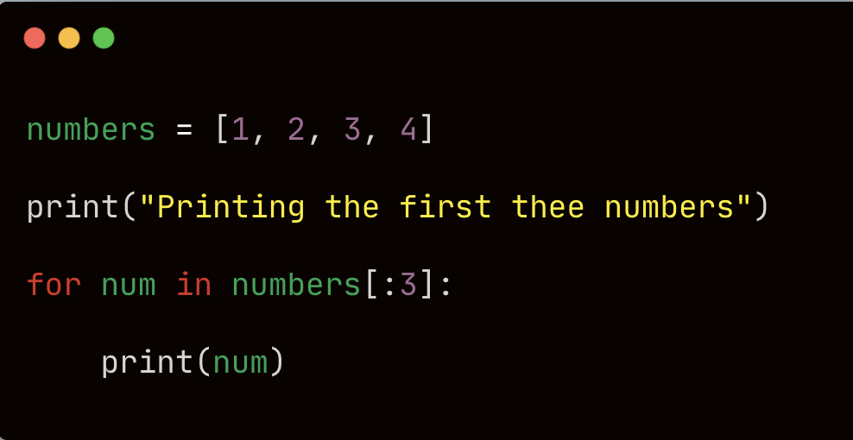
LOOPING THROUGH A SLICE

Slide 35
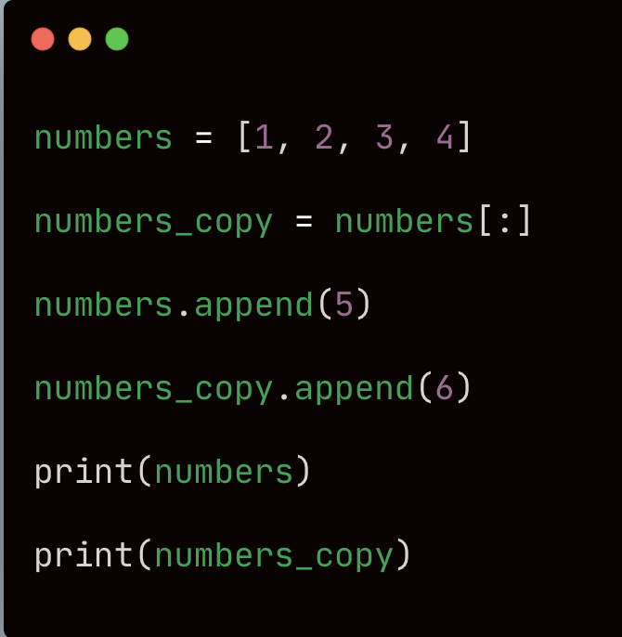
COPYING A LIST

Slide 36
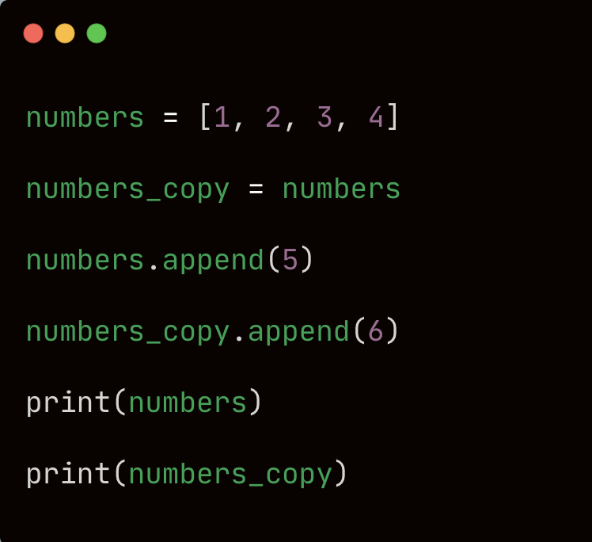

Slide 37
ASSIGNMENT
Print square of numbers from 1 to 10 using for loop
Store it a list first and then print
One liner code
fruits = [‘banana’, ‘apple’, ‘watermelon’, ‘orange’]
Print first 2 fruits ( using slicing )
Print last 2 fruits (suing slicing )
Print fruits at odd positions ( using for loop )
Print fruits at even positions (using for loop )
Paste your code in the comment

Slide 38
IF ELSE STATEMENTS IN PYTHON

