Slide 1
PART 1
VARIABLES AND DATA TYPES IN PYTHON
WANT TO LEARN PYTHON PROGRAMMING? (SUBTITLES)
SUBSCRIBE
TELEGRAM – FreeCodeSchool
Twitter – shivammitra4
LinkedIn – shivammitra
Link in description
PART 0 – Installing python and syllabus
Playlist link in description

Slide 2
CONTENT
What are variables ?
String data type
Numerical data type
Examples

Slide 3
VARIABLES IN MATHS
A symbol used to represent a numerical value which can change
2x = y + 1 ( Algebra )
  x = 1, y = 1
  x = 2, y = 3
Ten years from now, Rohit will be three times older than he is today. What is his current age?

Slide 4
WHAT ARE VARIABLES
Variables are used to store data
These data are stored in main memory when you run the program
Programming = data + logic
Different data types in python
  Numbers
  Strings
  Lists
  Tuple
  Dictionary

Slide 5
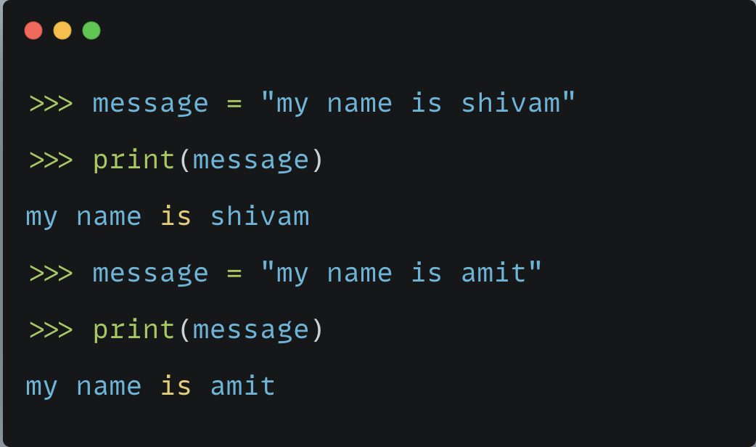
A SIMPLE EXAMPLE
What is print() here ?
What does it do ?

Slide 6
WHAT ARE FUNCTIONS IN MATHS ?
Takes inputs and gives an output depending on the input
f(x) = x^2
  f(1) = 1
  f(2) = 4
Programming functions also do the same.
Takes input and returns output ( not always )
Many built-in functions are present in python
print() is one example – prints the input on screen
More about functions in a separate video

Slide 7
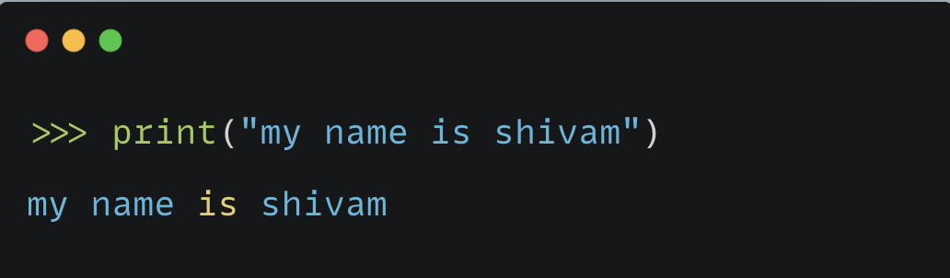
WHY SHOULD I USE VARIABLES ?

Slide 8
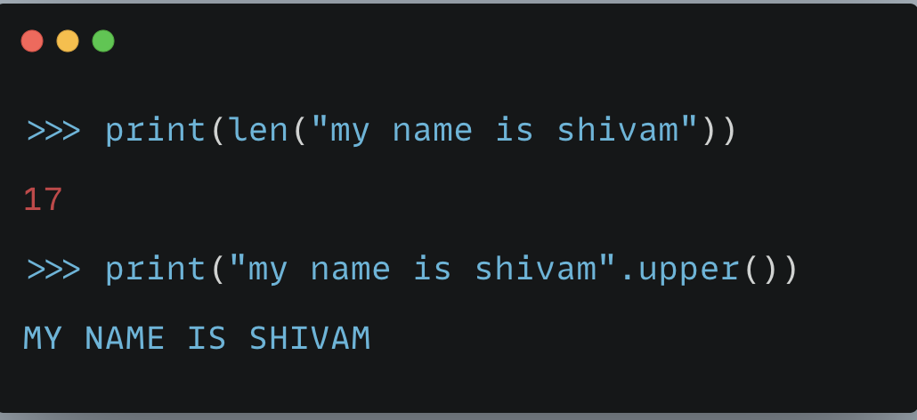
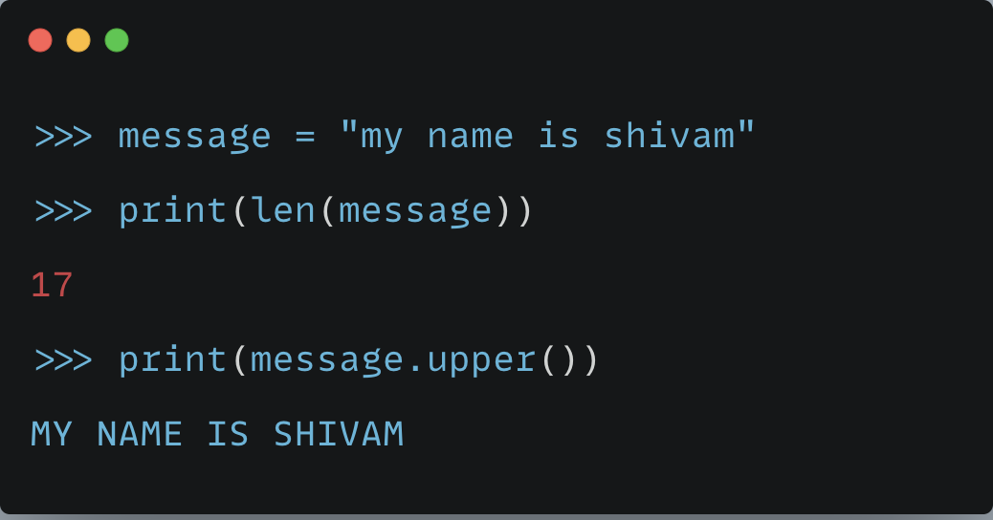
Using variables makes programs simpler
Reduces repeated work

Slide 9
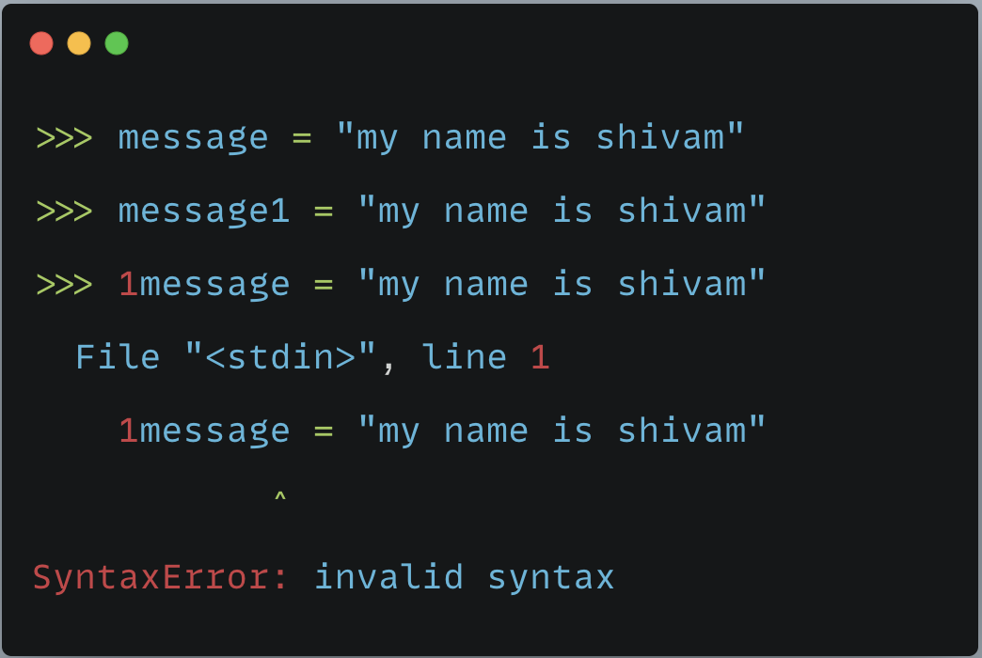
Naming Variables
Can you give any name to the variables ?
What are errors ?

Slide 10
WHAT ARE ERRORS IN PYTHON ?
My name is Shivam vs Is name Shivam my ?
My nam is Shivam vs My name is Shivam ?
My name are Shivam vs My name is Shivam ?
Every language has a syntax or a set of rules to follow while writing it
Python also has a syntax
If you do not follow it, you will get errors.
More about ”errors in python” in a separate video

Slide 11
RULES FOR NAMING VARIABLES

Slide 12
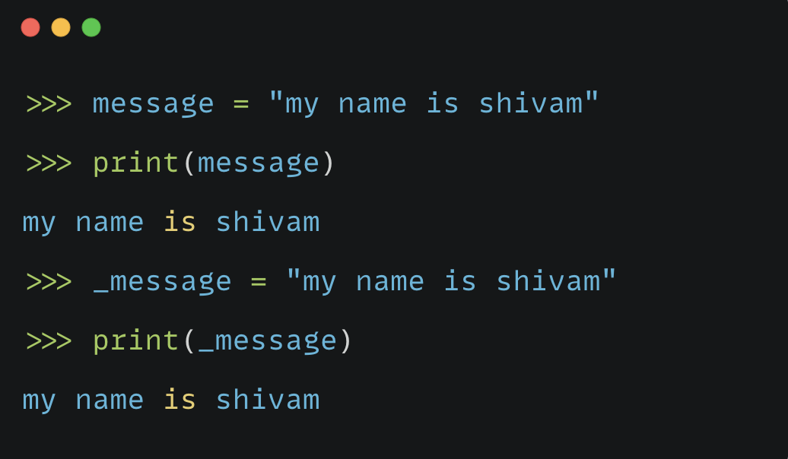
RULE 1 - Variable names can contain only letters, numbers, and underscores. They can start with a letter or an underscore, but not with a number.

Slide 13
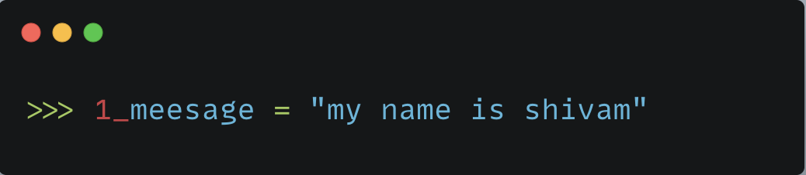
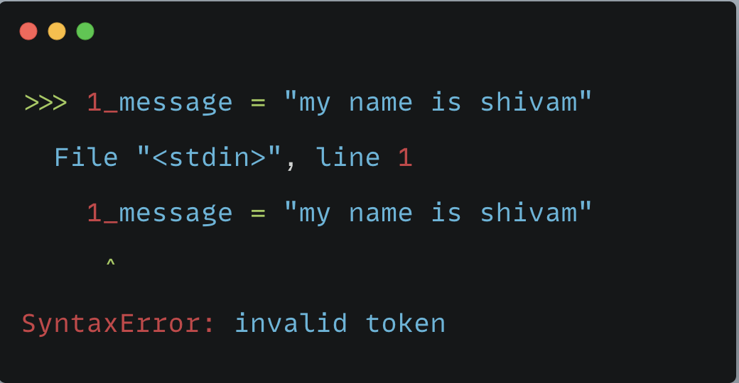
SUPPOSE YOU WANT TO WRITE TWO DIFFERENT MESSAGES ?

Slide 14
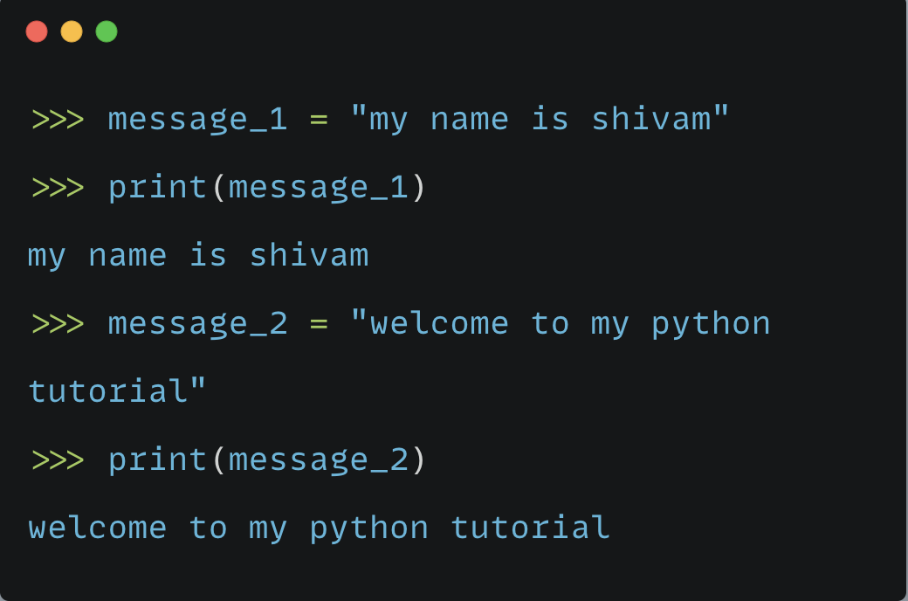

Slide 15
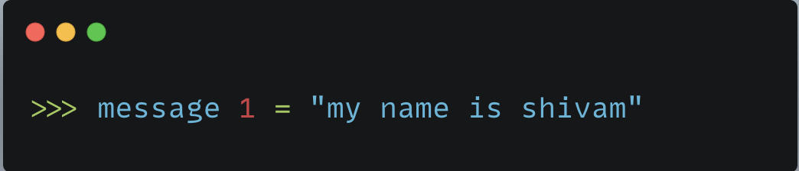
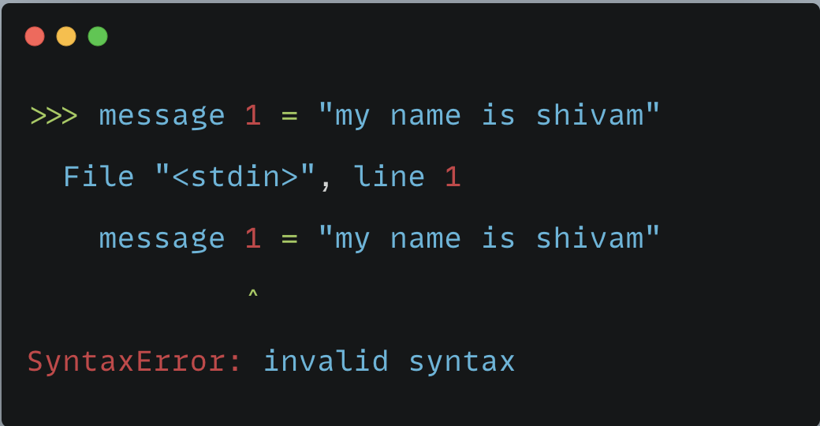
RULE 2 - Spaces are not allowed in variable names, but underscores can be used to separate words in variable names.

Slide 16
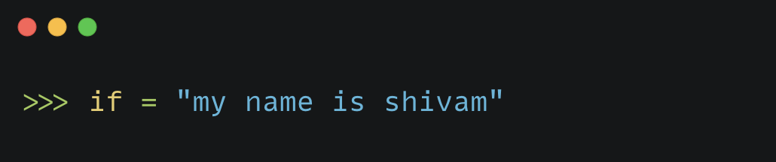
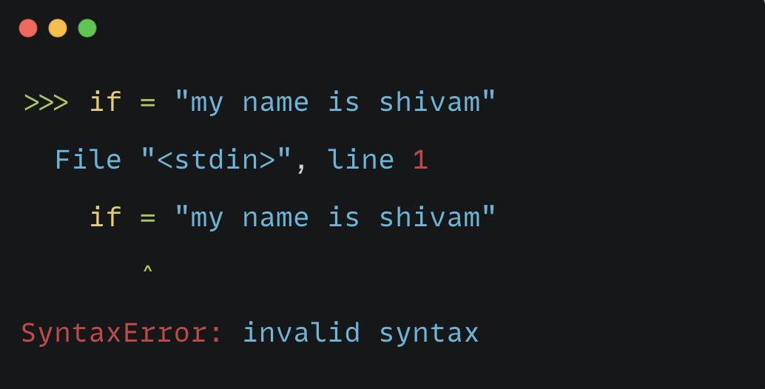
RULE 3 - Avoid using Python keywords and function names as variable names; that is, do not use words that Python has reserved for a particular programmatic purpose, such as the word print.

Slide 17
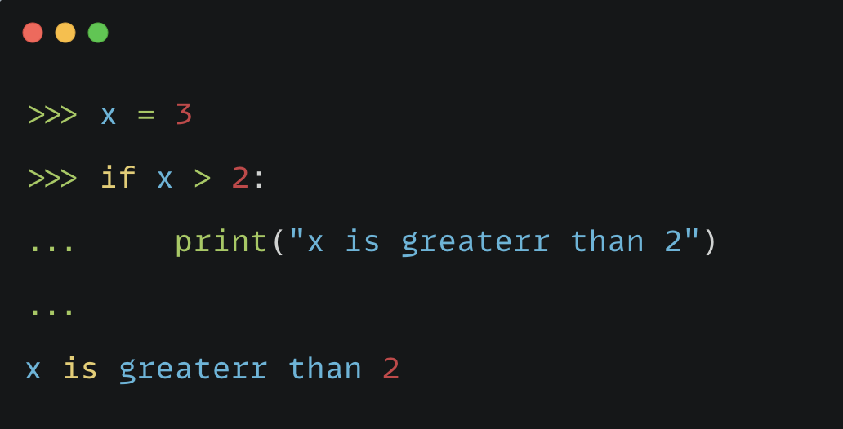
WHAT ARE KEYWORDS IN PYTHON?
These are reserved words in python which are used to define the syntax of python language.
In English, “is”, “the”, “you” etc. are reserved words which defines the grammar.
Keywords have different meaning for Python language.
Do not use them in your variables or function names.

Slide 18
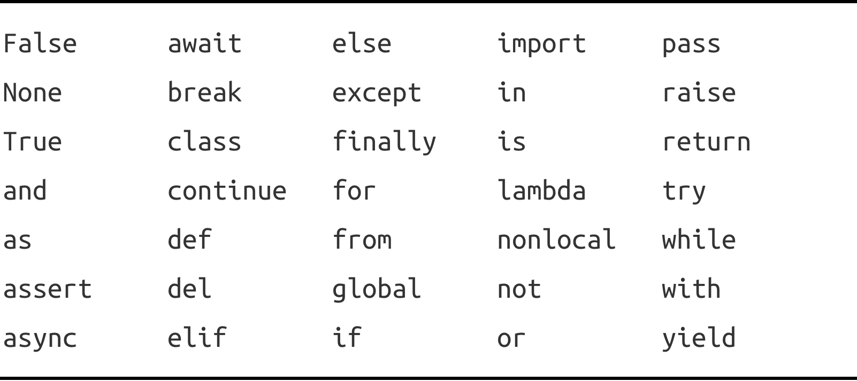
LIST OF KEYWORDS IN PYTHON

Slide 19
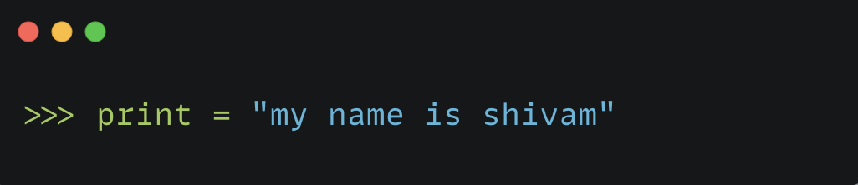
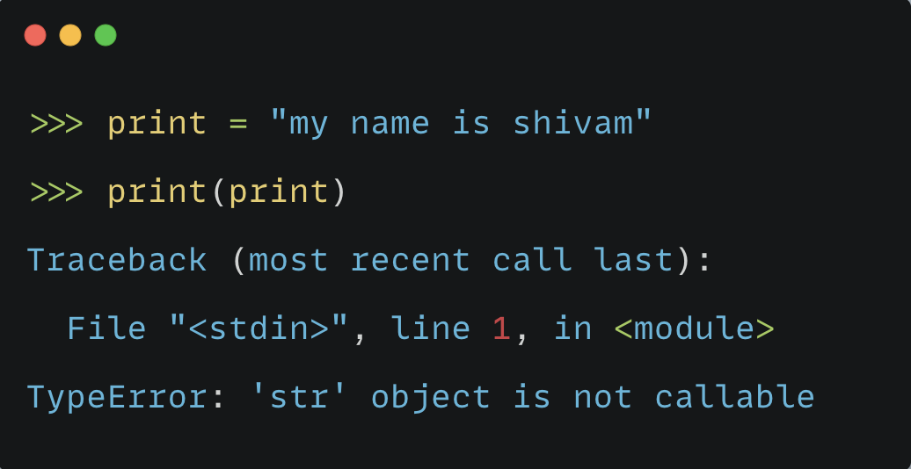

Slide 20
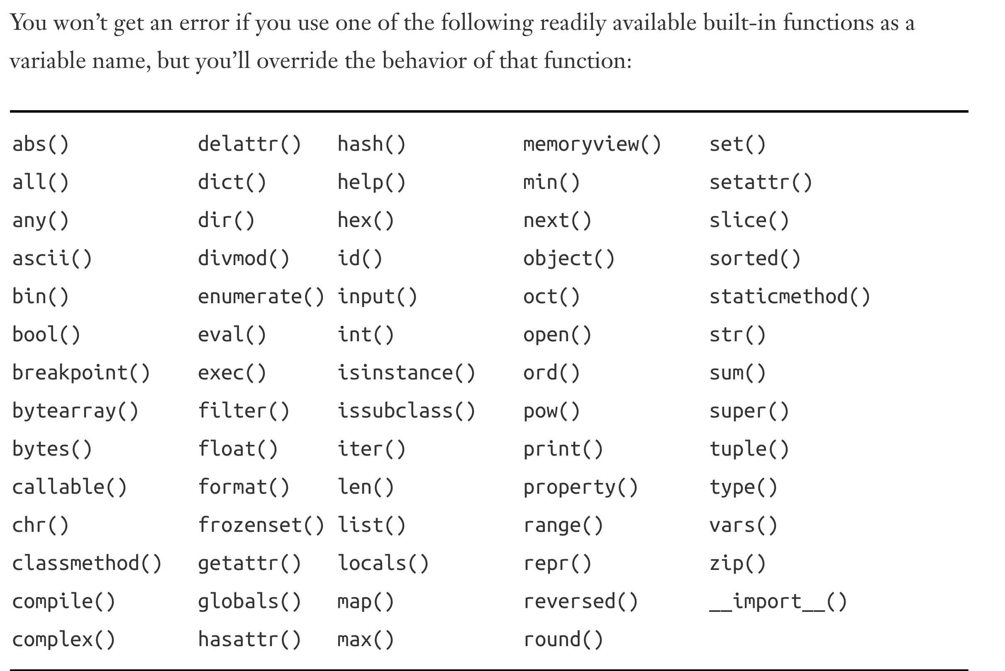
BUILT-IN FUNCTIONS IN PYTHON

Slide 21
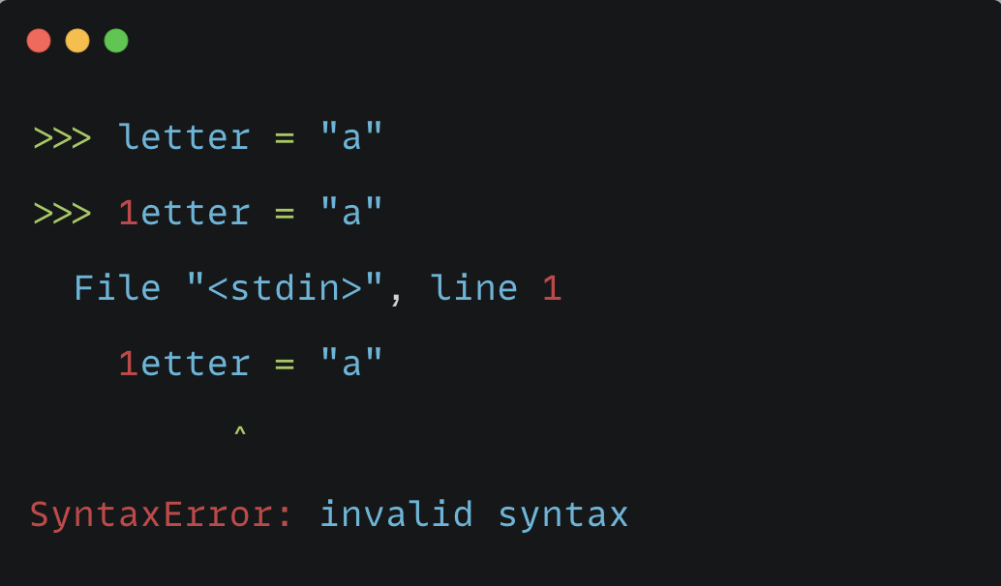
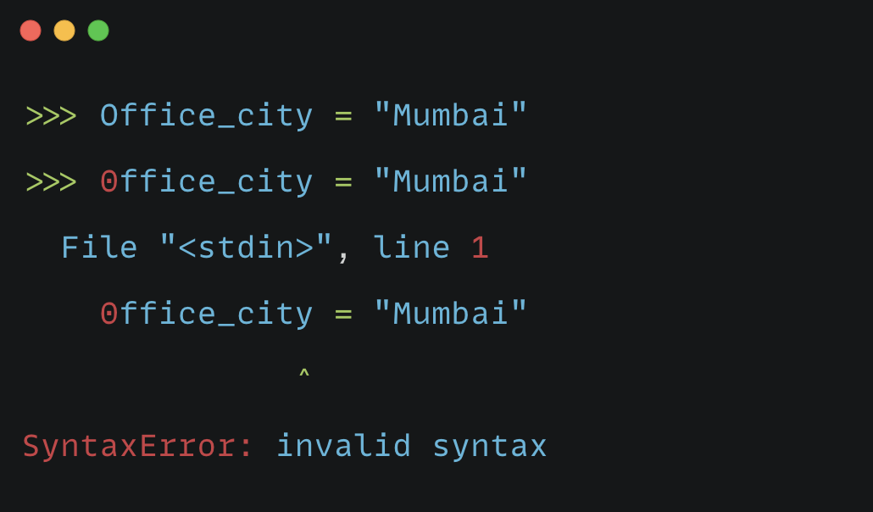
SOME OTHER IMPORTANT POINTS TO NOTE
Variable names should be short but descriptive.
  name is better than writing n
  message is better than writing m or my_name_message
Be careful when using the lowercase letter l and the uppercase letter O because they could be confused with the numbers 1 and 0.

Slide 22
It can take some practice to learn how to create good variable names, especially as your programs become more interesting and complicated. As you write more programs and start to read through other people’s code, you’ll get better at coming up with meaningful names.

Slide 23
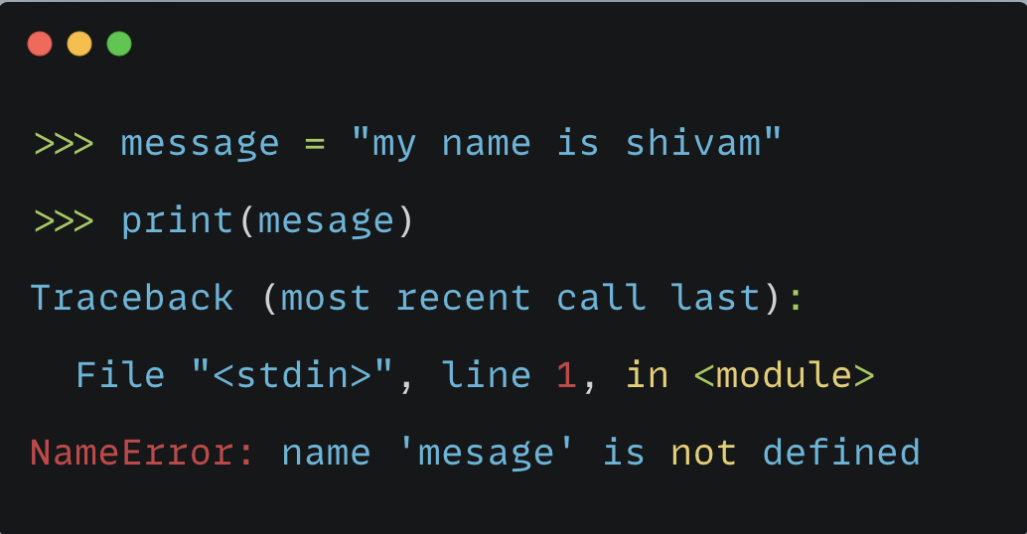
AVOIDING NAME ERRORS WHEN USING VARIABLES

Slide 24
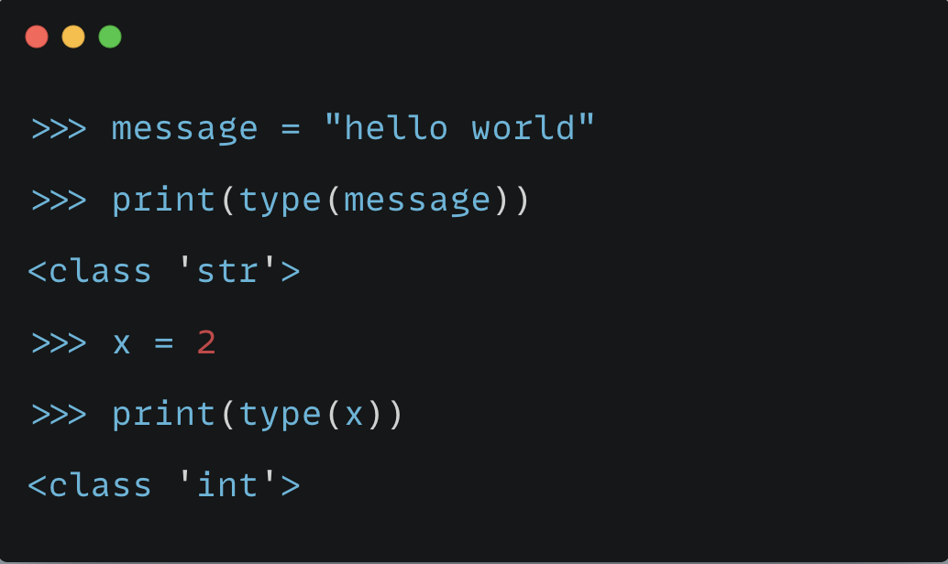
FINDING THE DATA TYPE OF A VARIABLE
Use type() built-in function

Slide 25
STRINGS DATA TYPE

Slide 26
WHAT ARE STRINGS ?
A string is a series of characters
Characters – alphabets, digits, special characters, white spaces
Anything inside quotes is considered a string in Python
You can use single or double quotes around your strings

Slide 27
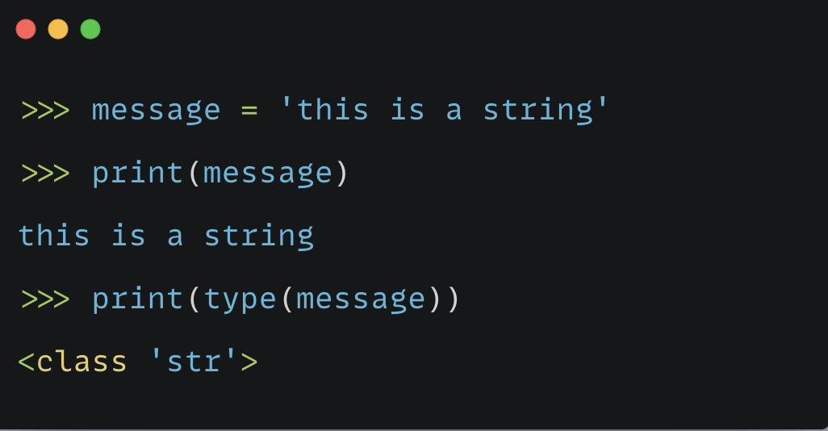
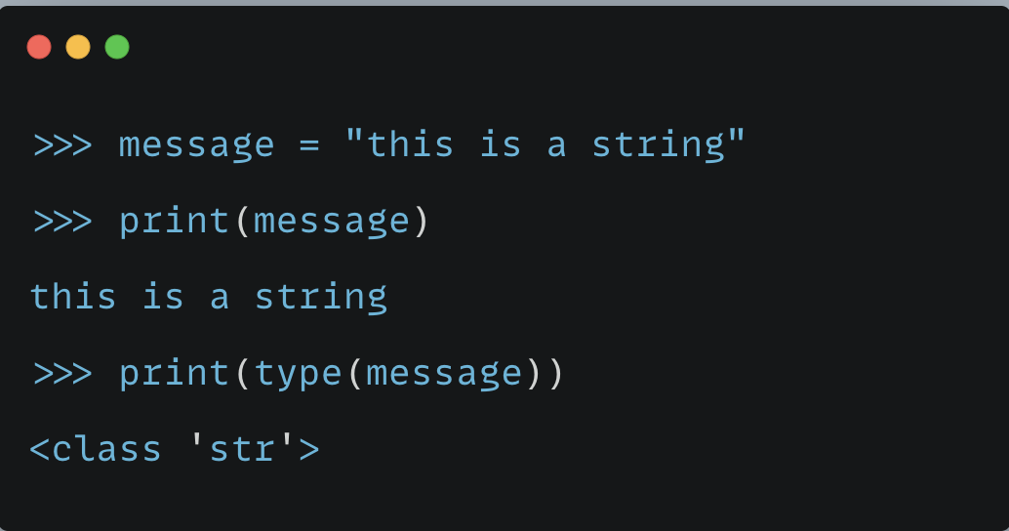

Slide 28
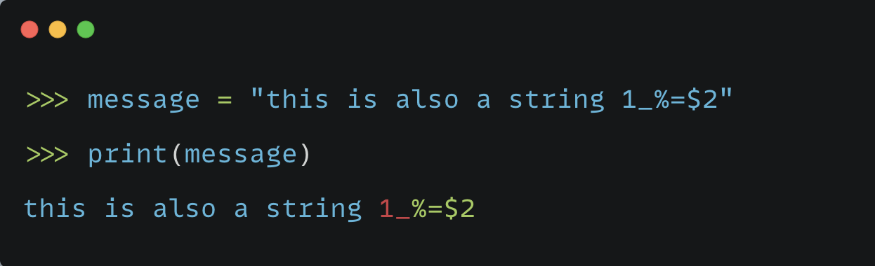

Slide 29
SINGLE QUOTE VS DOUBLE QUOTE ?
You can use any of these
Be consistent
Exceptions – print these text on screen:
  The language 'Python' is named after Monty Python, not the snake.
  I told my friend, "Python is my favorite language!"

Slide 30
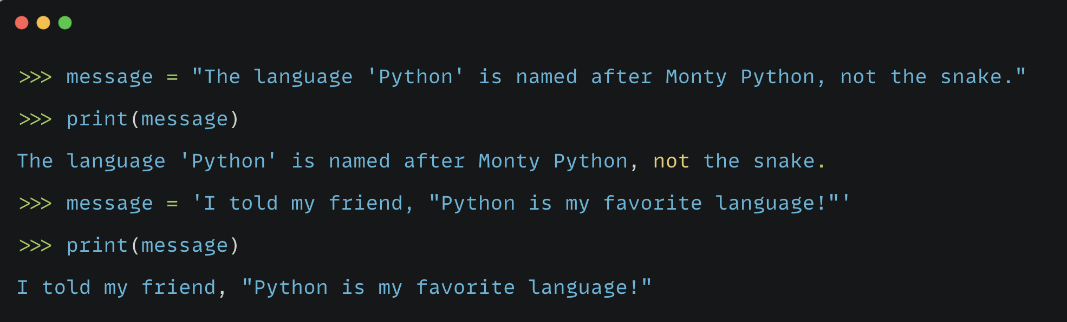
ASSIGNMENT: Try to find out if it is possible to print first message by using single quotes and second by using double quotes
and how ?

Slide 31
BUILT-IN FUNCTIONS ASSOCIATED WITH STRINGS

Slide 32
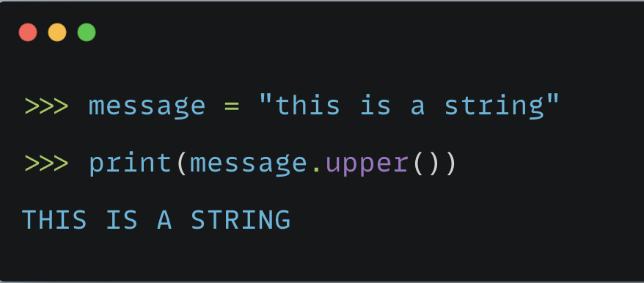
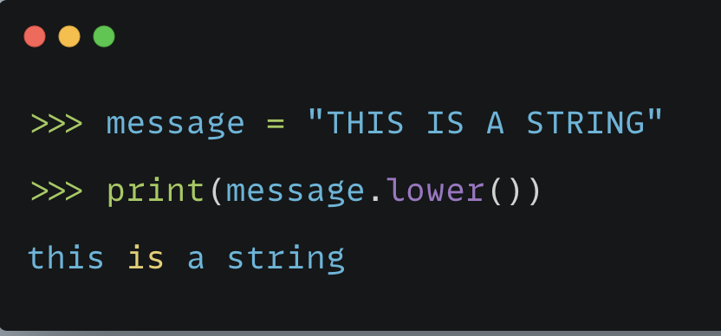
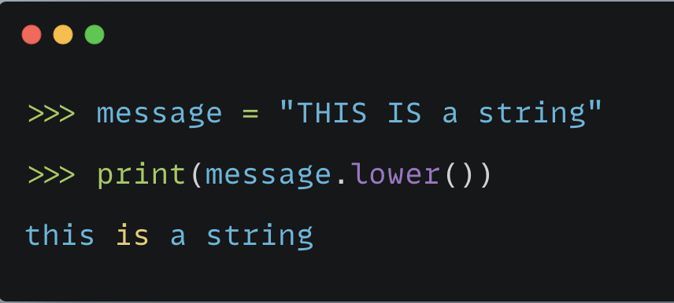
UPPER/LOWER FUNCTION

Slide 33
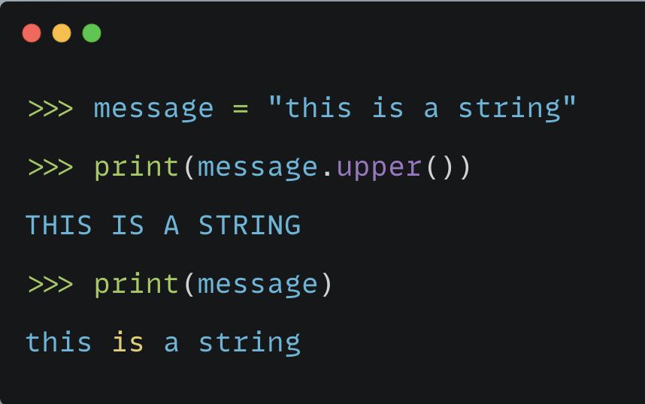
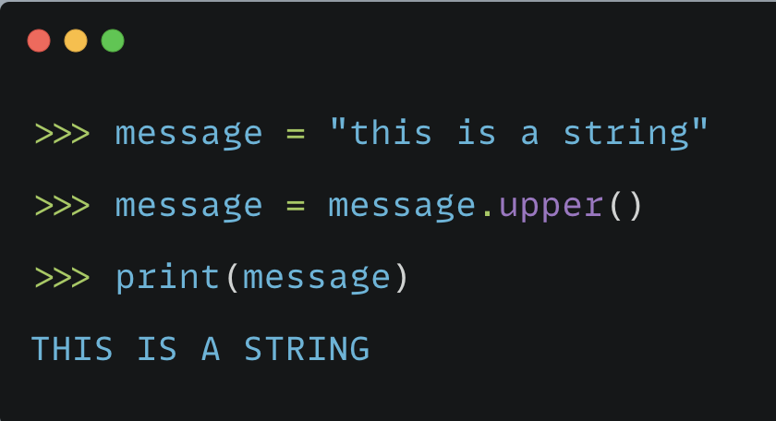
print() vs message.lower()
These built-in functions are specific to strings.
print() is specific to multiple data types
The dot(.) operator acts on the variable and converts it into upper/lower cases
The original data doesn’t change

Slide 34
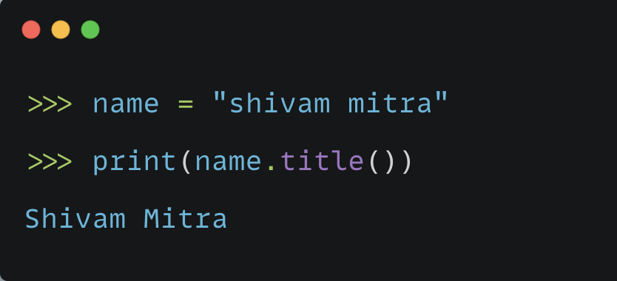
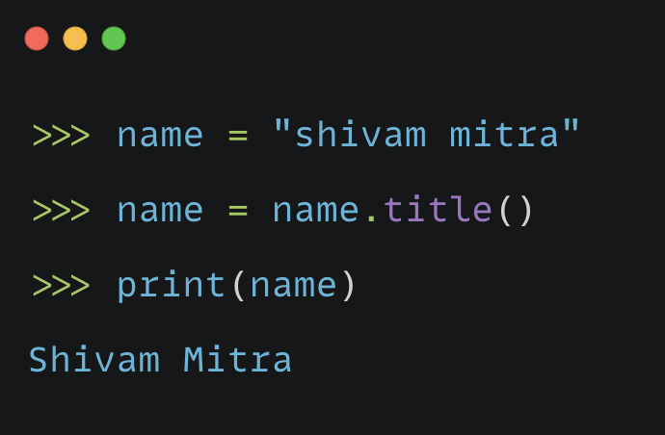
TITLE FUNCTION
Converts the first character of each word into upper case

Slide 35
LEN FUNCTION
Outputs the length of the string
A single character is of length 1
Characters can be alphabets or digits or punctuation or white spaces

Slide 36
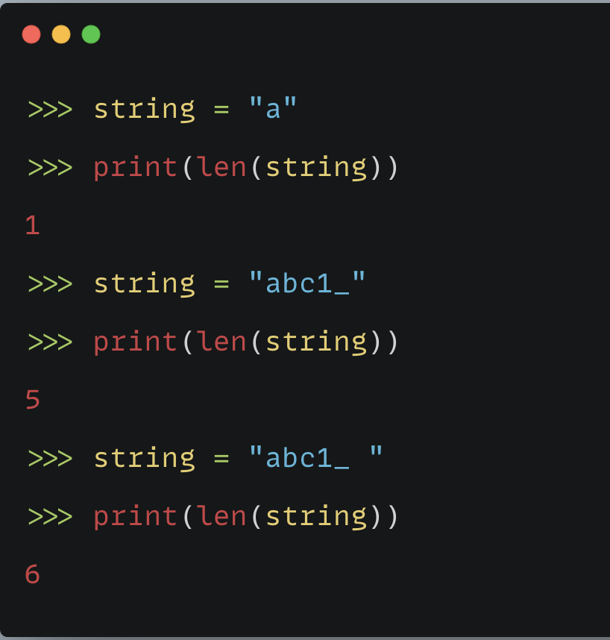
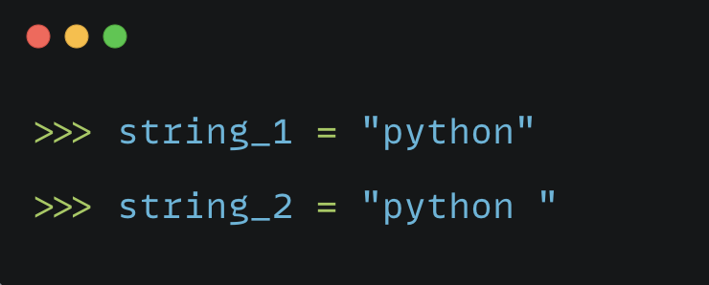
STRIP FUNCTIONS – strip(), lstrip(), rstrip()
Remove the extra whitespaces from a string

Slide 37
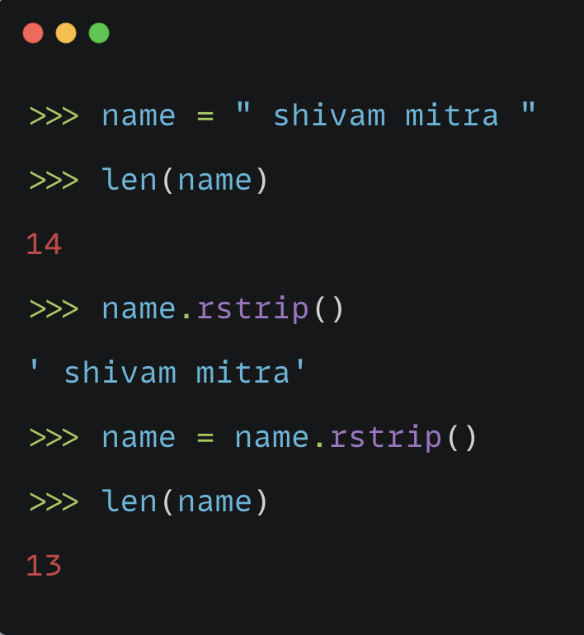
rstrip() – remove whitespace at right end

Slide 38
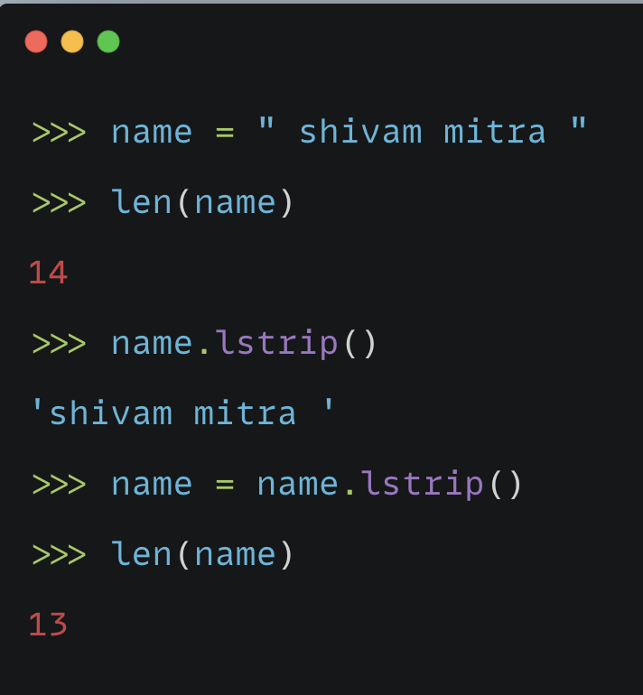
lstrip() – remove whitespace from left end

Slide 39
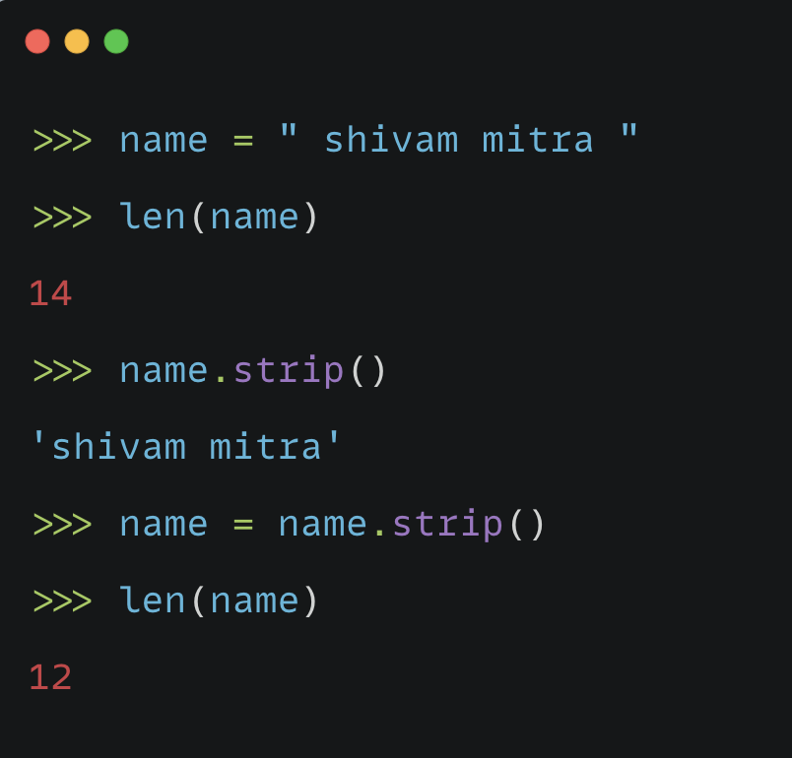
strip() – remove spaces from both ends

Slide 40
USING VARIABLES INSIDE A STRING

Slide 41
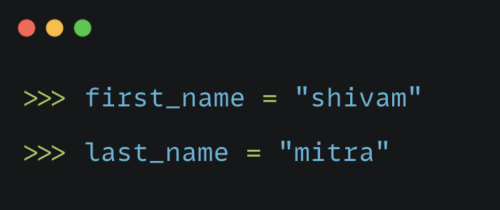
COMBINE THESE TWO TO PRODUCE FULL NAME

Slide 42
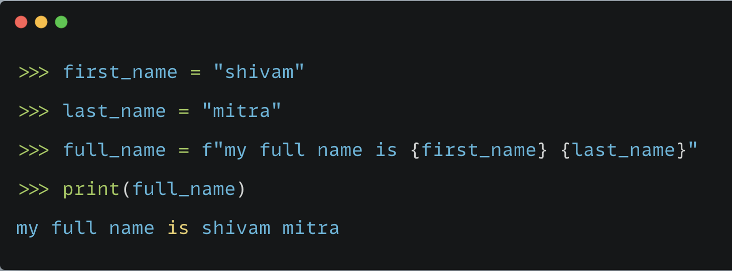
Use f-strings
Feature is available from python 3.6
Start string with f – f stands for format
Put braces around variable name

Slide 43
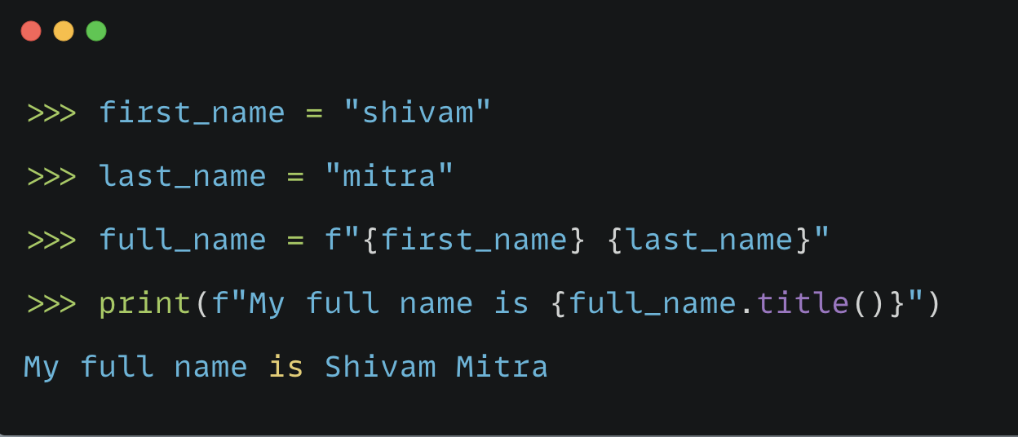

Slide 44
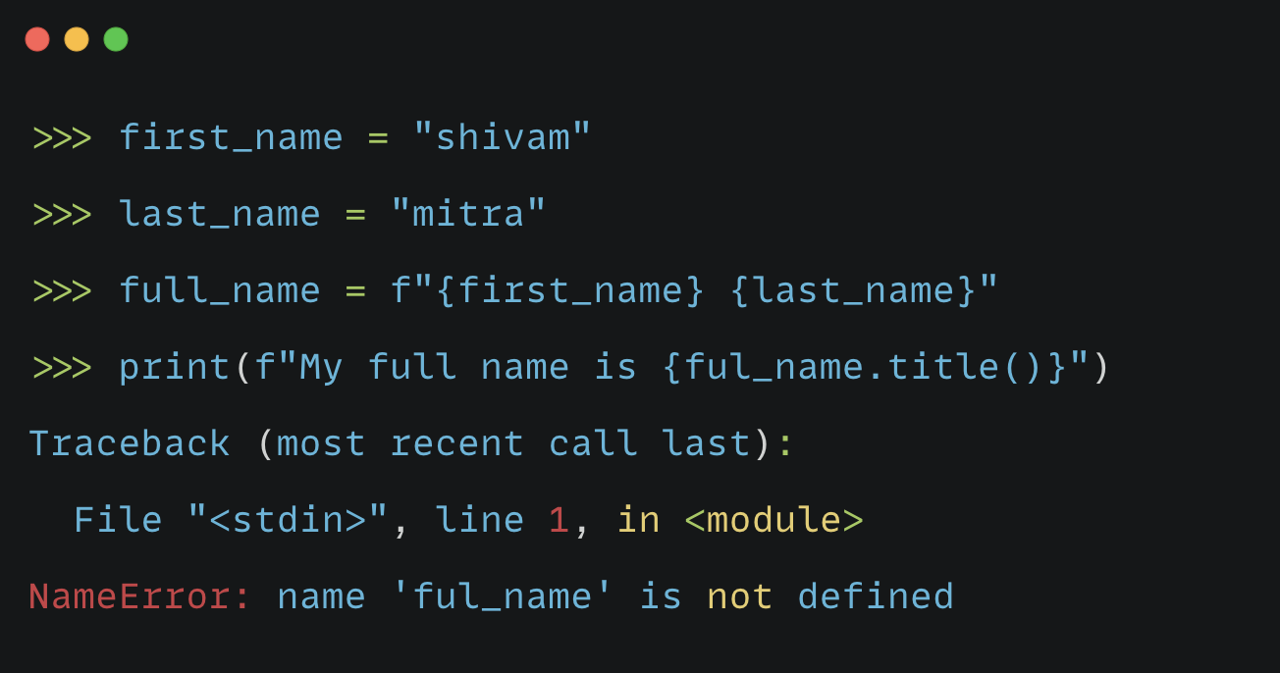

Slide 45
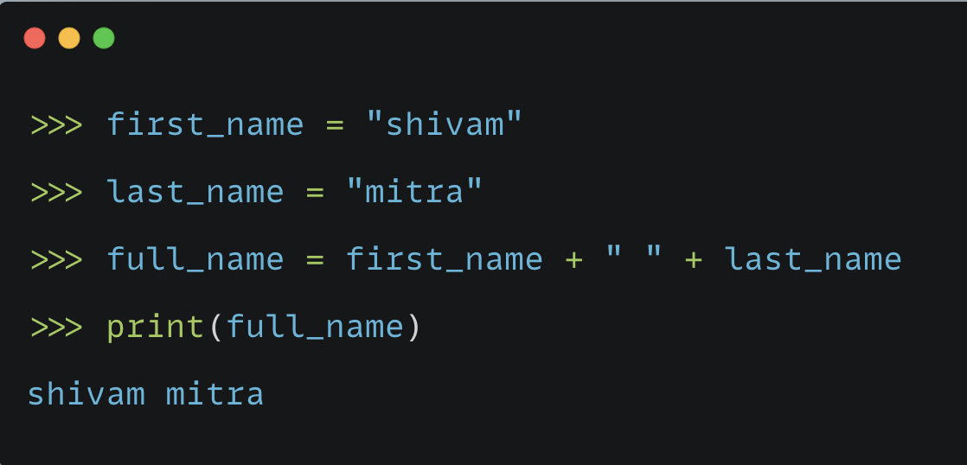
CONCAT MULTIPLE STRINGS

Slide 46
Adding Whitespace to Strings with Tabs or Newlines
In programming, whitespace refers to any nonprinting character, such as spaces, tabs, and end-of-line symbols.
You can use whitespace to organize your output so it’s easier for users to read.

Slide 47
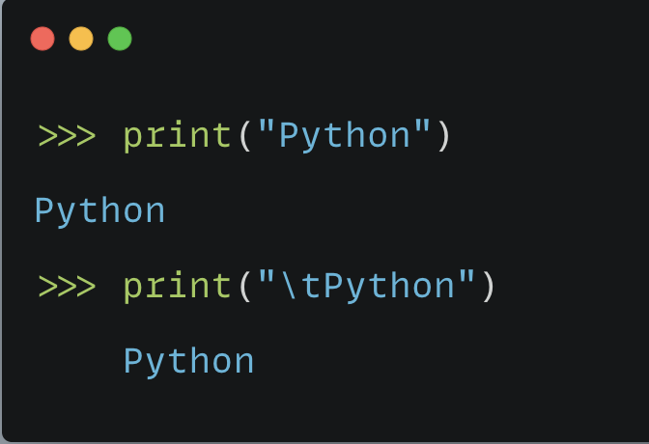
Add a tab to your text

Slide 48
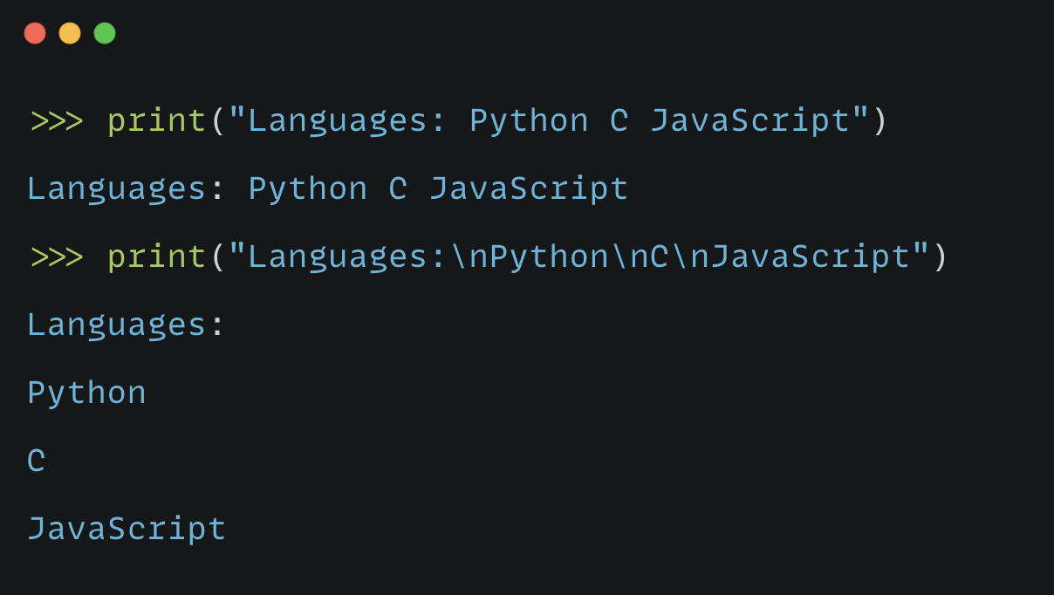
Add newline to your text

Slide 49
NUMBERS DATA TYPE

Slide 50
What are numbers ?
Integers = 1, 2, 3
Floats = 1.2, 2.55
These data are used very frequently in a program.

Slide 51
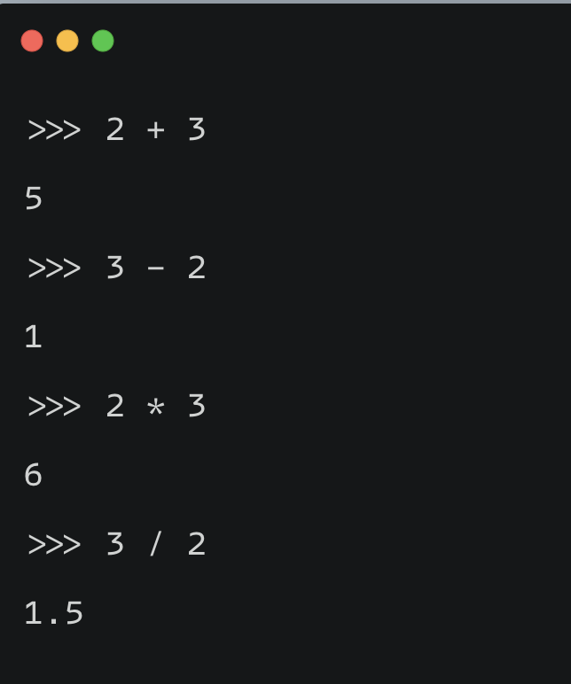
INTEGERS
You can add, subtract, multiply and divide python integers

Slide 52
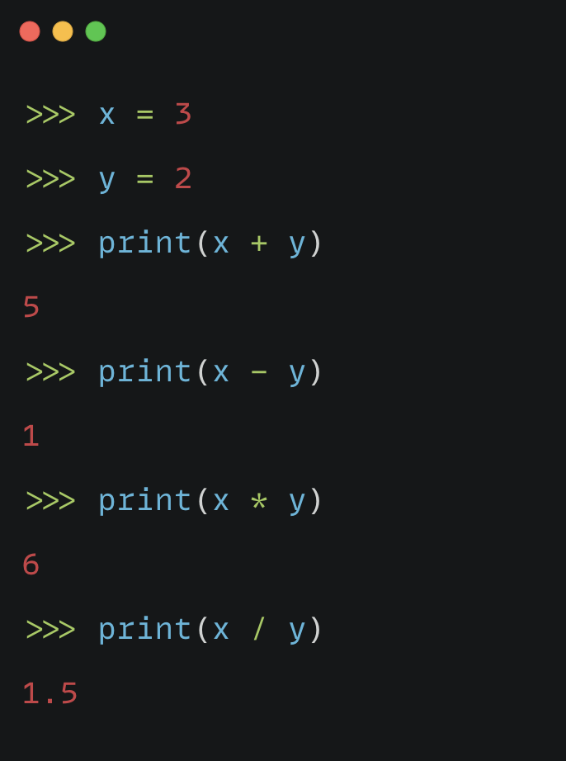

Slide 53
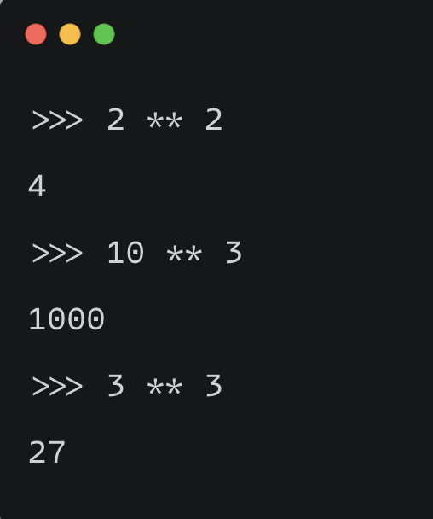
Python uses two multiplication symbols to represent exponents.

Slide 54
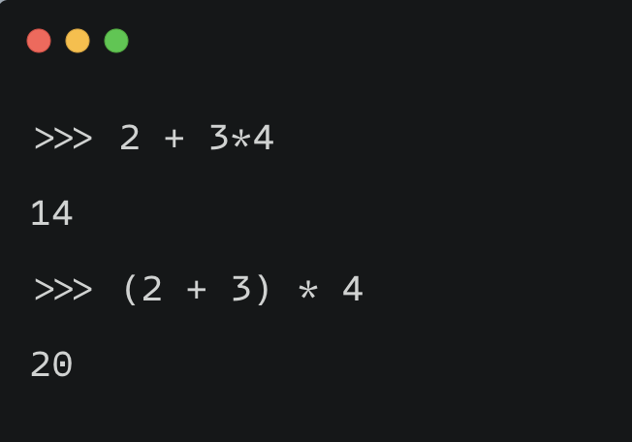
MULTIPLE OPERATORS IN ONE EXPRESSION

Slide 55
The spacing in these examples has no effect on how Python evaluates the expressions
Clarity
More about precedence of operators in a future video

Slide 56
FLOATS
Python calls any number with a decimal point a float.
This term is used in most programming languages, and it refers to the fact that a decimal point can appear at any position in a number.
Example: 1.2, 12.35

Slide 57
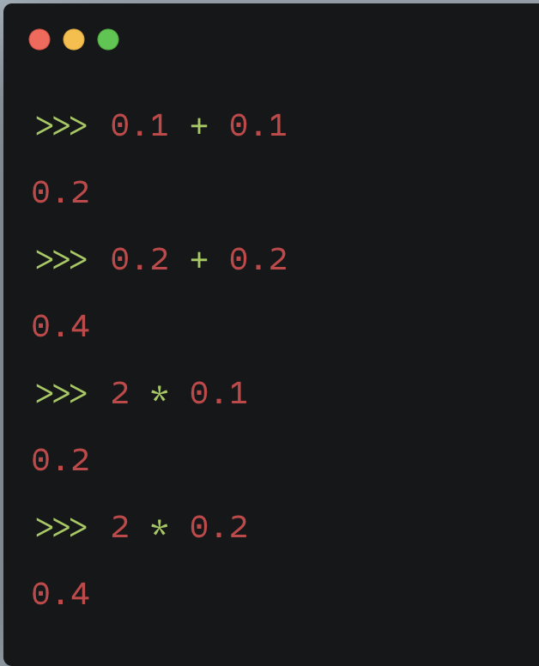

Slide 58

This happens in all languages and is of little concern. Python tries to find a way to represent the result as precisely as possible, which is sometimes difficult given how computers have to represent numbers internally.

Slide 59

USE ROUND FUNCTION

Slide 60

INTEGERS AND FLOATS

Slide 61

DATA TYPE CONVERSION

Slide 62

MULTIPLE ASSIGNMENTS
You can assign values to more than one variable using just a single line.
This can help shorten your programs and make them easier to read.
You’ll use this technique most often when initializing a set of numbers.

Slide 63

CONSTANTS IN PYTHON
A constant is like a variable whose value stays the same throughout the life of a program.
Python doesn’t have built-in constant types, but Python programmers use all capital letters to indicate a variable should be treated as a constant and never be changed.

Slide 64
LISTS IN PYTHON

