Slide 1

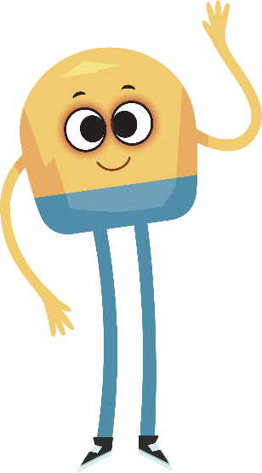

Unit 1: Week 3
Grade 2

Slide 2
Copyright © Savvas Learning Company LLC. All Rights Reserved.
This publication is protected by copyright, and permission should be obtained from the publisher prior to any prohibited reproduction, storage in a retrieval system, or transmission in any form or by any means, electronic, mechanical, photocopying, recording, or otherwise. For information regarding permissions, request forms, and the appropriate contacts within the Savvas Learning Company Rights Management group, please send your query to:
Savvas Learning Company LLC, 15 East Midland Avenue, Paramus, NJ 07652
or
k12learningpermissions@savvas.com
myView Literacy® is an exclusive trademark of Savvas Learning Company LLC in the U.S. and/or other countries.

Slide 3

Lesson 1

Slide 4


Page 92
Phonological Awareness
Notes:
Point to the picture of the key on p. 92 of the Student Interactive. Tell students to listen carefully to the ending sound as you say the word key. Repeat the sounds in the word several times, emphasizing the final sound: /ē/. Repeat for the word tree. Then have students repeat the words key and tree and ask what sound they hear at the end. Tell students these words rhyme.
Point to the pictures of the train, number three, and the kite. Name each picture for students (train, three, kite), and have them repeat the words. Have students identify the word that rhymes with the words key and tree. Ask students to name other words that rhyme with key, three, and tree. (me, see, he, she, free, etc.) Then say the following sets of words. Tell students to listen carefully to the final sounds in each word and tell which words in each set rhyme: can, man, hat; try, make, tie; hand, hat, mat.
Have partners say the word for each picture at the bottom of p. 92 in the Student Interactive. Then have them say as many words as they can that rhyme with cat and hat.

Slide 5
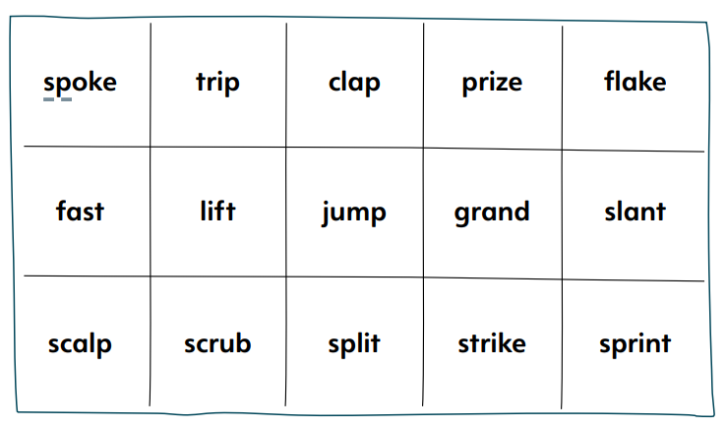
Page 93
Phonics
step
fast
Turn to page 93 in your Student Interactive.
Notes:
This week students will be decoding words with consonant blends. Introduce the skill by writing step and fast. Circle the blends. Say: The word step begins with the letters s and t. We hear both consonant sounds when we read step, but the two sounds are blended together.
Have students say step and listen to the blended sounds at the beginning of the word. Say: The letters s and t are called a blend. Blends can be at the end of words too. When I say the word fast, the sounds for s and t blend together.
Have students say fast and listen to the blended sounds.
Have students complete pg. 93 in their student interactive.

Slide 6
High-Frequency Words
sound
more
things
Notes:
Display the high-frequency words sound, more, and things. Remind students that there are some words we learn by remembering the letters instead of by saying the sounds.
Point to sound and read it. Point to it again and have students read it.
Repeat for each word, having students identify and read each word.

Slide 7
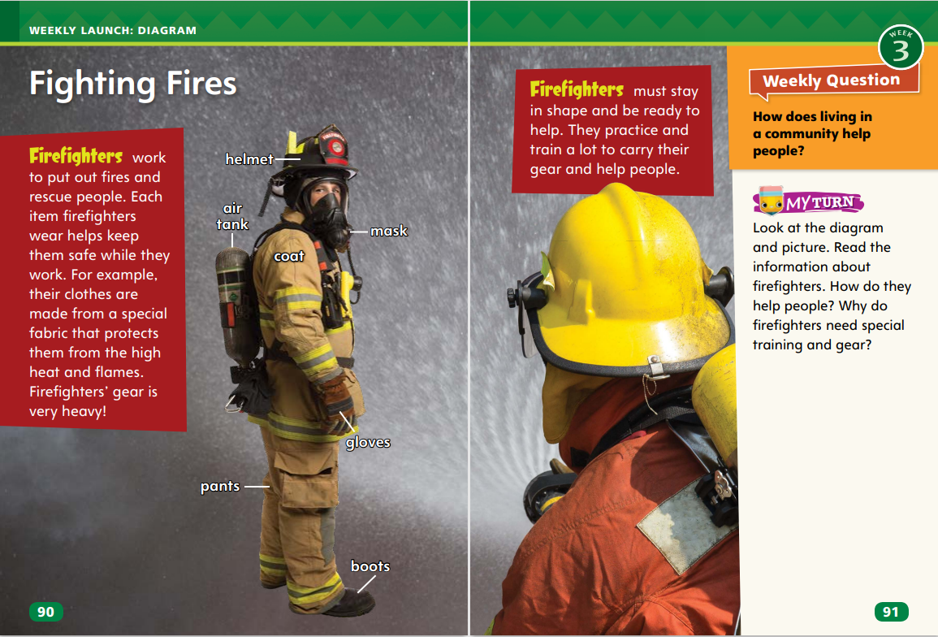
Page 90,91
Interact with Sources
How do firefighters help people?
Why do they need special training and gear?
Underline the answers to the questions.
Notes:
Revisit the Essential Question for Unit 1: How do different places affect us? Then read aloud the Week 3 Question: How does living in a community help people? Ask: How do you think the Weekly Question is related to the Essential Question?
Discuss the diagram “Fighting Fires” on pp. 90–91 in the Student Interactive. Tell students that diagrams are visual aids, such as drawings, pictures, or charts, that make it easier for the reader to obtain information about a topic. Start by reading the text aloud, prompting students to follow along. Then ask: What do you see in this diagram? Focus students’ attention on the images and labels. How do these pictures and labels help you understand the text?
Use the following questions to continue the discussion:
What do firefighters do?
Why are firefighters important to a community?
Would you want to be a firefighter one day? Why or why not?
Conclude the discussion by restating the Week 3 Question: How does living in a community help people? Then mention that “Fighting Fires” shows people in a community who help others. Say: This week, we will learn more about how living in a community helps people.
To help students answer the questions on p. 91 of the Student Interactive, have students underline the details in the text that answer the questions. Then have them use those details to discuss their ideas.

Slide 8
Listening Comprehension
You Are Here
“Helping the Community” | Realistic Fiction
Notes:
Encourage students to listen actively as you read aloud “Helping the Community.” Ask them to recognize the characteristics and structure of the informational text, including the central, or main idea. Prompt them to ask relevant questions to clarify information and answer using multi-word responses.
Have students actively listen for the main idea and key details.
Read the text aloud without stopping for the Think Aloud callouts.
Reread the text, pausing to model Think Aloud strategies.
After reading the informational text “Helping the Community,” ask students: How are “Helping the Community” and realistic fiction texts you have read similar and different? Have students use a T-chart to write their responses. Remind them that these similarities and differences can help them distinguish informational texts from realistic fiction.

Slide 9
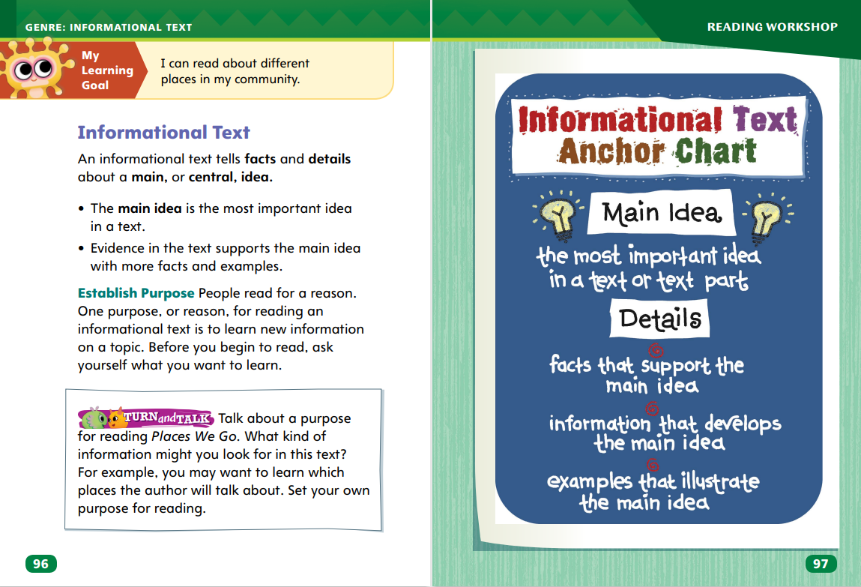
Page 96,97
Informational Text Qualities
Turn to page 96 in your Student Interactive.
Notes:
Explain that an informational text gives facts and details about real people, things, or events. These facts and details explain main ideas. Main ideas are the most important ideas in the text. Provide the following suggestions for reading informational text:
Set a purpose. What do you want to learn about the topic of the informational text? Explain that setting a purpose guides students’ reading and helps them think about the text as they read.
Look for evidence in the text. What do the facts and details tell you about a main idea?
Show students how to establish a purpose for reading assigned and self-selected informational text. Say: Before I read “Helping the Community,” I should set a purpose for reading. This is an informational text, so I know it will have facts about real people, things, or events. The title makes me want to learn how I can help my community, so I will say that my purpose is to learn how to help my community. When I start reading, I will look for facts and details. These facts and details will explain a main, or central, idea of the text. Next, read and discuss the anchor chart on p. 97 in the Student Interactive with students.
Read the Anchor Chart on page. 97 in the Student Interactive together. Editable Anchor Chart Click Path: Table of Contents -> Reading Anchor Charts -> Unit 1 Week 3 : Informational Text Editable Reading Anchor Chart

Slide 10
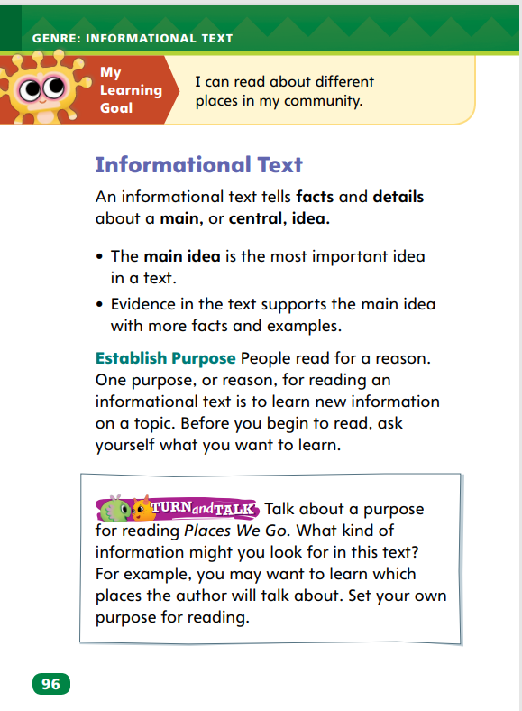

Page 96
Apply
Talk about the purpose for reading Places We Go.
Notes:
Have students complete the Turn and Talk activity on p. 96 of the Student Interactive.
Call on volunteers to share their purpose with the class.

Slide 11
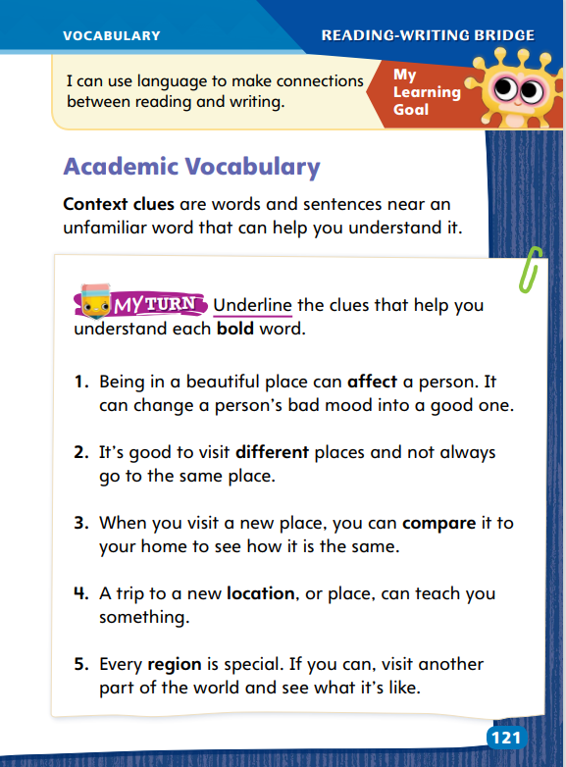
Page 121
Academic Vocabulary
affect
different
compare
location
region
Notes:
Review the Academic Vocabulary words for the unit: affect, different, compare, location, and region. Explain that context can refer to words within the same sentence as an unfamiliar word. Context can also refer to other sentences that surround an unfamiliar word. Students can use context to determine the meaning of an unfamiliar word.
Read the words and sentences near an unfamiliar word. Note any words that may suggest the meaning of the unfamiliar word.
Use these words as clues to help you figure out the meaning of the unfamiliar word.
Read both sentences in item 1 on SI p. 121: I don’t know what the bold word affect means, so I will reread the sentences. I notice that the second sentence explains the first sentence. I look for words in the second sentence that might help me understand the meaning of affect. I see the word change, which I know. The word change helps me understand the meaning of affect. So, change is a context clue. Have students identify the context clue in item 2. Tell students to reread as necessary, offering guidance as needed.
Have students complete the activity on p. 121 on the Student Interactive.

Slide 12

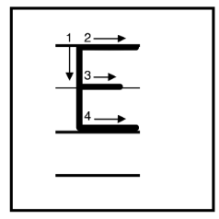

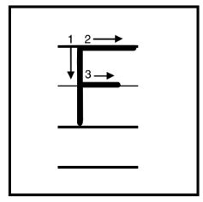
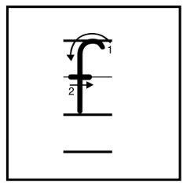
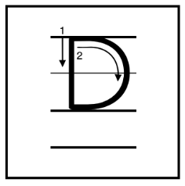
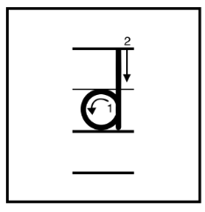
Handwriting
Notes:
Display the uppercase and lowercase letters Ee, Ff, and Dd.
Show students how to write uppercase and lowercase letters Ee, Ff, and Dd. Use the following words to demonstrate how to form the letters properly: Ed, Fed/fed, and Dad.
Have students use Handwriting p. 17 from the Resource Download Center to practice writing the uppercase and lowercase letters Tt. Click path: Realize -> Table of Contents -> Resource Download Center -> Handwriting Practice -> U1W3L1 Handwriting Practice

Slide 13
Writing – Launch Writing Workshop
Fiction
Characters | Setting | Plot
Notes:
Fiction stories usually contain characters, settings, and plots. Over the course of most stories, the characters experience a problem and then search for a resolution.
Hold up a fiction book from the stack. Say: This is a fiction book. Fiction means that the author made up the story. It is not true. Fiction stories have characters. Characters are animals or people. Let’s meet this book’s characters. Page through the book. Identify the main characters by name.
Tell students: Fiction stories have settings. The stories happen at specific times and places. Let’s explore the setting of this story. Page through the book. Read aloud details about the story’s setting. Point to images that depict where and when the story takes place.
Say: Fiction stories have plots. The plot is what happens in a story from the beginning to the middle to the end. In the plot, readers discover a problem that the characters face and learn what the characters do to solve that problem. (If necessary, clarify that a “problem” is not always a negative situation.)
Read the story aloud and then review the plot. Ask: What happens in the beginning of the story? How does the story end? What happens in the middle of the story, between the beginning and end? What problem did the characters solve?

Slide 14

Independent Writing
Think of a plot for a fiction story.
Begin writing a plot in your writing notebook.
Share your plot idea with the class.
Notes:
Instruct students to think of plots for fiction stories. If students have difficulty, invite them to orally tell a story, and then help them describe the beginning, middle, and end.
Writing Support
Modeled - Choose a stack text and do a Think Aloud to identify the plot, setting, and main character.
Shared - Have students choose fiction texts from the stack. Work with them to identify the plots, settings, or characters.
Guided - Provide explicit instruction on how to identify the plot, setting, and characters in a story.
Students who complete the task should begin to develop a plot in their writing notebooks.
Ask several volunteers to share their plot ideas.

Slide 15
Spelling
Drive down the brick road.
My dogs chase the stick.
Have you read my blog?
Do not spend too much cash.
What are those things?
The little bird is building a nest.
A shark has strong teeth.
Can I borrow some scrap paper?
Her pet frog can jump high!
We hear the sound of music.
Today is the first day of spring.
He walks past the store.
Notes:
(Note: Move the orange boxes to cover each bold spelling word before you read aloud the words and sentences.)
Read aloud the words and sentences. Have students spell each word with initial consonant blends and the two high-frequency words.
Drive down the brick road.
My dogs chase the stick.
Have you read my blog?
Do not spend too much cash.
What are those things?
The little bird is building a nest.
A shark has strong teeth.
Can I borrow some scrap paper?
Her pet frog can jump high!
We hear the sound of music.
Today is the first day of spring.
He walks past the store.
Reveal the spelling word and have students check their work.

Slide 16
Language and Conventions
Jack lunch at noon.
take train to the city.
Work together to edit the incomplete sentence.
Notes:
Review subjects and predicates. Remind students that a complete sentence has a subject, which tells who or what, and a predicate, which tells what the subject is or does.
Write the following incomplete sentence on the board: Jack lunch at noon. Then guide students to edit the incomplete sentence so that it is a complete sentence with a subject and predicate. (Jack eats lunch at noon.)
Ask students to work together to edit the following incomplete sentence: take the train to the city. (We take the train to the city.)

Slide 17
Lesson 2

Slide 18



Page 93
Phonics
Notes:
Use Sound-Spelling Cards 32, 38, and 41 to introduce beginning and ending blends. Point out the letters tr and str at the beginning of train and strawberry. Say: The first two letters of train, t and r, make a consonant blend. The sounds /t/ and /r/ blend together. Some blends have three letters, such as str in strawberry. Tell students that blends can be at the end of words too. Point out the letters m and p on Sound-Spelling Card 38. Explain that m and p make up an ending blend. Click path -> Table of Contents -> Unit 1 Week 2 Realistic Fiction-> Lesson 2
Point to spoke on SI p. 93. Say: When I see a word that begins with s and p, I know it is an s-blend. The sounds blend together. I also recognize that the word has a CVCe pattern, so the letter o has a long vowel sound. This helps me decode, or read, the word: spoke. Have students identify the blends in the words in the first row and decode the words with you. Then have them decode the rest of the words as you listen.
Have pairs reread the words in the chart. Tell them to underline the consonant blend in each word.

Slide 19
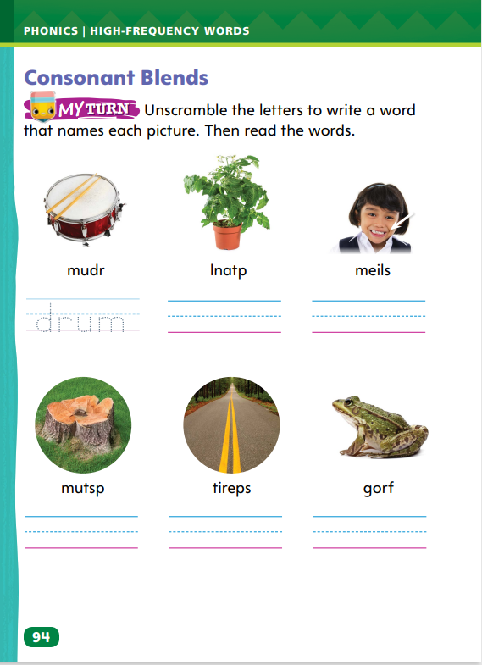
Page 94
Apply
Turn to page 94 in your Student Interactive and read the words.
Unscramble the letters to decode the word.
Read each word.
Notes:
Write: r-blends, l-blends, s-blends. Say: These are beginning blend families. Other consonants combine with these letters to make blends. Write: -mp, -nd, and -nt. These are some common ending blends.
Point to the picture of the drum on SI p. 94. This is a drum. The letters are mixed up but I can figure out how to unscramble them. I say the word drum. I hear an r-blend at the beginning: /dr/. The letters d and r stand for the sounds in the blend. I write dr. I hear a short /u/ sound followed by the consonant sound /m/. This helps me write the word drum. Ask students to write drum on the lines. Then have them name the next picture, tell the blend they hear, and unscramble and write the word.
Have students complete the rest of the activity on p. 94 of the Student Interactive.

Slide 20
High-Frequency Words
sound
more
things
Notes:
Write sound, more, and things.
Point to each word and have students read it.
Have students identify each word by pointing to it when you say the word.
Ask students to make oral sentences using the words.

Slide 21
Page 98
Preview Vocabulary
community
services
librarian
supermarkets
hospital
Notes:
Introduce the words on p. 98 in the Student Interactive. Define words as needed.
community: a place where people live, work, and play
services: work that people do to help others
librarian: a person in charge of a library
supermarkets: large stores that sell food and other goods
hospital: a place where doctors and nurses care for sick or injured people
Tell students: These words will help you understand information in Places We Go. As you read the words in the text, ask: Why are these words important?

Slide 22
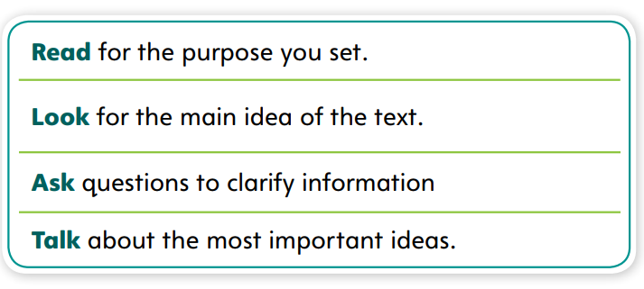
First Read Strategies
Notes:
Discuss the First Read Strategies with students. For this first read, tell students to read for understanding and enjoyment.
Explain the four steps of the first read.
READ Remind students to read the text for the purpose they set.
LOOK Encourage students to look for the main idea of the text.
ASK Have students ask questions to clarify information they do not understand.
TALK Prompt students to evaluate details to determine key ideas in the text. Then have them discuss the most important ideas.
Students may read the text independently, in pairs, or as a whole class. Use the First Read notes to help students connect with the text and guide their understanding.

Slide 23
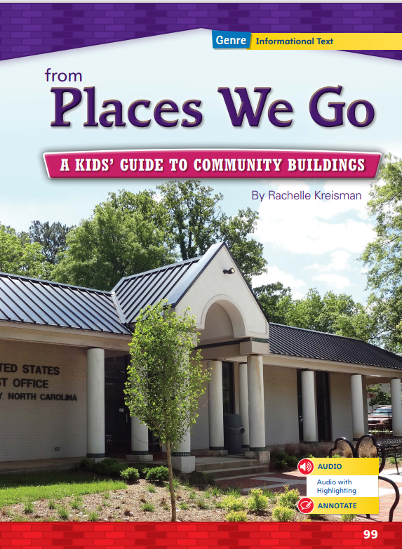
Page 99
First Read – Places We Go
Notes:
Students may read the text independently, in pairs, or as a whole class. Use the First Read notes to help students connect with the text and guide their understanding.

Slide 24
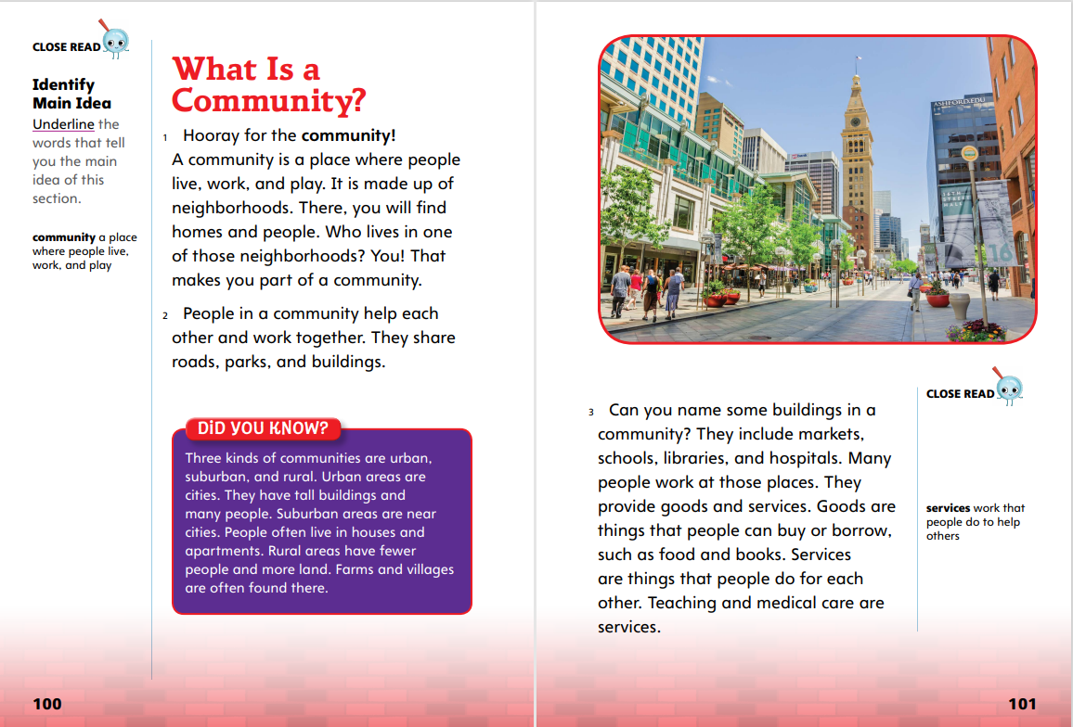

Page 100,101
First Read – Places We Go
Notes:
Read Together.
THINK ALOUD Before I read, I set a purpose, or a goal, for reading. I know that this text is informational text, or a text that gives facts and details about a main idea. I want to read to enjoy the text, but I also want to learn something new. My purpose will be to learn what makes up a community.
THINK ALOUD To help me understand what I read in the text, I look for the most important ideas. I notice three main categories in the text on this page: buildings, goods, and services. I'm going to write those three names down. Then I'm going to talk with a partner about examples of buildings, services, and goods.

Slide 25
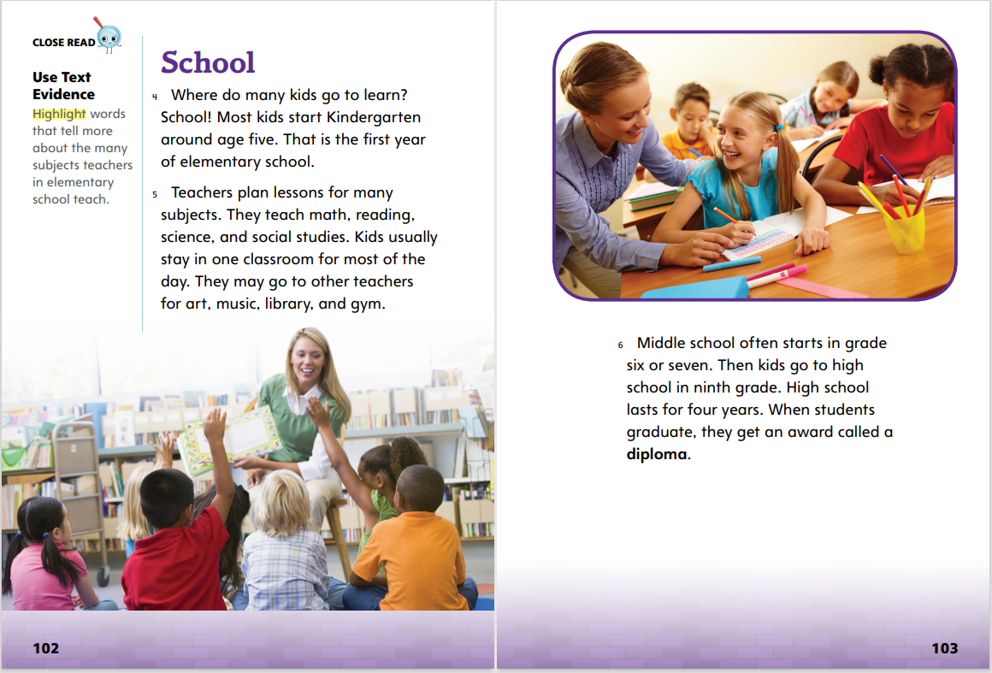
Page 102,103
First Read – Places We Go
Notes:
Read Together.
THINK ALOUD As I read, I look for clues that tell me about the main idea of the section. The heading is one clue. It tells the topic, which is “school.” Then I look for details that help answer the question, “What is the most important idea the author shares about school?” I will keep reading to find out.
THINK ALOUD As I read an informational text, I think of questions I have. I also highlight facts and ideas that I want to learn more about. As I read p. 103, I want to know more about how middle school and high school are different from elementary school. What classes do students in middle school have? Do students have the same teacher for all their classes? I’ll write these questions and see if I can find answers as I keep reading.

Slide 26
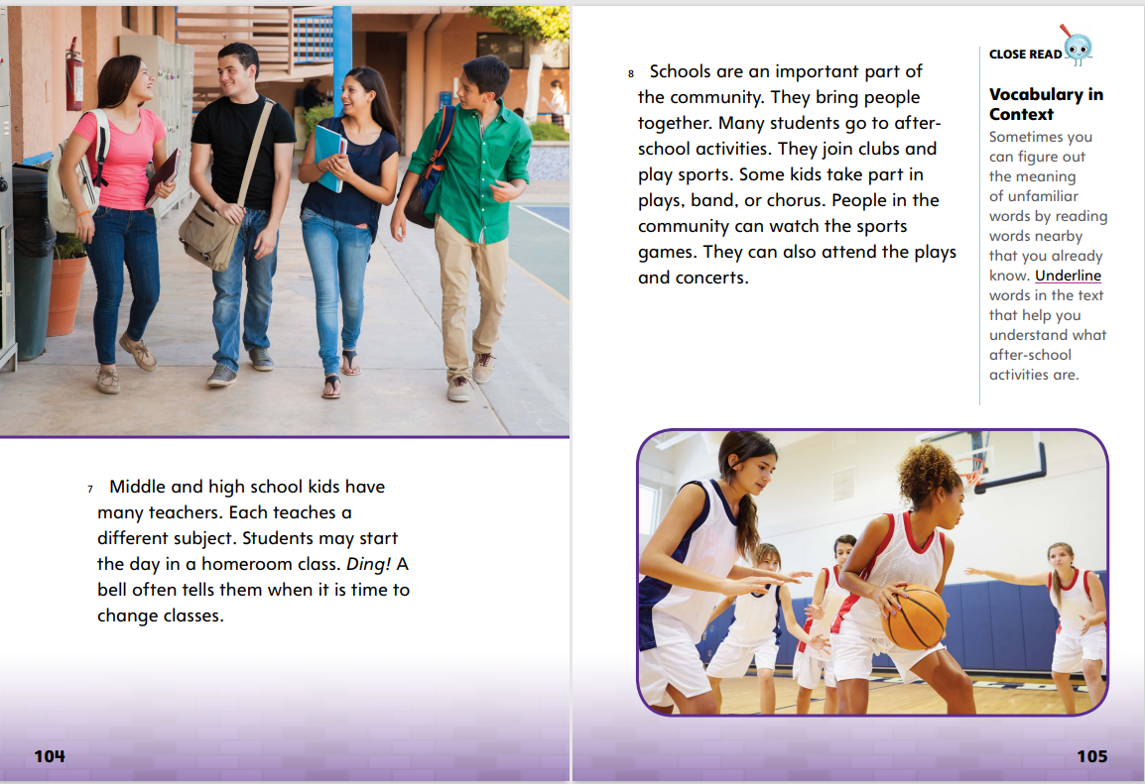
Page 104,105
First Read – Places We Go
Notes:
Read Together.
THINK ALOUD As I read p. 104, I learn that some middle and high school students start their day in a “homeroom class.” What is a homeroom class? I can tell based on the text that it is where students start the day, but that’s all I know so far. I‘m going to circle “homeroom class” in the text and continue reading to see if the text answers my question.
Have pairs of students work together to identify the most important ideas the author shares about schools. Guide students as needed to differentiate between factual details and important ideas. Point out that details such as “Some kids take part in plays” is a fact, not an idea. “Schools bring people together” is a key idea.

Slide 27
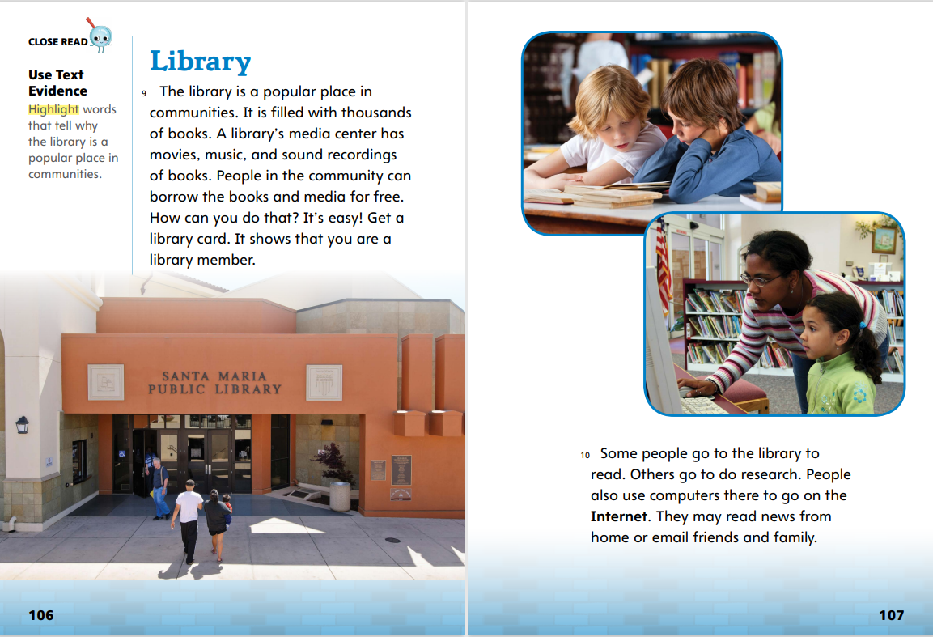
Page 106,107
First Read – Places We Go
Notes:
Read Together.
THINK ALOUD As I read, I think about my purpose for reading. At the beginning of the story, I said my purpose for reading was to find out what makes up a community. While reading, I mark details related to that purpose. For example, I learn that libraries are an important part of a community.
THINK ALOUD As I read, I pay attention to details that are unclear to me and ask questions about them. For example, I read that some people go to the library to use the computers to read news “from home.” What does “from home” mean? Does it mean that they are from a different country? I will continue reading to find out if my question is answered.

Slide 28
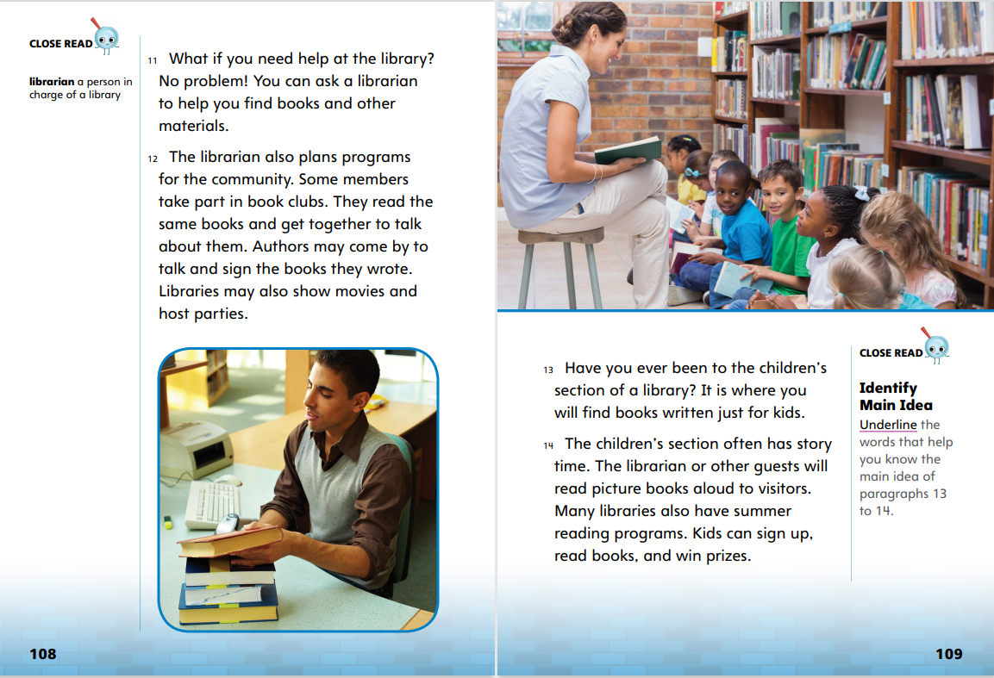
Page 108,109
First Read – Places We Go
Notes:
Read Together.
Point at the sentence in paragraph 12, “The Librarian also plans programs for the community.” Say: This sentence helps me understand the ideas I’m going to find in a paragraph. I know that everything in this paragraph relates to the idea of what a librarian does for people and a community. As I read, I’ll circle details that tell me what librarians do for people and the community.
In pairs, have students discuss any library events they have participated in. Ask: What makes a children’s section of the library an important part of the community? In pairs, have students use the details on p. 109 to answer the question.

Slide 29
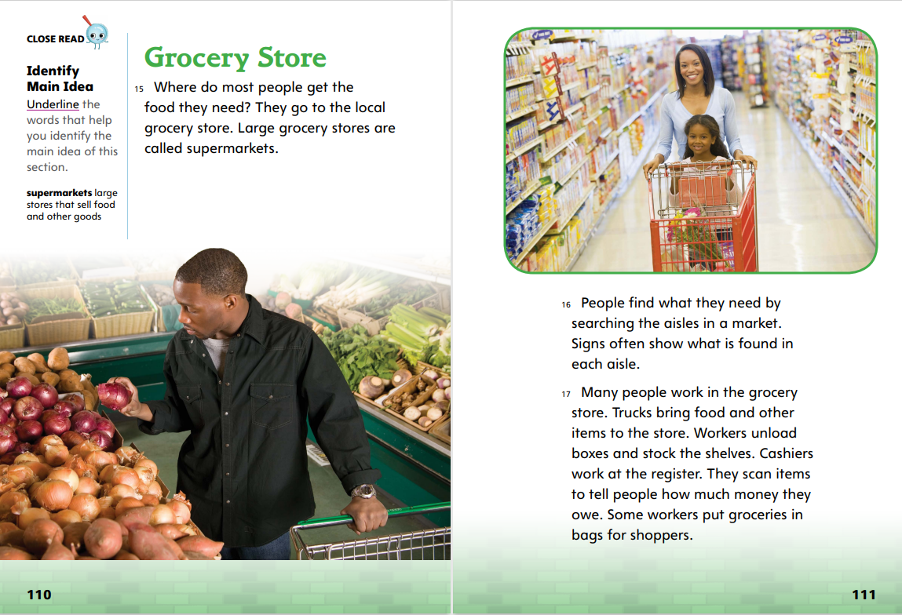
Page 110,111
First Read – Places We Go
Notes:
Read Together.
Direct students to paragraph 15. Ask: Why do you think the writer begins with a question? Explain that the writer anticipates, or predicts questions a reader might have and then answers them in the text. Have students look for this structure throughout the text.
Have students read paragraph 17. Ask students to identify the main idea of the section. Then have them share a detail that supports the main idea.

Slide 30
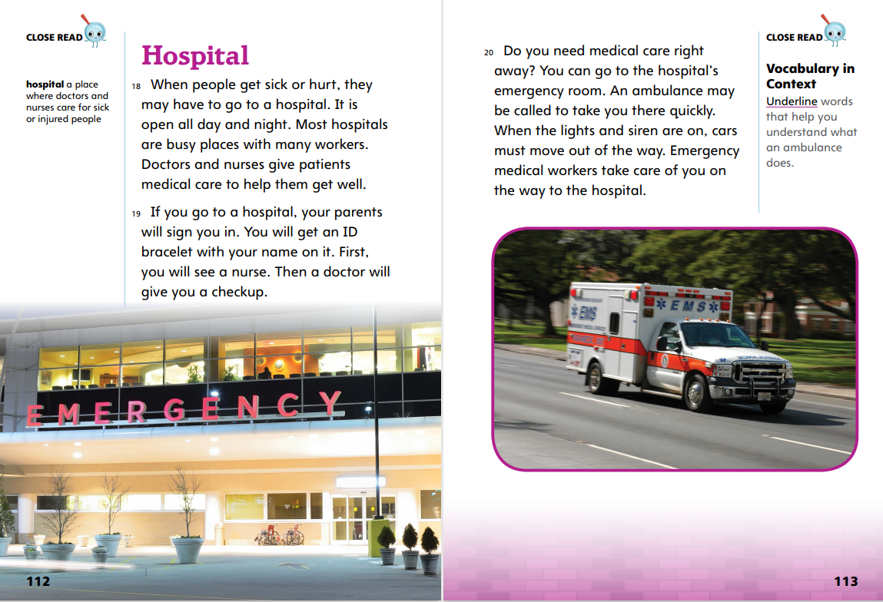
Page 112,113
First Read – Places We Go
Notes:
Read Together.
THINK ALOUD As I read, I think back to my purpose for reading. I wanted to learn more about what makes up a community. On p. 112, I learn that hospitals are an important part of a community. Hospitals have many different kinds of workers that help people who are sick or hurt.
Tell students: I understand from the text that an ambulance can help people get to the hospital quickly, but I have some questions about how that works. How do I call an ambulance? How long does it take for an ambulance to come? What type of medical workers ride in an ambulance? I’m going to write these questions so I can look up answers later.

Slide 31
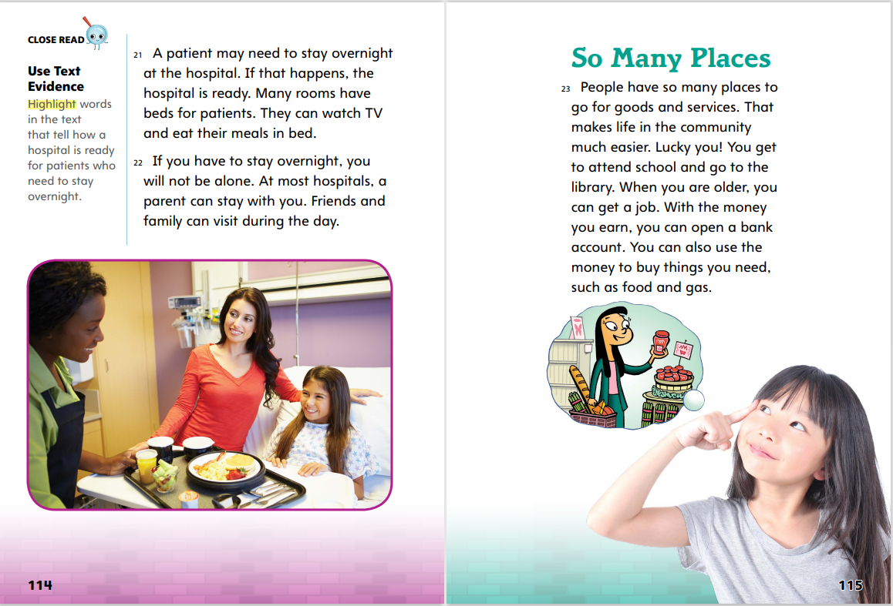
Page 112,113
First Read – Places We Go
Notes:
Read Together.
THINK ALOUD As I read the text, I keep track of any questions I have. The text says hospitals are ready for patients to stay overnight. I wonder how many people work in hospitals overnight. Is it the same number of people as during the day?
Remind students that headings can give clues about the topic or main idea of a section. Point out the heading “So Many Places.” Ask: Where does the author repeat this phrase? (in the first sentence) What is the most important idea the author is making about these places? Guide students to conclude that having many places for goods and services makes life in a community easier for members of the community

Slide 32
Respond and Analyze
Discuss: What did you like about the text? What did you not like?
Brainstorm: How has the text changed the way you think about people and places in your community?
Notes:
Use these suggestions to prompt students’ initial response to reading Places We Go.
Discuss What did you like about the text? What did you not like?
Brainstorm How has the text changed the way you think about people and places in your community?

Slide 33
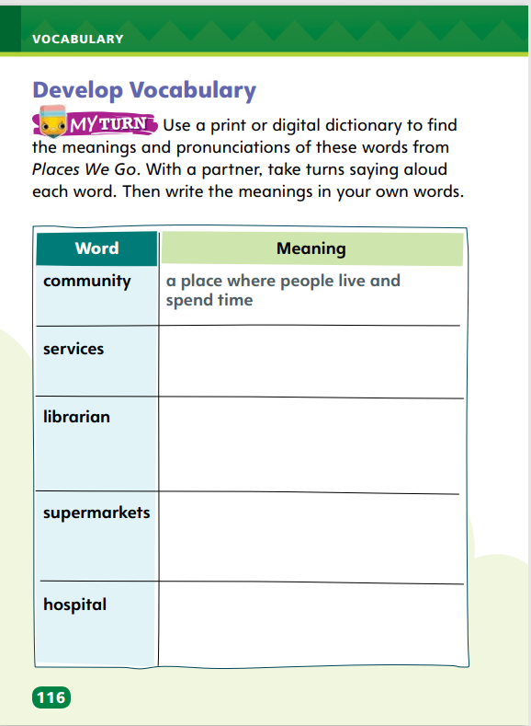
Page 116
Develop Vocabulary
Turn to page 116 in your Student Interactive and complete the activity.
Notes:
Explain that in Places We Go, the author uses the vocabulary words community, services, librarian, supermarkets, and hospital to help describe the main ideas of the text.
Use the strategies you know to remind yourself of the word’s meaning.
Think about how the word ties into the text. How does it relate to a main idea?
Model how to complete the activity on p. 116 in the Student Interactive using the word community.
Tell Students: First, I practice saying the word aloud. Next, I take out my dictionary to look up the word community. I look in the section for words that begin with c.
Find the definition of community and guide students to write its meaning in their own words.
Provide each student with access to a dictionary. Then ask students to complete p. 116 of the Student Interactive.

Slide 34
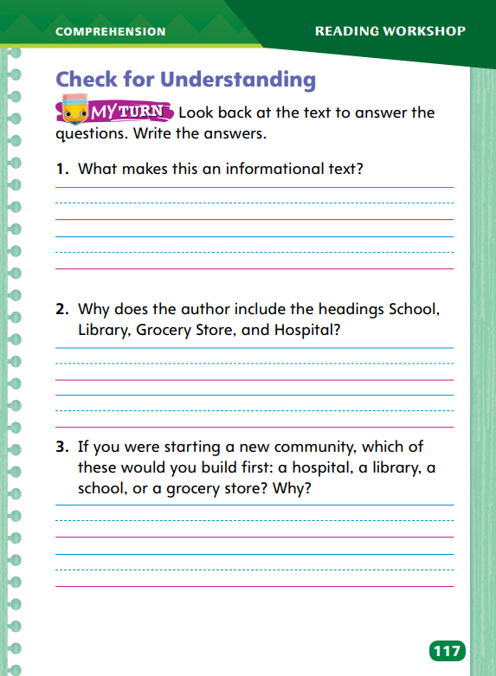
Page 117
Check for Understanding
Turn to page 117 in your Student Interactive and complete the activity.
Notes:
Have students complete p. 117 of the Student Interactive.

Slide 35
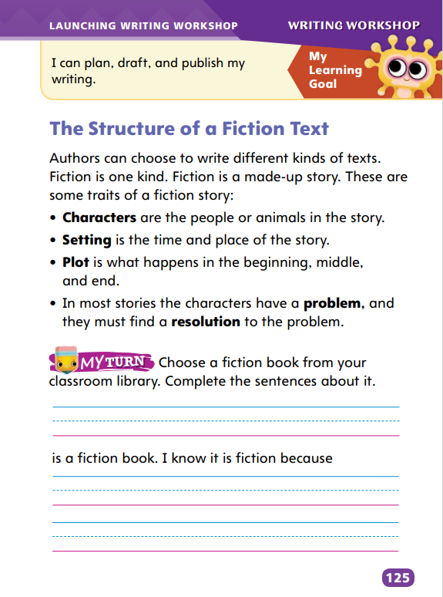
Page 125
Writing – Launch Writing Workshop
Turn to page 125 in your Student Interactive.
Notes:
A fiction book contains characters, a setting, and a plot. All of these elements are revealed throughout the structure of a story. Additionally, one or more characters are presented with a problem to resolve by the story’s end.
Direct students to p. 125 in the Student Interactive.
Read the traits of a fiction story. Ask: What is a character? What is a plot? What is a setting? Tell students that all fiction stories share these traits.
Read aloud another fiction book from the stack. Pause to discuss details that identify character, setting, and plot. Pose the following question?
What problem or conflict does the character/do the characters face?
How does the character/do the characters resolve this conflict or solve this problem?
Direct students to choose a fiction book from the stack and then complete the exercise at the bottom of p. 125 in the Student Interactive.

Slide 36
Independent Writing
Let’s review what we learning about problems and solutions in fiction stories.
You will begin writing your own fictional story in your journal.
Notes:
Students should continue to familiarize themselves with problems and solutions in fiction stories. If students are having trouble, refer them to texts from the stack and point out problems the authors introduce and solutions they use.
Writing Support
Modeled - Do a Think Aloud to model introducing a problem to a fictional character.
Shared - Ask students to describe a real-life problem and solution. Then have them brainstorm a story they could write about it.
Guided - Provide explicit instruction about types of problems fictional characters may face.
Students with a strong understanding of fiction structure can begin writing their own stories.
Invite students to explain the structure of fiction stories, using details from the books they’ve read.

Slide 37
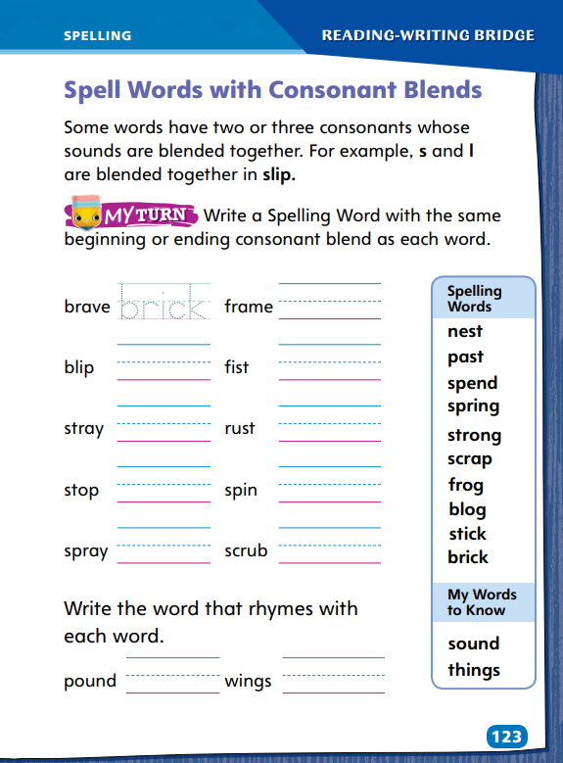
Page 123
Spelling
Turn to page 123 in your Student Interactive and complete the activity.
Notes:
Explain that some words have two or three consonants whose sounds blend together.
Display the spelling words. Point out the consonant blend in each word. Say the consonant blend in each word before saying the whole word. Then have students spell words they know with consonant blends.
Have students complete Student Interactive p. 123 to spell words with consonant blends. Use the leveled supports on p. T384 for ELLs.

Slide 38
Language and Conventions
I play baseball.
I play tennis.
and but or
Work with your partner to make up your own sentences with and, but, or.
Notes:
Introduce the lesson by discussing instances in which the ideas in two sentences are related. These sentences can be combined to make one compound sentence by inserting a comma and the word and, but, or or.
Write the words and, but, and or on the board before displaying this pair of sentences: I play baseball. I play tennis. Ask: How can I combine these sentences into one compound sentence? Guide students to choose an appropriate conjunction (and or or) and form a compound sentence. (I play baseball, and I play tennis. I play baseball, or I play tennis.)
Have students work in pairs to create three oral compound sentences, one using the word and, one using the word but, and one using the word or. Have pairs share their sentences with the class.

Slide 39
Lesson 3

Slide 40
Phonics
sleep trip jump help
dr | op
fl | ip
sl | ap
tr | ap
sn | ip
bl | ip
Notes:
Remind students that the sounds of two or three consonants at the beginning or end of words blend together. Provide examples: sleep, trip, jump, help.
Help pairs of students create note cards for each of the following consonant blends: dr, fl, sl, tr, sn, and bl. Then help the student pairs create note cards for the following phonograms: ap, ip, op. Model how you put together a blend card and a phonogram card to make a word. Say: I can put together the blend dr and the phonogram ip to make the word drip. Have partners see how many words they can make. As they make a word, ask them to write it down. Have partners share the words they made while you record them. Then read the list of words with students. Words they could make are flip, slip, trip, snip, snap, trap, slap, flap, flop, slop, and drop.
Repeat with ending blends. Have students make the blend cards nd, ft, nt, and st and the letter cards a, e, i, o, u, d, l, s, t, b, and r. Have partners make as many words as they can using the cards. Some words they can make are: hand, find, blend, brand, stand, pond, drift, left, raft, sift, lift, lent, lint, best, last, list, rest, and rust.
Ask students to choose a word with a beginning blend and an ending blend from their lists and write two sentences. Have them read the sentences with a partner.

Slide 41
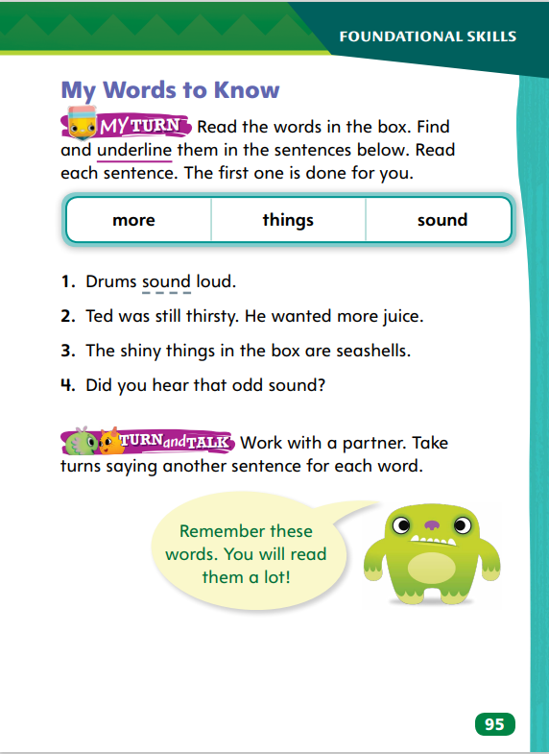
Page 95
High-Frequency Words
sound
Turn to page 95 in your Student Interactive and complete the activity.
more
things
Notes:
Direct students’ attention to the Close Read note on p. 100 of the Student Interactive. Say: To find the main idea, I first need to look at the text closely. I notice that this section of text is called “What Is a Community?” This heading, or title of the page, gives me a clue about the main idea. Next, I should look for words in the text that give me more clues. Then I will know the main idea.
Reread the page to students. Then ask: What is the main idea? Assist students in recognizing the words that add to the structure and develop the main idea of the section. Have them review SI p. 109 and underline the text that tells them the main ideas of paragraphs 13 and 14.

Slide 42
Page 99
Identify Main Idea
Notes:
It is important to recognize the structures of informational text, including the main, or central, idea. A paragraph or a section of text can also have a main idea.
Read the title and headings. Can you figure out the main idea from the title of a text or the heading of a paragraph?
Examine the text. Are there words or pictures that might help you recognize the main idea?
Focus on sentences that introduce a topic. Do these sentences tell you what the main idea is?

Slide 43
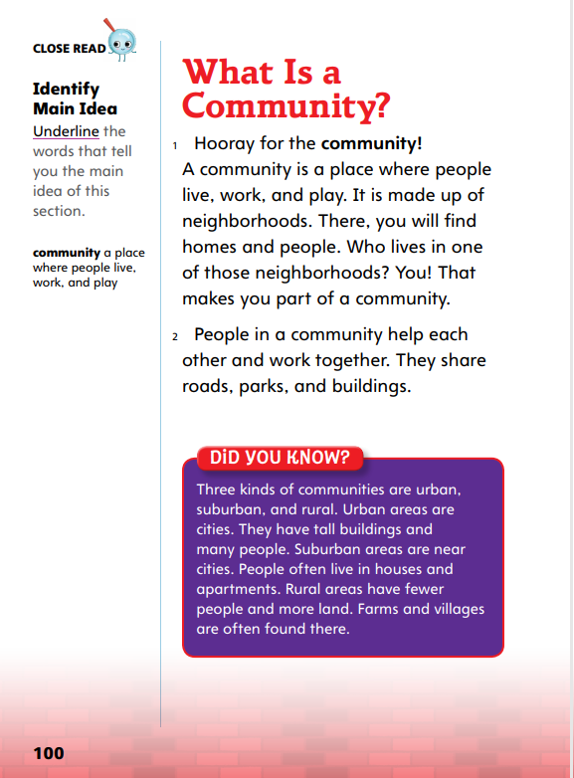
Page 100
Close Read – Identify Main Idea
Turn to page 100 in your Student Interactive
Notes:
Direct students’ attention to the Close Read note on p. 100 of the Student Interactive.
Say: To find the main idea, I first need to look at the text closely. I notice that this section of text is called “What Is a Community?” This heading, or title of the page, gives me a clue about the main idea. Next, I should look for words in the text that give me more clues. Then I will know the main idea.
Reread the page to students. Then ask: What is the main idea? Assist students in recognizing the words that add to the structure and develop the main idea of the section. Have them review SI p. 109 and underline the text that tells them the main ideas of paragraphs 13 and 14.

Slide 44

Page 109
Close Read – Identify Main Idea
Turn to page 109 in your Student Interactive
Notes:
Explain that to find a main idea, students should first read the entire section of text.
Ask: What is this section about? Have students try to summarize the text in a phrase or a word. Explain that this can help students think about the main idea. Then have students look for words in the text that are similar to the word or words in their summary.
See student page for possible responses. DOK 2

Slide 45

Page 110
Close Read – Identify Main Idea
Turn to page 110 in your Student Interactive
Notes:
Point out that students can use text features, in addition to the text, to determine the main idea. Look at the picture. Then read the heading.
Say: What do you think the main idea of the text will be? (People get food at grocery stores.) Direct students to then look at the text on p. 110 to find words that support their answer. DOK 2

Slide 46
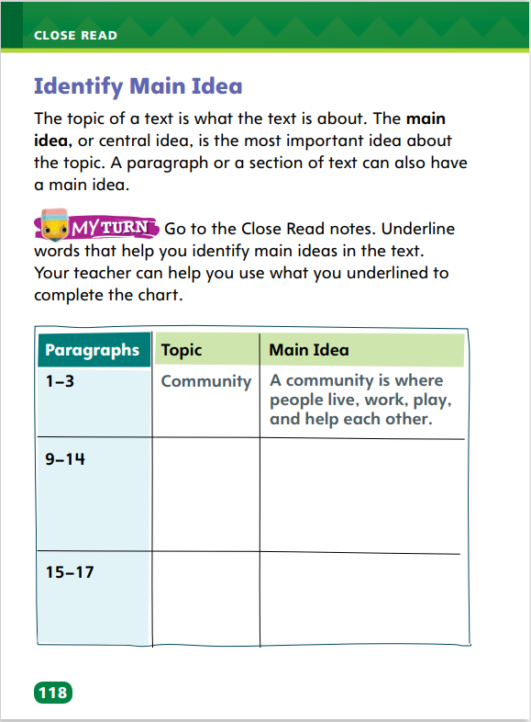
Page 118
Identify Main Idea
Turn to page 118 in your Student Interactive and complete the activity.
Notes:
Ask students to annotate the text on pp. 100–101 and pp. 109–111 using the Close Read notes for Identify Main Idea.
Then have them complete the chart on p. 118 in the Student Interactive.

Slide 47
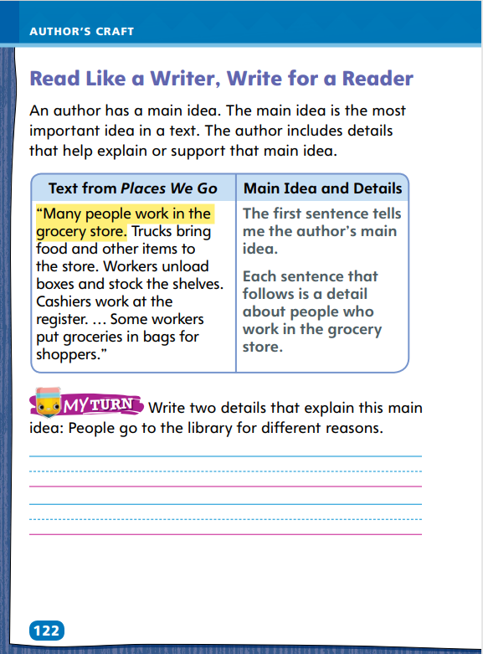
Page 122
Read Like a Writer, Write for a Reader
Turn to page 122 in your Student Interactive and complete the activity.
Notes:
Authors use relevant details to explain or support a main idea. A main idea is the most important idea in a text or section of text.
Readers evaluate the details they read to help them determine the main idea.
Authors can include relevant details as words or pictures. • Relevant details in an informational text often appear as examples that readers can connect to real life.
Use the example on p. 122 in the Student Interactive. Say: The first sentence of the text tells me the main idea. The main idea is that “many people work in the grocery store.” Each of the following sentences has a detail about people who work in the grocery store. These details support the idea that “many people work in the grocery store.”
Have students complete the activity on p. 122 of the Student Interactive.

Slide 48


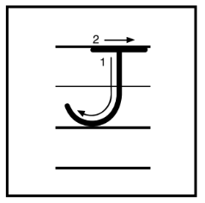
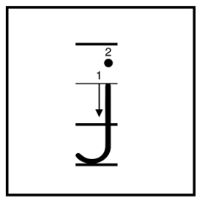

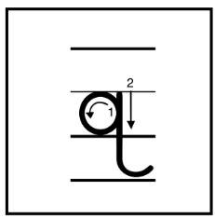
Handwriting
Notes:
Display uppercase and lowercase letters Gg, Jj, and Qq.
Model writing letters Gg, Jj, and Qq. Guide students by showing them how to form the uppercase and lowercase letters properly.
Have students use Handwriting p. 18 in the Resource Download Center to practice writing the letters Gg, Jj, and Qq. Click path: Table of Contents -> Resource Download Center -> Handwriting Practice -> U1W3L3 Handwriting Practice

Slide 49
Page 47
Writing – Launch Writing Workshop
Nonfiction
Details Main Ideas | Text Features | Graphic Features
Notes:
In nonfiction books, authors write about real events. Nonfiction books contain:
names of real people and places
a main idea and details
text features: headings and captions
graphic features: photographs, maps, and diagrams
Nonfiction books may be written in a story format, where all of the real information is presented in a way that engages and entertains the reader
Hold up a nonfiction book from the stack. Say: This is a nonfiction book. Nonfiction authors write about real places and people. Explain that nonfiction books contain a main idea and details. Read the book aloud, pausing to identify details and the main idea.
Tell students: Nonfiction books also contain text features, such as headings and captions. Page through the book, pointing out text features. Nonfiction books contain graphic features, too. Maps, diagrams, and photographs are all graphic features. Page through the book, pointing out graphic features.
Read another nonfiction text from the stack, following the routine above. Focus on the traits that make up the structure of a nonfiction book.

Slide 50
Independent Writing
Let’s develop an outline for writing about a non-fiction topic.
You will continue to work on your topics in your journals.
Share your topic for nonfiction writing.
Notes:
Students should begin experimenting with nonfiction text structure. If students have trouble, help them begin to develop an outline for writing on a nonfiction topic. Point out that they can create headings based on their outlines.
Writing Support
Modeled - Do a Think Aloud to model how to identify a stack book’s text and graphic features.
Shared - Have students choose stack texts. Prompt students to identify their text and graphic features. Discuss why authors might choose to use these features.
Guided - Provide explicit instruction on how authors use text and graphic features in nonfiction texts.
Students with a strong grasp of nonfiction structures should brainstorm nonfiction topics.
Ask students to share their topics for nonfiction writing. Instruct other students to offer any ideas they have about the topics presented.

Slide 51
Spelling
-st
sl-
scr-
best
sled
scram
Notes:
Flexible Option
Review two- and three-letter consonant blends. Remind students that consonant blends can appear at the beginning and/or end of a word. Emphasize that a blend is when you can hear the sound each consonant makes.
Display these consonant blends: -st, sl-, and scr-. Have students repeat each consonant blend aloud. Prompt students to spell the following words as you say them aloud: best, sled, and scram
Have students complete Spelling p. 25 from the Resource Download Center. Click path: Table of Contents -> Resource Download Center -> Spelling -> U1W3

Slide 52
Language and Conventions
Derek wants hamburgers, but Iris wants pizza.
We will add more details to the sentence.
Then we will rearrange the sentence.
Notes:
Review compound sentences with students. Go over how two sentences with related ideas can be combined into one compound sentence. Remind students that they must insert a comma, followed by and, but, or or, to create a compound sentence.
Display this compound sentence: Derek wants hamburgers, but Iris wants pizza. Work with students to find a way to expand the sentence with details. (Possible response: Derek wants hamburgers with pickles and ketchup, but Iris wants mushroom and onion pizza.) Then work with students to rearrange the sentence. (Possible response: Iris wants pizza, but Derek wants hamburgers.)

Slide 53
Lesson 4

Slide 54
Phonics
glide
snake
grant
trust
Beginning Blends
l-blends | r-blends | s-blends
Ending Blends
-nk | -lt | -st
Notes:
Write these words: glide, snake, grant, trust
Call on different students to come up and circle the blends in the words. Make sure students recognize that some words have both beginning and ending blends. Read the words with students.
Say: I know that some words have beginning blends and some have ending blends. Some words have both beginning and ending blends. Make a chart with the blends as column headings. Ask partners to think of words for each blend. Then have students share their words while you record the words on the chart.

Slide 55
Page 99
Use Text Evidence
Look through the text. What is the main idea?
Find details to use as evidence that explains the main idea.
Ask: What do the details tell you about the main idea?
Notes:
Text evidence is a characteristic of informational text that helps create structure. It supports the text’s main ideas. Readers can use text evidence to understand the main ideas in an informational text.
Look through the text. What is the main idea?
Find details to use as evidence that explains the main idea.
What do the details tell you about the main idea?
Revisit the Close Read note on SI p. 102. Say: The first sentence of paragraph 5 contains the main idea. Now I look for details that tell me more about the subjects that teachers teach. These details can help me better understand the main idea.
Have students demonstrate that they can recognize structures of informational text by having them highlight supporting evidence for the main idea on SI pp. 102, 106, and 114. Provide assistance as needed.

Slide 56

Page 102
Close Read – Use Text Evidence
Turn to page 102 in your Student Interactive.
Notes:
Explain that details in a text give more information about an idea. Sometimes, details include lists and examples. Direct students to paragraph 5 on p. 102.
Ask: Where do you see a list that gives more information about what elementary school teachers do?
Have students respond by highlighting words in the text. See student page for possible response. DOK 1

Slide 57
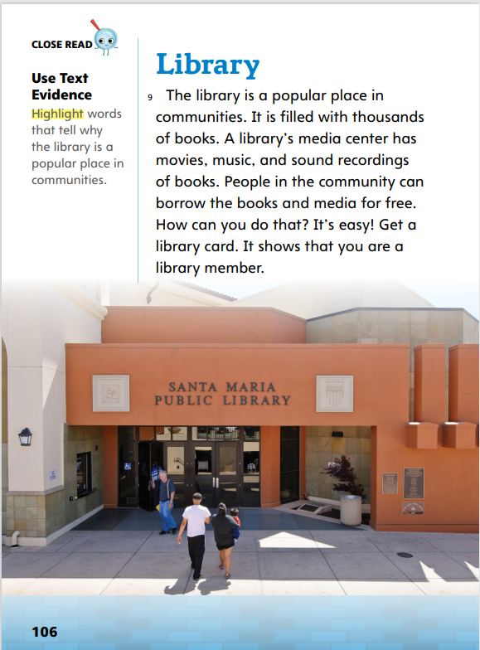
Page 106
Close Read – Use Text Evidence
Turn to page 106 in your Student Interactive.
Notes:
Help students recognize that structures of informational text include supporting evidence for the main idea. Explain that students should look for reasons that answer the question why? as they read. Point to the first sentence in paragraph 9 and explain that it states a main idea. Assist students in highlighting details, or reasons, that provide supporting evidence for the main idea. See student page for possible response.
Ask: How do these details explain why a library is a popular place?
Possible response: because these are things people like to do DOK 2

Slide 58
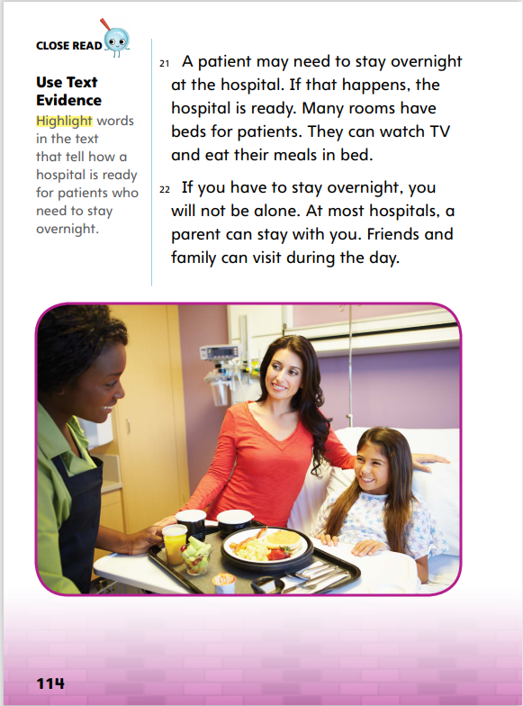
Page 114
Close Read – Use Text Evidence
Turn to page 114 in your Student Interactive.
Notes:
Prompt students with questions to help them find text evidence to answer the Close Read note on p. 114.
Ask: What kind of things do you need if you are staying overnight somewhere? What does a hospital provide for patients who need to stay overnight?
Guide students to find details in the text that support their answers. See student page for possible responses. DOK 2

Slide 59
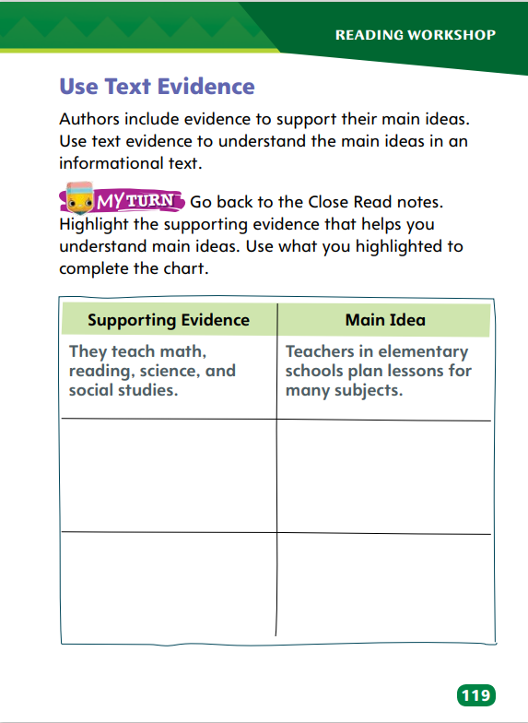
Page 119
Use Text Evidence
Turn to page 119 in your Student Interactive and complete the activity.
Notes:
Have students review the Close Read notes and their annotations to complete p. 119 in the Student Interactive.

Slide 60
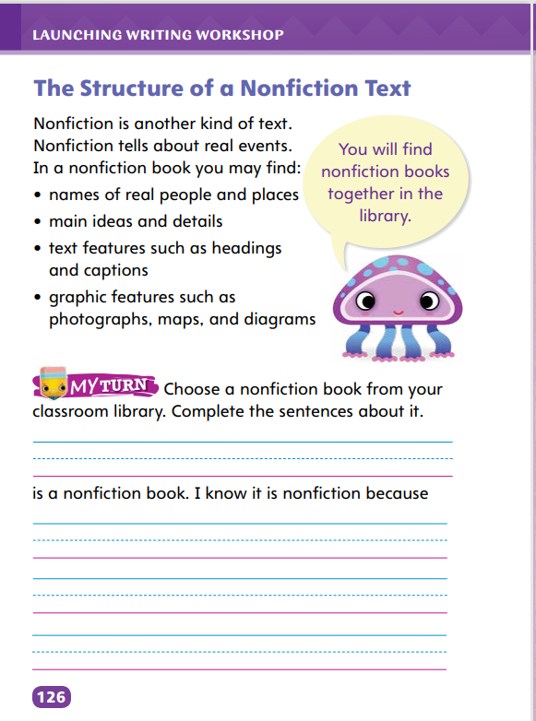
Page 126
Writing – Launch Writing Workshop
Turn to page 126 in your Student Interactive.
Notes:
A nonfiction book contains names of real people and places, a main idea and details, and text and graphic features.
Read aloud a nonfiction book from the stack. Have students identify its details and main idea. Point to its text and graphic features. Have students identify captions, headings, maps, photographs, and diagrams. Then explain how the text and graphic features that have been pointed out help communicate the author's main idea and supporting details.
Ask: What is the structure of a nonfiction book? Offer necessary corrections as volunteers answer the question.
Have students choose and read nonfiction books from the stack. Remind students that nonfiction authors write about whatever topics they want, and students can do the same as they work on their own nonfiction.
Direct students to p. 126 in the Student Interactive. Prompt them to complete the exercise at the bottom of the page.

Slide 61
Independent Writing
Now you will take the main idea and add supporting details.
You can also add text and graphics to your nonfiction idea.
Notes:
Instruct students to develop main ideas and supporting details for nonfiction texts. If students have difficulty, remind them that authors use details to support their main ideas, and guide them to sources they can use to find details about their topics.
Writing Support
Modeled - Do a Think Aloud to model how to distinguish minor details from important details and to cite a nonfiction story’s main idea.
Shared - Present a main idea to students and work with them to find key details that back it up.
Guided - Explicitly instruct students regarding how and where they should place supporting details into their nonfiction stories.
Students who show understanding should start adding text and graphic features to their work
As students write, use the conference prompts in the Teacher’s Edition or Resource Download Center to provide support. Click path: Table of Contents -> Resource Download Center -+ Writing Workshop Conference Notes
Ask students to share the main idea, details, and text and graphic features they’ve crafted for their own writing.

Slide 62
Spelling
home
Pete
Let’s review word with the CVCe pattern.
chase
cute
dime
Notes:
Flexible Option
Remind students how to spell long vowel words that have the consonant-vowel-consonant-silent e pattern.
As you read aloud the following words, have students spell them: home, chase, dime, Pete, cute.
Place students into pairs. Ask each pair to sort the words by their long vowel sounds. (long a: chase, long e: Pete, long i: dime, long o: home, long u: cute)

Slide 63
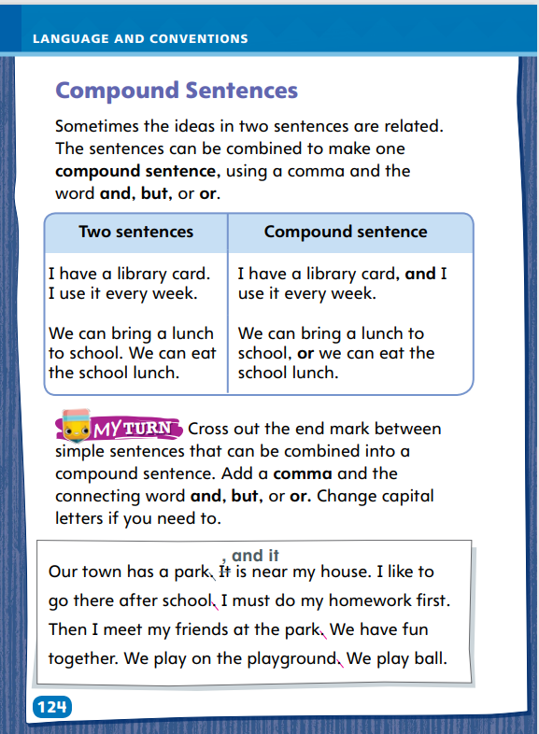
Page 123
Language and Conventions
Turn to page 124 in your Student Interactive and complete the activity.
Notes:
Have students complete the activity on p. 124 to edit drafts using compound sentences. Use the leveled supports on p. T393 for ELLs.

Slide 64
Lesson 5

Slide 65
Phonics
hope
wake
him
bike
space
help
tape
Notes:
Write the words hid and hide. Ask students to read the words with you. Ask them what the vowel patterns and vowel sounds are in the words. (CVC, short i; CVCe, long i) Remind students that words with a silent e at the end usually have a long vowel sound in the middle.
Write each of the words: hope, wake, him, bike, space, help, tape
Point to a word and have students read it. Have students identify whether the word has a CVC or CVCe pattern and whether it has a long or short vowel sound.

Slide 66
High-Frequency Words
 | s | o | u | n | d
 |  | m | o | r | e
t | h | i | n | g | s
sound
more
things
Notes:
Remind students that high-frequency words are words that they hear and see often. Explain that being able to recognize these words automatically will allow them to focus on sounding out and understanding other, less common words.
Ask students to review the chart. Have them say each word and repeat after you the letters each word contains. Then say one of the words and have a student write the word on a board. Another volunteer can use the word in a sentence.

Slide 67
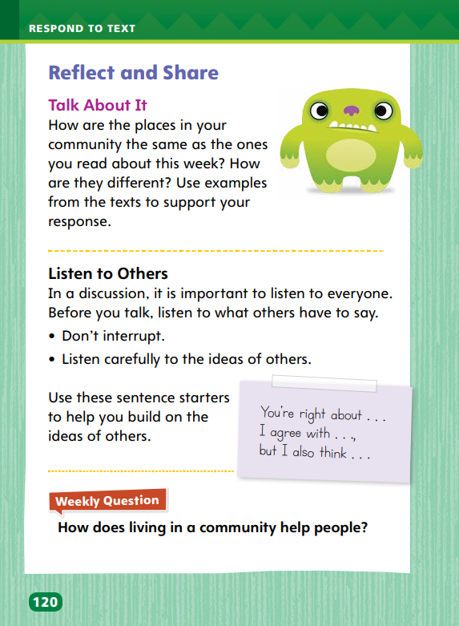
Page 120
Reflect and Share
Turn to page 120 in your Student Interactive.
Notes:
Explain to students that they will be talking about a topic in a group discussion. During group discussion, it is important that they listen actively to others and make comments that build on what they say.
Before making your comment, make sure that you are not interrupting another speaker.
Ask relevant questions to clarify information.
Answer questions using multi-word responses.
Describe listening to others during a discussion and addressing a topic using the Talk About It prompt on p. 120 in the Student Interactive.
Tell students: First, I listen as someone else is talking, giving my full attention to the speaker. I am careful not to interrupt by making noises or talking. I hear the speaker share details about a place in the community that is similar to the library we read about in Places We Go. I wait to make sure the speaker has finished talking. Now I can talk about a place I know, making sure it relates to the same topic.

Slide 68

Page 42
Apply
How does living in a community help people?
Notes:
Have students use the strategies for comparing information and ideas across texts.
Have students use evidence from the texts they have read this week to respond to the Weekly Question. Tell them to discuss in small groups.
If desired, distribute Speaking and Listening tips from the Resource Download Center. Click Path: Table of Contents -> Resource Download Center -> Speaking and Listening

Slide 69
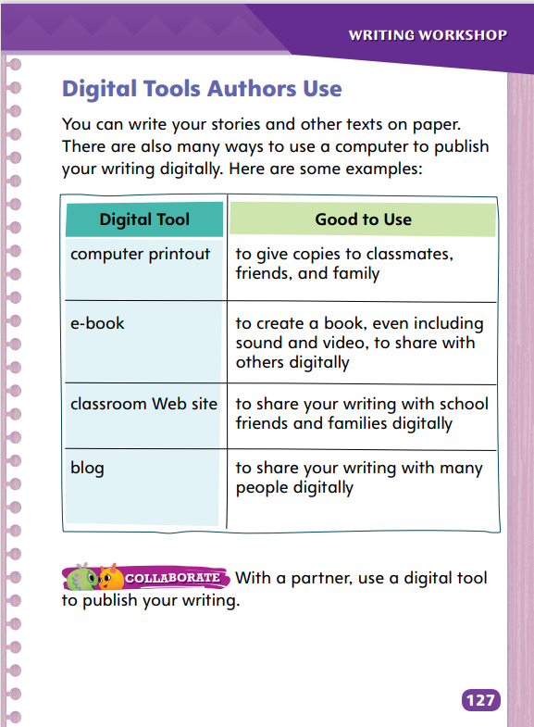
Page 127
Writing – Launch Writing Workshop
Turn to page 127 in your Student Interactive.
Notes:
Authors use digital tools to share their work. Examples of digital tools are
computer printouts, which allow them to share their writing with whomever they choose and make handwritten notes on their work
e-books, which allow them to incorporate digital effects like sounds and images in their work
classroom Web sites, which allow them to share their work with entire classes • blogs, which allow anyone with Internet access to read what they write
Direct students to p. 127 of the Student Interactive. Say: Writing on paper is only one way to publish your work. You can also use digital tools. Computers will help you publish your writing and share what you’ve written with more people.
Review various digital tools with students, using examples as necessary. Discuss with students the advantages of each.
Remind students that they may use fonts, colors, and images when they digitally publish their work. Review the Week 2 lesson on these digital tools.
Have students work in pairs to collaborate on using a digital tool to publish a piece of writing.

Slide 70
Spelling
Drive down the brick road.
My dogs chase the stick.
Have you read my blog?
Do not spend too much cash.
What are those things?
The little bird is building a nest.
A shark has strong teeth.
Can I borrow some scrap paper?
Her pet frog can jump high!
We hear the sound of music.
Today is the first day of spring.
He walks past the store.
Notes:
(Note: Move the orange boxes to cover each bold spelling word before you read aloud the words and sentences.)
Read aloud the words and sentences. Have students spell each word with initial consonant blends and the two high-frequency words.
Drive down the brick road.
My dogs chase the stick.
Have you read my blog?
Do not spend too much cash.
What are those things?
The little bird is building a nest.
A shark has strong teeth.
Can I borrow some scrap paper?
Her pet frog can jump high!
We hear the sound of music.
Today is the first day of spring.
He walks past the store.
Reveal the spelling word and have students check their work.

Slide 71
Language and Conventions
Which of these is a compound sentence?
I want to play.
I have to go home.
I want to play and go home.
I want to play, but I have to go home.
Notes:
Flexible Option
Ask students to respond to the following question on their own. Remind them to choose just one answer.
Which of these is a compound sentence?
I want to play.
I have to go home.
I want to play and go home.
I want to play, but I have to go home.
Have students complete Language & Conventions p. 31 from the Resource Download Center. Click path: Table of Contents -> Resource Download Center -> Language and Conventions -> U1 W3

Slide 72
Unit 1: Week 3
Grade 2

