Slide 1
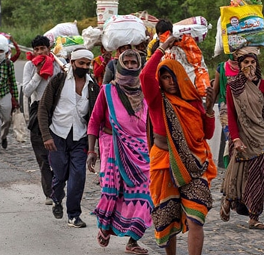
People on the move
This Photo by Unknown Author is licensed under CC BY-NC-ND

Slide 2
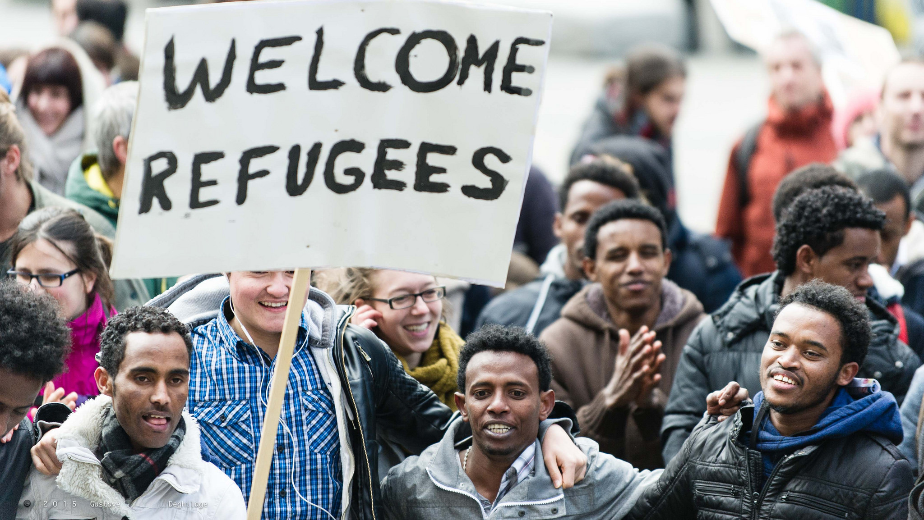
* In previous lessons , you learned how humans can affect the environment . As populations grew and people spread throughout the world , they changed the environment in dramatic ways .
People have continued to move to and settle in different environments throughout the world . What causes people to move and settle in certain areas ?
Many factors draw people to a new area , but just as many factors drive them away .
This Photo by Unknown Author is licensed under CC BY

Slide 3
Migration : Human migration is the act of people moving from one location to another .
There are several types of migration . Some people temporarily move to a new place . This means they will not stay for a long time and plan to return home .
Other people permanently move to another place . This means they plan to stay there for a long time , perhaps for their whole lives .

Slide 4
* Wen people migrate , they move from one place to another in the same country .
When people emigrate , they move away from their country to live in a different one . The process of moving into a new country is called immigration

Slide 5
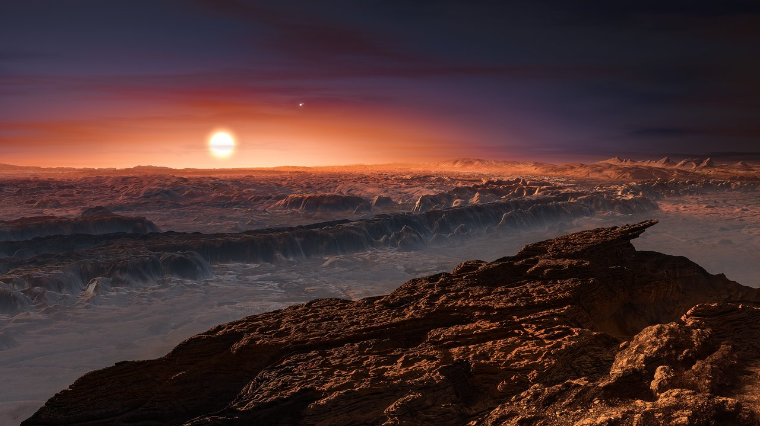
*Why People Move : No matter why people move , they must consider how livable or habitable the new place is .
Habitable : refers to whether an area is a safe and desirable place .
Determining if a place is habitable can be complicated since there are both social and physical factors to consider .
This Photo by Unknown Author is licensed under CC BY

Slide 6

*Many people move to places that are like where they already live . People often would want to be near others who share the same or a similar culture . These are the social factors of migration .

Slide 7
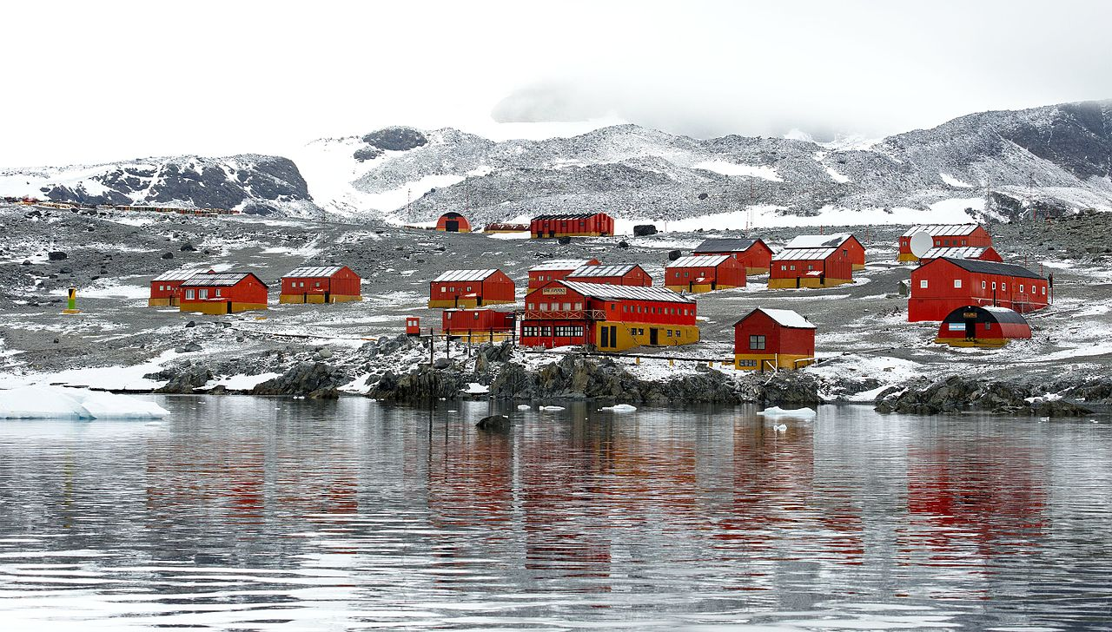
*Physical factors have to do with the environment and basic human needs . For example : people need to be clean to fresh water and sources of food .
Most habitable places to live are considered safe places to live .
This Photo by Unknown Author is licensed under CC BY-SA

Slide 8
* Pull factors : are the reasons why people move to an area .
These are positive , or good , reasons that people move to an area .
These can be social factors , such as an area’s job opportunities or familiar people .

Slide 9
*These can also be physical factors , such as an area’s natural resources or pleasant climate .
*Push factors are negative reasons people choose to leave .
Environmental problems , such as pollution , drought , or lack of food , can be push factors . Social issues also can be push factors .

Slide 10

*Economic Opportunities : In modern times , many people move for jobs . Some people move within their own country for a better job .
Other people move to a different country for job opportunities . Some of these opportunities are permanent , and some are temporary .
This Photo by Unknown Author is licensed under CC BY-NC-ND

Slide 11
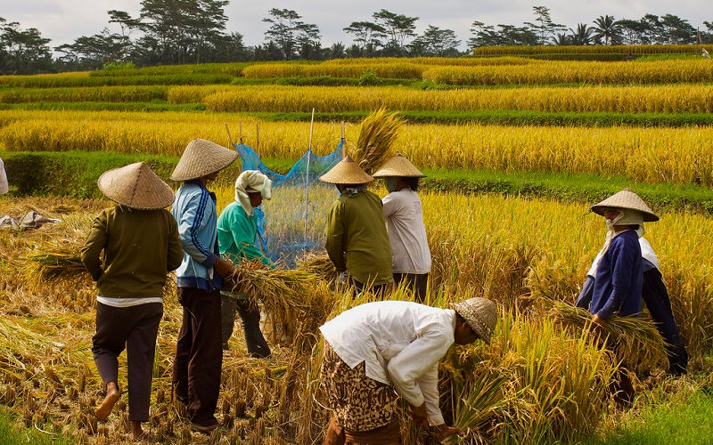
*A migrant worker is someone who moves often to find a job . Migrant workers rarely plan to stay in one location permanently . In areas where farming is a major part of the economy , migrant workers are very important .
They move to an area to find jobs around harvest time . When the harvest in one region is over , they will move .
This Photo by Unknown Author is licensed under CC BY-NC

Slide 12
*Migrant workers don’t only work on farms . They can be found all over the world doing a variety of jobs .
Some work in construction . Others might work in restaurants or hotels . Migrant workers will work in their own country and sometimes in other countries .

Slide 13
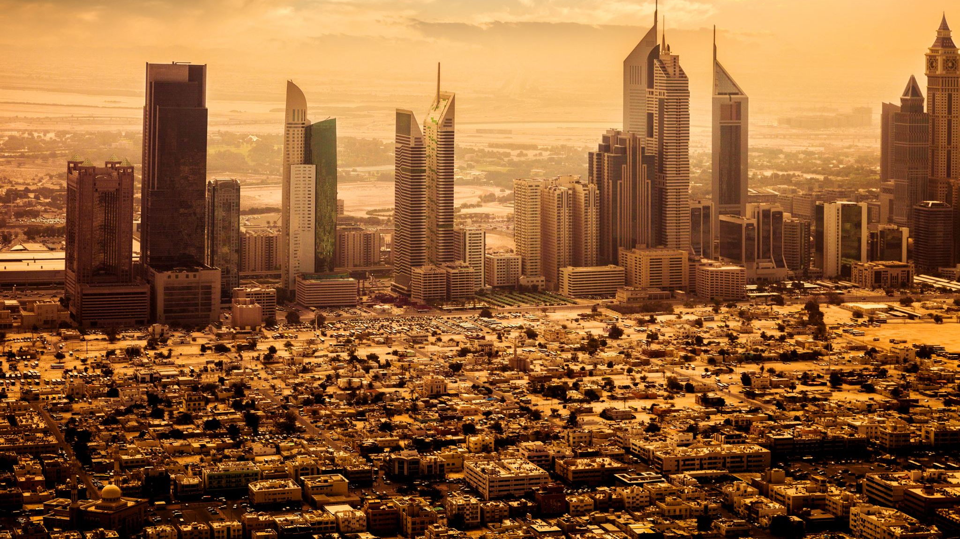
*Migration to the Middle East : The Middle East continues to be destination for human migration . Many factors cause people to move within their own countries .
Urbanization draws people from rural areas into cities . Business and trade bring others . Today , banking and the petroleum industry bring people from all over the world to the Middle east both temporarily and permanently .

