Slide 1
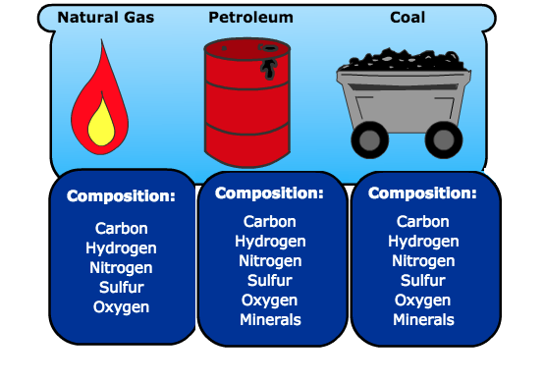
Beneath the sand
This Photo by Unknown Author is licensed under CC BY-SA-NC

Slide 2
*Today’s world uses a lot of energy . Much of this energy comes from fossil fuels .
Fossil fuel is formed in Earth from plant or animal remains .
Over time , heat and pressure from layers of soil turned these remains into crude oil , or natural gas .
Crude oil is a liquid that is found underneath Earth’s surface .People extract , or take out , this crude oil from the ground .

Slide 3
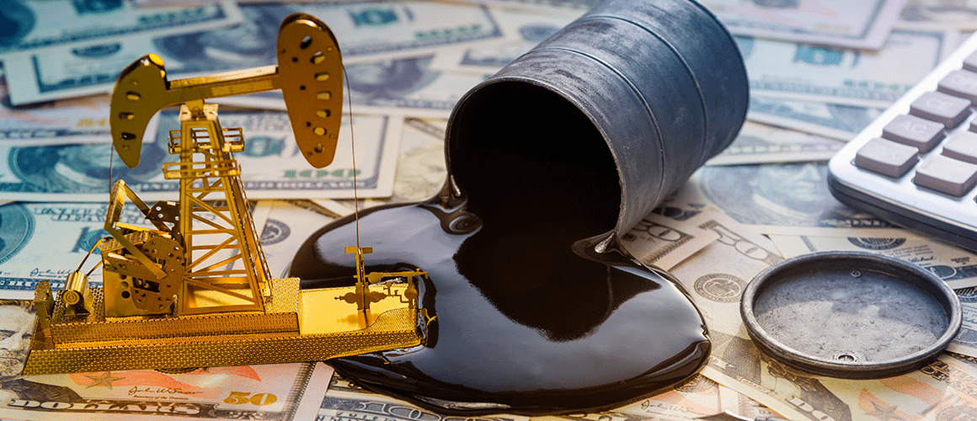
*One product that people make from it is petroleum , a liquid that can be burned for energy
Natural gas is another energy source found under Earth’s surface that people can use for fuel .
To remove crude oil from the ground , people drill deep into Earth to reach the rock that has oil in it .

Slide 4
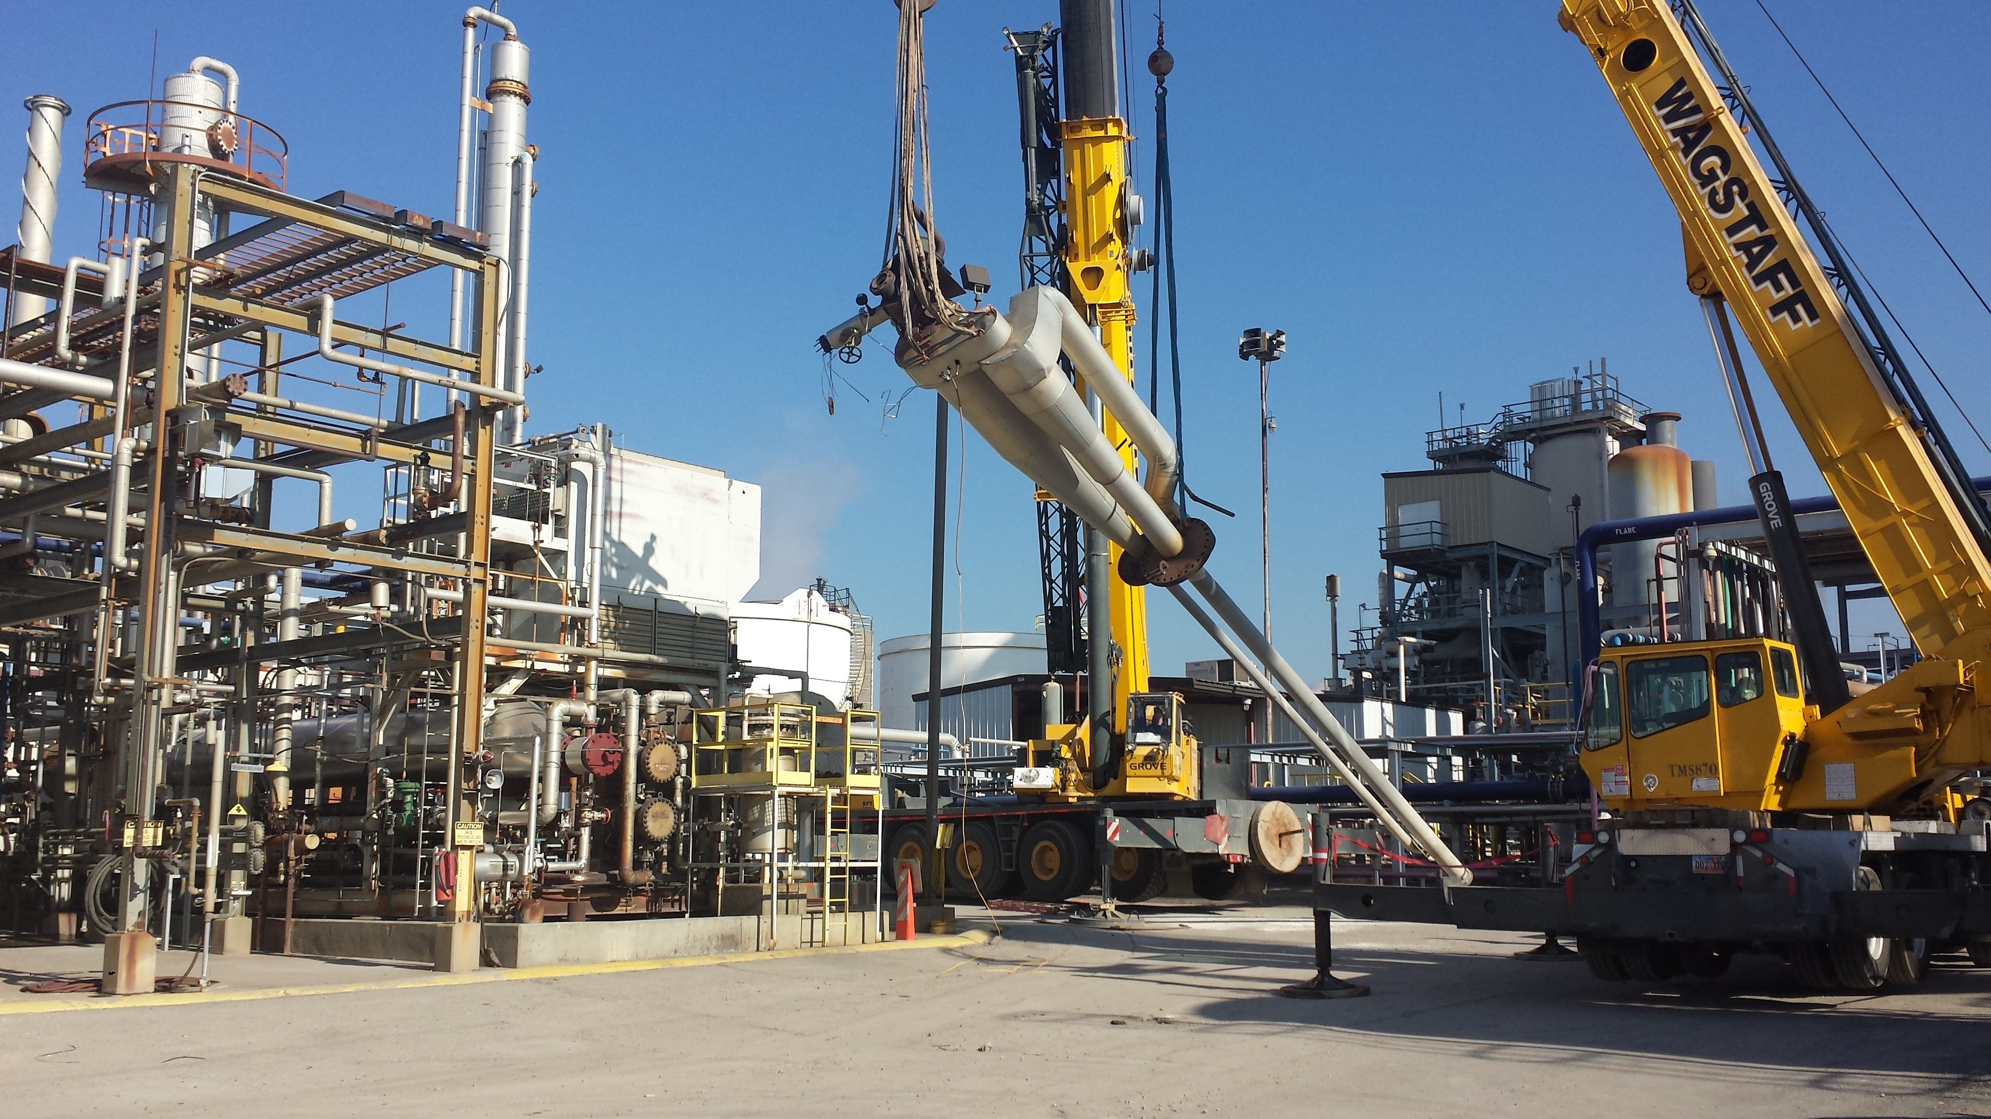
*Once the oil is removed from the rock it goes for refinement . Refinement means that crude oil is processed or broken down and converted into usable products .
These include gasoline for running vehicles , heating oil for keeping buildings warm , and ready for roads .

Slide 5
*Oil and the Environment : Products that come from crude oil make our lives more convenient and comfortable .
However , producing and using crude oil has negative effects on the environment .
For example : exploring and drilling for oil can harm natural habitats .
It’s important to use technology and laws to reduce these negative effects .

Slide 6

*Using technology like the Global Positioning System (GPS)makes searching for oil reserves more accurate .
Reserves are areas with underground supplies of oil . This means less wilderness needs to be disturbed . Drilling tools and methods have improved with new technology , too . The result is that drilling now causes less damage .
This Photo by Unknown Author is licensed under CC BY

Slide 7
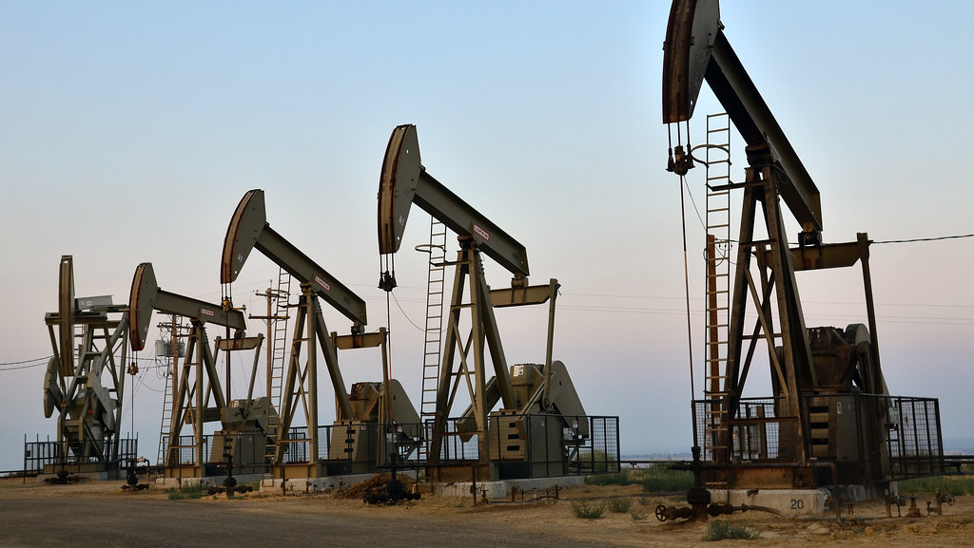
*However , drilling for oil may lead to oil spills and leaks . These can be harmful to plants , animals ,and people .
In the 1980s and early 1990s new laws made ships carrying oil safer . The law stated that these ships had to be made with double hull (the part of a boat that is underwater ) to protect against spills .

Slide 8
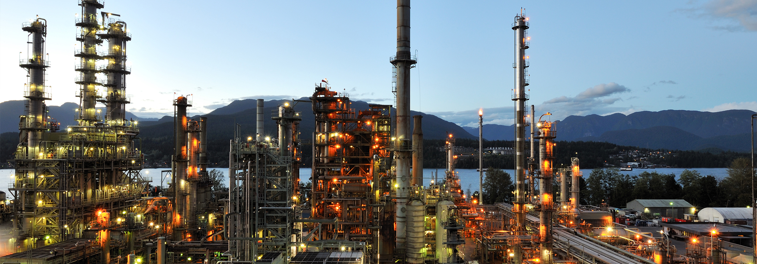
*The oil Industry in MENA : Nearly 100 countries produce oil for energy . The organization of the petroleum Exporting Countries , or OPEC , was founded in 1960 .
This Photo by Unknown Author is licensed under CC BY-ND
OPEC’s purpose is to help oil-exporting countries work together to keep the oil industry stable . This means these countries produce as much oil as the world needs , and they get paid in return . OPEC also takes part in research to find better and safer ways to extract crude oil .

Slide 9
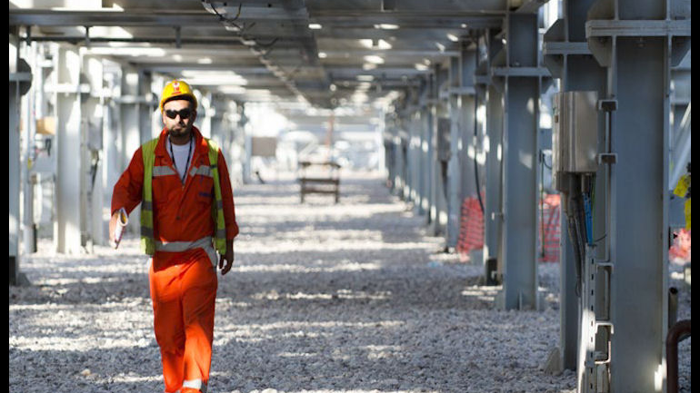
*There are thirteen countries in OPEC . Eight of those are in MENA region . Together , these countries hold 58 percent of the world’s oil reserves , which is the oil still in the ground .
As a result , the oil-producing countries in the MENA region have built much of their economies around oil . This means that a lot of money and jobs come from oil industry .
This Photo by Unknown Author is licensed under CC BY

